Slide 1
PROGQUIZ
Carbonell,Vincent
Benito,Tristan
Catapang, Jewerly
Mercado,Ken
CP1201

Slide 2
ABout progquiz
ProgQuiz is a web app that helps especially the beginners in programming to learn programming in a fun way by playing this web app they can learn about the basics of programming.

Slide 3
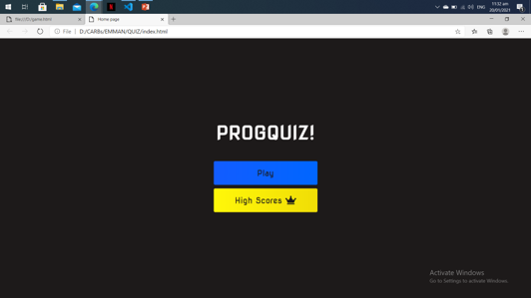
Home page
In the home page as you can see there is a play button which leads you to the main quiz game also the high scores where you can check the current leaderboards.

Slide 4
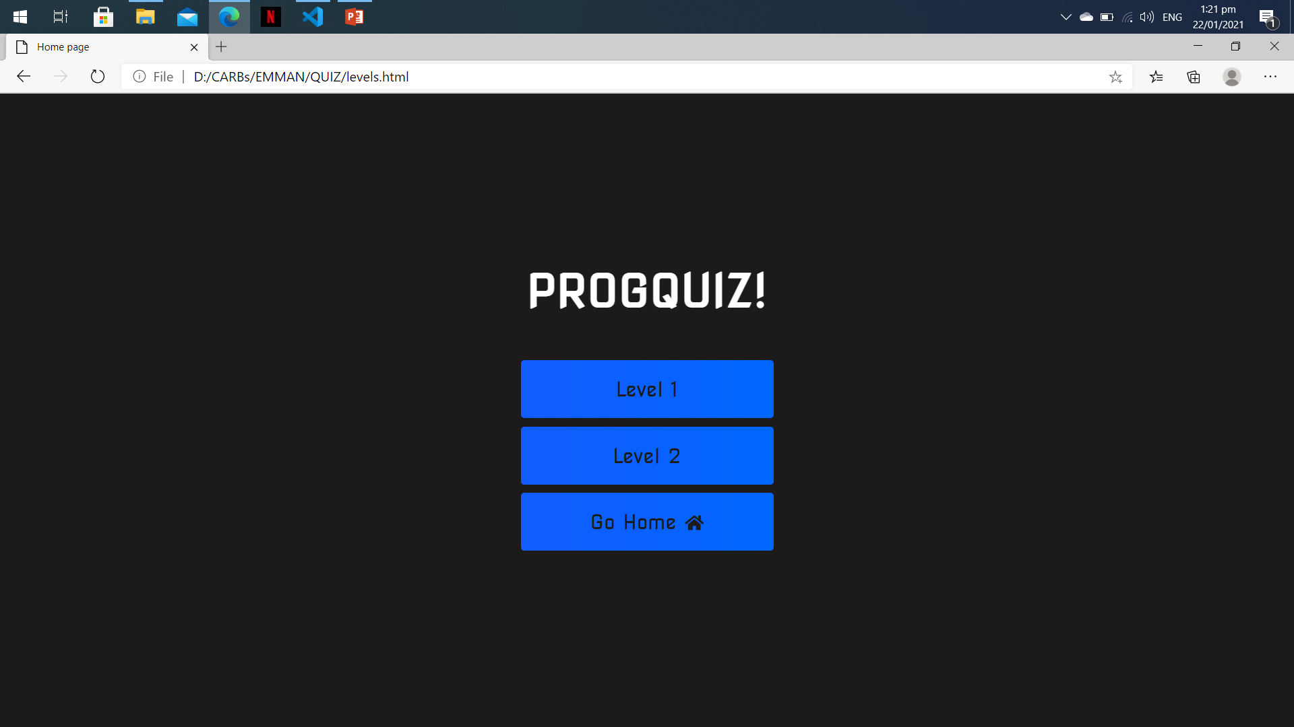
Levels
After clicking the play button you will now proceed on the game levels that you may choose between level 1 or 2 and also the Go home button that leads to the home page.

Slide 5
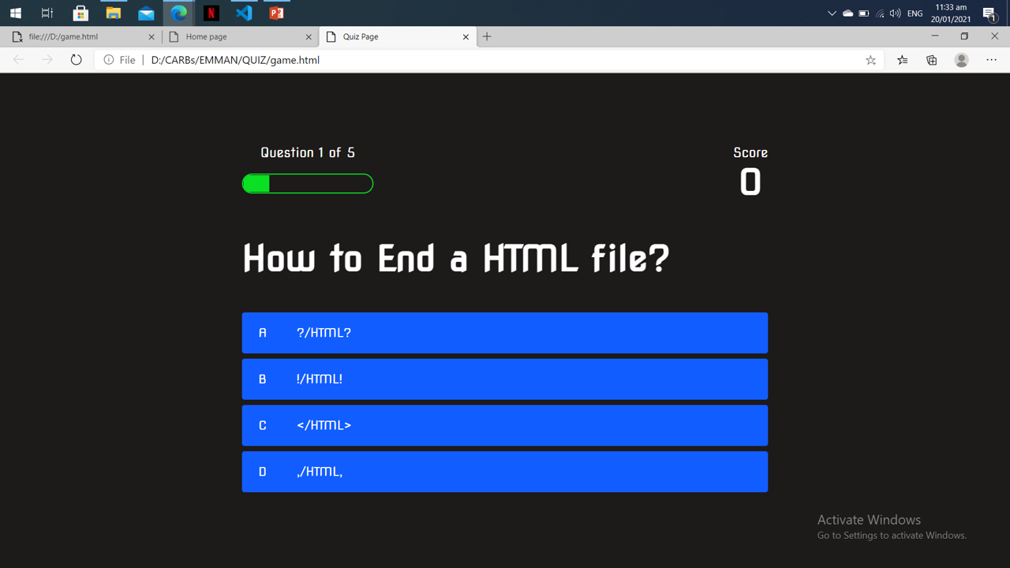
Game page
After clicking the Level 1 or 2 Button you will proceed to the game page. As you can see, there is the question and also the 4 choices
( A, B, C, D,)

Slide 6
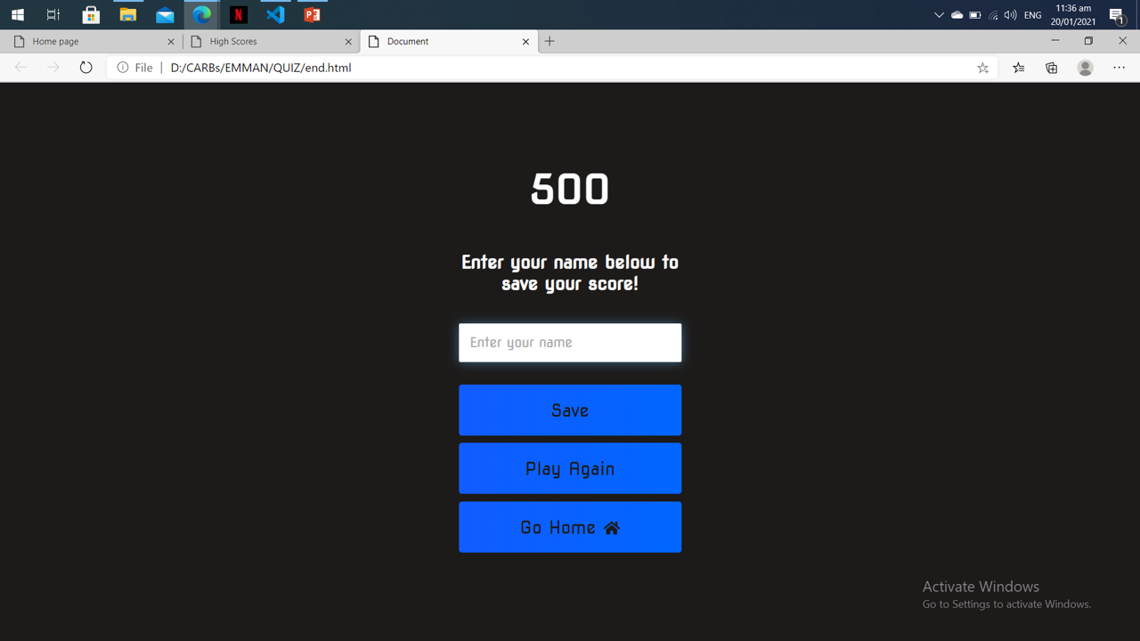
End page
After proceeding in all of your questions at the top, you can see your final score and there is the type box where you can put your name and click save to save your score, play again to restart the game and go home to back in the home page.

Slide 7
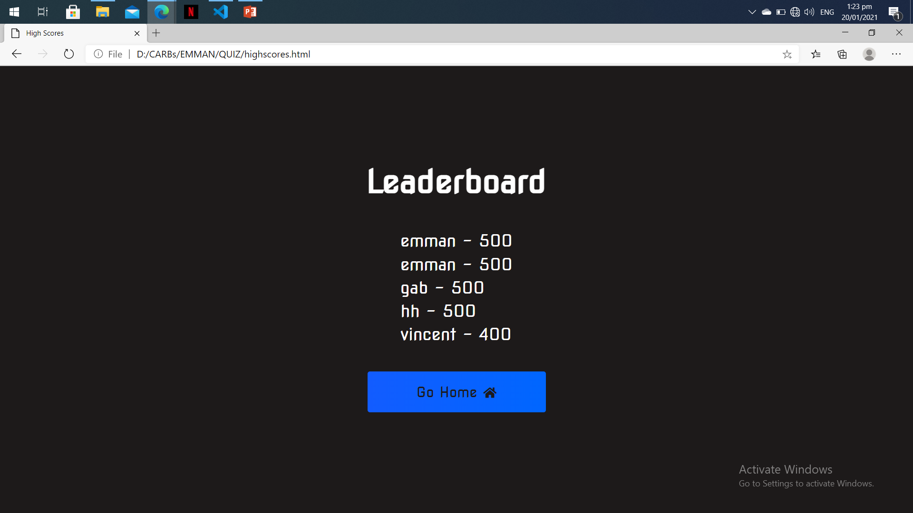
Highscores
In this high scores page you can see the leaderboards including the saved names and their scores also, the Go Home button that will lead you back to the home page.

Slide 8
Mini games!

Slide 9
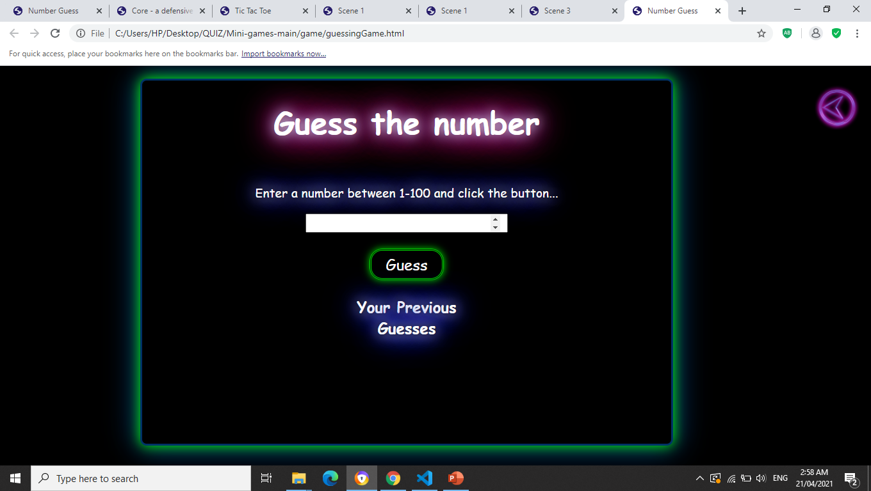
Number guessing
In this mini game you will guess a number from 1-100 and it will show if you’re too low or too high

Slide 10
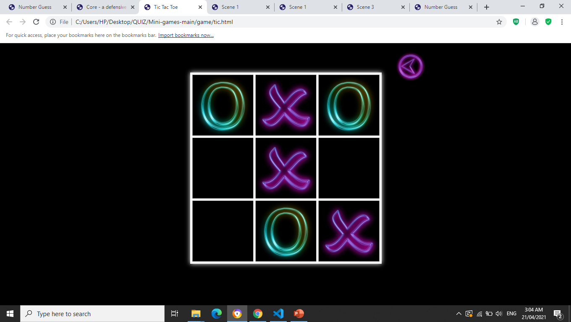
Tic tac toe
In this mini game you will just play the typical game of tic tac toe

Slide 11
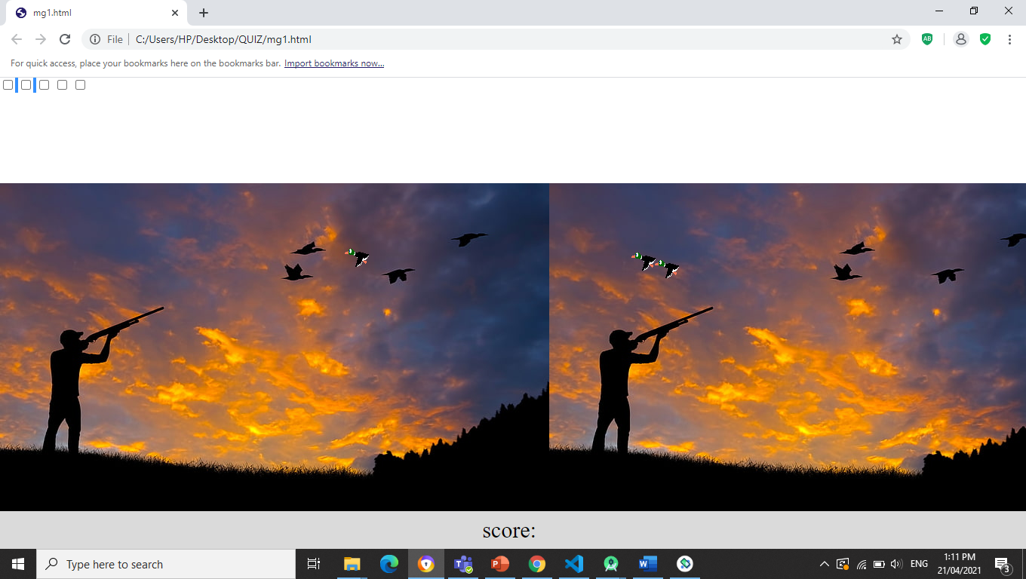
Duck hunt
Also a mini game that will be enjoyable using cursor as aim that helps you to hit the ducks.

Slide 12
Scenes

Slide 13
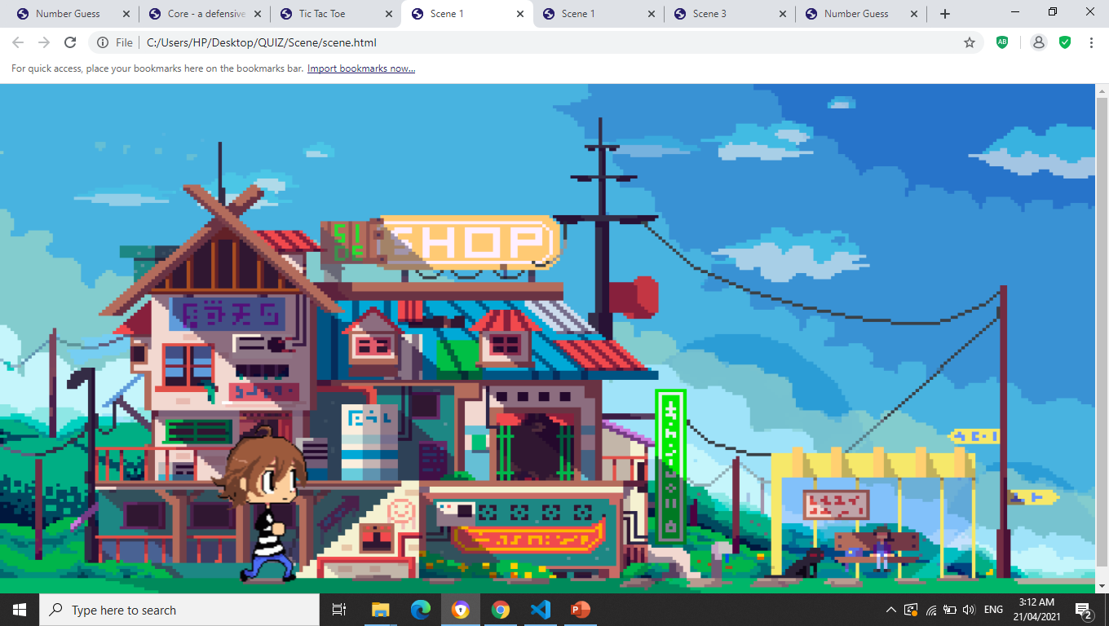
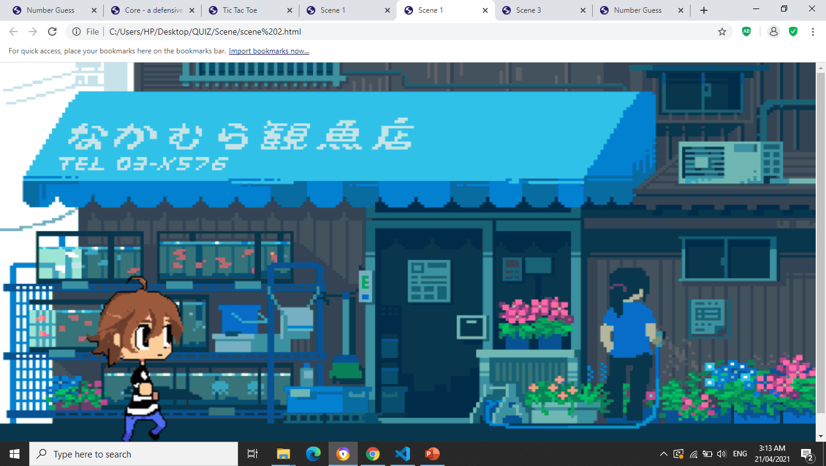
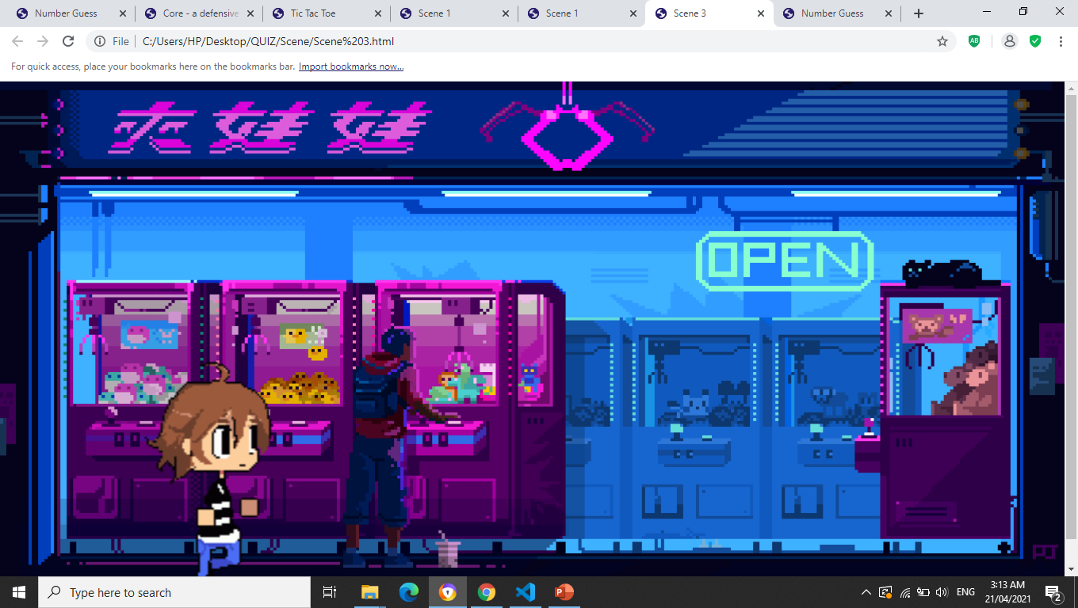
Scenes
To make this game more exciting we create some scenes that will go throughout the game

Slide 14
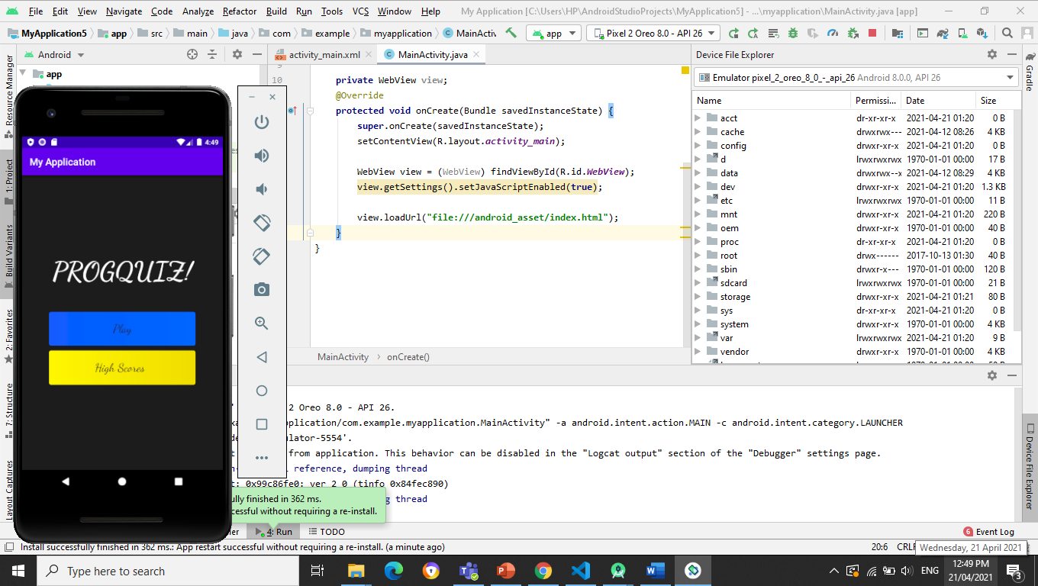
application
At this moment we manage to have the home screen game in our app, but unfortunately the app exits when we proceed to the play button.

Slide 15
Thank you!

