Slide 1


Slide 2


Slide 3
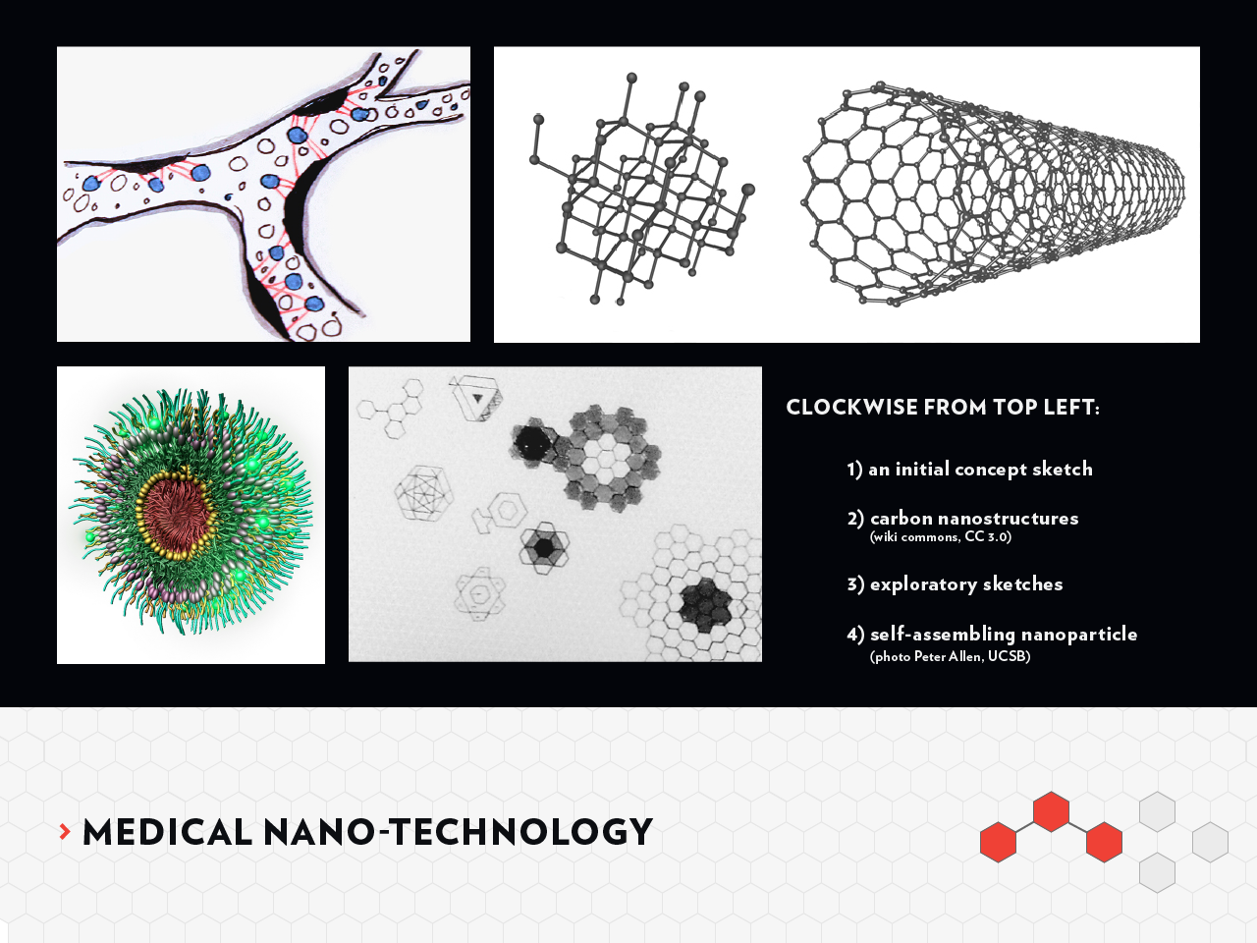

Slide 4


Slide 5

photo: http://www.flickr.com/photos/evilerin (CC)

Slide 6

photo: http://www.flickr.com/photos/evilerin (CC)

