Slide 1




Disinfection byproduct formation and regulatory thresholds
Lofton, M.E., Cooke, R.L., and Carey, C.C. 20 September 2025.
Macrosystems EDDIE: Exploring Tradeoffs in Water Quality Management Using Environmental Data.
Macrosystems EDDIE Module 10, Version 1.
https://serc.carleton.edu/eddie/teaching_materials/modules/module10.html
Module development supported by NSF EF-2318861 and NSF RISE-2438447.
Notes:
In this video, I will briefly introduce chlorination as a method for disinfection, as well as how disinfection byproducts may form during treatment and the risks and regulations associated with disinfection byproducts.

Slide 2
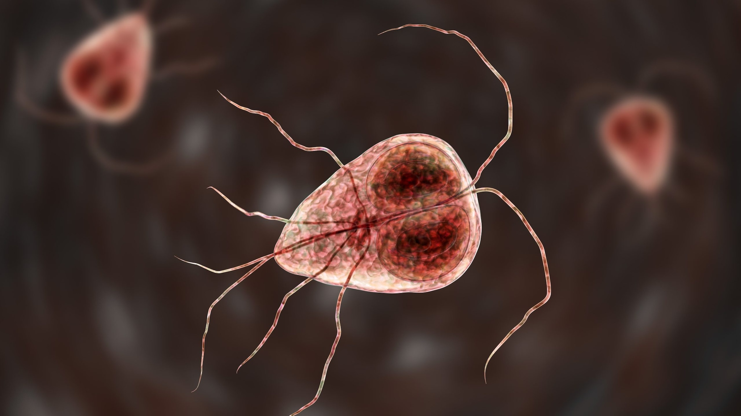
Chlorination is a common method to disinfect drinking water
Disinfection is the process by which harmful pathogens, such as bacteria, viruses, fungi, and protozoans, are removed from drinking water
Disinfection is necessary to protect public health!
Chlorination means treating the water with a chemical containing chlorine to kill or inactivate harmful pathogens
Giardia is a protozoan parasite that causes diarrhea if it is present in the water supply
Image source: https://www.cdc.gov/giardia/about/index.html
Notes:
Chlorination is a common method to disinfect drinking water. Disinfection is the process by which harmful pathogens, such as bacteria, viruses, fungi, and protozoans, are removed from drinking water, and it is necessary to protect public health!
Chlorination means treating the water with a chemical containing chlorine to kill or inactivate harmful pathogens.

Slide 3
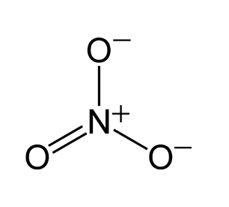
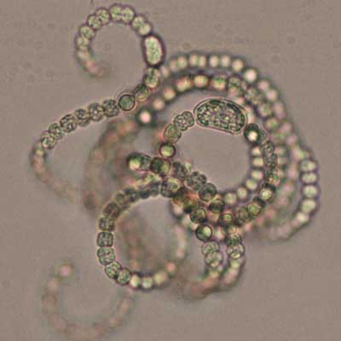
DBP precursors can react with chlorine to form disinfection byproducts (DBPs)
These compounds may be organic or inorganic, and may come from natural sources or be introduced by humans
Naturally-occurring phytoplankton may release organic compounds that form DBPs during treatment
Nitrate is an inorganic compound that may form DBPs during treatment; one source of nitrate is agricultural fertilizers
Image credits:
Phytoplankton - https://coastalscience.noaa.gov/monitoring-and-assessments/pmn/image-gallery/freshwater-plankton-gallery/
Nitrate molecule - https://en.wikipedia.org/wiki/Nitrate#/media/File:Nitrate-ion-resonance-2D.png
Notes:
However, certain compounds, called DBP precursors, can react with chlorine to form disinfection byproducts, or DBPs, during treatment. These compounds may be organic or inorganic, and may come from natural sources or be introduced by humans. Organic compounds are derived from living things and contain carbon. Inorganic compounds may also contain carbon but are not derived from living things. For example, phytoplankton, or algae, may release organic compounds that form DBPs during treatment. An example of an inorganic compound that may form DBPs during treatment is nitrate, which is commonly found in agricultural fertilizers applied by humans.

Slide 4
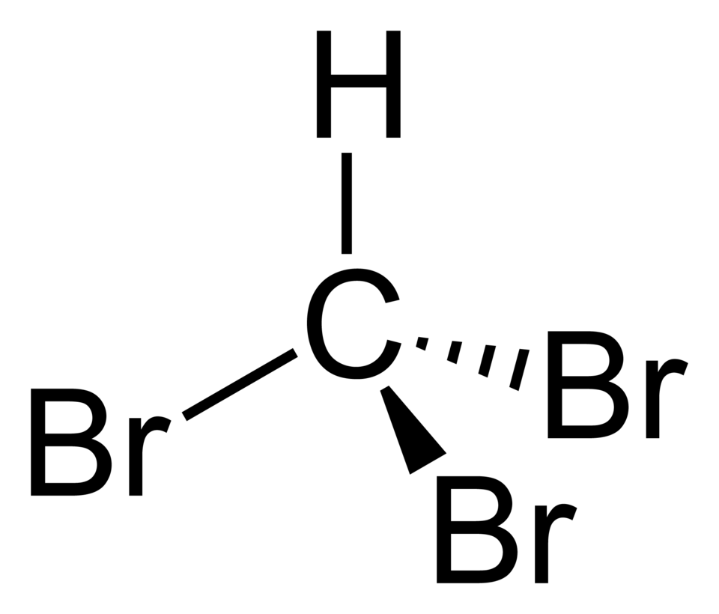
DBPs present health risks, including cancer
Several DBPs are known carcinogens
For example, researchers pooled the data from six studies in the U.S., Canada, France, Italy, Spain, and Finland and found that increased, long-term exposure to DBPs led to increased risk of bladder cancer in men
Bromoform is one example of a trihalomethane, the type of DBP analyzed in the pooled study.
Villanueva, Cristina M.*†; Cantor, Kenneth P.‡; Cordier, Sylvaine§; Jaakkola, Jouni J. K.∥; King, Will D.¶; Lynch, Charles F.**; Porru, Stefano††; Kogevinas, Manolis*‡. Disinfection Byproducts and Bladder Cancer: A Pooled Analysis. Epidemiology 15(3):p 357-367, May 2004. | DOI: 10.1097/01.ede.0000121380.02594.fc
Image source: https://commons.wikimedia.org/wiki/File:Bromoform-2D.png
Notes:
DBPs present health risks, including cancer. Several DBPs are known carcinogens
For example, researchers pooled the data from six studies in the U.S., Canada, France, Italy, Spain, and Finland and found that increased, long-term exposure to DBPs led to increased risk of bladder cancer in men. The image on the right shows the molecular structure of bromoform. Bromoform is one example of a trihalomethane, the type of DBP analyzed in the pooled study.

Slide 5
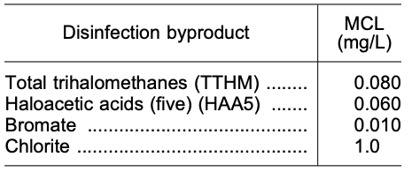
The EPA and VDH regulate DBPs
There are many, many kinds of DBPs (dozens or more!)
The US EPA and the VDH regulate both total trihalomethanes (TTHM) and the five most common haloacetic acids (HAA5), as well as bromate and chlorite in drinking water
The MCL is the maximum contaminant level permitted by the EPA and VDH in finished water
Source: https://www.govinfo.gov/content/pkg/FR-2006-01-04/pdf/06-3.pdf
Notes:
Because of the risks they pose to human health, the United States Enviromental Protection Agency, or EPA, as well as the Virginia Department of Health, or VDH, regulate DBPs in drinking water. However, because there are many, many types of DBPs (dozens or more), it is difficult to regulate all of them. Currently, the EPA and VDH regulate both total trihalomethanes (TTHM) and the five most common haloacetic acids (HAA5), as well as bromate and chlorite.
The MCL is the maximum contaminant level permitted by the EPA and VDH in finished water. You can see the MCLs for regulated DBPs in the table at the bottom of the slide.

Slide 6
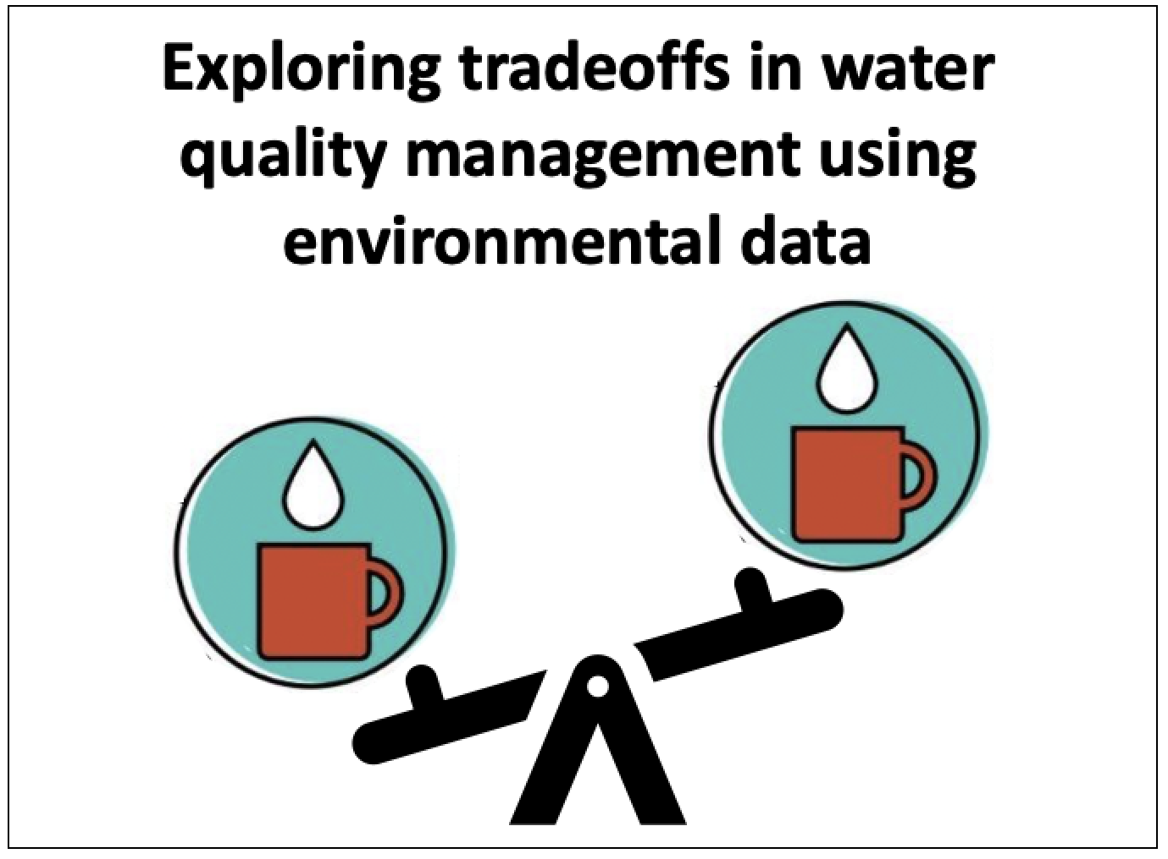
End of slideshow – please proceed with module activities!
Notes:
This is the end of the video; thanks for your attention!

