Slide 1
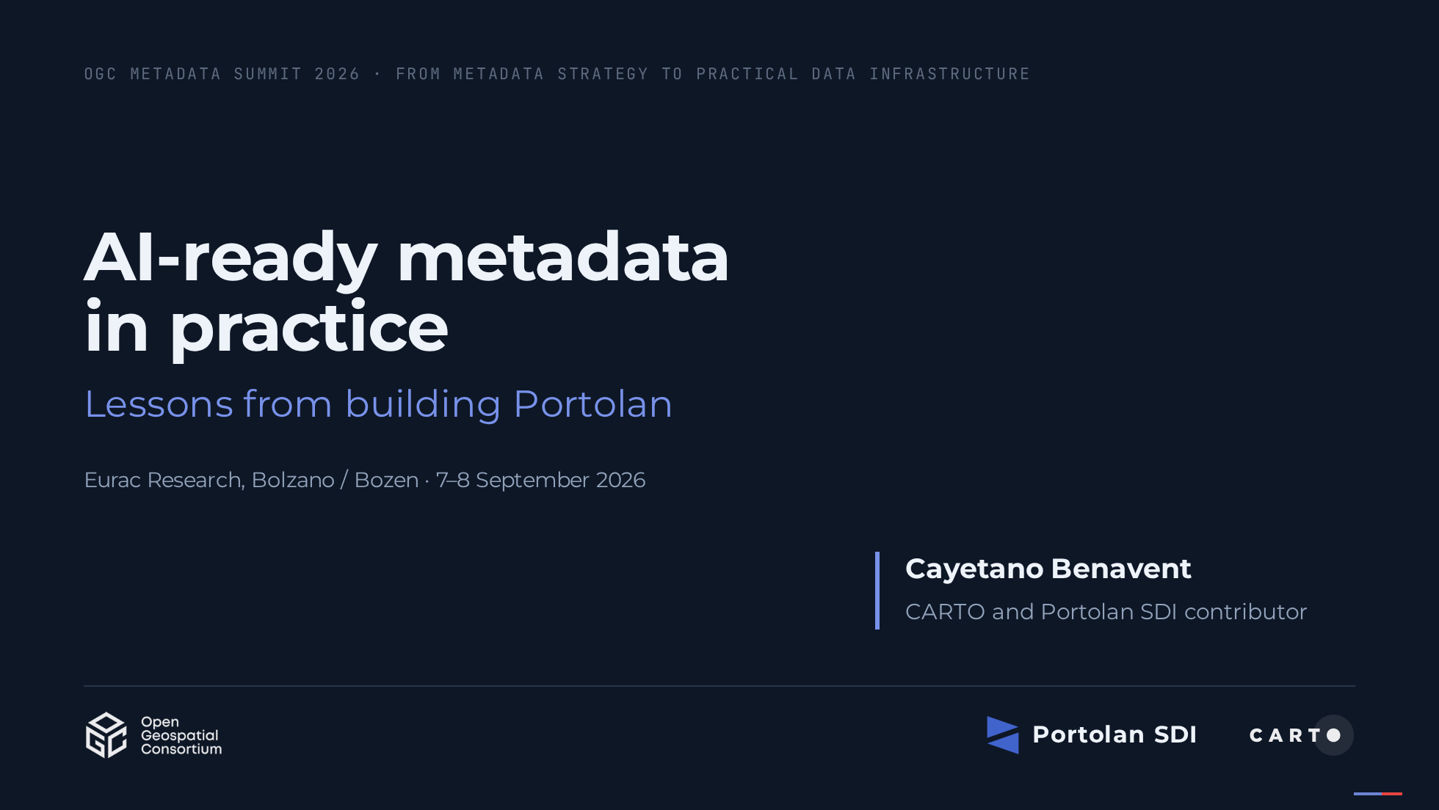
Notes:
[Say] (0:20) "Good afternoon. I am Cayetano Benavent. This is a success story with the scars still visible: what we learned building Portolan, an open specification for AI-ready geospatial catalogs, and what happened when we pointed it at this province's own data." [Sources] - https://events.ogc.org/MetadataSummit2026 - Logos: OGC (ogc.org, official blue logo file `OGC-Logo-Blue.png`, used to identify the host organisation of this event), Portolan mark (portolan-sdi.org), CARTO positive logo. Trademarks of their owners; used for identification only.

Slide 2
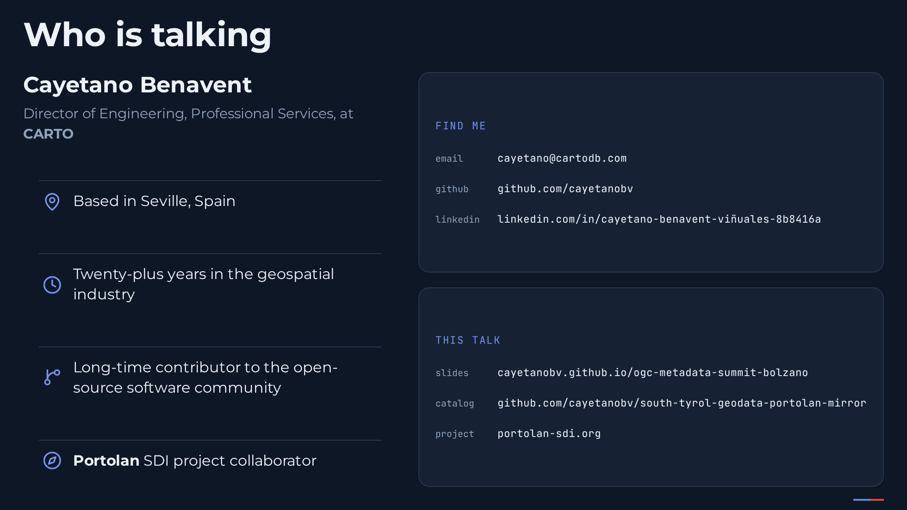
Notes:
[Say] (0:30) "Briefly, who is talking. I am Director of Engineering for Professional Services at CARTO, I collaborate on the Portolan SDI project, and I have spent more than twenty years in the geospatial industry, most of it contributing to open-source software. I am based in Seville. Everything I show is open; the slides and the catalog are at the addresses on the right." [Sources] - https://github.com/cayetanobv - https://cayetanobv.github.io/ogc-metadata-summit-bolzano/

Slide 3
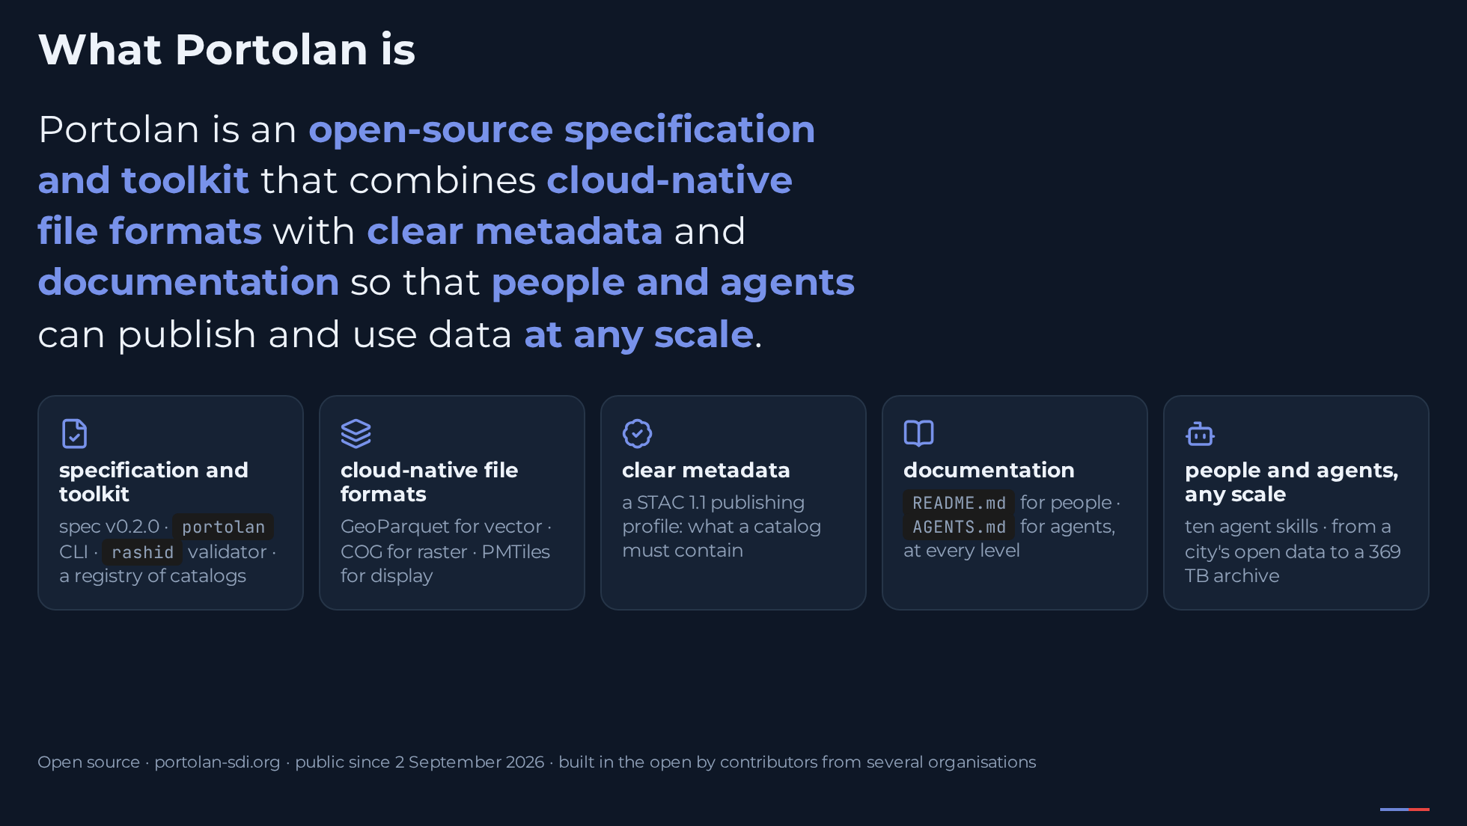
Notes:
[Say] (0:45) "Everyone says metadata should be AI-ready. Few people say what that means when you have to publish a dataset on a Monday morning. We tried to find out by building, not by defining. This is what we built. Portolan is an open-source specification and toolkit that combines cloud-native file formats with clear metadata and documentation, so that people and agents can publish and use data at any scale." [Click 1] "Each phrase in that sentence is a real thing. Specification and toolkit: a spec, a CLI, a validator called rashid, and a registry of catalogs. Cloud-native formats: GeoParquet, Cloud Optimized GeoTIFF, PMTiles. Clear metadata: a STAC publishing profile that says what a catalog must contain. Documentation: a README for people and an AGENTS file for agents, at every level. And people and agents at any scale: ten agent skills, and catalogs from a city's open data to a 369-terabyte archive. Portolan went public last Wednesday, after a year of building in the open. This is a success story with the scars still visible." [Sources] - https://www.portolan-sdi.org/ (definition sentence, checked 4 Sep 2026) - https://www.portolan-sdi.org/blog/introducing-portolan - https://github.com/portolan-sdi/portolan-spec · https://github.com/portolan-sdi/rashid · https://github.com/portolan-sdi/portolan-cli - https://github.com/portolan-sdi/portolan-registry · https://github.com/portolan-sdi/portolan-skills

Slide 4
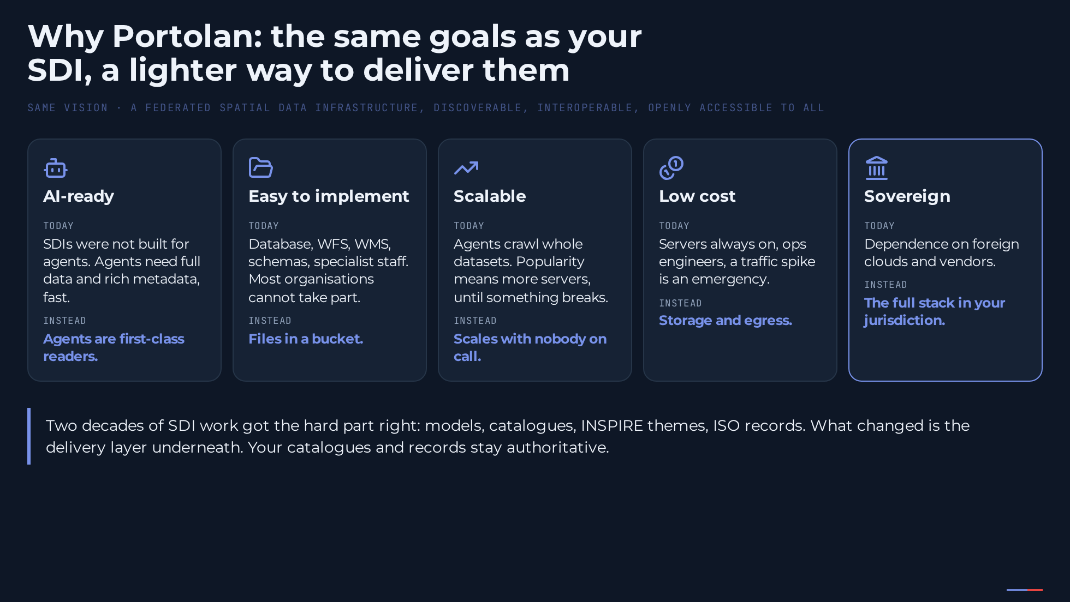
Notes:
[Say] (1:00) "Why did we build it? Not because spatial data infrastructures failed. The vision is the same one you have worked on for two decades: a federated infrastructure, discoverable, interoperable, open to all. What changed is what the delivery layer should give you. Five goals, borrowed from Chris Holmes's framing." [Click 1] "AI-ready. Our SDIs were not built for agents. Agents want the full dataset and rich metadata, fast, and they should be first-class readers, not scrapers." [Click 2] "Easy to implement. Today you need a database, a WFS, a WMS, schemas and specialist staff. That barrier keeps most organisations out. It should be files in a bucket." [Click 3] "Scalable. Agents crawl whole datasets. Today popularity means more servers, until something breaks. It should scale with nobody on call." [Click 4] "Low cost. Servers always on, ops engineers, and a traffic spike is an emergency. Sharing public data should cost storage and egress." [Click 5] "Sovereign. The full stack inside your jurisdiction, with storage, compute, models and standards you can swap independently. Your catalogues, records and models stay authoritative. What Portolan changes is how the data underneath them is delivered." [Sources] - https://cholmes.github.io/open-geodag-presentation/opengeo-dag.html (slides 5–10: the vision and the five goals; Chris frames the first as AI-first, this deck says AI-ready on screen) - https://www.portolan-sdi.org/blog/introducing-portolan ("What Portolan makes possible", "Built for people and agents") - https://github.com/portolan-sdi/portolan-ops/blob/main/copy/messaging.md ("Why Portolan?") - https://inspire.ec.europa.eu/

Slide 5
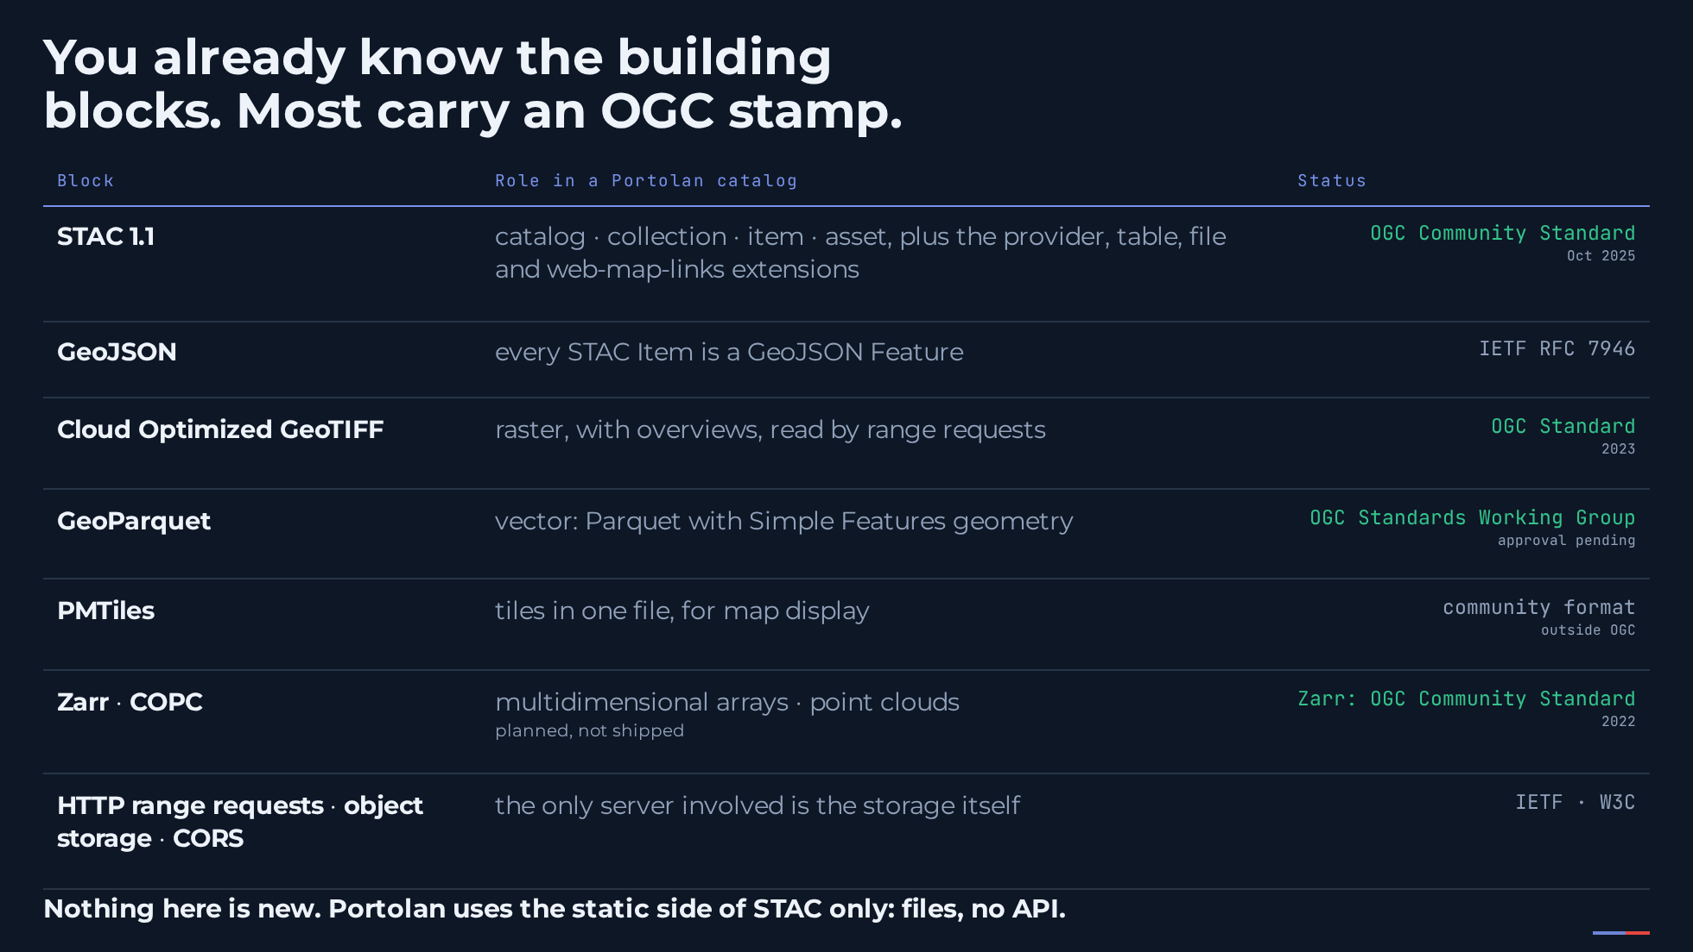
Notes:
[Say] (0:45) "Everything a Portolan catalog is made of, you already know, and most of it carries an OGC stamp. STAC, catalog to asset, has been an OGC Community Standard since last October. Every STAC Item is a GeoJSON Feature, an IETF standard. Cloud Optimized GeoTIFF is an OGC Standard since 2023. GeoParquet has its own OGC Standards Working Group; approval of 1.0 is the remaining formality. Zarr, which we plan but have not shipped, is an OGC Community Standard. PMTiles for display is a community format, and underneath it all are HTTP range requests on object storage. Nothing here is new. And Portolan uses the static side of STAC only: files, no API." [Sources] - https://www.ogc.org/announcement/ogc-announces-publication-of-the-spatiotemporal-asset-catalog-community-standards/ (28 Oct 2025; "an Item … is simply a GeoJSON Feature") - https://datatracker.ietf.org/doc/html/rfc7946 (GeoJSON, IETF, not an OGC document) - https://docs.ogc.org/is/21-026/21-026.html (OGC Cloud Optimized GeoTIFF Standard 1.0, 2023) - https://github.com/opengeospatial/geoparquet/blob/main/README.md ("official Standards Working Group … pending OGC approval", checked 3 Sep 2026) - https://www.ogc.org/announcement/ogc-forms-new-geozarr-standards-working-group-to-establish-a-zarr-encoding-for-geospatial-data/ (Zarr V2 endorsed as OGC Community Standard, June 2022) - https://docs.protomaps.com/pmtiles/ (PMTiles; not an OGC document)

Slide 6
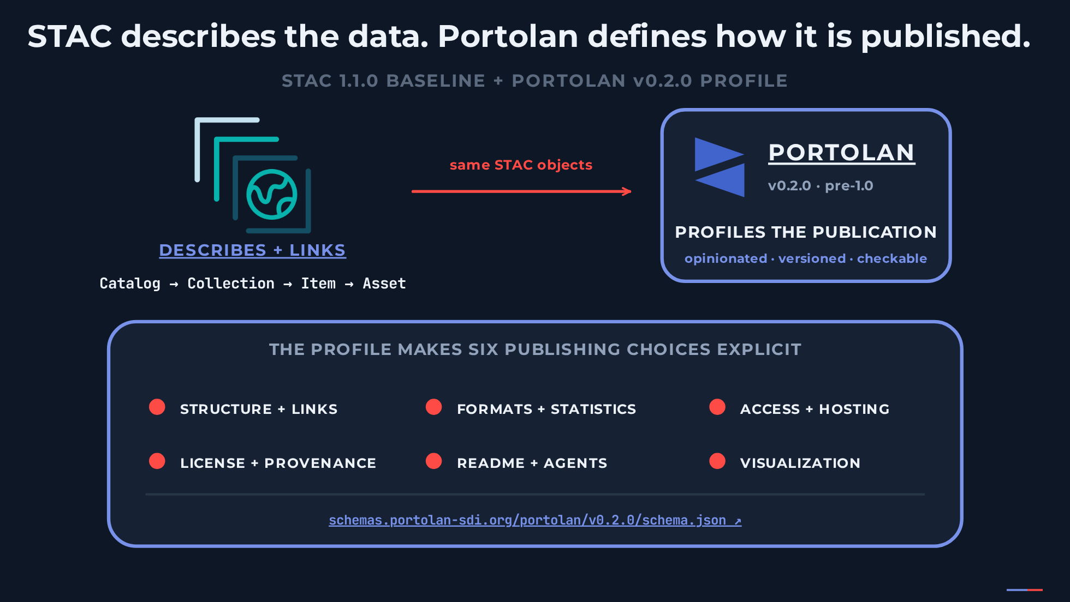
Notes:
[Say] (0:35) "So what is left to specify?" [Click 1] "STAC does its normal job: it describes and links the same objects, catalog, collection, item, asset." [Click 2] "Every one of those standards deliberately leaves the publishing choices open. That is the right design for a standard and the wrong thing to leave open for a reader, because every open choice is a branch every reader has to handle. Portolan makes six of those choices explicit: structure and links, formats and statistics, access and hosting, licence and provenance, README and AGENTS documentation, and visualisation. A catalog declares which version of the profile it follows. It is a publishing profile on top of these standards, not a new format." [Sources] - https://github.com/portolan-sdi/portolan-spec/blob/main/specs/portolan/core.md (the six families of publishing choices) - https://github.com/portolan-sdi/portolan-spec/releases/tag/v0.2.0 - https://github.com/portolan-sdi/portolan-ops/blob/main/copy/messaging.md ("Isn't this just STAC and cloud-optimized formats?") - VizTheGap by Youssef Harby, CNG Japan 2026 deck, reused as team material

Slide 7
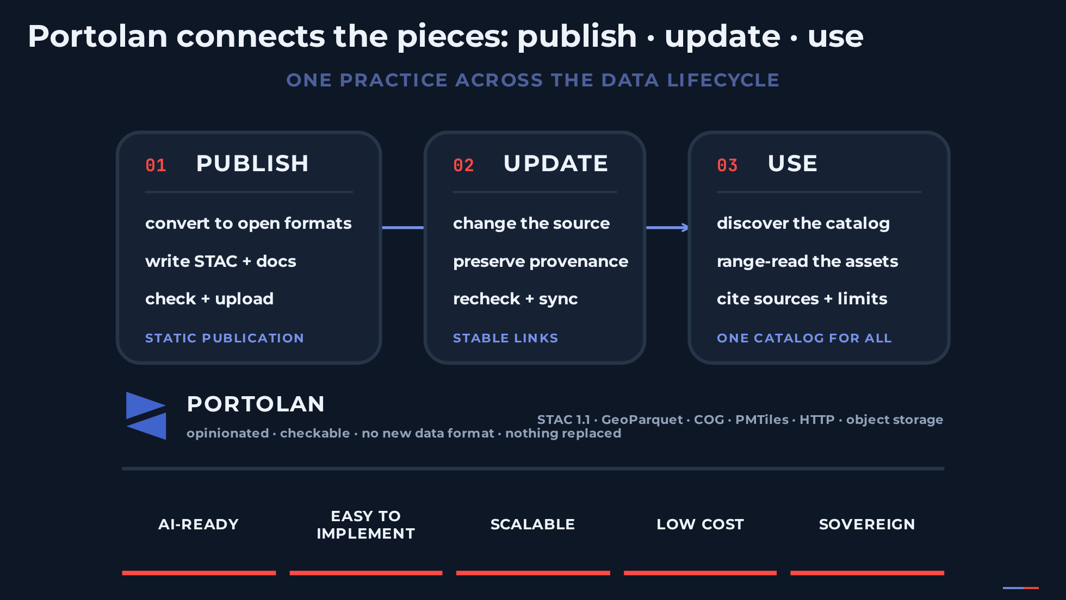
Notes:
[Say] (0:45) "Here is the big picture. Portolan is an opinionated, checkable STAC publishing profile and practice. It connects the pieces you just saw into one repeatable lifecycle: publish, update, use. It introduces no new data format and replaces none of STAC, GeoParquet, COG, HTTP or object storage." [Click 1] "Publish means convert the data to an open cloud-native format, describe it with STAC and documentation, validate it, and upload a static publication to storage the publisher controls." [Click 2] "Update follows the same contract. Change the source, preserve licence and provenance, regenerate the affected artifacts, check them again, and sync them. No second delivery path." [Click 3] "Use begins at the same catalog for software, for people and for agents. And the five goals from the previous slide are directions the design points at, not guarantees." [Sources] - https://github.com/portolan-sdi/portolan-spec/releases/tag/v0.2.0 - https://github.com/portolan-sdi/portolan-spec/blob/main/README.md - https://github.com/portolan-sdi/portolan-cli/blob/main/README.md - https://github.com/portolan-sdi/portolan-ops/blob/main/copy/messaging.md - VizPortolanContract by Youssef Harby, CNG Japan 2026 deck (slide 11 and its speaker notes), reused as team material

Slide 8
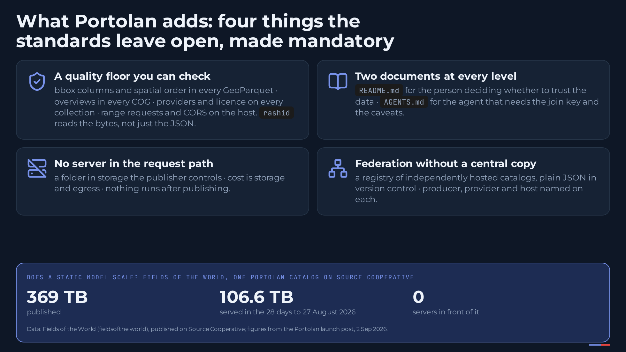
Notes:
[Say] (1:00) "So what does Portolan add on top of those standards? Four things they leave open become mandatory. One: a quality floor you can check. Bounding boxes and spatial ordering inside every GeoParquet, overviews in every COG, providers and a licence on every collection, range requests and CORS on the host; and the validator reads the bytes, not just the JSON. Two: two documents at every level, a README for the person deciding whether to trust the data and an AGENTS file for the agent that needs the join key and the caveats. Three: no server in the request path; a catalog is a folder in storage you control, cost drops to storage and egress, nothing runs after publishing. Four: federation without a central copy, a registry of independently hosted catalogs with producer, provider and host named on every one." [Click 1] "Does a static model scale? Fields of the World publishes its global field-boundary dataset as one Portolan catalog on Source Cooperative: 369 terabytes, and it served a hundred and six terabytes in the last four weeks of August. Nothing sits in front of it. The publisher pays for storage and egress; compute belongs to whoever asks the question. That is what lets a city and a planetary archive publish the same way." [Sources] - https://www.portolan-sdi.org/blog/introducing-portolan (Fig. 1: 369 TB, 106.6 TB in the 28 days ending 27 Aug 2026; "What Portolan makes possible", "Built for people and agents", "Toward a federated network") - https://github.com/portolan-sdi/portolan-ops/blob/main/copy/messaging.md ("Why Portolan?", "Common questions") - https://source.coop/ftw/global-data - https://github.com/portolan-sdi/portolan-spec/blob/main/specs/portolan/core.md - https://github.com/portolan-sdi/portolan-spec/blob/main/specs/portolan/formats.md

Slide 9
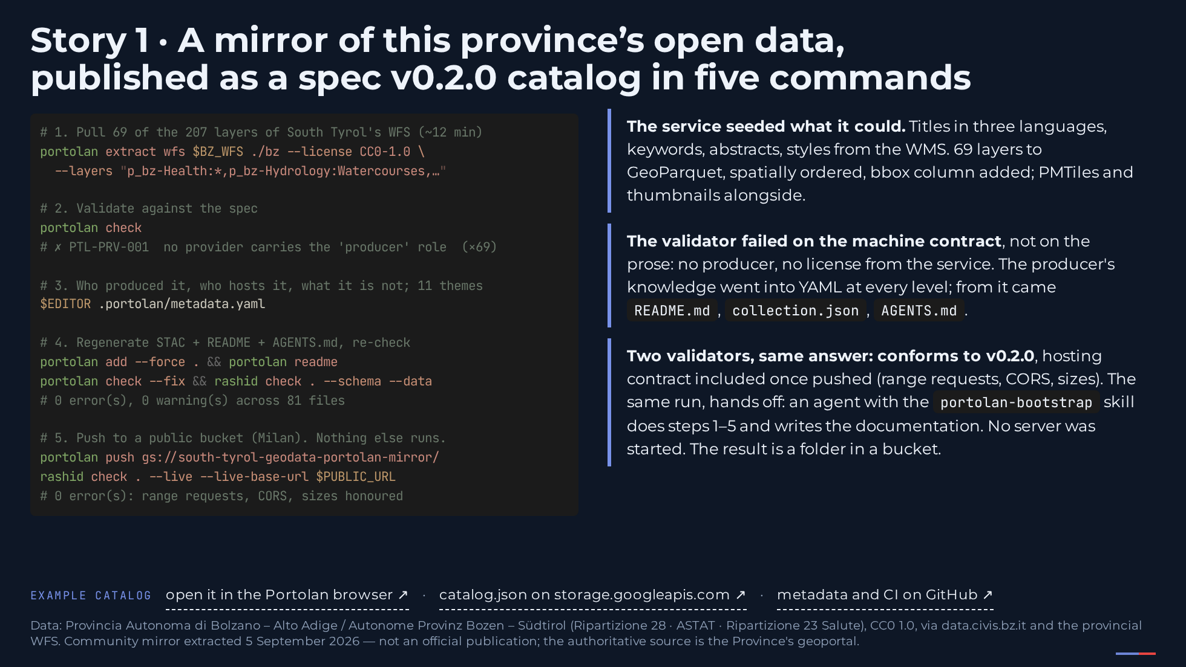
Notes:
[Say] (1:15) "First story, and it is yours. To be clear from the start: this is a mirror, not an official publication; the Province remains the authority. On Saturday I pointed the CLI at this province's WFS, the 207 INSPIRE-themed layers South Tyrol publishes, and took 69 of them, from municipalities and population to hazard-zone plans, health facilities, hydrology, transport and cultural heritage. Five commands." [Click 1] "The service seeded what it could: titles in three languages, keywords, an abstract, the map styles. Sixty-nine layers, 58 megabytes, became GeoParquet, spatially ordered, with a bbox column, plus PMTiles and thumbnails. Nobody retyped metadata." [Click 2] "Step two is the interesting one. Validation failed. Not on the prose, on the machine contract: no provider carries the producer role, and the service publishes no license. So the producer's knowledge went into YAML files, one per level: who produced it, who hosts this copy, that hospitals are points and not catchments, that hazard zones are planning classes and not forecasts. And a folder move grouped the 69 collections into 11 themes; the CLI wrote the subcatalogs. From that one file came the README for people, the STAC for software, the AGENTS file for agents." [Click 3] "Regenerate, re-check. Two independent validators, the CLI and rashid, give the same answer: conforms to version 0.2.0 of the spec. 128 requirements checked. The remaining notes are publisher judgment: there is no upstream STAC catalog to link to. And nothing was started. The result is a folder. Push it to a bucket and it is live." [Sources] - https://geoservices1.civis.bz.it/geoserver/ows?service=WFS&version=2.0.0&request=GetCapabilities - License verified Sep 3, 2026 on the Province's open-data portal (CKAN `license_id: cc-zero`, publisher "Provincia Autonoma di Bolzano - Alto Adige", records updated 2025-04-23): https://data.civis.bz.it/dataset/comuni · https://data.civis.bz.it/dataset/popolazione-ufficiale · https://data.civis.bz.it/dataset/piani-delle-zone-di-pericolo-pericoli-idraulici · https://data.civis.bz.it/dataset/ospedali · https://data.civis.bz.it/dataset/farmacie - https://github.com/portolan-sdi/portolan-cli · https://github.com/portolan-sdi/rashid - Example catalog, live: https://storage.googleapis.com/south-tyrol-geodata-portolan-mirror/catalog.json · in the Portolan browser: https://browser.portolan-sdi.org/#/external/storage.googleapis.com/south-tyrol-geodata-portolan-mirror/catalog.json

Slide 10
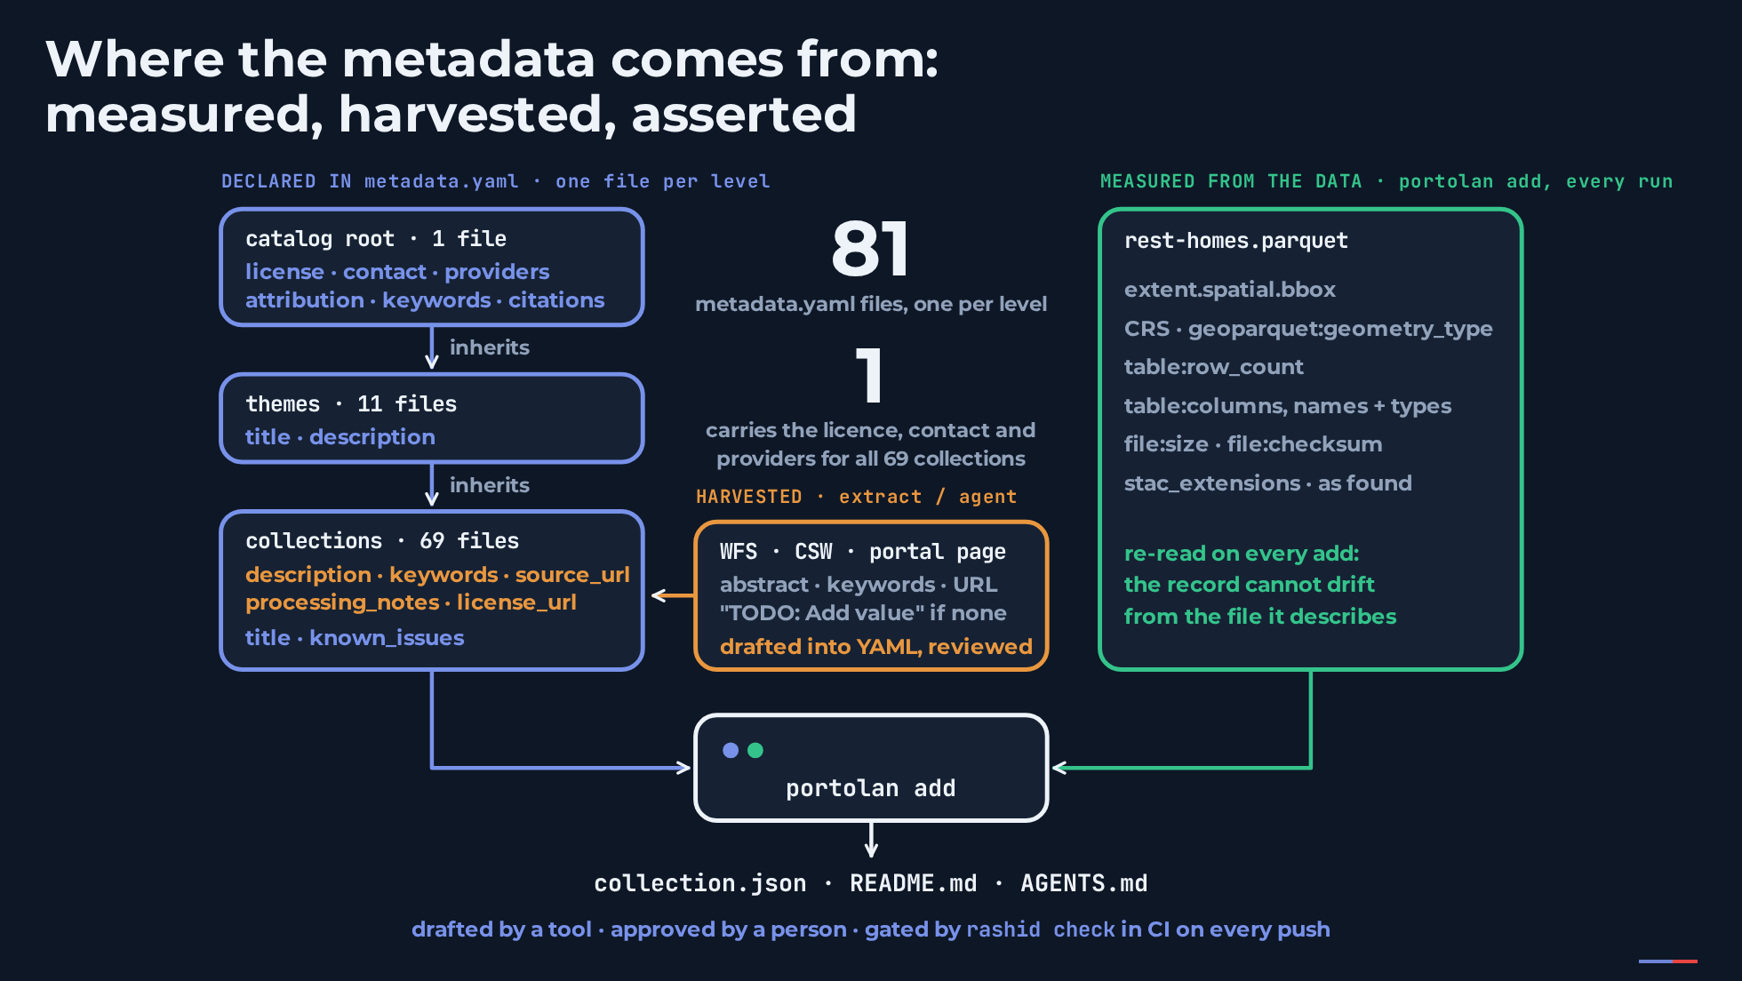
Notes:
[Say] (0:50) "Before the second story, one slide on where all that metadata actually came from, because this is the part metadata maintainers ask about. Two things reach the record: what the publisher declares in a YAML file, and what the tool measures from the data. And a third kind of value gets into the YAML by a shortcut." [Click 1] "Measured, in green: what the tool reads from the file itself. Extent, coordinate system, row count, columns and types, checksums. Re-read on every run, so the record cannot drift from the data. Harvested, in orange: what the source already published. Abstract, keywords, the dataset page, pulled from the WFS and the portal by portolan extract, or drafted by an agent. It is written into the collection's YAML for review, never straight into the record; where the service had nothing, the tool writes a TODO marker, so the reviewer opens a checklist and not a blank. Asserted, in blue: what only the publisher can say. Who is accountable, the licence, the providers, the known issues." [Click 2] "And the declared part is written once. Every level of the tree carries a metadata file; a child inherits everything from its ancestors. Eighty-one files in this catalog; one of them carries the licence, the contact and the providers for all sixty-nine collections. Only title and description stay local." [Click 3] "portolan add merges the YAML tree and the measurements into the STAC record, the README and the AGENTS file. So the working rule is: drafted by a tool, approved by a person, gated by the validator in CI on every push. Drafting is where tools help. The reading and the accountability stay human." [Sources] - https://github.com/cayetanobv/south-tyrol-geodata-portolan-mirror (81 metadata.yaml files, 11 themes, 69 collections; CI runs rashid check on every push; counted 4 Sep 2026) - https://cli.portolan-sdi.org/ (portolan add, portolan extract, metadata.yaml inheritance, --merge-strategy smart; portolan-cli 0.8.0) - https://github.com/portolan-sdi/portolan-spec/blob/main/specs/portolan/core.md - Portolan AI policy: "drafting is where tools help; the reading and the accountability stay human"

Slide 11
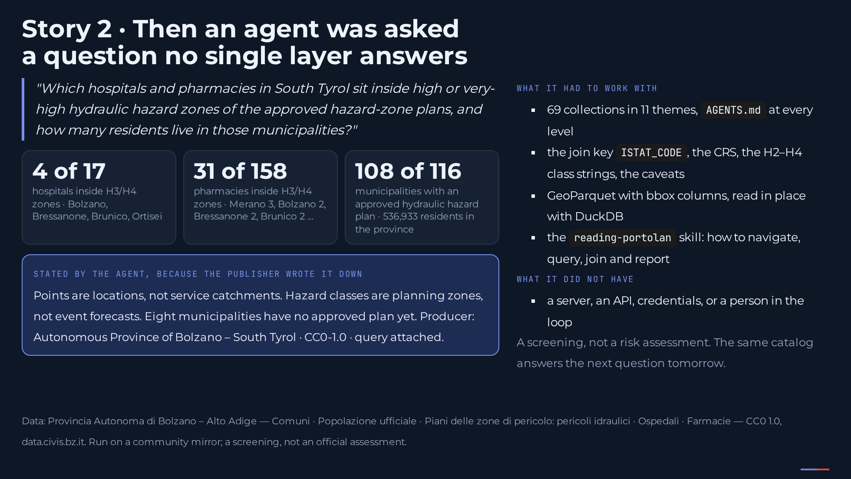
Notes:
[Say] (1:15) "Second story, same catalog, the next day. Out of 69 collections, an agent was asked a question no single layer answers: which hospitals and pharmacies sit inside high or very-high hydraulic hazard zones, and how many residents live in those municipalities. Nobody guided it." [Click 1] "Four of seventeen hospitals, in Bolzano, Bressanone, Brunico and Ortisei. Thirty-one of a hundred and fifty-eight pharmacies. A hundred and eight of the hundred and sixteen municipalities have an approved plan. The agent joined five collections on the ISTAT code, filtered the hazard classes by the strings the AGENTS file told it about, and ran the intersection in DuckDB against the GeoParquet in place." [Click 2] "And it said what the numbers do not mean, because the publisher wrote it down: points are locations, not catchments; hazard classes are planning zones, not forecasts; eight municipalities have no approved plan yet. Producer, license and the query came attached. This is a screening, not a risk assessment. But look at what it did not have: a server, an API, credentials, or a person in the loop. The same catalog answers the next question tomorrow." [Sources] - https://github.com/portolan-sdi/portolan-skills/tree/main/skills/reading-portolan

Slide 12
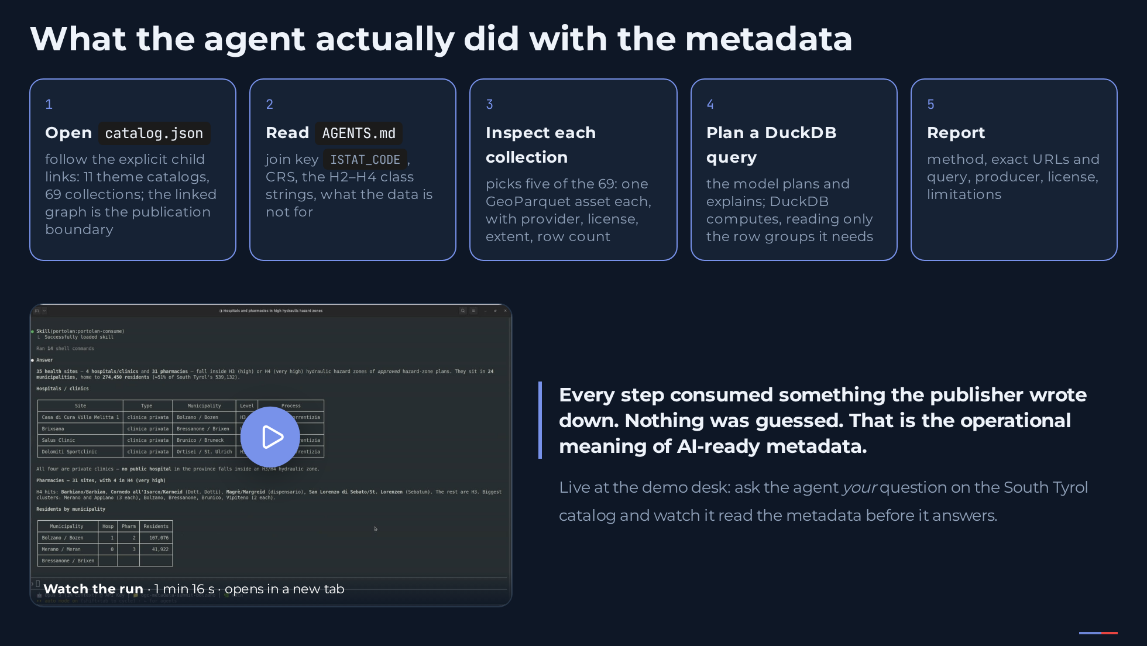
Notes:
[Say] (0:50) "Here is what the agent actually did, because this is where AI-ready stops being a slogan." [Click 1] "It opened the catalog and followed the explicit child links: eleven theme catalogs, sixty-nine collections. The linked graph is the publication boundary." [Click 2] "It read AGENTS dot md: the join key, the coordinate system, the exact hazard-class strings, and what the data is not for." [Click 3] "It inspected each collection: one GeoParquet asset each, with provider, license, extent and row count." [Click 4] "It planned a DuckDB query. The model plans and explains; DuckDB computes, reading only the row groups it needs thanks to the spatial ordering the spec requires." [Click 5] "It reported with method, URLs, producer, license and limitations. Every step consumed something the publisher wrote down. Nothing was guessed. I cannot run this in ten minutes, so it runs live at the demo desk: bring a question about South Tyrol and watch the agent read the metadata before it answers. The recording is linked here as well." [Sources] - https://github.com/portolan-sdi/portolan-skills/tree/main/skills/reading-portolan - Recording of the run (thumbnail: a frame from it, public/bz-agent-frame.jpg): https://storage.googleapis.com/ogc-metadata-summit-bolzano-talk-media/ogc-metadata-2026-bolzano-demo-south-tyrol-agent.mp4 (public bucket in europe-west8, 18 MB, H.264, 76 s, no audio; replaced 5 Sep 2026)

Slide 13
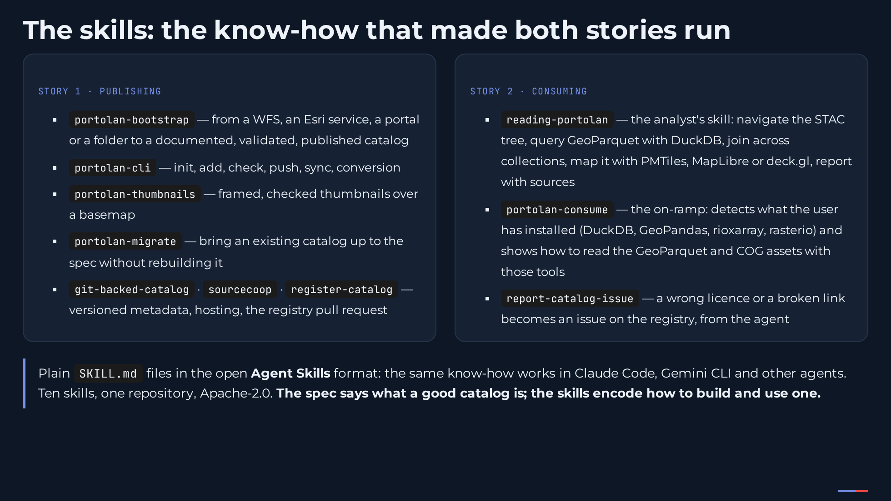
Notes:
[Say] (0:45) "One more thing the two stories relied on: skills. Portolan ships ten agent skills, plain SKILL files in the open Agent Skills format." [Click 1] "On the publishing side: bootstrap takes a WFS, an Esri service, a portal or a folder all the way to a documented, validated, published catalog; the CLI skill covers the day-to-day commands; thumbnails, migrate, and the skills for git-backed metadata, hosting and the registry pull request." [Click 2] "On the consuming side: reading-portolan is what the agent used in story two, navigating the STAC tree, querying GeoParquet with DuckDB, joining collections, mapping the result, reporting with sources. Consume is the on-ramp for someone who just wants the data in their own tools: it detects whether DuckDB, GeoPandas or rasterio is installed and shows how to read the assets with that. And report-catalog-issue turns a wrong licence into an issue on the registry. The same files work in Claude Code, Gemini CLI and other agents. The spec says what a good catalog is; the skills encode how to build and use one." [Sources] - https://github.com/portolan-sdi/portolan-skills (ten skills, README checked 4 Sep 2026) - skills/reading-portolan/SKILL.md (navigate, DuckDB, joins, analysis, PMTiles/MapLibre/deck.gl/Potree) and skills/portolan-consume/SKILL.md (detects DuckDB / GeoPandas / rioxarray / rasterio, then how to read GeoParquet and COG), checked 5 Sep 2026 - https://github.com/anthropics/agent-skills (Agent Skills open format, SKILL.md)

Slide 14
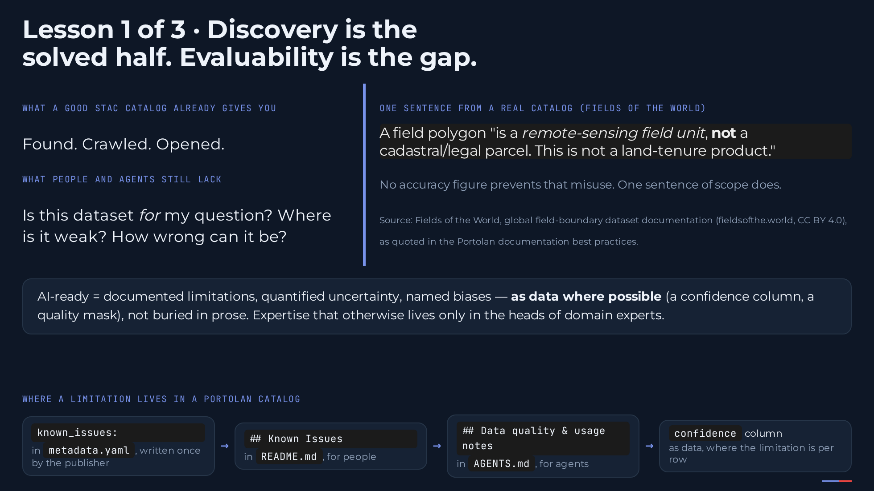
Notes:
[Say] (1:10) "Three lessons from building this. The first is the one I would keep if I could keep only one. A well-formed STAC catalog is already findable and crawlable. Discovery is largely solved. What people and agents cannot do yet is evaluate: is this dataset fit for my question, where is it weak, how wrong can it be." [Click 1] "One sentence from a real catalog, Fields of the World: a field polygon is a remote-sensing field unit, not a cadastral parcel. That single sentence prevents a whole category of misuse that no accuracy number would catch. In the Bolzano answer you saw the same thing: a hospital point inside a hazard polygon is a location, not a catchment. Someone wrote that down." [Click 2] "So our working definition: AI-ready means documented limitations, quantified uncertainty and named biases, as data where possible. And where does that live? In one field, known_issues, in the publisher's YAML. From there the CLI puts it in the Known Issues section of the README for people; the AGENTS file carries the data-quality and usage notes for agents; and the best practice is to make it a column an agent can filter on, a confidence value or a quality mask, rather than a paragraph it has to interpret. This is the expertise that otherwise lives only in the heads of domain experts, and it is the part of your metadata work that no automation replaces." [Sources] - https://github.com/portolan-sdi/portolan-spec/blob/main/specs/best-practices/documentation.md - South Tyrol mirror, health/rest-homes: `known_issues` in `.portolan/metadata.yaml` → `## Known Issues` in README.md; `## Data quality & usage notes` in AGENTS.md (portolan-cli 0.8.0, checked 4 Sep 2026) - Trochim & Roy 2025, Candid Core Framework, doi:10.5281/zenodo.15227664 - https://source.coop/ftw/global-data - https://www.portolan-sdi.org/blog/introducing-portolan ("context that'd otherwise be scattered across documentation or live only in the heads of domain experts")

Slide 15
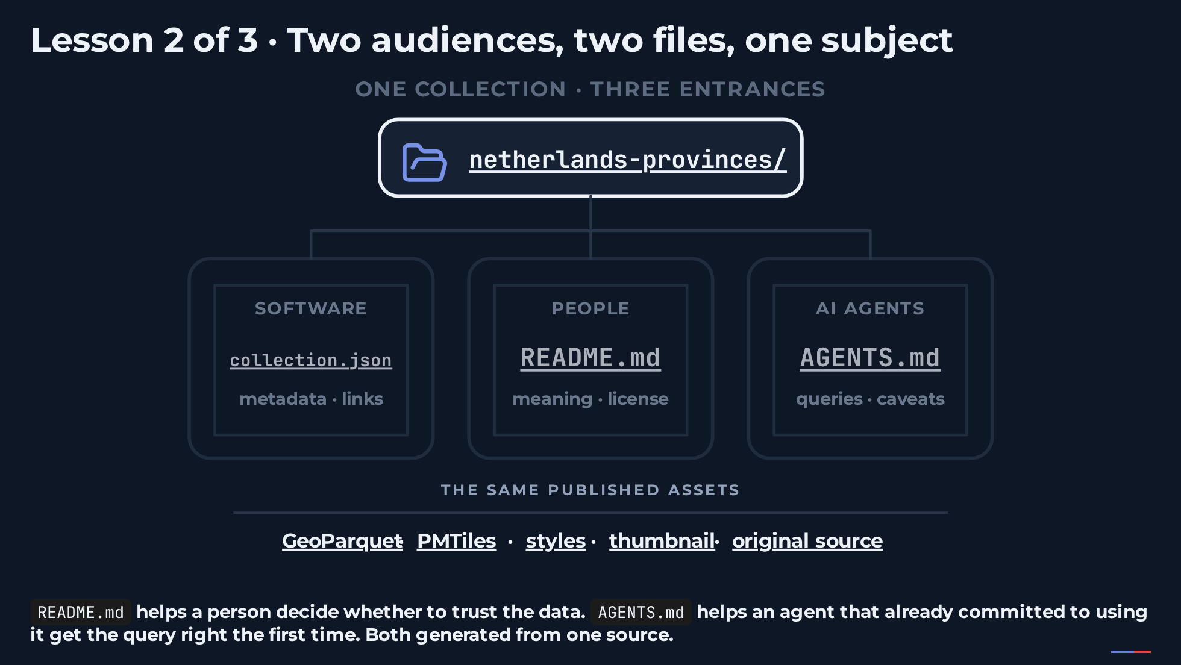
Notes:
[Say] (1:00) "Second lesson. Every catalog and collection carries two documents, and the spec requires both. The README is for the person deciding whether to trust the data. AGENTS dot md is for the agent that has already decided and now needs to get the query right on the first try. Same subject, different job." [Click 1] "Software reads collection dot json: structure, links, extents, providers." [Click 2] "People read the README: what it is, where it came from, the license, a schema table." [Click 3] "Agents read AGENTS dot md: the join key, the CRS, the sentinel values, a working query. A schema table orients a reader. Naming the join key saves an agent a failed query. Duplication between the two is fine. Drift is not, so both are generated from one source of truth, and the validator checks that they exist at every level." [Sources] - https://github.com/portolan-sdi/portolan-spec/tree/main/examples/catalog/portolan-reference/boundaries/netherlands-provinces - https://github.com/portolan-sdi/portolan-spec/blob/main/specs/portolan/core.md - https://www.portolan-sdi.org/blog/introducing-portolan ("All Portolan catalogs must include READMEs and AGENTS.md files")

Slide 16
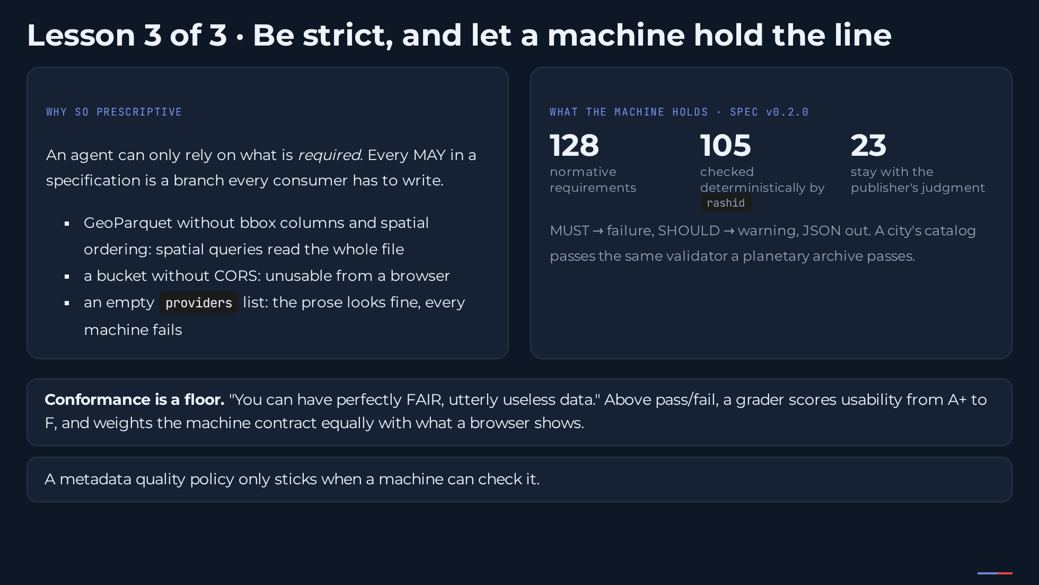
Notes:
[Say] (1:15) "Third lesson, and the uncomfortable one: be strict. Publishers do not love this. But an agent can only rely on what is required. Every MAY in a spec is a branch every consumer has to write, forever. So Portolan says: GeoParquet must carry bbox columns and be spatially ordered, or a spatial query reads the whole file. The bucket must serve CORS, or a browser cannot touch it. Every collection must name its providers, or the prose looks fine and every machine fails." [Click 1] "And strictness only works if a machine holds the line. The spec, version 0.2.0, has 128 normative requirements. 105 are checked deterministically by rashid, the validator: structure, required files, roles, license, provenance, and the actual bytes. 23 stay with the publisher: whether the upstream meaning survived, whether the license really applies. A city's catalog passes the same validator a planetary archive passes." [Click 2] "Conformance is a floor. You can have perfectly FAIR, utterly useless data. So above pass or fail, a grader scores usability from A plus to F, and it deliberately weights the machine contract equally with what a browser shows. A rubric that only rewards pretty thumbnails certifies catalogs that fail every machine that reads them. Many ISO records render nicely and parse badly. Same problem." [Click 3] "The lesson in one line: a metadata quality policy only sticks when a machine can check it." [Sources] - https://github.com/portolan-sdi/portolan-spec/blob/main/specs/portolan/requirements.yaml (regenerated 3 Sep 2026 at v0.2.0 and origin/main 2d1f972: 128 total, 105 validator / 23 process) - https://github.com/portolan-sdi/portolan-spec/releases/tag/v0.2.0 - https://github.com/portolan-sdi/rashid - https://github.com/portolan-sdi/portolan-spec/blob/main/specs/best-practices/grader.md - https://github.com/portolan-sdi/portolan-spec/blob/main/specs/best-practices/philosophy.md - https://www.portolan-sdi.org/blog/introducing-portolan (bbox structs + spatial ordering, CORS examples; MUST/SHOULD reporting) - Sundwall 2025, https://radiant.earth/blog/2025/11/great-data-products/

Slide 17
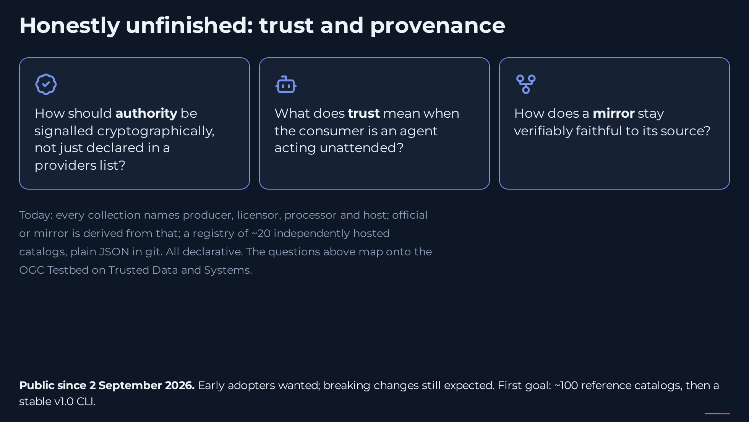
Notes:
[Say] (0:45) "Let me close with what we have not solved. Today every collection names who produced, licensed, processed and hosts the data; whether a catalog is official or a mirror is derived from that; and the registry is nothing more than a catalog of about twenty independently hosted catalogs. If it disappeared tomorrow, every one of them would keep working. All of that is declarative. So three open questions, and they map straight onto the Testbed on Trusted Data and Systems: how should authority be signalled cryptographically? What does trust mean when the consumer is an agent nobody is watching? And how does a mirror prove it is faithful to its source?" [Click 1] "Portolan has been public for five days. It is built by contributors across several organisations, it wants early adopters, and it still expects breaking changes. The first goal is about a hundred reference catalogs. The community call is Fridays at ten, Central European time, the Slack channel is on the next slide, and I am at the demo desk during the coffee breaks. These are the questions we would like to work on with the people in this room. Thank you." [Sources] - https://github.com/portolan-sdi/portolan-spec/blob/main/specs/portolan/core.md (Providers, Source Provenance) - https://github.com/portolan-sdi/portolan-registry - https://www.portolan-sdi.org/blog/introducing-portolan (registry framing, ~100 reference catalogs goal, Friday 10:00 CET meeting, #portolan channel, contributor organisations) - https://carto.com/blog/introducing-portolan-and-carto-sdi/ (twenty catalogs at launch; mirror must name producer and link back)

Slide 18
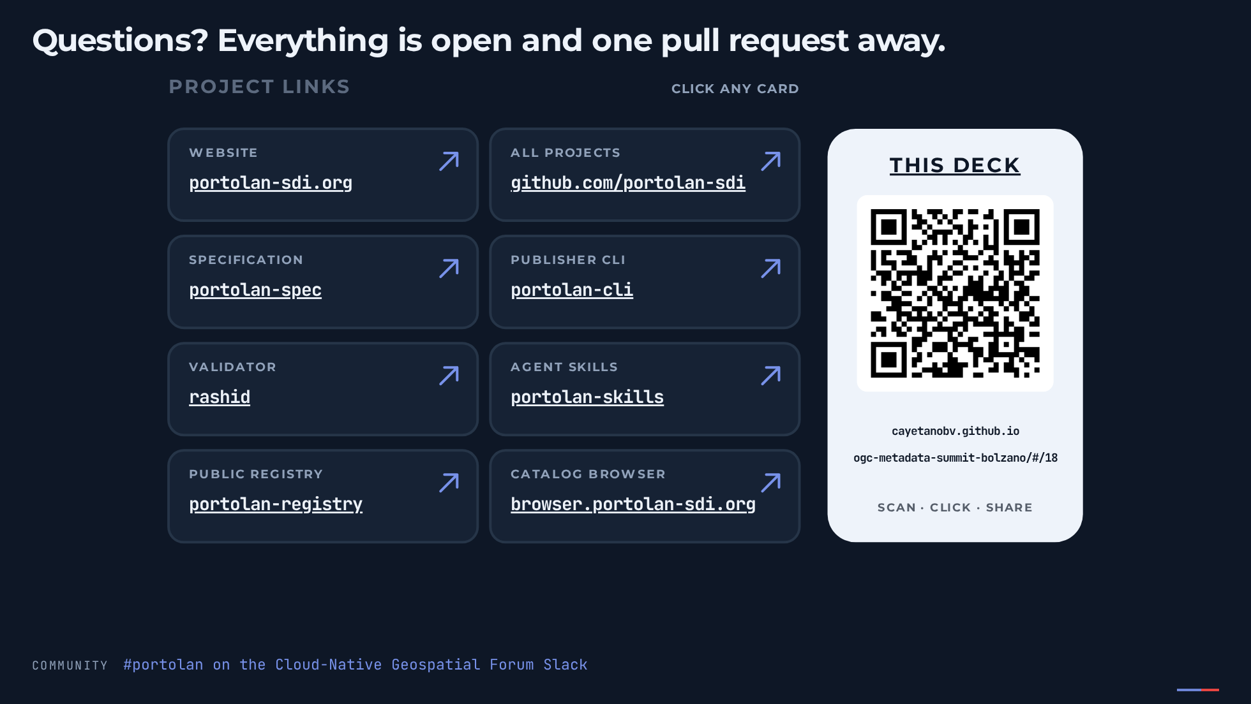
Notes:
[Say] (shown during Q&A, no talk time) "Feedback as GitHub issues against the spec or against any catalog. Mirrors of national datasets are welcome, there is an open list. The validator and the grader are open for anyone to run. One URL: portolan-sdi.org. The community lives in the #portolan channel of the Cloud-Native Geospatial Forum Slack and on the Friday call. And find me at the demo desk." [Sources] - https://www.portolan-sdi.org/ - https://github.com/portolan-sdi - https://github.com/portolan-sdi/portolan-data/issues (datasets to mirror) - https://github.com/portolan-sdi/portolan-spec - https://github.com/portolan-sdi/rashid - https://github.com/portolan-sdi/portolan-cli - https://github.com/portolan-sdi/portolan-skills - https://github.com/portolan-sdi/portolan-registry

Slide 19
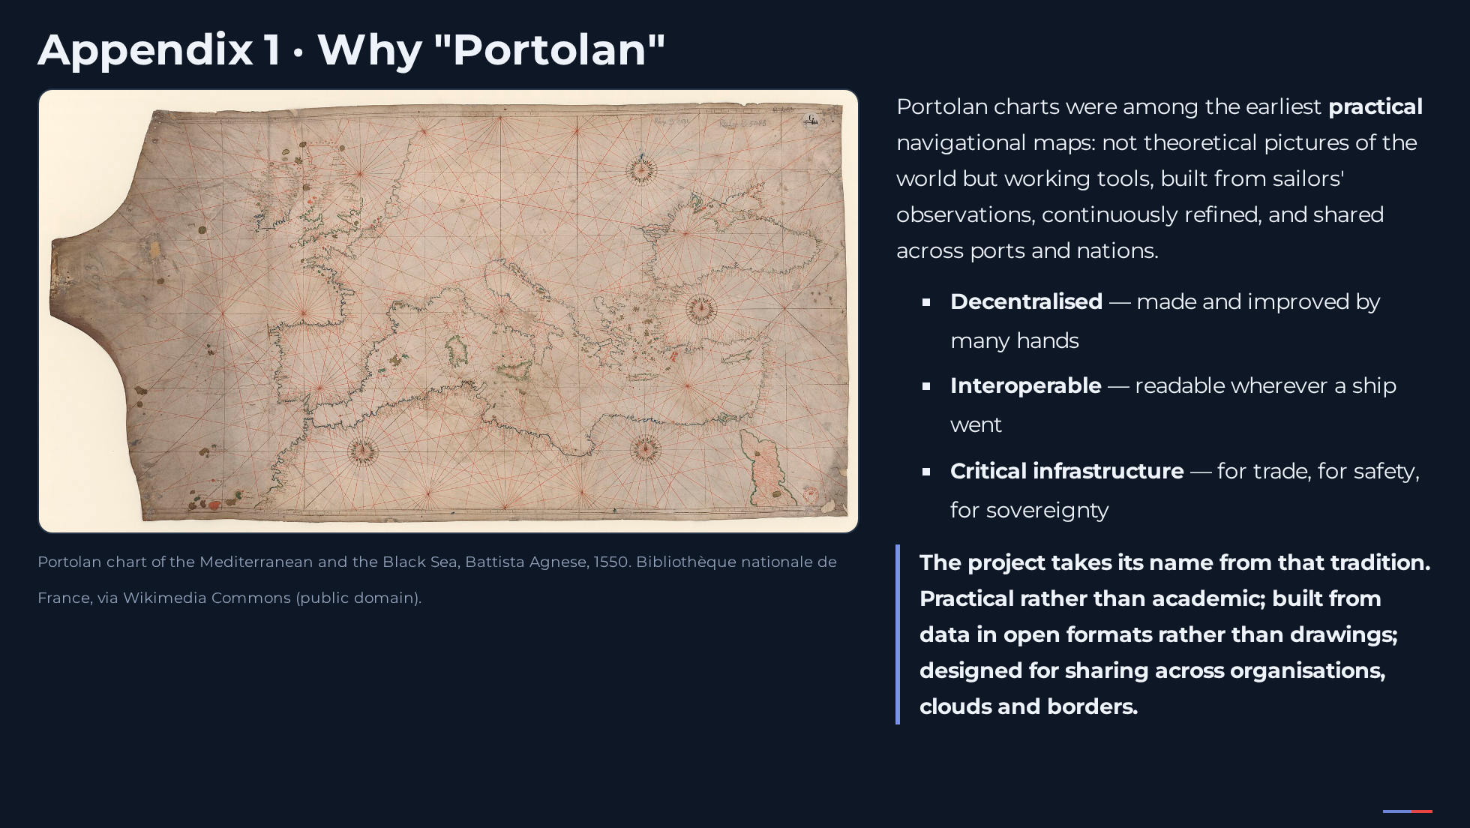
Notes:
[Say] (0:45) "Portolan charts were among the earliest practical navigational maps. Not theoretical pictures of the world but working tools: built from sailors' observations, continuously refined, shared across ports and nations. Decentralised, made and improved by many hands. Interoperable, readable wherever a ship went. And critical infrastructure, for trade, for safety, for sovereignty." [Click 1] "The project takes its name from that tradition. Practical rather than academic. Built from data in open formats rather than drawings. Designed for sharing across organisations, clouds and borders." [Sources] - Launch commentary, 2 September 2026: https://carto.com/blog/introducing-portolan-and-carto-sdi/ ("A postscript on the name") - Image: Wikimedia Commons, "1550 Portolan chart of the Mediterranean Sea and the Black Sea", Battista Agnese; Bibliothèque nationale de France; public domain

Slide 20
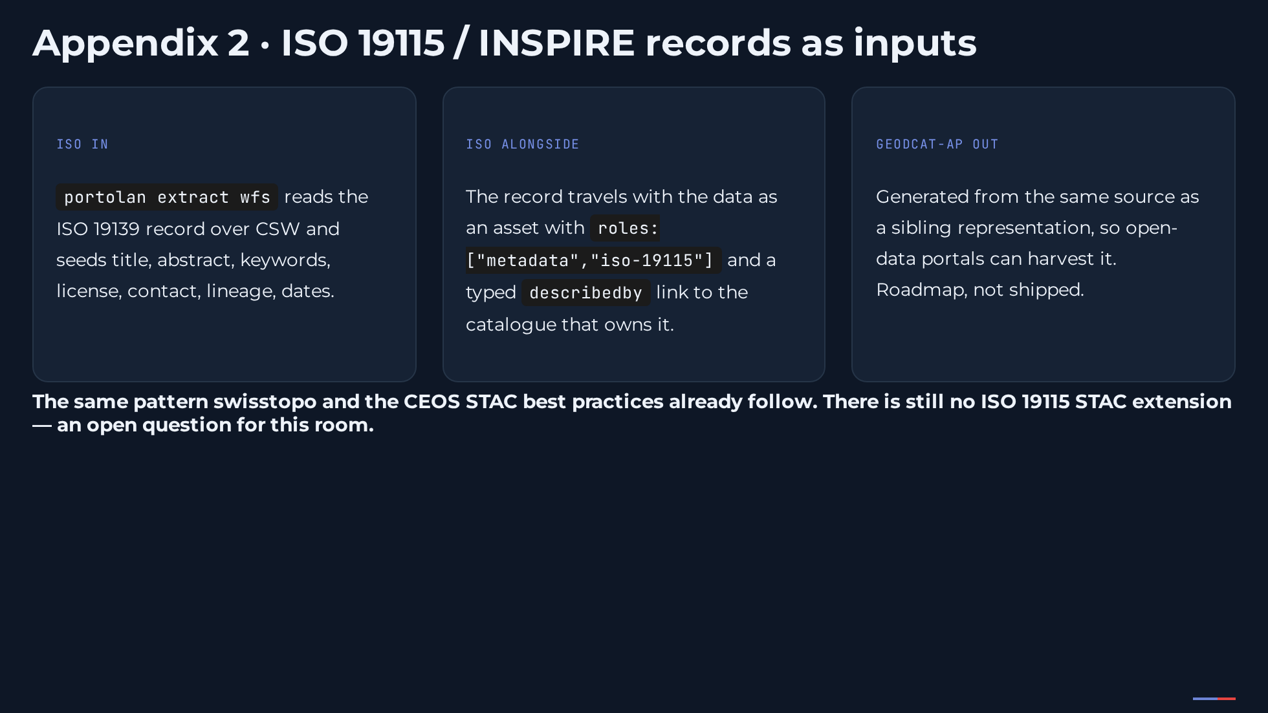
Notes:
[Say] "You maintain ISO 19115 and INSPIRE records. Let me be explicit about how this relates to them, because the honest answer is additive." [Click 1] "Your record is an input. The CLI reads it over CSW and seeds the catalog metadata from it. Nobody retypes anything." [Click 2] "Your record ships alongside the data as a metadata-role asset, with a typed link back to the catalogue that owns it. The catalogue stays authoritative. The Netherlands provinces example in the spec does exactly this." [Click 3] "GeoDCAT-AP comes out the other side, generated from the same source, for the portals that harvest DCAT. That part is roadmap, not shipped. And I want to be honest about one gap: there is still no ISO 19115 STAC extension, in Portolan or anywhere. Whether the record should hang off a typed link or ride as an asset is unresolved. This is the room that could settle it." [Sources] - https://github.com/ceos-org/stac-collection-and-granule-discovery-best-practices/blob/main/best-practices.md - https://data.geo.admin.ch/api/stac/v1/collections/ch.meteoschweiz.ogd-smn - https://github.com/portolan-sdi/portolan-spec/tree/main/examples/catalog/portolan-reference/boundaries/netherlands-provinces - https://portal.ogc.org/files/103396 (OGC GeoDCAT SWG charter)

Slide 21
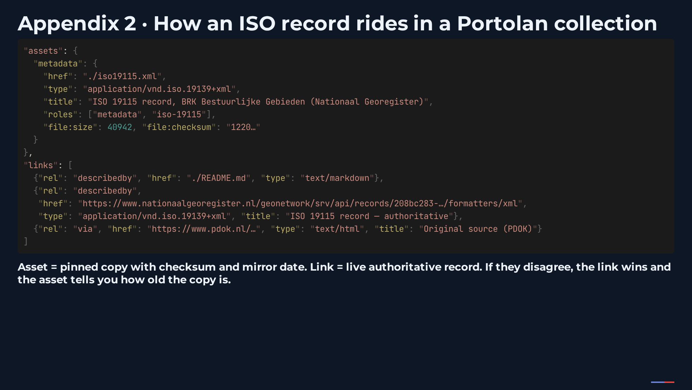
Notes:
[Say] "For the metadata people: the asset is the pinned copy, with a checksum and a mirror date. The typed describedby link points at the live authoritative record. via stays for provenance, on mirrors only. That is what real catalogs do and what CEOS codifies, with one deliberate difference: Portolan does not put metadata representations on via." [Sources]

