Slide 1
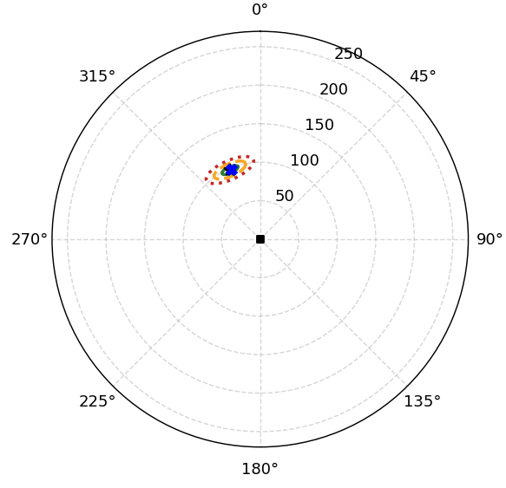
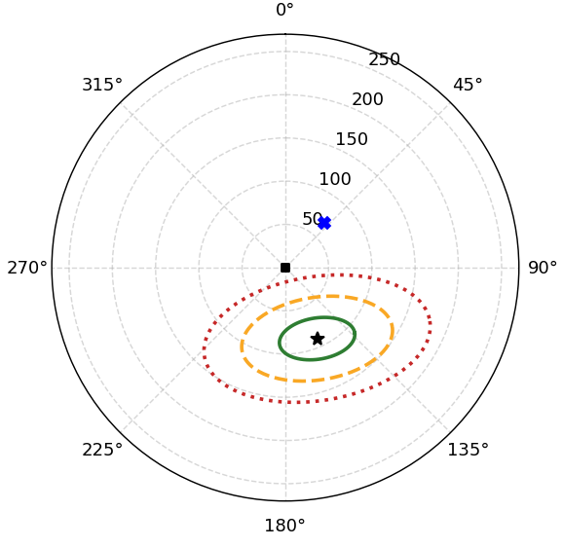
(a)
The acoustic system predicts a drone location at a bearing of -23.6 degrees and a range of 98.0 m. The GMM evaluation indicates that over 93% of the feature distribution falls into low and medium regions, showing that the internal representation remains within a familiar feature regime. Because the feature representation is familiar, the ERN uncertainty estimates can be interpreted normally; here, the ERN expresses low predictive uncertainty across both bearing (‘bearing_std_deg’ ≈ 6.46°, band 1) and range (‘sigma_range’ ≈ 0.016, band 1). Overall, the user can trust this localization prediction with relatively high confidence.
(b)
The acoustic system predicts a drone location at a bearing of 155.9 degrees and a range of 90.0 m. The GMM evaluation indicates that roughly 24% of the internal features fall into elevated or out-of-range regimes (high, very high, or above max), demonstrating a moderate-to-strong shift from the calibrated feature distribution. While the ERN reports very low predictive uncertainty for range alongside elevated uncertainty for bearing, these confidence levels must be interpreted with caution due to the feature-space deviation. Overall, the user should treat this localization estimate with strong caution and avoid relying heavily on it.
(a)
(b)

Slide 2
(a)
The model predicts a bearing of about -23.6° at a range of about 98.0 m. The GMM shows that the representation appears familiar: about 93% of feature positions are low or medium, with only around 7% in the high category and essentially none in very_high or above_max. The ERN uncertainty can therefore be interpreted normally, and both the bearing uncertainty (about 6.5°) and the range uncertainty sit in band 1, below the k = 1 level of the calibration values, indicating relatively high confidence in both components. The localization estimate can be trusted reasonably well in this feature regime.
(b)
The model predicts a bearing of about 155.9° at a range of about 90.0 m. The GMM shows that the representation is mostly familiar (about 76% of feature positions are low or medium), but roughly a quarter fall in the high, very_high or above_max categories, which is a meaningful deviation. The ERN uncertainty can therefore be treated as informative but cautiously: the range uncertainty is low relative to calibration (band 1), while the bearing uncertainty is mid-range (band 2, within the typical calibration range) but still numerically wide at about 33°. The localization estimate should be used cautiously, with more weight on the range component than on the bearing.
(a)
(b)

