Slide 1
Eclipse and JMX
Training 12/05/200
8

Slide 2
Eclipse RCP
What is Eclipse RCP?
The Rich Client Platform (RCP) is an exciting new way to build Java applications that can compete with native applications on any platform.

Slide 3
Eclipse RCP
Plug-in manifest
  MANIFEST.MF
  plugin.xml
The main program
  Application.java
The default perspective
The Advisor classes
  Workbench Advisor
  Workbench Window Advisor
  ActionBar Advisor
Plug-in class
Build properties

Slide 4
Eclipse RCP
Plug-in manifest: The plug-in manifest ties all the code and resources together
MANIFEST.MF: The OSGi bundle manifest is stored in MANIFEST.MF. OSGi is the name of a standard that Eclipse uses for dynamically loading plug-ins
plugin.xml: The Eclipse extension manifest is called plugin.xml. It's used for defining and using Eclipse extension points, so if you're not using extension points then this file may be omitted. Extension points are the fundamental way that Eclipse plug-ins are tied together so if you're not familiar with them see one of the articles in the Reference section

Slide 5
Eclipse RCP
The main program: The org.eclipse.core.runtime.applications extension tells the Eclipse runtime the name of your main program. This is a class that implements IPlatformRunnable and a run() method
The default perspective : A Perspective is a set of visible views, editors, and menus including their positions and sizes. In an RCP program you must define at least one perspective and make it the default. Perspectives are created by implementing IPerspectiveFactory using the class name referred to by the org.eclipse.ui.perspectives extension.

Slide 6
Eclipse RCP
The Advisor classes : The main program referenced a class called ApplicationWorkbenchAdvisor. This is one of three Advisor classes that you use to configure all aspects of the Workbench such as the title, menu bars, and so on. These are the most important classes for an RCP developer to understand. You extend the base version of the class, for example WorkbenchAdvisor, in your RCP application and override one or more of the methods to set whatever options you want.
Workbench Advisor : Methods in this class are called from the platform to notify you at every point in the lifecycle of the Workbench. They also provide a way to handle exceptions in the event loop, and provide important parameters to the Workbench such as the default perspective. With the exception of createWorkbenchWindowAdvisor() and getInitialWindowPerspectiveId(), the methods on WorkbenchAdvisor do not have to be overridden.

Slide 7
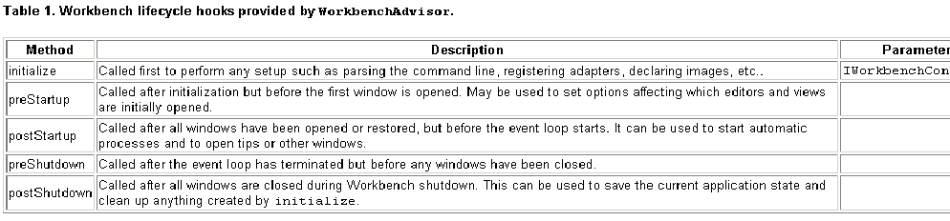
Eclipse RCP

Slide 8
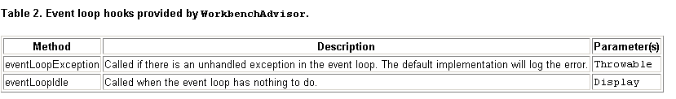
Eclipse RCP

Slide 9
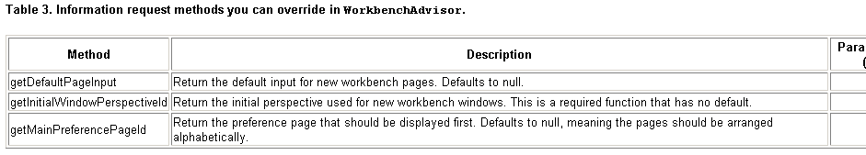
Eclipse RCP

Slide 10
Eclipse RCP
Workbench Window Advisor : This class is used to control the status line, toolbar, title, window size, and other things you'll almost certainly want to customize. You can also use it to hook into all the various lifecycle events of the Workbench Windows.

Slide 11
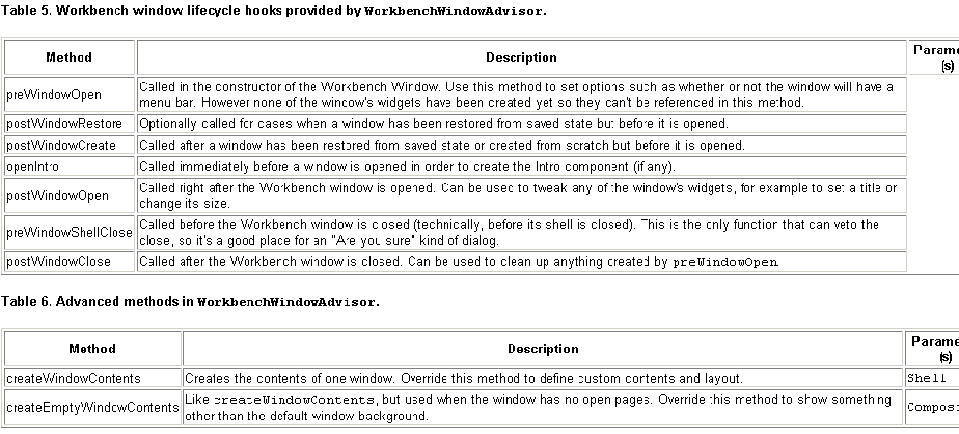
Eclipse RCP
Notes:
Methods on WorkbenchWindowAdvisor (see Table 5 and Table 6) will all need access to a Configurer interface (in this case, IWorkbenchWindowConfigurer) in order to do anything so they're expected to call getWindowConfigurer() to fetch it. You call methods on the Configurer interfaces to actually change the options

Slide 12
Eclipse RCP
ActionBar Advisor : "action bar" is a catch-all term for menus, toolbars, and status bars. The ActionBar Advisor handles creating Actions within these locations. A plug-in can also contribute actions dynamically with its plugin.xml file.
Plug-in class : The plug-in class is an optional singleton class that can be used to store global information for the plug-in. It's also a convenient place to put a few static utility functions used by other classes in the plug-in.
Build properties : The build.properties file will be needed when exporting the application for others to use. In particular if your application needs any resources like icons they should be listed here in the bin.includes section. The Plug-in Manifest editor provides a convenient interface to modify this file that is less error-prone than modifying it by hand.

Slide 13
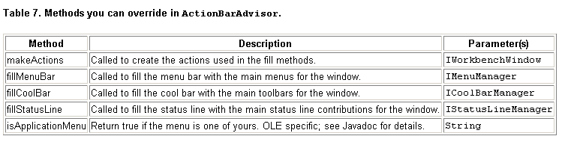
Eclipse RCP

Slide 14
Eclipse RCP
Demo

Slide 15
JMX
What is JMX?
JMX = Java Management eXtensions
Standard API for exposing and accessingmanagement and monitoring data in Java
Introduces the MBean, a JavaBean with a management interface
  Bean registration / discovery / query
  Exposes beans information
MBeans are uniquely identified by an ObjectName
Built-in Event / Notification Model
Built-in Monitoring / Timer Services
As of Java 5.0 part of the standard J2SE distribution
Java Management Extensions (JMX) is a Java technology that supplies tools for managing and monitoring applications, system objects, devices (e.g. printers) and service oriented networks. Those resources are represented by objects called MBeans (for Managed Bean). In the API, classes can be dynamically loaded and instantiated.

Slide 16
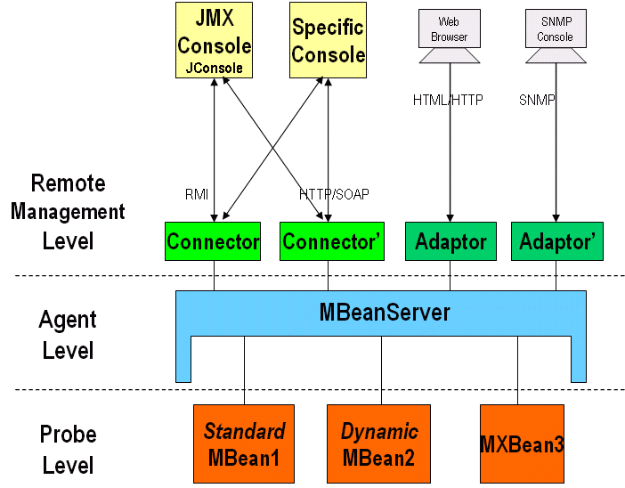
JMX Architecture
Notes:
JMX is based on a 3-level architecture:
The Probe level : contains the probes (called MBeans) instrumenting the resources. Also called the Instrumentation level.
The Agent level : the MBeanServer is the core of JMX. It is an intermediary between the MBean and the applications.
The Remote Management level : enables remote applications to access the MBeanServer through Connectors and Adaptors. A connector provides full remote access to the MBeanServer API using various communication frameworks (RMI, IIOP, JMS, WS-* ...), while an adaptor adapts the API to another protocol (SNMP, ...) or to Web-based GUI (HTML/HTTP, WML/HTTP, ...).
Applications can be generic consoles (such as JConsole and MC4J), or domain-specific (monitoring) applications. External applications can interact with the MBeans through the use of JMX connectors and protocol adapters. Connectors are used to connect an agent with a remote JMX-enabled management application. This form of communication involves a connector in the JMX agent and a connector client in the management application.
Protocol adapters provide a management view of the JMX agent through a given protocol. Management applications that connect to a protocol adapter are usually specific to the given protocol.

Slide 17
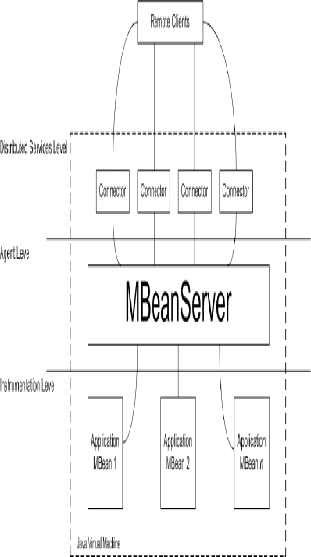
JMX Architecture

Slide 18
JMX Architecture
Agent Level
Contains the MBeanServer
Intermediary between applications and managed resources (MBeans)
All interaction is with the MBeanServer
Supplied by application server or VM

Slide 19
JMX Architecture
Instrumentation Level
Application resources exposed as MBeans
Provides four kinds of MBean
• Standard
• Dynamic
• Model
• Open
Java 5 introduces the MXBean
Inter-MBean references
Flexible local/open typing
Is standardised in Mustang (available now)
Supplied by you

Slide 20
JMX Architecture
Distributed Services Level
Outside the scope of the core JMX
specification
Covered by JSR-160…
Supplied by JMX/JSR-160 implementation

Slide 21
JMX Managed Beans (MBeans)
Standardized API for Instrumentation
● Exposes Properties (MBean Attributes)
● Exposes Operations
● Emit Event Notifications
● Hosted within MBean Server
● Accessible via Management Tools
– Query MBean Server for attribute values
– Access MBean operations
– Register for Mbean event notifications

Slide 22
JMX MBean Registration
Registers MBean with the MBean Server
● Use of the ObjectName Class
– Uniquely identifies registered MBean instances
– Provide naming strategy for MBean
– Specially formatted string
– domain:key=value[,key=value]*
– Example: house:room=familyroom
– Use apha-num characters only

Slide 23
JMX Standard MBean Definition
public interface LightMBean {
public void turnOn();
public void turnOff();
public boolean isOn();
}
public class Light implements LightMBean {
private boolean onState;
private int onCount;
public Light() { turnOn() }
public void turnOn() {
onState = true;
onCount ++;
}
public void turnOff() { onState = false; }
public boolean isOn() { return onState; }
public int getOnCount() { return onCount; }
}

Slide 24
JMX MBean Registration
public class LightingManager {
private ObjectName objName;
private MbeanServer svr
public void RegisterMBean () throws Exception {
svr = ManagementFactory.getPlatformServer();
String name = “home.lighting:type=light,location=porch”;
objName = new ObjectName(name);
svr.registerMBean(new Light(), objName);
}
}

Slide 25
MBean Manipulation
Note the followings:
– Manipulated classes not necessarily on classpath
– MBean sever can be local or remote
public class LightingManager {
...
public void turnOnLight() throws Exception {
svr.invoke(objName, “turnOn”, null, null);
}
public boolean isLightOn() throws Exception {
Boolean isOn = (Boolean) svr.getAttribute(objName, “On”);
return isOn;
}
}

Slide 26
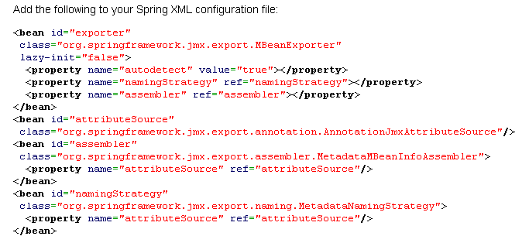
Spring JMX
Notes:
This will set up a Spring-managed JMX configuration with the following attributes:
- Using an existing MBean server
- Auto-detecting beans with the @ManagedResource annotation
- MBean naming defined by the “objectName” attribute of the @ManagedResource annotation

Slide 27
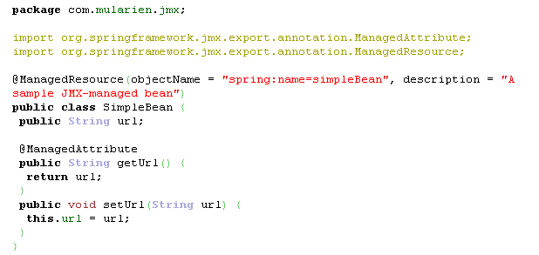
Spring JMX

