Slide 1
Spring Framework
Axs Training 08/08/07

Slide 2
Spring Framework
What is Spring?
A layered Java/JEE application framework
History:
The first parts coded in 2000 by Rod Johnson
Explained in Expert One-on-one J2EE Design And Development (Programmer to programmer) (2002)
2003 Feb – first team formed
2004 March – 1.0
End of 2004 – Aspect Oriented Programming
2005 – Partnership with BEA

Slide 3
Axs History behind using Spring
Eliminate application startup code
Dependency Injection
Configuration parameters outside of code
Misc:
Singletons
Consistent framework for data access
Cross module dependencies performing unit test

Slide 4
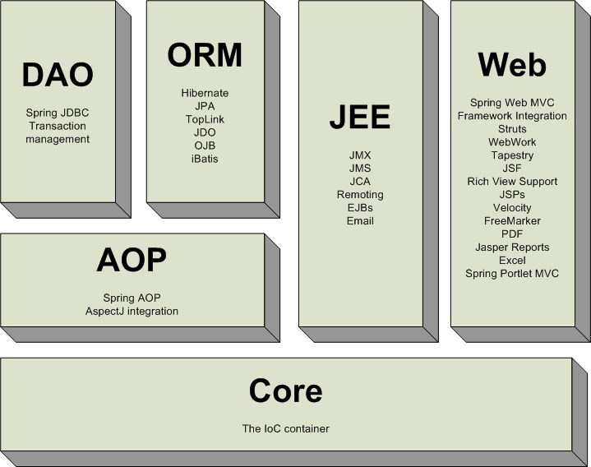
Spring Architecture

Slide 5
Spring Architecture contd…
Core – fundamental framework, provides IoC using Dependency Injection. BeanFactory – provides sophisticated impl for factory, decouples configuration and dependencies
Context – provides way to access objects in framework style manner.
Provides I18N, event-propagation, resource loading, creation of contexts
DAO – provides JDBC abstraction layer, standard exceptions (error codes). Declarative Tx management for POJOs
ORM – integration layers for Object-Relational Mapping APIs including Java Data Objects (JDO), Hibernate etc.
AOP – Aspect-oriented programming implementation ( method-interceptors, pointcuts )
Web – web-oriented integration features like file-upload, Inversion of Control (IoC) initialization using servlet listeners, struts etc.
MVC – for web-applications

Slide 6
What is possible?
Transaction Management (Java Transaction API (JTA), JDBC, Hibernate, Java Persistence API (JPA))
Data Access Object (DAO) Support
Data access using JDBC
AOP Support
MVC web framework
Testing

Slide 7

IoC Container

Slide 8
IoC Container contd…
org.springframework.beans.factory.BeanFactory – core class for instantiating, configuring and assembling the “beans”.
XmlBeanFactory – xml implementation of the same

Slide 9
Metadata
<?xml version="1.0" encoding="UTF-8"?>
  <beans xmlns="http://www.springframework.org/schema/beans"
  xmlns:xsi="http://www.w3.org/2001/XMLSchema-instance" xsi:schemaLocation="http://www.springframework.org/schema/beans
  http://www.springframework.org/schema/beans/spring-beans-2.0.xsd">
  <bean id="..." class="...">
  <!-- collaborators and configuration for this bean go here -->
  </bean>
  </beans>

Slide 10
Instantiating a container
ApplicationContext context = new ClassPathXmlApplicationContext( new String[] {"services.xml", "daos.xml"});
// an ApplicationContext is also a BeanFactory (via inheritance)
BeanFactory factory = (BeanFactory) context;

Slide 11
XML- metadata – using imports
<beans>
<import resource="services.xml"/>
<import resource="resources/messageSource.xml"/>
<import resource="/resources/themeSource.xml"/>
<bean id="bean1" class="..."/>
<bean id="bean2" class="..."/>
</beans>

Slide 12
XML- metadata – Constr Injection
<beans>
<bean name="foo" class="x.y.Foo">
<constructor-arg>
<bean class="x.y.Bar"/>
</constructor-arg>
<constructor-arg>
<bean class="x.y.Baz"/>
</constructor-arg>
</bean>
</beans>

Slide 13
XML- metadata – Constr Injection
<bean id="exampleBean" class="examples.ExampleBean">
<!-- setter injection using the nested <ref/> element -->
<property name="beanOne">
<ref bean="anotherExampleBean"/>
</property>
<!-- setter injection using the neater 'ref' attribute -->
<property name="beanTwo" ref="yetAnotherBean"/>
<property name="beanThree">
<ref local=“thirdBean"/>
</property>
<property name="integerProperty" value="1"/>
</bean>
<bean id="anotherExampleBean" class="examples.AnotherBean"/>
<bean id="yetAnotherBean" class="examples.YetAnotherBean"/>
<bean id=“thirdBean" class=“thirdBean"/>

Slide 14
XML- metadata – Collections
<bean id="moreComplexObject" class="example.ComplexObject">
<!-- results in a setAdminEmails(java.util.Properties) call -->
<property name="adminEmails">
<props>
<prop key="administrator">administrator@somecompany.org
</prop>
<prop key="support">support@somecompany.org
</prop>
<prop key="development">development@somecompany.org
</prop>
</props>
</property>
…
<bean>

Slide 15
XML- metadata – Scope
<bean id="command" class="fiona.apple.AsyncCommand" scope="prototype">
<!-- inject dependencies here as required -->
</bean>
Singleton [ default ]
Prototype
Session
Request
Global session

Slide 16
XML- metadata – init / destroy
<beans default-init-method="init“ default-destroy-method=“shutdown”>
<bean id="blogService" class="com.foo.DefaultBlogService">
</bean>
<bean id=“pingService" class=“com.foo.DefaultPingService”
init-method=“startService”
destroy-method=“stopService”>
</bean>
</beans>

Slide 17
JBoss & Spring integration in Axs
Sample jboss-service.xml
<?xml version="1.0" encoding="UTF-8" ?>
<server>
<mbean code="org.jboss.mq.server.jmx.Topic" name="jboss.mq.destination:service=Topic,name=neList">
<depends optional-attribute-name="DestinationManager"> jboss.mq:service=DestinationManager
</depends>
</mbean>
<mbean code="com.alcatel.axs.applications.common.mbean.AppStartup" name="application.nemgr:service=startup">
<depends>application.server:service=startup</depends>
<depends>jboss.mq.destination:service=Topic,name=neList
</depends>
</mbean>
</server>

Slide 18
AppStartup.java
package com.alcatel.axs.applications.common.mbean;
import org.apache.log4j.Logger;
import org.jboss.system.ServiceMBeanSupport;
import org.springframework.context.ConfigurableApplicationContext;
import org.springframework.context.support.ClassPathXmlApplicationContext;
import org.springframework.jmx.export.MBeanExporter;
public class AppStartup extends ServiceMBeanSupport implements AppStartupMBean {
private static final String DEFAULT_NAME = "META-INF/applicationContext.xml";
private ConfigurableApplicationContext ctx;
private String m_descriptorName = DEFAULT_NAME;
private Class m_classToLoad = null;
@Override
protected void startService() throws Exception {
logger.info("Starting Application Service " + getServiceName());
super.startService();
if (m_classToLoad == null) {
ctx = new ClassPathXmlApplicationContext(m_descriptorName);
} else { ctx = new ClassPathXmlApplicationContext(m_descriptorName, m_classToLoad); }
}
@Override
protected void stopService() throws Exception {
logger.info("Stopping Application Service: " + getName());
ctx.close();
ctx = null;
super.stopService();
}
}

Slide 19
Other integration classes
Files under core/container/axs-application-server/src/main/java/…
AppStartupMBean.java
PluginStartup.java
PluginStartupMBean.java

Slide 20
AOP
AOP is a programming technique where concerns that cut across a software system can be described in clear statements so that the underlying design intent remains clear in the source code.
Concepts
  Aspect: modularization of a concern
  Join point: A point during the execution of a program
  Advice: Action taken by an aspect at a Join point
  Pointcut: A predicate that matches join points
  Introduction: Declaring additional methods / fields
  Target object: Object being advised by 1 or more aspects
  AOP proxy: Object created by the AOP f/w to implement aspect contracts
  Weaving: Linking aspects with objects

Slide 21
Sample AOP – Backup/restore applicationContext.xml
<?xml version="1.0" encoding="UTF-8" ?>
<beans xmlns="http://www.springframework.org/schema/beans" xmlns:xsi="http://www.w3.org/2001/XMLSchema-instance" xmlns:aop="http://www.springframework.org/schema/aop" xmlns:tx="http://www.springframework.org/schema/tx" xmlns:jee="http://www.springframework.org/schema/jee" xsi:schemaLocation="http://www.springframework.org/schema/beans http://www.springframework.org/schema/beans/spring-beans-2.0.xsd http://www.springframework.org/schema/jee http://www.springframework.org/schema/jee/spring-jee-2.0.xsd http://www.springframework.org/schema/aop >
<bean id="jndiTemplate" class="com.alcatel.axs.container.spring.JndiTemplateFactoryBean" />
<bean id="jmsQueueConnectionFactory" class="org.springframework.jndi.JndiObjectFactoryBean">
<property name="jndiTemplate"> <ref bean="jndiTemplate" /> </property>
<property name="jndiName"> <value>UIL2ConnectionFactory</value> </property>
</bean>
<bean id="jmsTemplate" class="org.springframework.jms.core.JmsTemplate">
<property name="connectionFactory"> <ref bean="jmsQueueConnectionFactory" /> </property>
<property name="defaultDestination"> <ref bean="destination" /> </property>
<property name="receiveTimeout"> <value>30000</value> </property>
</bean>
<bean id="eventBroadcaster" class="com.alcatel.axs.applications.event.JmsEventBroadcasterSupport">
<constructor-arg value="com.alcatel.axs.app.backrest.api.BackrestServiceListener" />
<constructor-arg ref="jmsTemplate" />
</bean>

Slide 22
Sample AOP – Backup/restore applicationContext.xml contd…
<!—Advice implementation (org.springframework.aop.MethodBeforeAdvice in this case)-->
<bean id="LogBeforeExecution" class="com.alcatel.axs.app.useractivity.LogBeforeExecution">
<property name="loginService" ref="loginService" />
<property name="applicationName" value="BACKUP-RESTORE" />
<property name="methodToOperationMapping">
<map>
<entry>
<key><value>startBackup</value> </key>
<value>BACKUP</value>
</entry>
<entry>
<key> <value>startRestore</value> </key>
<value>RESTORE</value>
</entry>
<entry>
<key><value>migrationRestore</value> </key>
<value>MIGRATION_RESTORE</value>
</entry>
<entry>
<key> <value>startMigration</value> </key>
<value>DATABASE_MIGRATION</value>
</entry>
</map>
</property>
</bean>

Slide 23
Sample AOP – Backup/restore applicationContext.xml contd…
<!-- Advisor pointcut definition for before advice -->
<bean id="theLoggingBeforeAdvisor" class="org.springframework.aop.support.NameMatchMethodPointcutAdvisor">
<property name="advice">
<ref local="LogBeforeExecution" />
</property>
<property name="mappedNames">
<list>
<value>startBackup</value>
<value>startRestore</value>
<value>migrationRestore</value>
<value>startMigration</value>
</list>
</property>
</bean>

Slide 24
Sample AOP – Backup/restore applicationContext.xml contd…
<bean id="backrestService" class="org.springframework.transaction.interceptor.TransactionProxyFactoryBean">
<property name="transactionManager">
<ref bean="txManager" />
</property>
<property name="target">
<ref bean="backrest" />
</property>
<property name="transactionAttributes">
<props>
<prop key="*">PROPAGATION_REQUIRED</prop>
</props>
</property>
<property name="preInterceptors">
<list>
<ref bean="theLoggingBeforeAdvisor" />
</list>
</property>
</bean>

Slide 25
Differences between JEE &Spring
J2EE vs Spring1.2/2.x
JEE5 vs Spring 2.x

Slide 26
More information…
www.theserverside.com/tt/articles/content/SpringFramework/article.html
www.springframework.org/documentation -> Reference APIs
http://martinfowler.com/articles/injection.html - on IoC

