Slide 1


Cuong Nguyen – 6220119@gmail.com

Slide 2
Content
Introduction to AngularJS
What is AngularJS?
Why should we use it?
AngularJS Features
Tips

Slide 3


What is AngularJS?
“Superheroic JavaScript MVW Framework”
“HTML enhanced for web apps”
“Pretty sure that HTML6 is going under the codename @angularjs”

Slide 4

Why should we use it?
“Use AngularJS ☺”

Slide 5




Why should we use it?
10,374 stars (2,149 forks)
12,149 subscribers
13,098 followers, 4,836 community
15,378 followers
as of 4th June 2013

Slide 6
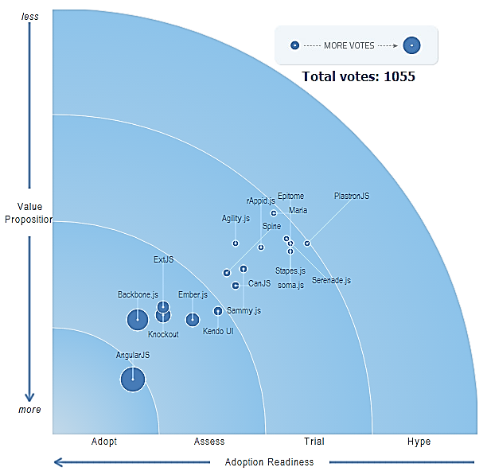
Why should we use it?
http://www.infoq.com/research/top-javascript-mvc-frameworks
AngularJS

Slide 7
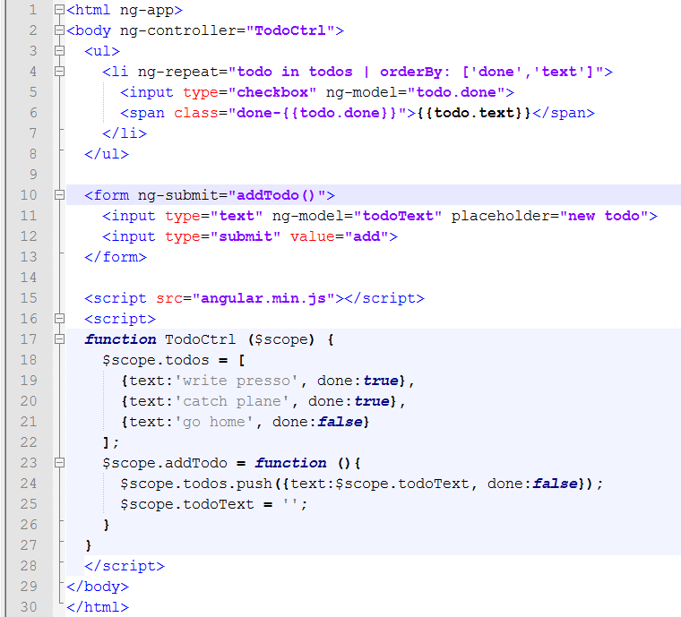
AngularJS Features

Slide 8
AngularJS Features
Model

Slide 9
AngularJS Features
Controller

Slide 10
AngularJS Features
View

Slide 11
AngularJS Features
Templating

Slide 12
AngularJS Features
Dependency Injection

Slide 13
AngularJS Features
Data Binding

Slide 14
AngularJS Features
Directive

Slide 15
AngularJS Features
Filter

Slide 16
AngularJS Features
What else?
Service
Deep Linking / Routing
Form Validation
Server communication
Modular architecture
Unit Test

Slide 17
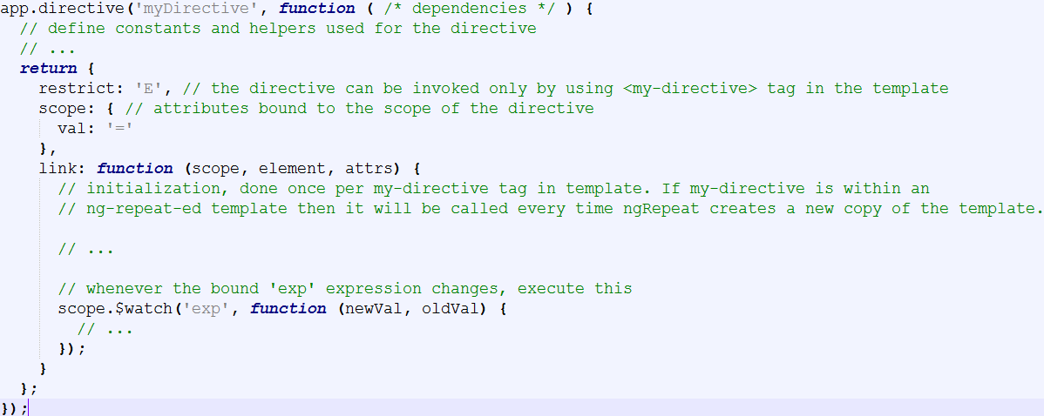
Create an UI component
This is equivalent to creating a custom directive

Slide 18
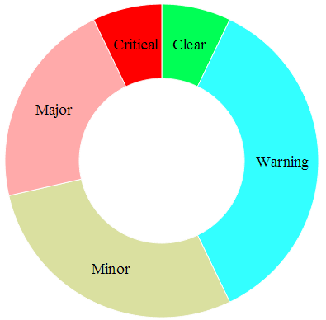
E.g. Create a pie chart using d3.js
Our goal:
Create a custom UI element: <ng-piechart />
Support data-binding to a source.
Use d3.js to draw the chart
➔ Use AngularJS directive

Slide 19
Tips
References:
http://www.aliaspooryorik.com/presentations/angularjs2013 (this is actually most of this slide ☺)
http://angularjs.slides.agavee.com
http://latentflip.com/imperative-vs-declarative/
http://docs.angularjs.org

Slide 20
Tips
Useful links:
http://briantford.com/blog/
http://www.bennadel.com/
http://www.yearofmoo.com/
http://www.egghead.io/
https://github.com/angular/angular.js/wiki/JsFiddle-Examples
http://docs.angularjs.org/api/

Slide 21
Tips
Popular modules
http://ngmodules.org/
angular-ui
angular-bootstrap
http-auth-interceptor
ng-grid
...

Slide 22
Tips
Project Template:
https://github.com/angular/angular-seed
http://joshdmiller.github.io/ng-boilerplate
How to organize your code in a large project:
http://cliffmeyers.com/blog/2013/4/21/code-organization-angularjs-javascript

Slide 23
Development Environment
A Text Editor (prefer syntax highlighting, auto-complete).
Node.js (server)
Karma (node.js package, unit test runner)
Jasmine (javascript Unit Test library)
Internet browsers
Chrome add-on: Batarang (spying AngularJS scopes and models)

Slide 24

6220119@gmail.com

