Slide 1
Overview
CNS 3320 – Numerical Software Engineering

Slide 2
Numerical Computing
What computers were invented for!
  Scientific research, engineering, real-time control systems
  NASA, satellites, electronic devices, ATMs
Today’s programmers don’t know what their predecessors did
  Most do “business data processing”
  But even then numbers are important
  The Patriot Missile failure was a needless floating-point error by clueless programmers
Getting accuracy from a machine is Hard Work
Example: roundoff.cpp

Slide 3
When Good Formulas Go Bad
How do you solve a quadratic equation?
How much accuracy do you need?
Example: x² – 100000x + 1 = 0
  quad1a.cpp (float, naive)
  quad1b.cpp (double, naive)
  quad2a.cpp (float, smart)
  quad2b.cpp (double, smart)
  Correct answers to 11 digits are:
    99999.99999, .000010000000001

Slide 4
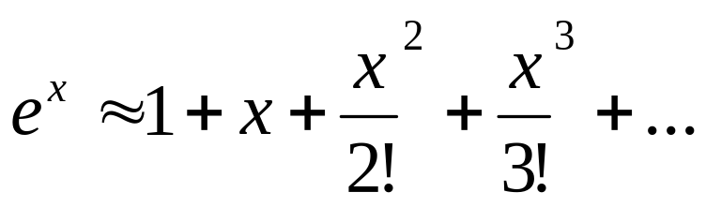
When Good Formulas Go Bad
How do you compute e^{x}?
Transcendental numbers can only be approximated by finite processes
We’ll use the MacLaurin Series
  Taylor’s series expanded about 0 (see below)
Examples:
  exp1.cpp (98 terms for float, 126 for double)
  exp2.cpp (uses reciprocal to avoid smearing)

Slide 5
Lesson to be Learned
You can’t just code formulas and expect them to work
Floating-point operations are like moving piles of sand:
  Every time you move one you lose a little
  You lose precision, that is (significant digits)
We will learn how to recognize and minimize numeric error
  By understanding floating-point number systems
  By using intelligent algorithms and techniques

Slide 6
What About Arbitrary Precision Packages?
Store numbers as strings of digits
  And use easy, grade school algorithms
  Java’s BigDecimal
  Other commercial and free libraries
They have their place
  But they’re SLOOOOOOOOOOOOOW
  Inappropriate for real-time control or for large, complex problems
Hardware is the best answer for most apps
  Fast, high-precision floating-point

Slide 7
About This Course
Overlaps with a traditional Numerical Methods course
  We’ll find roots of equations, solve linear systems, calculate integrals, etc.
But will have a CS emphasis
  You’ll know what’s going on under the covers
  You’ll become familiar with the pertinent IEEE floating-point standards
  You’ll be able to implement precise mathematical libraries (someone has to do it!)

Slide 8
Types of Error
Rounding error
  Also called “roundoff” error
  A fixed-size floating-point number system can only represent a finite collection of numbers
    x + y might not be in the set
    An input value x might not even be in the set to begin with
Truncation Error
  Similar in spirit to roundoff, but results from our stopping an infinite process
    Like the Taylor’s series example
    We have to stop sometime!
    We stop when we’re satisfied with the degree of accuracy
    Sometimes we must balance roundoff and truncation error
      Decreasing one can increase the other

