Slide 1
Where Did All My Decimals Go?
Chuck Allison
Utah Valley State College

Slide 2
Numerical Computing
What computers were invented for!
  Scientific research, engineering
Today’s programmers don’t know what their predecessors did about numerics
  Most master “information processing”
  The Patriot Missile failure was a needless floating-point error by clueless programmers
Getting numerical accuracy from a machine requires some effort

Slide 3
What Does This Program Print?
#include <iostream>
#include <limits>
using namespace std;
int main() {
float x = 1.0f - .2f -.2f -.2f -.2f -.2f;
cout << x << endl;
cout.precision(numeric_limits<double>::digits10);
double y = 1.0 - .2 -.2 -.2 -.2 -.2;
cout << y << endl;
}

Slide 4
Curious Output
-1.49012e-08
-5.55111512312578e-17
For everything else, there’s MasterCard. Seeing the look on their faces was priceless.

Slide 5
Curious Queries
Are those answers good enough?
Define “good enough”!
  Depends on the application
Errors can accumulate
  So you’ll want to minimize them
Where did the error come from?

Slide 6
Rounding Error
Also called “roundoff” error
A fixed-size floating-point number system can only represent a finite collection of numbers
  x + y might not be in the set
  An input value x might not even be in the set to begin with

Slide 7
Different Bases
Consider representing .1 in a base-2 system
1/10 = 1/1010₂
Use long division :
.000110011001100…
1010 | 1.000000000000000
1/10 is an infinite (repeating) decimal in base 2!
This is why 1 - .2 - .2 - .2 - .2 - .2 != 0 in a binary floating-point system

Slide 8
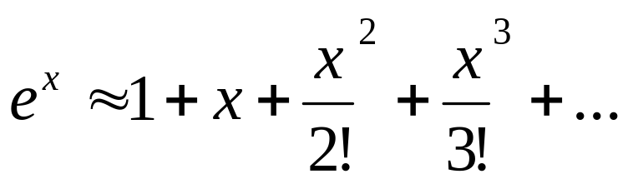
When Good Formulas Go Bad
How do you compute e^{x}?
Transcendental numbers can only be approximated by finite processes
Use the MacLaurin Series
  Taylor’s series expanded about 0 (see below)
Examples:
  exp1.cpp (bombs for negative x)
  exp2.cpp (uses reciprocal to avoid smearing)

Slide 9
Results for exp1.cpp
myexp(55.5f) = 1.26866e+24
myexp(55.5) = 1.26865561401096e+24
exp(55.5) = 1.26865561401096e+24
myexp(-55.5f) = -2.90487e+15
myexp(-55.5) = -6.76350603787201e+06
exp(-55.5) = 7.88235979060085e-25

Slide 10
Smearing
The initial terms of the Taylor’s Series are much larger than the final result
  A clue is that there is subtraction involved that whittles down the running total
So the roundoff in the initial terms is in decimal places more significant than the final answer!
That’s called “smearing”

Slide 11
Results from exp2.cpp
Calculates e^{-x} as 1/e^{x}
myexp(55.5f) = 1.26866e+24
myexp(55.5) = 1.26866e+24
exp(55.5) = 1.26866e+24
myexp(-55.5f) = 7.88236e-25
myexp(-55.5) = 7.88236e-25
exp(-55.5) = 7.88236e-25
Trig functions use argument reduction and telescoping

Slide 12
When Good Formulas Go Bad
How do you solve a quadratic equation?
How much accuracy do you need?
Example: x² – 100000x + 1 = 0
  quad1a.cpp (float, naive)
  quad1b.cpp (double, naive)
  quad2a.cpp (float, smart)
  quad2b.cpp (double, smart)
  Correct answers to 11 digits are:
    99999.999990, .000010000000001

Slide 13
Results
 | r₁ | r₂
True | 99999.99999 | .000010000000001
Naïve, float | 100000 | 0
Naïve double | 99999.99999 | 1.00000033853576e-05
Smart, float | 100000 | .00001
Smart, double | 99999.99999 | .000010000000001

Slide 14
Catastrophic Cancellation
When two numbers close together are subtracted, the most significant digits are lost
What’s left are the less significant digits
  Where roundoff takes it toll
  But they are now more significant after leading zeroes are discarded!
That’s what’s happening here

Slide 15
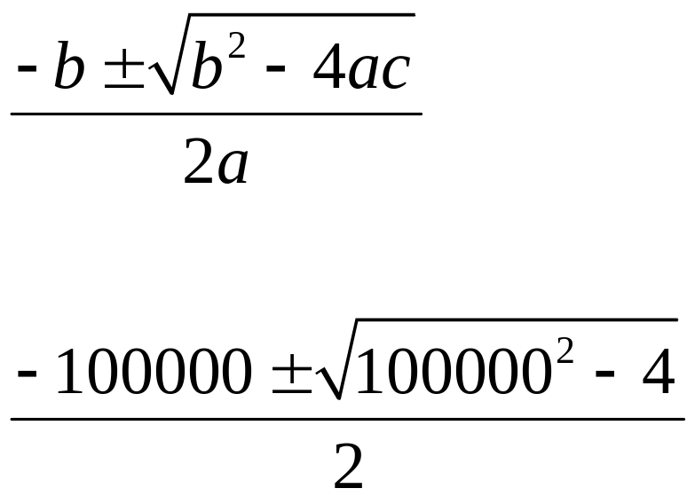
The Quadratic Formula

Slide 16
The Smarter Algorithm
Does the appropriate operation that avoids cancellation to compute r₁
  By checking the sign of b
Computes r₂ as 1/r₁
  In general, r₂ = c/(ar₂)

Slide 17
“Piles of Sand”
You can’t just code formulas and expect them to work
Must learn how to anticipate and minimize numeric error
  By understanding floating-point number systems
  By using intelligent algorithms and techniques

Slide 18
Floating-point Number Systems
Use “scientific notation”
They store a “significand” (“mantissa”) of a fixed number of digits, as well as an exponent and sign
The number of digits stored doesn’t depend on the magnitude of the number
  As with fixed-point systems
  You merely adjust (“float”) the exponent

Slide 19
Formal Definition of FP Systems
A Floating-number system is the set of numbers defined by the following integral parameters, using scientific notation:
  A base, B
  A precision, p
  A minimum exponent, m (usually negative)
  A maximum exponent, M

Slide 20
A Toy Floating-point System
Consider the normalized floating-point system F:
  base = B = 10
  precision = p = 4
  exponent range [m = -2, M = 3]
This system represents numbers of the form:

Slide 21
The Numbers in F
9,000 Significands
  From 1.000 through 9.999
6 powers
  From -2 through 3, inclusive
Positive and negative flavors
108,000 numbers in all

Slide 22
Distribution
The numbers in F are not evenly spaced
  And there is a gap about zero
Their magnitudes come in groups according to the exponent used:
{1.000 … 9.999} x 10⁻² (spacing = .001 x 10⁻²)
{1.000 … 9.999} x 10⁻¹ (spacing = .001 x 10⁻¹)
{1.000 … 9.999} x 10⁰ (spacing = .001)
{1.000 … 9.999} x 10¹ (spacing = .001 x 10¹)
{1.000 … 9.999} x 10² (spacing = .001 x 10²)
{1.000 … 9.999} x 10³ (spacing = .001 x 10³)

Slide 23
Spacing Between FP Numbers
It’s the value of the unit in the last place (.001 here) times the current exponent
.001 x 10e = 10⁻³ x 10e = 10^{1-p} x 10e
B^{1-p} x B^{e} = B^{1-p+e} in general for base B
B^{1-p} is a special number we’ll see again shortly

Slide 24
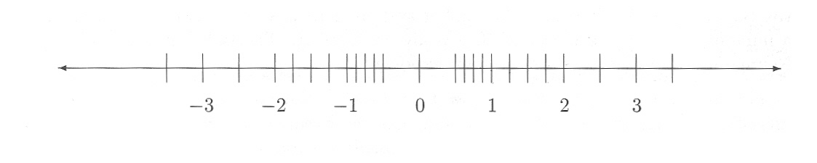
Another FP System (F2)
B = 2, p = 3, m = -1, M = 1
24 numbers (4 x 3 = 12 magnitudes):

Slide 25
The Binary Advantage
Take 1
With base 2, there is only one choice for the first digit (1) in a normalized system
  So it doesn’t have to be stored
It is just implied
  So we get a bit for free
See next 2 slides

Slide 26
Saving a Bit
Let F3 be the system:
  B = 2, p = 4 (3 stored), m = -1, M = 1
Now has 48 numbers (24 magnitudes)
  Greater precision / denser distribution
  See next slide

Slide 27
The Numbers of F3
8 bit patterns x 3 power groups = 24 unique magnitudes
 | x 2⁻¹ | x 2⁰ | x 2¹
(1).000 | .1 | 1 | 10
(1).001 | .1001 | 1.001 | 10.01
(1).010 | .101 | 1.01 | 10.1
(1).011 | .1011 | 1.011 | 10.11
(1).100 | .11 | 1.1 | 11
(1).101 | .1101 | 1.101 | 11.01
(1).110 | .111 | 1.11 | 11.1
(1).111 | .1111 | 1.111 | 11.11
Spacing: | (.0001)₂ | (.001)₂ | (.01)₂

Slide 28
Relative Spacing in FP Systems
Fairly uniform throughout the system:
Consider the range [B^{e}, B^{e+1})
  The inter-number spacing there is B^{1-p+e}
So the relative spacing between adjacent numbers is:
  Between B^{-p} and B^{1-p} (a factor of B)
    Called the system “wobble”
    Is the bound of roundoff error for the system
  Independent of e!

Slide 29
The Binary Advantage
Take 2
It has the smallest possible wobble:
  Because 2 is the smallest possible base
  Is between 2^{-p} and 2^{1-p}

Slide 30
Machine Epsilon
A measure of the “granularity” of a FP system
It is the (absolute and relative) spacing between 1.0 and its neighbor to the right
ε = B^{1-p}
Can use this to tune algorithms to the FP system being used
  We can’t expect smaller relative errors than ε

Slide 31
The Most Important Fact About Floating-point Numbers
The spacing between numbers in [B^{e}, B^{e+1}) is B^{1-p+e} = B^{1-p}B^{e} = εB^{e}
If |x| is in [B^{e}, B^{e+1}), then B^{e} <= |x| < B^{e+1}
=> spacing = εB^{e} <= ε|x| < εB^{e+1}
=> εB^{e-1} <= ε|x|/B < εB^{e} = spacing
=> ε|x|/B < spacing at x <= ε|x|
The last line is the fact to remember
  We use it in designing algorithms

Slide 32
Tuning an Algorithm
Consider finding a bracketed root by the method of bisection (binary search)
Often an error/precision tolerance is supplied
  Good to 5 decimals say
But what if the tolerance is less than the spacing near the root
  We’ll never terminate!
See bisect1.cpp, bisect2.cpp

Slide 33
Obtaining Maximum Accuracy
With bisection, it is possible to continue bisecting until either a root is found, or there are no numbers left in the interval
  Can’t do better than that!
  The number of bisections can even be estimated a priori
See bisect.cpp

Slide 34
IEEE 754
A standard for floating-point numbers systems
  Finalized in late 1980s
Defines two flavors of numbers
  Single precision (float)
  Double precision (double)
Also defines special values
  NaN, Infinity, subnormal numbers

Slide 35
IEEE 754
Single Precision
32 bits
Base = 2
Precision = 24
  Only 23 are stored for normalized numbers
  Will explain subnormal numbers shortly
    Will also explain 0!
ε = 2⁻²³ ≈ 1.9209*10⁻⁷

Slide 36
IEEE 754
Single Precision Layout
Three components stored in the following order:
  Sign: 1 bit
  Exponent: 8 bits
  Mantissa: 23 (24 logical) bits
    Stores only the fractional part
    Real mantissa is therefore 1 greater
  Order is significant
    Makes comparison easy (lexicographical)
What’s the exponent range?
  Can store 2⁸ = 256 numbers in 8 bits
  Could do [-127, 128]
    But we still have to solve the zero problem!

Slide 37
IEEE 754
Single Precision Layout - Exponent
Stores exponent in a biased format
  That is, it is offset by the bias before storing
  The bias for single precision is 127
The stored (biased) range [0-255] represents an actual (unbiased) range of [-127, 128]
  So when storing, add 127 to the actual exponent to get the biased exponent
  When retrieving, subtract 127 from the biased exponent to get the actual exponent

Slide 38
IEEE Float examples
1:
0 01111111 00000000000000000000000
2:
0 10000000 00000000000000000000000
6.5:
0 10000001 10100000000000000000000
-6.5
1 10000001 10100000000000000000000
Notes:
1.0 x 2⁰ (2¹²⁷⁻¹²⁷)
1.0 x 2¹ (2¹²⁸⁻¹²⁷)
1.101 x 2² = 110.1 = 6.5

Slide 39
IEEE 754
Single Precision – Zero and Friends
How shall we represent 0?
Since numbers are normalized, a 0 significand is impossible
Instead, we’ll usurp the exponent -127
  This exponent is unavailable for normalized numbers
  We’ll use it for multiple purposes
So 0 is represented as (1).00…0 * 2⁻¹²⁷
  But stored as all 0’s!

Slide 40
Consequences of Zero
We can have a negative zero too!
  The sign bit can be 1, everything else is 0
  They are considered the same number, naturally
Now that we have put exponent -127 out of commission for normalized numbers, how about if we use it for some more numbers…
  Let’s milk this thing!
  We’ll use non-zero fractions with it

Slide 41
Subnormal Numbers
(aka Denormalized Numbers)
Numbers with non-zero fractions and an exponent of -127 (or 0, biased)
  They assume that the unit digit is 0, not 1
  In other words, they represent the numbers:
  0.b₁b₂…b₂₃ * 2⁻¹²⁶
Why -126?
  Otherwise we’d be skipping numbers
  0.1 * 2⁻¹²⁶ = 1.0 * 2⁻¹²⁷

Slide 42
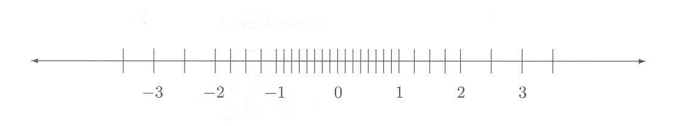
Qualities of Subnormals
One less number than the other power ranges
  2²³ – 1 bit patterns (all zeroes not allowed)
  Because zero is special
But it has the same spacing as the range to its right
  Because its ulp is 2⁻²³ * 2⁻¹²⁶ = 2⁻¹⁴⁹
  Same as the normalized range beginning at 2⁻¹²⁶
  Which evenly fills out the gap down to zero:
B = 2, p = 3, m = -1, M = 1

Slide 43
More Special Numbers
Infinity
  Both the positive and negative kind
  Once they are obtained in a calculation, the right thing mathematically happens
    e.g., 1/∞ = 0, 1/-∞ = -0
  Layout: exponent is all 1’s (the biased number 255, 128 unbiased), fraction is all 0’s
So the exponent 128 is also usurped
  So 127 is really the largest usable exponent
  Largest number = 1.111…1 * 2¹²⁷ ≈ 3.40282 * 10³⁸

Slide 44
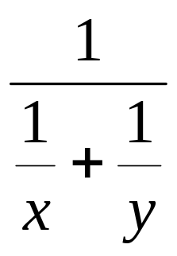
Using Infinity
Dividing by zero is no longer taboo
Computation can continue:

Slide 45
Another Special Number
NaN
  “not a number”
  Occurs when an invalid computation is attempted (like sqrt of a negative value)
Any subsequent calculations involving a NaN result in a NaN
  So you don’t have to mess with exceptions
Layout: exponent all 1’s (like ∞), but fraction is non-zero (usually just a leading 1 by default)
The only quantity that doesn’t compare equal to itself!
  That’s okay. It’s not a number :-)

Slide 46
Double Precision
Same basic layout as Single Precision
  sign | exponent | fraction = 64 bits total
Exponent occupies 11 bits
  Bias of 1023 maps [0, 2047] to [-1023, 1024]
  0/-1023 is for zero and subnormals
  2047/1024 is for infinities and NaNs
Fraction is the right-most 52 bits
  Implied 53rd bit of 1 for normals, 0 for subnormals

Slide 47
Summary
Can’t just use formulas blindly
Must understand sources of error
Can use properties of FP systems to tune algorithms
IEEE standards have helped portability
(Programming Assignments on next slide)
All materials for CNS 3320 are available at www.chuckallison.com

Slide 48
Programming Assignments
Someone has to know this stuff!
Generic functions (using templates):
  ulps(x, y)
    # of FP intervals between x and y
  ulp(x)
    FP spacing near x
  IEEE functions
    sign, exponent, significand, isNaN, isInf
Applications (to maximum machine accuracy):
  sin x
  Root finding
  Adaptive integration
  Linear systems
  Monte Carlo Methods

