Slide 1
Computing Elementary Functions

Slide 2
Elementary Functions
The basic building blocks of mathematical problem solving
  The stuff you learned in calculus
  sin, cos, log, etc.
These are transcendental functions
  Not obtained by finite algebraic means
    Like polynomials
  Require an infinite power series

Slide 3
Taylor Series
Suppose we know the value of f(x) and all its derivatives at x = 0
  Certainly the case with many elementary functions
We can approximate f(x) near 0 with polynomials of increasing-degree
  The more accuracy we need, the higher the degree of the approximating polynomial

Slide 4
Taylor Series continued
We can use the horizontal line y = f(0)
  Lousy approximation
How about a line?
  The slope at x = 0 is f'(0)
  y = f(x) ≈ f(0) + f'(0)x
Okay, how about a parabola?
  f(x) = a₀ + a₁x + a₂x²
  f''(0) = 2a₂ → a2 = ½ f''(0)
  f(x) ≈ f(0) + f'(0)x + ½ f''(0)x²

Slide 5
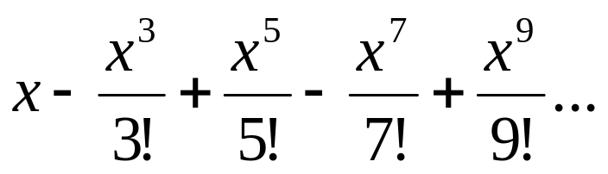
Taylor Series continued
If f(x) is infinitely, continuously differentiable at x = 0:
  f(x) = f(0) + f'(0)x + ½ f''(0)x² + f'''(0)/3! x³ + …
The further we go before we quit, the better the approximation
  Until roundoff takes over (so don’t go too far)
MATLAB demo:

Slide 6
Expanding about x ≠ 0
f(x) = f(a) + f'(a)(x-a) + ½ f''(a)(x-a)² + f'''(a)/3! (x-a)³ + …
Important for log x:
  Not defined at x = 0
  Can expand about x = 1:
    log x = (x-1) – (x-1)²/2 + (x-1)³/3 - …
  Radius of convergence: (0, 2)
    0 is a singularity

Slide 7
Truncation Error
The error resulting from terminating (“truncating”) an infinite process
  The n-th term of the Taylor series
The truncation error can be approximated
  This allows us to calculate how many terms we need for a certain accuracy
  Sometimes, though, we’ll just keep adding until the nth term doesn’t make a difference

Slide 8
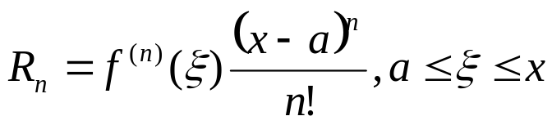
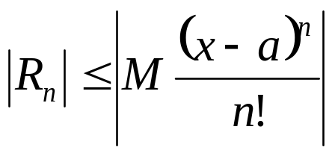
Estimation Truncation Error
Taylor’s Theorem
If we stop at the n-th term, the remainder, R_{n}, is equal to the formula below
  I’ll spare you the proof, even though it’s not hard
If M is the largest value of f^{(n)}(x) in [a,x], then:

Slide 9
Machine Computation of sin x
Will do for Program 3
Need to calculate the number of terms of Taylor’s series needed
  By examining R_{n} vs. the desired accuracy
What about large angles?
  Will need lots of terms (bummer)
  But what do we know about periodic functions?

Slide 10
Argument Reduction
sin(x) = sin(x + 2nπ) for all integers n
We will actually use sin(x) = ± sin(x+nπ)
  We will find an “n” where:
  t = x - nπ, and
  -π/2 <= t <= π/2

Slide 11
Sample Programs
findk.cpp
  Finds the number of Taylor’s terms needed
fsin.cpp
dsin.cpp

Slide 12
Horner’s Rule
A better way to evaluate polynomials
Sample programs:
  horners.cpp
  hfsin.cpp
  hdsin.cpp

Slide 13
Single Precision
We’ll just do a double precision version of sin x
A single precision version can be obtained by casting to float

Slide 14
Re-distribution of Error
The error is greatest at boundaries
  Multiples +/- π/2
Advanced research has shown that the error can be “evened out”
  And achieves maximal accuracy with a lower-degree polynomial!
    Through “Chebyshev Polynomials”
  The key idea is to reduce the magnitude of the coefficient of the high-order term

Slide 15
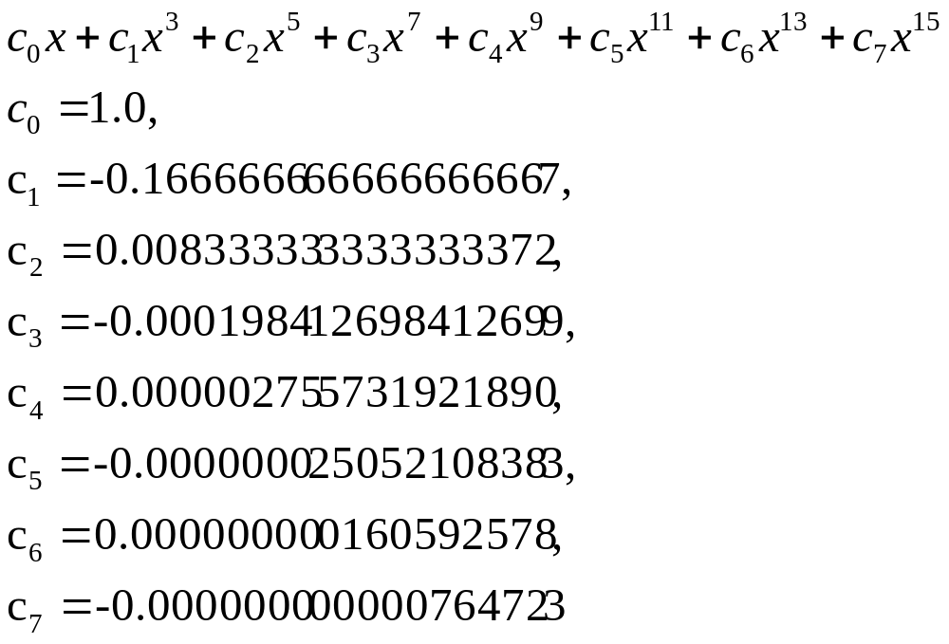
Cody & Waite/Plauger Coefficients
Double Precision
For 51 <= p <= 60, use the polynomial:

Slide 16
Special Handling for Small Angles
When x² < ε, just return x:
  Our polynomial = x(1 – 1/6x² + …c₇x¹⁵ )
  = x(1 + r) = x + xr
  Note that if x² = ε, then |r| ≈ 1/6∙ε
  Calling our approximation s = x + xr, we see that the difference between s and x itself is:
  |s – x| = |xr| ≈ 1/6∙ε|x| < spacing near x

Slide 17
Special Handling for Large Angles
Two strategies:
  For very large angles (> 10¹⁰), reduce by a multiple of 2π
    Divide |x| by 2π, take floor (call it f), then reduce |x| by f, then restore sign(x)
    Use std::fmod( )
    FYI: 2π = 6.28318530717958647693
  Maximize precision in reducing to [-π/2, π/2]
    Next slide

Slide 18
Maximizing Precision in Argument Reduction
Divide π into two parts: π₁ + π₂
  The latter represents past normal precision
    “1 ½ precision”
  π₁ = 3.1416015625
  π₂ = -8.908910206761537356617e-6
Then notice that x - n·π = x - n∙(π₁+π₂)
= x - nπ₁ - nπ₂
  So use the statements:
  x -= n π1;
  x -= n π2

Slide 19
Program 3
Will combine all of these strategies
It’s less than 60 lines of code

