Slide 1
Interpolation

Slide 2
Polynomial Interpolation
We’ll use it a little later in integrating
To interpolate is to overlay polynomials on available data points
  So you can infer values in between the given points
Linear Interpolation is often used by just about everyone
  Used to be a must for trig tables!

Slide 3
The Interpolating Polynomial
Given n+1 points, there is exactly one polynomial of degree n that passes through all n+1 points
  Easy to prove (will shortly)
How to find it?
  System of Equations
  Other formulas
    We’ll look at the LaGrange Formula

Slide 4
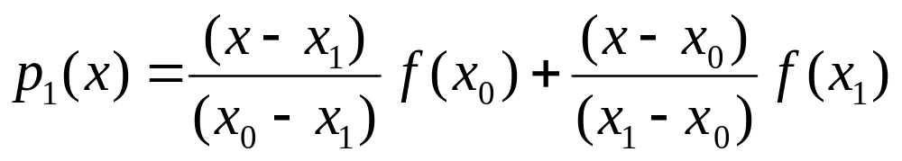
The LaGrange Formula
Very Clever
The formula for degree n = 1, given 2 points is below
  Note that it passes through the points (x₀,f(x₀)), (x₁,f(x₁))

Slide 5
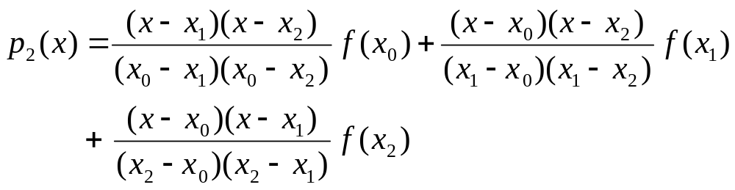
The LaGrange Formula
Degree n = 2
Require 3 points:

Slide 6
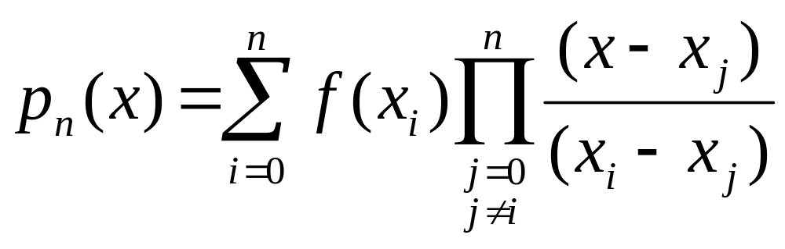
The LaGrange Formula
Degree n

Slide 7
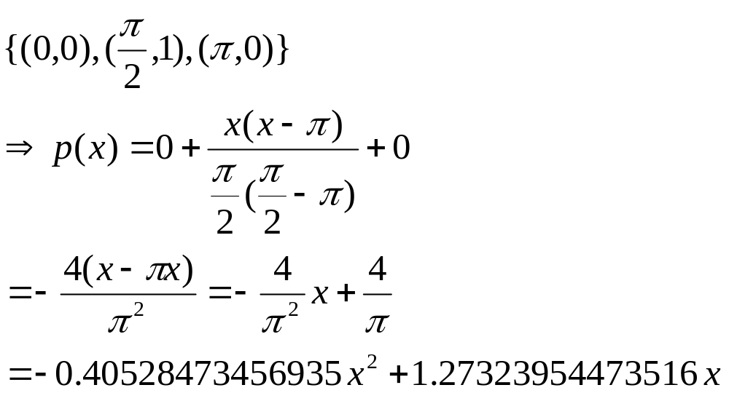
Example
Interpolate sin x at:
Graph in MATLAB; compare to sin x

Slide 8
Proof of Uniqueness
Suppose two polynomials of degree n exist that interpolate the points (x_{i}, f(x_{i}))
  Call them p_{n}(x) and q_{n}(x)
Consider the polynomial of degree n,
g_{n}(x) = p_{n}(x) – q_{n}(x)
g_{n}(x) has n+1 zeroes (namely the x_{i})
But a polynomial of degree n can have at most n zeroes!
  Contradiction!

Slide 9
Postscript
There are other formulas for arriving at the polynomial
There are approaches that compute interpolated values without arriving at the polynomial
  Newton’s divided differences
  These can also be used to find formulas for sequences
We’ll revisit interpolation in section 6.2

