Slide 1
Linear Systems

Slide 2
Systems of Linear Equations
n linear equations in n unknowns
Probably the most ubiquitous mathematical computer technique
  Economics, statistics, linear approximations of non-linear systems in engineering,…
Very well-defined theory
  Linear Algebra
  We’ll just scratch the surface

Slide 3
Analog to scalar mathematics
Scalar case:
  ax = b => x = b/a = a⁻¹ * b
Vector case:
  Ax = b => x = A⁻¹b
  A is a matrix
  A⁻¹ is the inverse of A
    Not all matrices have inverses

Slide 4
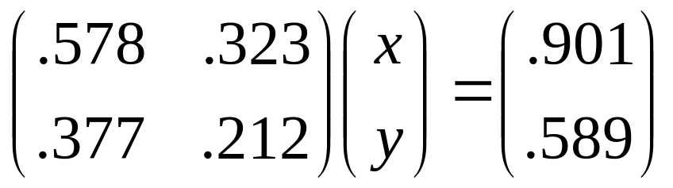
A Sample System
.578 x + .323 y = .901
.377 x + .212 y = .589
Could be written as:

Slide 5
Gaussian Elimination
Finding inverses of matrices is expensive
Inverses are not necessary to solve a linear system
A methodical procedure known as Gaussian Elimination is usually applied
The system is transformed into a triangular system
Then solutions are found by back-substitution

Slide 6
Gaussian Elimination
Uses elementary row operations
  Subtracting a multiple of one row from another
  Doesn’t change the “equality” of the equation
    Because we’re adding “equals”
The subdiagonal elements are zeroed-out through elementary row operations
  In a specific order
  See next slide

Slide 7
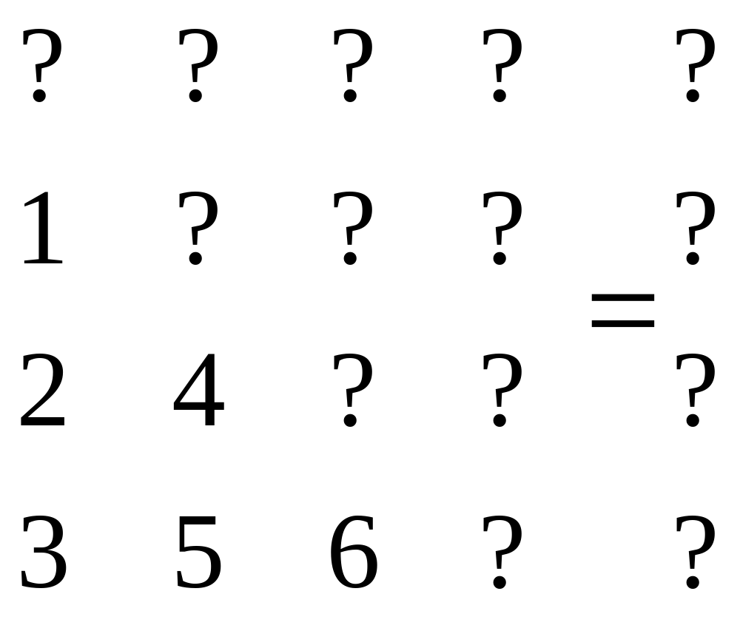
Order of Elimination

Slide 8
Solve the Following
10x – 7y = 7
-3x + 2y + 6z = 4
5x - y + 5z = 6
Solve without reordering
First make triangular:
  Eliminate x from row 2, x and y from row 3
Then solve for z and back-substitute

Slide 9
Naïve Algorithm
To eliminate a_{i,j} in row i:
  Multiply row a_{i-1} by a_{i,j}/a_{i-1,j}
  Subtract from row i
  a_{i-1,j} is called the pivot
See gaussian.cpp

Slide 10
Questions
What if the linear system has no solution?
How do we measure the quality of the solution?
Are there any numerical issues to be aware of?

Slide 11
Answers
What if the linear system has no solution?
Some linear systems have no solution
Some linear systems have an infinite number of solutions
We can spot these if we ever get a diagonal value of 0 in our final triangularized system

Slide 12
Answers
How do we measure the quality of the solution?
We can measure the “fitness” of our solution by calculating the residual:
  Calling our computed solution x*…
  Calculate the “distance” our Ax* is from the original b
    |Ax* – b|
Some matrices will cause a large residual, even when our x* is close to the real c
  Such matrices are “ill-conditioned”
  A tiny change in the input drastically changes the output

Slide 13
Exercise
Compute the solution of the system on Slide 4 with 3-digit arithmetic
Repeat after changing .212 to .211

Slide 14
Answers
Are there any numerical issues to be aware of?
What if a pivot is zero?
  We’ll end up dividing by zero
  But we can just swap our row with the next
What if a pivot is near zero?
  We’ll end up using very large numbers in our calculations
    Will likely lose accuracy during back substitution
    See page 279
Solution: Partial Pivoting

Slide 15
Partial Pivoting
When about to use a pivot to eliminate its subcolumn, make sure it is larger in magnitude than anything in its subcolumn
  Otherwise, swap with a subsequent row so the number of largest magnitude becomes the pivot

Slide 16
Exercise
Solve the System on Slide 8 using PP
Record your operations
  Multipliers (e.g., E₁₂(.5))
  Swaps (e.g., P₁₃)

Slide 17
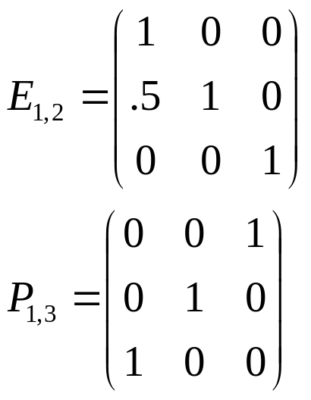
Factorizations
Elementary operations can be recorded
  Using special matrices (multiplying on the left)
Note: E₁₂⁻¹(.5) = E₁₂(-.5), P_{ij}⁻¹ = P_{ij}

Slide 18
The LU Factorization
Note that the E_{ij} are lower triangular
The result of Gaussian elimination is upper triangular
U = E_{n}E_{n-1}…E₂E₁A = L⁻¹A
Let L = E₁⁻¹E₂⁻¹…E_{n-1}⁻¹E_{n}⁻¹
Then LU = A
L has a special property
  It is a lower-triangular unit matrix containing the negative of the multipliers!

Slide 19
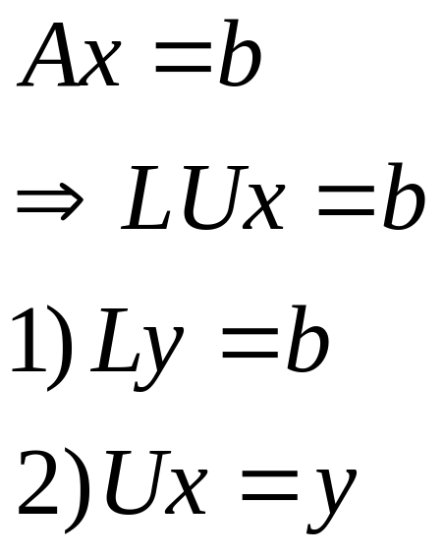
Using the LU Factorization
Since L and U are triangular, they are easily solved by substitution
We can factor the matrix A = LU independent of b, then…

Slide 20
The Benefit of the LU Factorization
The row operations have been recorded independent of the RHS, b
We can apply them to any RHS
So the elimination only has to be performed once
Optimization: we can store both L and U in a single matrix

Slide 21
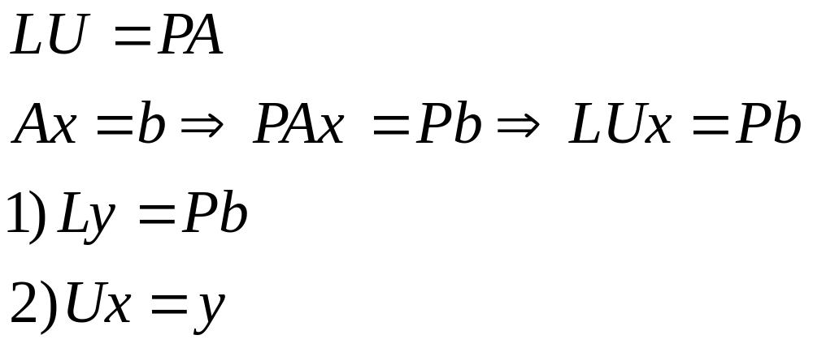
LU Factorization with Partial Pivoting
We need to record the row swaps
  And apply them to b before solving
The resulting product LU will be a row permutation of A (= PA):

Slide 22
Program 6
Gaussian Elimination with Partial Pivoting
Overwrite A with LU
Solve for multiple b’s
Watch for zero on diagonal

