Slide 1
Monte Carlo Methods

Slide 2
“Monte Carlo”?
Any technique that uses random numbers is called a Monte Carlo method
  Games
  Simulations
  What I’m going to show you
Named after the famous country that enshrines games of chance for the wealthy
Can be used to approximate the solution of difficult problems

Slide 3
Random Numbers
The key to Monte Carlo methods is a good random number generator
  Not all the ones that come in standard libraries are very good
There are statistical tests to evaluate random number generators
  For uniformity
    Are they sufficiently “spread out”
  For randomness
    Do they avoid gratuitous runs of repetitions or other patterns?
  It is difficult to achieve both simultaneously

Slide 4
Properties of RNGs
Deterministic
  They aren’t really “random”
    I mean, we use formulas!
    We call the numbers produced, “pseudo-random”
Reproducible
  You should be able to get the same sequence of pseudo-random numbers on request
    This is important for comparing experiments
Periodic
  You get the next number in the sequence by applying a formula to the last one
  Eventually, the sequence repeats

Slide 5
Uniform Generators
Generate a nicely spread-out sequence of numbers on some interval (usually (0, m))
  E.g., std::rand( ) covers (0, RAND_MAX)
If you use more than RAND_MAX calls to rand( ), you’ll start repeating the sequence
  RAND_MAX = 32767 is unacceptable
    It may even start repeating sooner
  We want a large period for Monte Carlo methods

Slide 6
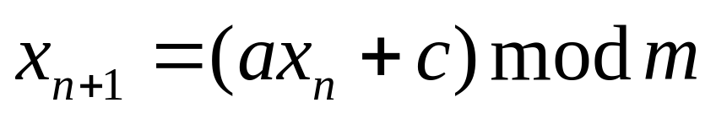
Linear Congruential Generators
Of the form:
The constants a, c, and m must be chosen carefully
  The period is <= m, but we want to maximize it
  There is an entire body of literature based on number theory for this
Some generators combine LCGs with other kinds

Slide 7
A Quick and Dirty RNG
Very fast
And pretty doggone good!
Period is not as large as others, though(?)
See qadrng.h

Slide 8
UNI
A uniform RNG from the 80s
In file uni.h, uni.cpp
Uses a lagged Fibonacci approach
  Uses different samples from a LCG with a=1, c = -7654321, m = 2²⁴
  x_{n+1} = x_{n-17} – x_{n-5}
Must call ustart( ) to seed

Slide 9
The Mersenne Twister
Has a very large period
  2¹⁹⁹³⁷-1 (!!!)
  Written by Makoto Matsumoto
    http://www.math.sci.hiroshima-u.ac.jp/~m-mat/eindex.html
Uses Mersenne primes and other tricks as a modification to a linear congruential method
  We won’t look any more into the theory
  We’ll just use it!

Slide 10
Using the Mersenne Twister
In file mersenne.c on web site
Pass a long to init_genrand( ) to seed
  Can use std::time( ) to get a random seed
Call genrand_int32( ) for numbers in the interval [0, 2³²)
Call genrand_real3( ) for numbers in the interval (0, 1)
Use math to transform to other intervals
Don’t forget to include a prototype for the functions you call

Slide 11
Interval mapping formulas
Most RNGs give reals in the range (0,1) or integers in the range (0, m)
You can map to and from these ranges with simple algebraic transformations
  Well, they’re simple to me ☺

Slide 12
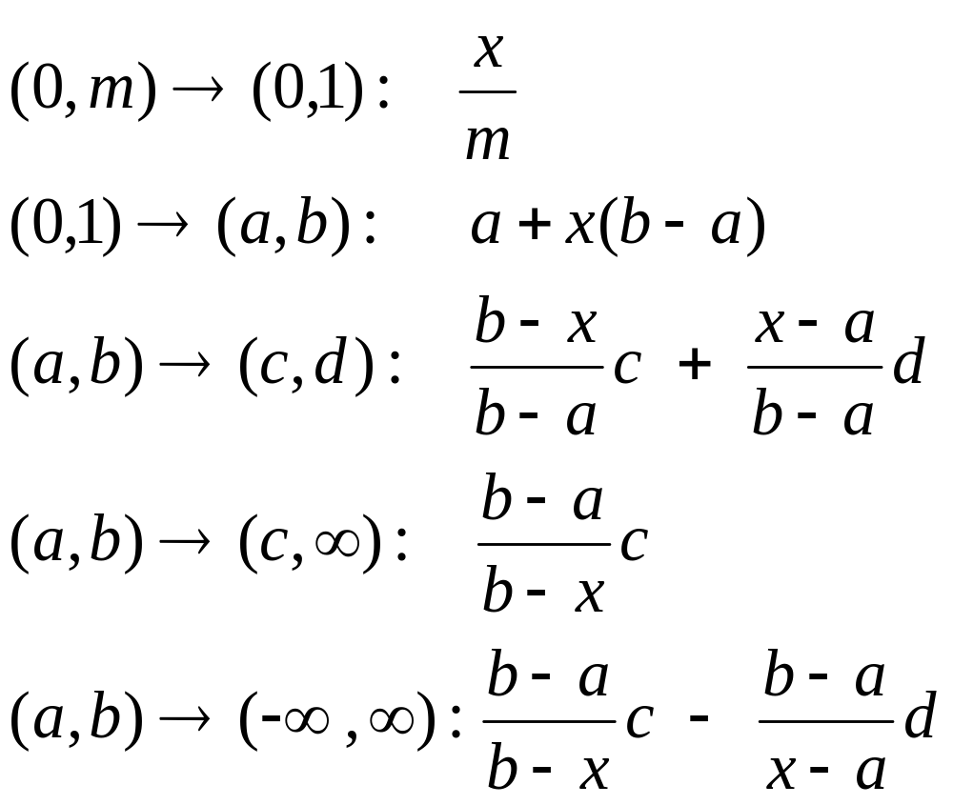
Interval Mapping formulas

Slide 13
Monte Carlo Methods
Example: Computing Pi
Monte Carlo methods use random numbers to solve numeric problems
For example, generate uniform random x-y points in the unit square
  Generate x and y independently in the range [0,1]
  The number of points should be >= 10,000
Determine if x² + y² <= 1 or not
  The ratio of points inside the circle = π/4
See pi.cpp
  pi = 3.141592;

Slide 14
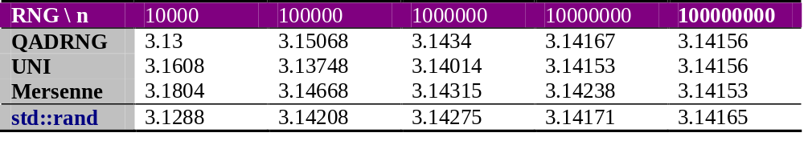
Results of pi.cpp

Slide 15
Monte Carlo Integration
Uses RNGs to approximate areas under curves, surfaces
Two approaches
  Average function value
  Throwing darts (what we did with pi)

Slide 16
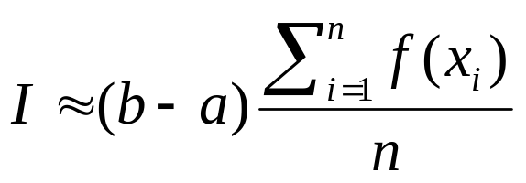
Monte Carlo Integration
Average Function Value Approach
Approximate the average function value on the interval (a,b)
  Just take the average of a large random sample of f(x_{i})
Multiply this by (b-a)
The result ≈ area:
See average.cpp

Slide 17
Monte Carlo Integration
Dart-Throwing Approach
Obtain many random points, (x_{i},y_{i}) in region of interest
  The area of the region is known, i.e., a rectangle with width (b-a) containing the curve
Count the number of y_{i} that are less than f(x_{i})
The percentage of “hits” (count / n) is the proportion of your region that represents an approximation of the sought-for area below the curve f(x)
See darts.cpp

Slide 18
When to use Monte Carlo
Not for simple integrals like these
They’re handy for multiple integrals
  Or for calculating volumes defined by constraints
See the homework!

