Slide 1
Number Systems
CNS 3320 – Numerical Software Engineering

Slide 2
Fixed-size Number Systems
Fixed-point vs. Floating-point
Fixed point systems fix the maximum number of places before and after the decimal
  Integers are a fixed-point system with 0 decimals
Advantage?
Disadvantage?

Slide 3
Advantages of fixed-point
They are evenly spaced within their range of values
  (Floating-point numbers are not!)
  So they (fixed-point) behave like integers
    Operations are truncated to a fixed decimal point
    Additions and subtractions within range are exact
  No memory is wasted storing exponents
You get dependable accuracy
  Moderate error only in last digit

Slide 4
Disadvantages of fixed-point
In a word: range
  There aren’t enough numbers
The values needed in scientific computation typically cover a range beyond what is feasible to store in a fixed-point machine word or double-word
  We’d like to fit numbers into machine units
    Like words and double-words
    For speed

Slide 5
Fixed-point Example
Consider the following fixed-point number system, F1:
  base = 10
  precision = 4
  decimals = 1
F1 has 19,999 evenly-spaced numbers:
  {-999.9, -999.8, …, 0, … 999.8, 999.9}
How many bits are needed to store such a number?
  1 for sign
  16 for mantissa (because each digit requires 4 bits)
    Note: we don’t convert the entire number to binary, just a digit at a time (BCD)
  17 total

Slide 6
Types of Error
Take Two
Absolute vs. relative
  Absolute = |x – y|
  Relative = |x – y| / |x|
    Percentage error (preferred)
Consider the relative error of representing x = 865.54 in F1:
  (865.54 – 865.5) / 865.54 = .00005
Now, how about .86554:
  (.86554 - .9) / .86554 = .04
The relative error depends on the number of significant digits we can have, which depends on the magnitude of the number
Bummer

Slide 7
Floating-point Number Systems
Use “scientific notation”
They store a “significand” (“mantissa”) of a fixed number of digits, as well as an exponent and sign
The number of digits stored no longer depends on the magnitude of the number
  You merely adjust (“float”) the exponent

Slide 8
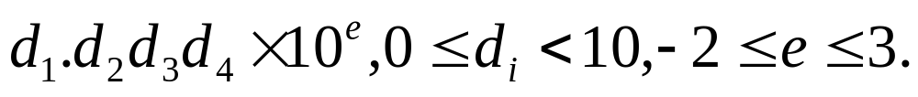
A Toy Floating-point System
Consider the floating-point system F2:
  base = 10
  precision = 4
  exponent range [-2, 3]
This system represents numbers of the form:

Slide 9
The Numbers in F2
A sample:
  9999 (= 9.999 x 10³)
  - 80.12
  .0001
  .00002 (= 0.002 x 10⁻²)
  0

Slide 10
The Numbers in F2
Are not evenly spaced
  Why?
How many numbers are there?
  We can’t tell easily right now, but an upper bound is:
    10⁴ x 6 x 2 = 120,000
How many bits are necessary to store such numbers?
  1 for sign, 3 for exponent (0->5 maps to -2->3), 16 for mantissa (4 x 4)
  20 total

Slide 11
Storage Efficiency
With 17 bits we can store 19,999 fixed-point numbers
  Approx. 1,141 numbers per bit
With 20 bits we can store 120,000 floating-point numbers
  6,000 numbers per bit
Increased by a factor of 5.26!

Slide 12
Rounding Error in F2
The absolute error depends on the exponent
  Because the numbers aren’t evenly spaced
  More on this later
Consider the relative error in approximating 865.54, then .86554:
  (865.54 – 865.5) / 865.54 = .00005
  (.86554 – .8655) / .86554 = .00005
Depends only on digits, not the magnitude

Slide 13
Different Bases
Consider representing .1 in a base-2 system
1/10 = 1/1010₂
Use long division :
.000110011001100…
1010 | 1.000000000000000
1/10 is an infinite (repeating) decimal in base 2!
This is why 1 - .2 - .2 - .2 - .2 - .2 != 0 in a binary floating-point system

Slide 14
Formal Definition of FP Systems
A Floating-number systems is the set of numbers defined by the following integral parameters:
A base, B
A precision, p
A minimum exponent, m (usually negative)
A maximum exponent, M

Slide 15
Unnormalized FP Systems
Numbers of the form:
d₀.d₁d₂d₃…d_{p-1} x B^{e}
where 0 <= d_{i} < B for all the i
and m <= e <= M
Not all such numbers are unique

Slide 16
A Sample FP System
Consider F3:
  B = 2
  P = 3
  m = -1, M = 1
List the numbers of F3
What is the cardinality of F3?
What are the different spacings between the numbers of F3?

Slide 17
The Numbers of F3
24 bit patterns – 16 unique numbers
 | x 2⁻¹ | x 2⁰ | x 2¹
0.00 | 0 | 0 | 0
0.01 | .001 | .01 | .1
0.10 | .01 | .1 | 1
0.11 | .011 | .11 | 1.1
1.00 | .1 | 1 | 10
1.01 | .101 | 1.01 | 10.1
1.10 | .11 | 1.1 | 11
1.11 | .111 | 1.11 | 11.1
Spacing: | (.001) | (.01) | (.1)

Slide 18
The Problem with Unnormalized Systems
There are multiple ways to represent the same number
  0.1 x 2 == 1.0 x 2⁻¹
This wreaks havoc with implementation
  Difficult to compare numbers
  Inefficient algorithms for floating-point arithmetic (too many special cases to consider)
  Not acceptable!

Slide 19
Normalized Systems
Require that d₀ not be zero
  Solves the duplicate problem
But other problems arise
  Fewer numbers can be represented
    But we’ll find a work-around
  The number 0 is not representable!
    We’ll solve this later
Added bonus for binary
  The leading digit must be 1
  So we won’t store it! We’ll just assume it
  This increases the cardinality of the system vs. unnormalized

Slide 20
A Normalized FP System
F4 (same parameters as F3)
  B = 2
  p = 3 (well, it will actually be 4)
  m = -1, M = 1
If we explicitly store d₁, we only get 12 distinct numbers
  Because the first bit must be 1, leaving 2 bits free
But we will assume d₀ = 1
  And not store it! (Only works for base = 2)
  Giving 4 bits altogether (the first being 1)

Slide 21
The Numbers of F4
24 bit patterns – 24 unique numbers (but different range vs. F3)
 | x 2⁻¹ | x 2⁰ | x 2¹
(1).000 | .1 | 1 | 10
(1).001 | .1001 | 1.001 | 10.01
(1).010 | .101 | 1.01 | 10.1
(1).011 | .1011 | 1.011 | 10.11
(1).100 | .11 | 1.1 | 11
(1).101 | .1101 | 1.101 | 11.01
(1).110 | .111 | 1.11 | 11.1
(1).111 | .1111 | 1.111 | 11.11
Spacing: | (.0001) | (.001) | (.01)

Slide 22
Properties of FP Systems
Consider the system (B, p, m, M)
Numbers are of the form:
  d₀.d₁d₂…d_{p-1} x B^{e}, m <= e <= M, d₀ > 0
What is the spacing between adjacent numbers?
It is the value contributed by the last digit:
  0.00…1 x B^{e} = B^{1-p} x B^{e} = B^{1-p+e}
  This is B^{1-p} for the interval [1.0, B¹)
    Increases going right; decreases going left

Slide 23
Relative Spacing in FP Systems
As we mentioned before, it’s fairly uniform throughout the system
Consider the range [B^{e}, B^{e+1}):
  {B^{e}, B^{e}+B^{1-p+e}, B^{e}+2B^{1-p+e}, … B^{e}+B^{p-1}B^{1-p+e}}
The relative spacing between adjacent numbers is:
  Between B^{-p} and B^{1-p} (a factor of B)
    Called the system “wobble”
    The second reason why 2 is the best base for FP systems!
      It’s the smallest possible wobble
  Independent of e!

Slide 24
Machine Epsilon
A measure of the “granularity” of a FP system
It is the spacing between 1.0 and its neighbor the right
We already computed this: ε = B^{1-p}
We will use this to tune our algorithms to the FP system being used
  We can’t expect smaller relative errors than ε
See epsilon.cpp

Slide 25
The Most Important Fact About Floating-point Numbers
Recall that the spacing between numbers in [B^{e}, B^{e+1}) is B^{1-p+e} = B^{1-p}B^{e} = εB^{e}
If |x| is in [B^{e}, B^{e+1}), then B^{e} <= |x| < B^{e+1}
=> spacing = εB^{e} <= ε|x| < εB^{e+1}
=> εB^{e-1} <= ε|x|/B < εB^{e} = spacing
=> ε|x|/B < spacing at x <= ε|x|
The last line is the fact to remember
  We’ll use it in designing algorithms

Slide 26
Error in Floating-point Computations
Due to the fixed size of the FP system
Roundoff error occurs because the true answer of a computation may not be in the FP system
Cancellation in subtraction is also nasty problem
Errors can propagate through a sequence of operations
  May increase or decrease

Slide 27
Measuring Roundoff Error
A single FP computation may result in a number between two consecutive FP numbers
The FP number returned depends on the Rounding Mode
  Round to nearest (the most accurate)
  Round down (toward negative infinity)
  Round up (toward positive infinity)
  Round toward zero

Slide 28
Measuring Roundoff Error
(continued)
The absolute error of a FP computation is bounded below by the size of the interval between adjacent numbers
  aka “one unit in the last place”
  Abbreviated as “ulp”
ulp(x) denotes the spacing of the current interval
  We already derived this
  ulp(x) = B^{1-p+e} = εB^{e}
We already observed that the relative spacing is fairly uniform throughout the FP system
  Within the system “wobble”
  With larger numbers, the absolute error will, alas, be larger
    Dem’s da breaks

Slide 29
Measuring Roundoff Error
(continued)
Sometimes, instead of relative error, we’ll ask, “how many ulps do two numbers differ by?”
  Same as asking: “How many floating-point intervals are between the two numbers”
  If we’re only off by a few ulps (intervals), we’re happy
ulps(x,y) is defined as the number of floating-point intervals between numbers
  Including fractions thereof
  If the numbers have different signs, or if either is 0, then ulps(x,y) is ∞

Slide 30
ulps(x, y)
Recall F4:
  B = 10, p = 4, m = -2, M = 3
Calculate ulps(.99985, 1.0013)
These numbers bracket the following consecutive numbers of F4:
  .9999, 1.000, 1.001
  Giving two complete intervals + two partial intervals = .5 + 1 + 1 + .3 = 2.8 ulps
  In program 1 we will approximate this
    Will get either 2 or 3 ulps, depending on how the actual numbers round

Slide 31
Example of Tuning an Algorithm
Suppose someone writes a root-finding routine using the bisection method:
  Start with 2 x-values, a and b, that bracket a root
    i.e., f(a) and f(b) have different signs
  Replace a or b by the midpoint of [a,b]
    So that the new f(a) and f(b) still have different signs
  Stop when |b – a| < some input tolerance
See bisect1.cpp

Slide 32
The Problem
The input tolerance may be unrealistically small
  It may be smaller than the spacing between adjacent floating-point numbers in the neighborhood of the solution
  Endless loop!
Solution:
  Reset tolerance to max(tol, ε|a|, ε|b|)
  Represents the spacing between adjacent numbers in the neighborhood of the solution (see bisect2.cpp)
Often we’ll use relative error instead
  Bound it by ε

Slide 33
Cancellation
Occurs when subtracting two nearly equal numbers
  The leading digits will be identical
  They cancel each other out (subtract to 0)
  Most of the significant digits can be lost
  Subsequent computations have large errors
    Because the roundoff has been promoted to higher-value digits
The problem with the quadratic example
  Because b and sqrt(b²-4ac) were very close
  Sometimes b² and 4ac can be close, too
    Not much we can do about that (use even higher precision, if possible, or try case-by-case tricks)

Slide 34
Differing Magnitudes
When very large and very small numbers combine
Sometimes not a problem
  Smaller numbers are ignored (treated as 0)
  Fine if the number is growing
But consider the exp(-x) case
  Initial terms in the Taylor series are large
  Their natural roundoff (in their last digit) is in a higher-valued digit than the final true answer
    All digits are bad!
  Made a difference because we were subtracting

Slide 35
Potential Overflow
Adding two numbers can result in overflow
  IEEE systems have a way of “handling” this
  But it’s best to avoid it
Example: (a + b) / 2 in bisection
  Alternative: a + (b-a)/2
  Also checking f(a)*f(c) < 0 can overflow
    Try f(a)/fabs(f(a))*f(c), or write a sign function

Slide 36
Error Propagation of Basic Ops
Multiplication
  Error tends to be no worse than the uncertainty in the worst argument (the one with the most error in it already)
  Ditto division
Addition
  Tends to be on the order of the operand with the largest magnitude
    Unless cancellation occurs (adding opposite signs)
    Can actually decrease (errors offset each other)!
  Cases where cancellation occurs are the worst of all

Slide 37
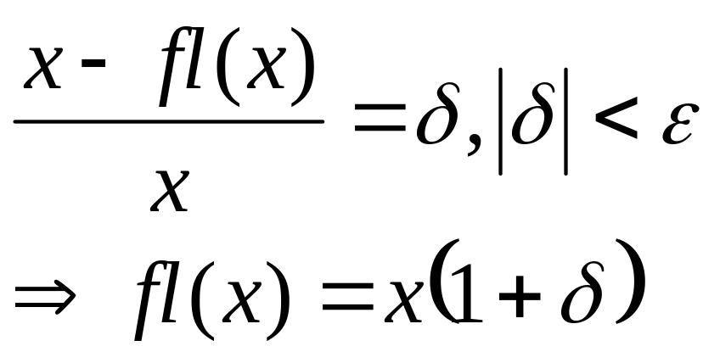
Error Analysis
We know that the floating-point approximation to a number x has relative error < ε
Rewrite this as:

Slide 38
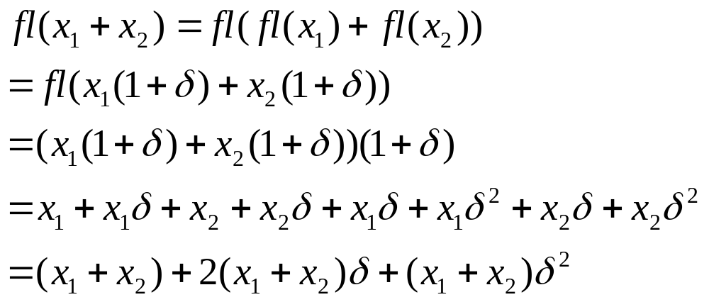
Error in Adding 2 Numbers
For simplicity, we’ll assume the roundoff error of each single operation is δ (they’re all bounded by ε anyway):

Slide 39
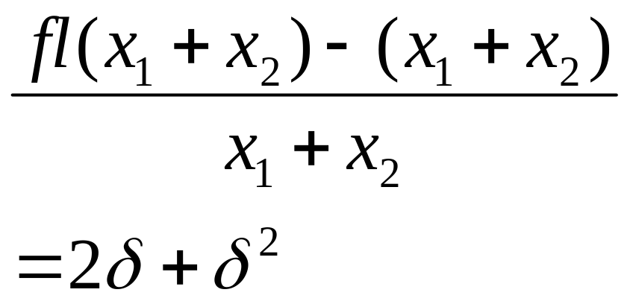
Now compute the relative error:
So the error of the sum is roughly the sum of the errors (2δ) plus a hair, but the two errors could be nice and offset each other a little.

Slide 40
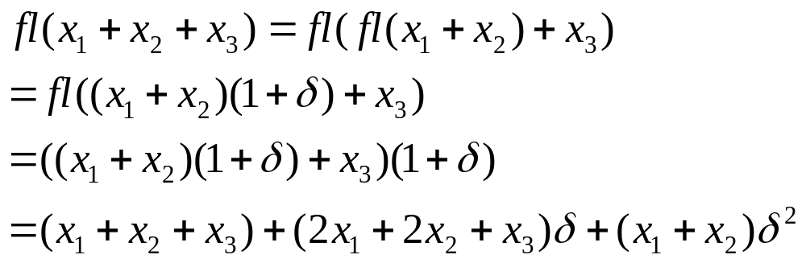
Now consider the sum x₁ + x₂ + x_{3:}
  We’ll even ignore the initial errors in approximating the original numbers
  Let’s just see what addition itself does when repeated
  We’ll again call each relative error δ (they differ by very little)
The smaller x₁ and x₂ are the better. Rule of thumb: add smallest to largest when possible.

Slide 41
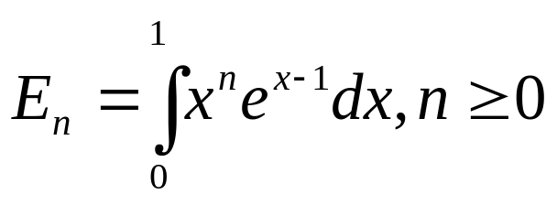
Error Propagation Example
The mathematical nature of a formula can cause error to grow or to diminish
  It’s important to examine how errors may propagate in iterative calculations
Example:

Slide 42
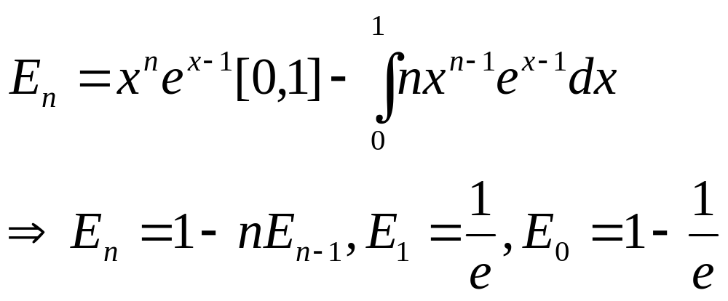
Integrating by parts, we end up with a recurrence relation:

Slide 43
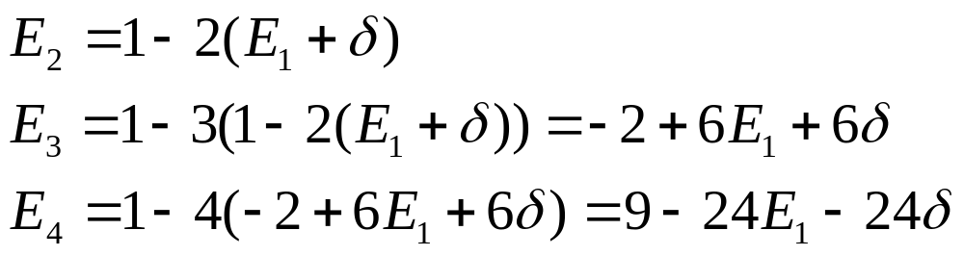
The initial error in E₁ (call it δ) gets magnified:

Slide 44
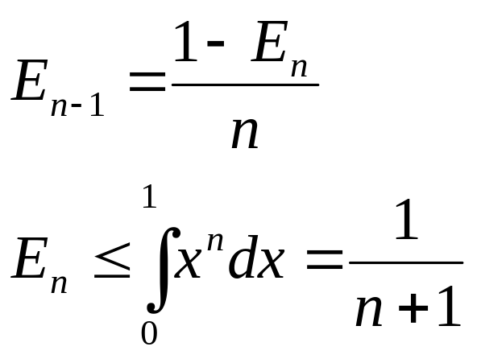
Solution
Rewrite the recurrence backwards, and use an initial guess for E_{n}
The initial guess doesn’t have to be too close, as you’ll see (analysis on next slide)
See en.cpp

Slide 45
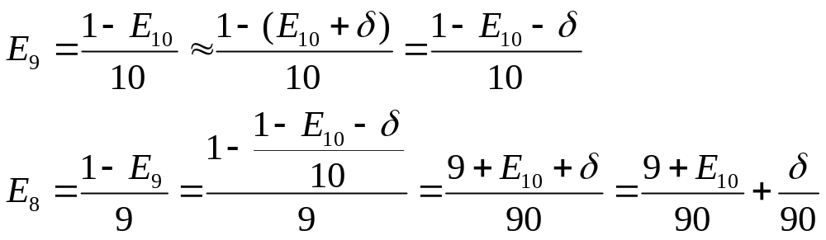
The initial error, δ, gets dampened with each iteration.

Slide 46
Computing Machine Parameters
They’re already available via <limits>
But they didn’t used to be
And you may not be using C/C++ forever
It is possible to determine by programming what B, p, and ε are!
See parms.cpp

Slide 47
Summary
Floating-point is better than fixed-point for:
  Range of available numbers
  Storage efficiency
  Uniform relative error
Floating-point is less resource intensive than using arbitrary precision algorithms
Floating-point is subject to roundoff error
  Because the set of numbers is finite
  The absolute error grows with the magnitude
    Because numbers aren’t evenly spaced (gap widens)
  But the relative error doesn’t

Slide 48
Summary
Normalized systems are preferred over unnormalized
  Unique bit patterns for distinct numbers simplifies algorithms
  Formulas that describe the behavior of the system are easier to derive
  Storage optimization with binary
Machine epsilon is the fundamental measure of a FP system
  Upper bound on relative roundoff error
  Used to tune algorithms

