Slide 1

C++ Programming
~ Introduction ~
Prepared for Ingenix, Inc.
Copyright 2004, Fresh Sources, Inc.

Slide 2
C++ in Three Days!!!
Three intense days
Ask questions
  We’ll customize as we go
Do the exercises
  We’ll set time aside for them
We’ll use but not emphasize the Microsoft Visual Studio .NET 2003 IDE
  You are learning Standard C++

Slide 3
About Me
CS Professor at UVSC since 2001
Used to work at Ingenix! (Nov 1998 - Mar 2000)
3 degrees in math
20+ years software engineering experience
  Defense contractors, LDS Church, Oracle, Novell
Contributing member of the C++ Standards Committee (designed the bitset container)
Past Editor of the C/C++ Users Journal (1992-2003)
Founding editor of The C++ Source (2004 -)
Author of 2 C++ books published by Prentice-Hall
“Teaching” since 1977 (7 colleges, corporate)

Slide 4
About You
Experienced Programmers
Very smart
  (otherwise you wouldn’t feel comfortable around David North)
Able to stay interested and alert while sitting in a dark room for extended periods
Actually, believe it or not, want to learn this Cool Stuff

Slide 5
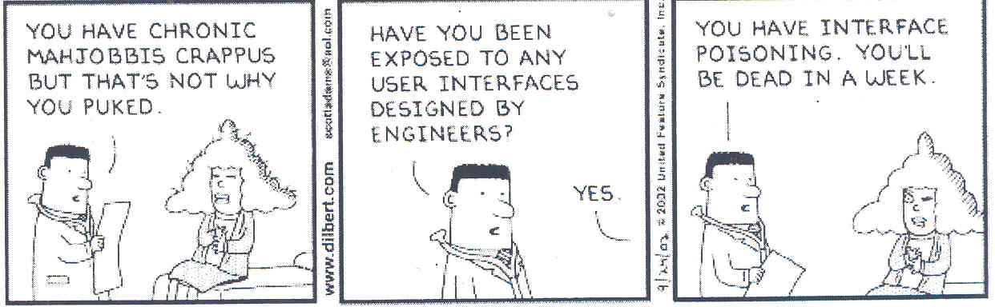

Slide 6
The Deception of Visual, Event-driven Programming
Only deals with UI
Seems simple, but encourages poor practice
  Prototypes become products before their time
  UI should be totally separate from object model
  Programming is not Mouse Engineering
<soapbox>
  Programmers shouldn’t design GUIs
  Let the users do it!
</soapbox>

Slide 7
Programming is more than Visual
“The effective exploitation of his powers of abstraction must be regarded as one of the most vital activities of a competent programmer.” -- Dijkstra

Slide 8
About C++
The most powerful programming language in the history of computing
It is low-level
  Evolved from C
  Only assembly language goes lower
It is high-level
  No language has higher-level constructs
  (Exception: no Lisp-like eval function)
It is everything else in between

Slide 9
More About C++
It is not easy to master
You can hurt yourself
  Especially if you stay low-level
  Should use the library components available
Is being revised
  C++0x is under construction
  Will have even more powerful components
  Will (hopefully) be easier to use
  Is not owned by a single company!
    But is the best choice for .NET development!

Slide 10
A Multi-paradigm Language
Procedural programming
  if-else, loops, functions, arrays, records (struct)
  Supports large, multi-file projects
  Compiles to native code (no virtual machine)
Object-based programming
  Classes (data members + member functions)
  Automatic initialization and clean-up
  Operator overloading

Slide 11
A Multi-paradigm Language
(continued)
Object-oriented Programming
  Inheritance
    Single and multiple
    Interface inheritance (public), implementation inheritance (private), and in between (protected)
  Polymorphism
    OO’s great contribution to software engineering
    The fastest there is
Generic Programming
  The next revolution in computing
  Key to “higher-level” programming
  C++’s advantage over competitors: type safety

Slide 12
The C++ Type System
C++ offers many built-in types
  char, int, float, etc.
  Library types: string, vector, list, map, etc.
Statically typed
  Proper use of types enforced at compile time
  Very difficult to violate type safety
User-defined classes are types
  But you must define them well!

Slide 13
Teasers
A look at typical Modern C++ usage
  Should look a little foreign to most of you
  Our goal for you after these 3 days!
  Don’t worry: we’ll step back and work our way there
Hello (6 examples)
  #include, namespaces, stream objects and operations, string objects, command-line arguments
STL (3 examples)
  vectors, maps, sets, common algorithms, iterators

Slide 14
Namespaces
Simply a way of packaging things
  Like packages in Java and Common Lisp
  To avoid name clashes
  Standard C++ library uses the namespace std
Three ways of accessing members
1) myspace::f( )
2) A using declaration:
  using myspace::f; … f( )
3) A using directive:
  using namespace myspace; … f( ); (+ more)
  Use sparingly (never in a header)!

Slide 15
Defining a Namespace
namespace myspace {
…
}
Can span multiple files
  That’s what the standard headers do

Slide 16
Vectors
An improvement on the array concept
Grows as needed
Generic: can hold any type
Homogeneous: holds only one type at a time
  Type-safe (checks proper usage)
Can be used by standard algorithms

Slide 17
Algorithms
Generic functions
  Can process a sequence (vector, deque, list, set, map) of any homogeneous type
  Including arrays!
Replace loops in most instances
Already written for you!
  Over 50
Flexible and customizable

Slide 18
The Modern C++ Programmer
Knows and uses standard library components
Uses string instead of arrays of characters
Uses vector or some other sequence container instead of arrays
Uses algorithms instead of loops
Rarely has to worry about memory management
  The standard library takes care of it for you!

Slide 19
Exercise
Write a program that reads the lines of a text file, and then prints those lines in descending alphabetical order, without repetition (discard duplicate lines). Your program should be able to handle an arbitrarily large number of text lines. Ignore blank lines altogether.

