Slide 1
Totally Awesome Computing
Python as a General-purpose Object-oriented Programming Language
OOPSLA 2006

Slide 2
About Me
Associate Professor of CS
  Utah Valley State College
A veteran C/C++ guy
  Two books
  80+ articles
  Past Senior Editor of C/C++ Users Journal
  Past contributing member of C++ Standards Committee

Slide 3
About You
You’re very bright
  You came to OOPSLA!
Love to code
  Problem-solving mentality
Can stay alert while sitting for extended periods
Dislike annoying slide animations

Slide 4
About Python
Developed around 1990 by Guido van Rossum
  Named after Monty Python
A superb scripting language
Also a general-purpose programming language
  Fully object-oriented
Can use with Java (Jython), C, C++ (Boost.Python), and .NET (IronPython)

Slide 5
Features
Simple syntax
  Very natural and easy to learn
Incredibly powerful (“Batteries Included”)
  Useful built-in types and data structures
  Huge library that supports…
    Networking
    XML and web applications
    Mathematical computing
    Text processing
    You name it!

Slide 6
Similarities to Other Languages
Interpreted
  Like Perl, Lisp (and Java, C#)
Garbage-collected (automatic memory mgt.)
  Like those just mentioned and others
Object-oriented
  More than most languages (everything is an object)
Supports Operator Overloading
  Like C++, C#

Slide 7
Python on The Web
Visit www.python.org
Can download Python and many related items of interest
Documentation is there
  Also Guido van Rossum’s tutorial
  And the library reference and module index
Python’s [Tutor] mail list: http://mail.python.org/mailman/listinfo/tutor
Free online book: http://diveintopython.org/

Slide 8
Jedi Wisdom
On Perl vs. Python
YODA: Code! Yes. A programmer’s strength flows from code maintainability. But beware of Perl. Terse syntax… more than one way to do it… default variables. The dark side of code maintainability are they. Easily they flow, quick to join you when code you write. If once you start down the dark path, forever will it dominate your destiny, consume you it will.
LUKE: Is Perl better than Python?
YODA: No… no… no. Quicker, easier, more seductive.
LUKE: But how will I know why Python is better than Perl?
YODA: You will know. When your code you try to read six months from now.

Slide 9
Agenda
The Nickel Tour
Built-in Types and Operations
In depth:
  String Processing
  Lists and Dictionaries
  Tuples and Files
Statements and Control Structures
Functions
Object-oriented Programming

Slide 10
Nickel Tour
Starting Python
Simple Expressions
Variables and Dynamic Typing
Saving and Running Programs

Slide 11
Starting Python
Several ways:
  Startup IDLE (or some other IDE)
  Type “python” at the command prompt
  Run a Python program
    Click on a .py file, or
    Enter “python <prog>” at command prompt

Slide 12
Entering Python Statements
Just type an expression or statement at the “>>>” prompt
Python answers
  Usually prints a result
  Then another prompt appears
To quit Python:
  Enter Ctrl-Z on a line by itself and press Enter
  Ctrl-D on UNIX
  Or close the window
Let’s do it now…

Slide 13
Expressions
An “expression” is code that invokes one or more operations
Valid operations include:
  Invoking operators (+, -, *, /, //, **, etc.)
  Calling functions
  Inspecting or modifying modules or data
You can also use the print statement to display the value of expressions and variables

Slide 14
Variables
A variable is a name associated with some entity (data, a function, etc.)
  Must begin with a letter or underscore
  The variable ‘_’ yields the last interactive result
The association (“binding”) occurs in an assignment statement:
  x = 5
  x = “the” + “ end”
  (Note: x is “rebound” to a string in the 2nd line)
A variable is bound to the last thing you assigned to it

Slide 15
Dynamic vs. Static Typing
Dynamic typing is more flexible
  It’s easier to code in such languages
    Like Python, Perl, Javascript, PHP, etc.
  It’s also easier to make mistakes!
Static typing is “safer”
  Because misuse of variables is discovered before runtime (when you compile)
    Dynamically typed languages typically don’t have a separate compile step
Python is worth the “risk”

Slide 16
Exercise
Using a text editor, save Python statements to a “.py” file that print out your name, age, and job title.
Import your file into a Python session and observe the result.
Repeat the import command and observe the result
Execute your program from your command line shell with the python command.

Slide 17
Built-in Types and Operations

Slide 18
Python Built-in Types
Numbers
Sequences
  Linear data structures
Sets
Dictionaries
Files

Slide 19
Numbers
Integers
  32-bit: from -2,147,483,648 to 2,147,483,647
Long integers
  Unlimited size! (Automatic promotion from int)
Real numbers (decimals)
  Same as double in C
Complex numbers
  2 + 3j

Slide 20
Numeric Operators
The usual arithmetic ones:
  +, -, *, /, //, **, %
Bitwise operators:
  |, ^, &, ~, >>, <<
Comparisons:
  <, >, <=, >=, ==, != (also <>)

Slide 21
Assignment Operators
A shorthand that combines a binary operator with assignment all at once
  And allows for execution optimization
  Borrowed from C
x += y is the same as x = x + y
Works for all binary operators:
+ - * / // % ** & | ^ >> <<

Slide 22
About Division
The '/' operator truncates decimals when dividing two integers
This will change in a future version
  It will always preserve decimals
  Can get this feature now (see next slide)
The '//' always truncates
  Even when dividing real numbers

Slide 23
Division Example
>>>1 / 2
0
>>> 1.5 / 2.5
0.59999999999999998
>>> 1.5 // 2.5
0.0
>>> from __future__ import division
>>> 1 / 2
0.5

Slide 24
Long Integers
Arbitrarily large
  Regular integers convert automatically to long:
>>> x = 12345
>>> type(x)
<type 'int'>
>>> x = x**5
>>> x
286718338524635465625L
>>> type(x)
<type 'long'>
>>> x ** 5
1937659030411463935651167391656422626577614411586152317674869233464019922771432158872187137603759765625L

Slide 25
Simple Print Formatting
print '<format string>' % (<items to print>)
>>> x = 16
>>> print x
16
>>> print '%X' % x
10
>>> x >>= 1
>>> x
8
>>> x <<= 2
>>> x
32
>>> print '%X' % x
20

Slide 26
Printing Multiple Values
>>> x, y = 2.4, 3.5 # tuple assignment
>>> x,y
(2.3999999999999999, 3.5)
>>> print "x = %4.2f, y = %4.2f" % (x,y)
x = 2.40, y = 3.50

Slide 27
Sequences
Collections accessed by position (0-based)
3 types:
    Strings
    Lists
    Tuples
Note: strings and tuples are immutable
  You can always rebind a variable to a new value, of course

Slide 28
Common Sequence Operations
Functions: len( ), min( ), max( ), zip( ), sum( ) (sum doesn't work on strings)
Comparisons: <, <=, >, >=, ==, !=
Concatenation with +
Replication with *
Membership tests with in
Iteration with for
Slices (subsequences)

Slide 29
Strings
A sequence of characters (letters)
  There is no character data type
  You just use a string of length 1
Use quotes to define a string literal
  Either single or double quotes
  Even triple quotes!
    For multi-line strings
Can extract substrings, do lotsa stuff

Slide 30
Applying Sequence Operations to Strings
>>> s = 'hello'
>>> s*4
'hellohellohellohello'
>>> t = "there"
>>> st = s + ', ' + t
>>> st
'hello, there'
>>> len(s)
5

Slide 31
Applying Sequence Operations to Strings (continued)
>>> s < t
True
>>> 'e' in s
True
>>> s[1]
'e'
>>> for c in s: print c
...
h
e
l
l
o

Slide 32
Slices
The way to extract substrings by position
Uses the syntax s[start:endp1]
For example "hello"[1:3] == "el"
The expression s[p:] extracts from position p to the end of the string
The expression s[:p] extracts from the beginning up to but not including position p (p letters are extracted)

Slide 33
"Negative" Slices
Negative indices refer to 1-based positions from the end of the string
  The expression s[-1] extracts the last character
  The expression s[-2:] extracts the last two characters
  The expression s[-m:-n] extracts the substring of length m-n from position len(s)-m through, but not including position len(s)-n
    m should be greater than n
      Else you'll get an empty string

Slide 34
Envisioning Slices
"Help"
+---+---+---+---+
| H | e | l | p |
+---+---+---+---+
0 1 2 3 4 (outside)
-4 -3 -2 -1
The first (0-th) character is s[-len(s)]

Slide 35
String Exercise
Assign the string "how now brown cow" to a variable
Compute the length of the string
Extract the word "how"
Extract the word "cow"
Extract the word "brown"
Extract all characters up through position 6 (7 letters)
Extract all characters from position 7 to the end
Find all positions of the substring "ow" (use .find( ))
Prepend the string "Well, ", overwriting the variable
Append a question mark (overwriting again)
Compute the new length

Slide 36
Working with Lists
Lists are mutable sequences of values
  Can change them with methods
Delimited by brackets: [a,b,c]
Can store any mixture of types
Lists store a reference to the objects they logically contain
  It is possible (and common) for different lists to refer to common objects

Slide 37
List Example
>>> folks = ["bob", "carol", "ted", "alice"]
>>> print folks[0]
bob
>>> print folks[-1]
alice
>>> folks.append("and friends")
>>> folks
['bob', 'carol', 'ted', 'alice', 'and friends']
>>> folks.pop()
'and friends'
>>> folks
['bob', 'carol', 'ted', 'alice']

Slide 38
List Example (continued)
>>> folks.insert(1,'and')
>>> folks
['bob', 'and', 'carol', 'ted', 'alice']
>>> folks.pop(1)
'and'
>>> folks
['bob', 'carol', 'ted', 'alice']
>>> 2*folks
['bob', 'carol', 'ted', 'alice', 'bob', 'carol', 'ted', 'alice']
>>> folks
['bob', 'carol', 'ted', 'alice']
>>> folks[1:3]
['carol', 'ted']

Slide 39
Working with Tuples
Tuples are like lists, but they are immutable
Delimited by parentheses: (a,b,c)
Commonly used to return multiple values from a function
Also used for multiple assignment
  Swap idiom (see next slide)

Slide 40
Multiple Assignment with Tuples
You can place tuples on either side of an assignment
  Parentheses are optional in this case
The assignments are made component-wise:
>>> x,y = 1,2
>>> x
1
>>> y
2
>>> x,y = y,x
>>> x
2
>>> y
1

Slide 41
Sets
Not a sequence
  More like a dictionary without values
Duplicates are not stored
Initialize with any iterable object
Mutable and immutable varieties
  set and frozenset
  But stored items must be immutable
Supports mathematical set operations

Slide 42
Set Example
>>> a = set(range(5))
>>> a
set([0, 1, 2, 3, 4])
>>> b = set(range(3,10))
>>> b
set([3, 4, 5, 6, 7, 8, 9])
>>> a.union(b)
set([0, 1, 2, 3, 4, 5, 6, 7, 8, 9])
>>> a.intersection(b)
set([3, 4])
>>> a.difference(b)
set([0, 1, 2])

Slide 43
Set Example continued
>>> a.symmetric_difference(b)
set([0, 1, 2, 5, 6, 7, 8, 9])
>>> a.issuperset(set([1,2,3]))
True
>>> c = a.copy()
>>> c.discard(3)
>>> c.issubset(a)
True
>>> c.update(a)
>>> c
set([0, 1, 2, 3, 4])

Slide 44
Dictionaries
Associate a key with a value
  Stored as pairs
  Keys must be immutable
Fast lookup by key
  Not position
  Uses slice notation

Slide 45
Working with Dictionaries
Delimited by braces: m = {'a' : 1, 'b' : 2}
Access by key with brackets: m['a'] == 1
Add pairs the same way: m['c'] = 3
  Now m == {'a' : 1, 'b' : 2, 'c' : 3}
  This also can update a value: m['a'] = 20
    Now m == {'a' : 20, 'b' : 2, 'c' : 3}

Slide 46
Exercise
Create a small phone book using a dictionary. The key is a name string and the value is a string containing the person’s phone number. Start by creating an empty dictionary: pbook = { }. Then add 3 entries and print the dictionary. Delete one of the entries with del and reprint.
Extra credit: Have the value be a list of strings containing all the person’s phone numbers.
Extra-extra credit. Have the value be a dictionary indicating whether the number is ‘home’, ‘work’, ‘cell’, or whatever.

Slide 47
Working with Files
You create a file object with "open( )"
  Optional second parameter determines mode:
    'r' = read (the default), 'w' = write
Can read files in various ways:
  a character at a time (.read(1))
  a line at a time (.readline( ))
  the whole file into a list of strings (.readlines( ))
  the whole file into a single string (.read( ))
We'll cover more later

Slide 48
Programming Assignment
Write a program that reads a text file, and reports the number of text lines in the file, the length of the longest line, the length of the shortest line, and then prints the lines out in the order they appear in the file.
  (You will need at least one for-loop)

Slide 49
String Processing

Slide 50
Topics
Escape Sequences
Raw Strings
Doc Strings
More formatting
Conversions
String Methods
The string module

Slide 51
Escape Characters
Newline ('\n')
Carriage return ('\r')
Audible bell ('\a')
Single quote ('\'')
Double quote ("\"")
Backspace ('\b')
Form feed ('\f')
Tab ('\t')
Vertical tab ('\v')
Backslash ('\\')

Slide 52
Raw Strings
Uses the syntax r"…"
Ignores escaping with the backslash
Handy for typing full file names
  Don’t have to repeat backslash in Windows
The raw_input( ) function reads a line from standard input as a raw string
  Used in interactive console programs

Slide 53
Conversions
str(x)
  Evaluates the expression x, then quotes it
  str(2+3) == ‘5’
  str((1,2)) == ‘(1,2)’
eval(s)
  Inverse of str( ): removes quotes and then evaluates the expression
  Useful for converting strings to numbers

Slide 54
Format Descriptors
%s (string)
%c (character)
%d (decimal integer)
%x (hex integer)
%X (uppercase hex)
%e (scientific notation for reals)
%f (fixed-point decimal for reals)
%g (attempts %f; bails to %e)

Slide 55
String Methods
A lot!
They all return a new string
capitalize, center, count, endswith, find, index, isalpha, isdigit (etc., as in C), istitle, join, lower, replace, split, strip, swapcase, title, translate, upper, zfill

Slide 56
Using split( )
Splits a string into substrings
Uses whitespace as a separator
You can provide your own separator
  It uses the whole separator string
  See next slide
The re module has a better version of split

Slide 57
Using split( ) and join( )
Example
>>> s = 'a,b,c d,e'
>>> s.split()
['a,b,c', 'd,e']
>>> s.split(',')
['a', 'b', 'c d', 'e']
>>> (s+',,').split(',')
['a', 'b', 'c d', 'e', '', '']
>>> ','.join(['x','y','z'])
'x,y,z'
>>> ''.join(['x','y','z'])
'xyz'

Slide 58
Exercise
Print the words from a sentence in the reverse order of the appearance, each on its own line
Write a module that reads a string from the console and tests to see if it is a palindrome (spelled the same backward as forward)
(Hint: for both of these, the reverse( ) list method comes in handy)

Slide 59
Lists and Dictionaries

Slide 60
Topics
List Methods
List Comprehensions
Copying Lists
zip( )
Conversions
Dictionary Methods
Iterators

Slide 61
Remember…
Lists, Tuples, and Dictionaries hold references to other objects
  Strings hold actual character encodings
This means that different lists / tuples / dictionaries can refer to common objects
  Changing the common object will be detectable by the holding containers

Slide 62
About List Methods
Remember, methods apply to objects of their type
  They use the dot-syntax
You’ve seen string methods
Also remember that lists are mutable
  All but 2 list methods modify the list
    count and index
    Mutators (other than pop) return None

Slide 63
List Methods
count(x)
index(x)
append(x)
extend(L)
insert(i,x)
remove(x)
pop(i = -1)
reverse()
sort(f = cmp)
Number of x’s
Where first x is
Adds an element
Appends a list
Inserts x at position i
Removes first x
Removes at position
Obvious!
Sorts in place

Slide 64
Using List Methods
L=[1,2,2,3,3,3]
for n in L: print L.count(n),
1 2 2 3 3 3
L.index(2)
1
L.append(5)
L
[1, 2, 2, 3, 3, 3, 5]
L.extend([5,5,5,5])
L
[1, 2, 2, 3, 3, 3, 5, 5, 5, 5, 5]
for i in range(4): L.insert(6+i, 4)
L
[1, 2, 2, 3, 3, 3, 4, 4, 4, 4, 5, 5, 5, 5, 5]

Slide 65
Using List Methods
Continued
L.reverse()
L
[5, 5, 5, 5, 5, 4, 4, 4, 4, 3, 3, 3, 2, 2, 1]
L.sort()
L
[1, 2, 2, 3, 3, 3, 4, 4, 4, 4, 5, 5, 5, 5, 5]
L.remove(3)
L
[1, 2, 2, 3, 3, 4, 4, 4, 4, 5, 5, 5, 5, 5]
L.pop()
5
L.pop(4)
3
L
[1, 2, 2, 3, 4, 4, 4, 4, 5, 5, 5, 5]

Slide 66
Slice Assignment
You can replace a list slice (sublist) with another list
  It must be a list on the right-hand side
List can either grow or shrink
You remove a slice with [ ] on the right
You insert a sublist with an empty slice on the left
You can delete a slice with del

Slide 67
Using Slice Assignment
x = [1,2,3,4]
x[1:3] = [22,33,44]
x
[1, 22, 33, 44, 4]
x[1:4] = [2,3]
x
[1, 2, 3, 4]
x[1:1] = [100, 200]
x
[1, 100, 200, 2, 3, 4]
x[1:2] = []
x
[1, 200, 2, 3, 4]
del x[1:2]
x
[1, 2, 3, 4]

Slide 68
The Meaning of +=
It’s conceptually the same as + followed by replacement (via assignment)
  But it’s more efficient
You can append any type of sequence
  Not just a list
  But it appends element-by-element
See next slide

Slide 69
Using +=
x = []
x += (1,2,3)
x
[1, 2, 3]
x += "abc"
x
[1, 2, 3, 'a', 'b', 'c']
x += [4,(5,6),'seven']
x
[1, 2, 3, 'a', 'b', 'c', 4, (5, 6), 'seven']

Slide 70
List Comprehensions
A powerful list-creation facility
Put special expression syntax in brackets
The result list is returned:
>>> x = [x*x for x in range(1,11)]
>>> x
[1, 4, 9, 16, 25, 36, 49, 64, 81, 100]
>>> [i for i in range(20) if i%2 == 0]
[0, 2, 4, 6, 8, 10, 12, 14, 16, 18]

Slide 71
Using zip( )
>>> nums = [1,2,3,4]
>>> fruit = ["Apples", "Peaches", "Pears", "Bananas"]
>>> print [(i,f) for i in nums for f in fruit if f[0] == "P"]
[(1, 'Peaches'), (1, 'Pears'),
(2, 'Peaches'), (2, 'Pears'),
(3, 'Peaches'), (3, 'Pears'),
(4, 'Peaches'), (4, 'Pears')]
>>> print [(i,f) for i in nums for f in fruit if f[0] == "P" if i%2 == 1]
[(1, 'Peaches'), (1, 'Pears'), (3, 'Peaches'), (3, 'Pears')]
>>> zip(nums,fruit)
[(1, 'Apples'), (2, 'Peaches'), (3, 'Pears'), (4, 'Bananas')]
>>> print [i for i in zip(nums,fruit) if i[0]%2==0]
[(2, 'Peaches'), (4, 'Bananas')]

Slide 72
Copying Lists
Assigning one list to another makes no copies
  A new variable referring to the original list is created
If you want a copy, there are several ways:
  Use the [:] syntax # shallow copy
  copy.copy( ) # shallow copy
  copy.deepcopy( ) # deep copy

Slide 73
Copying Lists
Example
>>> part = [1,2]
>>> whole = [part, part]
>>> shallow = whole[:] # not shallow = whole
>>> deep = copy.deepcopy(whole)
>>> del part[0]
>>> part
[2]
>>> whole
[[2], [2]]
>>> shallow
[[2], [2]]
>>> deep
[[1, 2], [1, 2]]

Slide 74
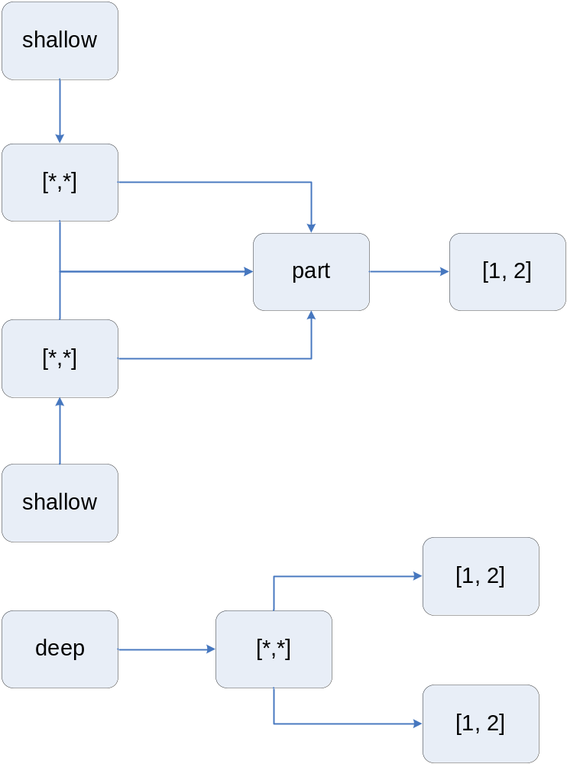

Slide 75
“is” vs. “==“
“is” means two variables refer to the same object
“==“ means that two variables or expressions refer to the same value:
>>> x = y = [1,2,3]
>>> z = [1,2,3]
>>> x is y
True
>>> x is z
False
>>> x is not z
True
>>> x == z
True

Slide 76
Conversions
Can convert other sequences to a list:
>>> s = "hello"
>>> list(s)
['h', 'e', 'l', 'l', 'o']
>>> t = (1, "two")
>>> list(t)
[1, 'two']
>>> list({1:'a', 2:'b'})
[1, 2]

Slide 77
Dictionaries
Dictionaries are unordered
  They are stored in a manner that guarantees fast retrieval later on
    They use hash tables
You can have only one instance of each key
  You can change its associated value
  You can remove its paired entry altogether

Slide 78
Dictionary Methods
has_key(x) (can also use “in”)
keys( )
values( )
items( ) (returns list of pairs)
copy( ) (shallow copy)
d1.update(d2) (merge 2 dictionaries)
get(key, def = None)
setdefault( ) (= get( ) + create)
popitem( ) Removes random item
Use del to remove elements by key

Slide 79
Dictionary Example
>>> d = {1:'a', 2:'b'}
>>> d[3] = 'c'
>>> d
{1: 'a', 2: 'b', 3: 'c'}
>>> d.has_key(2)
True
>>> d.has_key(4)
False
>>> 2 in d
True
>>> d.keys()
[1, 2, 3]
>>> d.values()
['a', 'b', 'c']
>>> d.items()
[(1, 'a'), (2, 'b'), (3, 'c')]
>>> d2 = {4:'d', 5:'e'}
>>> d.update(d2)
>>> d
{1: 'a', 2: 'b', 3: 'c', 4: 'd', 5: 'e'}
>>> d.get(1)
'a'
>>> d.get(10)
>>> d.get(10, 'j')
'j'
>>> d.setdefault(10, 'j')
'j'
>>> d
{1: 'a', 2: 'b', 3: 'c', 4: 'd', 5: 'e', 10: 'j'}

Slide 80
Making a Dictionary From Two Sequences
>>> dict(zip('abc',[1,2,3]))
{'a': 1, 'c': 3, 'b': 2}
Think “zipper”
  Items are interleaved in sequence order

Slide 81
Iterators
An iterator is an object that allows you to traverse a data structure
  Like with a for-loop
  Can also call .next( )
Map has the itervalues( ) method:
>>> it = d.itervalues()
>>> for x in it: print x,
...
a b c d e j
There are also: iteritems( ), iterkeys( )

Slide 82
Dictionary Formatting
You can reference dictionary values by their key in a format string:
words = {'noun1':'house', 'noun2':'mouse'}
print "In this %(noun1)s there is a %(noun2)s." % words
In this house there is a mouse.

Slide 83
Exercise
If you didn’t do the extra credit phone book exercises from before, do it now
Read a text file and report how many occurrences of each word there are.

Slide 84
Tuples and Files

Slide 85
Tuples
A tuple is a fixed-length, immutable sequence
  Length is fixed at creation
  Immutability is important for maintaining program integrity
    Especially in multi-threaded situations
Used to return multiple function values
  Like divmod( )
Can be nested, like lists
Hold references, like lists do

Slide 86
Tuple Example
>>> folks = ('bob',)
>>> folks += ('carol',)
>>> folks('bob', 'carol')
>>> folks += ('ted', 'alice')
>>> folks('bob', 'carol', 'ted', 'alice')
>>> 2*folks
('bob', 'carol', 'ted', 'alice', 'bob', 'carol', 'ted', 'alice')
>>> theTuple = ((1,2), ((3,4,5),6), 7)
>>> theTuple[1]
((3, 4, 5), 6)
>>> theTuple[1][0]
(3, 4, 5)
>>> theTuple[1][0][:2]
(3, 4)
>>> tuple([1,2,3])(1, 2, 3)

Slide 87
Exercise
Write a Python script to read a number, n, from the console (using input( )), and prints the first n Fibonacci numbers (0, 1, 1, 2, 3, 5, 8, 13, …). Assume that n > 2.

Slide 88
Files
Objects that support reading and writing files
  Simultaneously if needed
The file methods process byte strings
You can also use print to read and write objects other than strings
File objects are iterable
  Iterates on text lines

Slide 89
File Methods
open(<fname>, <mode> = ‘r’) (= file( ))
read( ) (whole file into a string)
read(n) (n bytes)
readline( ) (next line)
readlines() (all lines; also xreadlines( ))
write(s)
writelines(L)
close( )

Slide 90
File Example
>>> f = open('test.dat','w')
>>> f.write('This is line 1\n')
>>> lines = ['line 2 start', ' line 2 end\n', 'line 3\n']
>>> f.writelines(lines)
>>> f.close()
>>> lines = open('test.dat').readlines()
>>> lines
['This is line 1\n', 'line 2 start line 2 end\n', 'line 3\n']
>>> for line in lines: print line,
...
This is line 1
line 2 start line 2 end
line 3

Slide 91
Using the print Statement
>>> f = open('out.dat','w')
>>> print >> f, 1, 2
>>> f.close()
>>> s = open('out.dat').read()
>>> x,y = tuple(map(eval,s.split()))
>>> x,y
(1, 2)

Slide 92
File Iteration
>>> for line in open('test.dat'): print line,
...
This is line 1
line 2 start line 2 end
line 3
>>> list(open('test.dat'))
['This is line 1\n', 'line 2 start line 2 end\n', 'line 3\n']
>>> line1,line2,line3 = open('test.dat')
>>> line1
'This is line 1\n'
>>> line2
'line 2 start line 2 end\n'
>>> line3
'line 3\n'

Slide 93
Exercise
Write a program that prints out the number of characters, words, and lines in a text file

Slide 94
Exercise
Repeat the word frequency program, but print out the 10 most-frequently occurring words and their count, for example as follows:
the: 101
a: 54
to: 46
string: 46
in: 44
i: 40
and: 38
of: 35
is: 22
for: 22

Slide 95
Statements and Control Structures

Slide 96
Programs
Python programs are made of modules
  Including one main module (the one you launch)
  Modules may be gathered into packages
Modules are made up of statements
Statements consist of keywords and/or expressions
Program => Modules => Statements

Slide 97
Statements
Statements are executed for their side effects
  Defining functions or classes
  Printing something
  They typically return no value
They are often made up of expressions
  Like operations on objects

Slide 98
Python Statements
Assignments
Control flow
  if, while, for, break, continue, return, yield
Exceptions
  assert, try, raise
Definitions
  def (functions), class
Namespaces
  import, global
Miscellaneous
  pass, del, print, exec

Slide 99
The if statement
Syntax:
  if <condition>:
  <suite> (= indented group of statements)
  elif <condition>:
  <suite>
  …
  else
  <suite>
Indentation is critical!
  Unless you have a 1-liner

Slide 100
Long Lines
Since Python is line-oriented, long lines can be a problem
Fixes:
  Paired delimiters ({ },( ),[ ]," ") can span lines
  Lines ending with a backslash are joined in to a single line

Slide 101
“Case” Statement
Doesn't exist in Python
Either use if … elif … else or dictionaries
The following two slides are equivalent

Slide 102
Multi-way Branching
Using if
>>> if age < 20:
... print 'Just a baby'
... elif age < 40:
... print 'In your prime'
... elif age < 60:
... print 'Getting up there'
... elif age < 80:
... print 'Golden years'
... else:
... print 'Really?'

Slide 103
Multi-way Branching
Using a Dictionary
>>> d = {0:'Just a baby', 1:'In your prime', 2:'Getting up there', 3:'Golden years'}
>>> d.get(age//20, 'Really?')

Slide 104
Boolean Expressions
“Truth Statements”
They govern if statements and loops
They can be assigned to variables
Any non-zero number or non-empty object evaluates to True
Zero, empty objects, and None are False

Slide 105
Logical Connectives
and
  Both conditions must be True
or
  At least one condition must be True
These are short-circuited
not
  Negates the truth value of the expression

Slide 106
Compound Idioms
if a < b < c is equivalent to:
if a < b and b < c
What is the result of a or b?
  For example, 2 or 3
What is the result of a and b?
[ ] and { }?
3 or [ ]?
A or B or C or None?

Slide 107
Loops
for <item> in <iterable object>
while <condition>:
<suite>
  Continues until the condition becomes False
  Tests first before executing the block

Slide 108
Exiting Loops
Usually exit when iteration is exhausted or condition becomes False
Can exit early with break
Can skip the rest of the current iteration with continue
If the loop completes, an optional else block executes

Slide 109
pass
An empty placeholder (“empty block”)
  if (x < 0):
  pass
  else:
  …
Useful when defining methods in classes

Slide 110
Exercises
Print out every other element of a list

Slide 111
Functions

Slide 112
Topics
Defining Functions
Parameter Lists
Generators and Generator Expressions
Scope
  Namespaces
  Global names
  Nested Functions
Dynamic and Anonymous Functions
Functional programming

Slide 113
Terminology
A “parameter” is the name used in the function definition
  Sometimes called “formal parameter”
An “argument” is the value sent to the function when it is called
  Also called “actual parameter”

Slide 114
Defining Functions
Use the def statement:
def <func_name>(<args>):
<body>
Follows normal indentation rules

Slide 115
A Fibonacci Function
#Returns the nth Fibonacci number
def fibonacci(n):
curr,prev = 0,1
for i in range(n):
curr,prev = prev+curr,curr
return curr
# Note: We didn't "declare" n to be int

Slide 116
Parametric Polymorphism
If a function can take different types of parameters, it is called “polymorphic”
  In particular, it exhibits “parametric polymorphism”
    There are other types of polymorphism
    Python functions are by nature polymorphic
  A single interface (function definition) is a gateway to different implementations
This is also called “duck typing”
  “If it looks like a duck, quacks like a duck,…”

Slide 117
A Better Example
Python’s min( ) function
Can process sequences of any type
  The sequence must contain objects that can be compared compatibility
  For example, not a mixture of numbers and strings
The contained type(s) must just support a less-than operator
Let’s write it!

Slide 118
A min( ) function
def mymin(stuff):
smallest = stuff[0]
for x in stuff[1:]:
if x < smallest: smallest = x
return smallest
print mymin([4,3,2,1])
print mymin(['how','now','brown','cow'])
Output:
1
brown

Slide 119
Passing Parameters
Can have as many as you want
Parameters can have default values
Parameters can be accessed by name or positionally
The number of parameters can vary
Each argument is assigned to its corresponding parameter
  So the original binding at the call point is undisturbed (no pass-by-reference like C++)

Slide 120
Default Arguments
Assign a value to the parameter in the function definition
Only used if omitted by the caller
Example on next slide
Only use immutables!
  The default value is stored only once when the def statement is seen

Slide 121
Using Default Arguments
#mytime.py
def to_secs(hours, mins = 0, secs = 0):
return hours*3600 + mins*60 + secs
print to_secs(2)
print to_secs(2,3)
print to_secs(2,3,4)
Output:
7200
7380
7384

Slide 122
Parameters as Keywords
Sometimes functions can have many parameters
  Their order can be hard to remember
If you know their names, you can use them explicitly in the call
  And not worry about the order
See next slide

Slide 123
Using Parameters as Keywords
#keyparms.py
def displayStuff(name, address, city, zip, phone):
print 'Name =', name
print 'Address =', address
print 'City =', city
print 'Zip =', zip
print 'Phone =', phone
displayStuff(name='john doe', address='some street',\
city='somewhere', phone='123-4567‘,\
zip='98765')
displayStuff('john doe', 'some street',\
city='somewhere', phone='123-4567',\
zip='98765')

Slide 124
Variable-length Argument Lists
Arguments passed to a function can be collected into a tuple
You just process the tuple on the receiving end
Uses an asterisk before the param name
  The name is arbitrary, of course, but many people use ‘parms’, ‘args’, or ‘rest’
See next slide

Slide 125
Using Variable-length Arg Lists
#print_parms.py
def print_parms(*parms):
print parms
def print_parms2(*parms):
for x in parms:
print x
def mymax(*parms):
return max(parms)
print_parms(1,2,3)
print_parms2(1,2,3)
print mymax(1,2,3)
Output:
(1, 2, 3)
1
2
3
3

Slide 126
Going the Other Way
You can unpack a tuple at the call site
  Just use the asterisk there
  It calls the function as if you had provided comma-separated arguments
  They are unpacked in tuple order
Example:
>>> pair = (2,3)
>>> pow(*pair)
8

Slide 127
Variable-length Key-value Pairs
Allows a variable-length set of keyword parameters
Passes a dictionary instead of a tuple
Uses a double-asterisk (**parms)
See next slide

Slide 128
Using **parms
#keyparms2.py
def displayStuff(extra='', **stuff):
print 'Name =', stuff['name']
print 'Address =', stuff['address']
print 'City =', stuff['city']
print 'Zip =', stuff['zip']
print 'Phone =', stuff['phone']
if extra and stuff.has_key(extra):
print stuff[extra]
displayStuff(name='john doe', address='some street',\
city='somewhere', phone='123-4567',\
zip='98765')
displayStuff('state',name='john doe',address='some street',\
city='somewhere', phone='123-4567',\
zip='98765',state='oblivion')

Slide 129
Going the Other Way
You can pass a dictionary at the call site
It is unpacked into arguments by their names
  Like the “keyword” approach mention earlier
See next slide

Slide 130
All About Call Conventions
#hello.py
def hello(name = 'world', greeting = 'hello'):
print '%s, %s!' % (greeting, name)
hello()
hello(name = 'joe')
hello(name = 'joe', greeting = 'get lost')
stuff = ('jane','hello')
hello(*stuff)
stuff = {'name':'cruel world', 'greeting':'goodbye'}
hello(**stuff)

Slide 131
Exercises
Write a function named superpower that will raise its arguments to powers in succession. For example, the call superpower(2,3,4) computes 2**3**4, and superpower(2,3,4,5) computes 2**3**4**5. Remember that this operator associates right-to-left.

Slide 132
Exercise
Write a recursive version of superpower.

Slide 133
Generators
Defines an iterable object with function syntax
  Returns a “generator”
  Can call the next( ) explicitly, or can just iterate over it
Use yield instead of return
Each “call” to the generator starts where the last call left off

Slide 134
Generator Example
def countgen():
"""An infinite count generator"""
count = 0
while True:
count += 1
yield count
f = countgen()
f
<generator object at 0x00C3E878>
f.next()
1
f.next()
2
f.next()
3
del f

Slide 135
A Fibonacci Generator
def fibgen(n):
"""Generates (with yield) each successive fibonacci number"""
curr,prev = 0,1
for i in range(n):
yield curr
curr,prev = prev+curr,curr

Slide 136
A Fibonacci Generator
Output
f = fibgen(5)
f.next()
0
f.next()
1
f.next()
1
f.next()
2
f.next()
3
# Another call to next() would raise an exception
for n in fibgen(5): print n,
0 1 1 2 3

Slide 137
Generator Expressions
Similar to list comprehensions
Defines generators on-the-fly
For simple generators
  yield is not used
  The iteration is implicit from the generated sequence
Just place the expression in parentheses

Slide 138
Generator Expression Example
nums = (i*i for i in range(5))
nums.next()
0
nums.next()
1
nums.next()
4
nums.next()
9
nums.next()
25
nums = (i*i for i in range(5))
sum(nums)
30
sum(nums)
0

Slide 139
Scope
The region of code where a name is visible
Each scope has a “namespace”
  A dictionary that holds bindings of variables to values
When a name appears in code, its binding is looked up
  If the name is not in the current (local) namespace, the enclosing scopes are searched

Slide 140
Scope Creation
A scope is created for every:
  Module
    This is the “global” namespace
  Function
    This is a “local” namespace
  Class
    Discussed later
  Class instance (object)
    ditto

Slide 141
The LEGB Rule
First, the current (“local”) scope’s namespace is searched
  A local name “hides” an identical non-local name
If the name is not found, its enclosing scope’s namespace is searched
  This could be a function or the global (“top-level”) scope
Finally, the built-in namespace is searched
The vars( ) function returns local bindings

Slide 142
Scope Example
#scope.py
a = 1
n = 1
def f(n):
print 'In f, a =', a, 'and n =', n, vars()
f(10)
print vars()
""" Output:
In f, a = 1 and n = 10 {'n': 10}
{'a': 1, 'f': <function f at 0x00AEFE30>, '__builtins__': <module '__builtin__' (built-in)>, 'n': 1, '__name__': '__main__', '__doc__': None}"""

Slide 143
The Effect of import
An alternate form of the import statement does more than just load a module
  It injects all the top-level bindings from the imported module into the current module
  Use wisely
See next slide

Slide 144
from <module> import *
#import.py
"Shows the effect of 'from <module> import ...'"
from math import *
def f():
print vars() # prints {}
print vars() # prints everything in math!
print '\nExecuting f...'
f()

Slide 145
Modifying Global Variables
(Generally not a good practice!)
Remember that an assignment introduces a new binding
You need some special feature to modify a global variable
Note: you can’t directly modify any non-local variables other than globals
See next slide

Slide 146
The global Statement
#global.py
a = 2
def f():
global a
print vars() # {}
a = 4
print a # 2
f()
print a # 4

Slide 147
Another Scope Example
#scope2.py
a = 1
n = 1
def f(n):
print 'In f, a =', a, 'and n =', n, vars()
def g(a):
print 'In g, a =', a, 'and n =', n, vars()
g(5)
f(10)
print vars()

Slide 148
Output
In f, a = 1 and n = 10 {'n': 10}
In g, a = 5 and n = 10 {'a': 5, 'n': 10}
{'a': 1, 'f': <function f at 0x00AEFFB0>, '__builtins__': <module '__builtin__' (built-in)>, 'n': 1, '__name__': '__main__', '__doc__': None}

Slide 149
Nested Functions
Note that f’s binding of a appeared in the namespace for g
  That’s because g used f’s a
  If it didn’t, vars( ) would’ve just mentioned n
This packaging of needed non-local bindings in nested functions is called a closure
It really matters when a function is returned as a value

Slide 150
Functions as Objects
#closure.py
def addn(n):
def g(x):
return x + n
return g
f = addn(5)
print f(1) # 6
print f(2) # 7

Slide 151
Anonymous Functions
Note that g needed addn’s binding of n
Note also that the name g is not really needed outside of addn
  In fact, it’s not needed at all!
You can create simple, unnamed functions on-the-fly for cases just like this
  With a lambda expression
  The name is historical
See next slide

Slide 152
Using lambda
#closure2.py
def addn(n):
return lambda x: x+n
f = addn(5)
print f(1) # 6
print f(2) # 7

Slide 153
Customizing sort( ) with lambda
The built-in sort( ) function takes an optional comparison function
  The default is the built-in cmp( )
  cmp( ) takes two arguments and returns:
    Negative if the numbers are in order
    Zero if they’re equal
    Positive if they’re out of order
You can provide your own function
  See next slide

Slide 154
sort( ) Example
#sort.py
stuff = [1,2,3,4,5]
stuff.sort(lambda x,y: y - x)
print stuff # [5, 4, 3, 2, 1]

Slide 155
The def Statement is Executable
You can create functions on-the-fly!
  Meaning at runtime
Create a string containing a def statement
Call exec( )
You’ve got your function!
(See next slide)

Slide 156
Functions On The Fly
s = """def f(x):
return x+2
"""
s
'def f(x):\n return x+2\n‘
exec(s)
f
<function f at 0x00AEFEB0>
f(3)
5

Slide 157
Functional Programming
A style of programming that focuses on functions
  They are passed as parameters and returned from functions
Some support functions make it very powerful
  map, reduce, filter
Overlaps in applicability somewhat with list comprehensions

Slide 158
A Functional Programming Session
>>> map(lambda x: -x, [1,2,3])
[-1, -2, -3]
>>> import operator
>>> reduce(operator.add, map(lambda x: -x, [1,2,3]))
-6
>>> map(lambda x: reduce(operator.add, x), [(1,2), (3,4)])
[3, 7]
>>> filter(lambda x: x > 2, [1,2,3])
[3]
>>> filter(lambda x: x > 2, [1,2,3,4])
[3, 4]
>>> [x for x in [1,2,3,4] if x > 2] # list comprehension
[3, 4]
>>> [x+y for x in [1,2,3,4] for y in [5,6,7] if x > 2 if y > 5]
[9, 10, 10, 11]
# same as [3+6, 3+7, 4+6, 4+7]

Slide 159
A More Dynamic Example
Reads data and code as strings (from a file)
Converts the data to numbers, the code strings to functions
Applies the functions to the list preceding it in the file
That’s dynamic computer programming!

Slide 160
The File fdata
1 2 3 4
lambda (x): x+2
5 6 7 8
lambda (y): y*y
9 10 11 12
lambda (z): exp(z) - 2*z

Slide 161
The Execution
#processlists.py
from math import exp
f = open('c:/fdata')
for x in f:
s = map(eval, x.split())
print map(eval(f.next()), s)
""" Output:
[3, 4, 5, 6]
[25, 36, 49, 64]
[8085.0839275753842, 22006.465794806718, 59852.141715197817, 162730.79141900392]"""

Slide 162
Programming Assignment #1
Write a function named sentence( ) that generates random sentences according to the following grammar:
<S> => the <NP> <VP>
<NP> => <N> | <ADJ> <NP>
<VP> => <V> | <V> <ADV>
<N> => dog | cat | professor | student | rat
<V> => ran | ate | slept | drank
<ADJ> => red | slow | dead
<ADV> => quickly | happily | well
You can just define the words above as lists:
    nounlist = ['dog','cat','professor','student','rat']
    verblist = ['ran','ate','slept','drank']
    adjlist = ['red','slow','dead']
    advlist = ['quickly','happily','well']

Slide 163
Programming Assignment #1
(continued)
As you can by the grammar above, a sentence is just the word “the” followed by a noun-phrase followed by a verb-phrase. A verb-phrase is either a verb or a verb followed by an adverb. A noun-phrase is either a noun or an adjective followed by a noun-phrase(!). Write functions named verbphrase( ) and nounphrase( ) that are called by sentence. Note that nounphrase( ) is recursive. You also will want to use the function randrange( ) in the random module. Here is the output from several successive calls to sentence( ):
The rat slept well.
The slow dead professor drank well.
The dog drank quickly.
The dead dead slow cat slept quickly.

Slide 164
Programming Assignment #2
Write a function xref(s) that reads the text file named by s line by line and returns a dictionary with each word in the file as a key paired with a list of the line numbers where the word appears. Use xref to print out a cross-reference listing, which lists each word in alphabetic order, ignoring case. Here is what the output should resemble:
A : [48]
a : [9, 10, 12, 14, 17, 19, 26, 27, 28, 39, 41, 43, 45, 46, 49, 50, 51, 56, 81, 82, 94, 111, 112, 114, 117, 132, 135, 138, 142, 143, 144, 152, 156, 161, 163, 164, 167, 169, 175, 182, 190, 192]
about : [16, 29, 166, 190, 191]
…
yet : [191]
Yet : [181]
You : [45, 169]
you : [19, 41, 44, 81, 90, 112, 113, 134, 135, 143, 148, 170, 174, 179, 188, 190]

Slide 165
Object-oriented Programming

Slide 166
Topics
Classes
Inheritance
Accessibility and Properties
Static methods vs. Class methods
Bound vs. Unbound methods
Decorators
Operator Overloading

Slide 167
Classes
Like other languages, classes are a way of defining new types
What do we mean by “type”?
  A thing that contains attributes
  Can be data or functions
    Functions are objects!
  Modules do this too!

Slide 168
What’s Different About Classes vs. Modules
Functions defined inside classes are called methods
  They are called via obj.method( ) syntax
  The object is implicitly passed as the first parameter to the method
Name lookup traverses up the inheritance graph until the name is found
  In a well-defined order (bottom-top/left-right)
Most languages behave similarly

Slide 169
Defining Classes
The class statement
Evaluated at runtime
  Like everything else in Python
A class object is created
The class object is a factory:
  You “call” it to create instances
Example starts on next slide

Slide 170
An Animal Class
class Animal(object):
def __init__(self, name):
self.name = name
def speak(self): # could just omit
raise "speak method unspecified"
def whoAmI(self):
return self.name

Slide 171
Things to Note
All top-level classes should derive from the built-in class object
  Just trust me
Instance methods receive a hidden first parameter pointing to the object
  Called self by convention
Instance attributes are defined dynamically by assignment
  Like any other Python attribute

Slide 172
Special Methods
Names beginning and ending with double underscores are special
__init__( ) is a constructor
  Called to initialize an object at creation
There are many special methods
  e.g., operator overloading: __add__, __call__
We shouldn’t create Animals directly so let’s create another class:

Slide 173
Specific Animal Classes
class Dog(Animal):
def __init__(self, name):
Animal.__init__(self, name)
def speak(self):
print "Bark!"
class Antelope(Animal):
def __init__(self, name):
Animal.__init__(self, name)
def speak(self):
print "<silent>"

Slide 174
More Observations
Note the explicit calls to the Animal constructor
  It’s not done automatically
    For good reason (lookup algorithm)
  And the object reference is also passed explicitly
The speak method is overridden
  The most derived method is chosen by the lookup algorithm
  If we omitted it in a subclass, the exception in Animal would occur

Slide 175
Bringing Animals to Life
dog = Dog("Fido")
print dog.whoAmI(),':',
dog.speak()
ant = Antelope("Arnie")
print ant.whoAmI(),':',
ant.speak()
# Output:
Fido : Bark!
Arnie : <silent>

Slide 176
Binding Attributes
You can add attributes to modules, classes, and objects at any time via assignment:
  Dog.genus = ‘canus’ # class attribute
  dog.scent = ‘musty’ # instance attribute
However, if you bind a list of variable name strings to a __slots__ class attribute, then only those variables may be assigned

Slide 177
Accessibility
All names are public!
  Can cause name collisions with MI
There is a convention to “reduce” name visibility:
  Start with two underscores
  Do not use two trailing underscores
  Such names are “mangled”
    By prepending the class name
    See next slide

Slide 178
Pseudo-Private Attributes
class Controlled(object):
def __init__ (self, x, y):
self.__x = x
self.__y = y
__z = 'zee‘
def display(self):
print 'x:',self.__x,'y:',self.__y, \
'z:',Controlled.__z

Slide 179
Output
c = Controlled('ecks', 'why')
c.display()
print dir(c)
c.__x
# Output:
x: ecks y: why z: zee
['_Controlled__x', '_Controlled__y', '_Controlled__z', '__doc__', '__init__', '__module__', 'display']
Traceback (most recent call last):
File "C:\Presentations\OOPSLA\classes.py", line 106, in ?
c.__x
AttributeError: Controlled instance has no attribute '__x'

Slide 180
Properties
A way to transparently use getters and setters through data-like attribute reference
  More efficient than getters if no computation is involved
Use the property special function
  4 parms: getter, setter, deleter, doc string
  Last 3 default to None
  Omitted operations are not available

Slide 181
Properties
class HasProp(object):
def setProp (self, p):
print 'setProp trace'
self.__prop = p
def getProp (self):
print 'getProp trace'
return self.__prop
prop = property(getProp, setProp, None, None)
x = HasProp()
x.prop = 'theProperty'
print x.prop
# Output:
setProp trace
getProp trace
theProperty

Slide 182
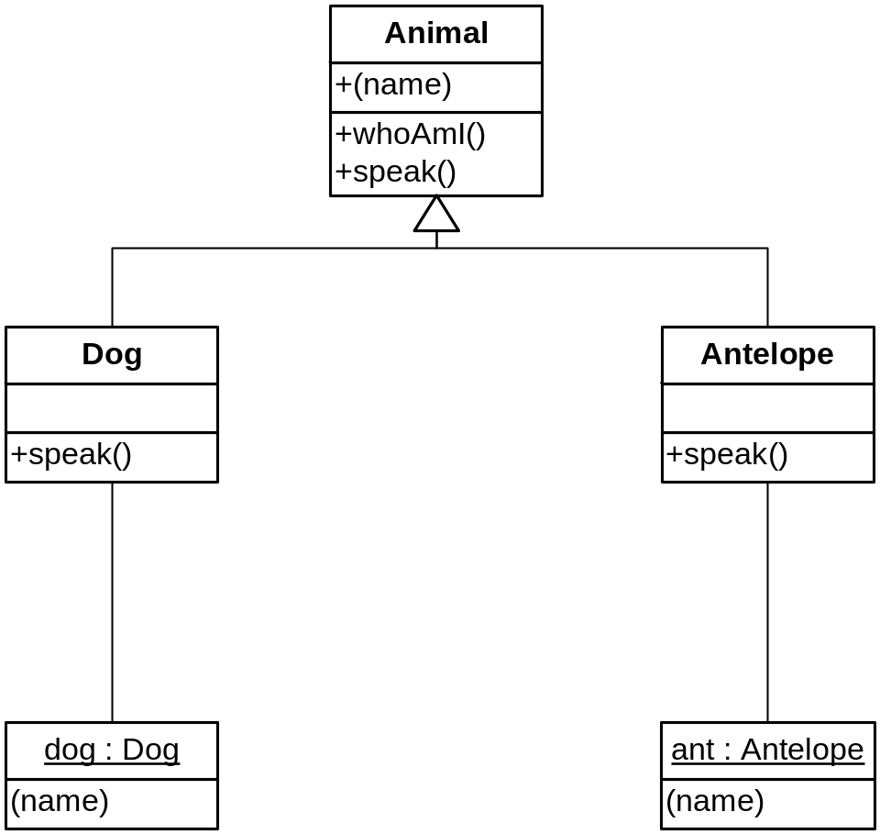
Classes are Objects

Slide 183
Classes are Objects
Objects named Animal, Dog, and Antelope exist
  Created by their respective class statements
They have a namespace (dictionary) mapping their attributes to values
  Animal has __init__, whoAmI, and speak
  But not name!
  name belongs to the object bound to self

Slide 184
Name Lookup Algorithm
When Python sees obj.attr:
  It first looks in the scope (namespace) of the object for the attribute name
  If the name is not found, and if obj is an instance of a class:
    Python looks in all superclasses, left-to-right
    The process repeats recursively up the inheritance graph
    So an object’s class and superclasses are an “enclosing scope” for qualified names

Slide 185
Multiple Inheritance
A class can have multiple superclasses
  Use a comma-separated list in the class definition
Order is important!
  Superclasses are searched left-to-right in declaration order
Example on next slide

Slide 186
A Dog and an Antelope?
class Basselope(Dog, Antelope):
def __init__(self, name):
Animal.__init__(self, name)
# Note the direct reference to Animal.__init__
bl = Basselope("Rosebud")
print bl.whoAmI(),':',
bl.speak()
# Output:
Rosebud : Bark!

Slide 187
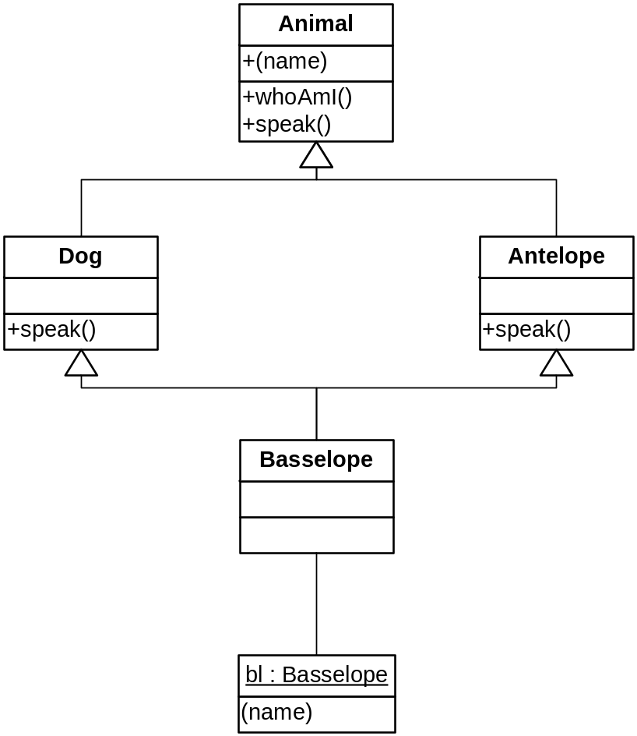
An MI Graph

Slide 188
Static Data
Assignments performed directly inside a class define static (or class) data attributes
They are added to the namespace of the class
Accessed as <class>.<attribute-name>
See next slide
Note: all attributes of a class or object must be accessed via the class or object name (e.g., self.attr) – unqualified names in methods are considered global!

Slide 189
Static Data
class Foo(object):
data = 'bar'
def __init__(self,data):
self.data = data
def display(self):
print self.data, Foo.data
foo = Foo('baz')
foo.display()
# Output:
baz bar

Slide 190
Static Methods
You can define methods that aren’t connected to an object
Normally accessed as:
  <class-name>.<method-name>
Use the @staticmethod decorator
See next slide

Slide 191
Static Stuff
class StaticStuff(object) :
foo = 1
@staticmethod
def bar () :
return StaticStuff.foo
x = StaticStuff()
print x.foo
print StaticStuff.bar()
# Output:
1
1

Slide 192
Class Methods
Do not exist in C++, Java, C#
Like static methods, you usually call them qualified by the class name
Whenever a class method is called, the class object is passed as a hidden first parameter
  Analagous to self
  cls is the conventional name

Slide 193
Class Methods
class Klass(object) :
@classmethod
def cmethod(cls, x):
print cls.__name__, "got", x
Klass.cmethod(1)
k = Klass()
k.cmethod(2)
# Output
Klass got 1
Klass got 2

Slide 194
An Application of Class Methods
Counting objects
  The logic of counting is type-independent
  How can we automatically make a class “countable”?
Need some form of inheritance, but we want a separate counter for each class
  We dynamically add a counter to each class through the class object parameter of a class method
See next slide

Slide 195
Classy Counting
class Shape(object):
__count = 0 # A shared initializer
@classmethod
def __incr(cls):
cls.__count += 1 # Create/update class attribute
@classmethod
def showCount(cls):
print 'Class %s has count: %s' % \
(cls.__name__, cls.__count)
def __init__(self): # A constructor
self.__incr()

Slide 196
Classy Counting
p1 = Point()
p2 = Point()
p3 = Point()
Point.showCount()
Line.showCount()
x = Line()
Line.showCount()
# Output:
Class Point has count: 3
Class Line has count: 0
Class Line has count: 1

Slide 197
Revisting +=
The expression cls.__count += 1 is the same as:
cls.__count = cls.__count + 1
New class Shape.__count (= 0)
(When cls.__count doesn’t exist)

Slide 198
Methods Are Objects
A method can be bound to an arbitrary variable
Two flavors:
  Unbound method (self is an open variable)
  Bound method (self object is fixed)
    Like delegates in C# and D, mem_fun in C++
    A “closure” for objects; interchangeable with functions
Handy for callbacks

Slide 199
Unbound Methods
sheba = Dog('Sheba')
op = sheba.whoAmI
print op
print op() # same as sheba.whoAmI()
# Output:
<unbound method Dog.whoAmI>
Muffy

Slide 200
Another Example
def eat (self, food):
print self.whoAmI(),'eating',food
Dog.eat = eat # Add new method to Dog!
dogs = [muffy, sheba]
food = ['melon', 'bones']
for i in range(2):
eat(dogs[i], food[i])
# Output:
Muffy eating melon
Sheba eating bones

Slide 201
Pairing Objects and Arguments
pairs = zip(dogs, food)
print pairs
for pair in pairs:
eat(*pair)
# Output:
[(<__main__.Dog object at 0x00A03090>, 'melon'), (<__main__.Dog object at 0x00A030D0>, 'bones')]
Muffy eating melon
Sheba eating bones

Slide 202
Bound Methods
sheba = Dog('Sheba')
op = sheba.whoAmI
print op
print op() # same as sheba.whoAmI()
map(muffy.eat, food)
# Output:
<bound method Dog.whoAmI of <__main__.Dog object at 0x009FF130>>
Sheba
Muffy eating melon
Muffy eating bones

Slide 203
Operator Overloading

Slide 204
Operator Functions
All operators have associated functions
  e.g., ‘+’ corresponds to __add__ and __radd__
Defining these as instance methods overloads the corresponding operator
Others: __or__, __str__, __call__, __getattr__, __setattr__, __getitem__, __setitem__, __len__, __cmp__, __lt__, __eq__, __iter__

Slide 205
Numeric Operators
class Number(object):
def __init__(self, num):
float(num) # correctness test
self.__num = num
def __add__(self, num):
if (isinstance(num, Number)):
return Number(self.__num + num.__num)
return Number(self.__num + float(num))
def __str__(self):
return '%g' % self.__num
def __neg__(self):
return Number(-self.__num)
__radd__ = __add__

Slide 206
Sample Execution
x = Number(1.2)
y = Number(3.4)
print x,y,-x
print x + y
print x + 2
print 2 + x
#Output:
1.2 3.4 -1.2
4.6
3.2
3.2

Slide 207
Indexing
The method __getitem__(self, i) is called when fetching self[i]
Likewise, __setitem__(self, i, x) processes self[i] = x
See next two slides

Slide 208
Indexing Example
class Stuff(object):
def __init__(self):
self.__data = []
def add(self, x):
self.__data.append(x)
def __getitem__(self, i):
return self.__data[i]
def __setitem__(self, i, x):
self.__data[i] = x
def display(self):
for item in self.__data:
print item,
print
def __len__(self):
return len(self.__data)

Slide 209
Indexing Example
s = Stuff()
s.add(2)
s.add('three')
s.add(4.0)
s.display()
for i in range(len(s)):
print s[i],
print
s[1] = 'one'
s.display()
# Output:
2 three 4.0
2 three 4.0
2 one 4.0

Slide 210
Iteration
You can define your own iterators
  They can be used for loops and in other iterable contexts
  Loops call iter( ) to get an iterator
The iter( ) built-in will in turn call your __iter__, or __getitem__ (in that order)
  Iteration is automatic if you define __getitem__!

Slide 211
Iteration via __getitem__
for x in s:
print x,
print
print 'one' in s
print map(None, s)
print list(s)
print tuple(s)
# Output:
2 one 4.0
True
[2, 'one', 4.0]
[2, 'one', 4.0]
(2, 'one', 4.0)

Slide 212
Using __iter__
Better for one-pass traversal than __getitem__
  You must implement a next method and maintain state
  Faster than __getitem__, since state is maintained across calls
See next slides

Slide 213
Using __iter__ and next
class MoreStuff(object):
def __init__(self):
self.__data = []
def add(self, x):
self.__data.append(x)
def __iter__(self):
self.__pos = 0
return self

Slide 214
Using __iter__ and next
def next(self):
if self.__pos == len(self.__data):
raise StopIteration
val = self.__data[self.__pos]
self.__pos += 1
return val
def display(self):
for item in self.__data:
print item,
print

Slide 215
Sample Execution
s = MoreStuff()
s.add(2)
s.add('three')
s.add(4.0)
s.display()
for x in s:
print x,
print
# Output:
2 three 4.0
2 three 4.0

