Slide 1
Sequences
The Rest Of The Story

Slide 2
Agenda
Review of Basic Sequence Operations
Slices
Tuples
Lists

Slide 3
Python Sequences
Strings
  str and unicode
Extended Range (xrange)
Generic container sequences
  tuple, list
  Note: (1) is not a tuple!
  Use (1,) instead
  But () is the empty tuple
Notes:
Python sequences are containers that hold objects in the order they are placed, and are zero-based (0 is the first element, 1 the second, etc.)
Strings contain 8-bit integers holding ASCII encodings, and unicode strings contain 16-bit integers holding UCS-2 (2-byte) Unicode encodings. They cannot, however, be treated as integers; they only support text processing
xrange objects hold integers
Tuples and lists are heterogeneous containers that can hold any Python objects

Slide 4
Basic Sequence Operations
These don’t alter the sequences
Iteration (for x in seq: …)
Membership testing (in, not in)
Indexing and slicing ([m:n:s])
Concatenation (+)
Copying and Replication
  [:], copy, deepcopy, *
len( ), min( ), max( )
Comparison (<, <=, >, >=, ==, !=, <>)

Slide 5
“Slice” Quiz
Given a = range(10)
a[::2]
a[::-2]
a[0:5:2]
a[5:0:-2]
a[:5:-1]
a[5::-1]
a[5:0:-1]
a[0:12:2]
a[0:12:-1]
a[-2:12]
a[12:-2]
Notes:
a[::2] == a[0:10:2] == [0,2,4,6,8]
a[::-2] == a[9:0:-2] = [9,7,5,3,1]
a[0:5:2] == [0,2,4]
a[5:0:-2] == [5,3,1]
a[:5:-1] == a[9:5:-1] == [9,8,7,6]
a[5:0:-1] == [5,4,3,2,1]
a[0:12:2] == a[0:10:2] == [0,2,4,6,8]
a[0:12:-1] = []
a[-2:12] == a[8:10] == [8,9]
a[12:-2] == []

Slide 6
Comparisons
>>> s
'abc'
>>> min(s)
'a'
>>> s = "abc123"
>>> min(s)
'1'
>>> max(s)
'c'
>>> t = "123abc"
>>> s < t
False
>>> s > t
True
>>> [1,2,3,4] < [3]
True
>>> (1,2,3) < (1,2,3,4)
True

Slide 7
Tuple Example
>>> folks = ('bob',)
>>> folks += ('carol',) # += creates a new tuple!
>>> folks('bob', 'carol')
>>> folks += ('ted', 'alice')
>>> folks('bob', 'carol', 'ted', 'alice')
>>> 2*folks
('bob', 'carol', 'ted', 'alice', 'bob', 'carol', 'ted', 'alice')
>>> theTuple = ((1,2), ((3,4,5),6), 7)
>>> theTuple[1]
((3, 4, 5), 6)
>>> theTuple[1][0]
(3, 4, 5)
>>> theTuple[1][0][:2]
(3, 4)
>>> tuple([1,2,3])
(1, 2, 3)

Slide 8
Tuple Assignment
>>> people = [('john','m', 42), ('jane', 'f', 38)]
>>> for name,gender,age in people:
... print name, age
...
john 42
jane 38
>>> list(enumerate(['a','fine','mess']))
[(0, 'a'), (1, 'fine'), (2, 'mess')]
>>> for i,x in enumerate(['a', 'fine', 'mess']):
... print i,x
...
0 a
1 fine
2 mess

Slide 9
Swap Idiom
x,y = y,x

Slide 10
Lists
list is the only mutable sequence
There are 9 list methods
  All but two modify the list (count and index)
  Only count and pop return a value

Slide 11
List Methods
count(x)
index(x)
append(x)
extend(L)
insert(i,x)
remove(x)
pop(i = -1)
reverse()
sort(f = cmp)
Number of x’s
Where first x is
Appends a new item
Same as +=
Inserts x at position i
Removes first x
Removes at position
Obvious!
Sorts in place

Slide 12
Using List Methods
L=[1,2,2,3,3,3]
for n in L: print L.count(n),
1 2 2 3 3 3
L.index(2)
1
L.append(5)
L
[1, 2, 2, 3, 3, 3, 5]
L.extend([5,5,5,5])
L
[1, 2, 2, 3, 3, 3, 5, 5, 5, 5, 5]
for i in range(4): L.insert(6+i, 4)
L
[1, 2, 2, 3, 3, 3, 4, 4, 4, 4, 5, 5, 5, 5, 5]

Slide 13
Using List Methods
Continued
L.reverse()
L
[5, 5, 5, 5, 5, 4, 4, 4, 4, 3, 3, 3, 2, 2, 1]
L.sort()
L
[1, 2, 2, 3, 3, 3, 4, 4, 4, 4, 5, 5, 5, 5, 5]
L.remove(3)
L
[1, 2, 2, 3, 3, 4, 4, 4, 4, 5, 5, 5, 5, 5]
L.pop()
5
L.pop(4)
3
L
[1, 2, 2, 3, 4, 4, 4, 4, 5, 5, 5, 5]

Slide 14
Slice Assignment
You can replace a list slice (sublist) with elements from another sequence
  Any sequence may appear on the right
List may grow or shrink
You remove a slice with [ ] on the right
  You can also remove a slice with del
You insert a sublist with an empty slice on the left

Slide 15
Using Slice Assignment
x = [1,2,3,4]
x[1:3] = [22,33,44]
x
[1, 22, 33, 44, 4]
x[1:4] = [2,3]
x
[1, 2, 3, 4]
x[1:1] = (100, 200) # Note tuple
x
[1, 100, 200, 2, 3, 4]
x[1:2] = []
x
[1, 200, 2, 3, 4]
del x[1:2]
x
[1, 2, 3, 4]

Slide 16
Prepending to a List
>>> x = [1,2,3,4]
>>> x[:0] = [-1, 0] # Same as x[0:0] = …
>>> x
[-1, 0, 1, 2, 3, 4]

Slide 17
Slice Assignment with Strides
Non-contiguous Replacement
>>> x = [1,2,3,4]
>>> x[::2] = ['x','y'] # Same as x[0:4:2] = …
>>> x
['x', 2, 'y', 4]
>>> x[::2] = ['x','y', 'z']
Traceback (most recent call last):
File "<stdin>", line 1, in ?
ValueError: attempt to assign sequence of size 3 to extended slice of size 2

Slide 18
The Meaning of +=
It’s conceptually the same as + followed by replacement (via assignment)
  But it’s generally more efficient
You can append any type of sequence to a list
  But not to tuples or strings (types must match)
  It appends each element of the sequence
  It creates a new object with the other sequences
See next slide

Slide 19
Using +=
x = []
x += (1,2,3)
x
[1, 2, 3]
x += "abc"
x
[1, 2, 3, 'a', 'b', 'c']
x += [4,(5,6),'seven']
x
[1, 2, 3, 'a', 'b', 'c', 4, (5, 6), 'seven']
>>> y = (1,2)
>>> id(y)
10362272
>>> y += (3,4)
>>> y
(1, 2, 3, 4)
>>> id(y)
10077120

Slide 20
List Comprehensions
A powerful list-creation facility
Builds a list from an expression
>>> x = [x*x for x in range(1,11)]
>>> x
[1, 4, 9, 16, 25, 36, 49, 64, 81, 100]
>>> [i for i in range(20) if i%2 == 0]
[0, 2, 4, 6, 8, 10, 12, 14, 16, 18]

Slide 21
Nested List Comprehensions
>>> set1
'abc'
>>> set2
(1, 2, 3)
>>> cartesian = [(x,y) for x in set1 for y in set2]
>>> for pair in cartesian: print pair
...
('a', 1)
('a', 2)
('a', 3)
('b', 1)
('b', 2)
('b', 3)
('c', 1)
('c', 2)
('c', 3)

Slide 22
Using zip( )
>>> nums = [1,2,3,4]
>>> fruit = ["Apples", "Peaches", "Pears", "Bananas"]
>>> print [(i,f) for i in nums for f in fruit if f[0] == "P"]
[(1, 'Peaches'), (1, 'Pears'),
(2, 'Peaches'), (2, 'Pears'),
(3, 'Peaches'), (3, 'Pears'),
(4, 'Peaches'), (4, 'Pears')]
>>> print [(i,f) for i in nums for f in fruit if f[0] == "P" if i%2 == 1]
[(1, 'Peaches'), (1, 'Pears'), (3, 'Peaches'), (3, 'Pears')]
>>> zip(nums,fruit)
[(1, 'Apples'), (2, 'Peaches'), (3, 'Pears'), (4, 'Bananas')]
>>> print [i for i in zip(nums,fruit) if i[0]%2==0]
[(2, 'Peaches'), (4, 'Bananas')]

Slide 23
Copying Lists
Assigning one list to another makes no copies
  A new variable referring to the original list is created and bound to the original list
If you want a copy, there are several ways:
  Use the [:] syntax # shallow copy
  copy.copy( ) # shallow copy
  copy.deepcopy( ) # deep copy

Slide 24
Copying Lists
Example
>>> part = [1,2]
>>> whole = [part, part]
>>> shallow = whole[:] # not shallow = whole
>>> deep = copy.deepcopy(whole)
>>> del part[0]
>>> part
[2]
>>> whole
[[2], [2]]
>>> shallow
[[2], [2]]
>>> deep
[[1, 2], [1, 2]]

Slide 25
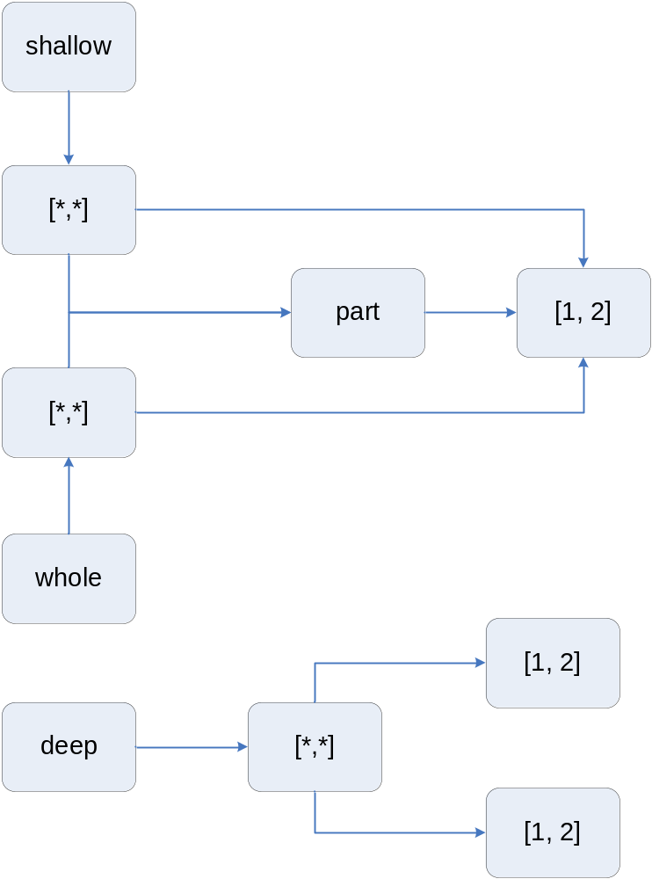

Slide 26
“is” vs. “==“
“is” means two variables refer to the same object
“==“ means that two variables or expressions refer to the same value:
>>> x = y = [1,2,3]
>>> z = [1,2,3]
>>> print id(x), id(y), id(z)
11100928 11100928 10383032
>>> x is y
True
>>> x is z
False
>>> x is not z
True
>>> x == z
True

Slide 27
Conversions
Can convert other sequences to a list:
>>> s = "hello"
>>> list(s)
['h', 'e', 'l', 'l', 'o']
>>> t = (1, "two")
>>> list(t)
[1, 'two']
>>> list({1:'a', 2:'b'}) # keys only
[1, 2]

Slide 28
Exercise
1) Stack
Write an interactive program that uses a list as a stack (last-in-first-out structure). The user commands are:
  push <expression>
  pop
  trace
  Any other string quits
It is easiest if the “top” of the stack is the end of the list
Sample session on next page

Slide 29
Sample Stack Session
C:\FreshSources\Symantec\Python07>python stack.py
Enter a command: push 1
Enter a command: trace
[1]
Enter a command: push 'two'
Enter a command: trace
[1, 'two']
Enter a command: push 1+1+1
Enter a command: trace
[1, 'two', 3]
Enter a command: pop
3
Enter a command: quit
[1, 'two']

Slide 30
Exercise
2) Fibonacci Numbers
Write a Python script that reads a number, n, from the console and then prints the first n Fibonacci numbers (0, 1, 1, 2, 3, 5, 8, 13, …). Assume that n > 2.
  As you can see, the first two Fibonacci numbers are 0 and 1
  Each succeeding number is the sum of the previous two

Slide 31
Exercise
3) Text Pairing
Write code that reads two lists of strings from the console, and forms a new list of all possible pairs of strings, where the first comes from the first list, likewise the second. Only include pairs where both of the strings contain the letter ‘e’.
Sample execution:
C:\FreshSources\Symantec\Python07>python common.py
Enter the first list: ['now','is','the','time']
Enter the second list: ['for','all','sentient','beings']
[('the', 'sentient'), ('the', 'beings'), ('time', 'sentient'), ('time', 'beings')]

Slide 32
Question
Suppose you have a list, x, and you want to append x to itself
For example, if x = [1,2], then you want to obtain [1,2,[1,2]]
How can you do this?
Notes:
What you want is to append a copy of x, of course: x.append(x[:]).

