Slide 1


Understanding Java Threads
Chuck Allison
Utah Valley State College
C/C++ Users Journal
www.freshsources.com

Slide 2
Resources
Thinking in Java, 3rd Edition, Eckel
The Java Prog. Lang, 3rd Ed., Arnold+
Java Threads, 2nd Ed., Oaks & Wong
Effective Java, Bloch
Taming Java Threads, Holub
Concurrent Prog. in Java, 2nd Ed., Lea

Slide 3
The Benefits of Threads
Effectively use system resources
  threads run in a single process (no IPC)
  share same address space (caveat!)
Concurrent programming
  independent tasks can run independently
    from your code’s point of view
    good design
    enables true parallelism on MP machines
    responsive user interfaces

Slide 4
The Challenges of Threads
Tricky to program correctly!
Must synchronize access to shared data
  Competition Synchronization
    Prevent simultaneous access to data
  Cooperation Synchronization
    Allow threads to work together
Must prevent deadlock
  can easily occur when sharing multiple resources

Slide 5
The Java Threading Model
Simple, High-level approach
Provides:
  a Thread class
    and a Runnable interface
  simple locks for synchronizing access to code
  inter-thread communication

Slide 6
What is a Thread?
A path of execution in a program
  shares CPU(s) with other threads
  keeps sufficient context for swapping
java.lang.Thread class
  override run( ) method
  call thread.start( )
  terminates when your run( ) returns

Slide 7
A First Example
// Illustrates Independent Threads
class MyThread extends Thread
{
private int count;
public MyThread(String name, int count)
{
super(name); // Optional thread name
this.count = count;
}
public void run()
{
for (int i = 0; i < count; ++i)
System.out.println(getName());
}
}

Slide 8
Main Program (launches 2 threads)
public class Independent
{
public static void main(String[] args)
{
Thread t1 = new MyThread("DessertTopping", 8);
Thread t2 = new MyThread("FloorWax", 4);
t1.start();
t2.start();
}
}
Note: There are 3 threads in this example – the main thread
launched by the JVM, and the other two launched inside main( ).

Slide 9
Output
(Dependent on platform and environment - YMMV)
DessertTopping
DessertTopping
DessertTopping
FloorWax
DessertTopping
FloorWax
DessertTopping
FloorWax
DessertTopping
FloorWax
DessertTopping
DessertTopping

Slide 10
Blocking I/O
Note that the calls to println( ) run uninterrupted
I/O is a blocking operation
  The thread waits until it completes
  Other threads may run, but the I/O will be undisturbed
    Reason: I/O is coarse-grained native code
JDK 1.4 java.nio provides non-blocking I/O
  Buffers, channels, selectors, for more fine-grained control
    One thread can manage multiple connections

Slide 11
Thread State
New
  after creation but before start( )
Alive
  Runnable
    running or swapped out by scheduler
  Blocked
    sleeping
    waiting for I/O, a lock, a notify, or a join
Dead
  run( ) has returned, or
  an uncaught exception occurred

Slide 12
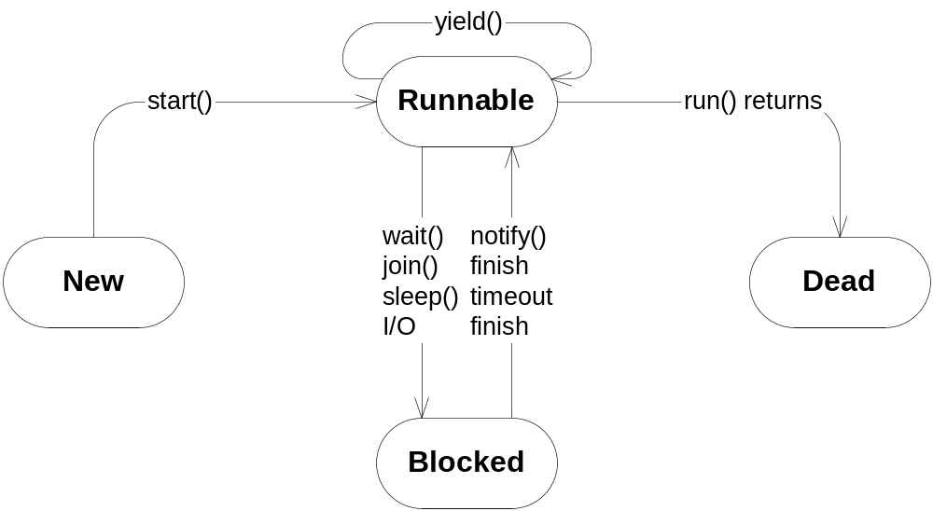
Thread State

Slide 13
Interleaved I/O with print( )
class MyThread extends Thread
{
// <snip>
public void run()
{
for (int i = 0; i < count; ++i)
{
display(); // Replaces println()
}
}
void display()
{
String s = getName();
for (int i = 0; i < s.length(); ++i)
System.out.print(s.charAt(i));
System.out.println();
}
}

Slide 14
Output (interleaved – oops!)
DessertTopping
DFloorWax
FloorWax
FloorWax
FloorWessertTopping
Desax
sertTopping
DessertTopping
DessertTopping
DessertTopping
DessertTopping
DessertTopping

Slide 15
Typical java.lang.Thread Methods
start( )
sleep( ) (static – for current thread)
  for a given time; let’s other threads run
join( )
  waits for another thread to complete
yield( ) (static – for current thread)
  let’s threads of equal or higher priority run (a hint)
interrupt( )
  set’s a flag in a thread object
isAlive( )
isInterrupted( )
interrupted( ) (static – for current thread)

Slide 16
From Effective Java
“The only use that most programmers will ever have for Thread.yield is to artificially increase the concurrency of a program during testing.”

Slide 17
// Illustrates Thread.sleep()
class MyThread extends Thread
{
private int delay;
private int count;
public MyThread(String name, int delay, int count)
{
super(name);
this.delay = delay;
this.count = count;
}
public void run()
{
for (int i = 0; i < count; ++i)
{
try
{
Thread.sleep(delay);
System.out.println(getName());
}
catch (InterruptedException x)
{}
}
}
}

Slide 18
class Independent2
{
public static void main(String[] args)
{
Thread t1 = new MyThread("DessertTopping",
100, 8);
Thread t2 = new MyThread("FloorWax", 50, 4);
t1.start();
t2.start();
}
}

Slide 19
Output
FloorWax
DessertTopping
FloorWax
FloorWax
DessertTopping
FloorWax
DessertTopping
DessertTopping
DessertTopping
DessertTopping
DessertTopping
DessertTopping

Slide 20
Thread Priority
Threads receive a priority equal to their creating thread
Thread.setPriority( )
  Priority levels 1 through 10
  Use Thread.MAX_PRIORITY (10), Thread.MIN_PRIORITY (1), Thread.NORM_PRIORITY (5; the default)
  Doesn’t map well to native priorities
    NT has 7, Solaris 2³¹
    Platform-dependent behavior
Only guarantee: threads with higher priorities tend to run more often than others

Slide 21
Thread Priority Example
class Priority
{
public static void main(String[] args)
{
Thread t1 = new MyThread("DessertTopping", 500);
Thread t2 = new MyThread("FloorWax", 500);
t2.setPriority(Thread.MAX_PRIORITY);
t1.start();
t2.start();
}
}

Slide 22
Output (compressed)
FloorWax (126)
DessertTopping (1)
FloorWax (70)
DessertTopping (1)
FloorWax (49)
DessertTopping (1)
FloorWax (119)
DessertTopping (1)
FloorWax (5)
DessertTopping (1)
FloorWax (1)
DessertTopping (1)
FloorWax (124)
DessertTopping (1)
FloorWax (6)
DessertTopping (493)

Slide 23
The Runnable Interface
Alternative to extending java.lang.Thread
Declares a run( ) method
2 virtues:
  Separates task from thread objects
  Leaves you free to extend another class
    Java only supports single inheritance
Thread has a constructor that takes a Runnable object

Slide 24
// Illustrates a Runnable Object
class MyTask implements Runnable
{
private int delay;
private int count;
private String name;
public MyTask(String name, int delay, int count)
{
this.delay = delay;
this.count = count;
this.name = name;
}
public void run()
{
for (int i = 0; i < count; ++i)
{
try
{
Thread.sleep(delay);
System.out.println(name);
}
catch (InterruptedException x)
{}
}
}
}

Slide 25
The Main Program
class Independent4
{
public static void main(String[] args)
{
Thread t1 = new Thread(
new MyTask("DessertTopping", 100, 8));
Thread t2 = new Thread(
new MyTask("FloorWax", 200, 4));
t1.start();
t2.start();
}
}

Slide 26
Making any Class a Concurrent Task
Yet another design alternative
Use an anonymous inner class
  Extends java.lang.Thread
  Has a run() that calls your entry point
Add a “start” method to create and start the thread
(See next slide…)

Slide 27
// Illustrates an anonymous "starter" nested class
class MyTask {
private int delay;
private int count;
private String name;
public MyTask(String name, int delay, int count) {
this.delay = delay;
this.count = count;
this.name = name;
}
public void start() { // The new method
new Thread() {
public void run() {doit();}
}.start();
}
  private void doit() { // The entry point
  for (int i = 0; i < count; ++i) {
  try {
  Thread.sleep(delay);
  System.out.println(name);
  }
  catch (InterruptedException x) {}
  }
  }}

Slide 28
public class Anonymous
{
public static void main(String[] args)
{
MyTask t1 = new MyTask("DessertTopping", 100, 8);
MyTask t2 = new MyTask("FloorWax", 200, 4);
t1.start();
t2.start();
}
}

Slide 29
Responsive UIs
User perceives multiple, simultaneous actions
User may want to cancel a task prematurely
  e.g., to cancel a time-consuming operation
“Counter” example
  Displays count until “interrupted”
    Not necessarily interrupted “immediately”

Slide 30
// Stops a task (not entirely safe!)
import java.io.*;
class Counter implements Runnable
{
private int count = 0;
private boolean cancelled = false;
public void run()
{
while (!cancelled)
{
System.out.println(count++);
try
{
Thread.sleep(1000);
}
catch (InterruptedException x){}
}
System.out.println("Counter Finished");
}
void cancel()
{
cancelled = true;
}
}

Slide 31
Stopping a Thread
class Cancel
{
public static void main(String[] args) {
System.out.println("Press Enter to Cancel:");
Counter c = new Counter();
Thread t = new Thread(c);
// Worker thread
t.setPriority(Thread.NORM_PRIORITY-1); // typical
t.start();
try {
System.in.read(); // Wait for Enter keypress
}
catch (IOException x) {
System.out.println(x);
}
c.cancel(); // Don't forget this!
System.out.println("Exiting main");
}
}

Slide 32
Output
Press Enter to Cancel:
0
1
2
Exiting main
Counter Finished

Slide 33
Did You Notice?
Notice that main( ) finished before Counter.run( ) did
The JVM runs until all user threads terminate

Slide 34
Thread Types
User Threads
  The default
  Run until completion
Daemon Threads (“DEE-mun”)
  JVM doesn’t care about them
  They die after the last user thread dies
    Then the JVM halts

Slide 35
A Daemon Counter
// cancel() not needed
import java.io.*;
class Counter implements Runnable
{
private int count = 0;
public void run()
{
for (;;)
{
System.out.println(count++);
try
{
Thread.sleep(1000);
}
catch (InterruptedException x){}
}
}
}

Slide 36
Setting a Daemon Thread
class Cancel2
{
public static void main(String[] args)
{
System.out.println("Press Enter to Cancel:");
Counter c = new Counter();
Thread t = new Thread(c);
t.setDaemon(true); // ←
t.start();
try {
System.in.read();
}
catch (IOException x) {
System.out.println(x);
}
System.out.println("Exiting main");
}
}

Slide 37
Output
(Daemon dies an unnatural death)
Press Enter to Cancel:
0
1
2
Exiting main

Slide 38
Interrupting a Thread
Thread.interrupt( )
Gets a thread’s attention
  Sets a flag in the thread
  Thread.interrupted( ) (static, current thread)
    Clears interrupted status
  Thread.isInterrupted( ) (non-static)
    Doesn’t clear interrupted status
  InterruptedException may occur:
    If interrupted during a sleep(), wait(), or join() (and flag is cleared)
Often used for asking a thread to quit

Slide 39
// Interrupts a thread
import java.io.*;
class Counter extends Thread
{
private int count = 0;
public void run()
{
while (!interrupted())
{
System.out.println(count++);
try
{
Thread.sleep(1000);
}
catch (InterruptedException x)
{
interrupt(); // recover interruption
}
}
System.out.println("Counter Finished");
}
}

Slide 40
class Interrupt
{
public static void main(String[] args)
{
System.out.println("Press Enter to Cancel:");
Counter c = new Counter();
c.start();
try
{
System.in.read();
}
catch (IOException x)
{
System.out.println(x);
}
c.interrupt();
System.out.println("Exiting main");
}
}

Slide 41
Output
Press Enter to Cancel:
0
1
2
Exiting main
Counter Finished

Slide 42
Sharing Resources
Two threads could contend for the same resource
  Race condition
Access could be interleaved, leaving data in an inconsistent state
Solution: critical sections
  Only one thread allowed in at a time
  Allowed to “finish” before another thread gets a chance at the same code

Slide 43
Locks and Monitors
Every object has a hidden lock object
  Used to protect code blocks
Monitor concept
  Only allows one thread in at a time
  Thread acquires a lock via some object
  Other related threads wait until lock is released
    Applies to all guarded methods for that object only
Achieved with the synchronized keyword
  Protects code (not data directly)
  Make data private!

Slide 44
How synchronized Works
(conceptually)
synchronized void f()
{
<protected code>
}
is the same as the following pseudocode…
void f() {
  this.lock.acquire();
  try
  {
  <protected code>
  }
  finally
  {
  this.lock.release();
  }
}

Slide 45
Library Example
Check-out system
  Usually solved by database locks, but humor me
Book class
Must only allow one thread access to check-out check-in code
Synchronized methods

Slide 46
// Illustrates synchronized methods
class Book
{
private final String title;
private final String author;
private String borrower;
public Book(String title, String author)
{
this.title = title;
this.author = author;
borrower = null;
}
public synchronized boolean
checkOut(String borrower)
{
if (isAvailable())
{
this.borrower = borrower;
return true;
}
else
return false;
}

Slide 47
public synchronized boolean checkIn()
{
if (!isAvailable())
{
borrower = null;
return true;
}
else
return false;
}
public String getTitle()
{
return title;
}
public String getAuthor()
{
return author;
}

Slide 48
public synchronized boolean isAvailable()
{
return borrower == null;
}
public synchronized String getBorrower()
{
return borrower;
}
}

Slide 49
Principles
Always make data private
Always protect access to shared data with a monitor (i.e., using synchronized)
Synchronize as little code as possible
  Blocks instead of entire methods:
    {… synchronized (obj) {…} … }

Slide 50
Synchronizing Static Methods
Same syntax
Thread obtains lock from the class object

Slide 51
// Prevents interleaving via a monitor
class MyThread extends Thread
{
private int delay;
private int count;
public MyThread(String name, int delay, int count)
{
super(name); // Optional thread name
this.delay = delay;
this.count = count;
}
public void run()
{
for (int i = 0; i < count; ++i)
{
try
{
Thread.sleep(delay);
display(getName());
}
catch (InterruptedException x)
{
// Won't happen in this example
}
}
}

Slide 52
synchronized static void display(String s) // <-
{
for (int i = 0; i < s.length(); ++i)
System.out.print(s.charAt(i));
System.out.println();
}
}
class StaticLock
{
public static void main(String[] args)
{
Thread t1 = new MyThread("DessertTopping",
100, 8);
Thread t2 = new MyThread("FloorWax", 200, 4);
t1.start();
t2.start();
}
}

Slide 53
Output (not interleaved)
DessertTopping
FloorWax
DessertTopping
DessertTopping
FloorWax
DessertTopping
DessertTopping
FloorWax
DessertTopping
DessertTopping
FloorWax
DessertTopping

Slide 54
From Effective Java
“Whenever multiple threads share mutable data, each thread that reads or writes the data must obtain a lock.”
“Do not let the guarantee of atomic reads and writes deter you from performing proper synchronization.”
“The use of the volatile modifier … is an advanced technique… the extent of its applicability will not be known until the ongoing work on the memory model is complete.”
“As a rule … do as little work as possible inside synchronized regions.”

Slide 55
New in JDK 1.4
The holdsLock( ) Method
Used with assertions (also new in 1.4)
For safety
  asserting that a lock is or isn’t held
For efficiency
  Calling a synchronized method that you already have a lock on still has a cost
  If a method will only be called in a monitor, don’t synchronize it, just assert that the thread holds the lock

Slide 56
holdsLock( ) Example
(courtesy Allen Holub)
public synchronized void f()
{ //...
workhorse();
//...
}
private /* not synchronized */ void workhorse()
{ assert Thread.holdsLock(this) : "Improper call";
//...
}
// Fires assertion:
protected void g(){ workhorse(); }

Slide 57
Deadlock
When multiple threads wait on each other forever
Can easily occur when multiple resources are shared
  Suppose threads X and Y both need resources A and B
  If X has A and is waiting for B, and Y has B and is waiting for A, Big Trouble!

Slide 58
Managing Multiple Resources
Techniques to prevent deadlock:
  Fixed locking order
  Try-and-back-off

Slide 59
Fixed Locking Order
All tasks obtain locks for the resources in the same order, and release them LIFO
Not always possible
  Only works if all threads must share the same, fixed set of resources
  Dining Philosophers can’t be solved this way

Slide 60
Try-and-back-off
See if all the locks are available, locking each one as you go
  Order not as crucial with this technique
If a lock is unavailable, back out all locks and start all over
More expensive
Requires a “try-lock” method
  Tells whether an object’s lock is in use
  Java doesn’t have one
    But it will!

Slide 61
class Resources {
static Integer A = new Integer(1);
static Integer B = new Integer(2);
}
class X extends Thread {
public void run()
{
for (int i = 0; i < 10; ++i) {
synchronized(Resources.A) {
synchronized(Resources.B) {
System.out.println("X in process");
try {
Thread.sleep(1000);
}
catch (InterruptedException x) {
}
}
}
}
}
}

Slide 62
class Y extends Thread
{
public void run()
{
for (int i = 0; i < 10; ++i) {
synchronized(Resources.B) { // oops!
synchronized(Resources.A) { // oops!
System.out.println("Y in process");
try {
Thread.sleep(100);
}
catch (InterruptedException x) {
}
}
}
}
}
}
class Deadlock {
public static void main(String[] args) {
(new X()).start();
(new Y()).start();
}
}

Slide 63
The Dining Philosophers
n philosophers seated at a round table
1 chopstick between each (n total)
Spend their time eating or thinking
To eat, must obtain both right and left chopstick
Try-and-back-off works
  Using Win32 WaitForMultipleObjects
How to solve in Java?

Slide 64
Avoiding Chopstick Wars
Must prevent circular waiting
  If every philosopher tried for Left chopstick, then Right, deadlock would occur quickly
  Instead, have all but 1 philosopher use the Left-Right sequence
  Have 1 use Right-left to break the cycle
Example from Thinking in Java, 3rd Ed.
  DiningPhilosophers.java

Slide 65
Inter-Thread Communication
Allows threads to cooperatively solve a problem
One threads waits for a condition to occur
  To be “notified” by another thread
The thread that causes the condition notifies other threads, so they can proceed
  The notify-ees still have to compete for CPU time
Typical in producer-consumer cases

Slide 66
Methods for Inter-Thread Communication
Object.wait( )
  Thread blocks until it is notified
    And releases its lock
  Optional timeout argument
Object.notify( )
  Another thread is awakened arbitrarily
    The notifying thread must release the lock
Object.notifyAll( )
  All threads waiting on the lock awaken
Must run in a monitor!

Slide 67
Object.wait( )
Equivalent (sort of) to:
  this.lock.release();
  this.condition.wait_for_true();
  this.lock.acquire();
Must check condition in a loop
  A loop that calls wait( )
  You could get notified on a different condition
  Or another thread might immediately invalidate the condition

Slide 68
Object.notify vs. Object.notifyAll
You usually use notifyAll( )
  Wakes up all waiting threads in the wait queue for the lock
  They compete for CPU, and check the condition
  Always use if there are multiple conditions
  Analogous to the Observer Design Pattern
Use notify( ) only if
  Threads are waiting on the same condition
  Only one thread should respond to the condition

Slide 69
A Producer-Consumer Example
Producer threads populate a shared queue
  Call notify after inserting an element
Consumer threads remove queue elements
  Wait until queue has something in it
Access to queue must be synchronized
  Threads synchronize on queue object

Slide 70
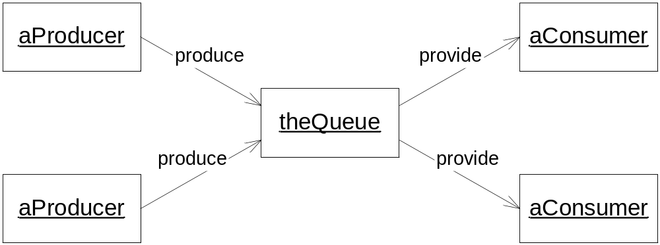

Slide 71
import java.util.*;
class Queue
{
// The shared buffer:
static Queue store = new Queue();
private LinkedList data = new LinkedList();
public void put(Object o)
{
data.addFirst(o);
}
public Object get()
{
return data.removeLast();
}
public int size()
{
return data.size();
}
}

Slide 72
class Producer extends Thread
{
static Random numbers = new Random();
Producer(String id) {
super(id);
}
public void run() {
// Generate some elements for the Queue
for (;;) {
int number = numbers.nextInt(1000);
System.out.println(getName() + " producing "
+ number);
synchronized(Queue.store) {
Queue.store.put(new Integer(number));
Queue.store.notify();
} // Give up lock!
}
}
}

Slide 73
class Consumer extends Thread
{
Consumer(String id) {
super(id);
}
public void run() {
for (;;) {
synchronized(Queue.store) {
while (Queue.store.size() == 0)
{
try {
Queue.store.wait();
}
catch (InterruptedException x) {
interrupt();
}
}
System.out.println(getName() +
" consuming " + Queue.store.get());
}
}
}
}

Slide 74
class CommTest
{
public static void main(String[] args)
throws InterruptedException
{
// Start Producers
new Producer("Producer1").start();
new Producer("Producer2").start();
// Start Consumers
new Consumer("Consumer1").start();
new Consumer("Consumer2").start();
}
}

Slide 75
/* Output:
Producer1 producing 289
Producer1 producing 34
Producer1 producing 975
Producer1 producing 804
Producer1 producing 913
Producer1 producing 514
Producer1 producing 94
Producer1 producing 425
Producer2 producing 863
Consumer1 consuming 289
Consumer2 consuming 34
Producer2 producing 758
Consumer1 consuming 975
Consumer2 consuming 804
Producer2 producing 274
Consumer1 consuming 913
Consumer2 consuming 514
Producer2 producing 311
Consumer1 consuming 94
Consumer2 consuming 863
Producer2 producing 997
(etc...)
*/

Slide 76
A Better Solution
The previous example doesn’t halt!
Suppose we terminate Producers
  After a certain number of inserts, say
How can the Consumers detect that all the Producers are finished?
Need an independent object
  Tracks the number of active Producers
  Consumers halt when reaches zero

Slide 77
import java.util.*;
class Counter
{
private int count;
public Counter()
{
count = 0;
}
public synchronized void increment()
{
++count;
}
public synchronized void decrement()
{
--count;
}
public synchronized int get()
{
return count;
}
}

Slide 78
class Producer extends Thread
{
private static Random numbers = new Random();
private Counter counter;
Producer(String id, Counter counter) {
super(id);
this.counter = counter;
}
public void run() {
counter.increment(); // ←
// Generate some elements for the Queue
for (int i = 0; i < 8; ++i) {
int number = numbers.nextInt(1000);
System.out.println(getName() +
" producing " + number);
synchronized(Queue.store) {
Queue.store.put(new Integer(number));
Queue.store.notify();
}
}

Slide 79
synchronized(Queue.store) {
// Prevent infinite loop
// (because there are multiple consumers)
counter.decrement();
Queue.store.notifyAll(); // ←
}
System.out.println("\t" + getName() +
" finished");
}
}
class Consumer extends Thread
{
private Counter counter;
Consumer(String id, Counter counter)
{
super(id);
this.counter = counter;
}

Slide 80
public void run()
{
for (;;) {
synchronized(Queue.store) {
while (Queue.store.size() == 0) {
if (counter.get() == 0) {
// Producers done and queue is empty
System.out.println("\t" + getName()
+ " terminating");
return;
}
try {
Queue.store.wait();
}
catch (InterruptedException x) {}
}
System.out.println(getName() + " consuming "
+ Queue.store.get());
}
}
}
}

Slide 81
class CommTest2
{
public static void main(String[] args)
{
// Start Producers
Counter counter = new Counter();
new Producer("Producer1", counter).start();
new Producer("Producer2", counter).start();
// Start Consumers
new Consumer("Consumer1", counter).start();
new Consumer("Consumer2", counter).start();
}
}
/* Output:
Producer1 producing 386
Producer1 producing 240
Producer1 producing 982
Producer1 producing 453
Producer1 producing 878
Producer1 producing 228
Producer1 producing 245
…

Slide 82
…
Consumer1 consuming 189
Consumer2 consuming 740
Producer2 producing 761
Consumer1 consuming 264
Consumer2 consuming 686
Producer2 producing 586
Consumer1 consuming 761
Producer2 producing 847
Consumer1 consuming 586
Producer2 producing 161
Consumer1 consuming 847
Consumer1 consuming 161
Producer2 finished
Consumer1 consuming 245
Producer1 producing 329
Consumer2 consuming 329
Consumer1 terminating
Consumer2 terminating
Producer1 finished
*/

Slide 83
Things to Remember
Every wait( ) needs a notify
Call notifyAll( ) if more than one thread needs to be notified
Always use condition loops

Slide 84
Thread Groups and Exceptions
Exceptions belong to a Thread
  Both are stack-based
When an exception occurs in a monitor, the lock is released
  Duh!
When an exception is not caught:
  It falls off the top of the stack
  It has no where to go

Slide 85
Uncaught Exceptions
The current thread dies
ThreadGroup.uncaughtException( ) is called
  Default behavior is to print stack trace to System.err
  You can override it
    That’s why you would create a new ThreadGroup
    Otherwise thread groups are useless!!

Slide 86
An Uncaught Exception
class MyThread extends Thread
{
public void run()
{
System.out.println("Throwing in " +
"MyThread");
throw new RuntimeException();
}
}

Slide 87
class Uncaught
{
public static void main(String[] args)
{
MyThread t = new MyThread();
try
{
t.start();
Thread.sleep(1000);
}
catch (Exception x)
{
System.out.println("This won't happen");
}
System.out.println("Exiting main");
}
}
/* Output:
Throwing in MyThread
java.lang.RuntimeException
at MyThread.run(Uncaught.java:7)
Exiting main
*/

Slide 88
Using Thread Groups
Extend ThreadGroup
Override uncaughtException( )
Place thread in group
  By using appropriate constructor

Slide 89
// Join a thread group
class MyThread extends Thread
{
public MyThread(ThreadGroup g, String name)
{
super(g, name);
}
public void run()
{
System.out.println("Throwing in " + "MyThread");
throw new RuntimeException();
}
}

Slide 90
Overriding uncaughtException( )
class MyGroup extends ThreadGroup
{
public MyGroup(String name)
{
super(name);
}
public void uncaughtException(Thread t,
Throwable x)
{
System.out.println(t + " aborted with a " + x);
}
}

Slide 91
class Uncaught2
{
public static void main(String[] args)
{
MyGroup g = new MyGroup("My Thread Group");
MyThread t = new MyThread(g, "My Thread");
try {
t.start();
Thread.sleep(1000);
}
catch (Exception x) {
System.out.println("This won't happen");
}
System.out.println("Exiting main");
}
}
/* Output:
Throwing in MyThread
Thread[My Thread,5,My Thread Group] aborted with a
java.lang.RuntimeException
Exiting main
*/

Slide 92
Finis, El Fin, O Fim, The End

