Slide 1

Where Did All My Decimals Go?
Chuck Allison
Assistant Prof., Utah Valley State College
Editor, The C++ Source
Owner, Fresh Sources, Inc.
chuck@freshsources.com

Slide 2
Oops!
“During the 1991 Gulf War, the United States used a missile defense system called Patriot to defend its troops. The system was largely effective but on one occasion it failed badly… the internal clock of the computer… stored the time as an integer value in units of tenths of a second, rounding the expansion accordingly. Because the program was an old one that had been updated to account for new technology, the conversion to floating-point was done more accurately in some places in the program than in others. To calculate a time interval, the program took two snapshots of the clock and subtracted them. Because of the rounding inconsistencies, the system failed to work when it had been running for more than 100 hours.”
-- Overton, Numerical Computing with IEEE Floating-point Arithmetic

Slide 3
What Does This Program Print?
#include <iostream>
#include <limits>
using namespace std;
int main() {
float x = 1.0f -.2f - 0.2f -.2f -.2f -.2f;
cout << x << endl;
cout.precision(numeric_limits<double>::digits10);
double y = 1.0 - .2 -.2 -.2 -.2 -.2;
cout << y << endl;
}

Slide 4
Curious Output
-1.49012e-08
-5.55111512312578e-17
For everything else, there’s MasterCard®. Seeing the look on students’ faces: priceless!

Slide 5
Curious Queries
Are those answers good enough?
Define “good enough”!
  Depends on the application
Errors can accumulate
  So you’ll want to minimize them
Where did the error come from?

Slide 6
Forgotten Numerics
What computers were invented for!
  Scientific research, engineering
Today’s programmers don’t know what their predecessors did about numerics!
  Most master “information processing”
  The Patriot Missile failure was a needless floating-point error by clueless programmers
Getting numerical accuracy from a machine requires some effort

Slide 7
Take a Lesson
“In this modern world, many critical matters are dependent on complex computer programs, from air traffic control systems to heart machines. Many of these codes depend, in one way or another, on floating-point computing.”
-- Ibid

Slide 8
Agenda
Numerical Error
  Rounding error
  Cancellation
Floating-point number systems
  Spacing/distribution of FP numbers
  “Holes”
Designing Algorithms for Maximum Accuracy
IEEE Floating Point

Slide 9
Rounding Error
Also called “roundoff” error
  The last digit of a FP number is always suspect
A fixed-size floating-point number system can only represent a finite collection of numbers
  An input value x might not be in the set to begin with
  The true value of x + y might not be in the set
How big can it get?
What can you do about it?

Slide 10
Different Bases
Consider representing .1 in a base-2 system
1/10 = 1/1010₂
Use long division :
.000110011001100…
1010 |1.000000000000000
1/10 is an infinite (repeating) decimal in base 2!
This is why 1 - .2 - .2 - .2 - .2 - .2 != 0 in a binary floating-point system

Slide 11
Arbitrary Precision Arithmetic
Java has BigDecimal
  Needs more functionality, though!
Many C packages are available
SLOOOOOOOOOOOOOOOW!!!
  But floating-point is in hardware
Use arbitrary precision when you need to, if you can
  Rarely seems to be practical

Slide 12
Fixed-point Arithmetic
Like integers
Numbers are all evenly spaced
Addition and subtraction within range are exact
Disadvantages:
  Range
  Storage efficiency
  Relative error dependent on magnitude

Slide 13
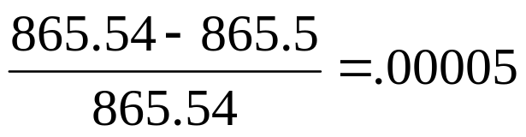
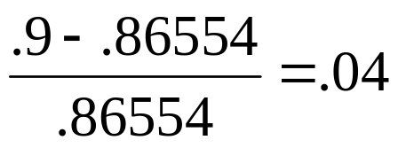
Relative Error in Fixed-point Systems
Assume a fixed-point system with 4 digits, 1 decimal
The relative error of storing 865.54 is:
The relative error of storing .86554 is:

Slide 14
A Toy Fixed-point System
Consider the following fixed-point number system, F1:
  base = 10
  precision = 4
  decimals = 1
F1 has 19,999 evenly-spaced numbers:
  {-999.9, -999.8, …, 0, … 999.8, 999.9}
How many bits are needed to store such a number?
  1 for sign
  16 for mantissa (because each decimal digit requires 4 bits)
    Note: we don’t convert the entire number to binary, just a digit at a time (BCD)
    We’re using base 10, not 2!
  17 total

Slide 15
The Floating-point Story
The most efficient
  Space-wise
Greater range than fixed-point
But have to deal with:
  The roundoff problem
    At least it is nicely bounded (will see later)
  The increased spacing problem
    Larger numbers are farther apart

Slide 16
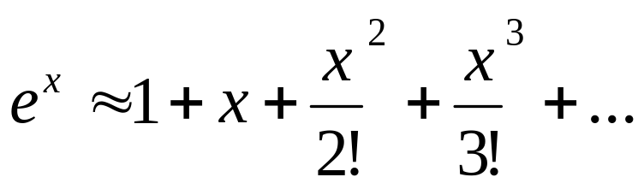
When Good Formulas Go Bad
How do you compute e^{x}?
Transcendental numbers can only be approximated by finite processes
Use the MacLaurin Series
  Taylor’s series expanded about 0 (see below)
Examples:
  exp1.cpp (bombs for negative x)
  exp2.cpp (uses reciprocal to avoid smearing)

Slide 17
Results for exp1.cpp
myexp(55.5f) = 1.26866e+24
myexp(55.5) = 1.26865561401096e+24
exp(55.5) = 1.26865561401096e+24
myexp(-55.5f) = -2.90487e+15
myexp(-55.5) = -6.76350603787201e+06
exp(-55.5) = 7.88235979060085e-25

Slide 18
Smearing
The initial terms of the Taylor’s Series are much larger than the final result
  A clue is that there is subtraction involved that whittles down the running total
So the natural roundoff in the initial terms is in decimal places more significant than the final answer!
That’s called “smearing”

Slide 19
Results from exp2.cpp
Calculates e^{-x} as 1/e^{x}
myexp(55.5f) = 1.26866e+24
myexp(55.5) = 1.26865561401096e+24
exp(55.5) = 1.26865561401096e+24
myexp(-55.5f) = 7.88236e-25
myexp(-55.5) = 7.88235979060085e-25
exp(-55.5) = 7.88235979060085e-25

Slide 20
When Good Formulas Go Bad
How do you solve a quadratic equation?
How much accuracy do you need?
Example: x² – 100000x + 1 = 0
  quad1a.cpp (float, naive)
  quad1b.cpp (double, naive)
  quad2a.cpp (float, smart)
  quad2b.cpp (double, smart)
  Correct answers to 11 digits are:
    99999.999990, .000010000000001

Slide 21
Results
 | r₁ | r₂
True | 99999.99999 | .000010000000001
Naïve, float | 100000 | 0
Naïve double | 99999.99999 | 1.00000033853576e-05
Smart, float | 100000 | .00001
Smart, double | 99999.99999 | .000010000000001

Slide 22
Catastrophic Cancellation
When two nearly-equal numbers are subtracted, the most significant digits are lost (see next slide)
What’s left are the less significant digits
  But they become the most significant digits in the result! (they’re all that’s left)
  A tremendous loss of precision
That’s what’s happening here

Slide 23
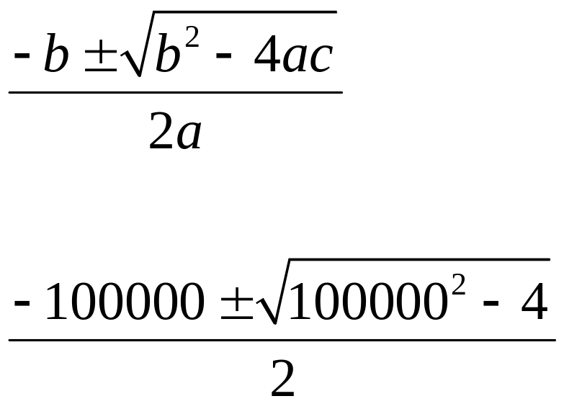
The Quadratic Formula

Slide 24
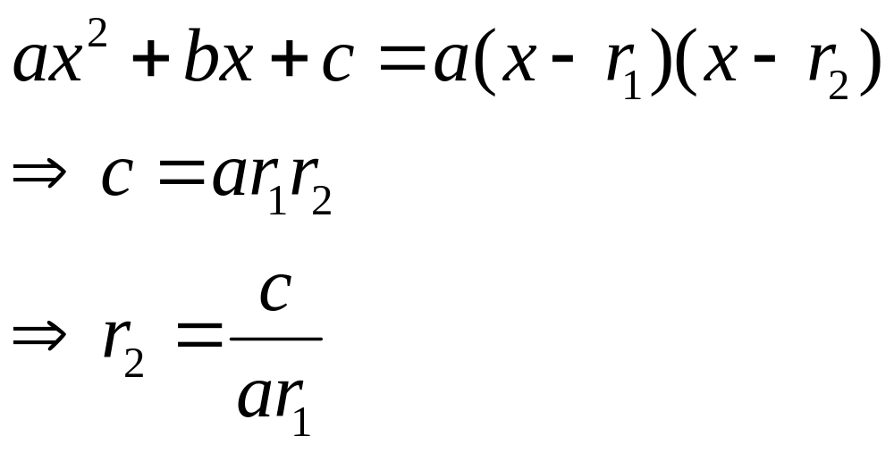
About Quadratic Equations

Slide 25
The Smarter Algorithm
Avoids cancellation in computing r₁
  By checking the sign of b
  Chooses the sign that does addition, not subtraction
Then computes r₂ as 1/r₁
  In general, r₂ = c/(ar₂)

Slide 26
“Piles of Sand”
You can’t always use code formulas naively and expect them to work
Must learn how to anticipate and minimize numeric error
  By understanding floating-point number systems
  By using intelligent algorithms and techniques

Slide 27
Floating-point Number Systems
Use “scientific notation”
  First used by the Babylonians! (Base 60)
They store a “significand” (“mantissa”) of a fixed number of digits, as well as an exponent and sign
The number of significant digits stored doesn’t depend on the magnitude of the number
  As fixed-point systems (like integers) do
  You merely adjust (“float”) the exponent

Slide 28
Formal Definition of FP Systems
A Floating-number system is the set of numbers defined by the following integral parameters, using scientific notation:
  A base, B (typically 2 or 10)
  A precision, p
  A minimum exponent, m (usually negative)
  A maximum exponent, M

Slide 29
A Toy Floating-point System
Consider the normalized floating-point system F:
  base = B = 10
  precision = p = 4
  exponent range [m = -2, M = 3]
This system represents numbers of the form:

Slide 30
The Numbers in F
9,000 Significands
  From 1.000 through 9.999
6 powers
  From -2 through 3, inclusive
Positive and negative flavors
9,000 x 6 x 2 = 108,000 numbers in all
How many bits are necessary to store such numbers?
  1 for sign, 3 for exponent (0->5 maps to -2->3), 16 for mantissa (4 x 4)
  20 total

Slide 31
Distribution
The numbers in F are not evenly spaced
  And there is a gap about zero
Their magnitudes come in groups according to the exponent used:
{1.000 … 9.999} x 10⁻² (spacing = .001 x 10⁻² = 10⁻⁵)
{1.000 … 9.999} x 10⁻¹ (spacing = .001 x 10⁻¹ = 10⁻⁴)
{1.000 … 9.999} x 10⁰ (spacing = .001 = 10⁻³)
{1.000 … 9.999} x 10¹ (spacing = .001 x 10¹ = 10⁻²)
{1.000 … 9.999} x 10² (spacing = .001 x 10² = 10⁻¹)
{1.000 … 9.999} x 10³ (spacing = .001 x 10³ = 10⁰ = 1)

Slide 32
Spacing Between FP Numbers
It’s the value of the unit in the last place (.001 here) times the current exponent
.001 x 10e = 10⁻³ x 10e = 10^{1-p} x 10e
B^{1-p} x B^{e} = B^{1-p+e} in general for base B
B^{1-p} is a special number we’ll see again shortly

Slide 33
Missing Numbers
The spacing in typical FP systems (like IEEE) grows quite large
  In particular, it becomes > 1
Even some integers are missing
  MAXINT is not a valid float in IEEE!
  The smallest positive integer missing in IEEE single precision (float) is 2²⁴+1 = 16,777,217
    It rounds to 16,777,216 (try it!)

Slide 34
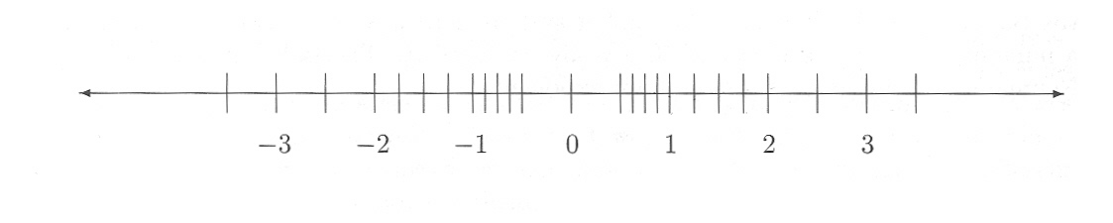
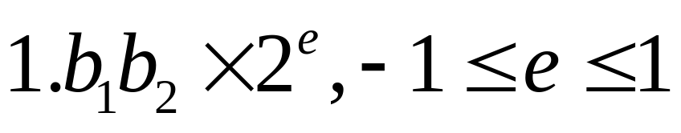
Another FP System (F2)
B = 2, p = 3, m = -1, M = 1
24 numbers (4 x 3 = 12 magnitudes):

Slide 35
The Binary Advantage
Take 1
With base 2, there is only one choice for the first digit (1) in a normalized system
  So it doesn’t have to be stored
It is just implied
  So we get a bit for free
See next 2 slides

Slide 36
Saving a Bit
Let F3 be the system:
  B = 2, p = 4 (3 stored), m = -1, M = 1
Now has 48 numbers (24 magnitudes)
  Greater precision / denser distribution
  See next slide

Slide 37
The Numbers of F3
8 bit patterns x 3 power groups = 24 unique magnitudes
 | x 2⁻¹ | x 2⁰ | x 2¹
(1).000 | .1 | 1 | 10
(1).001 | .1001 | 1.001 | 10.01
(1).010 | .101 | 1.01 | 10.1
(1).011 | .1011 | 1.011 | 10.11
(1).100 | .11 | 1.1 | 11
(1).101 | .1101 | 1.101 | 11.01
(1).110 | .111 | 1.11 | 11.1
(1).111 | .1111 | 1.111 | 11.11
Spacing: | (.0001)₂ | (.001)₂ | (.01)₂

Slide 38
Relative Spacing in FP Systems
Fairly uniform throughout the system:
Consider the range [B^{e}, B^{e+1})
  The inter-number spacing there is B^{1-p+e}
So the relative spacing between adjacent numbers is:
  Between B^{-p} and B^{1-p} (a factor of B)
    Called the system wobble
    Is the bound of roundoff error for the system
  Independent of e!

Slide 39
The Binary Advantage
Take 2
It has the smallest possible wobble factor:
  Because 2 is the smallest possible base
  Is between 2^{-p} and 2^{1-p}

Slide 40
Machine Epsilon
A measure of the “granularity” of a FP system
It is the (absolute and relative) spacing between 1.0 and its neighbor to the right
ε = B^{1-p}
Can use this to tune algorithms to the FP system being used
  We can’t expect smaller relative errors than ε

Slide 41
“The Most Important Fact About Floating-point Numbers” (Webb Miller)
The spacing between numbers in [B^{e}, B^{e+1}] is B^{1-p+e} = B^{1-p}B^{e} = εB^{e}
If |x| is in [B^{e}, B^{e+1}], then B^{e} <= |x| <= B^{e+1}
=> spacing = εB^{e} <= ε|x| <= εB^{e+1}
=> εB^{e-1} <= ε|x|/B <= εB^{e} = spacing
=> ε|x|/B <= spacing at x <= ε|x|
The last line is the fact to remember
  We use it in designing algorithms

Slide 42
Tuning an Algorithm
Consider finding a bracketed root by the method of bisection (binary search)
Often an error tolerance is supplied
  Good to “5 decimals,” say
But what if the tolerance is less than the spacing near the root
  We’ll never terminate!
See next two slides

Slide 43
How Not To Find a Root
double bisect(double tol, double a, double b, double f(double)) {
_{assert(b > a);}
while (b-a >= tol) { // May Loop for large a,b, small tol
_{assert(f(a)*f(b) < 0);}
_{double c = (a+b)/2.0;}
_{if (f(a)*f(c) < 0)}
_{b = c;}
_{else if (f(b)*f(c) < 0)}
_{a = c;}
_{else}
_{return c;}
}
_{return (a + b) / 2.0;}
}

Slide 44
Tuning the Bisection Algorithm
double bisect(double tol, double a, double b, double f(double)) {
_{assert(b > a);}
// Adjust tolerance to something obtainable
double eps = numeric_limits<double>::epsilon();
_{tol = max(tol, eps*fabs(a));}
_{tol = max(tol, eps*fabs(b));}
_{while (b-a >= tol) {}
_{// (As before…)}
}

Slide 45
Obtaining Maximum Accuracy
With bisection, it is possible to continue bisecting until either a root is found, or there are no numbers left in the interval
  Can’t do better than that!
  The number of bisections can even be estimated a priori
See next slide

Slide 46
A Precise Bisection Algorithm
Keeps bisecting until:
  f(c) happens to be zero, or
  There are no numbers between a and b
c = (a+b) / 2.0;
if (c <= a || b <= c)
return c;
And we can compute the maximum number of bisections that will be needed for any interval

Slide 47
IEEE 754
A standard for floating-point numbers systems
  Finalized in late 1980s
Defines two flavors of numbers
  Single precision (float)
  Double precision (double)
Also defines special values
  NaN, Infinity, subnormal numbers

Slide 48
Fascinating Tidbit
William Kahan of Berkeley received the Turing Award from ACM in 1989 for his work on IEEE 754
“The Old Man of Floating-point”
Google for his paper:
  “Why Java’s Floating-point Hurts Everyone Everywhere”
  Not to diss Java – reading it is a learning experience!

Slide 49
IEEE 754
Single Precision
32 bits
Base = 2
Precision = 24
  Only 23 are stored for normalized numbers
  Will explain subnormal numbers shortly
    Will also explain 0!
ε = 2⁻²³ ≈ 1.9209*10⁻⁷

Slide 50
IEEE 754
Single Precision Layout
Three components stored in the following order:
  Sign: 1 bit
  Exponent: 8 bits
  Mantissa: 23 (24 logical) bits
    Stores only the fractional part
    Real mantissa is therefore 1 greater
  Order is significant
    Makes comparison easy (lexicographical)
What’s the exponent range?
  Can store 2⁸ = 256 numbers in 8 bits
  Could do [-127, 128]
    But we still have to solve the zero problem!

Slide 51
IEEE 754
Single Precision Layout - Exponent
Stores exponent in a biased format
  That is, it is offset by the bias before storing
  The bias for single precision is 127 (2⁷-1)
The stored (biased) range [0-255] represents an actual (unbiased) range of [-127, 128]
  So when storing, add 127 to the actual exponent to get the biased exponent
  When retrieving, subtract 127 from the biased exponent to get the actual exponent

Slide 52
IEEE Float examples
1 (= 1.0 x 2⁰):
0 01111111 00000000000000000000000
2 (= 1.0 x 2¹):
0 10000000 00000000000000000000000
6.5 (= 1.101₂ x 2²):
0 10000001 10100000000000000000000
-6.5 (= -1.101₂ x 2²):
1 10000001 10100000000000000000000
Notes:
1.0 x 2⁰ (2¹²⁷⁻¹²⁷)
1.0 x 2¹ (2¹²⁸⁻¹²⁷)
1.101 x 2² = 110.1 = 6.5

Slide 53
Advantage of the Biased Representation
Floating-point numbers can be compared lexicographically
  Very efficient
  The first differing bit determines the answer

Slide 54
Gotcha!
Don’t forget about Endian-ness
  When inspecting bits of a number directly
  When transferring across platforms
Little Endian machines store bytes (and therefore, words) backwards

Slide 55
IEEE 754
Single Precision – Zero and Friends
How shall we represent 0?
Since numbers are normalized, a 0 significand is impossible
Instead, we’ll usurp the exponent -127
  This exponent is unavailable for normalized numbers
  We’ll use it for multiple purposes
So 0 is represented as (1).00…0 * 2⁻¹²⁷
  But stored as all 0’s!

Slide 56
Consequences of Zero
We can have a negative zero too!
  The sign bit can be 1, everything else is 0
  They are considered the same number, naturally
Now that we have put exponent -127 out of commission for normalized numbers, how about if we use it for some more numbers…
  Let’s milk this thing!
  We’ll use non-zero fractions with it

Slide 57
Subnormal Numbers
(aka Denormalized Numbers)
Numbers with non-zero fractions and an exponent of -127 (or 0, biased)
  They assume that the unit digit is 0, not 1
  In other words, they represent the numbers:
  0.b₁b₂…b₂₃ * 2⁻¹²⁶
Why -126?
  Otherwise we’d be skipping numbers
  0.1 * 2⁻¹²⁶ = 1.0 * 2⁻¹²⁷

Slide 58
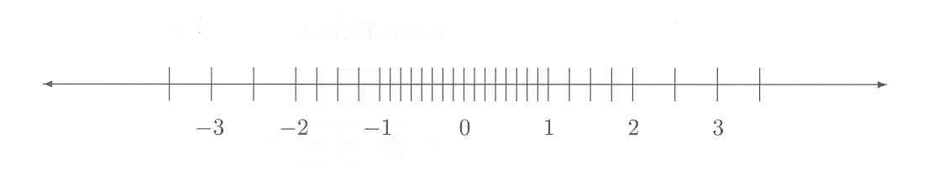
Qualities of Subnormals
But it has the same spacing as the range to its right
  Because its ulp is 2⁻²³ * 2⁻¹²⁶ = 2⁻¹⁴⁹
  Same as the normalized range beginning at 2⁻¹²⁶
  Which evenly fills out the gap down to zero:
B = 2, p = 3, m = -1, M = 1

Slide 59
More Special Numbers
Infinity
  Both the positive and negative kind
  Once they are obtained in a calculation, the right thing mathematically happens
    e.g., 1/∞ = 0, 1/-∞ = -0
  Layout: exponent is all 1’s (the biased number 255, 128 unbiased), fraction is all 0’s
So the exponent 128 is also usurped
  So 127 is really the largest usable exponent
  Largest number = 1.111…1 * 2¹²⁷ ≈ 3.40282 * 10³⁸

Slide 60
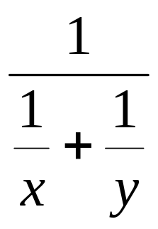
Using Infinity
Dividing by zero is no longer taboo
Computation can continue:

Slide 61
Another Special Number
NaN
  “not a number”
  Occurs when an invalid computation is attempted (like sqrt of a negative value)
Any subsequent calculations involving a NaN result in a NaN
  So you don’t have to mess with exceptions
Layout: exponent all 1’s (like ∞), but fraction is non-zero (usually just a leading 1 by default)
The only quantity that doesn’t compare equal to itself!
  That’s okay. It’s not a number :-)

Slide 62
Double Precision
Same basic layout as Single Precision
  sign | exponent | fraction = 64 bits total
Exponent occupies 11 bits
  Bias of 1023 maps [0, 2047] to [-1023, 1024]
  0/-1023 is for zero and subnormals
  2047/1024 is for infinities and NaNs
Fraction is the right-most 52 bits
  Implied 53rd bit of 1 for normals, 0 for subnormals

Slide 63
Fascinating Tidbit
IEEE requires “correct rounding”
  +, -, *, /, √ must be accurate within .5 – 1 ulp
  Cancellation can totally thwart this!
Solution: Guard digits
  IEEE uses a 3-bit guard scheme:
    Guard bit
    Round bit
    Sticky bit
  See next 4 slides

Slide 64
Guard Digit Example
B = 2, p = 3, subtract 1.00 x 2¹ – 1.11 x 2⁰ (2 – 1.75 = .25)
Must align (always to larger power, so you don’t go beyond 1’s place):
1.00 x 2¹
0.11 x 2¹ (shifted right 1 place)
--------------
0.01 x 2¹ = 1.00 x 2⁻¹ = 1/2 => 100% error
With a guard digit:
1.000 x 2¹
- 0.111 x 2¹ (preserves original 1 in 3rd place)
---------------
0.001 x 2¹ = 1.000 x 2⁻² = 1.00 x 2⁻² = 1/4 => correct

Slide 65
Another Example
1 – 1.00…01 x 2⁻²⁵
1.00…0
- 0.00…0 | 0100…01 x 2⁰ (25 guard bits)
=0.11…1 | 1011…11 x 2⁰
=1.11..11 | 0111…10 x 2⁻¹ (normalized)
=1.11…1 x 2⁻¹ (rounded)
This is correct
Now try with 24 guard bits (next slide)

Slide 66
Another Example continued – 24 guard bits
1 – 1.00…01 x 2⁻²⁵
1.00…0
- 0.00…0 | 0100…0 x 2⁰ (lost final ‘1’)
=0.11…1 | 1100…0 x 2⁰
=1.11..11 | 1000…0 x 2⁻¹ (normalized)
=10.0…0 x 2⁻¹ (rounded)
=1.00…0 x 2⁰ (re-normalized)
1 ulp off
We needed 25 guard bits to round correctly

Slide 67
The Example Revisited
Using a Sticky Bit
1 – 1.00…01 x 2⁻²⁵
1.00…0
- 0.00…0 | 011 x 2⁰ (sticky bit is ‘1’)
=0.11…1 | 101 x 2⁰
=1.11..11 | 01 x 2⁻¹ (normalized)
=1.11…1 x 2⁻¹ (rounded)
This is correct!
  Sticky bits save the day!

Slide 68
sin(10³⁰) “In the Wild”
Popular Compilers:
  0.738533997569377
  -0.838299394218616
  0.99076965259920
Popular calculators:
  -0.09103119
  -0.090116901912138058030386428952987
  -0.863505811

Slide 69
What’s the Problem?
sin(x) is computed by a Taylor Series
The argument is first reduced to [-π/2,π/2]
  t = x – nπ, sin(x) = +/- sin(t)
  To minimize truncation error
  To require fewer terms of the Taylor series
For numbers > 10⁹, n overflows a 32-bit integer!
Returning a NaN is better!

Slide 70
Using Arbitrary Precision
_{class BigSine {}
public static void main(String[] args) {
BigDecimal t = residue(new BigDecimal("1.0e30"));
System.out.println(t.toEngineeringString());
System.out.println(Math.sin(t.doubleValue()));
}
static BigDecimal residue(BigDecimal arg) {
// Find nearest integer to arg/pi
String pi1 = "3.14159265358979323846264338327";
String pi2 = "9502884197169399375105820974944";
BigDecimal pi = new BigDecimal(pi1 + pi2);
BigDecimal quotient = arg.divideToIntegralValue(pi);
_{System.out.println(quotient);}
BigInteger n = quotient.toBigInteger();
return arg.subtract(quotient.multiply(pi));
}
}

Slide 71
Summary
Can’t just use formulas blindly
  Must understand sources of error
  Can use properties of FP systems to tune algorithms
  If CS majors don’t do this who will?
IEEE standards have helped portability
All materials for CNS 3320 are available at www.chuckallison.com

Slide 72
References
Overton, Numerical Computing with IEEE, SIAM, 2001.
Miller, The Engineering of Numerical Software, Prentice-Hall, 1984.
Goldberg, What Every Computer Scientist Should Know About Floating-point Arithmetic
  http://docs-pdf.sun.com/800-7895/800-7895.pdf
www.uvsc.freshsources.com/decimals.pdf
www.uvsc.freshsources.com/sine.pdf

