Slide 1

The Simplest Automated Unit Test Framework That Could Possibly Work
Chuck Allison

Slide 2

About the Title
A variation of the XP Principle: TheSimplestThingThatCouldPossiblyWork
Anything simpler wouldn’t be there!
A Discipline/Tool for Programmers
Article in September 2000 Issue of C/C++ Users Journal
  Code available at www.cuj.com/code

Slide 3
Extreme Programming
Reaction to Heavy Methodologies
Code Reviews are good…
  Therefore, review continuously
  Pair Programming
Testing is good…
  Therefore, test relentlessly
    Many times daily
    Integrate daily
  Automate tests

Slide 4
What We’ll Discuss
Testing in General
Meeting Requirements
Dealing with Change
Test Automation
… All From a Programmer’s Perspective

Slide 5
What We Won’t Discuss
Performance Testing
Usability Testing
Stress Testing

Slide 6
Testing
Verifies that Requirements are met
  Do you really know what they are?
Should be Requirements-driven
Translating Requirement into tests should be easy
  Use Cases drive Functional (End-user) Testing
  Modules drive Unit Testing

Slide 7
“You guys start coding while I go find out what the users want.”

Slide 8
Requirements
Are never really “done”
WANTED: Agile Developers
  “Embrace Change”
Incremental Development
  Specify a little
  Design a little
  Code a little
  Test a little
  Repeat…

Slide 9
Unit Testing
What a programmer does to verify two things:
  “I understand the requirements”
  “My code meets those requirements”
Avoids hand-waving and other Nasty Things
  “All my tests pass”
Should be done many times daily
  After each code change

Slide 10
Integration Testing
A Unit Test validates a module in isolation
An Integration Test validates that modules work together correctly
An extension of Unit Testing
  Validates subsystem requirements
  Assumes Unit Testing “complete”
This talk is about Unit Testing

Slide 11
What’s a Unit?
Object-orientation helps here:
  Module
  Class
From the Developer’s point of view
Developers write and run unit tests

Slide 12
Object Orientation 101a
Classes and Objects
  A Class is a type (category of objects : Person)
  An object is an instance of a class (Alberto)
Attributes and Methods
  Defined by the class
  Methods are services (functions)
    Common to all objects
  Attributes are data members
    Each object has the same type of attributes, but different values

Slide 13
A Simple Date Class in C++
// date.h
#include <string>
class Date {
public:
Date(); // Today
Date(int year, int month, int day);
Date(const std::string&);
int getYear() const;
int getMonth() const;
int getDay() const;
string toString() const;
friend Duration duration(const Date&, const Date&);
};

Slide 14
#include <iostream>
#include "date.h"
using namespace std;
int main()
{
Date today;
cout << "Today is " << today.toString()
<< '\n';
Date mybday(1951,10,1);
Duration dur = duration(today, mybday);
cout << "Today I am " << dur.years
<< " years, " << dur.months
<< " months, and " << dur.days
<< " days old\n";
}
/* Output:
Today is 2001-8-11
Today I am 49 years, 10 months, and 10 days old
*/

Slide 15
Refactoring
Another kind of change
  To program’s internal structure
    Without changing outward behavior
Instigated by Programmer
  Eases maintenance
  Prolongs the system’s useful life
  What you would do if you “had the time”

Slide 16
Refactoring Activities
Add a method
Combine two methods into one
Replace a method with an object
Parameterize a method or class
Replace conditionals with polymorphism
See Martin Fowler’s book

Slide 17
“If It Ain’t Broke…”
Managers resist Refactoring
  Requires long-term thinking
  “Pay Me Now or Pay Me Later”
  Don’t tell them about it <g>
Lack of Refactoring leads to:
  Premature program death
    “We can’t fix it; rewrite it”
  Bloated maintenance cycles
  Unhappy programmers

Slide 18

Regression Testing
Change happens
  Whether it comes from users, managers, or developers (refactoring)
Today’s changes mustn’t break what worked yesterday
A Unit Test is Dynamic
  Evolves until delivery
Multiple Unit tests comprise a suite
  Run entire suite on each change

Slide 19
“Test Relentlessly”
Test Early
Test Often
Test Automatically

Slide 20
Test Early
Write tests first!
  Clarifies your understanding of requirements
  Validates the Module’s Interface
  Code will be better sooner
Testing + Programming is faster than just Programming

Slide 21
RADical Ideas
RAD relies in large part on nifty tools
Advantages:
  Quicker edit-compile cycles
  Allows assembling pre-built components
Disadvantages:
  Tempts developer to code before thinking
    Especially novices
  Test-first Programming is a valuable counter-measure

Slide 22
Test Often
“Code a little, test a little”
Whenever you complete a programming task
  e.g., adding/updating a method

Slide 23
Test Automatically
“Civilization advances by extending the number of important operations we can perform without thinking” – Alfred North Whitehead
All tests can be formulated as boolean expressions
  WRONG: visually inspect that the output is 42
  RIGHT: have the test program compare the output to 42 and report Yes or No

Slide 24
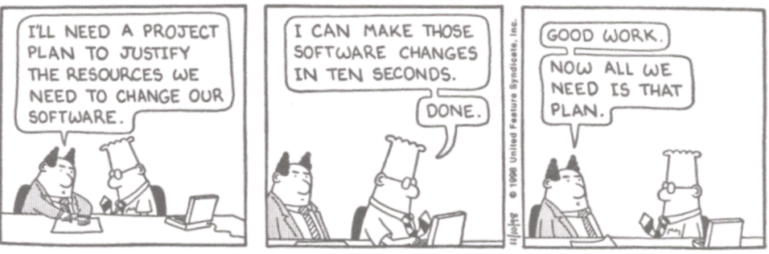

Slide 25
What’s a Unit Test?
Code!
  Written by the Programmer
  Commented for all readers
  Accompanies production code
No need to write a “Unit Test Plan”
The Universal Test Plan is:
  Validate requirements
  “Test everything that could possibly break”
  Automate your tests with a Cool Test Framework

Slide 26
Definition
Unit Test
  A collection of boolean expressions
Unit Test Report
  Output of running a Unit Test
  Reports number of successes and failures
  Reports information on each failure

Slide 27
Example
Suppose users need typical date processing capability
  Initialize with numbers or a string
  Comparisons and duration computation
You might define the following Date class in C++

Slide 28
// date.h
#include <string>
class Date {
public:
Date();
Date(int year, int month, int day);
Date(const std::string&);
int getYear() const;
int getMonth() const;
int getDay() const;
string toString() const;
friend operator<(const Date&, const Date&);
friend operator<=(const Date&, const Date&);
friend operator>(const Date&, const Date&);
friend operator>=(const Date&, const Date&);
friend operator==(const Date&, const Date&);
friend operator!=(const Date&, const Date&);
friend Duration duration(const Date&, const Date&);
};

Slide 29
// Automated Tests…
int main()
{
Date mybday(1951,10,1);
Date today;
test_(mybday < today);
test_(mybday <= today);
test_(mybday != today);
test_(mybday == mybday);
Date mywed(1975,5,10);
Duration dur = duration(mywed, mybday);
test_(dur.years == 23);
test_(dur.months == 7);
test_(dur.days == 9);
cout << "Passed: " << nPass << ", Failed: "
<< nFail << endl;
}
/* Output (after implementation complete):
Passed: 7, Failed: 0
*/

Slide 30
Even Professors Write Tests!
CNS 3370 – Advanced C++
Proxy Design Pattern
I delivered two things:
  1) A Specification
  2) A Test Harness

Slide 31
The Proxy Design Pattern
Allows changing implementations at runtime
  While satisfying a fixed interface

Slide 32
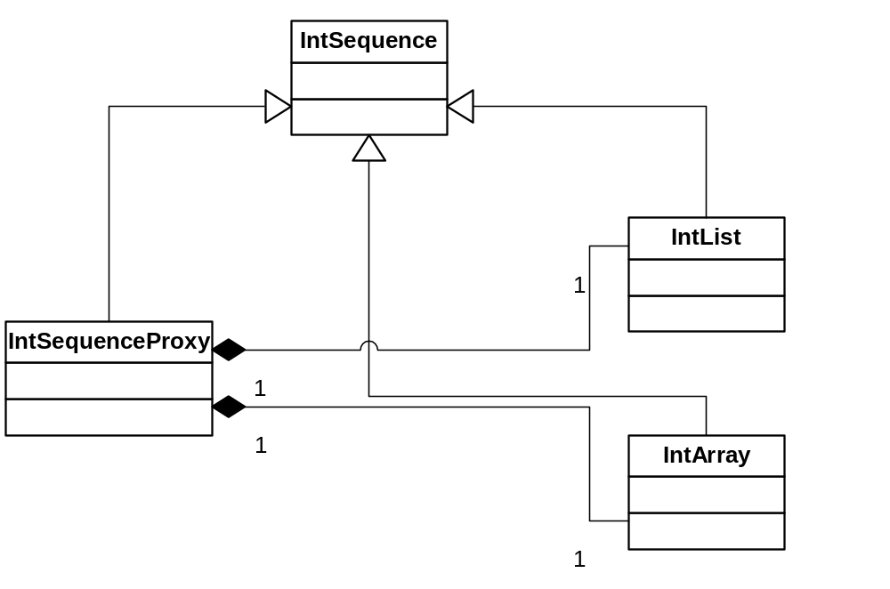
The Proxy Design Pattern

Slide 33
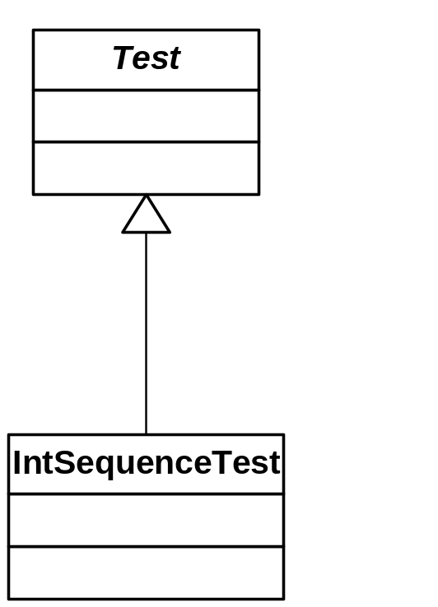
Writing a Unit Test

Slide 34
Code Samples
IntSequence.h
IntSequenceProxy.h
IntArray2.cpp
IntList2.cpp

Slide 35
Test Samples
IntSequenceTest.h
TestIntSequence2.cpp

Slide 36
Testing Exceptions
A Stack Template
Tests Exceptions
  Failure to throw is an error
Uses fail_( ) and succeed_( ) explicitly

Slide 37
template<typename T>
class Stack
{
public:
Stack(size_t) throw(StackError);
~Stack();
void push(const T&) throw(StackError);
T pop() throw(StackError);
T top() const throw(StackError);
size_t size() const;
void clear();
private:
T* data;
size_t max;
size_t ptr;
};
(Implementation omitted)

Slide 38
// Test of Stack Template
#include "stack.h" // a given Stack template
#include "test.h"
class StackTest : public Test
{
enum {SIZE = 5}; // fixed size
Stack<int> stk; // The “Fixture”
public:
StackTest() : stk(SIZE)
{}
void run()
{
testUnderflow();
testPopulate();
testOverflow();
testPop();
testBadSize();
}

Slide 39
void testBadSize()
{
try
{
Stack<int> s(0);
fail_("Bad Size");
}
catch (StackError&)
{
succeed_();
}
}

Slide 40
void testUnderflow()
{
stk.clear();
test_(stk.size() == 0);
try
{
stk.top();
fail_("Underflow");
}
catch (StackError&)
{
succeed_();
}
try
{
stk.pop();
fail_("Underflow");
}
catch (StackError&)
{
succeed_();
}
}

Slide 41
void testPopulate()
{
stk.clear();
try
{
for (int i = 0; i < SIZE; ++i)
stk.push(i);
succeed_();
}
catch (StackError&)
{
fail_("Populate");
}
test_(stk.size() == SIZE);
test_(stk.top() == SIZE-1);
}

Slide 42
void testOverflow()
{
try
{
stk.push(SIZE);
fail_("Overflow");
}
catch (StackError&)
{
succeed_();
}
}
void testPop()
{
for (int i = 0; i < SIZE; ++i)
test_(stk.pop() == SIZE-i-1);
test_(stk.size() == 0);
}
};

Slide 43
void reset()
{
stk.clear();
Test::reset();
}
};

Slide 44
int main()
{
StackTest t;
t.run();
t.report();
}
/* Output:
Test "StackTest":
Passed: 14 Failed: 0
*/

Slide 45
Fixtures
Tests often need fixed data to work with
You may need to reset that data often during a test
That’s why Test::reset( ) is virtual
Override it with code to re-establish the fixture
  Don’t forget to call Test::reset( ) to reset counters!

Slide 46
Managing Multiple Tests
A Build can involve many classes
Each Build should have an associated Test Project/Build
  Run against each build
Requires grouping tests together

Slide 47
Definition
Test Suite
  A collection of related Unit Tests
  Meant to be run together

Slide 48
Example
Julian Date Processing
5 modules:
  JulianDate (C-like date API)
  JulianTime (does both date & time)
  Date (a C++ class, uses julianDate)
  Time (uses julianTime)
  MonthInfo (miscellaneous)

Slide 49
Sample Code
Microsoft Visual C++ Workspace
Two Projects
  Build
  Test

Slide 50
#include <iostream>
#include "suite.h"
#include "JulianDateTest.h"
#include "JulianTimeTest.h"
#include "MonthInfoTest.h"
#include "DateTest.h"
#include "TimeTest.h"
using namespace std;
int main()
{
Suite s("Date and Time Tests", &cout);
s.addTest(new MonthInfoTest);
s.addTest(new JulianDateTest);
s.addTest(new JulianTimeTest);
s.addTest(new DateTest);
s.addTest(new TimeTest);
s.run();
long nFail = s.report();
s.free();
cout << "\nTotal failures: " << nFail << endl;
return nFail;
}

Slide 51
/* Output:
Suite "Date and Time Tests"
===========================
Test "class MonthInfoTest":
Passed: 18 Failed: 0
Test "class JulianDateTest":
Passed: 36 Failed: 0
Test "class JulianTimeTest":
Passed: 29 Failed: 0
Test "class DateTest":
Passed: 57 Failed: 0
Test "class TimeTest":
Passed: 84 Failed: 0
===========================
Total failures: 0
*/

Slide 52
The TestSuite Framework
Two classes:
Test
  Abstract
  Override run( ) method
Suite
  addTest( ) method
  run( ) method

Slide 53
// test.h
#ifndef TEST_H
#define TEST_H
#include <string>
#include <iostream>
#include <cassert>
using std::string;
using std::ostream;
using std::cout;
// The following have underscores because they are
// macros.(The motivation was to avoid a conflict with
// ios::fail).
// For consistency, succeed_() also has an underscore.
#define test_(cond) \
do_test(cond, #cond, __FILE__, __LINE__)
#define fail_(str) \
do_fail(str, __FILE__, __LINE__)

Slide 54
class Test {
public:
Test(ostream* osptr = &cout);
virtual ~Test(){}
virtual void run() = 0;
long getNumPassed() const;
long getNumFailed() const;
const ostream* getStream() const;
void setStream(ostream* osptr);
void succeed_();
long report() const;
protected:
void do_test(bool cond, const string& lbl,
const char* fname, long lineno);
void do_fail(const string& lbl,
const char* fname, long lineno);
virtual void reset();

Slide 55
private:
ostream* m_osptr;
long m_nPass;
long m_nFail;
// Disallowed:
Test(const Test&);
Test& operator=(const Test&);
};

Slide 56
The Suite Class
Collects Tests
Suite::run( ) calls Test::run( )
Likewise Suite::report( )

Slide 57
#ifndef SUITE_H
#define SUITE_H
#include "Test.h"
#include <vector>
using std::vector;
class TestSuiteError;
class Suite {
public:
Suite(const string& name, ostream* osptr = &cout);
string getName() const;
long getNumPassed() const;
long getNumFailed() const;
const ostream* getStream() const;
void setStream(ostream* osptr);
void addTest(Test* t) throw (TestSuiteError);
void addSuite(const Suite&) throw(TestSuiteError);
void run(); // Calls Test::run() repeatedly
long report() const;
void free(); // Deletes tests

Slide 58
private:
string m_name;
ostream* m_osptr;
vector<Test*> m_tests;
void reset();
// Disallowed ops:
Suite(const Suite&);
Suite& operator=(const Suite&);
};

Slide 59
No C++?
No Problem!
C and Java versions exist
C doesn’t have RTTI
  Test name required
Java doesn’t have a preprocessor
  File names and line numbers not readily available
  No Stringizing operator

Slide 60
C API
/* ctest.h
*
* Defines a test framework for C projects.
*/
#ifndef CTEST_H
#define CTEST_H
#include <stdio.h>
#include "bool.h"
#define ct_test(test, cond) \
ct_do_test(test, #cond, cond, __FILE__, __LINE__)
#define ct_fail(test, str) \
ct_do_fail(test, str, __FILE__, __LINE__)
typedef struct Test Test;
typedef void (*TestFunc)(Test*);
Test* ct_create(const char* name, void (*init)(Test*));
void ct_destroy(Test* pTest);

Slide 61
const char* ct_getName(Test* pTest);
long ct_getNumPassed(Test* pTest);
long ct_getNumFailed(Test* pTest);
long ct_getNumTests(Test* pTest);
FILE* ct_getStream(Test* pTest);
void ct_setStream(Test* pTest, FILE* stream);
bool ct_addTestFun(Test* pTest, TestFunc tfun);
void ct_succeed(Test* pTest);
long ct_run(Test* pTest);
long ct_report(Test* pTest);
void ct_reset(Test* pTest);
/* Not intended for end-users: */
void ct_do_test(Test* pTest, const char* str,
bool cond, const char* file, long line);
void ct_do_fail(Test* pTest, const char* str,
const char* file, long line);
#endif

Slide 62
// Illustrates the C Test API */
#include <stdio.h>
#include <assert.h>
#include "ctest.h"
/* Stuff to test (usually #include'd) */
/* The data type */
typedef struct
{
double real, imag;
} complex;
/* A function to test */
complex c_add(complex c1, complex c2)
{
complex r;
r.real = c1.real + c2.real;
r.imag = c1.imag + c2.imag;
return r;
}
/* The Fixture */
complex c1 = {1.0, 1.0};
complex c2 = {2.0, 2.0};
complex c3 = {3.0, 3.0};

Slide 63
/* Other functions to test */
void testEqual(Test* pTest)
{
complex z = {1.0, 1.0};
ct_test(pTest, z.real == c1.real && z.imag ==
c1.imag);
ct_test(pTest, z.real != c2.real && z.imag !=
c2.imag);
}
void testAdd(Test* pTest)
{
complex r = c_add(c1, c2);
ct_test(pTest, r.real == c3.real &&
r.imag == c3.imag);
}

Slide 64
int main()
{
Test* pTest = ct_create("Complex", NULL);
bool rc = ct_addTestFun(pTest, testEqual);
rc = ct_addTestFun(pTest, testAdd);
assert(rc);
ct_setStream(pTest, stdout);
ct_run(pTest);
ct_report(pTest);
ct_destroy(pTest);
return 0;
}
/* Output:
Test "Complex":
Passed: 3
Failed: 0
*/

Slide 65
Java Version

Slide 66
package testsuite;
import java.io.*;
public abstract class Test
{
int nPass = 0;
int nFail = 0;
BufferedWriter sink;
public final void setSink(BufferedWriter sink)
{
this.sink = sink;
}
public final Writer getSink()
{
return sink;
}
public final void test(String label,
boolean condition)
throws IOException
{
if (!condition)
fail(label);
else
succeed();
}

Slide 67
public final void fail(String label)
throws IOException
{
if (sink != null)
{
sink.write(getClass().getName() +
" failure: " + label);
sink.newLine();
}
++nFail;
}
public final void succeed()
{
++nPass;
}
public final void flush()
throws IOException
{
if (sink != null)
{
sink.flush();
}
}

Slide 68
public final int report()
throws IOException
{
if (sink != null)
{
sink.write("Test \"" +
getClass().getName() +
"\":");
sink.newLine();
sink.write("\tPassed: " + nPass);
sink.newLine();
sink.write("\tFailed: " + nFail);
sink.newLine();
}
return nFail;
}
public final int getNumPassed()
{
return nPass;
}
public final int getNumFailed()
{
return nFail;
}

Slide 69
public final void close()
throws IOException
{
sink.close();
}
protected void reset()
{
nFail = nPass = 0;
}
public abstract void run()
throws IOException;
}

Slide 70
package testsuite;
import java.io.*;
import java.util.*;
public final class Suite
{
String name;
BufferedWriter sink;
ArrayList tests = new ArrayList();
public Suite(String name)
throws IOException
{
this.sink =
new BufferedWriter(
new OutputStreamWriter(System.out)
);
this.name = name;
}
public Suite(String name,
BufferedWriter sink)
{
this.sink = sink;
this.name = name;
}

Slide 71
public void addTest(Test t)
{
t.setSink(sink);
tests.add(t);
}
public void run()
throws IOException
{
for (int i = 0; i < tests.size(); ++i)
{
Test t = (Test) tests.get(i);
t.run();
}
}
public void report()
throws IOException
{
sink.write("Suite \"" + name + "\"");
sink.newLine();
sink.write("=======");
int i = 0;
for (i = 0; i < name.length(); ++i)
sink.write('=');
sink.newLine();

Slide 72
for (i = 0; i < tests.size(); ++i)
{
Test t = (Test) tests.get(i);
t.report();
}
sink.write("=======");
for (i = 0; i < name.length(); ++i)
sink.write('=');
sink.newLine();
sink.flush();
}
public void flush()
throws IOException
{
sink.flush();
}
public void close()
throws IOException
{
sink.close();
}
}

Slide 73
/* Java TestSuite Example */
import java.io.*;
import testsuite.*;
class MyTest extends Test
{
public void run()
throws IOException
{
test("1 + 1 == 2", 1 + 1 == 2); // Error
test("1 + 1 == 3", 1 + 1 == 3);
}
}

Slide 74
import java.io.*;
import testsuite.*;
class MyOtherTest extends Test
{
public void run()
throws IOException
{
test("2 > 3", 2 > 3); // Error
test("2 < 3", 2 < 3);
}
}

Slide 75
import java.io.*;
import testsuite.*;
class SuiteTest
{
public static void main(String[] args)
throws IOException
{
Suite s = new Suite("My Test Suite");
s.addTest(new MyTest());
s.addTest(new MyOtherTest());
s.run();
s.report();
s.close();
}
}

Slide 76
/* Output:
MyTest failure: 1 + 1 == 3
MyOtherTest failure: 2 > 3
Suite "My Test Suite"
====================
Test "MyTest":
Passed: 1
Failed: 1
Test "MyOtherTest":
Passed: 1
Failed: 1
====================
*/

Slide 77
Summary
Test Relentlessly
  Write tests first!
  Automate tests
  Run often
  Review tests in Code Reviews
A Test is a set of booleans expressions
A Suite is a collection of Tests
Keep it Simple!

