Slide 1
Roots of Equations
Chapter 3

Slide 2
Roots of Equations
Also called “zeroes” of the equation
  A value x such that f(x) = 0
Extremely important in applications
  Can represent optimal shapes for structures, equilibrium points for the economy, etc.
Polynomials up to degree 4 can be solved “exactly”
  But we’ve already seen the care you need to exercise with even a quadratic equation

Slide 3
Solution Methods
Two categories:
Iterative methods
  Fixed-point Iteration
  Newton’s method
  Secant method
Bracketing methods
  Bisection
  False position
We’ll do a hybrid method for Program 4

Slide 4
Fixed-point Methods
Rewrite f(x) = 0 as x = g(x)
Choose a starting value, x₀
Calculate the sequence x_{i+1} = g(x_{i})
Maybe it will converge, maybe it won’t :-)
  We’ll investigate convergence criteria

Slide 5
Example
Consider f(x) = x² – 5x + 4
  The solutions are 4 and 1
Rewrite as x = (x² + 4) / 5
Try initial guesses of 2, then 5
  One converges to 1, the other diverges!
  See iterate.cpp

Slide 6
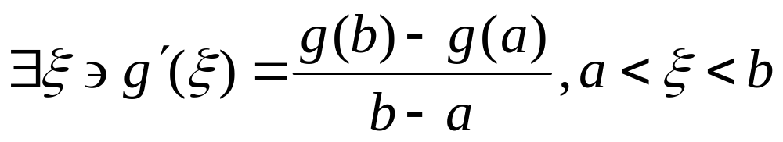
Convergence Criterion
If the x_{i} converge, then their difference diminishes
  In other words |x_{i+1} – x_{i}| decreases
By the Mean Value Theorem:

Slide 7
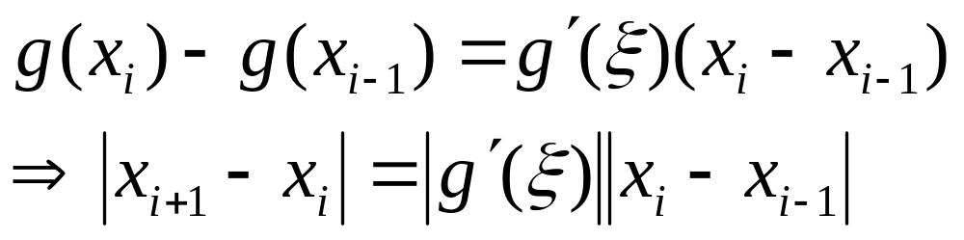
Convergence Criterion
(continued)
Let a = x_{i-1}, b = x_{i} in the MVT
Remember that x_{i+1} = g(x_{i})

Slide 8
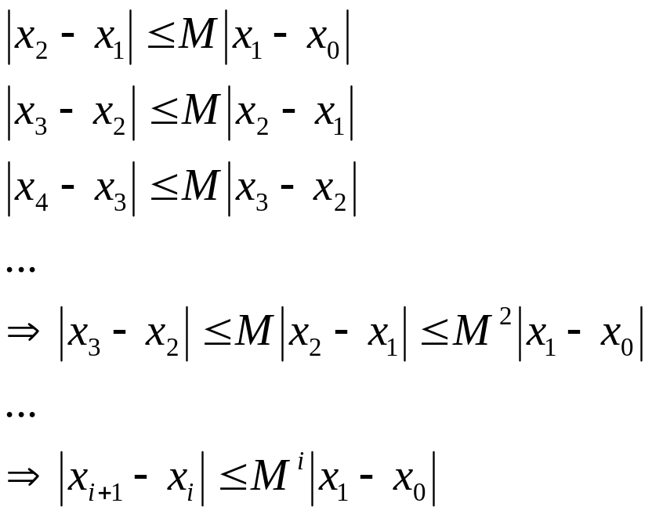
Convergence Criterion
(continued)
Suppose that the derivative of g(x) is bounded in the region of interest, say |g(x)| <= M
The reasoning that follows shows that |g(x)| < 1 will guarantee convergence:

Slide 9
Order of Convergence
The smaller the first derivative, the faster the iteration will converge
  If the first derivative is zero, it will converge an order of magnitude faster
  We will show this by looking at the Taylor series
Definition:
  The Order of Convergence of an iterative method is the order of its lowest, non-zero derivative
  Simple iteration as we just saw is linear
    Because the first derivative is not necessarily 0

Slide 10
Newton’s Method
An iterative method with a quadratic order of convergence (g'(r) = 0)
Uses g(x) = x – f(x)/f'(x)
Two derivations:
  Taylor Series
  Geometric

Slide 11
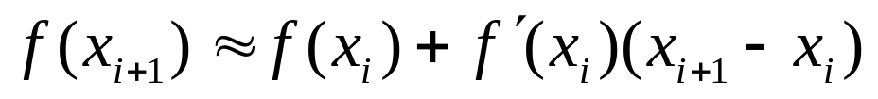
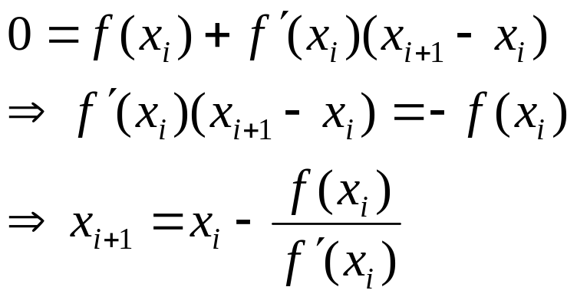
Newton’s Method
Taylor Series Approach
Expand f(x) about x_{i} at x_{i+1}, and drop terms after second term:
We want the iterates to approach zero, so substitute 0 for f(x_{i+1}) on the left:

Slide 12
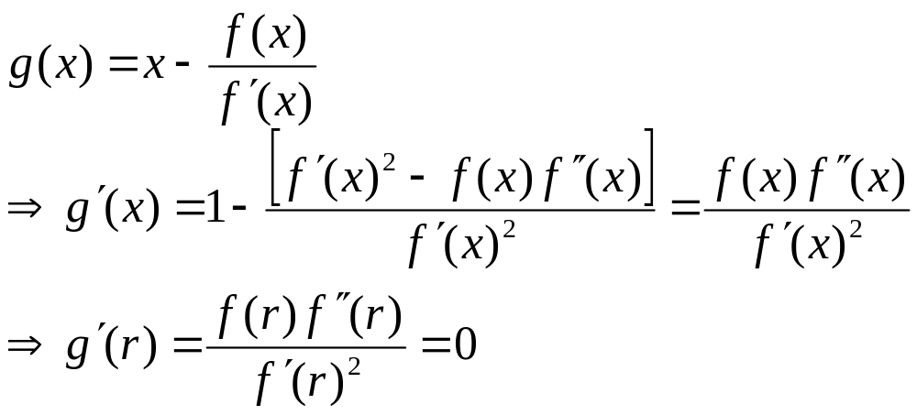
Newton’s Method
Order of Convergence
Newton’s method is quadratic because g'(r) = 0 (remember f(r) = 0):

Slide 13
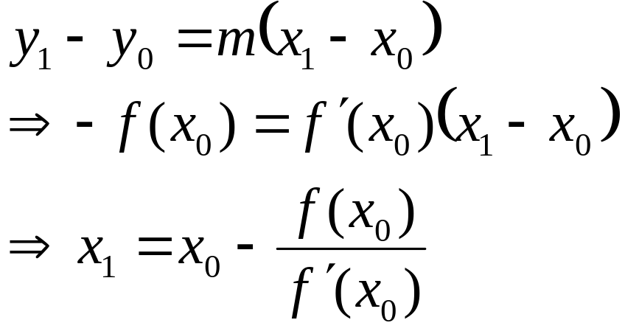
Newton’s Method
Geometric Approach
Given a guess x₀, x₁ is obtained by finding where the tangent line at (x₀, f(x₀)) intersects the x-axis
The line can be found by setting y₁ to 0 and solving the following for x₁:

Slide 14
Newton’s Method
Problems
The obvious problem is the divisor f'(x)
  If it’s zero, bad news!
  Happens when you have a double root (like the vertex of a parabola on the x-axis (y = x²)
    Because the first derivative is zero (horizontal)
The closer the derivative goes to zero, the worse Newton’s Method behaves
  It can spin forever if there’s no real root (like x² + 2 = 0)

Slide 15
Complex Roots
Can just use Newton’s method with complex numbers
  Must start with a non-zero imaginary part!
  In C++ we use the complex class template
  See cnewton.cpp
Can also solve an equivalent system of real equations
  But we’ll skip that (it’s mathy)

Slide 16
Secant Method
Like Newton’s Method, but uses the difference approximation to f'(x)
Order of Convergence ≈ 1.618
  (1 + √5)/2 (Fibonacci!)
Only requires 1 function evaluation per iteration
  Newton’s requires two
See secant.cpp (see next two slides first)

Slide 17
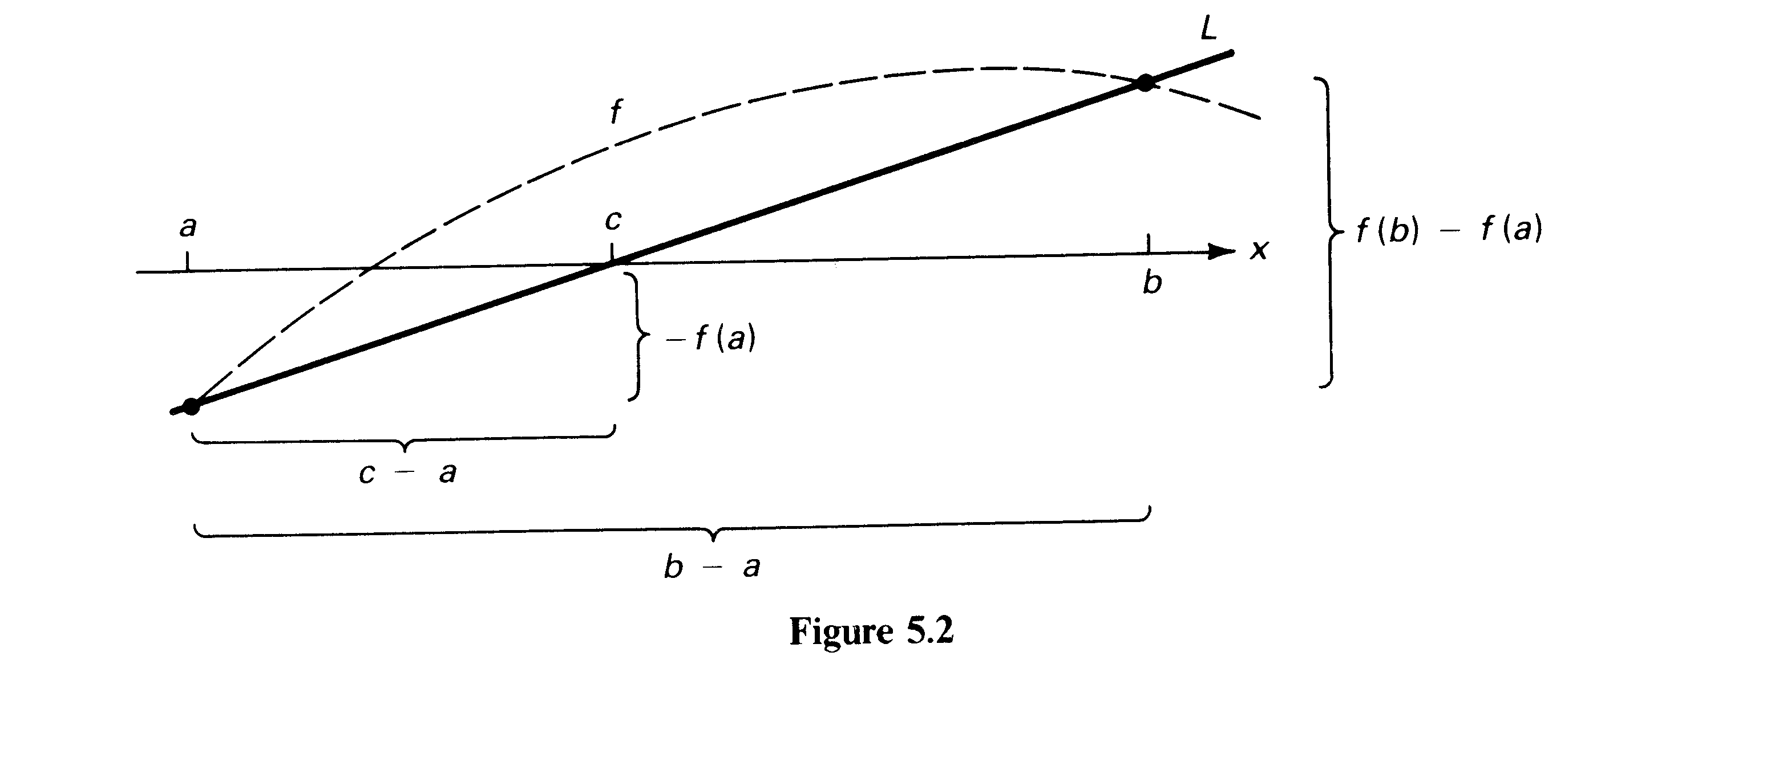
Secant Method

Slide 18
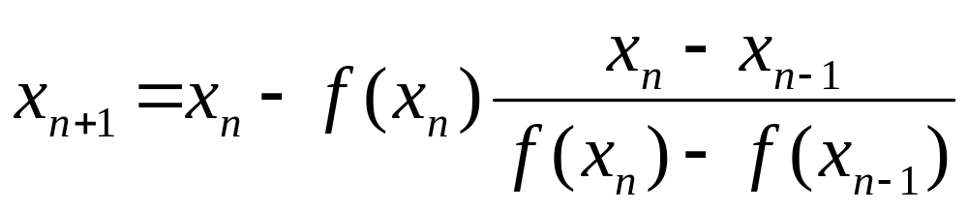
Secant Method
Problems
Requires 2 initial guesses
Can still divide by 0
Two places where cancellation can occur

Slide 19
Bracketing Methods
Begin with the endpoints of an interval that “bracket” a root
  Signs of f(a) and f(b) differ
  A root is guaranteed to be found
Bisection (bisect.cpp)
  Halves the interval, like binary search
  Sure, but slow
False Position
  Like secant, but maintains the bracketing behavior
  Also quite slow

Slide 20
Hybrid Methods
Combine the safety of bracketing methods with the speed of iterative methods
Program 4
  Will use secant/false position
    But maintains bracketing
  Also will use a “secondary secant”
    To reduce interval at both ends
  Reverts to bisection if the secants “stray”

Slide 21
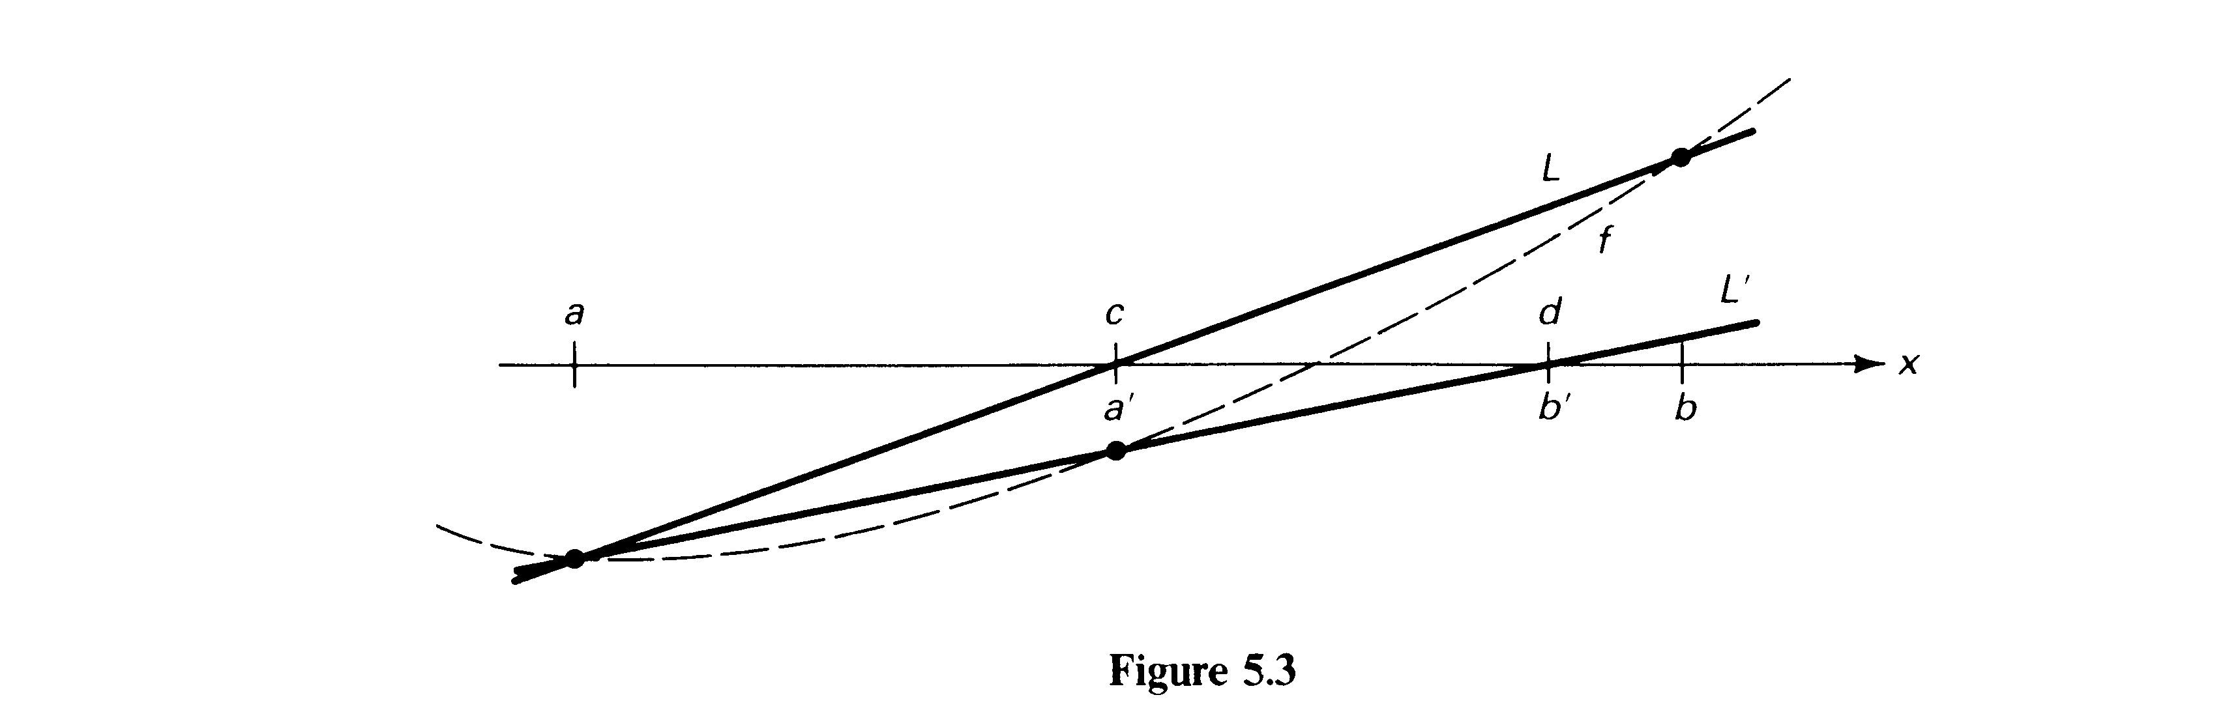
Secondary Secants
Connect f(a) to f(c)
Replace [a, b] by [c, d]

Slide 22
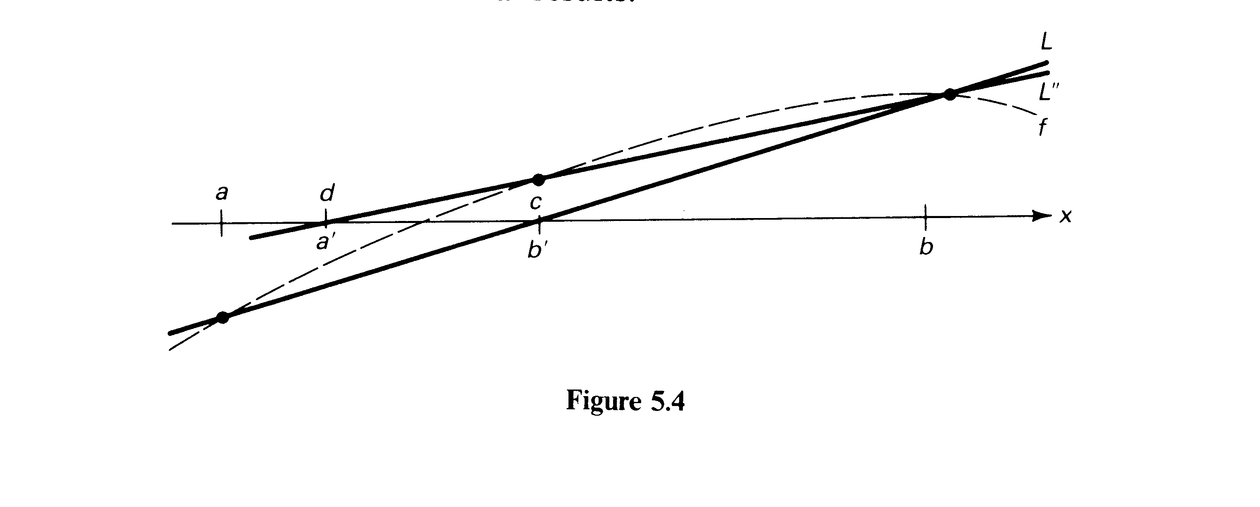
Secondary Secants
Or, replace [a, b] by [d, c]
  Governed by what will maintain a sign change

Slide 23
Program 4
(Approximately 100 lines of code)
Tricky to write correctly and efficiently
  Remember to minimize function evaluations
    Only 3 per iteration
  My current version uses goto’s to navigate back and forth between bisection and secant (but I’m working on an OO version)
Procedure (other optimizations will appear in spec):
  Every time you evaluate f, check to see if it’s 0 (you’ve found a root!)
  Try secant first
  If c hits an endpoint, or d falls outside [a,b], bisect instead
  If the new [a,b] is more than half the length of the previous interval, bisect instead
  Every time you bisect, you go back to the secant step and try again
  Exit when f evaluates to 0 for a, b, c, or d, or if the bisection step narrows to 1 ulp

