Slide 1


Exceptions
Prepared especially for Novell Custom Development
December 15-18, 2003
Copyright 2003, Fresh Sources, Inc.

Slide 2

Agenda
Error Handling
The C++ Exception Model
Resource Management
Standard Exceptions
Exception Specifications
Exception Safety

Slide 3
Pop Quiz
What does printf( ) return?

Slide 4
Revealing Question
When was the last time you checked the return value from printf( )?

Slide 5
Return Codes
An inferior form of error handling
Nothing forces you to check them
If you check them fastidiously, your code sucks pond water in the Readability Department
In addition, you always burn CPU cycles checking them, whether an error occurs or not

Slide 6
Error Handling with Exceptions
Forces you to defend yourself
Separates error handling code from the source of error
  The source detects, but doesn’t know how to handle
Localizes error handling code, reducing clutter
Saves CPU cycles if no errors occur
  End user errors are the “exception”, not the rule

Slide 7
The C++ Exception Model
Very similar to Java’s
  C++ came first, of course!
Uses try blocks to introduce exception handling code at strategic places in code
  Via a catch clause
Exceptions are raised via the throw keyword
Execution backtracks to an appropriate handler
Execution resumes after the last handler below a try block

Slide 8
C++ vs. Java Exceptions
The compiler does not force you to handle exceptions
  But execution may abort
  Handle them or die!
You can throw anything
  Primitives or objects
  It’s best to use objects, though
Exception specifications (like “throws” in Java) are enforced at runtime
  Except for one special case
Example: NonLocal2.cpp

Slide 9
Catching an Exception
One or more handlers may follow a try block
They are tested in order of appearance
The first “matching” handler is executed
An exception matches a handler if:
  It is the same type as the catch parameter
  It is derived from the catch type
  A void* catch type will match any pointer type
  catch(…) catches anything
Always place the most specific handlers first

Slide 10
Standard Conversions “Gotcha”
Standard Conversions aren’t applied
  A long handler may not handle an int
    Of course, you shouldn’t throw primitives anyway!
  But applies to user-defined types too
Example: Autoexcp.cpp

Slide 11
Throwing an Exception
The exception object travels back up the call chain
  Execution backtracks until a matching handler is found
Some very useful things happen along the way…

Slide 12
Stack Unwinding
As execution backtracks to a matching exception handler, the runtime stack is “unwound”
The destructors for all local objects execute
  So resources aren’t leaked
  No need for a finally clause
    Provided you use RAII!
Example: Cleanup.cpp

Slide 13
A Curiosity
The statement “throw Foo( )” creates an exception object in its scope
How is that object eventually made available in the scope of the handler?

Slide 14
Exceptions are Copies
A copy of the exception object is made
So exceptions must be copyable!
  Must have an accessible copy constructor
  Which is usually the case
If you catch by value, another copy is made
  Normal call-by-value semantics
Therefore: always catch exceptions by reference!
  Catching by pointer is problematic
    Is it on the heap?
    Who owns it?

Slide 15
How does all this really work?
throw is conceptually like a function call
  Takes the exception object as a “parameter”
This special “function” backtracks up the program stack (the dynamic call chain)
  Reading information placed there by each function invocation
    Information placed in each “Stack Frame”
    About each function’s local objects and try blocks
If no matching handler is found in a function, local objects’ are destroyed and the search continues
  Until a matching handler is found
  Or terminate( ) is ultimately called

Slide 16
Space Overhead
struct C
{
~C(){}
};
void g(); // for all we know, g may throw
void f()
{
C c; // Destructor must be called
g();
}

Slide 17
Compiler Exception Support
Microsoft Visual C++ .NET (-GX)
  1,420 bytes vs. 2,069 bytes
Borland C++ Builder 6.0 (-x-)
  813 bytes vs. 2,150 bytes

Slide 18
Runtime Overhead
Two Types
  Adding exception-related info to each stack frame
  The work done during stack unwinding
    This is good overhead, since you want things cleaned up
    Following return-code paths the old-fashioned way has a cost too, you know!

Slide 19
The Zero-cost Model
Adorning each stack frame with exception-related info can have a runtime cost
Can be avoided
  Offsets for objects with destructors can be computed once at compile time and stored outside the runtime stack
GNU and Metrowerks compilers currently support this

Slide 20
An “Alternative” to RAII
Catch any exception
  With catch(…)
Don’t handle it
  Just deallocate your resource
  Then rethrow the exception:
    throw;
Requires deallocation in two places, however
  So finally is better than this approach

Slide 21
Uncaught Exceptions
If no handler exists for an exception, the program terminates
  Like in Java, the thread terminates
Actually, std::terminate() is called
  Which calls abort()
You can override this behavior
  But you should terminate the program anyway
  Maybe log a message first, close connections, etc.
Example: Terminator.cpp

Slide 22
Resource Management
When an exception occurs you want to guard against resource leaks
Solution is simple:
  Use RAII
Examples: Wrapped.cpp, Auto_ptr.cpp

Slide 23
Exceptions in Constructors
No problem normally
  Just catch them
But what if a base class destructor throws when creating a derived object?
  Usually no big deal, unless you want to handle it immediately
    During the construction of the derived object
Can catch in the initializer list
Example: InitExcept.cpp

Slide 24
Standard Exceptions
A standard way of categorizing exceptions
Two broad categories:
  runtime_error
    For unforeseen errors, like java.lang.Exception
  logic_error
    For careless programmer errors, like java.lang.RuntimeException
  Both declared in <stdexcept>
  Both derive from std::exception
    Declared in <exception>
All exceptions thrown by the standard library are in this hierarchy
Example: StdExcept.cpp

Slide 25
Exception Specifications
Adorns function declarations
  Like in Java, but optional
  Uses the throw keyword (not throws)
    Plus parentheses around the list of types
    “throw( )” means no exceptions will occur
Enforced at runtime
  If an unexpected exception occurs:
    std::unexpected( ) executes
    Which calls std::terminate( )
Example: Unexpected.cpp

Slide 26
Covariance of Exception Specifications
The one error caught at compile time
An override in a derived class should be compatible with the base class version
  No new exceptions should be possible
    Not fair to user!
  Compatible exceptions are okay
    Derived from those in base class function
Example: Covariance.cpp (next two slides)

Slide 27
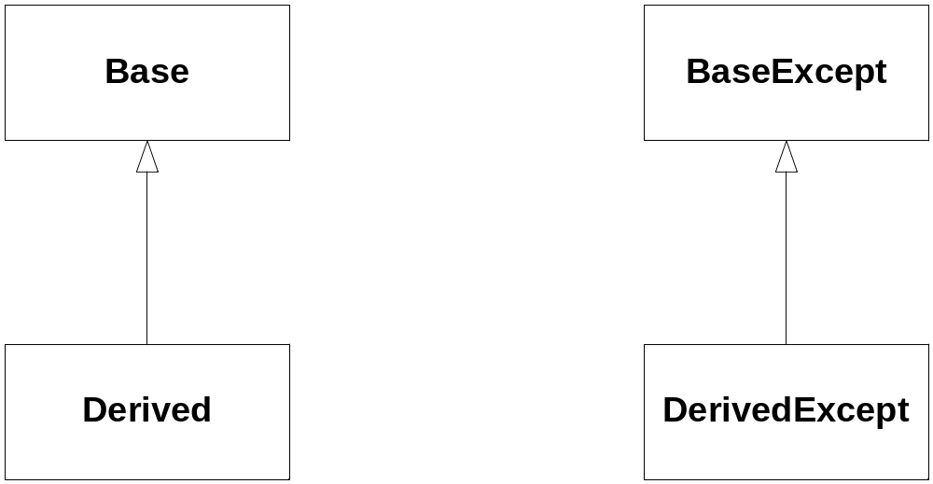

Slide 28
class Base
{
public:
virtual void f() throw(BaseExcept);
};
class Derived : public Base
{
public:
// Any of these three is okay:
// void f() throw(BaseExcept);
// void f() throw(DerivedExcept);
// void f() throw() {}
// These would be errors (caught at compile time):
// void f() throw(RogueExcept);
// void f() {}
};

Slide 29
What if g() throws?
void f() throw(A,B)
{
// Whatever…, then:
g();
}

Slide 30
Pretty Good Idea…
If f() calls g(), and g() has no exception specification, don’t declare an exception specification for f()

Slide 31
Exception Specifications and Templates
They just don’t mix!
You never know what a generic type might do
  Containers call copy constructors and assignment operators a lot
    Which can throw exceptions
Especially crucial with container design
You can use throw( ), of course

Slide 32
Rule of Generic Container Design
Don’t use Exception Specifications with generic containers
Instead, document the exception you know about
  This is what the Standard Library does
  It only uses throw( )

Slide 33
What’s Wrong Here?
void StackOfInt::grow()
{
// (Fields are capacity and data)
// Enlarge stack’s data store
capacity += INCREMENT;
int* newData = new int[capacity];
for (size_t i = 0; i < count; ++i)
newData[i] = data[i];
delete [] data;
data = newData;
}

Slide 34
An Improvement
void StackOfInt::grow()
{
// Enlarge stack’s data store
size_t newCapacity = capacity + INCREMENT;
int* newData = new int[newCapacity];
for (size_t i = 0; i < count; ++i)
newData[i] = data[i];
// Update state only when "safe" to do so
delete [] data;
data = newData;
capacity = newCapacity; // moved
}

Slide 35
Fundamental Principle of Exception Safety
Separate operations that may throw from those that change state
  only change state when exceptions can no longer occur
Corollary:
  Do one thing at a time (cohesion)
  why std::stack<T>::pop() returns void
    The returned copy might throw during construction
      and the state has changed!

Slide 36
Rules of Exception Safety
If you can’t handle an exception, let it propagate up (“Exception neutral”)
Leave your data in a consistent state
  Use RAII to allocate resources
  Only change your state with non-throwing ops
  An object should only own one resource
Functions should perform only one logical operation
Destructors should never throw
Good references:
  Sutter, Exceptional C++ and More Exceptional C++
  Abrahams, www.boost.org/more/generic_exeption_safety.html

Slide 37
Levels of Exception Safety
(David Abrahams)
Basic Guarantee
  No resources will be leaked
  Good, but not always sufficient
    State may be “consistent”, but not “acceptable”
Strong Guarantee
  No changes will occur if an exception happens
  Requires roll-back semantics (not always possible)
    Iterators may be invalidated, for example
No-throw Guarantee
  No exceptions will escape
  Required of destructors and swap( )

Slide 38
A Safe operator=( )
First provide a swap member function that doesn’t throw
  Just swap state (ptrs and ints) with std::swap
Then op= swaps its rhs value parameter
  No need to worry about self-assignment (value parm)
template<class T>
Stack<T>& Stack::operator=(Stack<T> rhs)
{
swap(rhs); // Stack<T>::swap(Stack<T>&)
return *this;
}
Another alternative:
  See SafeAssign.cpp

Slide 39
Really Good Idea…
Don’t let an exception escape from a destructor.
If you see no alternative, however, make sure an exception isn’t pending with the uncaught_exception() library function, then proceed.
  I’ve never seen it done

Slide 40
Exercises
Do 6, 7, 8.

