Slide 1

The Java 2 Collections
Chuck Allison
http://www.freshsources.com

Slide 2


Agenda
java.util.Arrays
Comparators and java.util.Comparable
Collections
java.util.Collections
Maps
An Application

Slide 3
Foreword
Data Structures are OLD
Useful generic data structures are RECENT
Useful Collections in Java are QUITE NEW
If you know STL, Java 2 doesn’t have:
  function objects (except Comparator)
  customizable algorithms (except via Comparators)
  queues, stacks, deques, priority queues
    but you can use LinkedList for the first 3

Slide 4

java.util.Arrays
Algorithms for array processing:
  binarySearch
  equals
  fill
  sort
    unstable quicksort for primitives
    stable mergesort for Objects
  asList (to use List methods discussed later)
Overloaded for Object and all Primitives

Slide 5
Arrays.binarySearch
Requires a sorted list
  Ascending only!
Returns 0-based index
  Where found (if non-negative), or
  Where belongs (if negative)
    -1 => 0; -2 => 1, -3 => 2; …
    Formula: rval = -index – 1
    Compute: -(rval + 1)

Slide 6
import java.util.*;
class ArraysTest
{
static void printArray(int[] a)
{
System.out.print("[");
for (int i = 0; i < a.length; ++i)
{
System.out.print(a[i]);
if (i < a.length-1)
System.out.print(",");
}
System.out.println("]");
}

Slide 7
static void search(int[] a, int x)
{
// Must be in ascending order:
int where = Arrays.binarySearch(a, x);
if (where < 0)
{
where = -(where + 1);
if (where == a.length)
System.out.println("Append " + n +
" to end of list");
else
System.out.println("Insert " + n +
" before " +
a[where]);
}
else
System.out.println("Found " + n +
" in position " +
where);
}

Slide 8
public static void main(String[] args)
{
// Build Array:
int[] array = {88, 17, -10, 34, 27, 0, -2};
System.out.print("Before sorting: ");
printArray(array);
// Sort:
Arrays.sort(array);
System.out.print("After sorting: ");
printArray(array);
/* Output:
Before sorting: [88,17,-10,34,27,0,-2]
After sorting: [-10,-2,0,17,27,34,88]
*/

Slide 9
// Search:
search(array, -10);
search(array, -1);
search(array, 0);
search(array, 1);
search(array, 34);
search(array, 100);
/* Output:
Found -10 in position 0
Insert -1 before 0
Found 0 in position 2
Insert 1 before 17
Found 34 in position 5
Append 100 to end of list
*/

Slide 10
// Equals:
System.out.println("array == array? " +
Arrays.equals(array,
array));
int[] ones = new int[array.length];
Arrays.fill(ones, 1);
System.out.println("array == ones? " +
Arrays.equals(array, ones));
}
}
/* Output:
array == array? true
array == ones? false
*/

Slide 11
Arrays.sort “Feature”
Can only sort Primitives in ascending order
Sorting Object arrays allows a Comparator
  override compare( ) method
  strcmp-like semantics
  should be consistent with equals
    return 0

Slide 12
The Comparator Interface
int compare(Object o1, Object o2)
boolean equals(Object o)
  Don’t have to supply if not used
    Because inherited from Object

Slide 13
A Descending Comparator
import java.util.*;
class Descending implements Comparator
{
// Works for Integers only:
public int compare(Object o1, Object o2)
{
Integer c1 = (Integer) o1;
Integer c2 = (Integer) o2;
return -c1.compareTo(c2); // - 0 +
}
}

Slide 14
The Comparable Interface
Interface with one method
  int compareTo(Object o)
  strcmp-like semantics
Implemented by String, Date, and all Primitive Wrappers

Slide 15
A Generic Comparator
import java.util.*;
class Descending implements Comparator
{
// Works for any Comparable object:
public int compare(Object o1, Object o2)
{
Comparable c1 = (Comparable) o1;
Comparable c2 = (Comparable) o2;
return -c1.compareTo(c2);
}
}

Slide 16
import java.util.*;
class ArraysTest2
{
static Descending desc = new Descending();
static void printArray(Object[] a)
{
// (same as before)
}
static void search(Object[] a, Object x)
{
int where = Arrays.binarySearch(a, x, desc);
// (rest as before)
}

Slide 17
public static void main(String[] args)
{
// Build Array:
Integer[] array = {new Integer(88),
new Integer(17), new Integer(-10),
new Integer(34), new Integer(27),
new Integer(0), new Integer(-2)};
System.out.println("Before sorting:");
printArray(array);
// Sort via Comparator:
Arrays.sort(array, desc);
System.out.println("After sorting:");
printArray(array);
/* Output:
Before sorting:
{88,17,-10,34,27,0,-2}
After sorting:
{88,34,27,17,0,-2,-10}
*/

Slide 18
// Search:
search(array, new Integer(-10));
search(array, new Integer(-1));
search(array, new Integer(0));
search(array, new Integer(1));
search(array, new Integer(34));
search(array, new Integer(10));
}
}
/* Output:
Found -10 in position 6
Insert -1 before -2
Found 0 in position 4
Insert 1 before 0
Found 34 in position 1
Insert 10 before 0
*/

Slide 19
Collections.reverseOrder( )
// Use the following instead of Descending:
static Comparator desc =
Collections.reverseOrder();

Slide 20
User-defined Types
public class Person implements Comparable, Cloneable
{
private String name;
private int year;
private int month;
private int day;
public Person(String name, int year, int month,
int day)
{
this.name = new String(name);
this.year = year;
this.month = month;
this.day = day;
}
public String getName()
{
return name;
}

Slide 21
// Override Object methods:
public Object clone()
{
try
{
Person p = (Person) super.clone();
p.name = new String(name);
return p;
}
catch (CloneNotSupportedException x)
{
throw new InternalError(x.toString());
}
}
public boolean equals(Object o)
{
if (o instanceof Person)
{
Person p = (Person) o;
return name.equals(p.name) &&
year == p.year &&
month == p.month &&
day == p.day;
}
else
return false;
}

Slide 22
public int hashCode()
{
int hval = name.hashCode() + year;
hval = (hval << 4) + month;
hval = (hval << 4) + day;
return hval;
}
public String toString()
{
return '{' + name + ',' + month +
'/' + day + '/' + year + '}';
}
// Implement Comparable:
public int compareTo(Object o)
{
Person p = (Person)o;
int result = name.compareTo(p.name);
if (result == 0)
{
result = (year - p.year);
result = result*16 + (month - p.month);
result = result*16 + (day - p.day);
}
return result;
}
}

Slide 23
import java.util.*;
class ArraysTest3
{
static void printArray(Object[] a)
{
System.out.print("[");
for (int i = 0; i < a.length; ++i)
{
System.out.print(a[i]);
if (i < a.length-1)
System.out.println(",");
else
System.out.println("]");
}
}
static void search(Object[] a, Object x)
{
int where = Arrays.binarySearch(a, x);
// (rest as before)
}

Slide 24
public static void main(String[] args)
{
// Build Array:
Person[] array = new Person[3];
array[0] = new Person("Horatio", 1835,12,6);
array[1] = new Person("Charles",1897,3,11);
array[2] = new Person("Albert",1901,1,20);
System.out.println("Before sorting:");
printArray(array);
/* Output:
Before sorting:
[{Horatio,12/6/1835},
{Charles,3/11/1897},
{Albert,1/20/1901}]
*/

Slide 25
// Sort:
Arrays.sort(array);
System.out.println("After sorting:");
printArray(array);
/* Output:
After sorting:
{{Albert,1/20/1901},
{Charles,3/11/1897},
{Horatio,12/6/1835}}
*/

Slide 26
// Search:
search(array, array[1].clone());
search(array,
new Person("Gregory", 1582, 10, 15));
}
}
/* Output:
Found {Charles,3/11/1897} in position 1
Insert {Gregory,10/15/1582} before {Horatio,12/6/1835}
*/

Slide 27
Sorting by Key
import java.util.*;
class ByName implements Comparator
{
public int compare(Object o1, Object o2)
{
Person p1 = (Person) o1;
Person p2 = (Person) o2;
return p1.getName().compareTo(p2.getName());
}
}
class ArraysTest4
{
static ByName comp = new ByName();

Slide 28
static void search(Object[] a, Object x)
{
// (as before)
}
public static void main(String[] args)
{
// Build Array:
Person[] array = new Person[3];
array[0] = new Person("Horatio", 1835,12,6);
array[1] = new Person("Charles",1897,3,11);
array[2] = new Person("Albert",1901,1,20);
Arrays.sort(array, comp);
search(array, array[1]);
search(array, new Person("Fred",0,0,0));
search(array, new Person("Joe",0,0,0));
}
}
/* Output:
Found {Charles,3/11/1897} in position 1
Insert {Fred,0/0/0} before {Horatio,12/6/1835}
Append {Joe,0/0/0} to end of list
*/

Slide 29
Collections
Implement the Collection interface
Must provide the following constructors:
  C( ) {…}
  C(Collection c) {…}
Modifiers are optional
  can throw UnsupportedOperationException
  standard implementations don’t throw

Slide 30
interface Collection
{
boolean add(Object o);
boolean addAll(Collection c);
void clear();
boolean contains(Object o);
boolean containsAll(Collection c);
boolean equals(Object o);
int hashCode();
boolean isEmpty();
Iterator iterator();
boolean remove(Object o);
boolean removeAll(Collection c);
boolean retainAll(Collection c);
int size();
Object[] toArray();
Object[] toArray(Object[] a);
}

Slide 31
Iterators
Traverse a Collection
Like Enumeration, only better
  can remove objects
  ListIterator can modify elements
“Fail Fast” Operation
  exception thrown if collection is modified externally (i.e., not via the iterator itself)

Slide 32
interface Iterator
{
boolean hasNext();
Object next();
void remove();
}

Slide 33
Collection Interface Hierarchy
Collection
List

Slide 34
// List defines a Sequence
interface List extends Collection
{
// Everything from Collection plus:
void add(int index, Object element)
Object get(int index)
int indexOf(Object o)
int lastIndexOf(Object o)
ListIterator listIterator()
ListIterator listIterator(int index)
Object remove(int index)
Object set(int index, Object element)
List subList(int fromIndex, int toIndex)
}

Slide 35
interface ListIterator extends Iterator
{
// Everything from Iterator plus:
void add(Object o);
boolean hasPrevious();
int nextIndex();
Object previous();
int previousIndex();
void set(Object o);
}

Slide 36
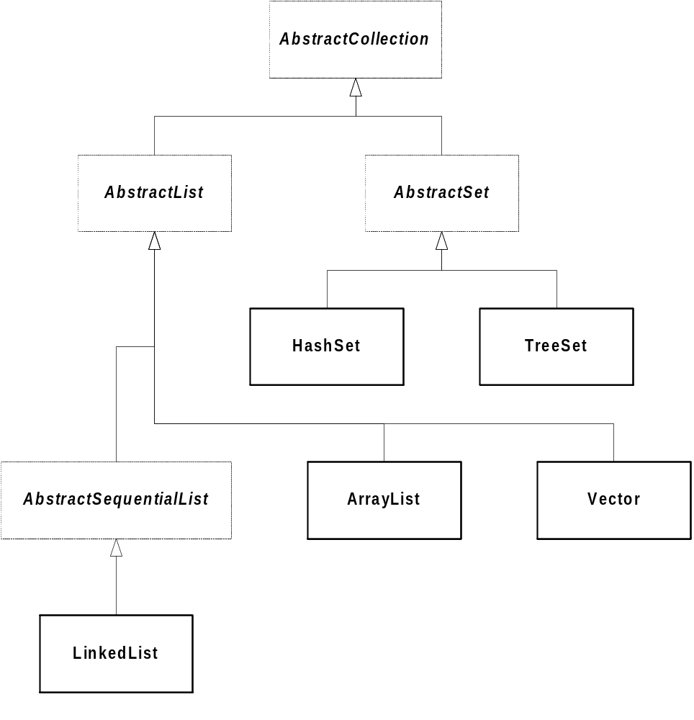
Implementations

Slide 37
import java.util.*;
class ListTest
{
public static void test(List x)
{
// Do a linear search:
Object p = x.get(2);
if (x.contains(p))
System.out.println("Found " + p);
// Do another:
int index = x.indexOf(p);
if (index != -1)
System.out.println("Found " + p +
" in position "
+ index);

Slide 38
// Do a binary search:
Collections.sort(x);
System.out.println(x);
index = Collections.binarySearch(x, p);
if (index >= 0)
System.out.println("Found " +
p + " in position "
+ index);
// Misc:
System.out.println("max == " +
Collections.max(x));
System.out.println("min == " +
Collections.min(x));
Comparator desc = Collections.reverseOrder();
System.out.println("max (desc) == " +
Collections.max(x, desc));
System.out.println("min (desc) == " +
Collections.min(x, desc));
Collections.shuffle(x);
iterate(x);
}

Slide 39
public static void iterate(Collection c)
{
System.out.println("Iterating...");
Iterator i = c.iterator();
while (i.hasNext())
System.out.println(i.next());
}

Slide 40
public static void main(String[] args)
{
// Build ArrayList:
ArrayList array = new ArrayList();
array.add(new Person("Horatio", 1835,12,6));
array.add(new Person("Charles",1897,3,11));
array.add(new Person("Albert",1901,1,20));
System.out.println(array);
/* Output:
[{Horatio,12/6/1835}, {Charles,3/11/1897}, {Albert,1/20/1901}]
*/

Slide 41
test(array);
/* Output:
Found {Albert,1/20/1901}
Found {Albert,1/20/1901} in position 2
[{Albert,1/20/1901}, {Charles,3/11/1897}, {Horatio,12/6/1835}]
Found {Albert,1/20/1901} in position 0
max == {Horatio,12/6/1835}
min == {Albert,1/20/1901}
max (desc) == {Albert,1/20/1901}
min (desc) == {Horatio,12/6/1835}
Iterating...
{Horatio,12/6/1835}
{Charles,3/11/1897}
{Albert,1/20/1901}
*/

Slide 42
array.add(new Person("James", 1976, 8, 13));
System.out.println(array);
System.out.println();
/* Output:
[{Horatio,12/6/1835}, {Charles,3/11/1897}, {Albert,1/20/1901}, {James,8/13/1976}]
*/

Slide 43
// Build LinkedList:
LinkedList list = new LinkedList(array);
List view = list.subList(1,3);
view.add(new Person("Gregory", 1582, 10, 15));
Collections.reverse(view);
System.out.println(list);
/* Output:
[{Horatio,12/6/1835}, {Gregory,10/15/1582}, {Albert,1/20/1901}, {Charles,3/11/1897}, {James,8/13/1976}]
*/

Slide 44
test(list);
}
}
/* Output:
Found {Albert,1/20/1901}
Found {Albert,1/20/1901} in position 2
[{Albert,1/20/1901}, {Charles,3/11/1897}, {Gregory,10/15/1582}, {Horatio,12/6/1835}, {James,8/13/1976}]
Found {Albert,1/20/1901} in position 0
max == {James,8/13/1976}
min == {Albert,1/20/1901}
max (desc) == {Albert,1/20/1901}
min (desc) == {James,8/13/1976}
Iterating...
{Gregory,10/15/1582}
{Horatio,12/6/1835}
{James,8/13/1976}
{Albert,1/20/1901}
{Charles,3/11/1897}
*/

Slide 45
class Collections
{
static List EMPTY_LIST;
static Set EMPTY_SET;
static int binarySearch(List list, Object key);
static int binarySearch(List list, Object key,
Comparator c);
static void copy(List dest, List src);
static Enumeration enumeration(Collection c);
static void fill(List list, Object o);
static Object max(Collection coll);
static Object max(Collection coll,
Comparator comp);
static Object min(Collection coll);
static Object min(Collection coll,
Comparator comp);
static List nCopies(int n, Object o);
static void reverse(List l);
static Comparator reverseOrder();
static void shuffle(List list);
static void shuffle(List list, Random rnd);
static Set singleton(Object o);

Slide 46
static void sort(List list);
static void sort(List list, Comparator c);
static Collection
synchronizedCollection(Collection c);
static List synchronizedList(List list);
static Map synchronizedMap(Map m);
static Set synchronizedSet(Set s);
static SortedMap
synchronizedSortedMap(SortedMap m);
static SortedSet
synchronizedSortedSet(SortedSet s);
static Collection
unmodifiableCollection(Collection c);
static List unmodifiableList(List list);
static Map unmodifiableMap(Map m);
static Set unmodifiableSet(Set s);
static SortedMap
unmodifiableSortedMap(SortedMap m);
static SortedSet
unmodifiableSortedSet(SortedSet s);
}

Slide 47
Collections.binarySearch
Random-access lists sort in log(n) time
Arbitrary sequences sort in n*log(n) time
Instances of AbstractSequentialList in O(n)
  e.g., LinkedList

Slide 48
// Modify.java:
// Uses an iterator to
// modify a collection.
import java.util.*;
class Modify
{
public static void main(String[] args)
{
// Build Array:
ArrayList a = new ArrayList();
a.add(new Integer(1));
a.add(new Integer(2));
a.add(new Integer(3));
System.out.println(a);
/* Output:
[1, 2, 3]
*/

Slide 49
// Modify via iterator:
ListIterator p =
(ListIterator) a.listIterator();
while (p.hasNext())
{
Integer i = (Integer) p.next();
p.set(new Integer(i.intValue()
+ 1));
}
System.out.println(a);
}
}
/* Output:
[2, 3, 4]
*/

Slide 50
Queues, Stacks and Deques
Not there!
Use LinkedList
  addFirst, addLast
  removeFirst, removeLast
  getFirst, getLast

Slide 51
import java.util.*;
class Queue
{
private LinkedList data;
public Queue()
{
data = new LinkedList();
}
public void put(Object o)
{
data.addFirst(o);
}
public Object get()
throws NoSuchElementException
{
return data.removeLast(); // change for Stack
}
public int size()
{
return data.size();
}
}

Slide 52
class QueueTest
{
public static void main(String[] args)
{
Queue q = new Queue();
q.put(new Integer(1));
q.put(new Integer(2));
q.put(new Integer(3));
while (q.size() > 0)
System.out.println((Integer) q.get());
}
}
/* Output:
1
2
3
*/

Slide 53
Sets
Mathematical Set Abstraction
No Duplicates
Two Interfaces
  Set (Identical to Collection)
  SortedSet
Two Implementations
  HashSet, TreeSet

Slide 54
interface Set extends Collection
{
//(same as Collection - specifies no duplicates)
}
interface SortedSet extends Set
{
Comparator comparator();
Object first();
SortedSet headSet(Object toElement);
Object last();
SortedSet subSet(Object fromElement,
Object toElement);
SortedSet tailSet(Object fromElement);
}

Slide 55
import java.util.*;
class SetTest
{
public static void test(Set x)
{
// Do a search:
Person p = new Person("Albert",1901,1,20);
if (x.contains(p))
System.out.println("Found " + p);
// Misc:
System.out.println("max == " +
Collections.max(x));
System.out.println("min == " +
Collections.min(x));
iterate(x);
}

Slide 56
public static void iterate(Collection c)
{
System.out.println("Iterating...");
Iterator i = c.iterator();
while (i.hasNext())
System.out.println(i.next());
}

Slide 57
public static void main(String[] args)
{
// Build HashSet:
HashSet h = new HashSet();
h.add(new Person("Horatio", 1835,12,6));
h.add(new Person("Charles",1897,3,11));
h.add(new Person("Albert",1901,1,20));
// The following is ignored:
h.add(new Person("Albert",1901,1,20));
System.out.println(h);
/* Output:
[{Charles,3/11/1897}, {Albert,1/20/1901}, {Horatio,12/6/1835}]
*/

Slide 58
test(h);
/* Output:
Found {Albert,1/20/1901}
max == {Horatio,12/6/1835}
min == {Albert,1/20/1901}
Iterating...
{Charles,3/11/1897}
{Albert,1/20/1901}
{Horatio,12/6/1835}
*/

Slide 59
// Build TreeSet:
TreeSet t =
new TreeSet(Collections.reverseOrder());
t.addAll(h);
System.out.println(t);
test(t);
/* Output:
[{Horatio,12/6/1835}, {Charles,3/11/1897}, {Albert,1/20/1901}]
Found {Albert,1/20/1901}
max == {Horatio,12/6/1835}
min == {Albert,1/20/1901}
Iterating...
{Horatio,12/6/1835}
{Charles,3/11/1897}
{Albert,1/20/1901}
*/

Slide 60
// Extra TreeSet stuff:
boolean ctest =
t.comparator()
.equals(Collections.reverseOrder());
System.out.println("Comparator test: " +
ctest);
System.out.println("first = " + t.first());
System.out.println("last = " + t.last());
Person p = new Person("Charles",1897,3,11);
System.out.println("headSet: " + t.headSet(p));
System.out.println("tailSet: " + t.tailSet(p));
}
}
/* Output:
Comparator test: true
first = {Horatio,12/6/1835}
last = {Albert,1/20/1901}
headSet: [{Horatio,12/6/1835}]
tailSet: [{Charles,3/11/1897}, {Albert,1/20/1901}]
*/

Slide 61
Maps
Store key/value pairs of Objects
Duplicate Keys not allowed
Not part of the Collections Hierarchy
Returns keys as a Set view
Returns values as a Collection

Slide 62
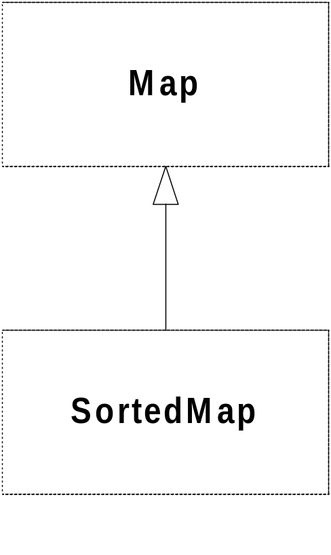
The Map Interface Hierarchy

Slide 63
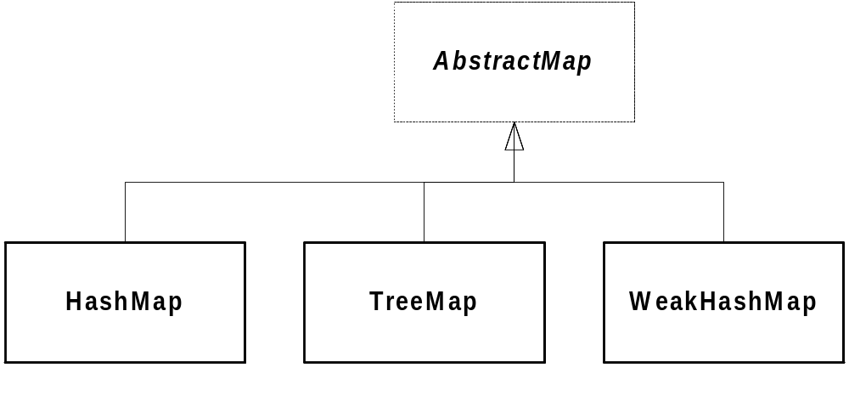
Map Implementations

Slide 64
import java.util.*;
class MapTest
{
public static void test(Map m)
{
if (m.containsKey("Alabama"))
System.out.println("Alabama is a key");
if (m.containsValue("Montgomery"))
System.out.println("Montgomery is a value");
System.out.println("m[Georgia] = " +
m.get("Georgia"));
System.out.println("m[Michigan] = " +
m.get("Michigan"));
System.out.println("Keys: " + m.keySet());
System.out.println("Values: " + m.values());
iterate(m);
}

Slide 65
public static void iterate(Map m)
{
System.out.println("Iterating...");
Set s = m.entrySet();
Iterator i = s.iterator();
while (i.hasNext())
{
Map.Entry e = (Map.Entry)(i.next());
System.out.println(e);
}
}

Slide 66
public static void main(String[] args)
{
HashMap h = new HashMap();
h.put("Alabama", "Montgomery");
h.put("Tennesee", "Nashville");
h.put("Georgia", "Savannah");
// The following value replaces "Savannah":
h.put("Georgia", "Atlanta");
System.out.println(h);
/* Output:
{Alabama=Montgomery, Georgia=Atlanta, Tennesee=Nashville}
*/

Slide 67
test(h);
/* Output:
Alabama is a key
Montgomery is a value
m[Georgia] = Atlanta
m[Michigan] = null
Keys: [Alabama, Georgia, Tennesee]
Values: [Montgomery, Atlanta, Nashville]
Iterating...
Alabama=Montgomery
Georgia=Atlanta
Tennesee=Nashville
*/

Slide 68
TreeMap t =
new TreeMap(Collections.reverseOrder());
t.putAll(h);
System.out.println(t);
test(t);
/* Output:
{Tennesee=Nashville, Georgia=Atlanta, Alabama=Montgomery}
Alabama is a key
Montgomery is a value
m[Georgia] = Atlanta
m[Michigan] = null
Keys: [Tennesee, Georgia, Alabama]
Values: [Nashville, Atlanta, Montgomery]
Iterating...
Tennesee=Nashville
Georgia=Atlanta
Alabama=Montgomery
*/

Slide 69
// Extra TreeMap Stuff:
boolean ctest =
t.comparator()
.equals(Collections.reverseOrder());
System.out.println("Comparator test: " + ctest);
System.out.println("firstKey = " +
t.firstKey());
System.out.println("lastKey = " +
t.lastKey());
System.out.println("headMap: " +
t.headMap("Georgia"));
System.out.println("tailMap: " +
t.tailMap("Georgia"));
}
}
/* Output:
Comparator test: true
firstKey = Tennesee
lastKey = Alabama
headMap: {Tennesee=Nashville}
tailMap: {Georgia=Atlanta, Alabama=Montgomery}
*/

Slide 70
An Application
Cross-reference Lister
  lists tokens and their line numbers
Uses a Map
  maps token string to a list of line numbers
  could map to a Set of line numbers, but that’s more expensive (re-balancing)
Longer than C++ version
  by 14 lines (107 vs. 93)
  but much easier to get right

Slide 71
Sample Output
*** File: Xref.java ***
a: 2, 28
Add: 45, 68
addLast: 69
already: 49
and: 45
args: 95, 98, 107, 114, 115
at: 28
boolean: 51
BufferedReader: 21, 102, 116
(etc.)

Slide 72
// Xref.java:
// Generates a token-to-line cross-reference listing
import java.util.*;
import java.io.*;
class Xref
{
// Comparator to ignore case:
static class NoCase implements Comparator
{
public int compare(Object o1, Object o2)
{
String s1 = (String) o1;
String s2 = (String) o2;
return s1.compareToIgnoreCase(s2);
}
}

Slide 73
// This method does the work:
static void process(LineNumberReader r)
throws IOException
{
TreeMap map = new TreeMap(new NoCase());
String line;
// Build map, reading a line at a time:
while ((line = r.readLine()) != null)
{
// Read each token:
String delim =
" `~!@#$%^&*()-_=+\\|[{]};:'\",<.>/?"
+ "0123456789";
StringTokenizer tokens =
new StringTokenizer(line, delim);

Slide 74
while (tokens.hasMoreTokens())
{
String token = tokens.nextToken();
if (!map.containsKey(token))
{
// Add token and empty list to map:
map.put(token, new ArrayList());
}
// See if this line is in there already:
LinkedList lines =
(LinkedList) map.get(token);
int lineno = r.getLineNumber();
if (lines.isEmpty() ||
((Integer)lines.getLast()).intValue() !=
lineno)
{
// Add line number to list:
lines.addLast(new Integer(lineno));
}
}
} // end of read-line logic

Slide 75
// Output:
Iterator p = map.entrySet().iterator();
while (p.hasNext())
{
Map.Entry e = (Map.Entry) p.next();
System.out.print(e.getKey() + ": ");
ArrayList lines = (ArrayList) e.getValue();
for (int i = 0; i < lines.size(); ++i)
{
if (i > 0)
System.out.print(", ");
System.out.print(lines.get(i));
}
System.out.println();
}
} // end of process() method

Slide 76
public static void main(String[] args)
throws IOException
{
if (args.length == 0)
{
// Process standard input:
Reader r =
new InputStreamReader(System.in);
process(new LineNumberReader(r));
}
else
{
// Process each specified file:
for (int i = 0; i < args.length; ++i)
{
if (i > 0)
System.out.println();
System.out.println("*** File: " +
args[i] + " ***");
FileReader f = new FileReader(args[i]);
process(new LineNumberReader(f));
}
}
}
}

Slide 77
~ The End ~

