Slide 1
got quality?
A Perspective on Code Quality
Chuck Allison

Slide 2
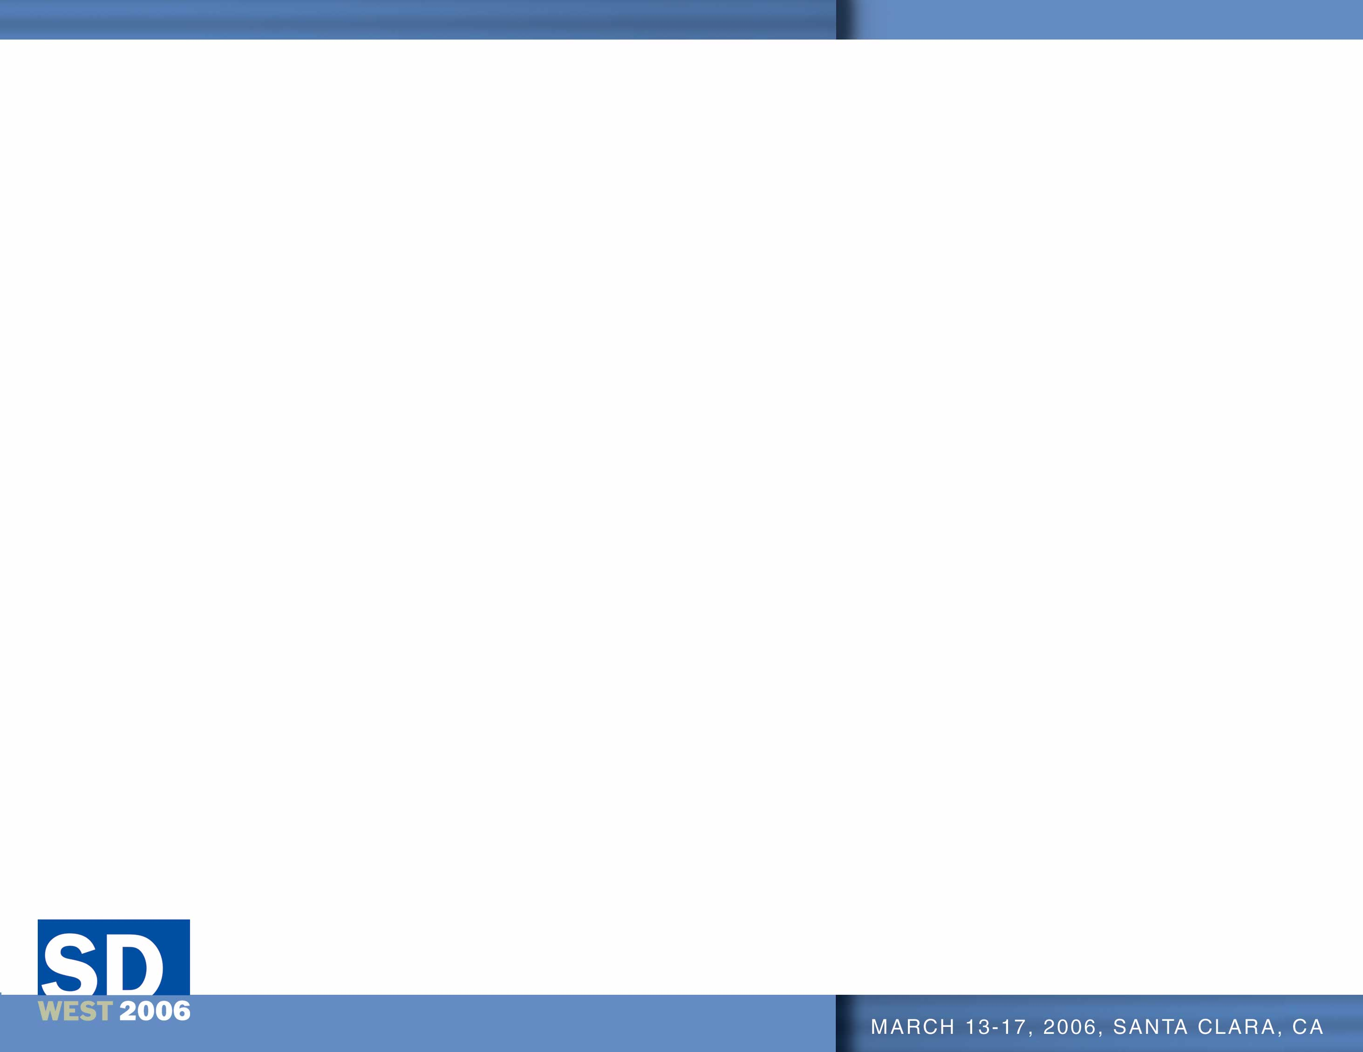
The Nature of Software
Many skills are required to produce quality software
These skills are not possessed in toto by a single individual

Slide 3
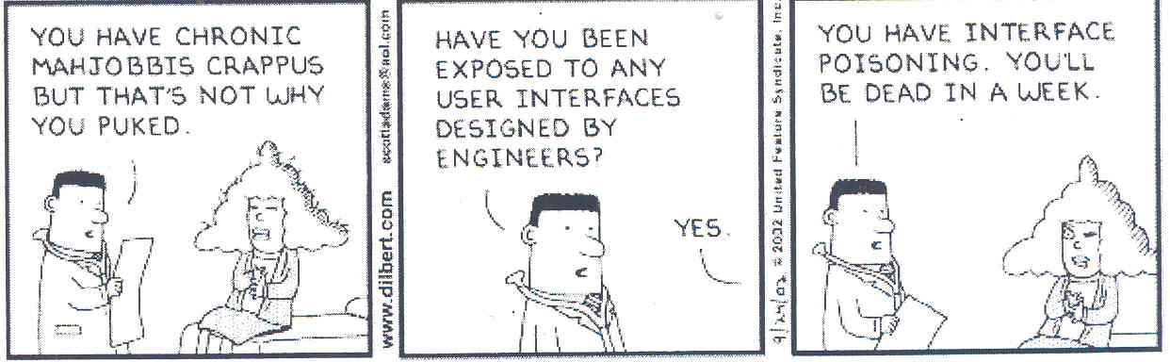

Slide 4
This discussion will focus on most aspects of developing quality code…

Slide 5
Software Verification
“I have a good idea why it's hard to verify programs.”
“They're usually wrong.”
  Manuel Blum, IEEE FOCS 94

Slide 6
BANGKOK (Reuters – May 12, 2003) – Security guards smashed their way into an official limousine with sledgehammers on Monday to rescue Thailand’s finance minister after his car’s computer failed… All doors and windows had locked automatically when the computer crashed, and the air-conditioning stopped, officials said. “We could hardly breathe for over 10 minutes… It took my guard a long time to realize that we really wanted the window smashed so that we could crawl out. It was a harrowing experience.”

Slide 7
“Malfunctions caused by bizarre and frustrating glitches are becoming harder and harder to escape now that software controls everything from stoves to cell phones, trains, cars, and power plants.”
-- “Spread of buggy software raises new questions”, CNN.com, April 27, 2003.

Slide 8
Summit on Code Quality
Portland, Oregon, January 15-17, 2003
Agenda:
  How bad are things now?
  How did they get that way?
  How can they be fixed?

Slide 9
Attendees
Scott Meyers
Bruce Eckel
Chuck Allison
Bill Venners
Joshua Bloch
Alistair Cockburn
Matt Gerrans
Kevlin Henney
Andrew Hunt
Angelika Langer
Pete McBreen
Chris Sells
Randy Stafford
Dave Thomas

Slide 10
How Bad Are Things Now?
Scott Meyers is Upset
  that should be enough to get our attention!
So are a lot of other people:
  ~50% of projects never get deployed
  too many programs hang or fail to meet spec.
  schedule/budget overruns are a cliche’
  help desks are woefully understaffed and overworked
  NIST* estimates the cost of software bugs in the U.S. is $59.5 billion annually
  * (NIST) http://www.nist.gov/director/prog-ofc/report02-3.pdf

Slide 11
Software Disasters
Mars Polar Lander
  www.nasa.gov/newsinfo/marsreports.html
American Airlines Flight 965, Dec. 1995
  see “The Inmates are Running the Asylum” by Alan Cooper
$60,000,000,000 wasted annually is a disaster!

Slide 12
About the NIST Report
Of the $59.5 billion lost, $22.2 billion is estimated preventable by improved testing
So what caused the other $37.3 billion?

Slide 13
What Does This Code Print?
float x = 1.0f;
float y = 0.2f;
x = x - y - y - y - y - y
cout << x << endl;
-1.49012e-08

Slide 14
What Does This Code Print?
double x = 1.0;
double y = 0.2;
x = x - y - y - y - y - y
cout << x << endl;
-5.55111512312578e-17

Slide 15
Patriot Missile Bug
On the night of the 25th of February, 1991, a Patriot missile system operating in Dhahran, Saudi Arabia, failed to track and intercept an incoming Scud. The Iraqi missile impacted into an army barracks, killing 28 U.S. soldiers and injuring another 98. The cause of the missile system failing to defend against the incoming Scud was traced back to a bug in Patriot’s radar and tracking software.
The algorithm used to predict the next air space to scan by the radar requires that both velocity and time be expressed as real numbers. However, the Patriot’s computer only has 24 bit fixed-point registers. Because time was measured as the number of tenth-seconds, the value 1/10, which has a non-terminating binary expansion, was chopped at 24 bits after the radix point. The error in precision grows as the time value increases, and the inaccuracy resulting from this is directly proportional to the target’s velocity.

Slide 16
Floating-point Arithmetic
Becoming an “ethical issue”
How many developers understand:
  Changing density of floating-point numbers
  Machine epsilon
  ULPS
Required Reading:
  What Every Computer Scientist Should Know About Floating-point Arithmetic, by David Goldberg

Slide 17
Weinberg’s Laws
Gerald Weinberg
Professionally Pre-dates FORTRAN!

Slide 18
Weinberg’s Second Law
“If builders built buildings the way programmers wrote programs, then the first woodpecker that came along would destroy civilization.”

Slide 19
How Did Things Get So Bad?
The effect of:
  Management
  Development tools
  Programmer skill level
  … among other things

Slide 20
Question for Developers
Are you influenced by your work environment?
Are you influenced by your management?

Slide 21
Haste Makes Waste
“The purpose of publishing this piece of code is to let you see that working under pressure can result in a marked deterioration of code quality.”
-- Francis Glassborow, You Can Do It!, page 307.

Slide 22
Technical Terms
From the Washington Post Style Invitational
Change an existing word by altering, deleting, or adding a single letter, and give a new definition
Example:
Intaxication: Euphoria at getting a tax refund, which lasts until you realize it was your money to start with.

Slide 23
Technical Term
From the Washington Post Style Invitational
Dopeler Effect:
“The tendency of stupid ideas to seem smarter when they come at you rapidly.”

Slide 24
Stupid Management Tricks
Expect the impossible from the under-supported
  micro-manage scheduling and technical decisions
  demand overtime
Rush to meet a market window
  Not always a bad thing (but shouldn’t be the norm)
  But don’t allow for periodic code “clean-up”
Don’t support needed training/mentoring
  My experiences with NASA, Hughes Aircraft

Slide 25
“I have met managers who would rather fail knowing whom to blame rather than succeed without knowing to whom to give credit.”
-- Gerald Weinberg, Keynote Address, Agile Development conference, August 2003

Slide 26
Rewarding Programmers
Do you reward testers by number of bugs found?
Then how do you reward programmers?
  By number of bugs generated?
  By LOC?
    More LOC => more bugs
  Wouldn’t you rather have them construct good code?
  But how do you prove the absence of bugs?
    Good testing, of course.
    I think we’re in a loop!

Slide 27
You (or Your Staff) are very scary
People have been trying to eliminate programmers for years
  It’s Black Magic
COBOL
4GLs
Visual BASIC

Slide 28
The Deception of Visual, Event-driven Programming
Focuses mainly on UI
Seems simple, but encourages poor practice
  Prototypes become products before their time
  UI should be totally separate from object model
  Programming is not Mouse Engineering
  A Programmer is more than an API Technician
“Who Moved My State”, C/C++ Users Journal, April 2003, Miro Samek
Programmers don’t need to design GUIs
  Let the users do it!

Slide 29
“I Click, Therefore I Program”
Tools like Visual BASIC have “lowered the bar” for entering the field of programming
  “90-day wonders” have filled the ranks
  They build screens, not software
Their numbers exceed our capacity to properly mentor them
  We’re losing this “Battle of the Exponents”
  “Dumbing down” programming has back-fired

Slide 30
Moral
Tools used without the requisite skill are dangerous weapons

Slide 31
Programming is more than Visual
“The effective exploitation of his powers of abstraction must be regarded as one of the most vital activities of a competent programmer.”
-- Dijkstra

Slide 32
Computational Thinking
CACM, March 2006
Thinking recursively
Parallel processing
Code ↔ Data
Type Checking ↔ Dimensional Analysis
Evaluating correctness, efficiency, simplicity, elegance
Abstraction (multiple levels) and decomposition
Separation of Concerns
Modeling
Using Invariants, Interface Contracts
Heuristic Reasoning

Slide 33
Programming will always be difficult
“Programming will remain very difficult, because once we have freed ourselves from the circumstantial cumbersomeness, we will find ourselves free to tackle the problems that are now well beyond our programming capacity.”
-- Dijkstra

Slide 34
Corollary
The Bar is always being Raised
When one niche becomes automated, another opens up for exploration and mastery

Slide 35
While we’re tackling ever harder issues…
… who is minding the Quality Store?

Slide 36
The Degradation of Software Quality
“Architecture degradation begins simply enough. When market pressures for key features are high and the needed capabilities to implement them are missing, an otherwise sensible engineering manager may be tempted to coerce the development team into implementing the requested features without the requisite architectural capabilities.”
-- Luke Hohmann, Beyond Software Architecture

Slide 37
Technical Debt
Market and budget pressures can “require” cutting corners
  This shouldn’t be the “norm”, but all too often is
This constitutes a technical “debt”
  The software is not in a state suitable for long-term maintenance
  Such a system will be abandoned “before its time”

Slide 38
Software Entropy
Entropy:
  A measure of the disorder in a closed system.
  Inevitable and steady deterioration of a system.
Software Entropy
  Code can easily become an unmanageable patchwork
  Complexity encourages disorder
How do you fight entropy?

Slide 39
Rearchitecting/Refactoring
Paying-off your Technical Debt
Improving the internal design of existing code
Examples:
  Add parameter
  Extract class
  Extract hierarchy
  Extract method
  Substitute algorithm
  Replace parameter with method…

Slide 40
Post-release Entropy Reduction
(Luke Hohmann)
No time for refactoring near release
  Quick hacks pay off near release time
  Market windows are important
There must be time to refactor after release
  Otherwise entropy kills you prematurely
  Yes, there is a short-term cost
  The long-term reduction of technical debt is worth it!

Slide 41

Code Quality without PRER
(suggested by Randy Stafford)
Code Quality
Time

Slide 42
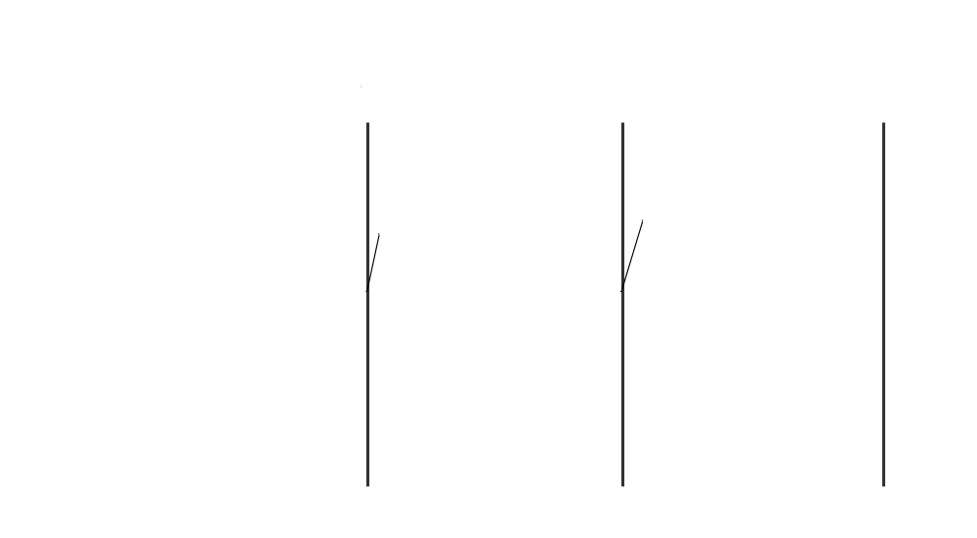
Code Quality with PRER
(suggested by Randy Stafford)
Code Quality
Time

Slide 43
Technical Debts Interact
(from Alistair Cockburn)
Cumulative costs:
First maintenance visit: 1 + u
Second visit: 1 + u + v + uv (interaction)
  second fix affected by first technical debt
  approximates 1 + 2u + u² = (1 + u)²
Third visit: 1 + u + v + w + uv + uw + vw + uvw
  approximates 1 + 3u + 3u² + u³ = (1 + u)³

Slide 44
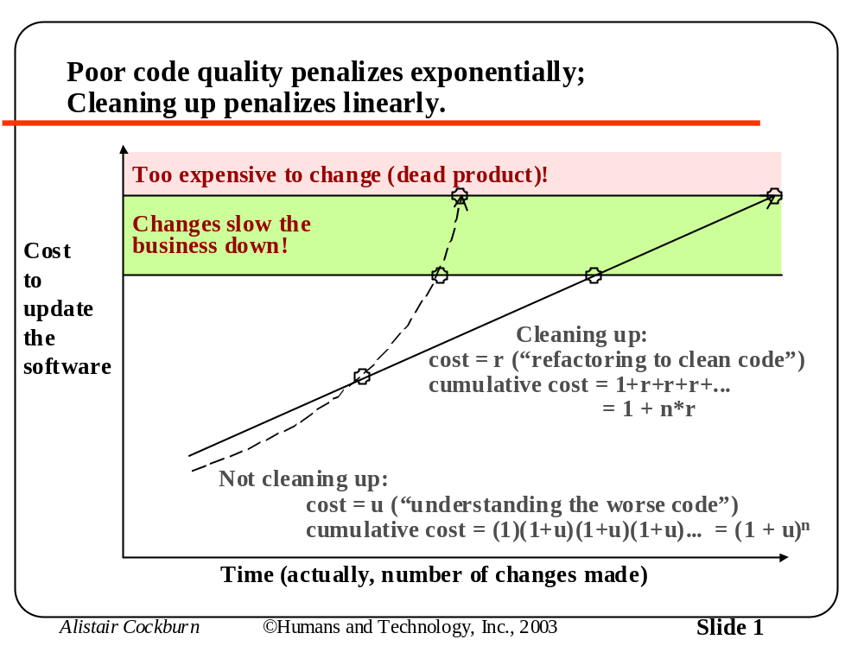

Slide 45
Moral
Treat Technical Debt as a Defect
It is well known that the cost to fix a defect increases over time
Pay your debts early

Slide 46
True or False?
“It is just as easy to write good software as it is to write bad software”…
It is if you know how!

Slide 47
From Steve McConnell’s Keynote
SD West, 2006
Developers differ up to 20 times in their productivity (code speed, debug sped, etc.)
Defect creation is inevitable
  But defect creation rates differ among developers
Rhetorical Questions
  What makes the difference?
  How can a developer improve?

Slide 48
Don’t find bugs, avoid them
“Those who want really reliable software will discover that they must find means of avoiding the majority of bugs to start with, and as a result the programming process will become cheaper. If you want more effective programmers, you will discover that they should not waste their time debugging, they should not introduce the bugs to start with.”
– Dijkstra

Slide 49
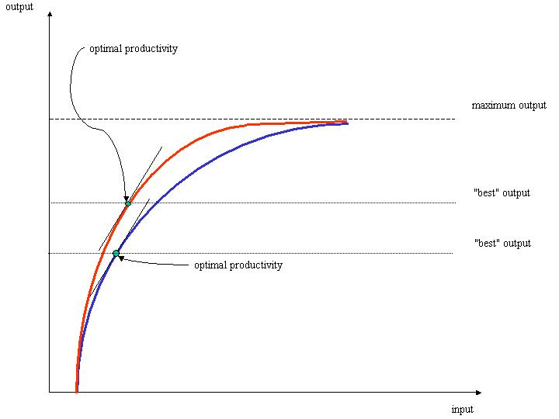
The Productivity Curve
(from Angelika Langer)

Slide 50
The Cost of Competence
Less than the cost of incompetence
  Assertion: Changing curves is cheaper than the consequences of producing poor quality
    “Proof”: Japanese Auto Industry
Mentoring vs. Training
  A trainer “loves ‘em and leaves ‘em”
    “drinking from the fire hose” approach
    although this can be a good “jump start”
  A mentor takes an apprentice under his wing
    “Expert within earshot”

Slide 51
Technical Term
From the Washington Post Style Invitational
Bozone:
“The substance surrounding stupid people that stops bright ideas from penetrating. The bozone layer, unfortunately, shows little sign of breaking down in the near future.”

Slide 52
Stupid Programmer Tricks
Poor design
  poor choice of algorithm or data structure
  not enough critical thinking up front
    bug prevention is better than cure
Reinventing the Proverbial Wheel
  insufficient mastery of library, tools, and techniques
Many don’t continue to learn
  stuck in their initial “imprint”
Copy-and-paste “reuse”
  automated bug replication!
Inadequate testing/error handling

Slide 53
The Evils of Code Duplication
Two Forms
  Explicit:
    You copy and paste code (bugs)
    You should’ve extracted a function to call
  Implicit:
    You create similar functions
    You still should extract the common part
Becomes a maintenance nightmare
Example: Manifest constants, C++ string class

Slide 54
Manifest Constants
Better to use symbols instead of magic numbers
  Only have to change them in one place
  No risk of getting one of the values wrong
All code should follow this pattern:
  Have only one definition
  A form of “automation”
    Because you’re not repeating yourself!

Slide 55
A C++ String Class
Constructor allocates memory
Destructor releases it:
class String
{
char* data;
public:
String(const char* str = "") {
data = new char[strlen(str) + 1];
strcpy(data,str);
}
~String() {
delete [] data;
}
};

Slide 56
A C++ String Class
What about copying strings?
Need a Copy and Copy-Assignment:
String(const String& s) {
data = new char[strlen(s.data) + 1];
strcpy(data, s.data);
}
String& operator=(const String& s) {
if (this != &s) {
char* newData = new char[strlen(s.data) + 1];
strcpy(newData, s.data);
delete [] data;
data = newData;
}
return *this;
}

Slide 57
A C++ String Class
Factor out common code into a private member function:
char* dup(const char* from) {
char* to = new char[strlen(from) + 1];
return strcpy(to, from);
}
An aside: C++0x will have delegating constructors

Slide 58
A C++ String Class
Now call it from all 3 places:
String(const char* str = "") {
data = dup(str);
}
String(const String& s) {
data = dup(s.data);
}
String& operator=(const String& s) {
if (this != &s) {
char* newData = dup(s.data);
delete [] data;
data = newData;
}
return *this;
}

Slide 59
Practices that “Work”
DRY (don’t repeat yourself)
Seek invariants early and assert them
Design in terms of interfaces
  Whether explicit or implicit
  Really separate interface and implementation
Minimize coupling, maximize cohesion
Test-first Development
Pair programming (“review as you go”) [CM Corollary*]
Automate builds, tests, deployments
Keep a technical diary

Slide 60
More Practices that “Work”
Write to be read
  use a consistent style/standard
  publish your code somewhere
Study Good Code
Avoid premature optimization
  use a profiler
Have post-partum reviews (entertain PRER options)
Design in public places (white board)
Refactor mercilessly
  “remove to improve” (Kevlin’s term; omit needless code)
Take pride in your work

Slide 61
Revealing Questions
Are any of the practices new to you?
  probably not
Do you employ them?
Do your colleagues employ them?
  mentor them

Slide 62
Pride Implies Ownership
“[The Company] shall not be liable in any manner whatsoever for results obtained for using this software. THESE MATERIALS ARE PROVIDED ‘AS-IS’ WITHOUT WARRANTY OF ANY KIND… [THE COMPANY] AND ITS SUPPLIERS DISCLAIM ANY AND ALL WARRANTIES AND CONDITIONS, EITHER EXPRESS OR IMPLIED.”
“Bugs would be greatly reduced if software makers were held legally responsible for defects. ‘Software is being treated in a way that no other consumer products are,’ said Barbara Simons, former president of the ACM. 'We all know that you can’t produce 100% bug-free software. But to go to the other extreme, and say that software makers should have no liability whatsoever, strikes me as absurd.'” (CNN.com)

Slide 63
Accountability
It’s coming! [Wall Street Journal, 2-25-05]
GM … is attempting to get software and computer-services vendors to agree to penalty provisions in new contracts that could hold the vendors liable if they fail to meet security requirements.
“Can you imagine if GM produced a vehicle and said, 'We did a pretty good job of engineering this. It worked in the laboratory. Here it is, consumer, you go crash-test it,"' asks Eric Litt, chief information-security officer in GM's information-systems and services unit. "We wouldn't accept that as a society.“
Each time a software maker issues a "patch," or fix, to repair a flaw "is in a sense a recall," says Alan Levine, head of global information security for Alcoa, the Pittsburgh-based aluminum giant. Levine suggests that software makers should cover customers' costs for installing these patches, "or at least assist us in paying for it."

Slide 64
The Quality - Wall Street Squeeze
(From Jack Ganssle)
“I fear the software development is decoupled from the perceived needs of business. The boss is rewarded by the stockholders for getting the thing out the door today to meet the company’s quarterly numbers. If the numbers slump he’s fired. So lousy software whose warts surface next year is someone else’s problem.”
“The complicated thing is that the stockholders are us … we try to buy those stocks that perform. If we see the numbers falling for a few quarters it gets our attention.”
“In general we do poorly at dealing with long-term problems.”
“I think software will always be caught in this squeeze, at least until some software disaster kills thousands of people. Then regulation will intervene and fix things… for a while.”

Slide 65
Talent vs. Knowledge
The practices just mentioned are more valuable than understanding the technology du jour
You can know Java, XML, XSLT, J2EE, C++, STL, C#, SOAP, .NET, Ruby on Rails… and still produce low quality
Master the enduring fundamentals first
  Technology is a vehicle for quality, not its substance

Slide 66
The Great Programmer
(from Gerald Weinberg)
Has a Service Posture
  User-centered
Learns continually, no matter how skilled he is today
  Many IT-related skills have a short shelf life
Openly shares his code, insights and expertise
  Keeping secrets does not promote “job security”
Gives credit where credit is due
  colleagues, vendors, good management, staff, family
Does not sacrifice quality or integrity for job security
Takes care of his whole self (he rests, plays…)

Slide 67
Waxing Philosophical…

Slide 68
Practical Excellence
Be True to your Inner Programmer
Highly ethical programmers do things as correctly as they can all the time. They fight management’s stupid decisions. To an ethical programmer, some things (e.g., buffer overrun vulnerabilities) just cannot happen.”
-- Jack Ganssle
An ethical programmer doesn’t purposely leave bugs in so he can be a “hero” by finding them later.

Slide 69
Practical Excellence
Care, Be Connected
“When one isn't dominated by feelings of separateness from what he's working on, then one can be said to "care'' about what he's doing. That is what caring really is, a feeling of identification with what one's doing. When one has this feeling then he also sees the inverse side of caring, Quality itself.”
-- Robert Pirsig, Zen and the Art of Motorcycle Maintenance

Slide 70
Practical Excellence
Persist in Working toward Meaningful Change
“You cannot undo a [or introduce a new] habit by any single act of willpower; only a time-consuming training process can undo [or form] a habit.”
-- Jef Raskin
“Maintaining a large range of agilities—mental and physical—requires regular exercise. That is why the capable are always busy.”
-- Edsger Dijkstra

Slide 71
Practical Excellence
Keep Current
“In times of change learners inherit the earth while the learned find themselves beautifully equipped to work in a world that no longer exists.”
-- Eric Hoffer

Slide 72
Practical Excellence
Become a Mentor
With time and effort, you (will) have gained valuable expertise
  Share it
    Write
    Teach
What kind of Mentor are you?
  “He who learns from one who is learning drinks from a running stream.”

Slide 73
O Fim

