Slide 1
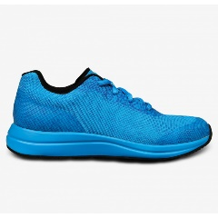

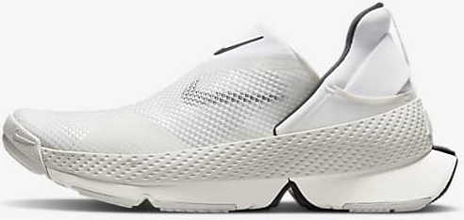


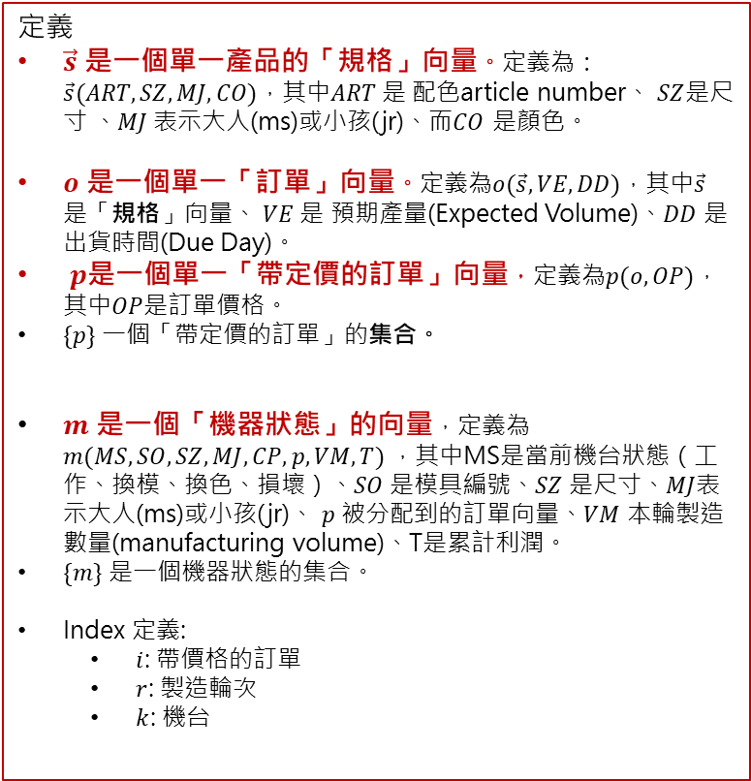
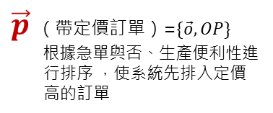
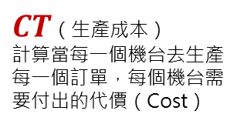

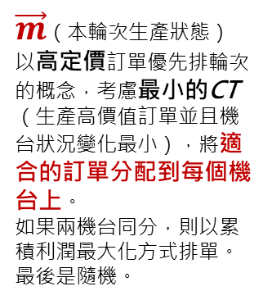
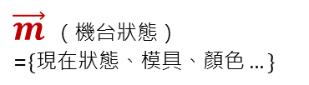
以「最大化生產訂單」與「最小化生產成本」為導向的多機台生產排程
定義
$\vec{s}$ 是一個單一產品的「規格」向量。定義為： $\vec{s}(ART, SZ,MJ,CO)$，其中$ART$ 是 配色article number、 $SZ$是尺寸 、$MJ$ 表示大人(ms)或小孩(jr)、而$CO$ 是顏色。
$o$ 是一個單一「訂單」向量。定義為$o(\vec{s}, VE,DD)$，其中$\vec{s}$ 是「規格」向量、 $VE$ 是 預期產量(Expected Volume)、$DD$ 是出貨時間(Due Day)。
$p$是一個單一「帶定價的訂單」向量，定義為$p(o, OP)$，其中$OP$是訂單價格。
$\{p\}$ 一個「帶定價的訂單」的集合。
$m$ 是一個「機器狀態」的向量，定義為 $m(MS,SO, SZ, MJ, CP, p, VM, T)$ ，其中MS是當前機台狀態（工作、換模、換色、損壞）、$SO$ 是模具編號、$SZ$ 是尺寸、$MJ$表示大人(ms)或小孩(jr)、 $p$ 被分配到的訂單向量、$VM$ 本輪製造數量(manufacturing volume)、T是累計利潤。
$\{m\}$ 是一個機器狀態的集合。
Index 定義:
$i$: 帶價格的訂單
$r$: 製造輪次
$k$: 機台
$\vec{s}$ （產品規格）
$\vec{o}$ （訂單）=$\{\vec{s},VE, DD\}$
以權重評分
$\vec{p}$ （帶定價訂單）=$\{\vec{o},OP\}$
根據急單與否、生產便利性進行排序 ，使系統先排入定價高的訂單
（更新）
以權重評分
$\vec{m}$ （機台狀態）
=$\{現在狀態、模具、顏色…\}$
$CT$（生產成本）
計算當每一個機台去生產每一個訂單，每個機台需要付出的代價（Cost）
$\vec{m}$（本輪次生產狀態）
以高定價訂單優先排輪次的概念，考慮最小的CT（生產高價值訂單並且機台狀況變化最小），將適合的訂單分配到每個機台上。
如果兩機台同分，則以累積利潤最大化方式排單。最後是隨機。
（更新）

Slide 2
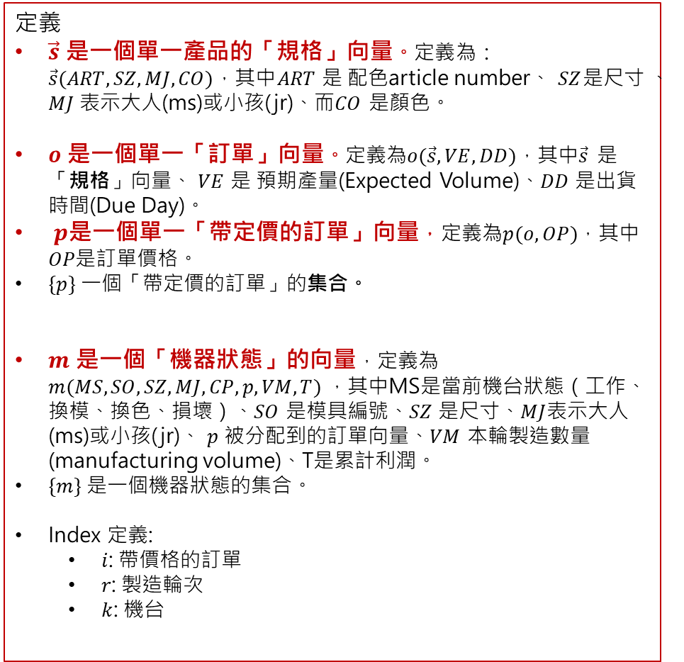
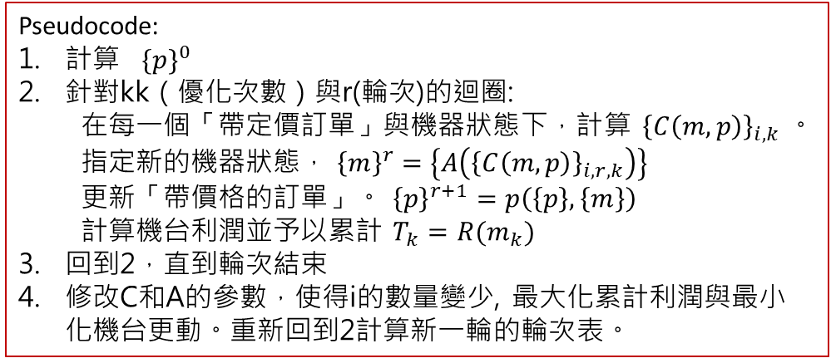
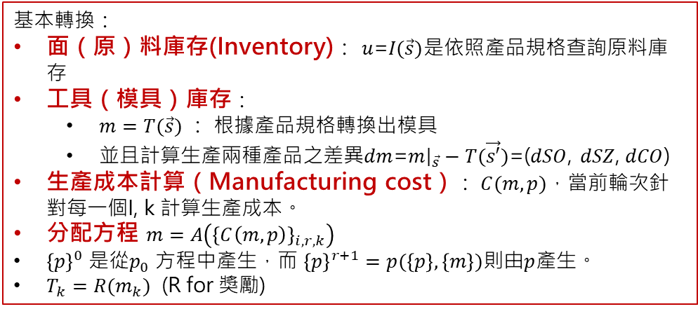
CAA 概念(數學推導)
定義
$\vec{s}$ 是一個單一產品的「規格」向量。定義為： $\vec{s}(ART, SZ,MJ,CO)$，其中$ART$ 是 配色article number、 $SZ$是尺寸 、$MJ$ 表示大人(ms)或小孩(jr)、而$CO$ 是顏色。
$o$ 是一個單一「訂單」向量。定義為$o(\vec{s}, VE,DD)$，其中$\vec{s}$ 是「規格」向量、 $VE$ 是 預期產量(Expected Volume)、$DD$ 是出貨時間(Due Day)。
$p$是一個單一「帶定價的訂單」向量，定義為$p(o, OP)$，其中$OP$是訂單價格。
$\{p\}$ 一個「帶定價的訂單」的集合。
$m$ 是一個「機器狀態」的向量，定義為 $m(MS,SO, SZ, MJ, CP, p, VM, T)$ ，其中MS是當前機台狀態（工作、換模、換色、損壞）、$SO$ 是模具編號、$SZ$ 是尺寸、$MJ$表示大人(ms)或小孩(jr)、 $p$ 被分配到的訂單向量、$VM$ 本輪製造數量(manufacturing volume)、T是累計利潤。
$\{m\}$ 是一個機器狀態的集合。
Index 定義:
$i$: 帶價格的訂單
$r$: 製造輪次
$k$: 機台
基本轉換：
面（原）料庫存(Inventory)： $u$=$I(\vec{s})$是依照產品規格查詢原料庫存
工具（模具）庫存：
$m=T(\vec{s})$ ： 根據產品規格轉換出模具
並且計算生產兩種產品之差異$dm$=$m{\left.​\right|}_{\vec{s}}−T(\vec{s′})$=($dSO$, $dSZ$, $dCO$)
生產成本計算（Manufacturing cost）： $C(m,p)$，當前輪次針對每一個I, k 計算生產成本。
分配方程 $m=A\left({\left\{C\left(m,p\right)\right\}}_{i,r,k}\right)$
${\left\{p\right\}}^{0}$ 是從$p_{0}$ 方程中產生，而 ${\left\{p\right\}}^{r+1}=p(\left\{p\right\},\left\{m\right\})$則由$p$產生。
$T_{k}=R(m_{k})$ (R for 獎勵)
Pseudocode:
計算 ${\{p\}}^{0}$
針對kk（優化次數）與r(輪次)的迴圈:
在每一個「帶定價訂單」與機器狀態下，計算 ${\left\{C\left(m,p\right)\right\}}_{i,k}$ 。指定新的機器狀態， ${\left\{m\right\}}^{r}$ $=\left\{A\left({\left\{C\left(m,p\right)\right\}}_{i,r,k}\right)\right\}$
更新「帶價格的訂單」。 ${\left\{p\right\}}^{r+1}=p\left(\left\{p\right\},\left\{m\right\}\right)$
計算機台利潤並予以累計 $T_{k}=R(m_{k})$
回到2，直到輪次結束
修改C和A的參數，使得i的數量變少, 最大化累計利潤與最小化機台更動。重新回到2計算新一輪的輪次表。

Slide 3
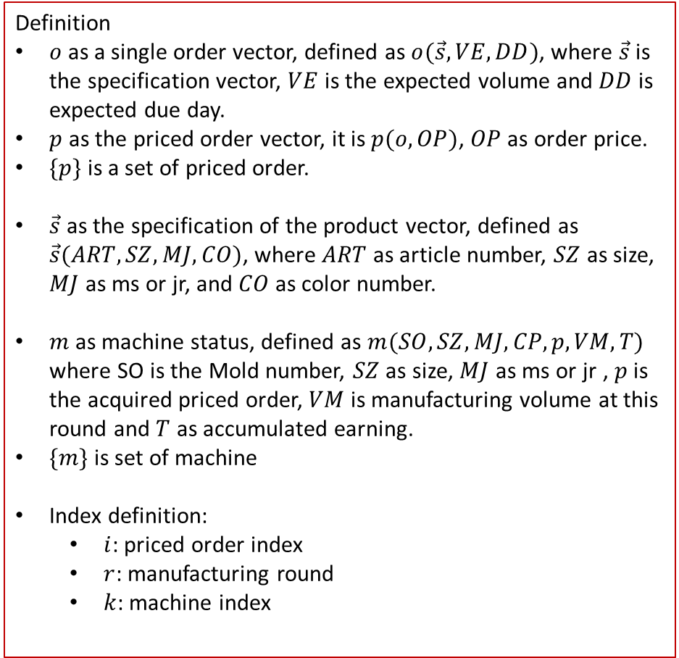
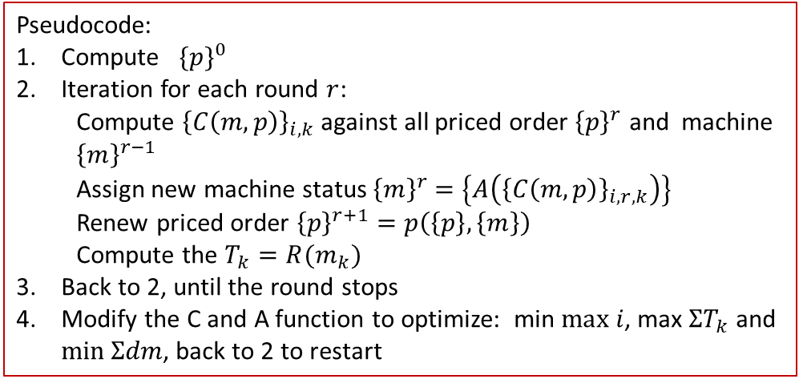
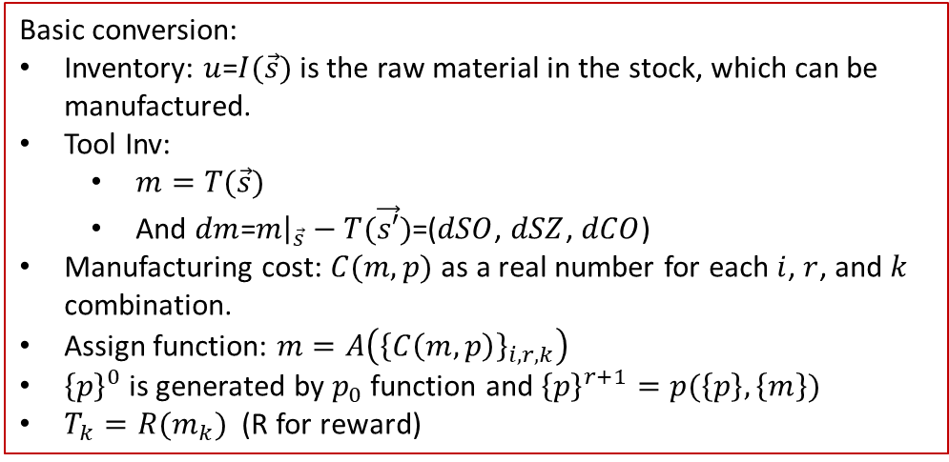
CAA concept (mathematical derivation)
Basic conversion:
Inventory: $u$=$I(\vec{s})$ is the raw material in the stock, which can be manufactured.
Tool Inv:
$m=T(\vec{s})$
And $dm$=$m{\left.​\right|}_{\vec{s}}−T(\vec{s′})$=($dSO$, $dSZ$, $dCO$)
Manufacturing cost: $C(m,p)$ as a real number for each $i$, $r$, and $k$ combination.
Assign function: $m=A\left({\left\{C\left(m,p\right)\right\}}_{i,r,k}\right)$
${\left\{p\right\}}^{0}$ is generated by $p_{0}$ function and ${\left\{p\right\}}^{r+1}=p(\left\{p\right\},\left\{m\right\})$
$T_{k}=R(m_{k})$ (R for reward)
Definition
$o$ as a single order vector, defined as $o(\vec{s}, VE,DD)$, where $\vec{s}$ is the specification vector, $VE$ is the expected volume and $DD$ is expected due day.
$p$ as the priced order vector, it is $p(o, OP)$, $OP$ as order price.
$\{p\}$ is a set of priced order.
$\vec{s}$ as the specification of the product vector, defined as $\vec{s}(ART, SZ,MJ,CO)$, where $ART$ as article number, $SZ$ as size, $MJ$ as ms or jr, and $CO$ as color number.
$m$ as machine status, defined as $m(SO, SZ, MJ, CP, p, VM, T)$ where SO is the Mold number, $SZ$ as size, $MJ$ as ms or jr , $p$ is the acquired priced order, $VM$ is manufacturing volume at this round and $T$ as accumulated earning.
$\{m\}$ is set of machine
Index definition:
$i$: priced order index
$r$: manufacturing round
$k$: machine index
Pseudocode:
Compute ${\{p\}}^{0}$
Iteration for each round $r$:
Compute ${\left\{C\left(m,p\right)\right\}}_{i,k}$ against all priced order ${\left\{p\right\}}^{r}$ and machine ${\left\{m\right\}}^{r−1}$
Assign new machine status ${\left\{m\right\}}^{r}$ $=\left\{A\left({\left\{C\left(m,p\right)\right\}}_{i,r,k}\right)\right\}$
Renew priced order ${\left\{p\right\}}^{r+1}=p\left(\left\{p\right\},\left\{m\right\}\right)$
Compute the $T_{k}=R(m_{k})$
Back to 2, until the round stops
Modify the C and A function to optimize: min $max i$, max $ΣT_{k}$ and $\min{Σdm}$, back to 2 to restart

Slide 4
.USR_read
.USR_write
.show_USR_folder
CAA_const_structure
CAA_ORDER
Weighting file id v.s. title
Format: (condition), weighting
CAA_USR
Implemented as OR
CAA_USR_UI
CAA_copyright
MultithreadSetting
KeyWindowStartPosition
CAA_initial_file
name+location
ORD()
1 | Dueday(3):(a,b),weighting
2 | MachineStatus: (dCO, dSO, dSZ), weighting
3 | Inventory: (a,b), weighting
4 | MachineStatus (dCO, dSO, dSZ), weighting
5 | Previous Earning (dT), weighting
Base_Data_Folder
Current_working_Folder
WeightingFile_title() as string
WeightingFile_name() as string
.import_OrderFile
.assign_Price
.update_Order
.export_ORDER
.import_ORDER
CAA_general_func
Each setupfile should be defined one by one
MS as enum: manufacturing, Mold_change, down
ORD (order)
SP
VE
DD
CAA_Round_UI (Main)
CAA_PriceNCostAssign
WeiTbl()
Some lib/func
CAA_Round
CAA_PriceNCost_Assign_UI
SP (specification)
MA() as CAA_MachineStatus
OR() as CAA_ORDER
Round as integer
Max_Round as integer
標準後綴
Json R/W
CALA
.Compute_Price_Wei_DueDay
.Compute_Price_Wei_MachineStatus
.Compute_Price_Wei_Inventory
.Compute_Price
ART, SZ, MJ, CO
CAA_Round_Matching
.Compute_Cost_Wei_MachineStatus
.Compute_Cost_Wei_PreviousEarning
.Compute_Cost
CAA_MachineStatus
.gogo (computation entering point)
Implemented as MA
CAA_WT (Weighting Table)
MACH()
CAA_MatchingFunction
Name as string
FileName as string
FullFileName as string
ID as integer
lstCondition() as integer()
lstWeight() as double
.import_MachineStatus_JSON
.import_MachineStatus_CSV
.export_MachineStatus, JSON
.export_MachineStatus_CSV
.matching1(MA,OR) as MA
This is because, you got ORD inside, and ORD is an object, not a value
For the last machine status output
MACH (single machine)
.File_read
.File_write
MS,SO, SZ, MJ,CP,ORD,VM,T

Slide 5
.USR_read
.USR_write
.show_USR_folder
CAA_const_structure
CAA_ORDER
Weighting file id v.s. title
Format: (condition), weighting
CAA_USR
Implemented as OR
CAA_USR_UI
CAA_copyright
MultithreadSetting
KeyWindowStartPosition
CAA_const
CAA_profile_name
lstORD as list (of order)
1 | Dueday(3):(a,b),weighting
2 | MachineStatus: (dCO, dSO, dSZ), weighting
3 | Inventory: (a,b), weighting
4 | MachineStatus (dCO, dSO, dSZ), weighting
5 | Previous Earning (dT1 dT2), weighting
Base_Data_Folder
Current_working_Folder
WeightingFile_title() as string
WeightingFile_name() as string
.import_OrderFile
.assign_Price
.update_Order
.export_ORDER
.import_ORDER
Only 3 types, i put them in enum CAA.Weighting.CAA_weighting_Fromt
CAA_general_func
Each setupfile should be defined one by one
MS as enum: manufacturing, Mold_change, down
CheckFolderExisted: 1=existed 2:notexisted, but add, 0: not existed,, added fail
CheckFolderSurfix check folder
ORD (order)
SP
VE
DD
CAA_Round_UI (Main)
CAA_PriceNCostAssign
Format: yyyyMMdd
CAA_Round
WeiTbl()
SP (specification)
MA() as CAA_MachineStatus
OR() as CAA_ORDER
Round as integer
Max_Round as integer
CAA_PriceNCost_Assign_UI
ART, SZ, MJ, CO
.Compute_Price_Wei_DueDay
.Compute_Price_Wei_MachineStatus
.Compute_Price_Wei_Inventory
.Compute_Price
SZ: 4.5->45 13->130
MJ=0: JR, MJ=1: MS
Some lib/func
dSP ( specification)
CAA_Round_Matching
attachDateTimeSurfix
CAA_JsonRW : with indented json string
CALA
dART,dSZ, dMJ, dCO, same, dSZ_value
=false: it is different, =true: same
.Compute_Cost_Wei_MachineStatus
.Compute_Cost_Wei_PreviousEarning
.Compute_Cost
.gogo (computation entering point)
CAA_SOARTMJ
CAA_MachineStatus
CAA_WT (Weighting Table)
SO_ART_MJ
SO,
ART,
MJ
Implemented as MA
CAA_MatchingFunction
Name as string
FileName as string
FullFileName as string
ID as integer
lstCondition() as integer()
lstWeight() as double
MACH()
.matching1(MA,OR) as MA
.import_MachineStatus_JSON
.import_MachineStatus_CSV
.export_MachineStatus, JSON
.export_MachineStatus_CSV
This is because, you got ORD inside, and ORD is an object, not a value
All path with “\” as surfix
.defineMeFromCSV
.findSObyART as string
.findARTsbySO as string()
Need update
For the last machine status output
.defineMEfromCSV
.defineMEFromJSON
.exportME2JSON
.exportME2CSV
.
CAA_ARTCO
.File_read
.File_write
.normalization
MACH (single machine)
MS,SO, SZ, MJ,CP,ORD,VM,T
CAA_INVENTORY
lstARTCO
CAA, CO
lstINV as list (of INV)
SOTOOL
SO, Sta(machineToolstatus)
lstSZ
UnitProducts,
SN1: the SIZE, start with 4,5,6, (the smllest size in integal)
SN2: the SN number against the number of TOOL, start with 1, 2,3,
Public Enum MachineToolStatus
Available
InMaintainence
Down
Not_Available
Available_Plan_free
Available_Plan_inUse
End Enum
INV: SP, VI
.import_OrderFile
.assign_Price
.update_Order
.export_ORDER
.import_ORDER
.defineMeFromCSV
.findMachineStatus () as MachineToolStatus
.findAvailable() as Boolean
.recruitForProduction()
.releaseFromProduction()

Slide 6
Public Enum MachineToolStatus
Available
InMaintainence
Down
Not_Available
Available_Plan_free = 100
Available_Plan_inUse = 150
Available_ToolChange1 = 200
Available_ToolChange2 = 250
Available_ToolChange3 = 300
End Enum
This is color change
CAA_MachineStatus
In the machinestatus, one should id which mold is in-use. As in the SN1 and SN2. if not assigned, the program will assign one to it.
This is mold change
This is size change (no mold change)
CAS_OSARTMJ
lstSO,
lstART,
Implemented as MA
MACH()
.import_MachineStatus_JSON
.import_MachineStatus_CSV
.export_MachineStatus, JSON
.export_MachineStatus_CSV
.defineMeFromCSV
.findSObyART as string
.findARTsbySO as string()
This is because, you got ORD inside, and ORD is an object, not a value
Need update
For the last machine status output
MACH (single machine)
MS,SO, SZ, MJ,CP,ORD,VM,T
CAA_INVENTORY
lstINV as list (of INV)
CAA_OSTOOLs
OSTOOL
SO, Sta(machineToolstatus)
lstSZ
UnitProducts,
SN1: the SIZE, start with 4,5,6, (the smllest size in integal)
SN2: the SN number against the number of TOOL, start with 1, 2,3,
Public Enum MachineToolStatus
Available: 0
InMaintainence : 1
Down: 2
Not_Available: 3
Available_Plan_free : 4
Available_Plan_inUse
End Enum
INV: SP, VI
.import_OrderFile
.assign_Price
.update_Order
.export_ORDER
.import_ORDER
.defineMeFromCSV
.findMachineStatus () as MachineToolStatus
.findAvailable() as Boolean
.recruitForProduction()
.releaseFromProduction()

Slide 7
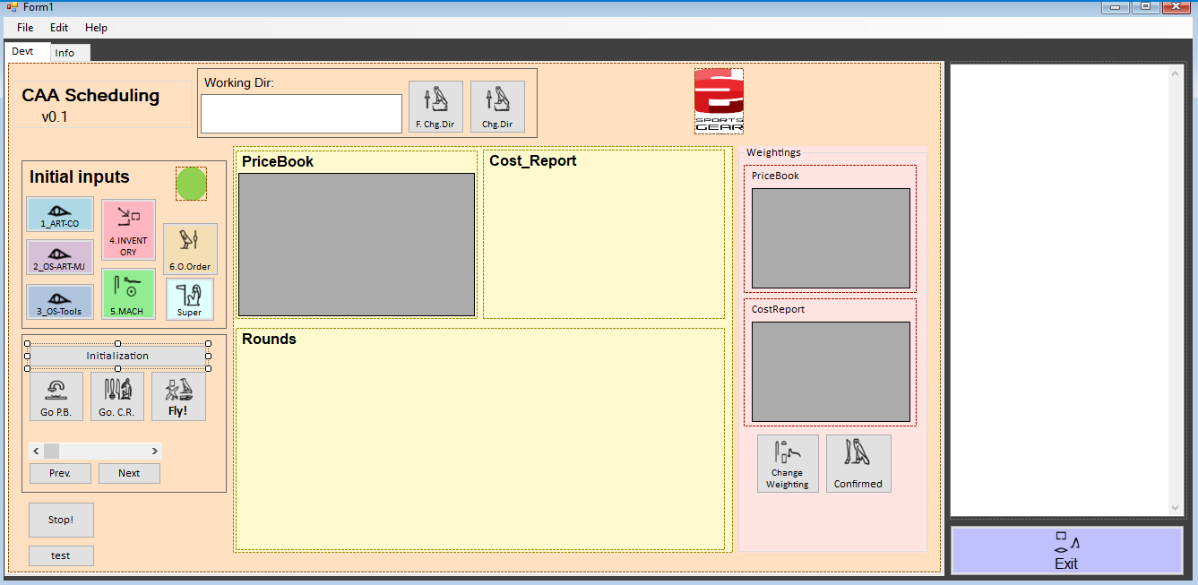
Machine view
Order view

Slide 8
