Slide 1
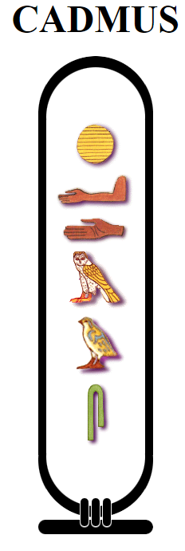

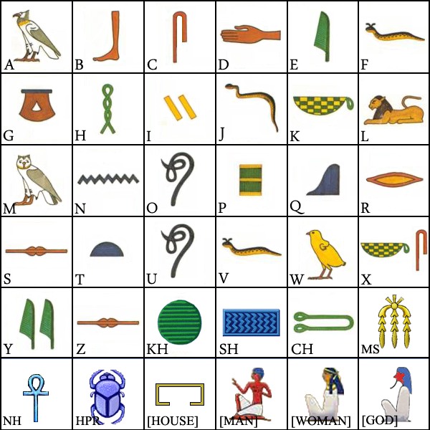
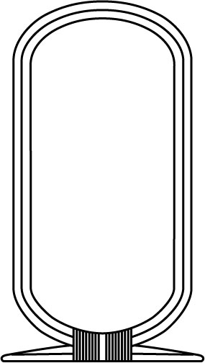

Slide 2
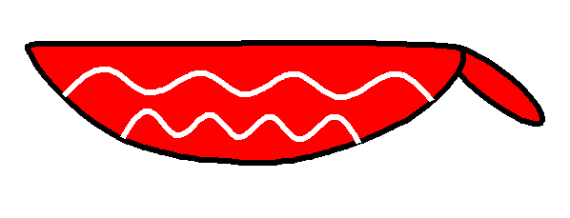
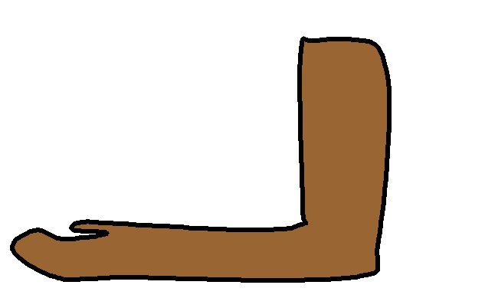
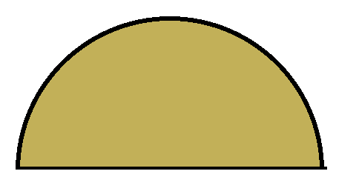
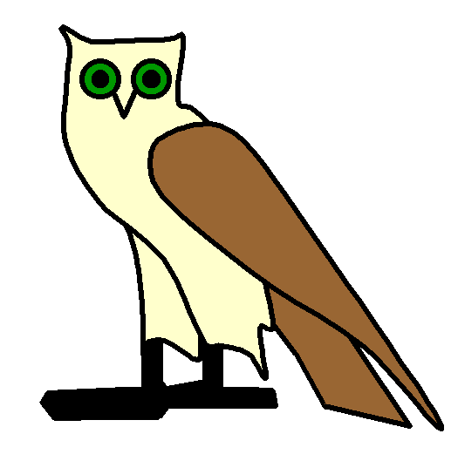
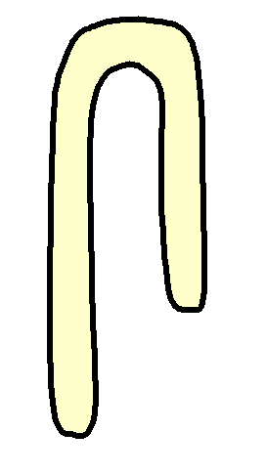
https://www.kidzone.ws/cultures/egypt/hieroglyph.htm

Slide 3
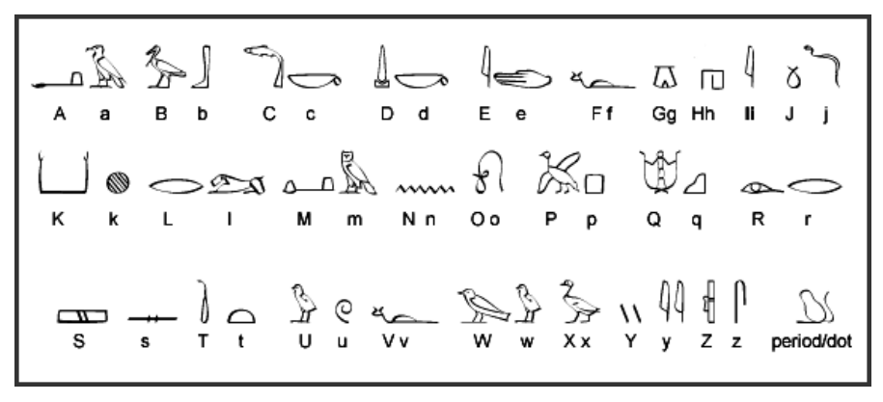

𓌞 𓀁
𓇋𓅱𓌞𓋴𓂻𓈖𓇓𓅱
as
𓇋𓅱𓌞𓋴𓂻𓈖𓇓𓅱
𓇋𓅱𓌞𓋴𓂻𓈖𓇓𓅱

Slide 4





I leap.
M17-G43 | I9:X1-I9:X1-D54 | A1
𓇋𓅱 𓆑𓏏𓆑𓏏𓂻𓀀
http://hieroglyphs.net/cgi/pager.pl?p=36
https://www.lexilogos.com/keyboard/hieroglyph.php#
https://www.egyptianhieroglyphs.net/gardiners-sign-list/
https://en.wikipedia.org/wiki/List_of_Egyptian_hieroglyphs
𓆥
𓎟𓈃
𓏙𓋹
𓉡
𓇳𓏇
𓊹𓄤
𓎡𓄿𓂧𓅓𓋴
Load of upper and lower Egypt
Lord of two lands
Good god
Given life
beloved of Hathor
Like Ra
Cadmus
X8 s34
o10
n5 w19
m23
l2
r8
f35
v30
x1
x1
n19
d46
𓇋𓇋𓄿𓈖
v31
s29
Or l2a
g17
Yuan
M17 m17
g1
n35

Slide 5
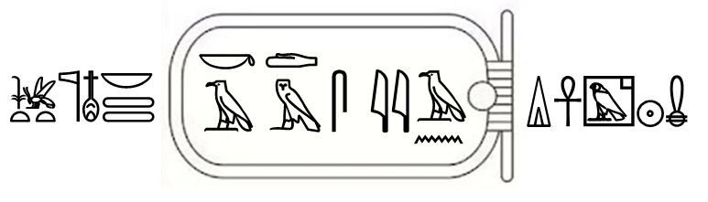
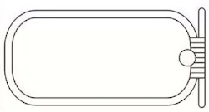
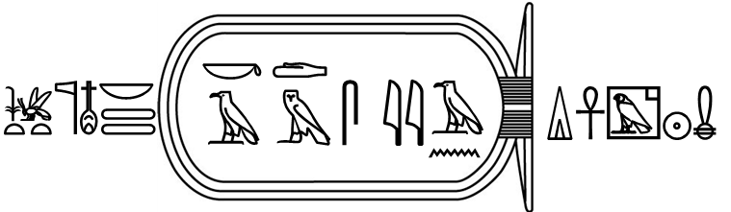
𓎟
𓎡
𓂧
𓆥𓊹𓄤𓈃
𓋴
𓇋𓇋
𓄿
𓏙𓋹𓉡𓇳𓏇
𓅓
𓄿
𓈖

Slide 6
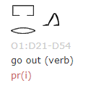
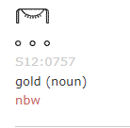


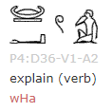
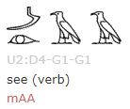

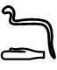
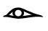
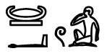
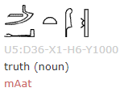
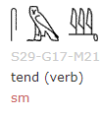
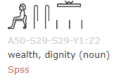
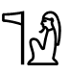
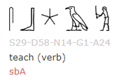
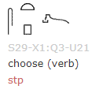
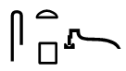
𓆓
𓂧
𓉐
𓁹
𓂋
𓂻
𓊠
𓂝
𓍢𓀁
𓉐
𓂋
𓂻
asdf
𓊹𓀭
𓊠𓂝𓍢𓀁
𓏏
𓋴
𓍉
𓆓𓂧
𓊪
https://www.egyptianhieroglyphs.net/egyptian-hieroglyphs/lesson-7/

Slide 7


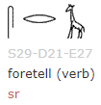
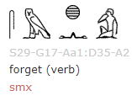
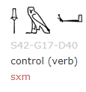
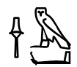
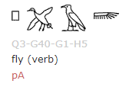
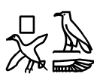
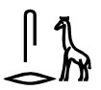
𓌂𓅓𓂡
𓌂
𓅓
𓂡
𓊪
𓊪𓅮𓄿𓆃
𓄿
𓅮
𓆃
𓋴
𓃱
𓂋

