Slide 1

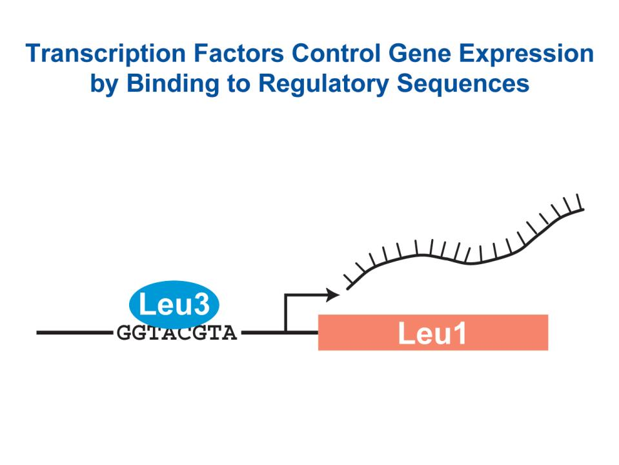
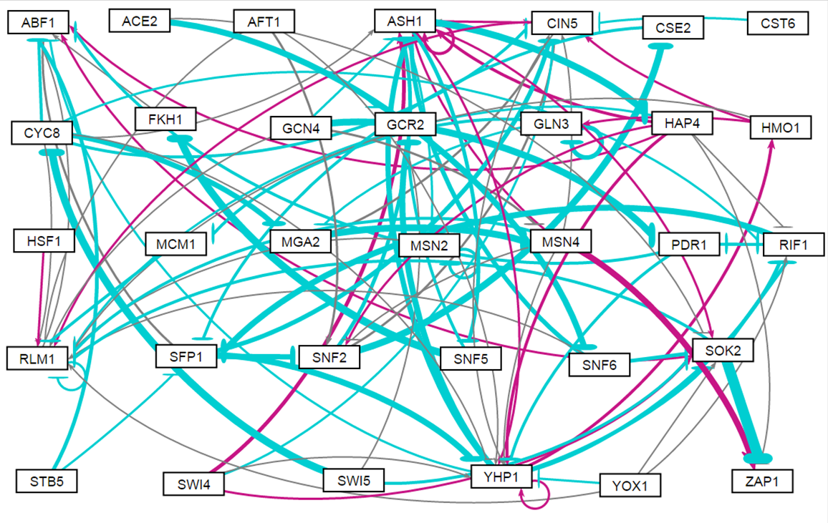
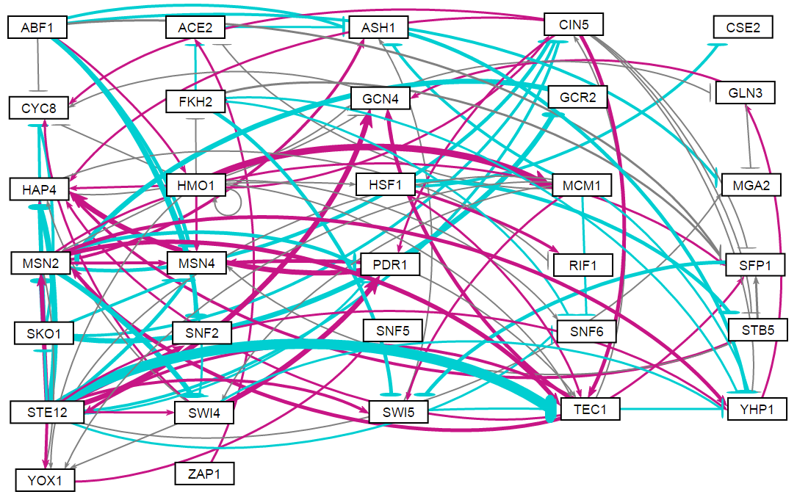
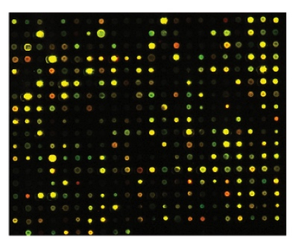
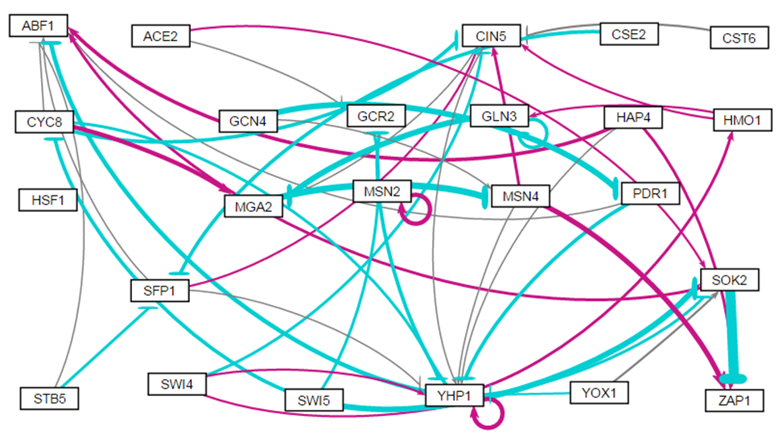
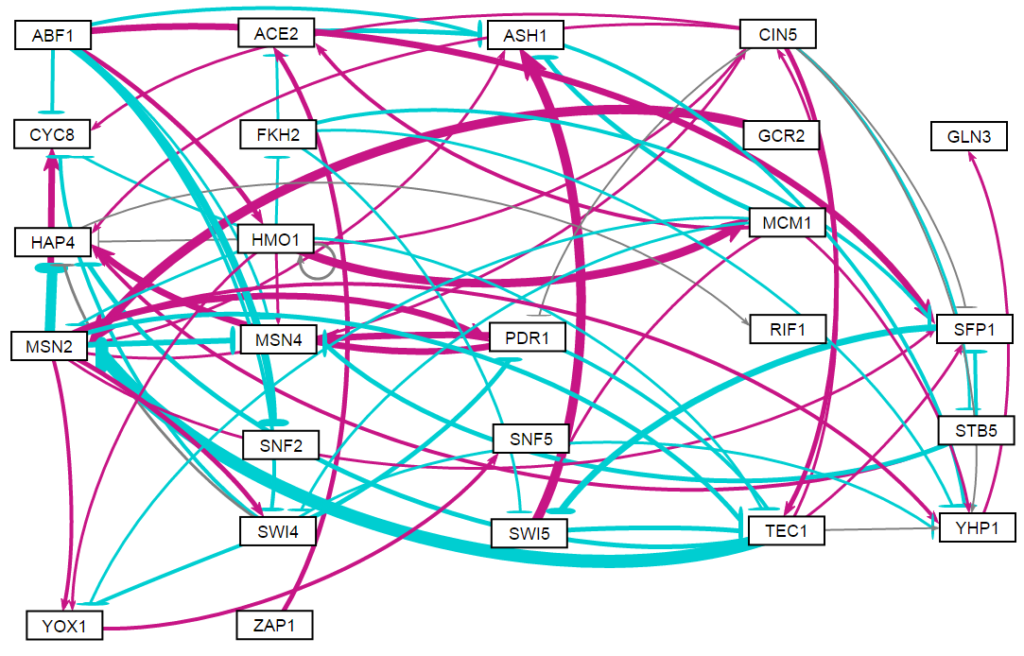
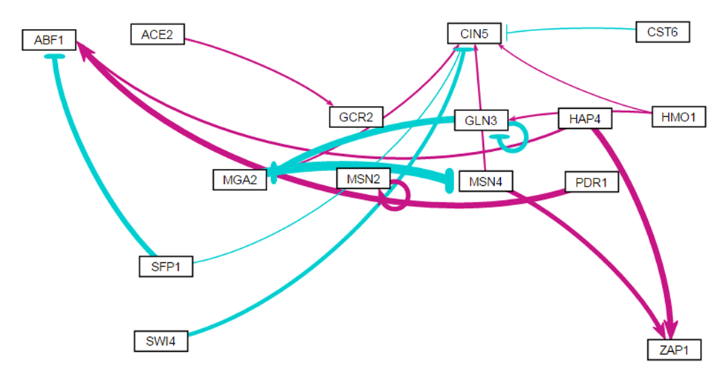
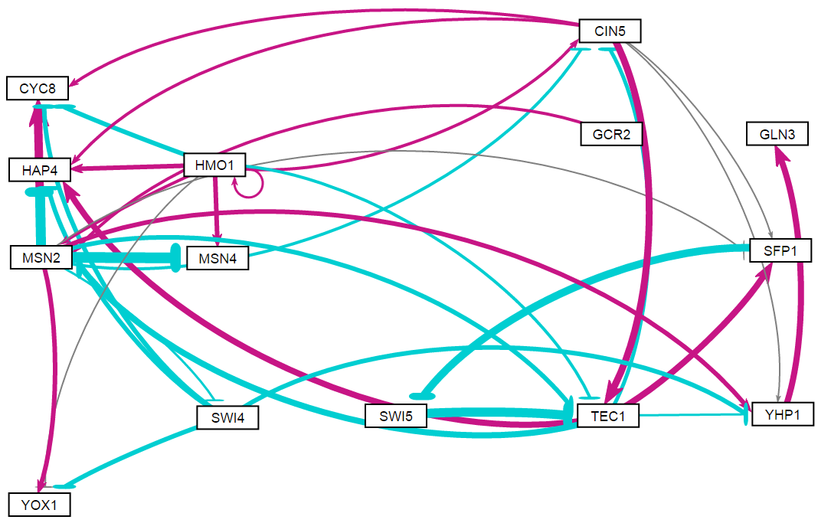
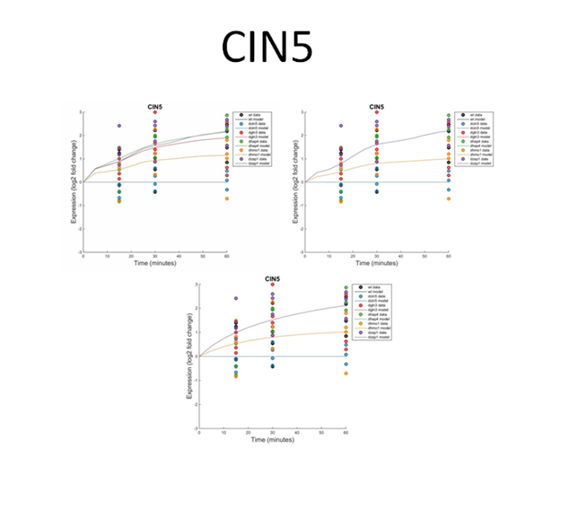
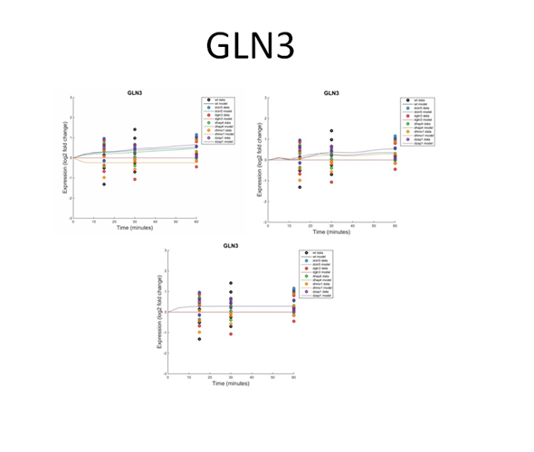
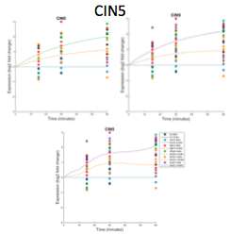
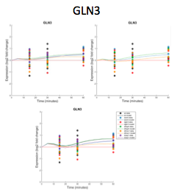
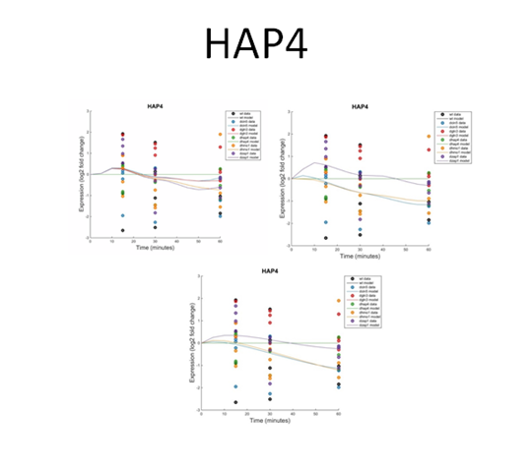
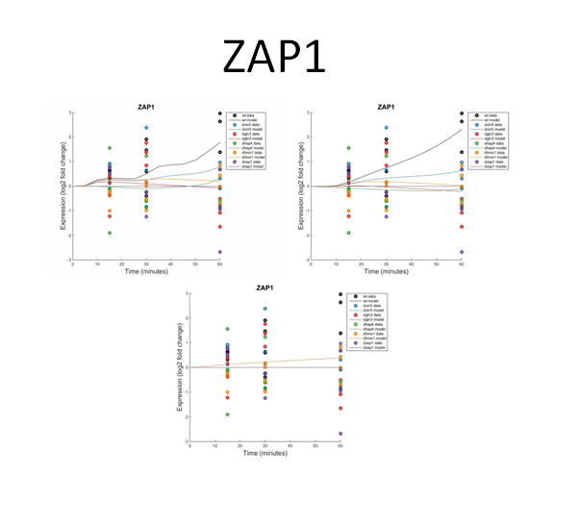
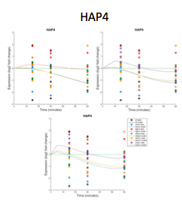
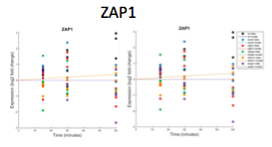
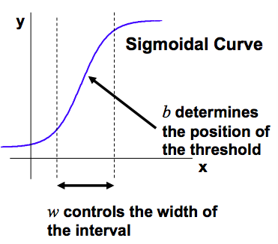
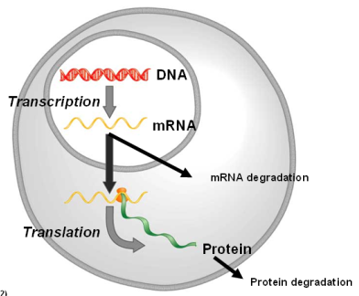
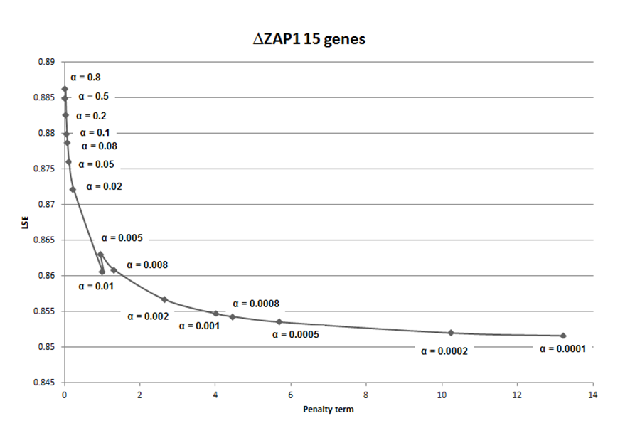
Mathematical modeling shows that Gln3 and Zap1 affect the dynamics of the gene regulatory network
controlling the cold shock response in Saccharomyces cerevisiae
Tessa A. Morris¹, Kristen M. Horstmann², Kayla C. Jackson³, Kam D. Dahlquist², and Ben G. Fitzpatrick¹
¹Department of Mathematics, ²Department of Biology, Loyola Marymount University, 1 LMU Drive, Los Angeles, CA 90045 USA,
³Department of Mathematics, Spelman College, Atlanta, GA 30314 USA
Gene Expression is Controlled by Regulatory Transcription Factors
Visualization of Three Networks from Each Family with Weighted Edges
ZAP1 family | GLN3 family
33 Genes, 98 Edges | 32 Genes, 98 Edges
24 Genes, 46 Edges | 25 Genes, 71 Edges
15 Genes, 28 Edges | 14 Genes, 35 Edges
Expression Plots Show How Well the Model Fits the Data for Individual Transcription Factors
ZAP1 family | GLN3 family
ANOVA p values and Mean Squared Errors for Individual Genes Explain the Goodness of Fit
ZAP1 family | GLN3 family
The ANOVA test shows whether each gene showed a significant change in expression at any of the time points (Benjamini & Hochberg corrected p < 0.05). Mean squared errors (MSE) shows the goodness of fit of the simulated data to the experimented data for individual genes. It appears that the model works well when an individual gene has significant dynamics, but does not work as well when the genes are not changing expression.
Parameter comparisons for threshold b, production rates, and network weights
ZAP1 family | GLN3 family
Conclusions and Future Directions
The cold shock microarray data for the GLN3 and ZAP1 deletion strains was analyzed with an ANOVA statistic, the YEASTRACT database, and an ordinary differential equations model in order to model the change in expression of each gene over time. Three networks of different sizes were each derived from the GLN3 and ZAP1 data and compared. These networks yielded optimized weight, threshold, and production rate parameters using a sigmoidal production function. The output was visualized through GRNsight to see the changes in the weight parameters, which represent activation and repression relationships between transcription factors. The actual LSE to minimum theoretical LSE ratio demonstrated the model works consistently for this range of network sizes. The parameter comparisons show how the parameters can change with the removal of nodes and edges from the networks. Expression plots showed that the model fit the smaller networks better than the larger ones, which may have been due to the smaller number of parameters being estimated. From the sum MSE’s, it was found that the genes that have inputs are modeled more accurately than those that have only outputs. In the future, the causes of the anomalies with the L-curve analysis and production rates will be investigated and fixed, if necessary. Comparison with model runs of random networks with the same number of nodes and randomized edges will be important to determine if the goodness of fit of the dynamics depend entirely on just the sheer number of nodes and edges, or on the biological validity of the connections.
Acknowledgments
For their work on the GRNmap code, we would like to thank Juan S. Carrillo, Trixie Anne M. Roque, Chukwuemeka E. Azinge, Katrina Sherbina, and Nicholas A. Rohacz. We thank Nicole A. Anguiano, Anindita Varshneya, Mihir Samdarshi, and Britain J. Southwick for their work on the GRNsight visualization software. Microarray data were collected by Cybele Arsan, Wesley Citti, Kevin Entzminger, Andrew Herman, Monica Hong, Heather King, Lauren Kubeck, Stephanie Kuelbs, Elizabeth Liu, Matthew Mejia, Kevin McGee, Kenny Rodriguez, Olivia Sakhon, Alondra Vega, and Kevin Wyllie. This work was supported by NSF-RUI Award 0921038 (K.D.D., B.G.F.), a Kadner-Pitts Research Grant (K.D.D.), and the Rains Research Assistant Program (T.A.M.).
References
Belle, A., Tanay, A., Bitincka, L., Shamir, R., & O’Shea, E. K. (2006). Quantification of protein half-lives in the budding yeast proteome.Proceedings of the National Academy of Sciences, 103(35), 13004-13009. Dahlquist, K., Fitzpatrick, B., Camacho, E., Entzminger, S., & Wanner, N. (2015). Parameter Estimation for Gene Regulatory Networks from Microarray Data: Cold Shock Response in Saccharomyces cerevisiae. Bulletin Of Mathematical Biology, 77(8), 1457-1492. http://dx.doi.org/10.1007/s11538-015-0092-6. Dário Abdulrehman, Pedro T. Monteiro, Miguel C. Teixeira, Nuno P. Mira, Artur B. Lourenço, Sandra C. dos Santos, Tânia R. Cabrito, Alexandre P. Francisco, Sara C. Madeira, Ricardo S. Aires, Arlindo L. Oliveira, Isabel Sá-Correia, Ana T. Freitas (2011). YEASTRACT: providing a programmatic access to curated transcriptional regulatory associations in Saccharomyces cerevisiae through a web services interface Nucl. Acids Res., 39: D136-D140. Freeman, S. (2002). Biological science. Upper Saddle River, NJ: Prentice Hall. GRNsightt. (n.d.). Retrieved March 10, 2016, from http://dondi.github.io/GRNsight/ GRNmap. (n.d.). Retrieved March 10, 2016, from https://github.com/kdahlquist/GRNmap
Activators increase gene expression, while repressors decrease gene expression.
Transcription factors themselves are proteins that are encoded by genes.
A gene regulatory network (GRN) consists of a set of transcription factors that regulate the level of expression of a set of target genes, which can include other transcription factors.
The dynamics of a GRN is how the expression of genes in the network change over time.
Yeast Respond to the Environmental Stress of Cold Shock by Changing Gene Expression
Little is known about which transcription factors regulate the response to cold shock.
The Dahlquist Lab has studied the transcriptional response to cold shock using DNA microarrays, which measure the level of mRNA expression for all 6000 genes in yeast.
Expression data was collected from the wild type and five transcription factor deletion strains (Δcin5, Δgln3, Δhap4, Δhmo1, and Δzap1) before cold shock (30°C) and after 15, 30, and 60 minutes of cold shock (13°C).
Mathematical modeling is then used to determine the relative influence of each transcription factor in the GRN that controls cold shock response.
Microarray at 60 minutes after cold shock
The Δzap1 and Δgln3 Strain Microarray Data Were Used to Generate a Family of Related GRNs from the YEASTRACT Database
An ANOVA test of the DNA microarray data from the Zap1 deletion strain showed that 1859 genes (30%) had a log₂ fold change significantly different than zero at any time point for a Benjamini and Hochberg corrected p < 0.05, whereas data from the Gln3 deletion strain had 1683 (28%).
Each list of genes was submitted to the YEASTRACT database, which outputted their potential regulatory transcription factors (TFs) in order of significance.
Two families of related gene regulatory networks were created, one based on each deletion strain’s data. The other deletion strain transcription factors were added to 29 of the most significant TFs to generate the largest GRNs. These networks were pared down one-by-one by removing genes and edges in order of increasing significance.
These are considered “medium-scale” networks as they represent only a small subset of the yeast genome’s approximately 250 transcription factors.
A Nonlinear Differential Equation Determines the Rate
at Which Each Gene is Expressed
The model, called GRNmap (Gene Regulatory Network modeling and parameter estimation) was implemented in MATLAB (Dahlquist et al. 2015).
MATLAB code and executable are available under an open source license at http://github.com/kdahlquist/GRNmap/.
Each gene has a ordinary differential equation which models the change in expression over time measured as production minus degradation.
A sigmoidal production function is used where:
P_{i} is mRNA production rate for gene i
d_{i} is the mRNA degradation rate for gene i
w is weight term, determining the level of activation or repression of gene j on i
b is a unique threshold for each gene
The production rate (P_{i} ), weight (w ), and threshold (b) values were estimated from DNA microarray data using a penalized least squares approach:
(Freeman, 2002)
E represents the error between estimated values and microarray data values.
Θ is the penalty term of combined w, P, and b parameter values
L-curve Analysis Suggested a Good Alpha Value to be 0.002
Gene | ANOVA BH p-value | Sum MSE by Network Size
 |  | 33 gene | 24 gene | 15 gene
CIN5 | 0.0103 | 4.2541 | 4.2057 | 4.2191
GLN3 | 0.0276 | 1.6946 | 1.6586 | 1.6857
HAP4 | 0.0134 | 7.9825 | 8.4690 | 8.4698
HMO1 | 0.0009 | 5.4088 | 5.4220 | 5.5691
ZAP1 | N/A | 7.2831 | 6.7759 | 7.7856
Gene | ANOVA BH p-value | Sum MSE by Network Size
 |  | 32 gene | 25 gene | 14 gene
CIN5 | 0.0109 | 4.2377 | 4.2973 | 3.5837
GLN3 | 0.05879 | 1.6871 | 1.6708 | 1.4206
HAP4 | 0.0620 | 7.1334 | 7.1343 | 6.7382
HMO1 | 0.0006 | 5.5361 | 5.5368 | 4.9896
ZAP1 | 0.0276 | 9.0081 | 9.0087 | N/A
L-curve for ZAP1 15 Gene, 28 Edge Network
The estimation was run iteratively for alpha values ranging from 0.8 down to 0.0005.
Parameter outputs from one run were used as the initial estimates for the next run. Least Squares Error (LSE) was plotted against the penalty term for each alpha value.
The ideal alpha value minimizes both the LSE and penalty term, and therefore lies near the “elbow” of the L-curve.
Therefore, 0.002 was chosen and used for further runs of the model.

