Slide 1
Comparison of the Regulatory Dynamics of Related Small Gene Regulatory Networks that Control the Cold Shock Response in Saccharomyces cerevisiae
Natalie Williams
Kam D. Dahlquist and Ben G. Fitzpatrick
March 25, 2017

Slide 2
Overview of Today’s Presentation
Yeast respond to cold shock by changing gene expression.
Microarray data was generated for yeast under cold shock conditions.
A family of related networks was generated from the YEASTRACT database.
The dynamics of each gene in the network was modeled using ordinary differential equations.
Database-derived network 5 was modeled better in comparison to random networks.

Slide 3
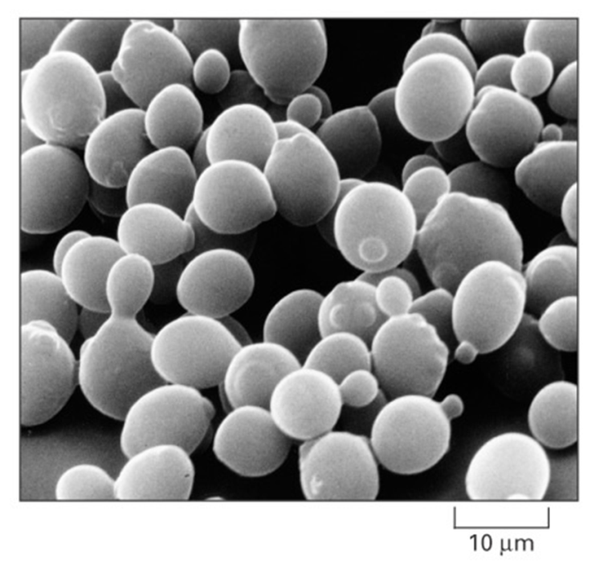
Saccharomyces cerevisiae is a Model Organism for Systems Biology
Budding yeast is used as a model organism due to its small genome size of approximately 6000 genes.
These 6000 genes are regulated by ~250 transcription factors, which can regulate gene expression.
Yeast deletion strains and other molecular genetic tools are readily available.
For example, we have gained important information about cancer from studying yeast.
Alberts et al. (2004)

Slide 4
The Response to the Environmental Stress Cold Shock Is Not Well Studied
Cold shock for yeast is from 10-18℃.
The response is not as well characterized as heat shock.
Heat Shock | Cold Shock
Proteins denature | Decrease fluidity of membranes
Induction of heat shock proteins that assist in protein folding | Stabilizes DNA and RNA secondary structures
Conserved in all organisms | Impair ribosome function and protein synthesis
 | Decreased Enzymatic activities
 | No equivalent set of cold shock proteins that are conserved in all organisms

Slide 5
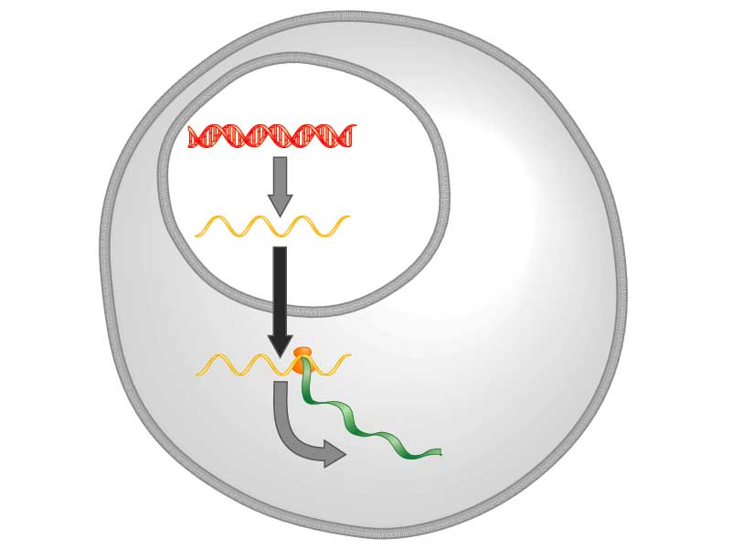
Yeast respond to cold shock by changing the level of gene expression
Transcription factors control gene expression by binding to regulatory DNA sequences.
Activators increase expression and repressors decrease expression
Transcription factors are themselves proteins encoded by genes.
A gene regulatory network (GRN) is a set of transcription factors that regulate the expression of genes encoding other transcription factors.
DNA
Transcription
mRNA
Translation
Protein
Freeman (2003)

Slide 6
The Questions the Dahlquist Lab investigates:
DNA
1. Which transcription factors regulate the cold shock response in yeast?
2. What is the indirect effect of other transcription factors?
3. Can we make predictions based on our understanding of the network?
Transcription
mRNA
Translation
Protein
Freeman (2003)

Slide 7
Overview of Today’s Presentation
Yeast respond to cold shock by changing gene expression.
A family of related networks was generated from the YEASTRACT database, using microarray data.
The dynamics of each gene in the network was modeled using ordinary differential equations.
Database-derived network 5 was modeled better in comparison to random networks.

Slide 8
The Microarray Data from the Dahlquist Lab Was Used to Derive a Family of Related GRNs from the YEASTRACT Database
Indicates which genes had significant changes in expression at any time point
YEASTRACT Database
These genes were submitted to the YEASTRACT database, which returned a list of candidate regulatory transcription factors that potentially regulate those target genes, in order of significance.
Within-strain ANOVA
Generate “Family” of Related Networks
Notes:
Change title

Slide 9
A “Family” of Related Networks Was Created by Paring Down Genes and Edges from the Largest Network
We started with a network of 30-35 genes made up of the most significant regulators.
Transcription factors and edges were removed from the GRN in a stepwise fashion in order of least to most significant until the network was pared down to 14 - 16 genes and 27 - 35 edges.
We then ran the smallest model of each databased-derived network on GRNmap.
New nomenclature was given to describe this family of related GRNs.
Previously | wt | dcin5 (14-gene) | dcin5 (17-gene) | dgln3 | dhap4 | dzap1
 | Network derived from wt data | Network derived from ∆cin5 data | Network derived from ∆cin5 data | Network derived from ∆gln3 data | Network derived from ∆hap4 data | Network derived from ∆zap1 data
 | db1 network | db2 network | db3 network | db4 network | db5 network | db6 network

Slide 10
A “Family” of 31 Random Networks was Generated from an R Script, using data derived from ∆hap4.
Db5 network was used for comparison to random networks.
Random networks have the same number of nodes (15 for db5 network) and the same number of edges (28 for db5 network).
Random networks 1 – 10 were previously generated, so they were re-run.
Using an R script, adjacency matrices were generated to pasted into input sheets with identical parameters as db5 network to create random networks 11 – 31.
These db and random networks were all run on GRNmap v1.4.4.

Slide 11
Overview of Today’s Presentation
Yeast respond to cold shock by changing gene expression.
A family of related networks was generated from the YEASTRACT database, using microarray data.
The dynamics of each gene in the network was modeled using ordinary differential equations.
Database-derived network 5 was modeled better in comparison to random networks.

Slide 12
GRNmap Uses Ordinary Differential Equations to Model the Dynamics of Each Gene in the Network
The MATLAB code and executable are available under an open source license at
https://github.com/kdahlquist/GRNmap/.
Each gene’s expression level is described using ordinary differential equations with a sigmoidal production function.
Degradation rates calculated using RNA half lives provided by Neymotin et al. 2014
RNA degradation rate for gene i
mRNA production rate for gene i
weight term
determines the level of activation or
repression of gene j on gene i
Unique threshold for each gene
Notes:
Degradation rates were provided by Neymotin et al. 2014

Slide 13
Overview of Today’s Presentation
Yeast respond to cold shock by changing gene expression.
A family of related networks was generated from the YEASTRACT database, using microarray data.
The dynamics of each gene in the network was modeled using ordinary differential equations.
Database-derived network 5 was modeled better in comparison to random networks.

Slide 14
LSE:minLSE ratio comparison between DB5 network and 31 random networks validates that DB5 network is modeled better
Notes:
Closer to the ideal (1) means that it was perfect; modeled accurately & all time points fit data

Slide 15
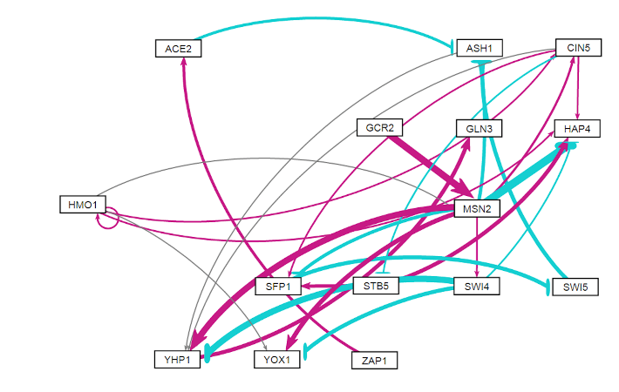
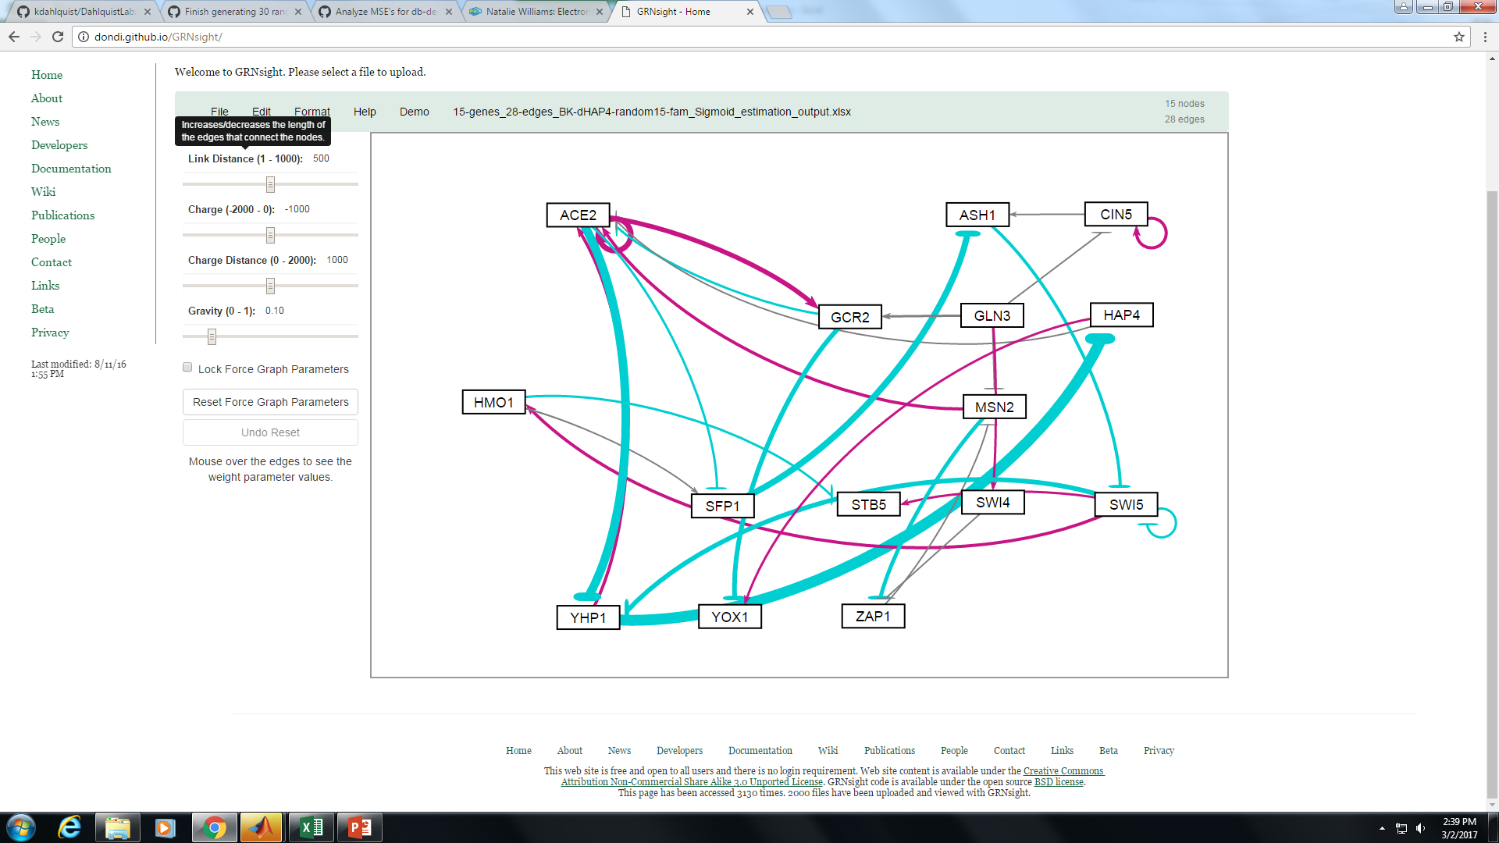
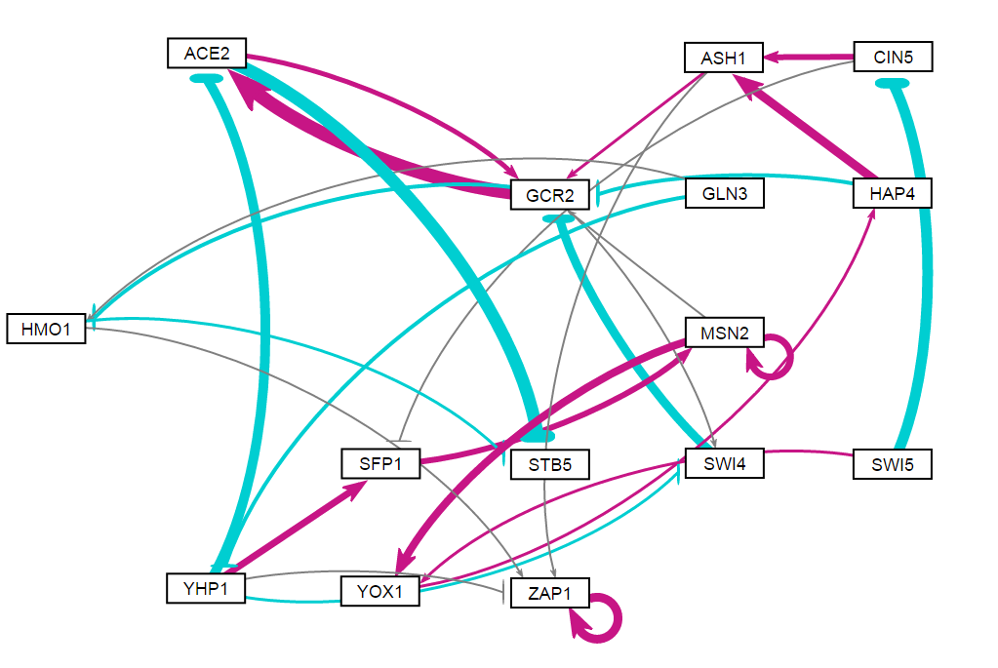
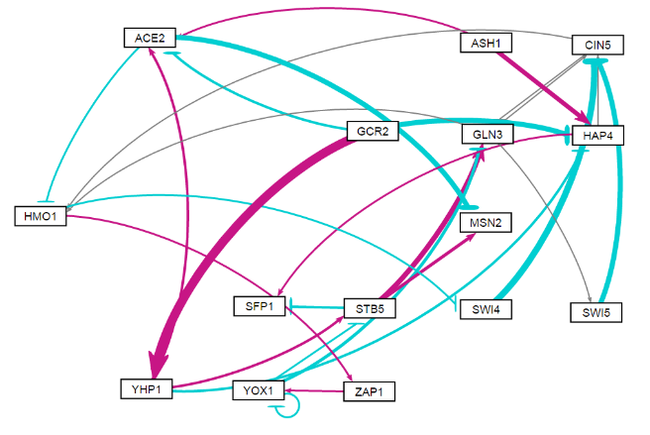
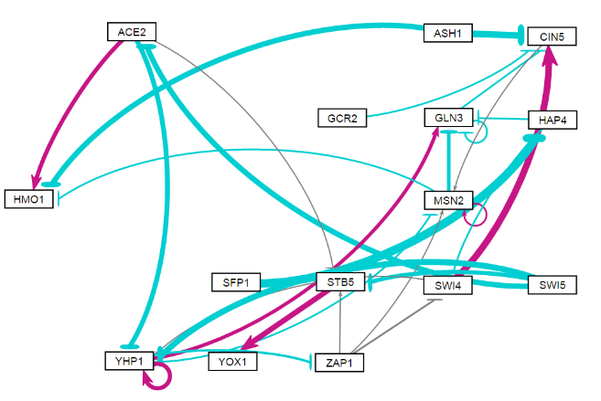
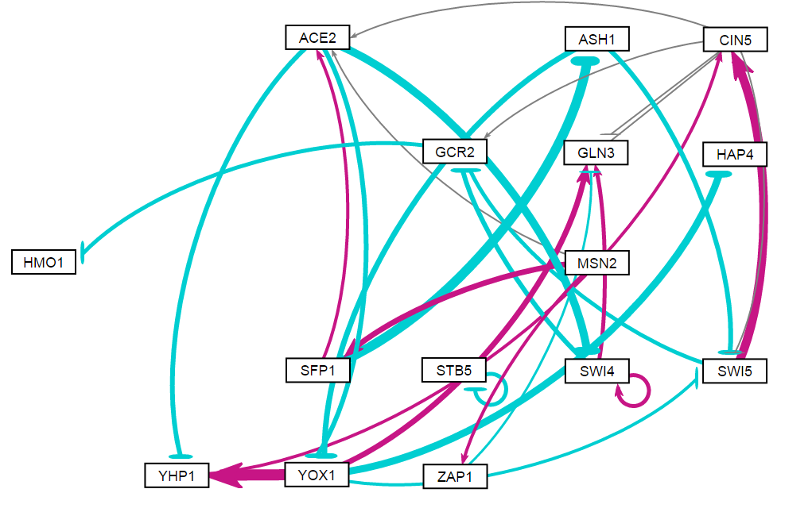
GRNsight visualization highlight the presence of more repressive regulatory relationships in the random networks compared to db5 network
db5 Network
Random Network 15
Random Network 16
Random Network 24
Random Network 7
Random Network 12
Random Network 31

Slide 16
Unique regulatory relationships appeared in only in the random networks.
Random networks with better LSE:minLSE ratios have MSE:minMSE values less than those of db5 network
Random networks with worse LSE:minLSE ratios have MSE:minMSE values greater than those of db5 network
Regulatory Relationship | Number Observed
Only in Better Randoms | 10
Shared between db5 & better | 4
Shared between db5 & worse | 4
Shared amongst randoms (same regulation) | 12
Shared amongst randoms (different regulation) | 7
Only in Worse Randoms | 4

Slide 17
References
Dahlquist, K., Fitzpatrick, B., Camacho, E., Entzminger, S., & Wanner, N. (2015). Parameter Estimation for Gene Regulatory Networks from Microarray Data: Cold Shock Response in Saccharomyces cerevisiae. Bulletin Of Mathematical Biology, 77(8), 1457-1492. http://dx.doi.org/10.1007/s11538-015-0092-6.
Dário Abdulrehman, Pedro T. Monteiro, Miguel C. Teixeira, Nuno P. Mira, Artur B. Lourenço, Sandra C. dos Santos, Tânia R. Cabrito, Alexandre P. Francisco, Sara C. Madeira, Ricardo S. Aires, Arlindo L. Oliveira, Isabel Sá-Correia, Ana T. Freitas (2011). YEASTRACT: providing a programmatic access to curated transcriptional regulatory associations in Saccharomyces cerevisiae through a web services interface Nucl. Acids Res., 39: D136-D140, Oxford University Press.
Freeman, S. (2002). Biological science. Upper Saddle River, NJ: Prentice Hall.
GRNsightt. (n.d.). Retrieved March 10, 2016, from http://dondi.github.io/GRNsight/
GRNmap. (n.d.). Retrieved March 10, 2016, from https://github.com/kdahlquit/GRNmap
Neymotin, B., Athanasiadou R., and Gresham D. (2014). Determination of in vivo RNA kinetics using RATE-seq. RNA, 20, 1645-1652.

