Slide 1
Usability Improvements to GRNmap:
Software for Gene Regulatory Network Modeling and Parameter Estimation
Students: Juan Carrillo Quinche, Trixie Anne Roque
Mentors: Dr. Kam Dahlquist, Dr. John David Dionisio, Dr. Ben Fitzpatrick
Undergraduate Research Symposium
Loyola Marymount University
March 19, 2016
Notes:
Juan:1-11
Trixie:12-FIN
Suggestions:
make title before colon big, and after smaller

Slide 2
Outline
GRNmap is an open-source MATLAB program that estimates parameters for a gene regulatory network and performs a forward simulation of the dynamics of the gene expression.
We improved the code by
Modularizing it
Fixing Bugs
Adding a testing framework
Adding new functionality
Future directions include providing additional test coverage and new features to support the data analysis team.

Slide 3
Outline
GRNmap is an open-source MATLAB program that estimates parameters for a gene regulatory network and performs a forward simulation of the dynamics of the gene expression.
We improved the code by
Modularizing it
Fixing Bugs
Adding a testing framework
Adding new functionality
Future directions include providing additional test coverage and new features to support the data analysis team.
Notes:
Trix

Slide 4
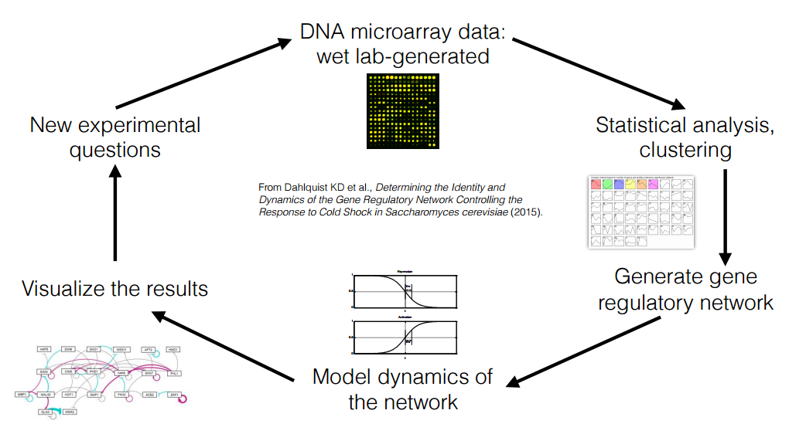
GRNmap is Part of a Larger Systems Biology Research Project
Notes:
Wetlab gets data,
Data analysis does statistical analysis
GRNmap does us
GRNsight

Slide 5
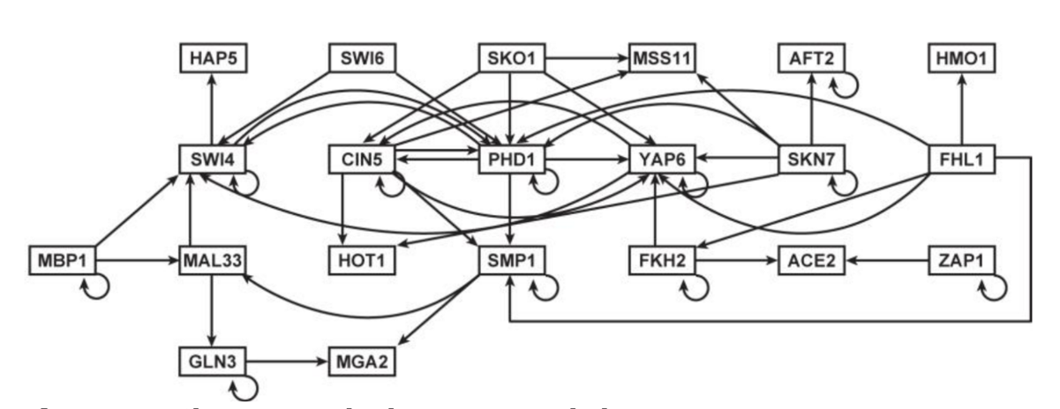
A Gene Regulatory Network Consists of a Set of Transcription Factors that Regulate the Expression of Target Genes
Notes:
So what are we modeling? A gene regulatory network!!!
Suggestions:
Show black line before
Show color line later, after we give this to GRNsight

Slide 6
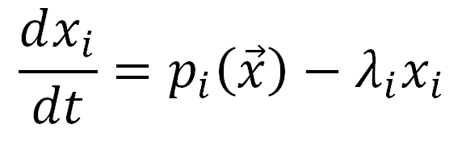
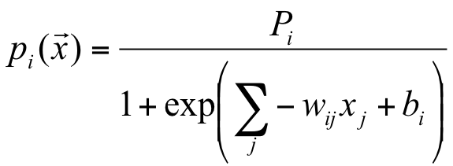
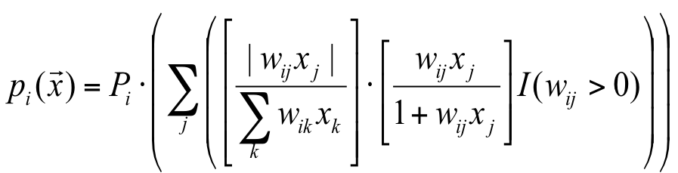
GRNmap Uses Ordinary Differential Equations to Model Expression for Each Gene in the Network
Mass Balance Equation
Sigmoidal Production Function
Michaelis-Menten Production Function
Notes:
We are studying how the differnt genes are being expressed. The expression rate of each gene is given by the difference between the production rate of the gene, which is modeled by these two nasty things, and the degradation rate. Our goal is to solve this differential equation, which can be rather complex.

Slide 7
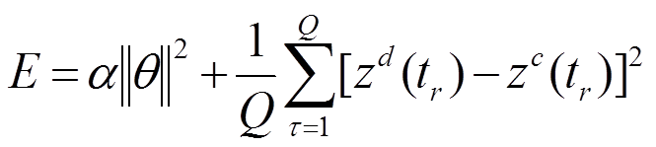
GRNmap Estimates Parameters Using
a Penalized Least Squares Error Function
Penalized least square error function
We can estimate the following parameters
w_{ij} - Production weights
P_{i} - Production Rates
b_{i} - Thresholds (Sigmoidal Model only)
Notes:
This should have its own slide
k?
let;s go as asoon as possible
you wanna practice some more right now?

Slide 8
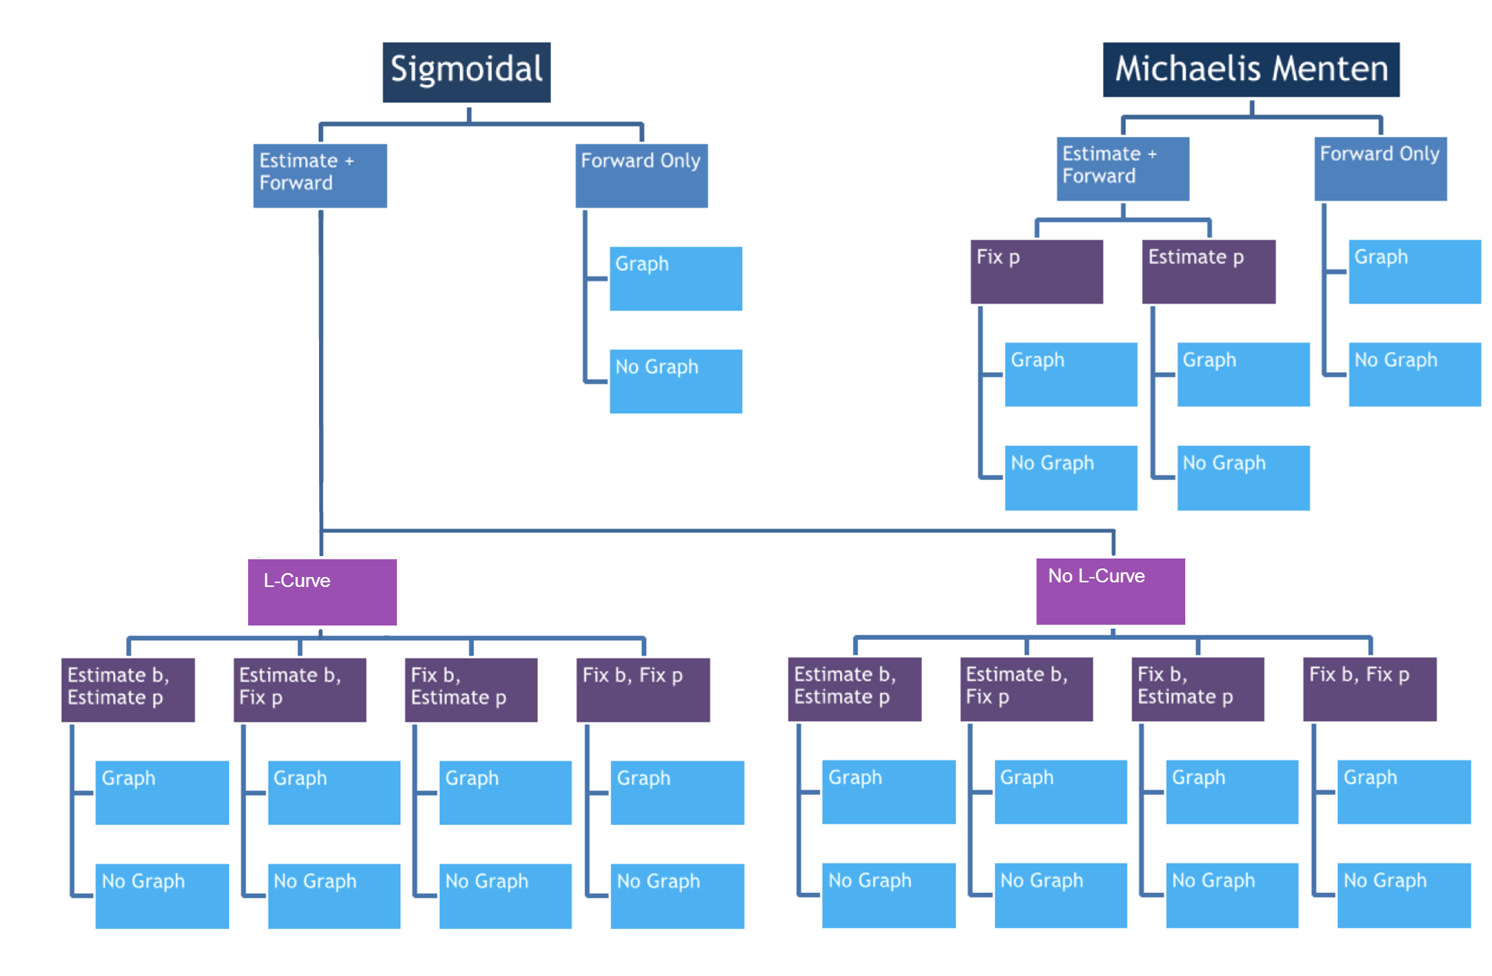
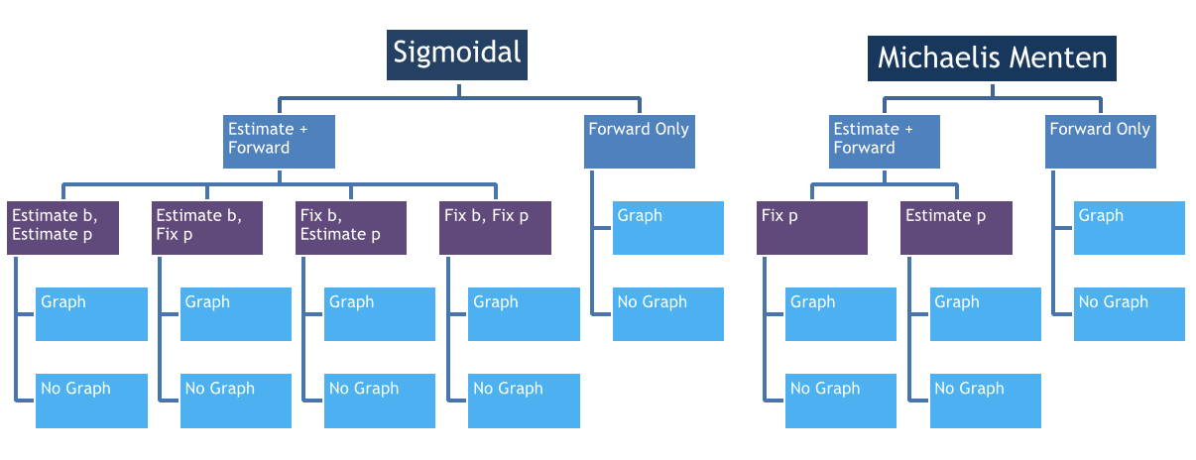
GRNmap Allows Users to Select Various Runtime Parameters
Notes:
Theres a bunch of ways to run GRNmap and solve the dfq. We can specify things like the production function, whether we want to estimate the parameters, and if so,, which parameters to use.
We show l-curve option for Sigmoidal, but we can also do it for mm.

Slide 9
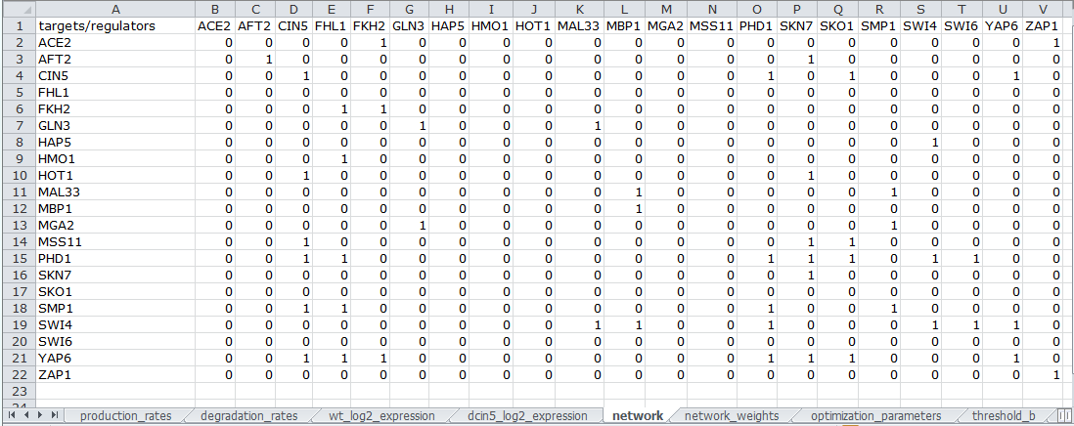
GRNmap Uses an Excel Workbook as Input
An adjacency matrix defines the gene network
We provide the following parameters in an Excel workbook:
Production rates
Degradation rates
Thresholds
Gene expression for different strains for different time points
Adjacency matrix
Network weights
Runtime parameters
Simulation timepoints
Notes:
Once we’ve decided what we want GRNmap to do, we prepare an Excel worksheet that will serve as input GRNmap. In this screenshot we see the sheet that describes the network, so it describes how all the genes are related to one another.
We also include information such as production rates, deg rates, gene expressions collected by the WET lab, network weights, optimization parameters, and threshold.

Slide 10
Users Can See How GRNmap Optimizes The Parameters

Slide 11
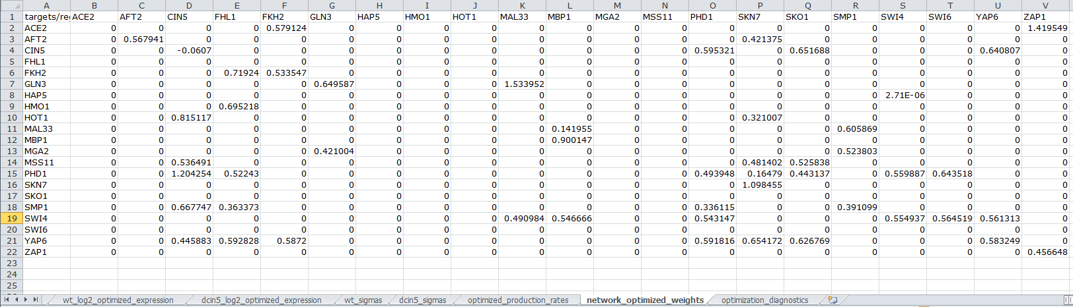
GRNmap Outputs Excel Workbook and Gene Expression Plots
Network weights have been replaced by optimized weight values
Notes:
The user gets back an Excel workbook as output.
We get:
simulated expression
sigmas
any estimated parameters
and an optimization
gene expression plots
bullet they have ben replaced by optimized weight values

Slide 12
GRNmap Produces Optimized Gene Expression Plots
Notes:
make gif of looping gene expressions figure
gene expressi

Slide 13
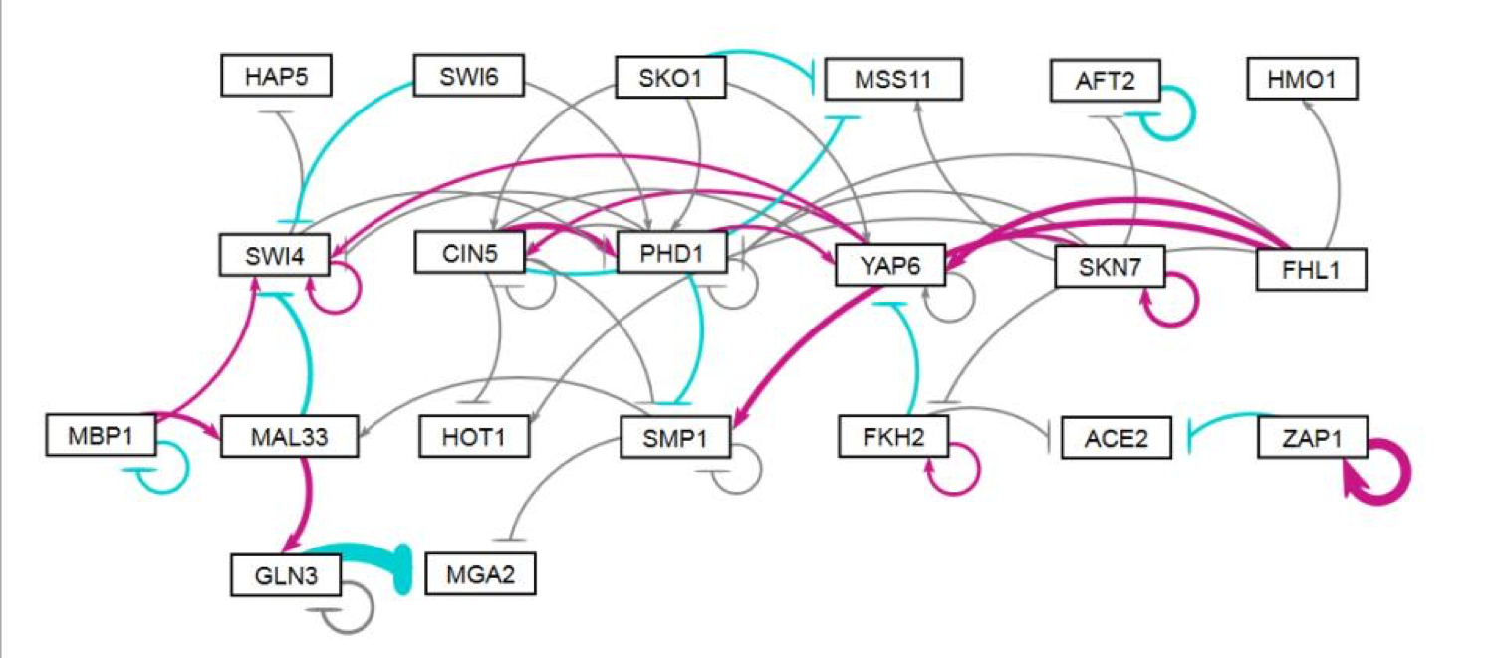
Information from GRNmap is Visualized by GRNsight
Notes:
So what are we modeling? A gene regulatory network!!!
Suggestions:
Show black line before
Show color line later, after we give this to GRNsight

Slide 14
Outline
GRNmap is an open-source MATLAB program that estimates parameters for a gene regulatory network and performs a forward simulation of the dynamics of the gene expression.
We improved the code by
Modularizing it
Fixing Bugs
Adding a testing framework
Adding new functionality
Future directions include providing additional test coverage and new features to support the data analysis team.
Notes:
TRIXIE

Slide 15
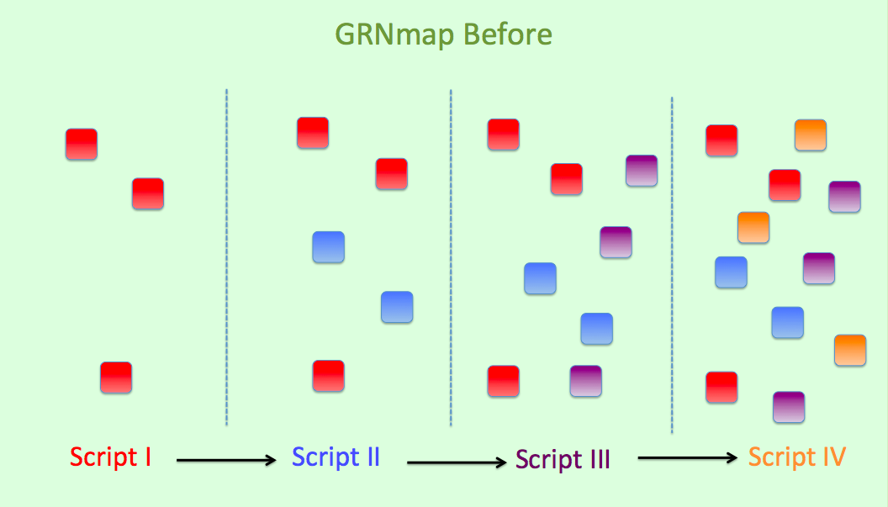
GRNmap was Previously Composed of Scripts
Notes:
Originally, our code base written using scripts which was very difficult to maintain because it was using global variables that would persist throughout the rest of the code.
So then, we modified the code such that… *click*

Slide 16
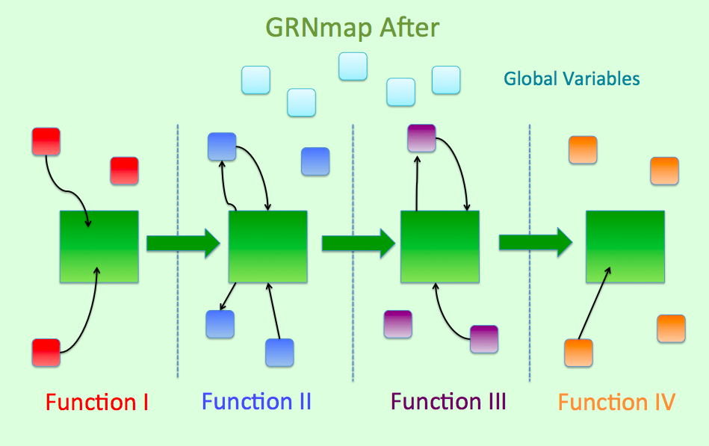
Current Version of the Code is More Modular and Readable
Notes:
We are using functions that uses a data structure to pass only the relevant data around.
Using these functions, we managed to get rid of most of the global variable.
Unfortunately, couldn’t get rid of some global variables because we had to use MATLAB functions ode45 and fmincon

Slide 17
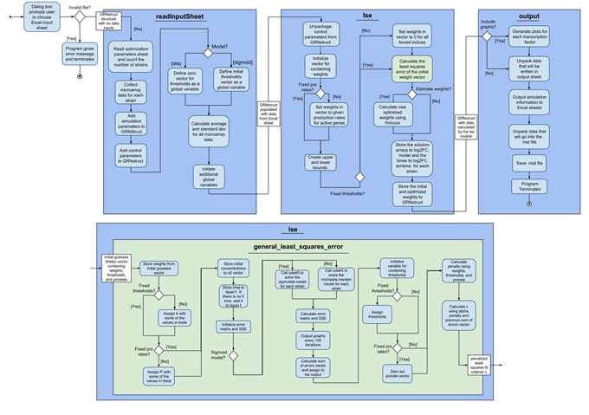
Current Version of the Code is More Modular and Readable
Notes:
This diagram shows the three main steps of GRNmap:
Basically, the flow of information starts with reading the input sheets, then we estimate parameters and simulate the model, and lastly we write out the output sheets

Slide 18
Our Software Development Team has Implemented Substantial Usability Improvements
Standardized formatting of input and output workbooks
Refactored code to include better variable names
Users provide less redundant information
GRNmap provides more information about the simulation
Least squared error and minimum theoretical least squared error
Mean squared error for individual genes
Standard deviation of gene expression data
Automated L-curve analysis
Routine bug fixes
Notes:
in addition to a major refactoring of the code, we have also added some new features
We’ve made it more convenient for users to make input sheets for GRNmap
Improved how users read the output
Added new, sexy feature called L-”CURVE” analysis: L-curve analysis enables users to fine tune one of the parameters for one of the models
We also fixed bugs that were reported
( ＾◡＾)っ✂╰⋃╯

Slide 19
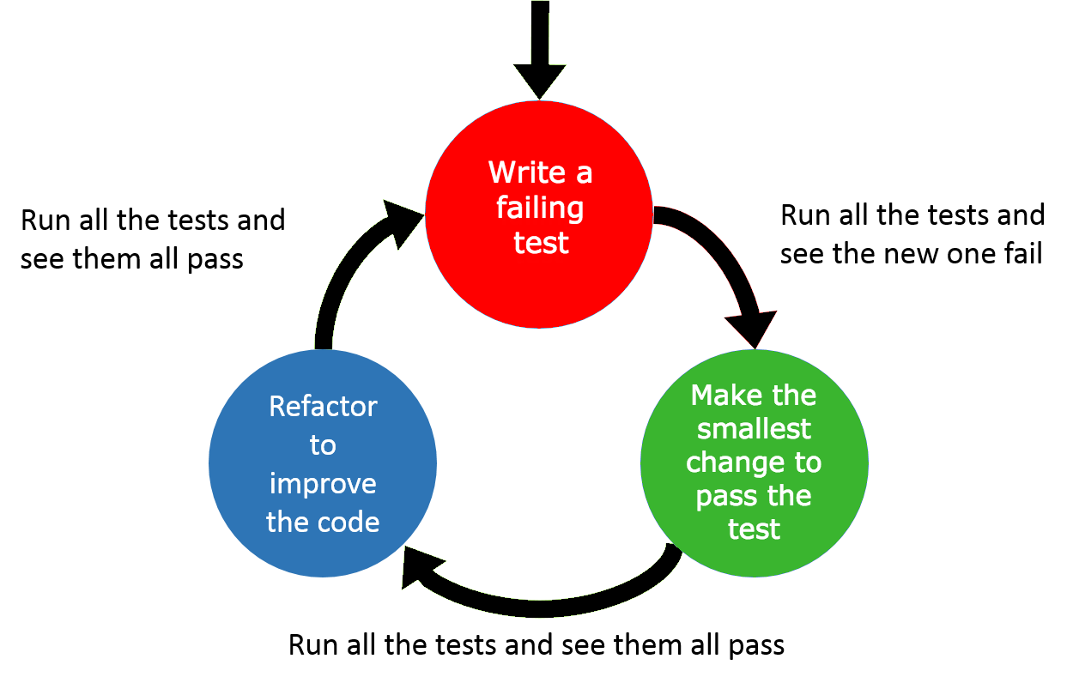
GRNmap Uses Test Driven Development (TDD),
A Process For Ensuring Code Correctness
Number of Tests | Number of Files
~650 | ~90
Notes:
Our program is complex so now we have approximately 650 tests that cover only a certain portion of the program

Slide 20
Summary
GRNmap is an open-source MATLAB program that estimates parameters for a gene regulatory network and performs a forward simulation of the dynamics of the gene expression.
We improved the code by
Modularizing it
Fixing Bugs
Adding a testing framework
Adding new functionality
Future directions include providing additional test coverage and new features to support the data analysis team.
Notes:
Trix

Slide 21
Summary
GRNmap is an open-source MATLAB program that estimates parameters for a gene regulatory network and performs a forward simulation of the dynamics of the gene expression.
We improved the code by
Modularizing it
Fixing Bugs
Adding a testing framework
Adding new functionality
Future directions include providing additional test coverage and new features to support the data analysis team.
Notes:
TRIXIE

Slide 22
Summary
GRNmap is an open-source MATLAB program that estimates parameters for a gene regulatory network and performs a forward simulation of the dynamics of the gene expression.
We improved the code by
Modularizing it
Fixing Bugs
Adding a testing framework
Adding new functionality
Future directions include providing additional test coverage and new features to support the data analysis team.
Notes:
Right now, we do not have a full test coverage, so one of our future plans is to increase our testing coverage

Slide 23
Acknowledgments
We would like to thank the following people:
Dr. Kam D. Dahlquist
Dr. John David N. Dionisio
Dr. Ben G. Fitzpatrick
Dahlquist Lab
Data Analysis Team
GRNsight
Wet Lab Team
Thank you for listening!

