Slide 1


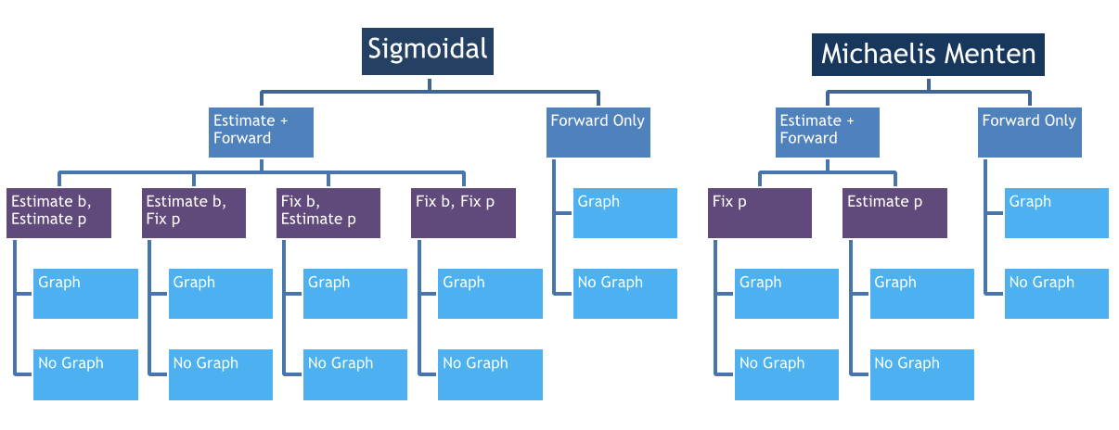
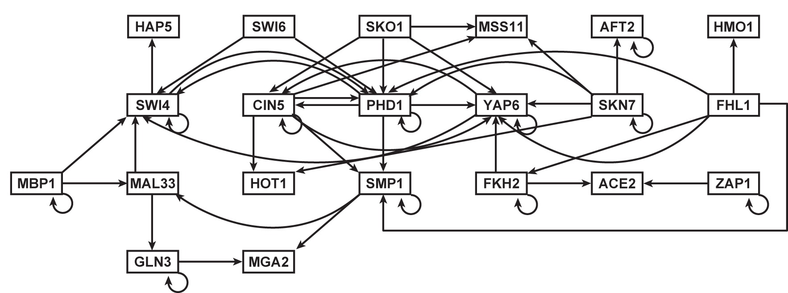
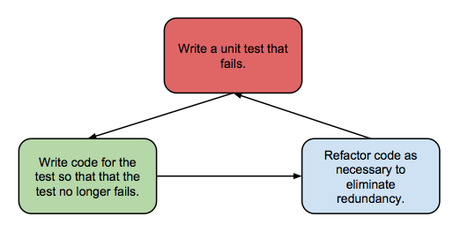
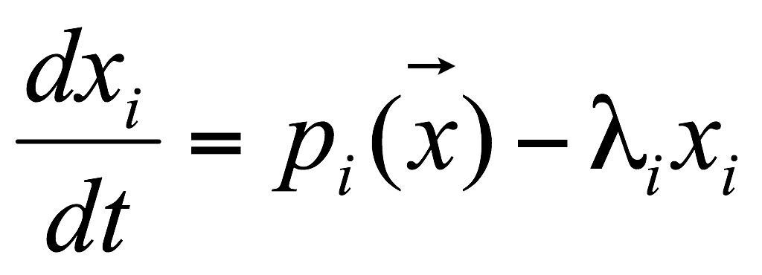
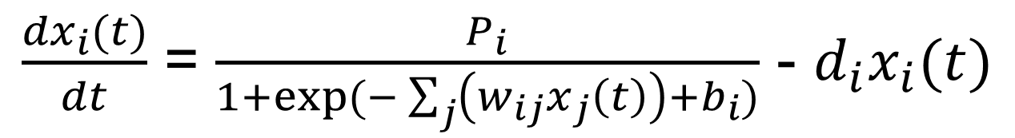
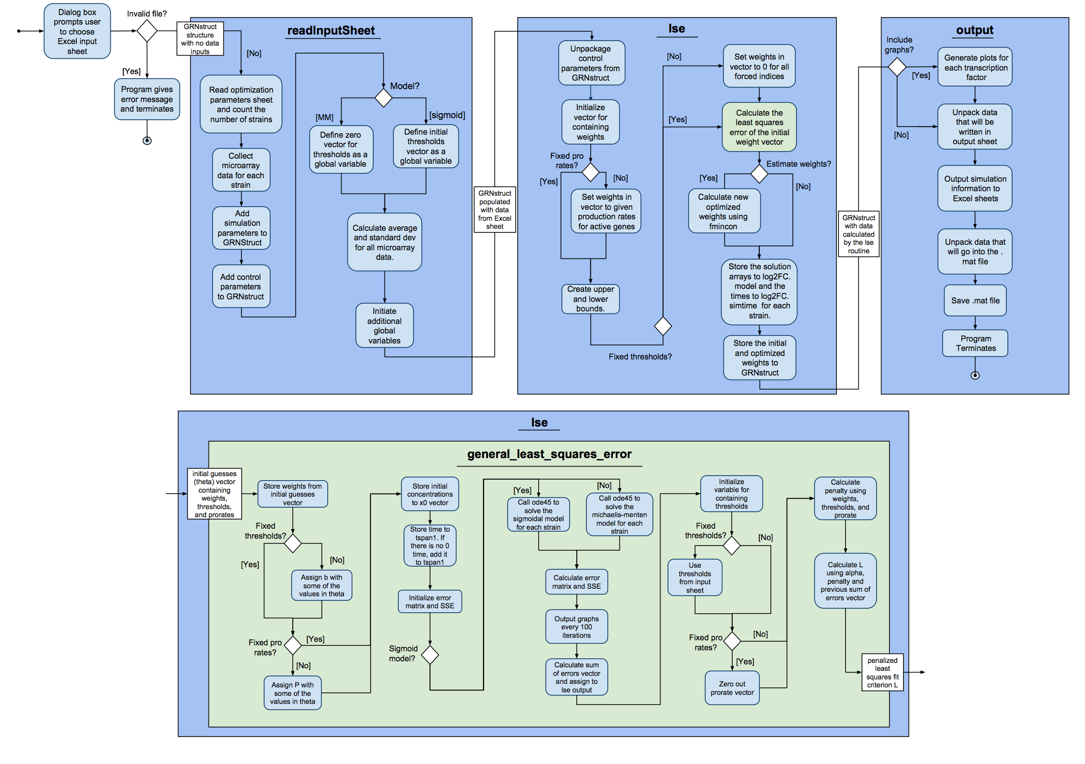
Test-Driven Development and Functionality Improvements to GRNmap,
a Gene Regulatory Network Modeling Application
Trixie Anne Roque¹, Kam D. Dahlquist², Ben G. Fitzpatrick³ , and Dr. John David N. Dionisio¹
¹Department of Electrical Engineering and Computer Science, ²Department of Biology, ³Department of Mathematics,
Loyola Marymount University, 1 LMU Drive, Los Angeles, CA 90045 USA
GRNmap Uses ODE to Model Networks
GRNmap Manipulates Data Provided by Our Group
Test-Driven Development Process
GRNmap is a MATLAB software that models the gene regulatory network (GRN) dynamics of Saccharomyces cerevisiae, budding yeast, in response to the environmental stress of cold shock. Figure 1 shows the hypothesis network developed by our group throughout the years.
Figure 2: DNA microarray data flow
Our group consists of 4 teams in charge of generating and manipulating data as shown in Figure 2.
Wet Lab: Generates gene expression data from DNA microarrays. Individual gene deletion experiments are conducted at this stage in order to observe how each transcription factor affects the network.
Dry Lab: Transforms the wet lab data into log2 expression profiles for each deletion strain and works on data normalization and statistical analysis in order to generate the GRN. They compile the data into an Excel workbook.
GRNmap takes in the Excel file. It gives the user the option to estimate parameters or just run the forward simulation. The parameters that the user can manipulate are the production rates, threshold, plots generated, and model used to solve the differential equation.
Over the course of its development, we have improved on the functionalities of the software package. Since v1.0.8, changes we have made to the source code include changing the names of the worksheets in the input and output workbooks, computing standard deviations, optimization diagnostics outputted for each run (contains LSE, penalty term, and iteration count), computing minimum LSE and sum of squares error of individual genes, and saving the graphs according to their gene names.
Routine bug fixes were also performed on the packages. They include corrected estimated production rates and threshold parameters output worksheets, corrected computation for threshold for genes with no inputs, and corrected penalty computation for production rates.
These changes have been documented in our external GRNmap website (http://kdahlquist.github.io/GRNmap/index.html) and GRNmap developer wiki (https://github.com/kdahlquist/GRNmap/wiki)
The data outputted by GRNmap is used by GRNsight to visualize the network. A visual depiction of the hypothesis network developed by our group is shown in Figure 1. The network is represented as an adjacency matrix where each node represents a gene, each edge represents a regulatory relationship between the genes (activation/repression depending on the sign of the weight in the model).
Figure 1: A 21-gene 50-edge gene regulatory network
Figure 4: 16 manual test input sheets
The rate of change in expression of each gene (xi) in the network is modeled by a differential equation (Equation 1) where p(x) is the production rate of the gene, λi is the degradation rate constant and xi is the expression profile of the gene. We model the production term, p(x), using two different models, the sigmoidal model (Equation 2) and the Michaelis-Menten model (not shown)
DEFINE main function
CALL functiontests (localfunctions) to make a tests array
END
DEFINE function firstTest (testCase)
actualOutput = evaluate function by using known inputs
expectedOutput = assign expected results
VERIFY actualOutput equals expectedOutput
END
Equation 1
Equation 2: Sigmoidal model used by GRNmap
Figure 5: Pseudocode for unit tests
Figure 6: Test-driven development process
In the Sigmoidal model (Dahlquist et al., in press), Pi, is the production rate constant of a particular gene i, wij is the production weight of transcription factor j, and bi is the expression threshold.
Written in MATLAB, GRNmap loads an Excel spreadsheet containing DNA microarray data provided as log2 ratios of expression for each gene in the network as inputs. It outputs another Excel sheet containing the estimated network weights, expression thresholds, and production rates.
The software makes heavy use of two MATLAB functions: ODE45 and FMINCON. We use ODE45 to solve the model’s differential equation and we use FMINCON to estimate the parameters of the model using a penalized least squares fit criterion.
The GRNmap software has been in development for over 7 years, but has only recently been refactored to a more modular function-based package and moved to GitHub where we employ its version control system. Because of GRNmap’s complexity and history of switching developers, we are trying to impose test-driven development post-hoc to make debugging easier. Our approach first involved creating manual tests for every combination of optimization parameters that the user enters (as shown in Figure 4). Next, we proceed to write automated tests for these 16 different inputs. The pseudocode in Figure 5 shows what a unit test would look like when coded. Once we’ve finished automating these tests, we will switch over to writing the failing tests first and follow the standard procedure for test-driven development (as shown in Figure 6).
Activity Diagram Shows How Data is Processed by GRNmap
Future Work
Acknowledgments
References
We plan to complete the testing framework for all current functionality of the code, fixing bugs and refactoring code as needed.
We will then revise the variable names and worksheet formats so that they follow a consistent style and make intuitive sense to the user. In the future, GRNmap will automatically detect when data are present for different strains, based on the worksheets present.
With these changes, the documentation will then be ready to be moved from our developer wiki to our front-end production web site for the users.
We will add new functionality so that GRNmap computes the within- and between-strain ANOVA p values for the expression data, not just the standard deviations. This will allow the user to judge the quality of the expression data upon which the model parameters are based.
We would like to thank Juan S. Carrillo, Nicholas A. Rohacz, Katrina Sherbina, and Alondra J. Vega, for previous work on the GRNmap program. This project was supported by the Summer Undergraduate Research Program at Loyola Marymount University (T.A.R.), a Kadner-Pitts Research Grant (K.D.D.), and the Clarence Wallen, S.J. Chair in Mathematics (B.G.F.).
Dahlquist, K.D., Fitzpatrick, B.G., Camacho, E.T., Entzminger, S.D., and Wanner, N.C. (2015) Parameter Estimation for Gene Regulatory Networks from Microarray Data: Cold Shock Response in Saccharomyces cerevisiae. Bulletin of Mathematical Biology, in press.
Making GRNmap more accessible by including radio buttons and check boxes in Excel rather than typing values in cells.
We will integrate GRNmap with GRNsight (http://dondi.github.io/GRNsight/), a web application and service that is being developed to visualize the results of the GRNmap modeling.
Implementing the unit testing framework will accelerate model improvement and scientific inquiry by streamlining the verification, validation, and assurance process.

