Slide 1
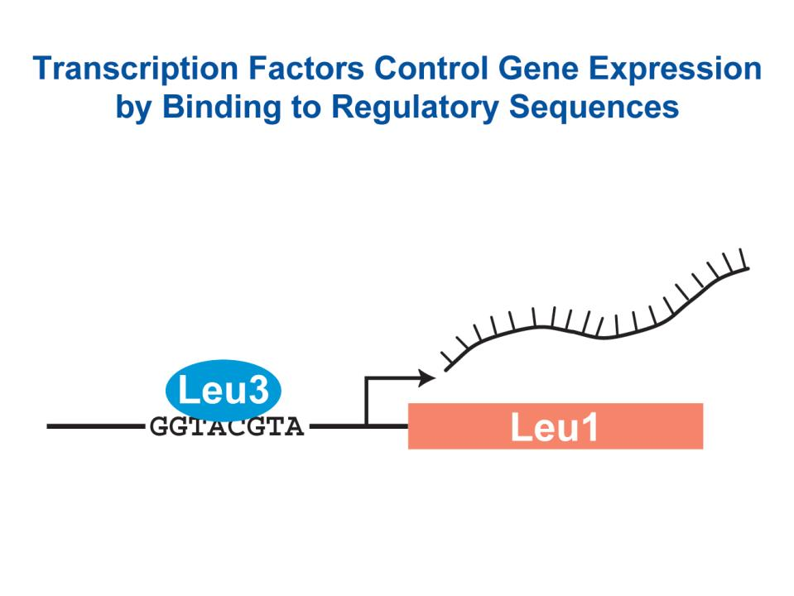
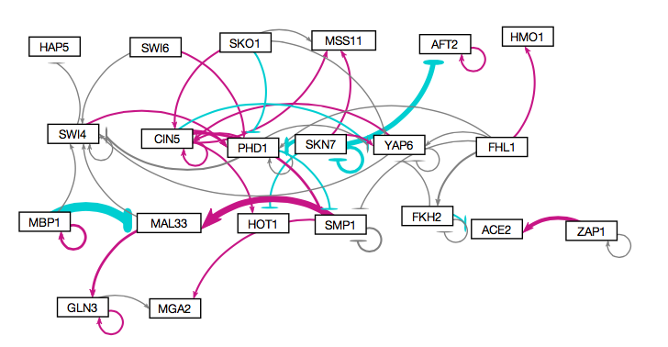
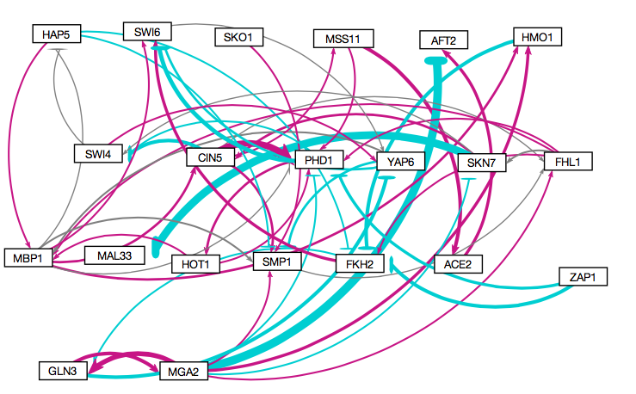
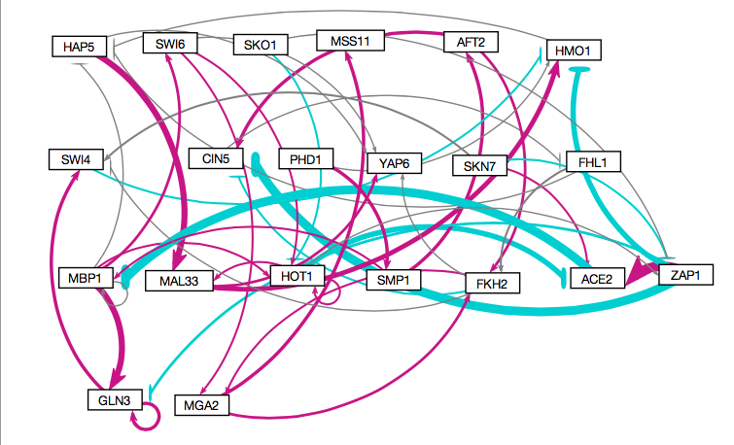
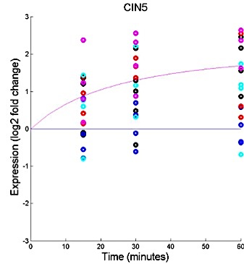
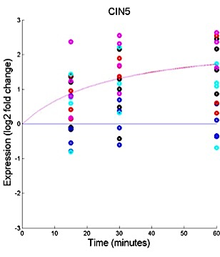
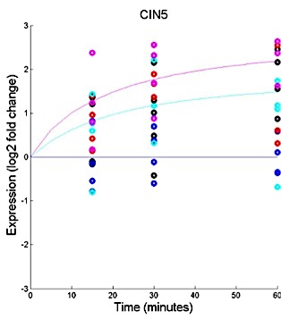
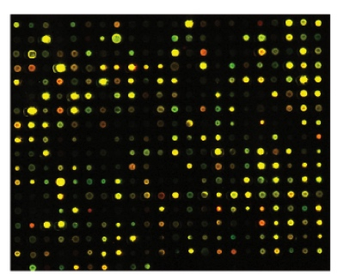
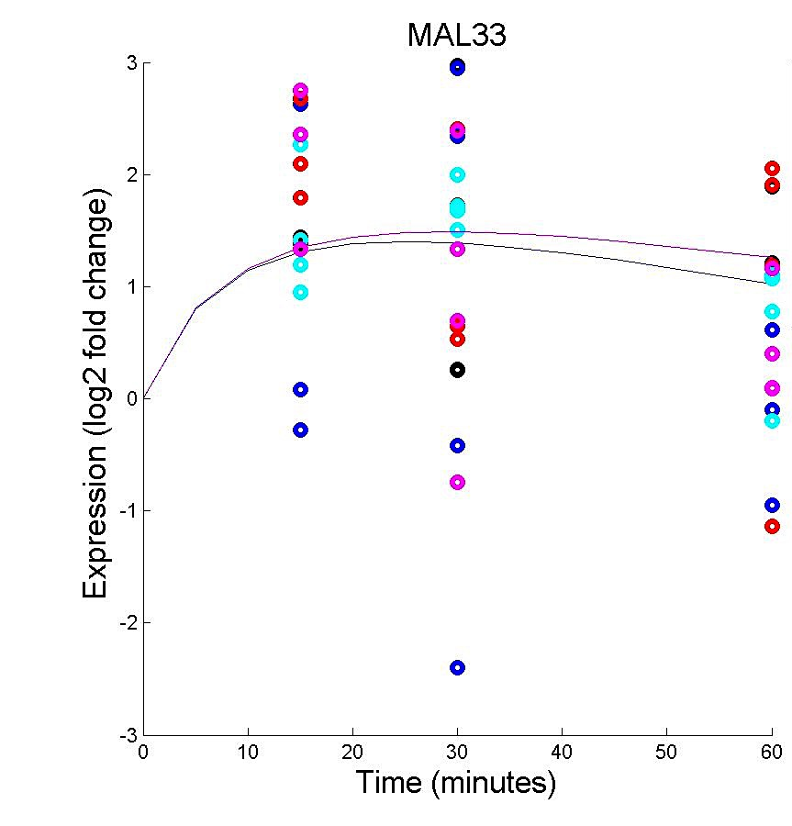
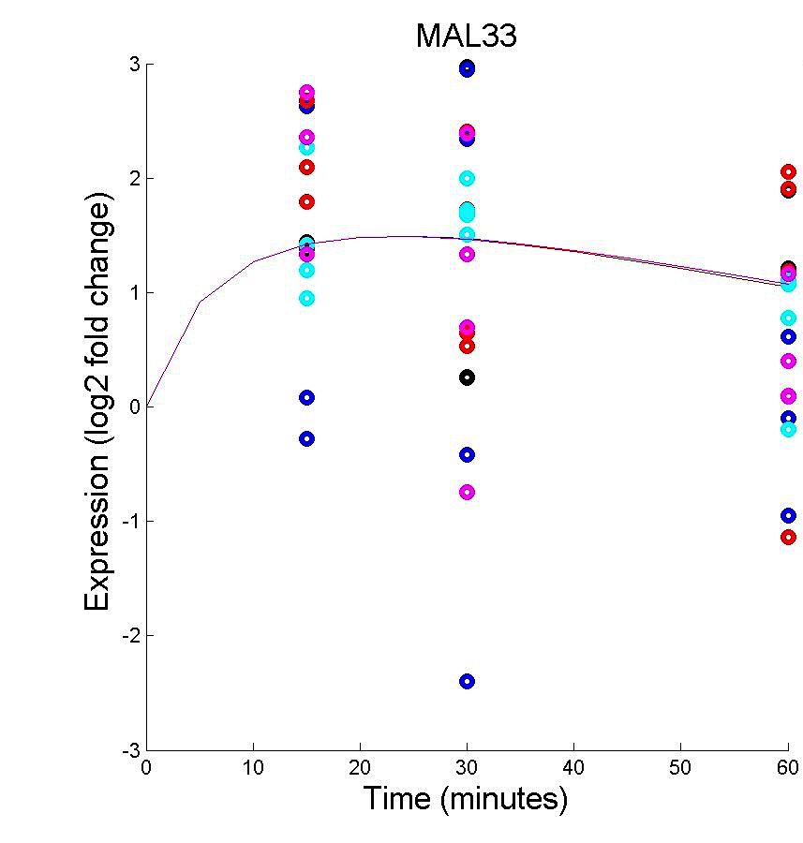
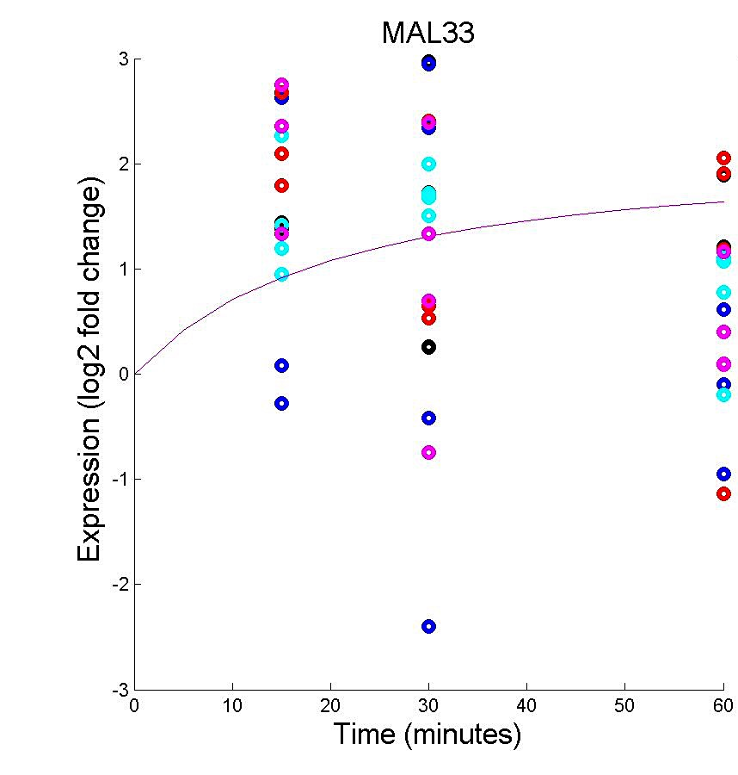
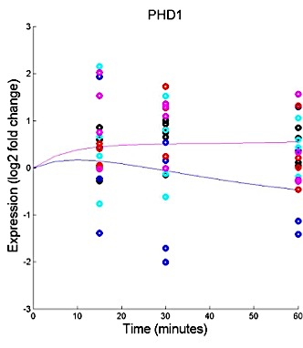
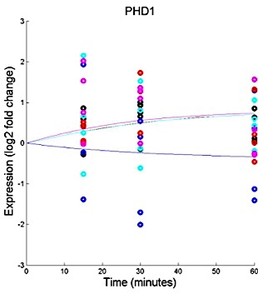
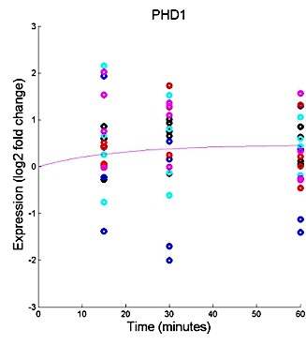
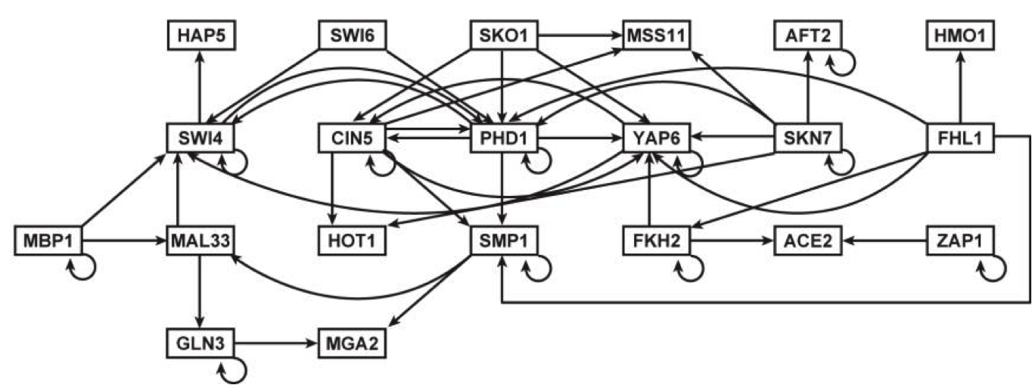





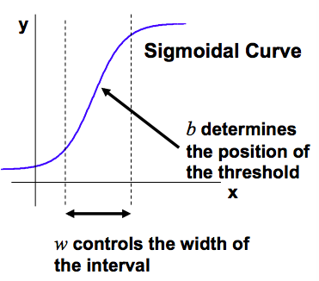
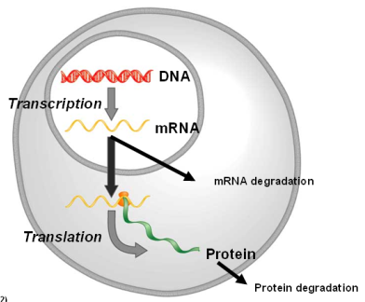
Comparing the Dynamics of the Cold Shock Gene Regulatory Network in Yeast with a Random Network
K. Grace Johnson¹, Natalie E. Williams², Kam D. Dahlquist², and Ben G. Fitzpatrick³
¹Department of Chemistry and Biochemistry, ²Department of Biology, ³Department of Mathematics
Loyola Marymount University, 1 LMU Drive, Los Angeles, CA 90045 USA
Transcription Factors Control Gene Expression by Binding to Regulatory DNA Sequences Upstream of Genes
The Random Networks Do Not Have Any Autoregulation
The Model Output Fits the Experimental Data Better in the Literature-Derived Network than the Random Networks
Activators increase gene expression.
Repressors decrease gene expression.
Transcription factors are themselves proteins that are encoded by genes.
A gene regulatory network (GRN) consists of a set of transcription factors that regulate the level of expression of a set of target genes, which can include other transcription factors.
The dynamics of a GRN is how the expression of genes in the network change over time.
Literature Derived Network
Random 1 Network
Random 4 Network
Yeast Respond to the Environmental Stress of Cold Shock by Changing Gene Expression
Literature-Derived Network
Random Network 1
Random Network 4
However, little is known about which transcription factors regulate this response.
The Dahlquist lab has studied the global transcriptional response to cold shock using DNA microarrays, which measure the level of mRNA expression for all 6000 genes in yeast.
We have collected expression data from the wild type strain and four transcription factor deletion strains (Δcin5, Δgln3, Δhmo1, Δzap1) before cold shock and after 15, 30, and 60 minutes of cold shock at 13°C.
We are using mathematical modeling to determine the relative influence of each transcription factor in the GRN that controls the cold shock response.
GRNsight: automatically generates weighted network graphs from the spreadsheets produced by GRNmap.
Absolute value of weight outputs from GRNmap are divided by the largest value, which distributes them between 0 and 1. The thickness of the lines is on a linear scale with thin lines for values near 0 and thick lines for values near 1.
Positive weights are colored magenta to denote up regulation, negative weights are colored cyan to denote down regulation, weights within ± 0.05 of zero are colored gray to denote negligible influence on the target gene.
The normalization of the weight values makes it appear that genes have a stronger influence on each other in the random networks than the literature-derived network.
In and Out Degree Frequencies of Random Network 1 More Closely Resembles Those of the Literature-Derived Network
Microarray at 60 minutes after cold shock
We Generated a “Literature-Derived” GRN that Consists of 21 Transcription Factors (Nodes) and 50 Regulatory Relationships (Edges)
We selected candidate transcription factors based on the microarray data and other experimental evidence and determined the connections between them from data in the YEASTRACT database.
This is a “medium-scale” GRN because it represents only a small subset of the approximately 250 transcription factors in the yeast genome.
In degree and out degree frequencies for literature-derived network compared to random networks 1 and 4
The In degree is number of genes that regulate a given gene.
The Out degree is number of genes that a given gene regulates.
The number of connections refers to the number of other genes to which a given gene is connected.
Compared to the random networks, the literature-derived network has more genes that are either not regulated or do not regulate any genes within the GRN.
Interestingly, the similar shape of the degree distribution of the literature-derived and random 1 networks corresponds with similar LSE values.
Variations in the model fit were seen with different connectivity among the genes.
For CIN5, the literature-derived and random 1 networks fit the data points better than the random 4 network, which saw a larger distribution of data points.
For MAL33, the literature-derived network better fits the data points compared to the larger deviations seen in Random 1 and Random 4.
PHD1: the right figure does not fit the model well while the data points in the left and middle better fit the trend, but not all of the data points are equally distributed along the line.
These differences warrant further exploration.
Medium-scale cold shock GRN in yeast
The Normalized Weight Frequencies of the Random Networks Have a Wider Distribution
than the Literature-Derived Network
For Each Gene in the Network, a Nonlinear Differential Equation Determines the Rate at Which the Gene is Expressed
(Transcribed and Translated)
The model, called GRNmap (Gene Regulatory Network modeling and parameter estimation) was implemented in MATLAB.
The MATLAB code and executable are available under an open source license at https://github.com/kdahlquist/GRNmap/.
Conclusions and Future Directions
Each gene has a differential equation that models the change in expression over time.
We use a sigmoidal model for each differential equation
P_{i} is mRNA production rate for gene i
d_{i} is the mRNA degradation rate for gene i
w is weight term, determining the level of activation or repression of j on i
b is a unique threshold for each gene
The production rate (P_{i} ), weight (w ), and threshold (b) values were estimated from DNA microarray data using a penalized least squares approach.
In order to determine how well our literature-derived GRN for cold shock response in yeast fits experimental data, we compared it to 10 random networks.
We found that the least squares error of the literature-derived network was smaller than the LSE of the average random network. This means the literature-derived model fit the microarray data more closely than the average random network.
Random networks 1 and 4 were chosen for further analysis because of their low and high LSE, respectively. When the three networks were compared, it was found that:
The literature-derived network exhibited more auto-regulation than random networks 1 and 4.
The shape of the in and out degree frequency graphs of Random 1 and the literature-derived networks are similar. Interestingly, the LSE of these networks is also very similar.
Normalized weight values seem to show a stronger influence on the random networks. For this reason, the visualized networks of random 1 and 4 appear more colorful.
Actual, optimized weights in the literature-derived GRN have larger maximum weights resulting in the smaller normalized values. The random networks have many small optimized weights, resulting in larger normalized weights.
For each of the the three networks, gene expression output graphs for CIN5, MAL33, and PHD1 transcription factors showed variation
In the future, we plan to generate several literature-derived networks to compare to a large number (100+) of random networks. To do this, we must somehow control for auto-regulation. Through these comparisons, we will aim to understand what distinguishes a literature-derived network from a random network as a better model for cold shock response in yeast.
Normalized weight distributions for literature-derived, Random 1 and Random 4 networks
To obtain normalized weights, all weight values were divided by the absolute value of the greatest single weight magnitude.
These graphs show the normalized distribution of weights. Numbers below zero refer to repression of gene expression. Numbers above zero refer to activation of gene expression.
The normalization of the weight values makes it appear that genes have a stronger influence on each other in the random networks than the literature-derived network.
E represents the error between estimated values and microarray data values.
The Magnitudes of Weights in the Random Networks Were Smaller than Those of the Literature Derived Network
To determine how well the literature-derived GRN model fit the experimental data, we compared it to 10 randomly generated networks with the same number of nodes and edges, but different connectivity.
(Freeman, 2002)
The Least Squares Error Was Greater in Random Networks
than in the Literature-Derived Network
Acknowledgments
For their work on the GRNmap code, we would like to thank Juan S. Carrillo, Trixie A. Roque, Nicholas A. Rohacz, and Katrina Sherbina. We thank Nicole A. Anguiano and Anindita Varshneya for their work on GRNsight visualization. Microarray data was collected by Cybele Arsan, Wesley Citti, Kevin Entzminger, Andrew Herman, Heather King, Lauren Kubeck, Stephanie Kuelbs, Elizabeth Liu, Matthew Mejia, Kenny Rodriguez, Olivia Sakhon, and Alondra Vega. Partial funding for this project was provided by NSF-RUI 0921038.
Least squares error measures the approximation of a solution of a system. For this approximation, the solution minimizes the sums of squares of error for every equation in the system.
The literature derived least squares error was 46.3169.
We chose Random networks 1 and 4 for further analysis because they had the smallest and largest LSE, respectively.
Optimized weight values for literature-derived, Random 1 and Random 4 networks
References
The optimized weight parameters and their regulation (activation vs. repression) of genes are identified.
The actual weights of the literature-derived GRN shows more variance in regulation with a stronger magnitude compared to the smaller magnitudes in Random 1 and Random 4.
Dahlquist, Kam., Fitzpatrick, Ben., Camacho, Erika., Entzminger, Stephanie., Wanner, Nathan. (2015). Parameter estimation for gene regulatory networks from microarray data: cold shock response in Saccharomyces cerevisiae. Submitted.
Freeman, S. (2002). Biological science (First ed.). Prentice Hall.
GRNmap. (n.d.). Retrieved March 14, 2015, from https://github.com/kdahlquist/GRNmap/.
GRNsight. (n.d.). Retrieved March 14, 2015, from http://dondi.github.io/GRNsight/.
Dário Abdulrehman, Pedro T. Monteiro, Miguel C. Teixeira, Nuno P. Mira, Artur B. Lourenço, Sandra C. dos Santos, Tânia R. Cabrito, Alexandre P. Francisco, Sara C. Madeira, Ricardo S. Aires, Arlindo L. Oliveira, Isabel Sá-Correia, Ana T. Freitas (2011). YEASTRACT: providing a programmatic access to curated transcriptional regulatory associations in Saccharomyces cerevisiae through a web services interface Nucl. Acids Res., 39: D136-D140, Oxford University Press.
Weights | Max | Min | Overall Sum | Overall Average
Literature-derived | 1.4702 | -2.2588 | 1.0703 | 0.0024
Random 1 | 1.0162 | -1.4131 | -0.0689 | -0.0002
Random 4 | 0.8996 | -0.8167 | 1.8970 | 0.0043
Weights | Positive Sum | Negative Sum | Positive Average | Negative Average
Literature-derived | 7.0696 | -5.9993 | 0.2159 | -0.4000
Random 1 | 5.9939 | -6.7395 | 0.2300 | -0.3547
Random 4 | 4.5844 | -2.9735 | 0.1624 | -0.2287

