Slide 1

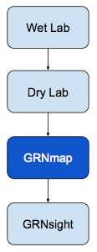
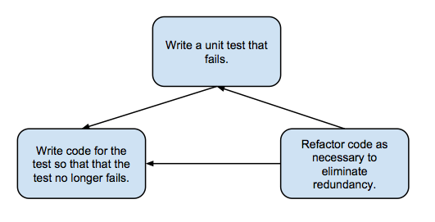
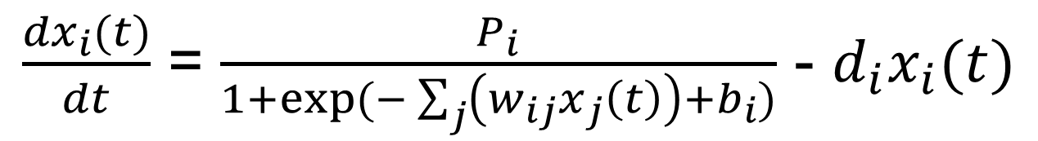
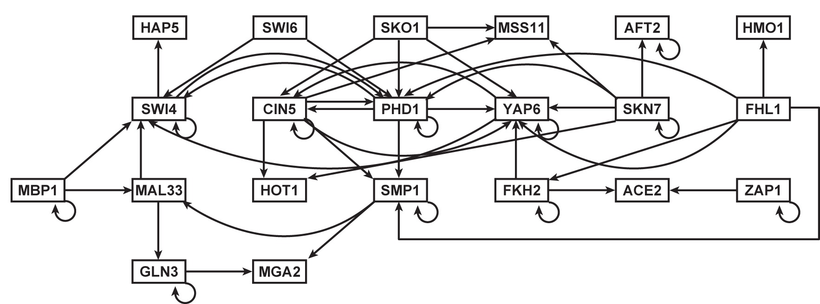
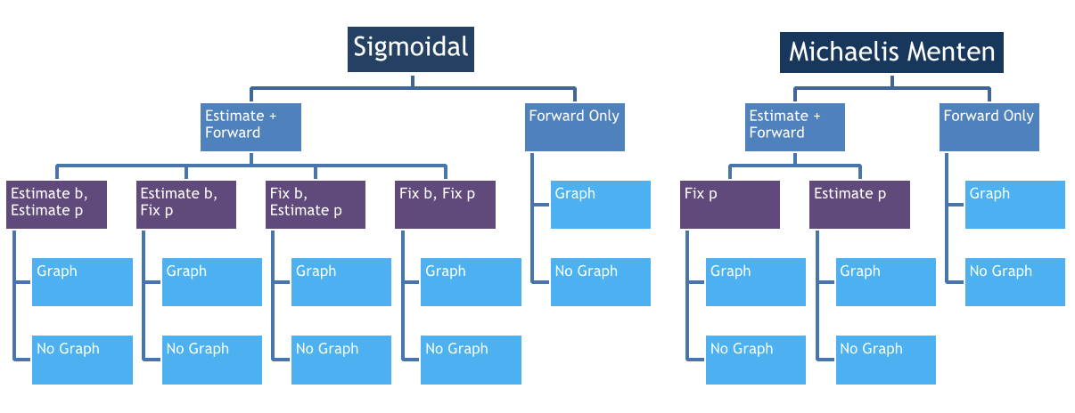
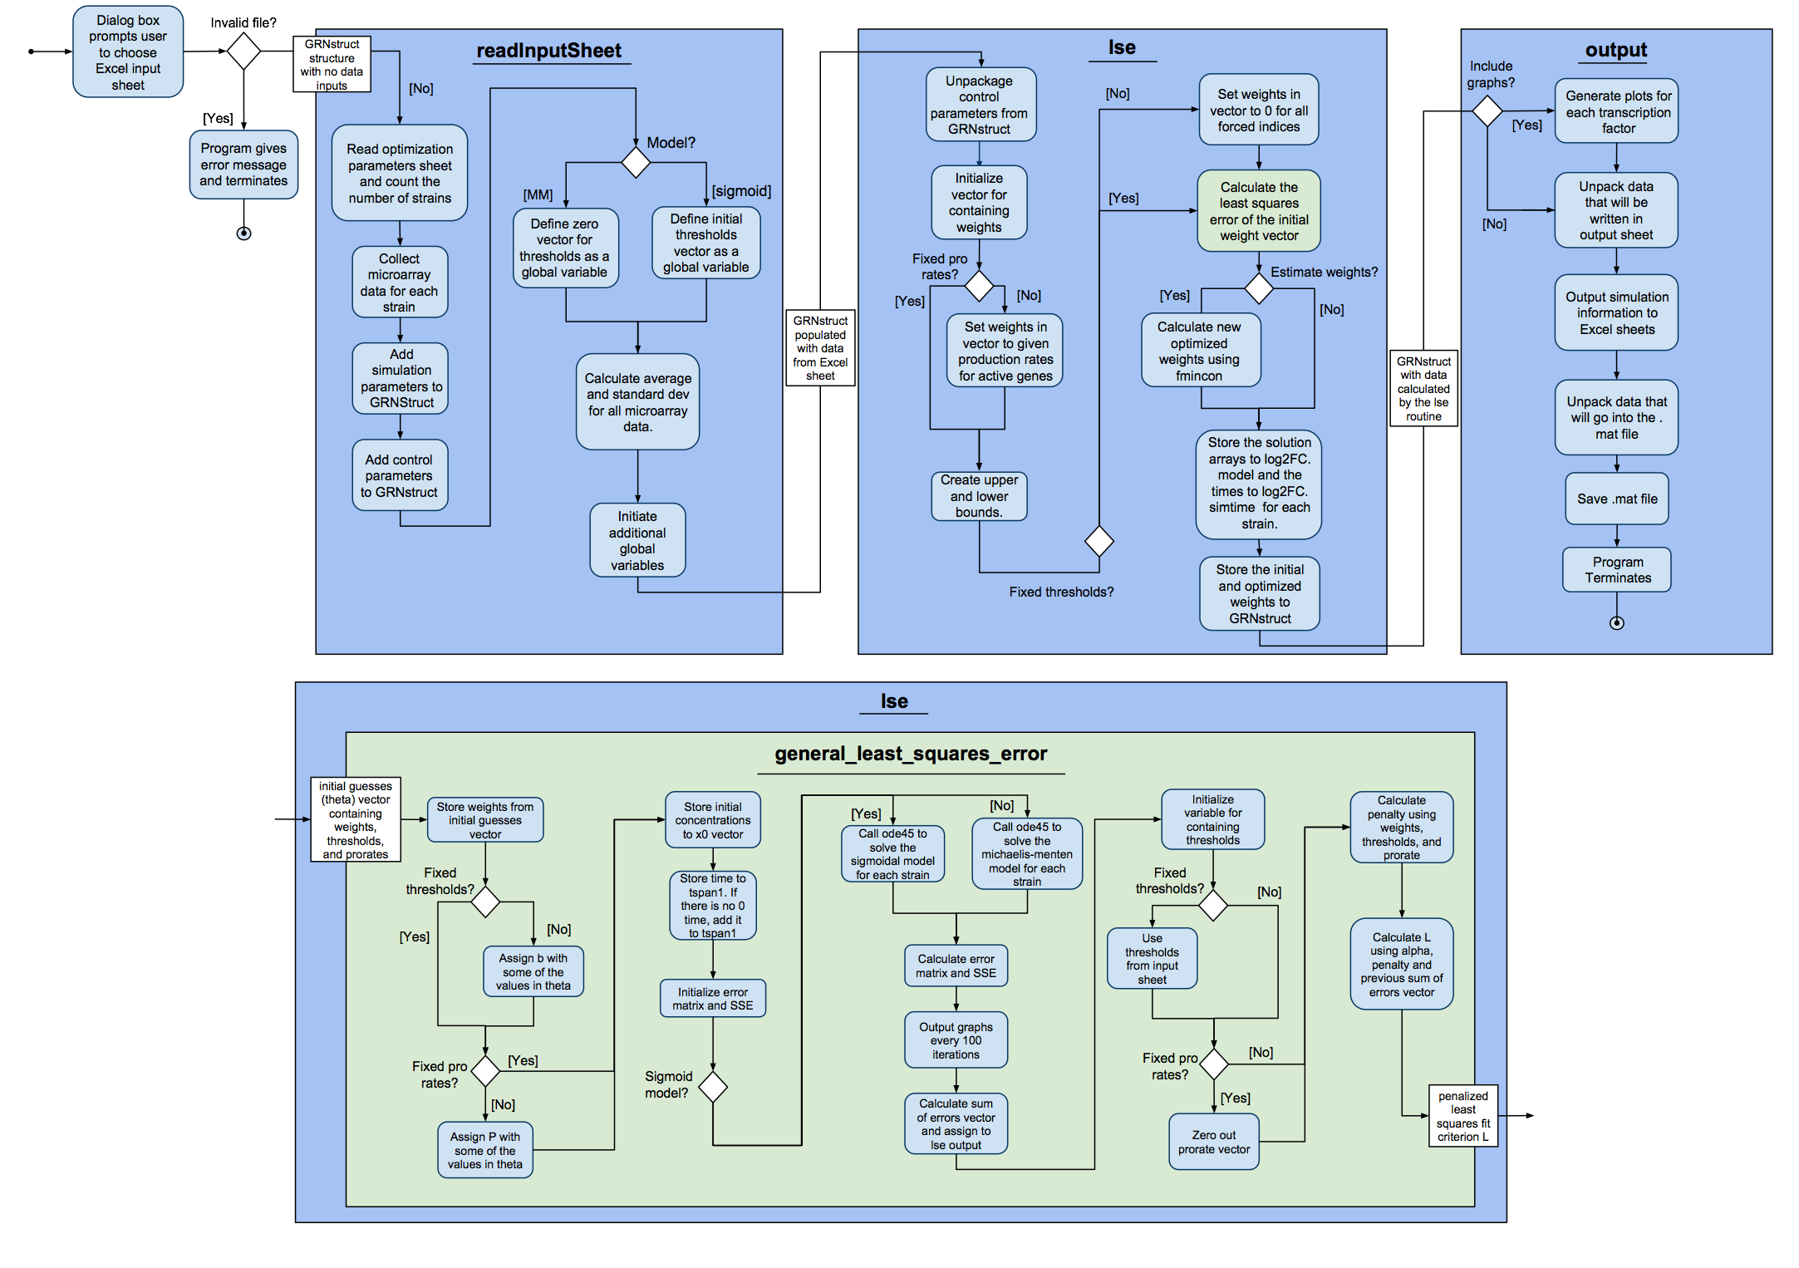
Test-Driven Development and Functionality Improvements to GRNmap, a Gene Regulatory Network Modeling Application
Trixie Anne Roque¹, Kam D. Dahlquist², Ben G. Fitzpatrick³ , and Dr. John David N. Dionisio¹
¹Department of Electrical Engineering and Computer Science, ²Department of Biology, ³Department of Mathematics,
Loyola Marymount University, 1 LMU Drive, Los Angeles, CA 90045 USA
GRNmap Uses ODE to Model Networks
GRNmap Functionality Changes
Test-Driven Development Process
Over the course of its development, we have improved on the functionalities of the software package. Since v1.0.8, changes we have made to the source code include:
New Features:
Changed the names of the worksheets in the input and output workbooks
Computed standard deviations
Optimization diagnostics outputted for each run (contains LSE, penalty term, and iteration count)
Computed minimum LSE and sum of squares error of individual genes
Plots are saved according to their gene names
Bugs fixes:
Correctly outputting estimated production rates and threshold parameters worksheets
Corrected computation for threshold for genes with no inputs
Corrected penalty computation for production rates
Test-driven development:
The standard process is shown in Figure 4
Created 16 manual input test sheets to compare outputs with when running the code. A visual representation of all 16 is shown in Figure 5
Created some minor unit tests for checking if correct outputs are present. Pseudocode for what the unit tests look like is shown in Figure 6
These changes have been documented in our external GRNmap website (http://kdahlquist.github.io/GRNmap/index.html) and GRNmap developer wiki (https://github.com/kdahlquist/GRNmap/wiki)
Figure 2: Sigmoidal model used by GRNmap
Figure 4: Test-driven development process
Figure 1: Laboratory data flow
Figure 3: Example of a gene regulatory network
GRNmap is a Matlab software that models gene regulatory network dynamics. It accepts laboratory microarray data that is pipelined and processed by our various groups as shown in Figure 1:
The wet lab generates gene expression data using DNA Microarrays.
The dry lab works on statistical analysis of the data and generates gene regulatory networks (GRN). The data is presented as an Excel workbook.
The GRN is run through GRNmap which estimates production rates, weights, and thresholds using 1 of 2 ordinary differential equations (one is shown in Figure 2).
The data outputted by GRNmap is used by GRNsight to visualize the network. A visual depiction of a GRN is shown in Figure 3:
Each node represents a gene
Each edge represents a regulatory relationship between the genes
The network is represented as an adjacency matrix
Figure 5: 16 manual test input sheets
DEFINE main function
CALL functiontests (localfunctions) to make a tests array
END
DEFINE function firstTest (testCase)
actualOutput = evaluate function by using known inputs
expectedOutput = assign expected results
VERIFY actualOutput equals expectedOutput
END
Figure 6: Pseudocode for unit tests
Activity Diagram Shows How Data is Processed by GRNmap
References
Future Work
Acknowledgments
Dahlquist, K.D., Fitzpatrick, B.G., Camacho, E.T., Entzminger, S.D., and Wanner, N.C. (2015) Parameter Estimation for Gene Regulatory Networks from Microarray Data: Cold Shock Response in Saccharomyces cerevisiae. Bulletin of Mathematical Biology, in press.
Complete the testing framework for all current functionality of the code, fixing bugs and refactoring code as needed
Clean up the variable names, and how the program discovers which strains are present and which genes are deleted
Move the documentation for how to use GRNmap from the wiki to the documentation page of the web site
Add functionality so that GRNmap computers the within- and between-strain ANOVA values
We would like to thank Juan Carrillo, Nicholas A. Rohacz, Alondra Vega, Stephanie D. Kuelbs, Nathan C. Wanner, and Erika T. Camacho for previous work on the GRNmap program. This project was supported by the Summer Undergraduate Research Program at Loyola Marymount University (J.S.C.), NSF-DMS award #0921038 (K.D.D., B.G.F., and K.S), and the Clarence Wallen, S.J. Chair in Mathematics (B.G.F.).
Making GRNmap more accessible by including radio buttons and check boxes in Excel rather than typing values in cells.
We will integrate GRNmap with GRNsight (http://dondi.github.io/GRNsight/), a web application and service that is being developed to visualize the results of the GRNmap modeling.
Implementing the unit testing framework will accelerate model improvement and scientific inquiry by streamlining the verification, validation, and assurance process.

