Slide 1



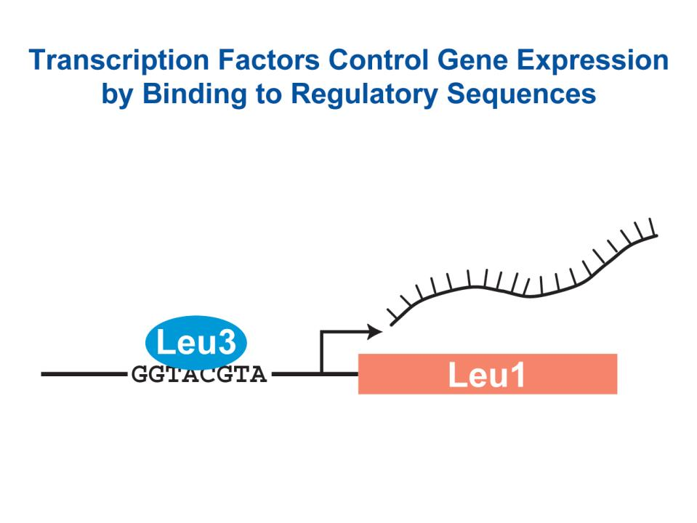
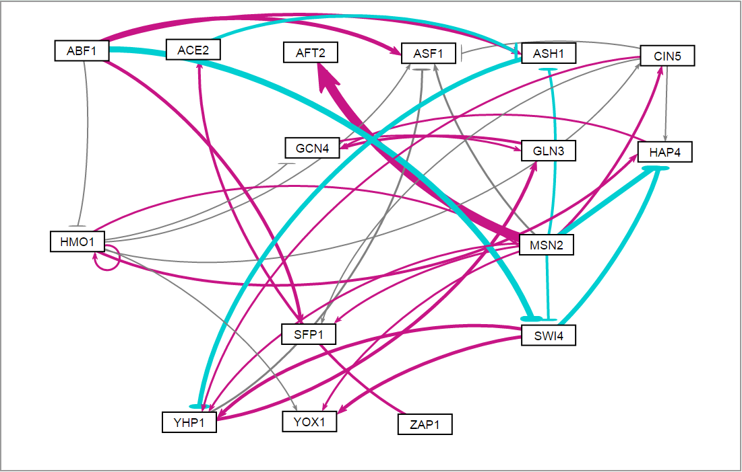
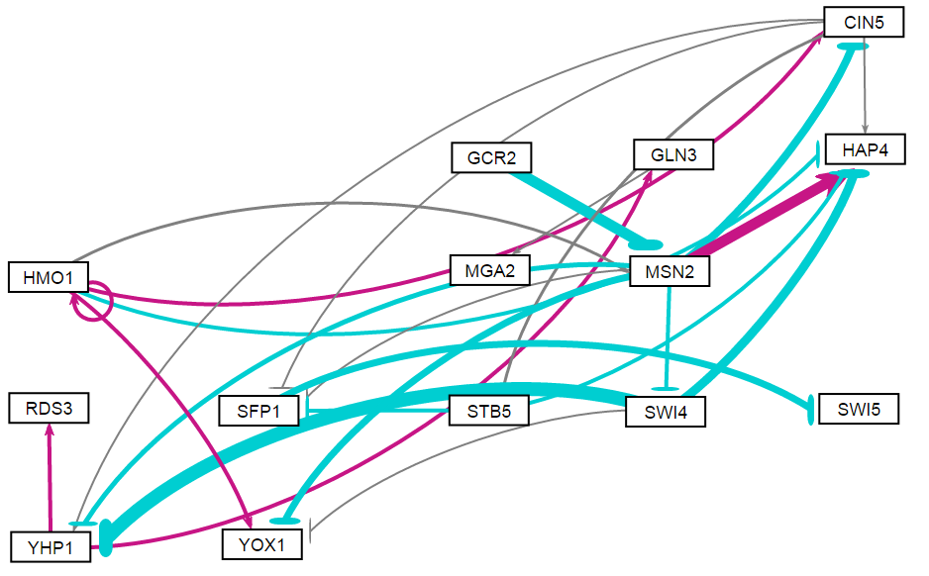
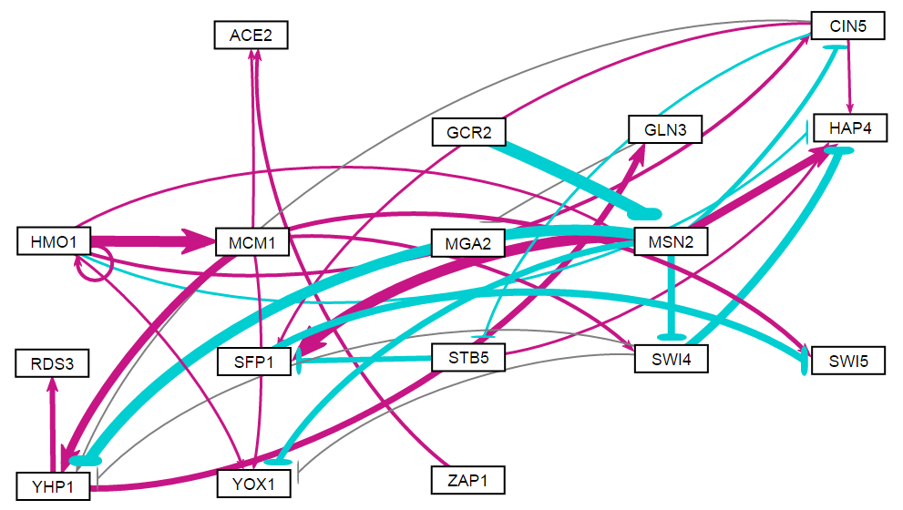
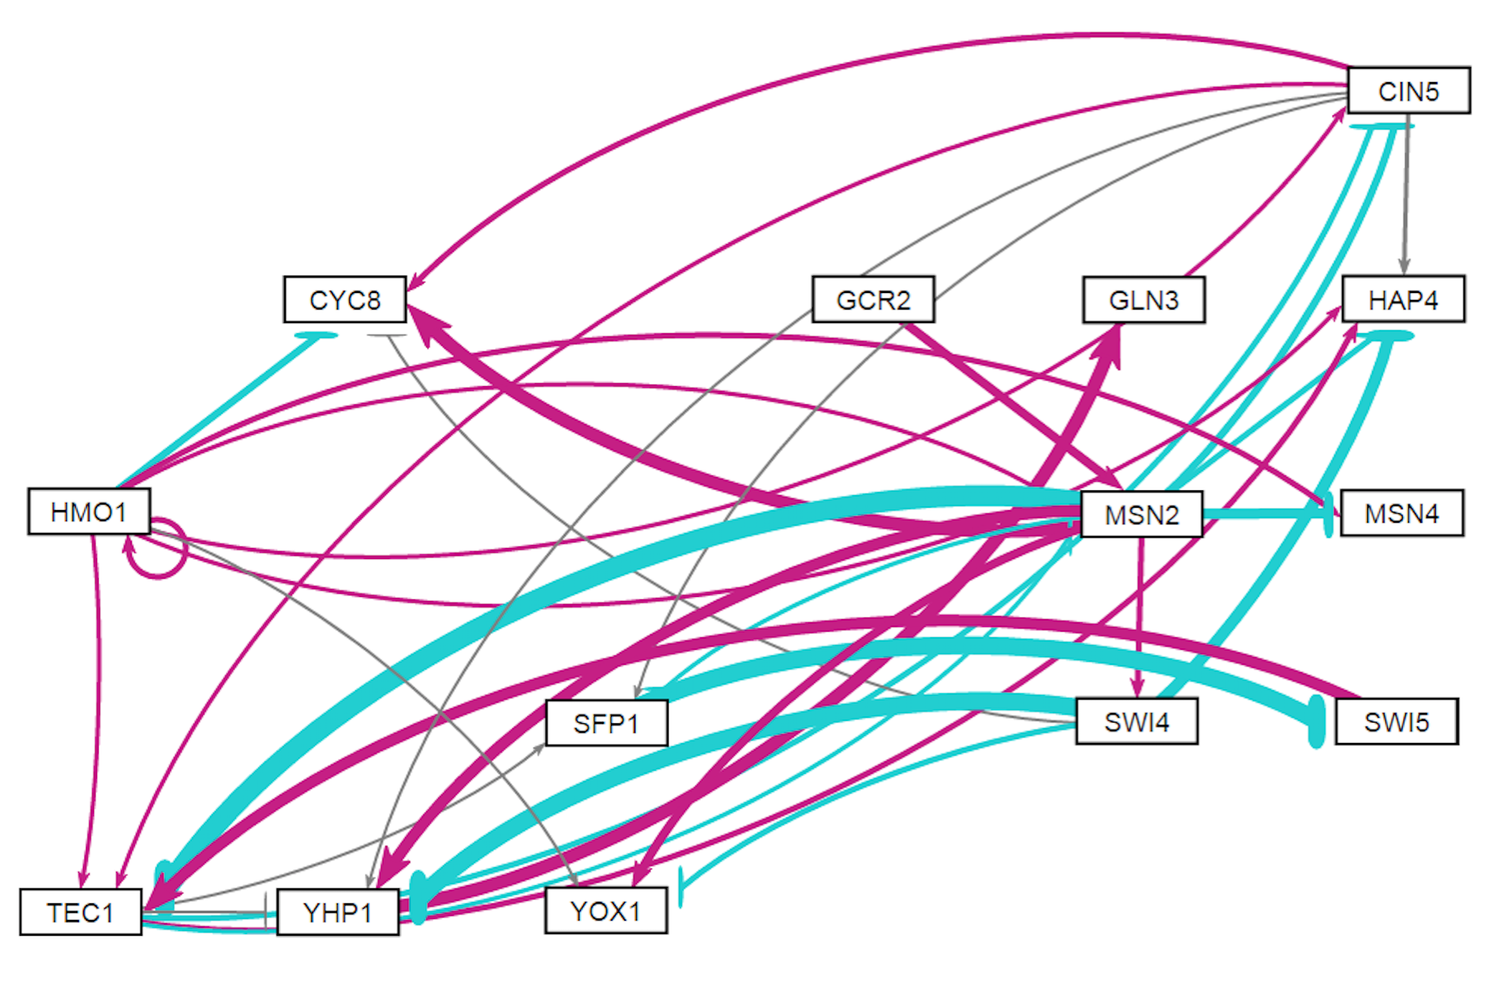
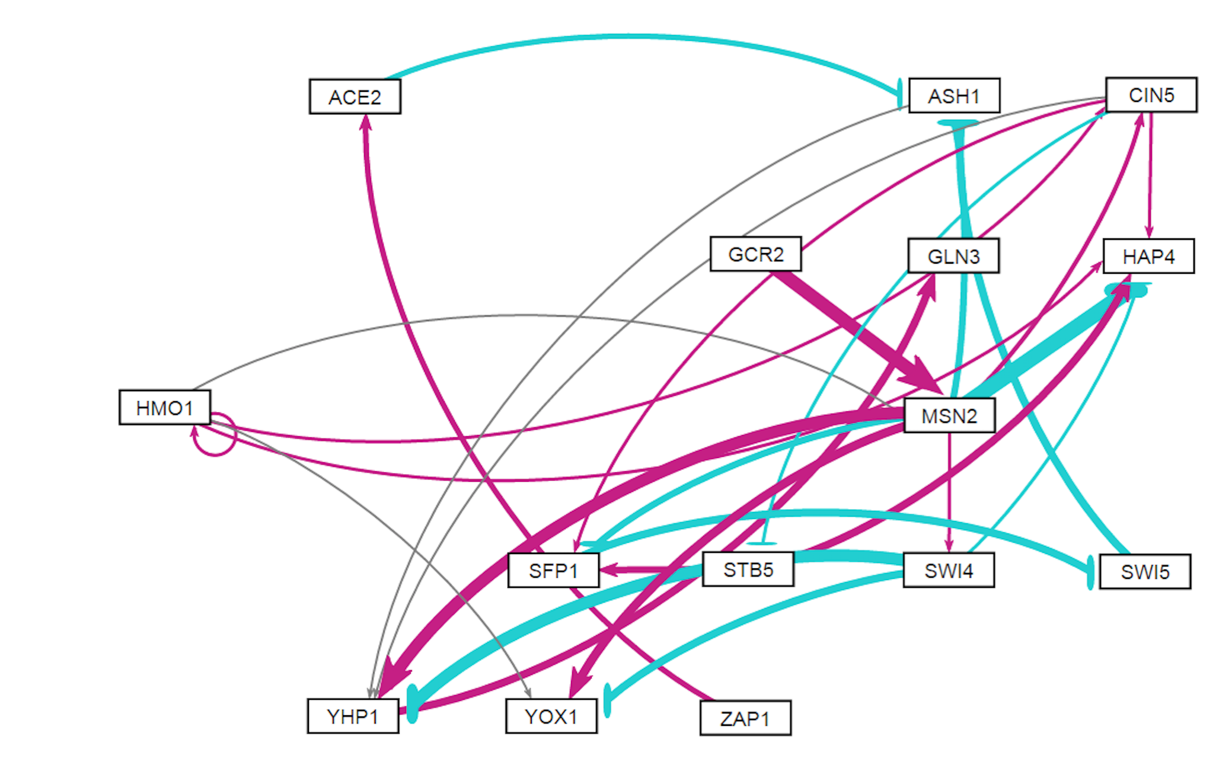
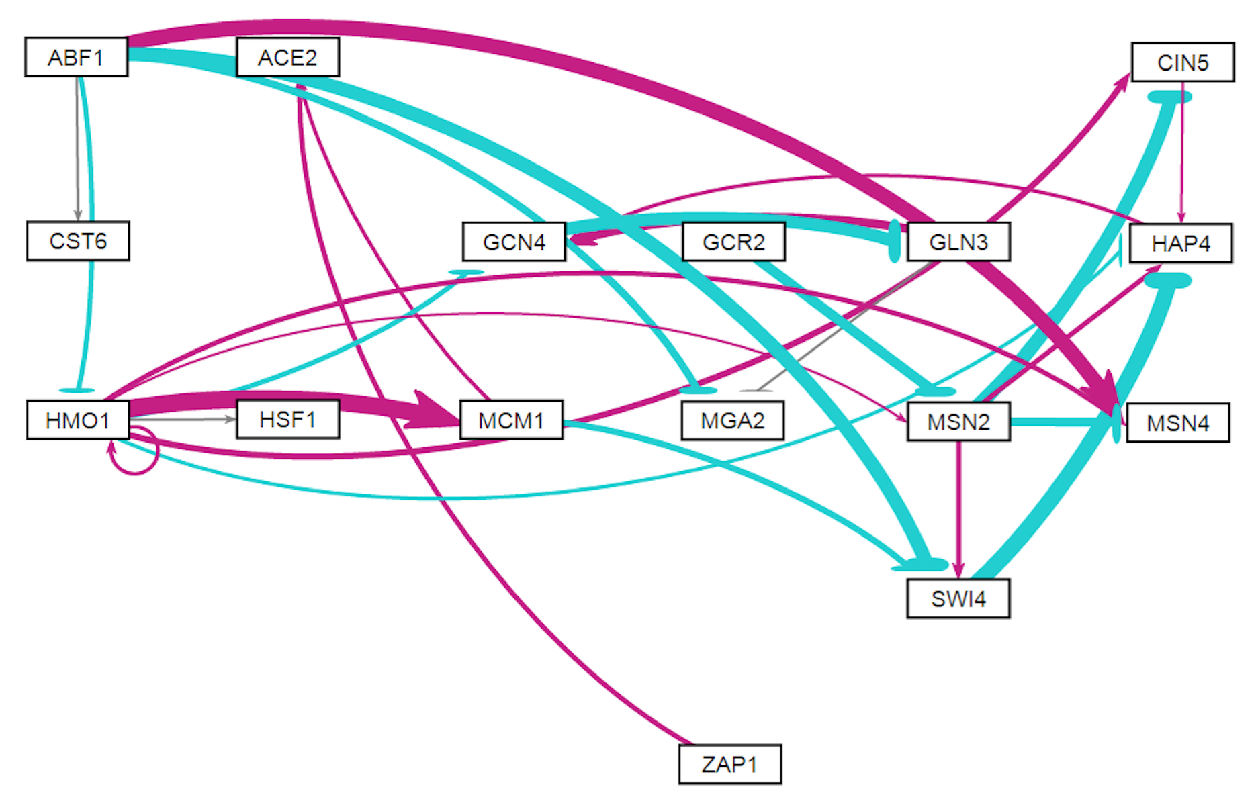
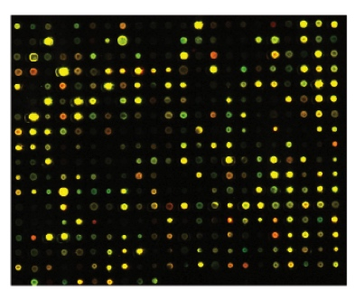
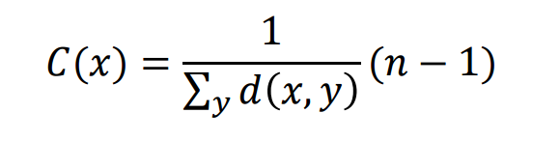
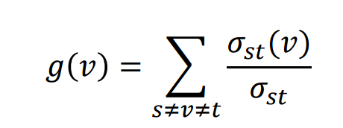
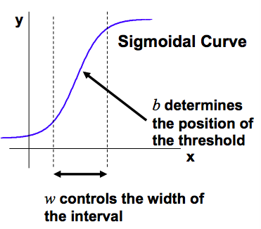
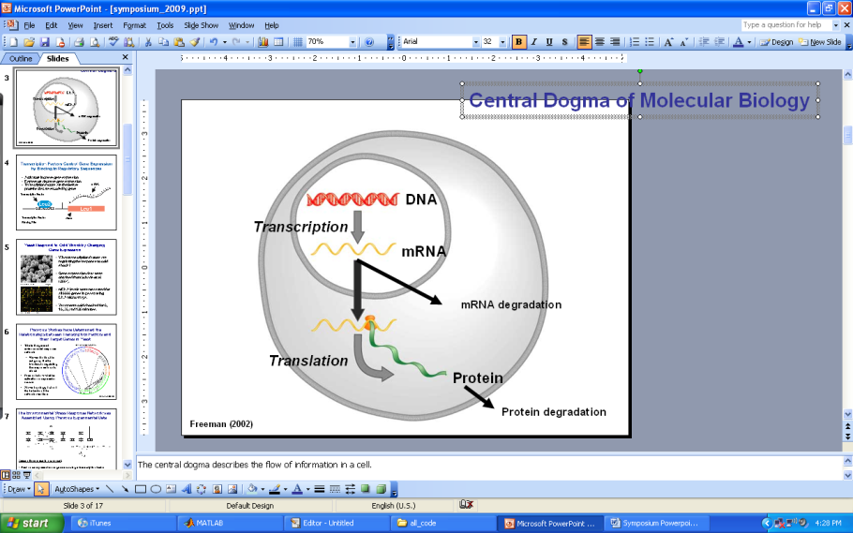
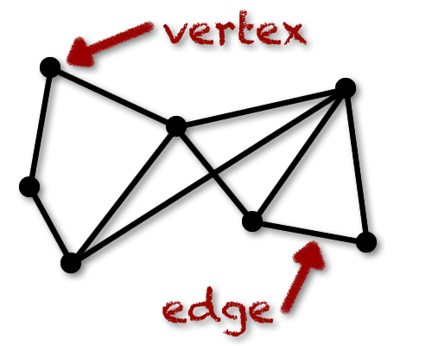
Using Graph Statistics to Investigate the Properties of Six Candidate Gene Regulatory Networks
for Controlling the Cold Shock Response in Saccharomyces cerevisiae
Margaret J. O’Neil¹, Ben G. Fitzpatrick², and Kam D. Dahlquist¹
¹Department of Biology, ²Department of Mathematics
Loyola Marymount University, 1 LMU Drive, Los Angeles, CA 90045 USA
Transcription factors control gene expression by binding
to regulatory DNA sequences upstream of genes
Regulatory relationship data (weight parameters) can be visualized using GRNsight
Activators increase gene expression.
Repressors decrease gene expression.
Transcription factors are themselves proteins that are encoded by genes.
A gene regulatory network (GRN) consists of a set of transcription factors that regulate the level of expression of a set of target genes, which can include other transcription factors.
The dynamics of a GRN is how the expression of genes in the network change over time.
1. Network derived from wt data
16 genes, 36 edges
2. Network derived from ∆cin5 data
14 genes, 25 edges
3. Network derived from ∆cin5 data
17 genes, 32 edges
4. Network derived from ∆gln3 data
14 genes, 35 edges
5. Network derived from ∆hap4 data
15 genes, 28 edges
6. Network derived from ∆zap1 data
16 genes, 27 edges
Network Legend
Activation
Repression
Yeast respond to the environmental stress of cold shock
by changing gene expression
Strong
Weak
Little is known about which transcription factors regulate this response.
The Dahlquist Lab studies the global transcriptional response to cold shock using DNA microarrays, which measure the level of mRNA expression for all 6000 yeast genes.
We have collected expression data from the wild type strain and five transcription factor deletion strains (Δcin5, Δgln3, Δhmo1, Δzap1, Δhap4 ) before cold shock at 30°C and after 15, 30, and 60 minutes of cold shock at 13°C.
The Dahlquist Lab has shown that yeast deleted for the Hap4 transcription factor, a heme activator protein, show impaired growth at cold temperatures, implying that it is important for regulating the response to cold shock.
We use mathematical modeling to determine the relative influence of each transcription factor in the GRN that controls the cold shock response.
Gephi was used to compute the centrality measures of the six networks
Gephi was used to compute the graph properties of the Δhap4 data-derived network
The average eccentricity, closeness centrality, and betweenness centrality was calculated for each gene that appeared in 4 or more of the six networks.
Genes that have high average eccentricity, closeness centrality, and betweenness centrality are genes that are central in all 6 networks.
Genes that have low statistic values are likely more central in some networks than others, or are not central to the networks across all six networks.
Based on the graph statistics, MSN2 and HMO1 appear to be genes of particular importance due to their appearance in all six networks and their high averages for all centrality measures
Microarray at 60 minutes after cold shock
Microarray data from the Dahlquist lab was used to derive a family of related GRNs from the YEASTRACT database
DNA microarray data for each of the six strains was analyzed to show which genes exhibited significant changes in expression during cold shock. The criteria for significance was a corrected Benjamini & Hochberg ANOVA p value < 0.05.
The genes with significant expression changes were submitted to the YEASTRACT database, which returned a list of transcription factors that could regulate those targets.
Transcription factors for which we had deletion strain microarray data were added to the list of the most significant regulators for each strain to generate six GRNs.
Transcription factors and edges were removed from each GRN in a stepwise fashion in order of least to most significant until the network was pared down to have fewer than 20 genes.
Each of the pared-down GRNs, labeled db1-db6, were input into the Dahlquist lab’s GRNmap program to model the dynamics of each gene’s expression in their respective networks.
The eccentricity centrality of a network shows how easily accessible a node is from other nodes (Pavlopoulos et al. 2011).
The eccentricity is calculated using an algorithm for identifying the max{dist(i,j)} where i is the node listed in the table and j is any other node in the network.
Eccentricity centrality is a directional statistic, which only takes a node’s out degree into account.
To have a high eccentricity centrality means that the gene is connected indirectly to many other genes in the network. This indicates these genes with high eccentricities have a greater impact on other nodes than a node with low eccentricity.
Closeness Centrality is a centrality measure that indicates how long it will take for information from a node x to reach other nodes in the network (McSweeney, 2009).
The closeness centrality of a node can be determined using the following formula:
which is looking at the average shortest path from x to all other nodes.
Closeness centrality, like eccentricity centrality is a directional statistic, which only takes a node’s out degree into account.
Nodes with high closeness centralities are the most central nodes in the network. These are the nodes that can communicate the quickest in the network.
The directional aspect of the closeness centrality measure means those genes and nodes with no out-degree connections have a closeness centrality of 0.
Betweenness Centrality is a centrality measure that indicates how often a node is found on a shortest path between two nodes, s and t (McSweeney, 2009).
The betweeness centrality of a node can be calculated using the following function:
Without these “between” nodes, there would be no way for two separated nodes to communicate.
Betweenness centrality requires there to be at least one in degree and one out degree in order to be calculated, so in cases where there is either no in degree or no out degree, the betweenness centrality of those nodes is 0.
Nodes with high betweenness centralities are key genes associated with regulating other genes in the network, and are known as “bottlenecks” that must be passed through in the network.
 |  | Average
Node | In How Many Networks ? | Eccentricity | Closeness Centrality | Betweenness Centrality
ACE2 | 4 | 3.5 | 0.44 | 4
CIN5 | 6 | 3 | 0.59 | 3.93
GCR2 | 5 | 3.8 | 0.43 | 0
GLN3 | 6 | 1 | 1 | 6.25
HAP4 | 6 | 2.5 | 0.58 | 9
HMO1 | 6 | 3.17 | 0.60 | 6.42
MSN2 | 6 | 2.67 | 0.72 | 13.61
SFP1 | 5 | 2.5 | 0.68 | 5.75
SWI4 | 6 | 2.67 | 0.65 | 2.44
YHP1 | 5 | 1.6 | 0.85 | 13.13
YOX1 | 5 | 0 | 1 | 0
ZAP1 | 4 | 2.75 | 0.57 | 0
Strain | Wild-type | ∆cin5 | ∆gln3 | ∆hap4 | ∆zap1
Significant genes | 1936 (31%) | 1683 (28%) | 1683 (28%) | 1794 (29%) | 1859 (30%)
Dynamical systems modeling was used to estimate weight parameters for each regulatory relationship
The model, called GRNmap (Gene Regulatory Network modeling and parameter estimation) was implemented in MATLAB (Dahlquist et al. 2015).
The MATLAB code and executable are available under an open source license at https://github.com/kdahlquist/GRNmap/.
Averages of the in- and out-degree of nodes show activation and repression trends across networks
Conclusions and Future Directions
Each gene has a differential equation that models the change in expression over time as production – degradation.
Degradation rates for each gene were taken from mRNA half life data from Neymotin et al. (2014).
We use a sigmoidal production function where:
P_{i} is mRNA production rate for gene i
d_{i} is the mRNA degradation rate for gene i
w is weight term, determining the level of activation or repression of j on i
b is a unique threshold for each gene
The production rate (P_{i} ), weight (w ), and threshold (b) values were estimated from DNA microarray data using a penalized least squares approach.
DNA microarray data from all six strains subjected to cold shock was analyzed using an ANOVA test, the YEASTRACT database, and an ordinary differential equations model called GRNmap that modeled the dynamics of each gene in candidate gene regulatory networks. The output weight parameters were visualized using GRNsight.
The Gephi results showed that many of the centrality measures are consistent with the in-degree, out-degree statistics, where the genes with the highest degree and overall degree measures are also found to have the highest betweenness centrality measures, and those nodes with the lowest degree measures also have the lowest betweenness centrality. The statistics from Gephi provided useful information through which to view the graphs. While MSN2 has the highest betweenness centrality and the highest degree measure, it is tied for the highest eccentricity with SWI4, which shows that high accessibility might not be directly related to high centrality in the networks.
The average in- and out-degrees across all networks reveal trends across the board, such as YOX1 having very little activation. YOX1 was also found to not be regulating any other gene across the board. This is similar to the graph statistics which show YOX1 as being least central on average to all networks. This might suggest that it should not be included in the networks moving forward, and might not play a significant role in regulation in response to cold shock.
In addition to the above, future directions include comparing the Gephi statistics to the statistics from random networks. Then, comparisons of the database-derived network statistics to the random networks could be performed to determine if genes such as MSN2 were deemed to be similarly central and important in those networks. It would also be interesting to run Gephi analysis on networks of larger size in order to see how the centrality of nodes and connections change with the deletion of important nodes and edges.
E represents the error between estimated values and microarray data values.
θ is the penalty term, which is the combined w, P, and b parameter values.
(Freeman, 2002)
Average weight of incoming and outgoing edges for each gene were computed.
Average weights of the incoming an outgoing edges across all six networks was also found for each gene, in order to identify trends across networks.
If the average incoming edge weight is positive, then across networks or for that specific network, our GRNmap model suggests that that gene is mostly being activated in our networks. If a gene has a negative average incoming edge weight, then that means the model is suggesting that gene is mostly being reppressed in the network. An average incoming edge weight of zero means that no other genes in the network are regulating that gene.
If the average outgoing edge weight is positive, then across all networks or for that specific network, our GRNmap model suggests that the gene is mostly activating other genes in the network. If a gene has a negative average outgoing edge weight, then that gene is mostly reppressing other genes in the network. If a gene has an average outgoing edge weight of zero, then that gene is not regulating the production of other genes in any of our networks.
For the table below, the average incoming and outgoing edge weights across all networks for genes found in four or more (the majority) of our networks. This table shows the overall trends in genes that are central to all networks.
Statistics based in graph theory were used to analyze each network
Acknowledgments
A graph (GRN) is a collection of nodes (genes) that are connected by edges, similar to how a social network is visualized.
The GRN graphs are directed: edges only go in one direction.
The edges represent activation or repression of other genes in the network.
Positive weights to the edges represent activation, negative weights to edges represent repression.
The magnitude of the weight parameter represents the strength of the regulatory relationship.
For their work on the GRNmap code, I would like to thank Trixie Anne M. Roque, Chukwuemeka E. Azinge, and Justin Kyle T. Torres. I thank Nicole A. Anguiano, Anindita Varshneya, Mihir Samdarshi, Edward Bachuora, Jen Shin, and Eileen Choe for their work on the GRNsight visualization software. Microarray data were collected by Cybele Arsan, Wesley Citti, Kevin Entzminger, Andrew Herman, Monica Hong, Heather King, Lauren Kubeck, Stephanie Kuelbs, Elizabeth Liu, Matthew Mejia, Kevin McGee, Kenny Rodriguez, Olivia Sakhon, Alondra Vega, and Kevin Wyllie. Further, I would like to thank Kristen M. Horstmann, Natalie E. Williams and Brandon J. Klein for their contributions to the GRNmap data analysis team. This work is partially supported by NSF award 0921038 (K.D.D., B.G.F.) and a Kadner-Pitts Research Grant (K.D.D.).
node
References
Gene | ACE2 | CIN5 | GCR2 | GLN3 | HAP4 | HMO1 | MSN2 | SFP1 | SWI4 | YHP1 | YOX1 | ZAP1
In Degree | 0.7983 | -0.1803 | 0 | 0.6953 | -0.4436 | 0.4875 | -0.2592 | 0.1064 | -0.6293 | -0.4825 | 0.0629 | 0
Out Degree | -1.1220 | 0.1283 | -0.8480 | 0.4024 | 0.0797 | 0.4874 | -0.2452 | -2.1639 | -1.6075 | 1.3506 | 0 | 0.9120
Dahlquist, K., Fitzpatrick, B., Camacho, E., Entzminger, S., & Wanner, N. (2015). Parameter Estimation for Gene Regulatory Networks from Microarray Data: Cold Shock Response in Saccharomyces cerevisiae. Bulletin Of Mathematical Biology, 77(8), 1457-1492. http://dx.doi.org/10.1007/s11538-015-0092-6.
Dário Abdulrehman, Pedro T. Monteiro, Miguel C. Teixeira, Nuno P. Mira, Artur B. Lourenço, Sandra C. dos Santos, Tânia R. Cabrito, Alexandre P. Francisco, Sara C. Madeira, Ricardo S. Aires, Arlindo L. Oliveira, Isabel Sá-Correia, Ana T. Freitas (2011). YEASTRACT: providing a programmatic access to curated transcriptional regulatory associations in Saccharomyces cerevisiae through a web services interface Nucl. Acids Res., 39: D136-D140, Oxford University Press.
Freeman, S. (2002). Biological science (First ed.). Prentice Hall.
GRNsight - Home. (n.d.). Retrieved March 10, 2016, from http://dondi.github.io/GRNsight/.
Gephi – Home. (n.d.). Retrieved November 15, 2016, from https://gephi.org/.
Kdahlquist/GRNmap. (n.d.). Retrieved March 10, 2016, from https://github.com/kdahlquist/GRNmap
Ma, H. W., & Zeng, A. P. (2003). The connectivity structure, giant strong component and centrality of metabolic networks. Bioinformatics, 19(11), 1423-1430.
McSweeney, Patrick J. (2009). Gephi Network Statistics: Google Summer of Code 2009 Project Proposal. http://web.ecs.syr.edu/~pjmcswee/gephi.pdf
Neymotin, B., Athanasiadou, R., & Gresham, D. (2014). Determination of in vivo RNA kinetics using RATE-seq. Rna, 20(10), 1645-1652.
Pavlopoulos, G. A., Secrier, M., Moschopoulos, C. N., Soldatos, T. G., Kossida, S., Aerts, J., ... & Bagos, P. G. (2011). Using graph theory to analyze biological networks. BioData mining, 4(1), 10.
edge
http://world.mathigon.org/Graph_Theory

