Slide 1
Comparison of the Regulatory Dynamics of Related Small Gene Regulatory Networks that Control the Cold Shock Response in Saccharomyces cerevisiae
Natalie Williams
Biology Department
Loyola Marymount University: Undergraduate Research Symposium
Saturday March 25, 2017

Slide 2
Overview
Yeast respond to cold shock by changing gene expression, but which transcription factors remains unknown.
To address this, microarray data was generated for yeast under cold shock conditions.
A family of candidate related gene regulatory networks was generated from submitting this data into the YEASTRACT database.
Random networks with the same number of nodes and edges were also generated.
The dynamics of each gene in each network was modeled using ordinary differential equations.
A database-derived network was modeled better in comparison to random networks, supporting the evidence that the network explains the biological response to cold shock.

Slide 3
Overview
Yeast respond to cold shock by changing gene expression, but which transcription factors remains unknown.
To address this, microarray data was generated for yeast under cold shock conditions.
A family of candidate related gene regulatory networks was generated from submitting this data into the YEASTRACT database.
Random networks with the same number of nodes and edges were also generated.
The dynamics of each gene in each network was modeled using ordinary differential equations.
A database-derived network was modeled better in comparison to random networks, supporting the evidence that the network explains the biological response to cold shock.

Slide 4
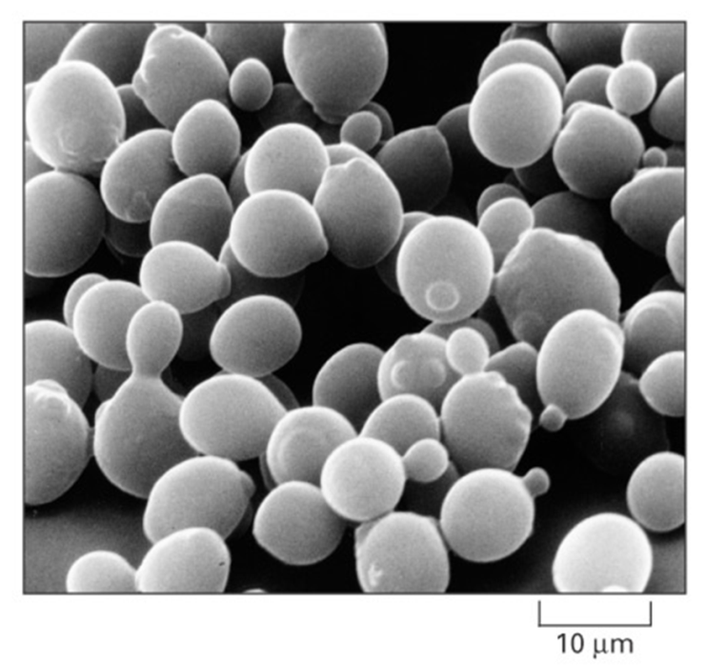
Saccharomyces cerevisiae is an Ideal Model Organism for Systems Biology
Small genome size of approximately 6000 genes.
These 6000 genes are regulated by ~250 transcription factors
Yeast deletion strains and other molecular genetic tools are readily available online
Alberts et al. (2004)

Slide 5
The Response to the Environmental Stress Cold Shock is not Well Studied
Heat Shock | Cold Shock (10-18℃)
Proteins denature | Decreases fluidity of membranes
Induction of heat shock proteins that assist in protein folding | Stabilizes DNA and RNA secondary structures
Conserved in all organisms | Impairs ribosome function and protein synthesis
 | Decreased enzymatic activities
 | No equivalent set of cold shock proteins that are conserved in all organisms

Slide 6
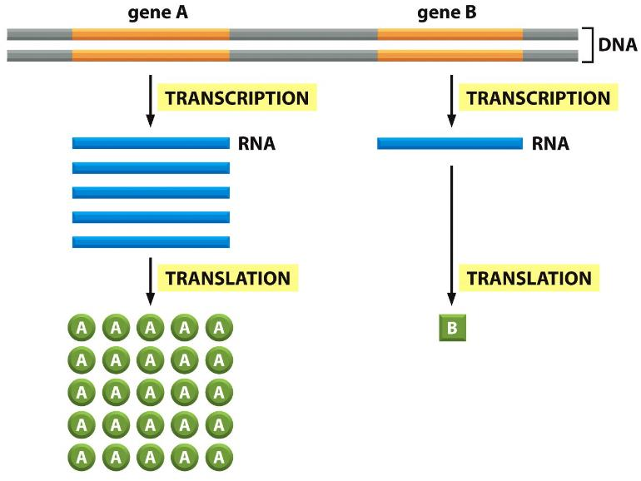
Yeast Respond to Cold Shock by Changing the Level of Gene Expression
Alberts et al. (2014)

Slide 7
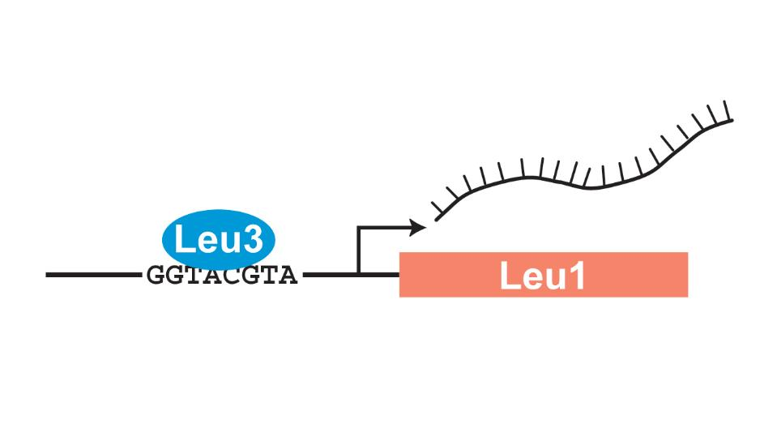
Transcription Factors Control Gene Expression by Binding to Regulatory DNA Sequences
Activators increase expression and repressors decrease expression
Transcription factors are themselves proteins encoded by genes.

Slide 8
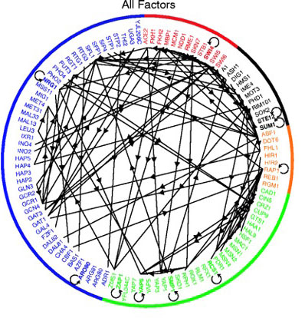
A Gene Regulatory Network (GRN) is a Set of Transcription Factors that Regulate the Expression of Genes Encoding Other Transcription Factors
Example Gene Regulatory Network (GRN)
of 106 Transcription Factors
1. Which transcription factors regulate the cold shock response in yeast?
2. What is the indirect effect of other transcription factors?
3. Can we make predictions based on our understanding of the network?
Lee et al. (2002)

Slide 9
Overview
Yeast respond to cold shock by changing gene expression, but which transcription factors remains unknown.
To address this, microarray data was generated for yeast under cold shock conditions.
A family of candidate related gene regulatory networks was generated from submitting this data into the YEASTRACT database.
Random networks with the same number of nodes and edges were also generated.
The dynamics of each gene in each network was modeled using ordinary differential equations.
A database-derived network was modeled better in comparison to random networks, supporting the evidence that the network explains the biological response to cold shock.

Slide 10
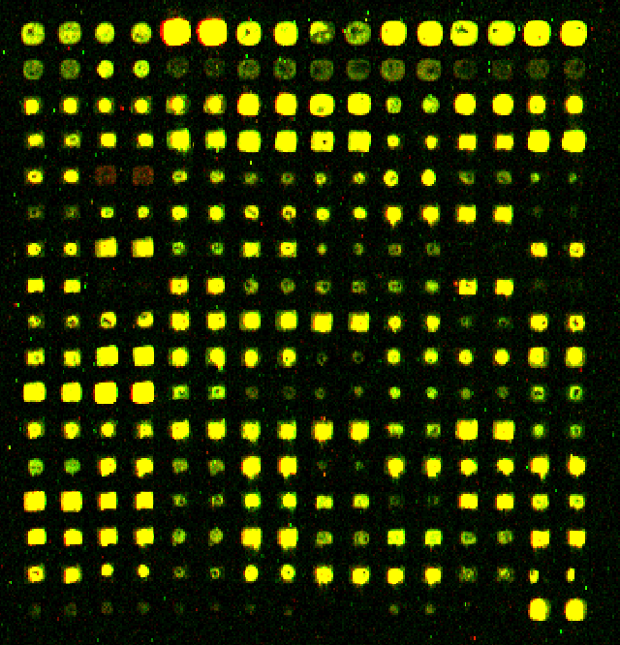
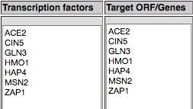
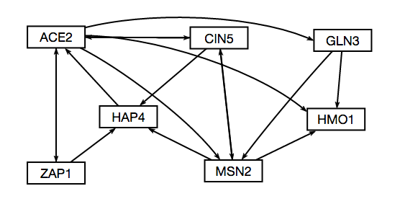
The Microarray Data was Used to Derive a Family of Related GRNs from the YEASTRACT Database
Indicates which genes had significant changes in expression at any time point
YEASTRACT Database
These genes were input into the YEASTRACT database, which returned a list of potential regulatory transcription factors that may regulate those target genes, in order of significance.
Within-strain ANOVA
Generate “Family” of Related Networks
Notes:
Change title

Slide 11
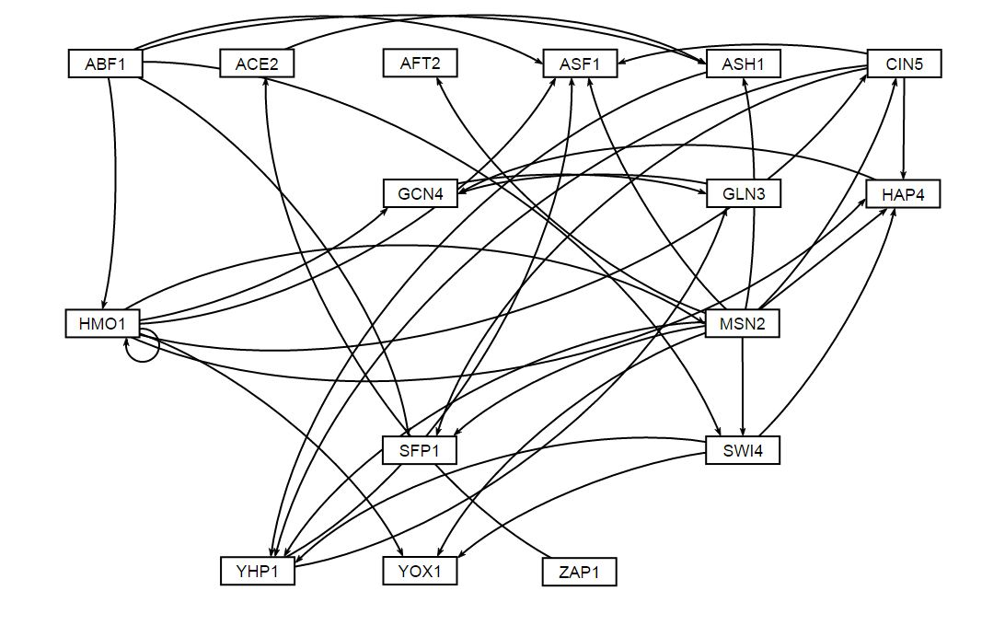
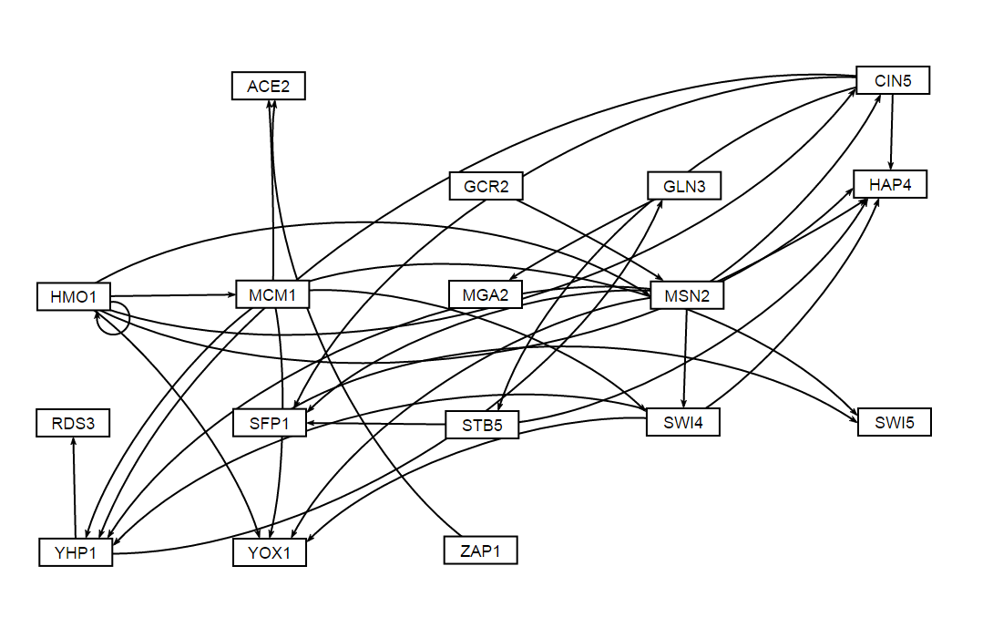
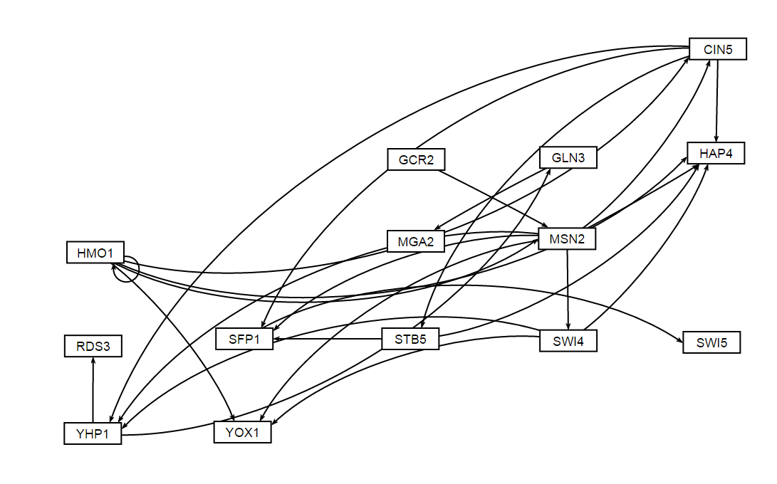
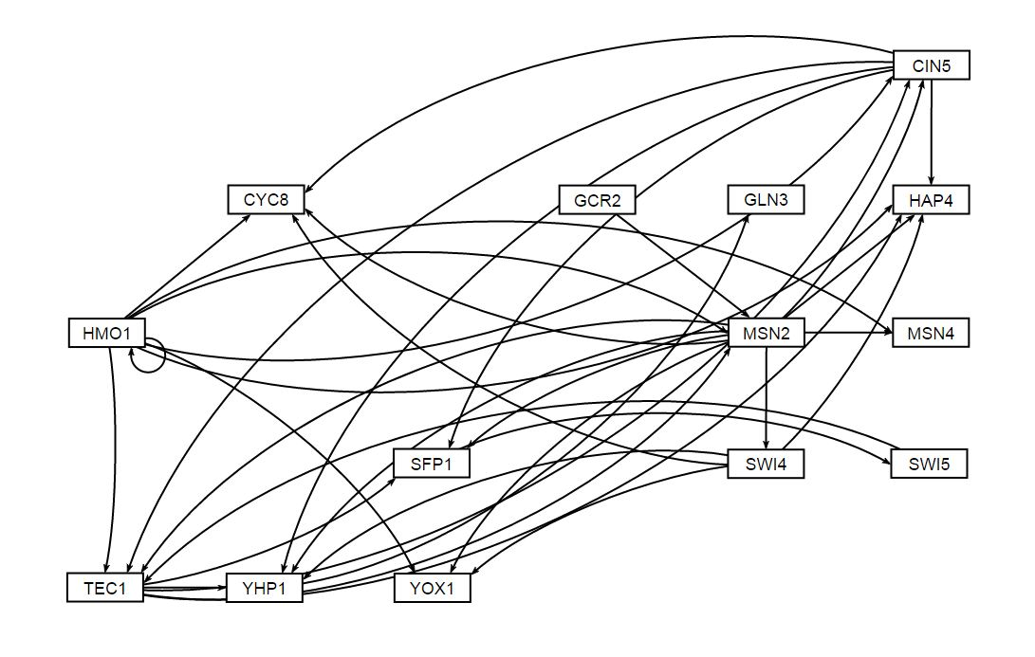
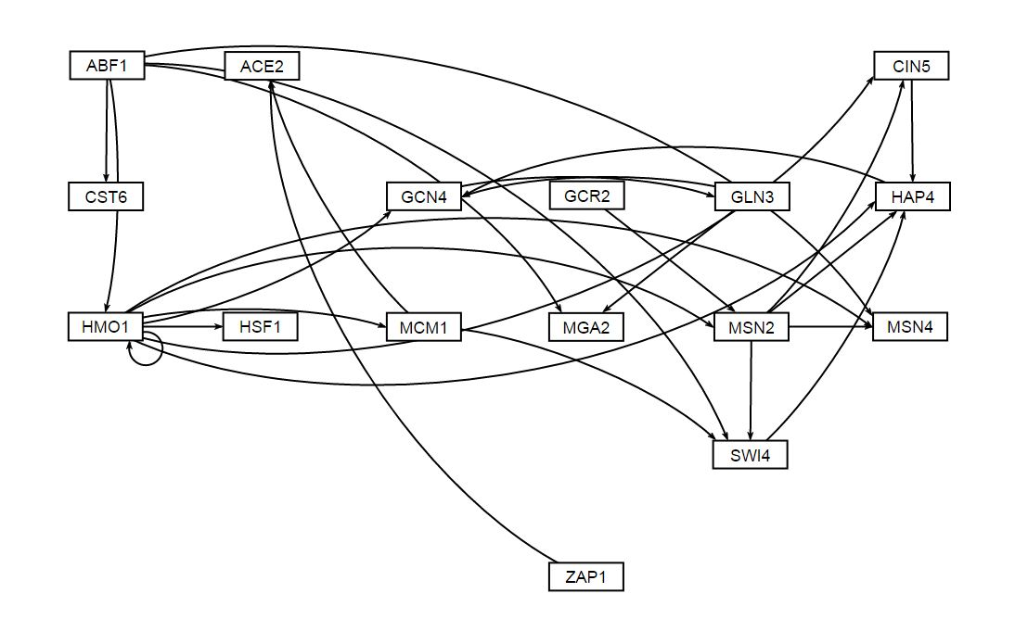
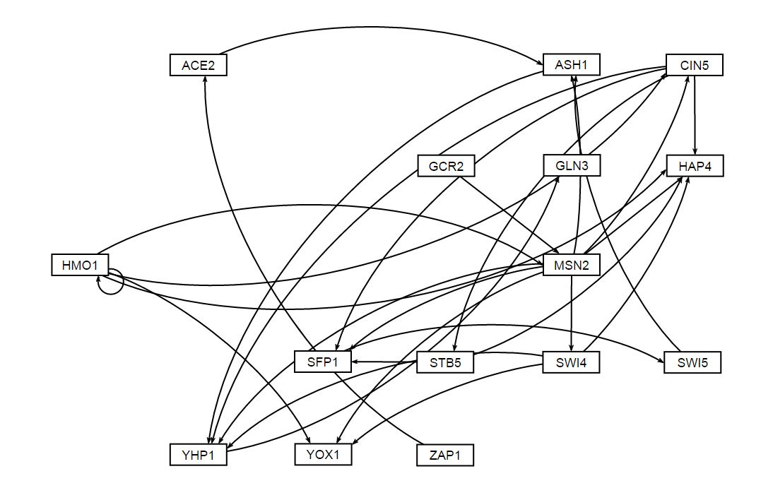
A “Family” of Candidate Related GRNs was Created by Paring Down Genes and Edges from the Largest Network
Db1: Network derived from wt data
Db2: Network derived from Δcin5 data
Db3: Network derived from Δcin5 data
16 genes, 36 edges
14 genes, 25 edges
17 genes, 32 edges
Db4: Network derived from Δgln3 data
Db5: Network derived from Δhap4 data
Db6: Network derived from Δzap1 data
14 genes, 35 edges
15 genes, 28 edges
16 genes, 27 edges

Slide 12
Overview
Yeast respond to cold shock by changing gene expression, but which transcription factors remains unknown.
To address this, microarray data was generated for yeast under cold shock conditions.
A family of candidate related gene regulatory networks was generated from submitting this data into the YEASTRACT database.
Random networks with the same number of nodes and edges were also generated.
The dynamics of each gene in each network was modeled using ordinary differential equations.
A database-derived network was modeled better in comparison to random networks, supporting the evidence that the network explains the biological response to cold shock.

Slide 13
A “Family” of 30 Random Networks Related to DB5 was Generated from R Script
Random networks have the same number of nodes (15) and the same number of edges (28), but with edges randomized.
Db5: Network derived from Δhap4 data
15 genes, 28 edges

Slide 14
Overview
Yeast respond to cold shock by changing gene expression, but which transcription factors remains unknown.
To address this, microarray data was generated for yeast under cold shock conditions.
A family of candidate related gene regulatory networks was generated from submitting this data into the YEASTRACT database.
Random networks with the same number of nodes and edges were also generated.
The dynamics of each gene in each network was modeled using ordinary differential equations.
A database-derived network was modeled better in comparison to random networks, supporting the evidence that the network explains the biological response to cold shock.

Slide 15
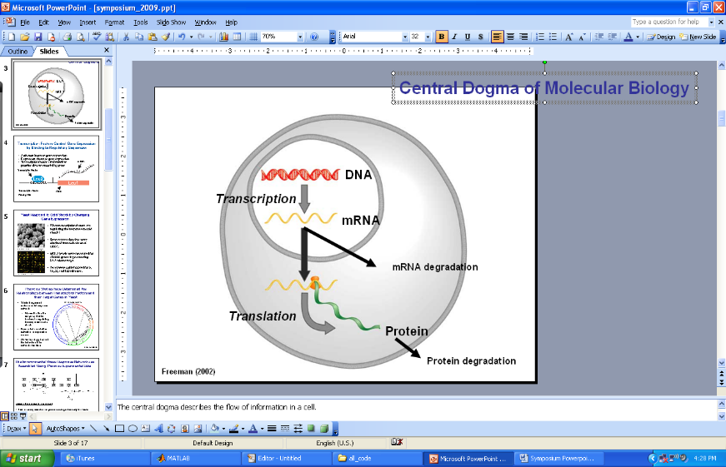
GRNmap Uses Ordinary Differential Equations to Model the Dynamics of Each Gene in the Network
[mRNA] for each gene
mRNA production rate
mRNA degradation rate
weight term
determines the level of activation or
repression
Unique threshold for each gene
The change in expression of one gene is production – degradation.
Weight parameter, w, gives the direction (activation or repression) and magnitude of regulatory relationship.
Freeman (2003)
http://kdahlquist.github.io/GRNmap/

Slide 16
GRNmap Uses Ordinary Differential Equations to Model the Dynamics of Each Gene in the Network
The MATLAB code and executable are available under an open source license at
https://github.com/kdahlquist/GRNmap/.
Each gene’s expression level is described using ordinary differential equations with a sigmoidal production function.
Degradation rates calculated using RNA half lives provided by Neymotin et al. 2014
[mRNA] for each gene
mRNA production rate
mRNA degradation rate
weight term
determines the level of activation or
repression
Unique threshold for each gene
Notes:
Degradation rates were provided by Neymotin et al. 2014

Slide 17
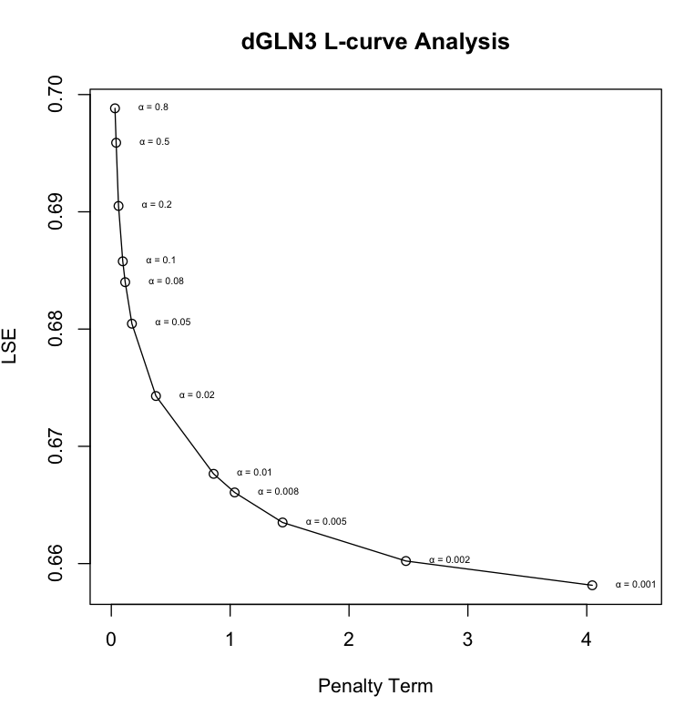
A Penalized Least Squares Approach is Used to Estimate Parameters
alpha : determined empirically from the “elbow” of the curve
Penalty Term: combined production rate, weight, and threshold parameters
Experimental
Theoretical
L-curve for the Smallest Network
Plotting the least squares error function showed that not all the graphs had clear minima.
We added alpha and the penalty term to force the function to minimize on a single solution
We performed an L-curve analysis to determine the best value to use for alpha.

Slide 18
MSE for Each Gene Shows how Well the Model Fits the Data

Slide 19
Overview
Yeast respond to cold shock by changing gene expression, but which transcription factors remains unknown.
To address this, microarray data was generated for yeast under cold shock conditions.
A family of candidate related gene regulatory networks was generated from submitting this data into the YEASTRACT database.
Random networks with the same number of nodes and edges were also generated.
The dynamics of each gene in each network was modeled using ordinary differential equations.
A database-derived network was modeled better in comparison to random networks, supporting the evidence that the network explains the biological response to cold shock.

Slide 20
LSE:minLSE ratio comparison between DB5 network and 30 random networks validates that DB5 network is modeled better
Average, DB: 1.3853
Average, Rand: 1.4537
Notes:
Closer to the ideal (1) means that it was perfect; modeled accurately & all time points fit data

Slide 21
LSE:minLSE ratio comparison between DB5 network and 30 random networks validates that DB5 network is modeled better
Average, DB: 1.3853
Average, Rand: 1.4537
Notes:
Closer to the ideal (1) means that it was perfect; modeled accurately & all time points fit data

Slide 22
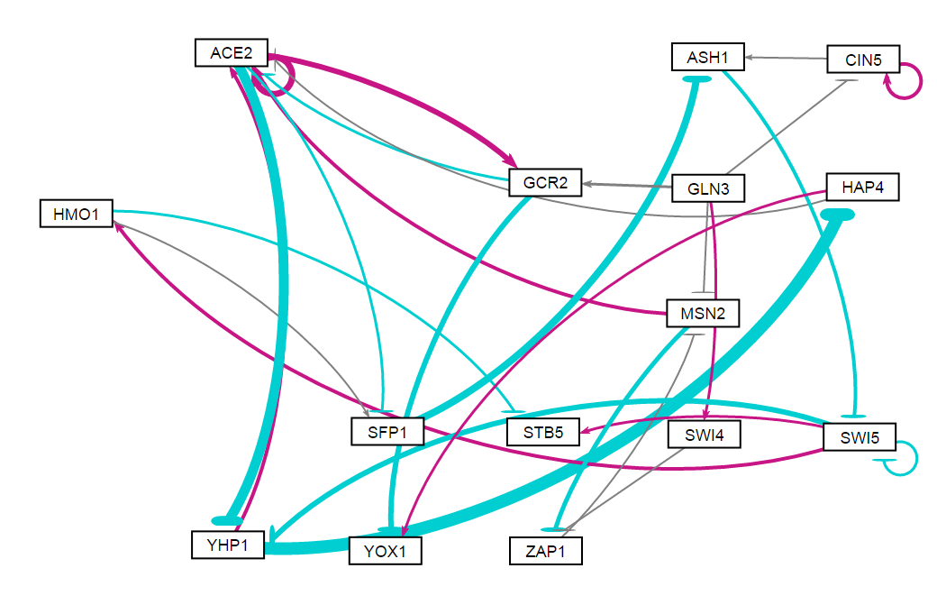
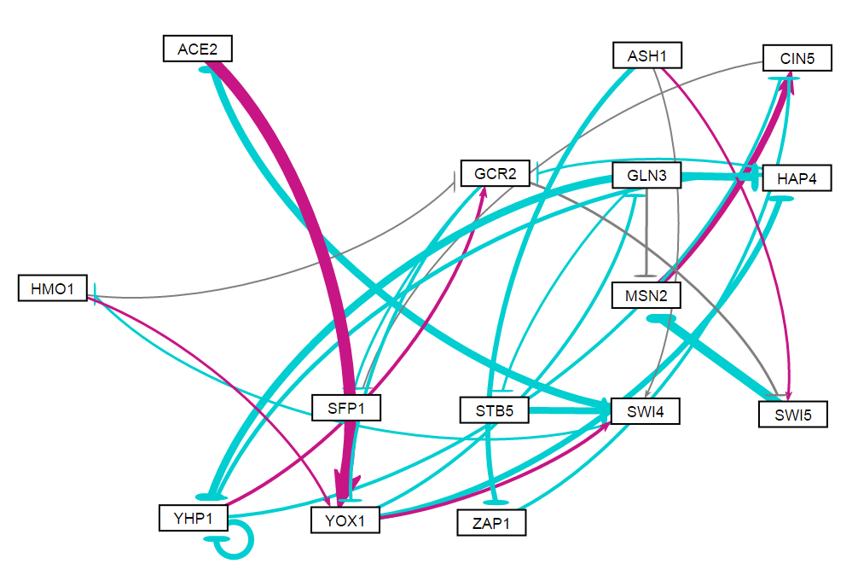
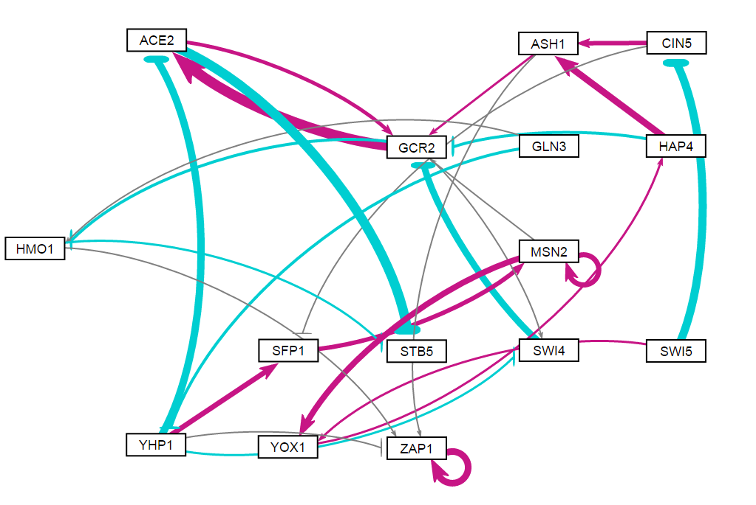
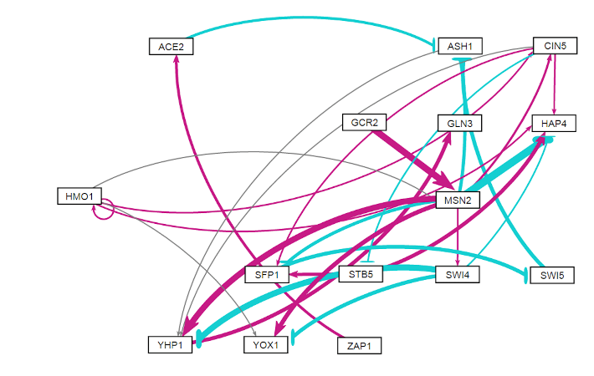
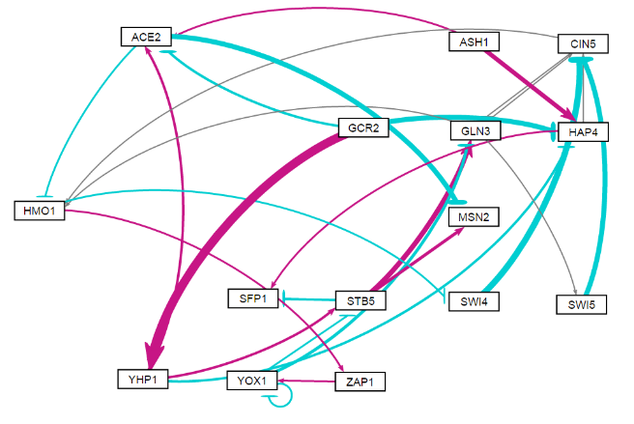
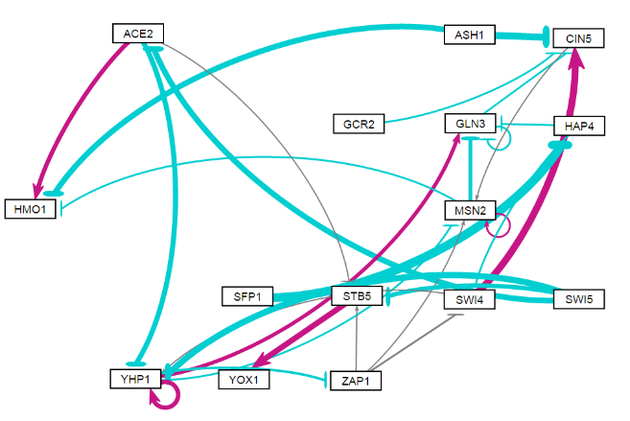
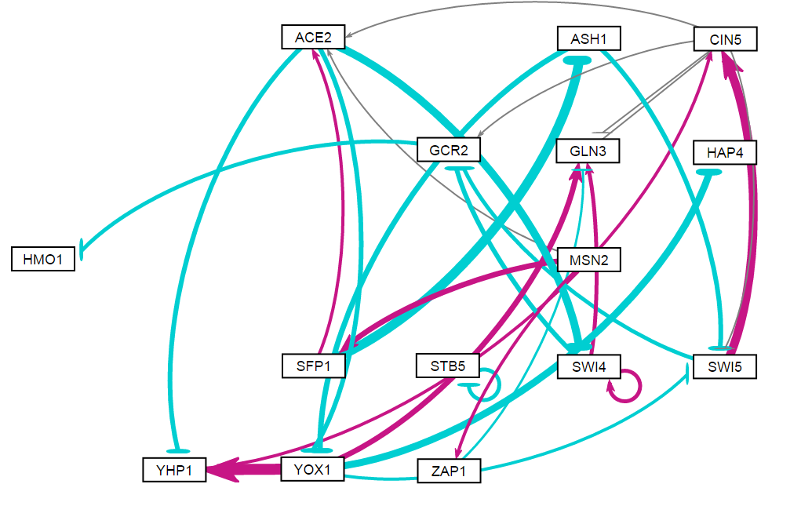
More Repressive Regulatory Relationships in the Random Networks Compared to DB5 Network
Random Network 15
Random Network 16
Random Network 24
DB5 Network
Sum of Weights: -15.1608
Sum of Weights: -18.6326
Sum of Weights: 5.7721
Random Network 7
Random Network 12
Random Network 31
Sum of Weights: 1.2366
Sum of Weights: -2.1505
Sum of Weights: -16.4437
Sum of Weights: -5.7855

Slide 23
Random Networks with Edges Similar to DB5 Network Performed Better than Networks that were not Similar
Nodes shared:
CIN5→ SFP1, negligible
HMO1→ YOX1, same regulation type
MSN2→ CIN5, same regulation type
DB5 Network
Random Network 16
Nodes shared:
MSN2→ SFP1, different regulation type
Random Network 31

Slide 24
Summary
Average LSE:minLSE for DB networks was lower than ratio for 30 random networks
LSE:minLSE ratio for DB5 network was less than the average LSE:minLSE ratio for 30 random networks
Random networks that performed better in the model shared more regulatory relationships with the DB5 network than those random networks that performed worse

Slide 25



Acknowledgments
Dr. Kam Dahlquist and Dr. Ben Fitzpatrick
GRNmap data analysis current team: Brandon Klein, Kristen Horstmann, and Maggie O’Neil
GRNmap current coding team: Trixie A. Roque, Chukwuemeka (Edward) Azinge, and Justin Torres
GRNsight current team: Anindita Varshneya, Nicole A. Anguiano, Mihir Samdarshi, Eileen Choe, and Edward Bachoura, Jen Shin

Slide 26
References
Dahlquist, K., Fitzpatrick, B., Camacho, E., Entzminger, S., & Wanner, N. (2015). Parameter Estimation for Gene Regulatory Networks from Microarray Data: Cold Shock Response in Saccharomyces cerevisiae. Bulletin Of Mathematical Biology, 77(8), 1457-1492. http://dx.doi.org/10.1007/s11538-015-0092-6.
Dário Abdulrehman, Pedro T. Monteiro, Miguel C. Teixeira, Nuno P. Mira, Artur B. Lourenço, Sandra C. dos Santos, Tânia R. Cabrito, Alexandre P. Francisco, Sara C. Madeira, Ricardo S. Aires, Arlindo L. Oliveira, Isabel Sá-Correia, Ana T. Freitas (2011). YEASTRACT: providing a programmatic access to curated transcriptional regulatory associations in Saccharomyces cerevisiae through a web services interface Nucl. Acids Res., 39: D136-D140, Oxford University Press.
Freeman, S. (2002). Biological science. Upper Saddle River, NJ: Prentice Hall.
GRNsightt. (n.d.). Retrieved March 10, 2016, from http://dondi.github.io/GRNsight/
GRNmap. (n.d.). Retrieved March 10, 2016, from https://github.com/kdahlquit/GRNmap
Neymotin, B., Athanasiadou R., and Gresham D. (2014). Determination of in vivo RNA kinetics using RATE-seq. RNA, 20, 1645-1652.

