Slide 1
Natalie Williams
Kam D. Dahlquist and Ben G. Fitzpatrick
March 25, 2017

Slide 2
Overview of Today’s Presentation
Brief background
GRNmap & Mathematical modeling of dynamics
Validity of network by comparison to random networks

Slide 3
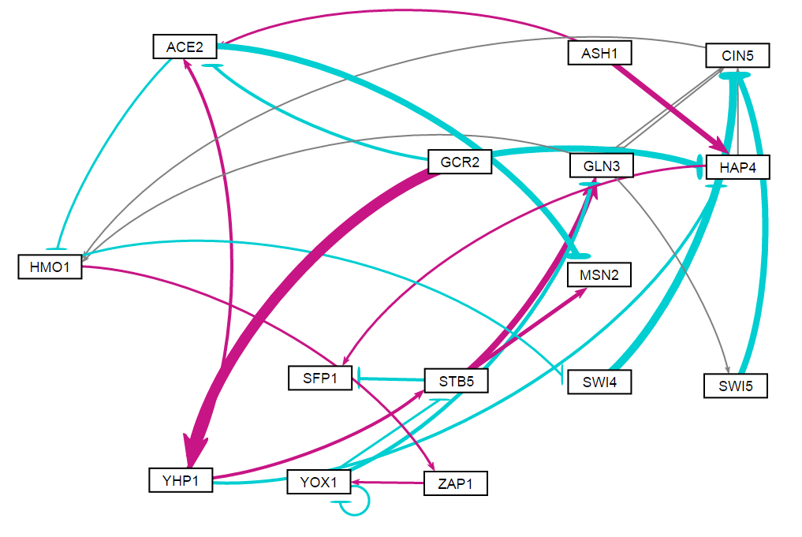
Random Network 7

Slide 4
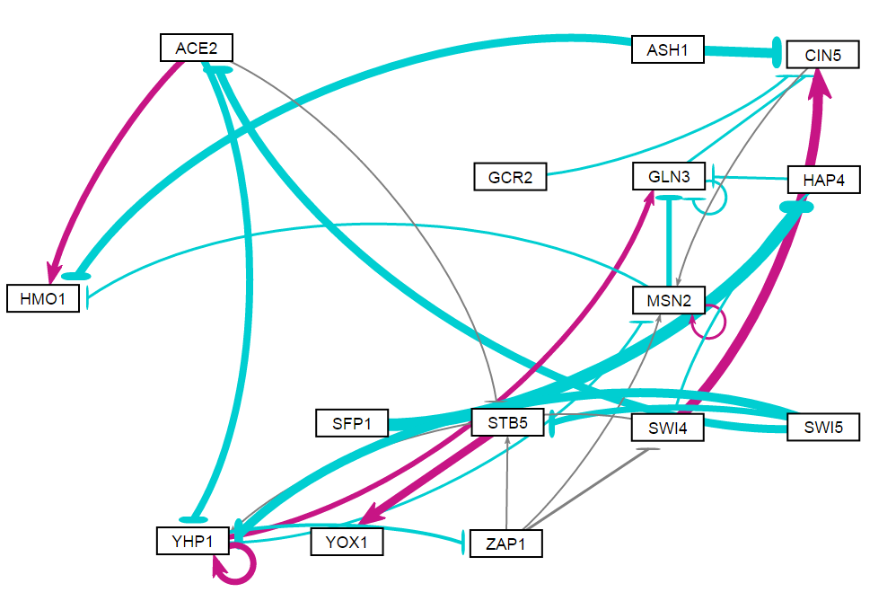
Random Network 12

Slide 5
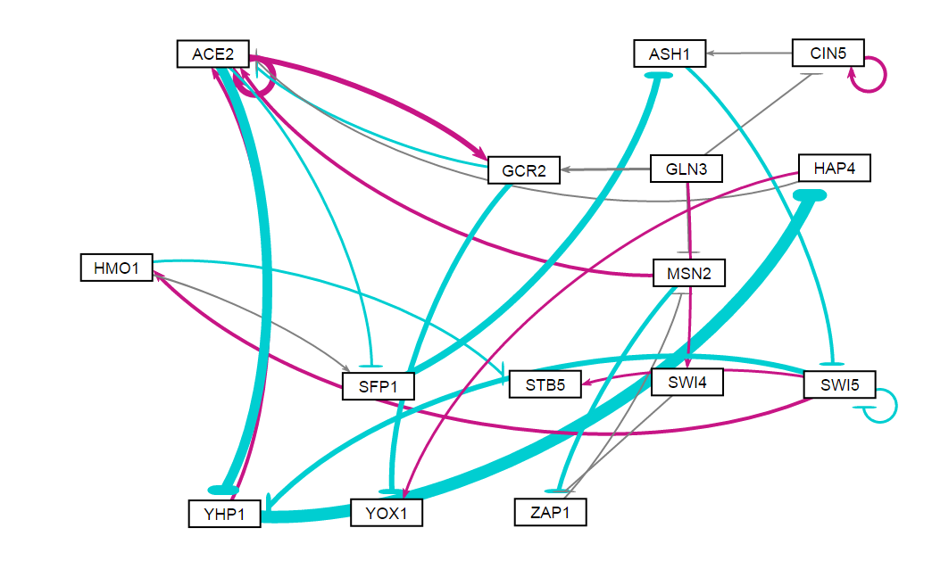
Random Network 15

Slide 6
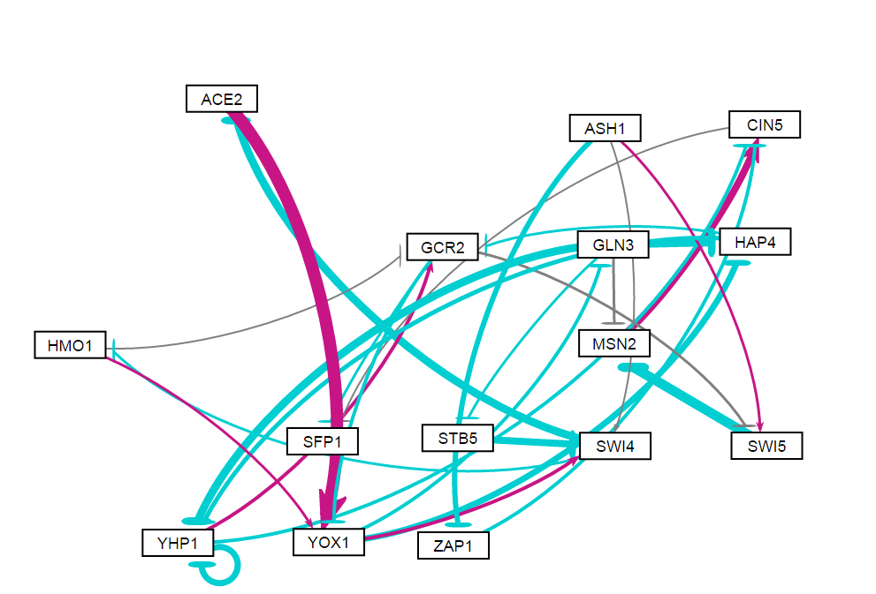
Random Network 16

Slide 7
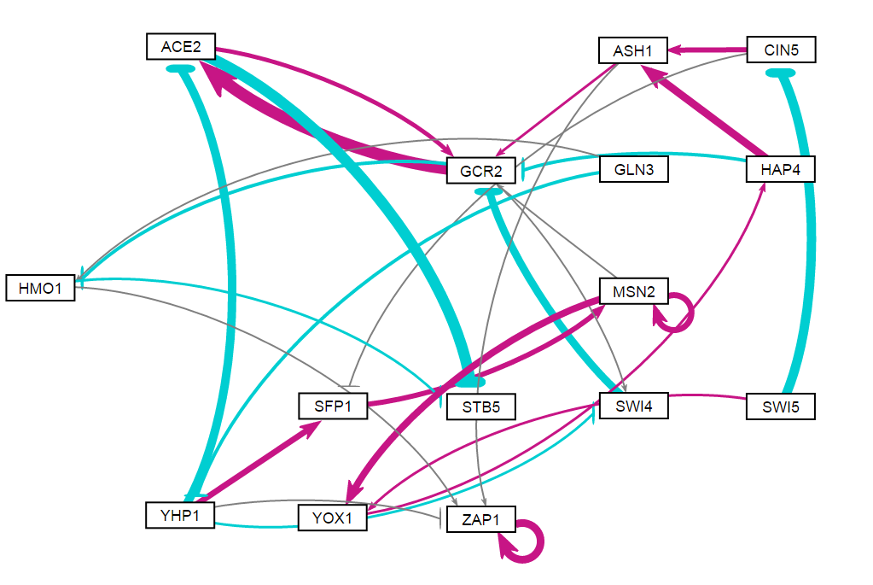
Random Network 24

Slide 8
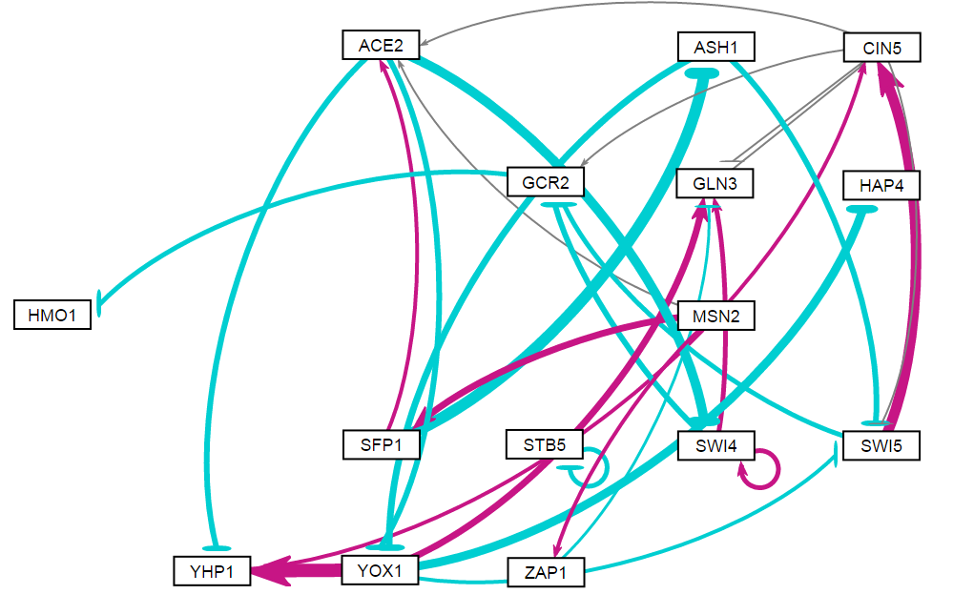
Random Network 31

Slide 9
LSE:minLSE ratio comparison between DB5 network and 31 random networks validates that DB5 network is modeled better via GRNmap.

