Slide 1
Building a Simple Shiny App
Calum Walsh
Doherty Applied Microbial Genomics
Stinear Lab Group

Slide 2
Intro to Shiny
What is Shiny?
A web application framework for R (or python) that allows you to turn your data into an interactive web app
Do I need to know some HTML?
No, but knowing a bit of HTML, CSS, or Javascript can help
(I know none of these)
How does it work?
Shiny apps have two components
a user interface (UI) script that controls layout and appearance by converting R (or python) to HTML
a server script to contains the code for the app

Slide 3
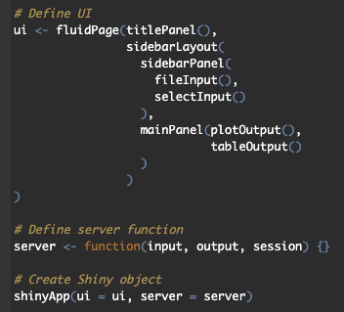
Basic App Layout
Allows display to adjust automatically to browser dimensions
Title text to be displayed
Defines a specific page layout (⅓ sidebar, ⅔ main page)
Function contains code to be run in app
Panels within sidebar, typically inputs
Panels within main page, typically outputs
Create the Shiny App object

Slide 4
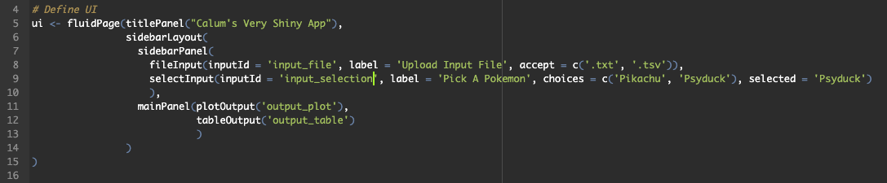
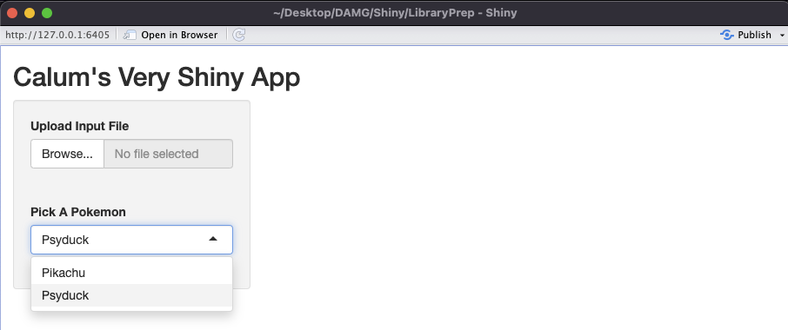
UI Layout

Slide 5
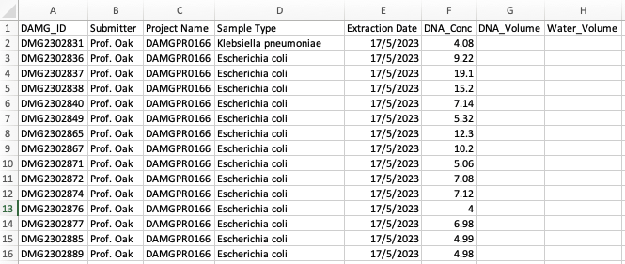
Problem of the Day
How many μl of extracted DNA and Nuclease Free Water should we add to the PCR reaction for each sample?
Requirements:
Equal DNA concentration (ng/μl) per sample
Equal total volume per sample
Total volume depends on sample prep method used

