Slide 1
Intro To Statistical Testing
Matthieu Ranger

Slide 2
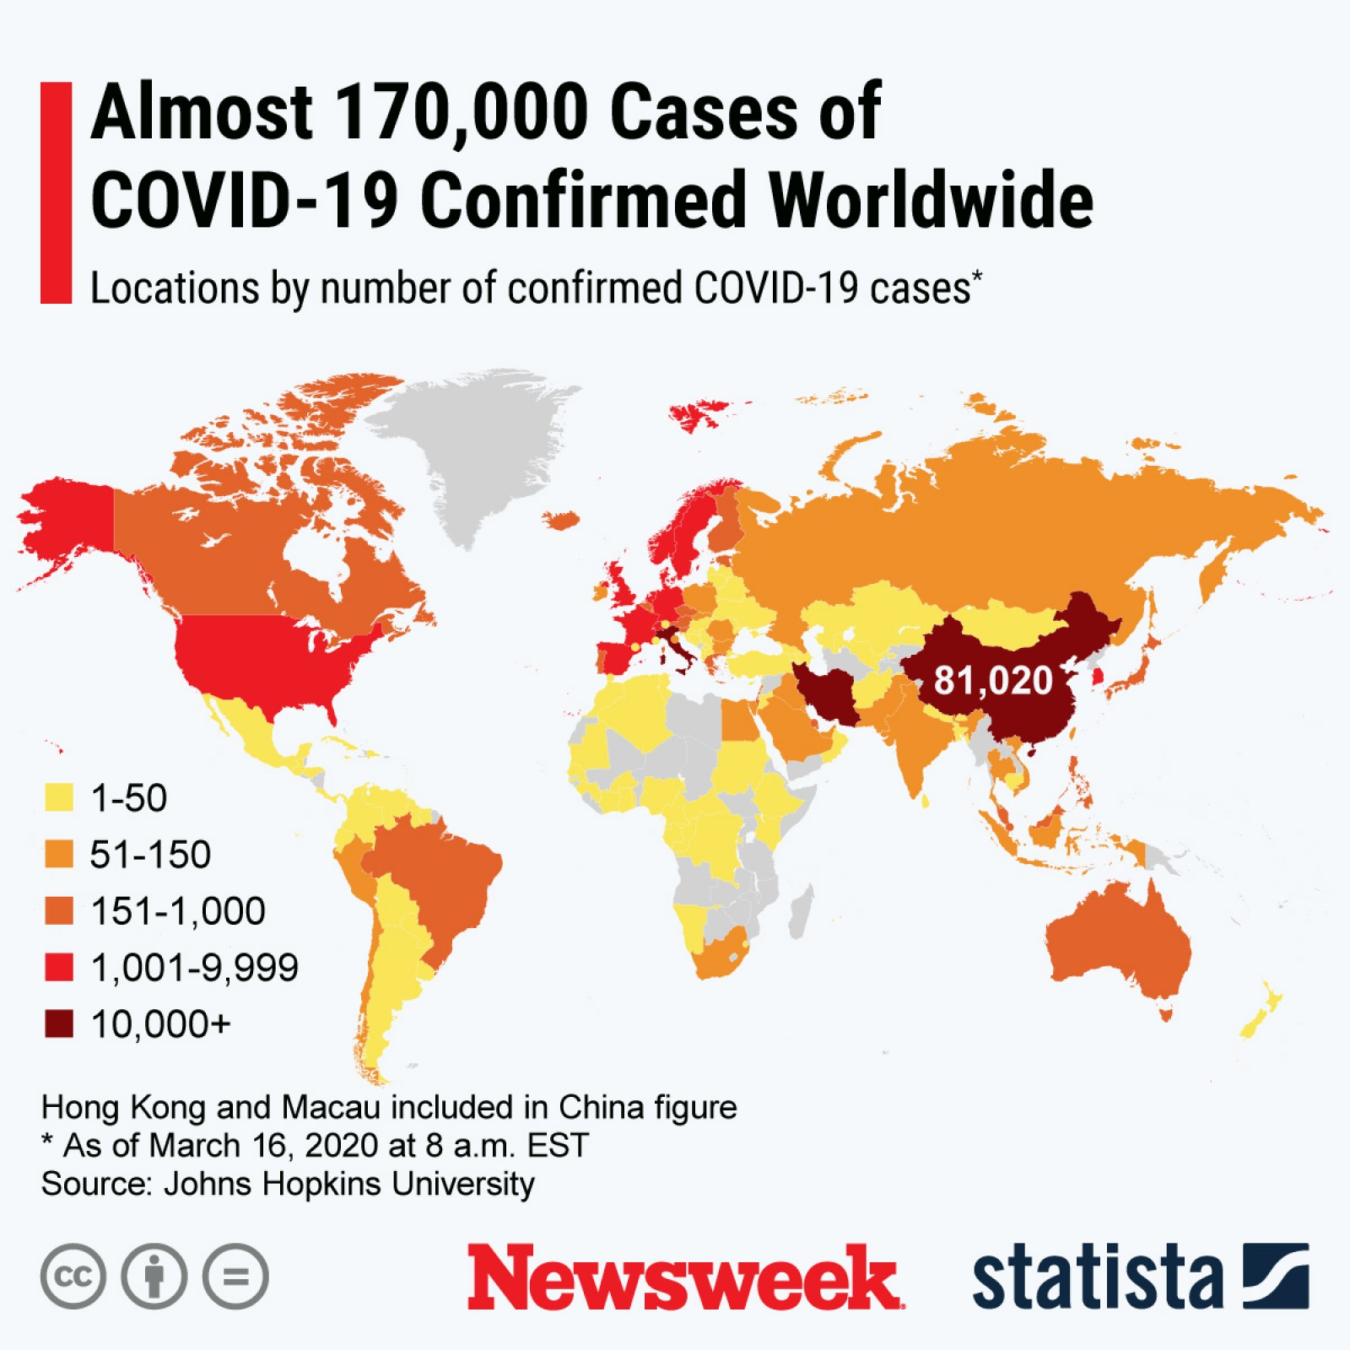
Introduction
Statistical literacy is one of the most important modern skills
Factual claims are statistical in nature
You need numbers to make decisions
Numbers are inherently uncertain things
You should be able to reframe numbers into statistical questions (when relevant)

Slide 3

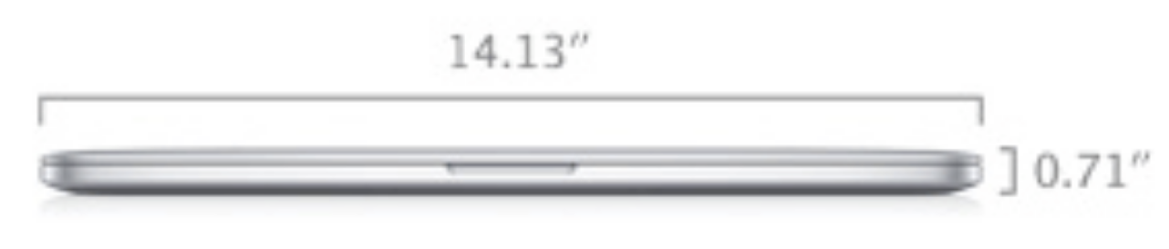
All measurements are uncertain
All measurements are statistical quantities
Even the simplest you can think of!
Example: Measuring a physical object
Changes based on room temperature
Measuring is inaccurate at the μm level!

Slide 4
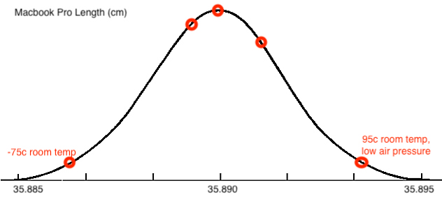
Statistical quantities are distributions
The value of the quantity of interest is linked to other variables

Slide 5
Fundamental uncertainty
Ex: “number of COVID cases”
Unclear what “infected” means (test results themselves are a statistic)
Testing is dependent on human behavior
Testing criterion differs by location
Philosophical: at quantum scale, everything is fundamentally random
Why do people talk about fixed numbers?
Statistics is hard
Sometimes precision << value of interest

Slide 6
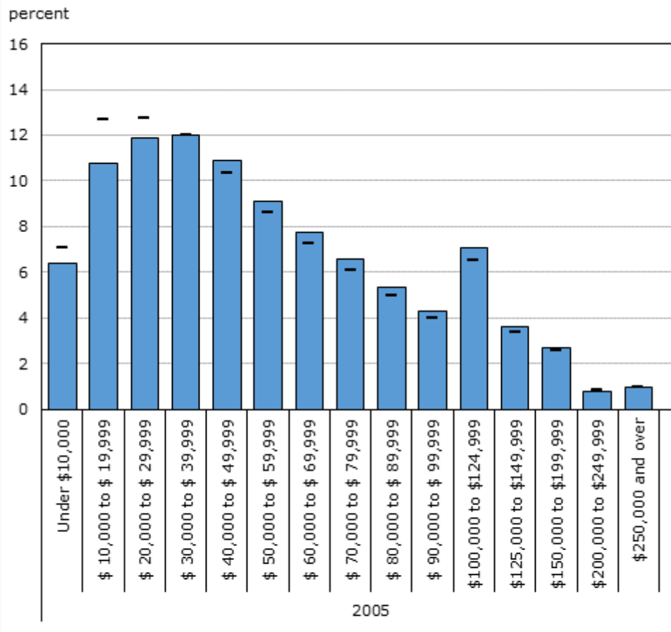
Measurement (the correct way)
A useful measurement contains:
A representative statistic of the distribution
The associated uncertainty
Examples:
Average height for a Canadian is 178 ± 2 cm
Median income in Canada is $61,400 ± $?
Notes:
- Note average height depends on if you’re a man or woman!
- Stats Canada doesn’t quickly report CI around their values

Slide 7
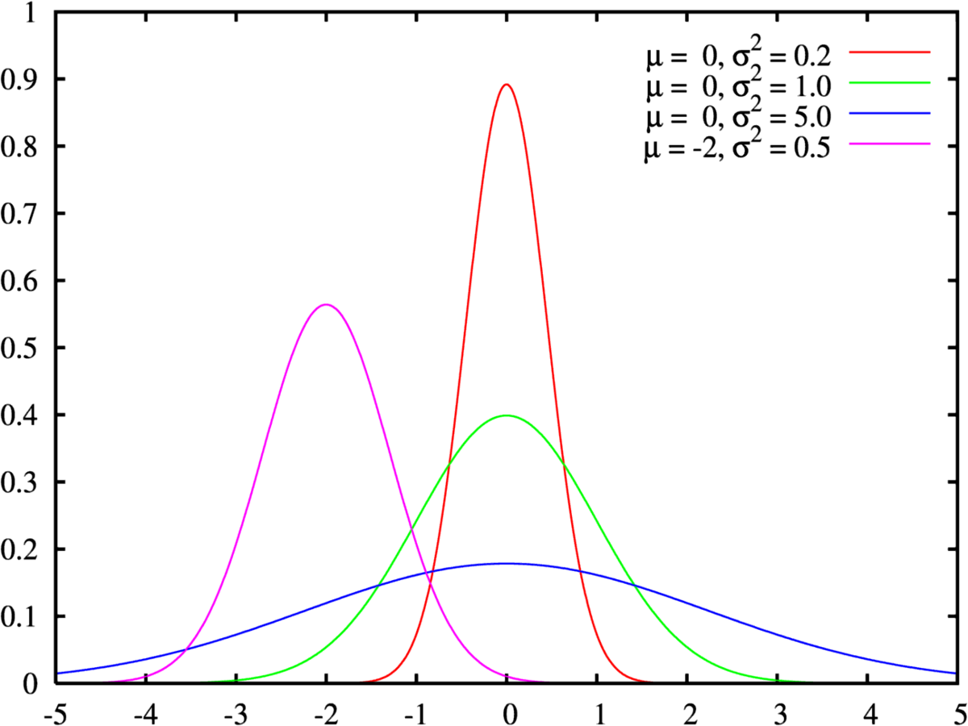
Statistical testing
Given a sample of measurements, what is the probability that a statistic comes from a certain distribution?
A distribution has shape and parameters
Most questions can be reframed:
Given two samples, what is the probability they come from the same distribution?
The difference between two samples is a distribution itself
Given a sample, is the mean different than 0?
Compare with a zero-mean distribution

Slide 8
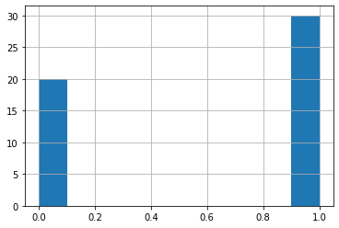
Sampling example: coinflip
Question: am I flipping a “fair” coin?
Flip 50 coins, results:
[1 0 0 0 0 0 1 0 1 0 1 1 0 0 1 1 1 1 1 0 0 1 0 0 1 1 0 1 0 1 0 0 1 1 1 1 0 0 1 0 1 0 0 1 0 0 1 0 0 0]
(30 heads, 20 tails)
Reframe the question:
“How likely is a 60% average on 50 coinflips to be from a coin with a 50% average?”

Slide 9
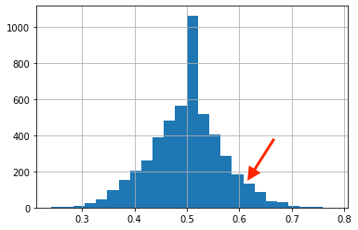
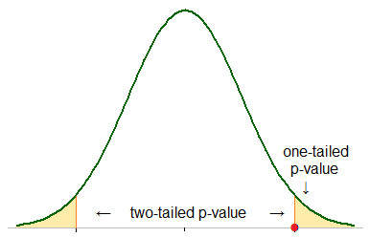
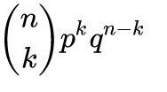
Distribution of 50 coinflip results
Flip 50 coins 5000 times, resulting distribution
Binomial test P-Value for our example: 0.203
Eg. 100 – 20.3 = 79.7% probability that coin is unfair
Yellow areas are ”rejection areas” for a given probability
Actual binomial distribution PDF formula:

Slide 10
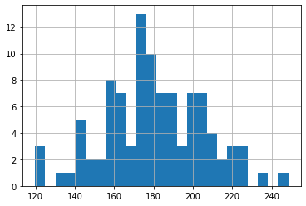
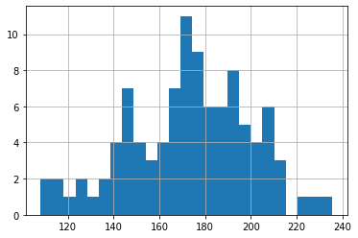
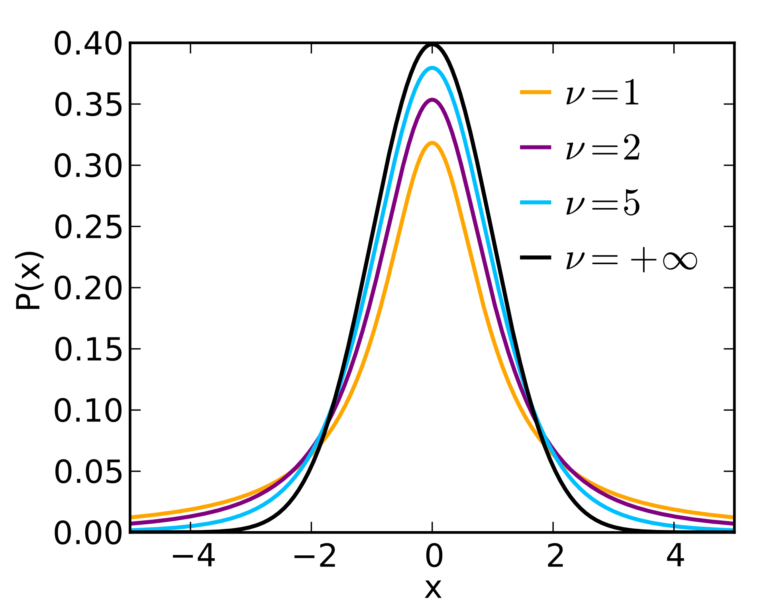
Sampling example 2: Heights
Measure 50 women and 50 men’s heights.
Are men taller than women?
Is the men’s mean > women’s mean
Student’s ”T distribution”: distribution of the sample means given ”normally distributed” data
Men
Women

Slide 11
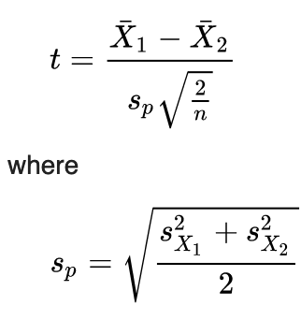
T-test: difference of two sample means
Actual test formula:
Actual test P-value: 0.043

