Slide 1
THE IMPACT OF COVID-19 PANDEMIC ON UNEMPLOYMENT IN CANADA
Unemployment by industry

Slide 2
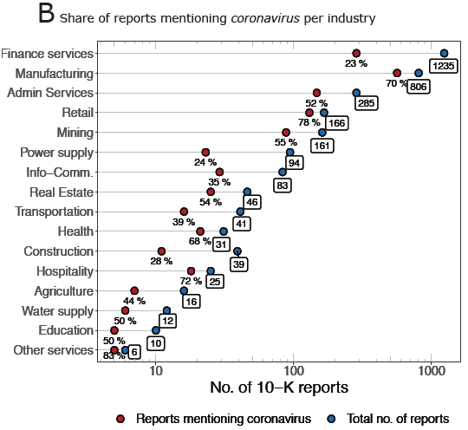
Unemployment by industry
The CoRisk-Index: A data-mining approach to identify industry-specific risk assessments related to COVID-19 in real-time (27th April 2020 - Fabian Stephany et al.)
The study presented here investigates a potential data source that could provide an empirical basis to identify industry-specific economic risks related to COVID-19 and to inform models on the economic effects of the current crisis. We examine company risk reports (10-K reports) filed to the U.S. Securities and Exchange Commission (SEC) and introduce a data-mining approach to measure firms’ risk assessments.
The empirical information provided could help to inform macro-economic models on the effects of the corona-crisis and, thus, help to inform policymakers to better target current economic support programmes to industries that report most severe risks at the current phase of the crisis.
The robustness of the results needs to be checked in more detail. In particular, we will compare historical and unemployment data with risk measures (text negativity) extracted from 10-K reports to investigate the correlation between risk reports and overall economic trends.

Slide 3
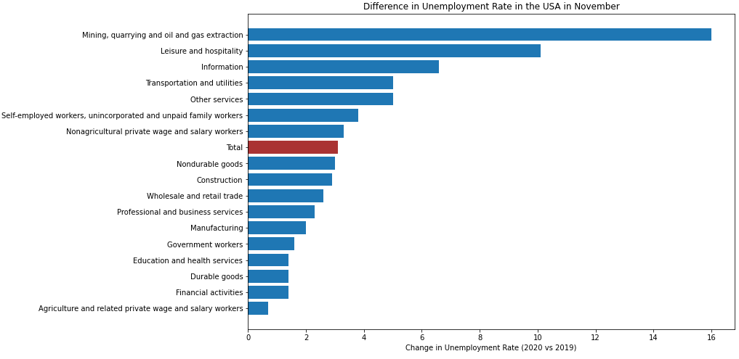
Unemployment by industry
Leisure and hospitality (which include restaurants), is still one of most impacted industry in november. No true for Retail and Manufacturing.

Slide 4
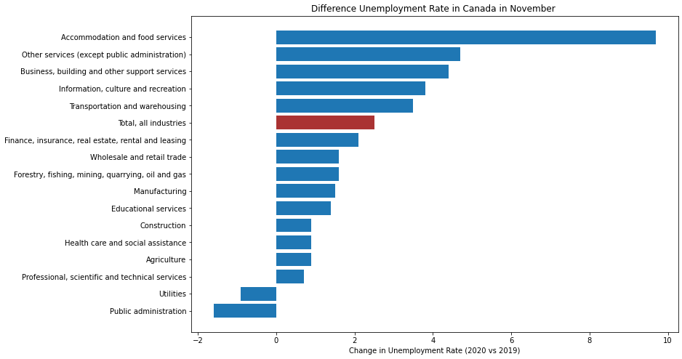
Unemployment by industry

Slide 5
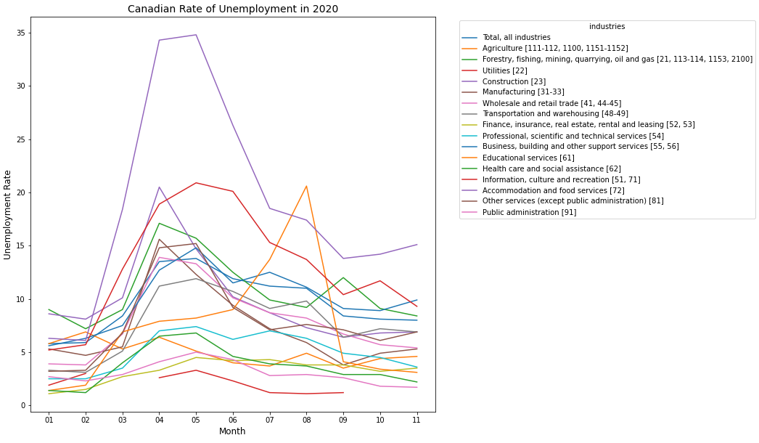
Unemployment by industry

Slide 6
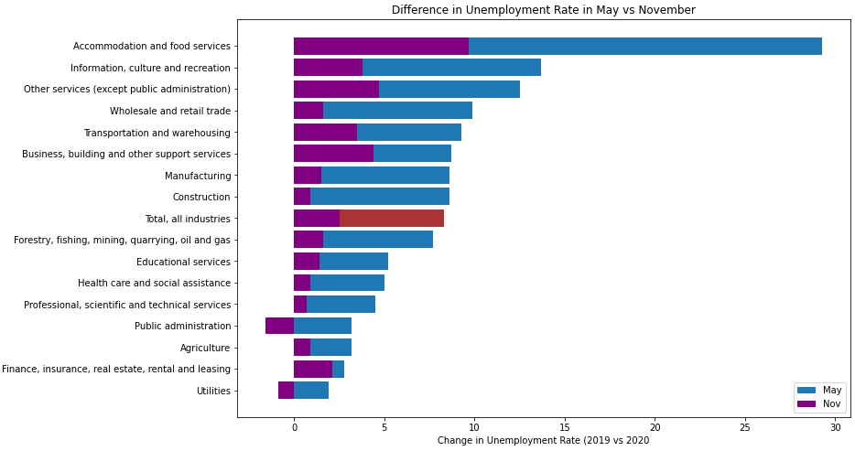
Unemployment by industry

Slide 7
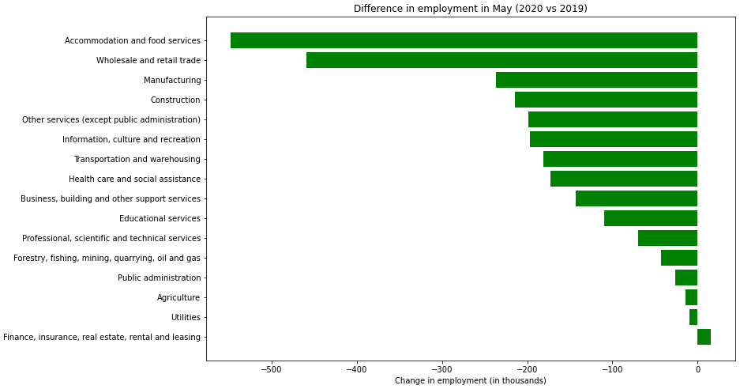
Unemployment by industry

Slide 8
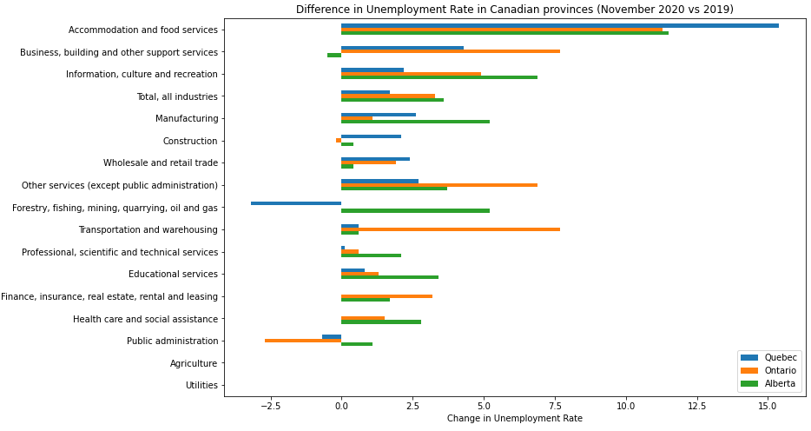
Unemployment by industry

