Slide 1
Linux Fundamental
By Chetan Bansal

Slide 2
Who is Chetan Bansal (Cb-Kali)
Certified Ethical Hacker
Cyber Security Mentor at THE INFOSQUAD.
Ex Intern in keycybr and We are Plymouths
I have own community (CB-Blackhat).
I wrote a one book “Cyber Crime and Online Safety” under Nitin Pandey Sir.
Pursuing Diploma in Information Technology Enabled Services & Management.

Slide 3
History of Linux
In 1964 Bell Laboratories New Jersey think about UNIX Operating System.
In 1969 they withdraw this idea but Dennis Ritchie and Ken Thompson told we create this project.
Then they created UNIXS (Uniplexed Information & Computing System).
This is open source project.
In 1975 they update UNIX and lunch UNIXv6
After UNIX many company create own UNIX based OS and sale.

Slide 4
History of Linux
Some UNIX name:
IBM-AIX
Sun Solaris
Max OX
HP-UX
These are flavours of UNIX.
In 1991 Linus Torvalds submit own collage project.
He create a OS with help of open source.
He create a Linux kernel and add GNU
GNU basally collocations of software.

Slide 5
History of Linux
He read MINIX after read this OS then create Linux.
MINIX develops by Linus Torvalds teacher, Andrew Tanenbaum.
Linus Torvalds use UNIX command but he read MINIX OS.
Linus Torvalds create a Linux kernel.
After build Linux kernel he add GNU.
This project also open source.
Some company create own OS some are paid and some are free/open source.

Slide 6
Flavours of Linux
RHEL
Fedora
Debian
Other (Free to all)
3rd most used OS:
Ubuntu
CentOS
Amazon Linux

Slide 7
Point to Remembered
Linux is kernel not OS.
Linux is not a UNIX derivative. It was written from scratch.
A Linux distribution is the linux kernel and a collection of software that together, Create an OS.

Slide 8
Linux Feature
Open Source
Large Community Support
Secure
Light Weight
Multi user
Multi task
Simplified up dates for all Installed software/package.
Customization
Programming interface
Various Distributions

Slide 9
Architecture
Windows
Linux
User
User
Shell
Shell
OS
Kernel
H/W
H/W
H/W interact with OS
H/W interact with Kernel

Slide 10
- CLI always faster then GUI - Some term in windows and linux
Windows
Folder
Administrator
Software
Command Prompt
Linux
Directory
Root User
Package
Terminal

Slide 11
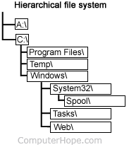
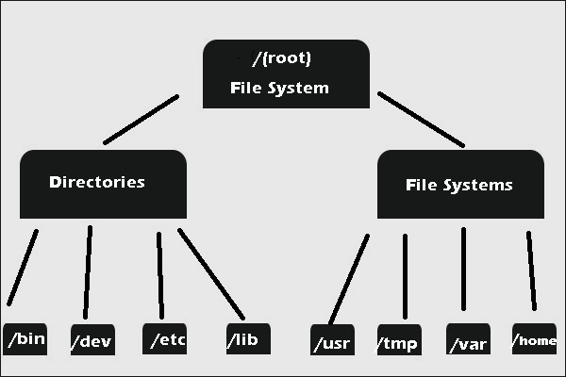
File System Hierarchy (only we discuss about imp directory)
Windows
Linux

Slide 12
Linux File System Hierarchy
/home: Home directory for other user.
/root: It is home directory for root user.
/boot: It contains bootable files for linux.
/etc: It contain all configuration files.
/usr: By default package are installed in this directory.
/bin: It contains commands used by all user excerpt root users.
/sbin: It contains commands used by only root user.
/otp: Optional application software packages.
/dev: Essential device file. This include terminal devices, usb or any device attached to system.

Slide 13
Installation of Kali Linux
Open kali.org
Download iso file for booting or VM ware image for virtual installation.
After installation configure file and start machine.
Kali linux user and password: kali and kali
Update and upgrade kali linux.

Slide 14


Slide 15
Understanding the terminal
root@cbkali~#
root = username
cbkali = hostname
~ = current directory
# user act indicator

Slide 16
Type of shell
sh = original Unix shell
bash = bourne-again shell
csh = "C" programming shell
tcsh = turbo C programming shell
zsh = zee shall
ksh = korn shell (public domain shell)

Slide 17


Slide 18

This Photo by Unknown Author is licensed under CC BY

