Slide 1
Networking Fundamental
By Chetan Bansal

Slide 2
Who is Chetan Bansal (Cb-Kali)
Certified Ethical Hacker
Cyber Security Mentor at THE INFOSQUAD.
Ex Intern in keycybr and We are Plymouths
I have own community (CB-Blackhat).
I wrote a one book “Cyber Crime and Online Safety” under Nitin Pandey Sir.
Pursuing Diploma in Information Technology Enabled Services & Management.

Slide 3
Contact Information
LinkedIn
Twitter
Instagram
GitHub
WhatsApp
bchetan031@gmail.com

Slide 4
What is Computer Network
A group of computer which are connected to each other for the purpose of sharing resources (Information, Data, files) is called computer network.
A
B
C
D

Slide 5
Fact
First Computer Network: ARPANET
ARPANET: Advanced Research Project Agency Network

Slide 6
Characteristic of computer Network
Recourse Sharing
Communication Speed
Backup
Secure
Software and Hardware sharing
Reliability

Slide 7
Network Types
Personal Area Network (PAN)
Local Area Network (LAN)
Campus Area Network (CAN)
Metropolitan Area Network (MAN)
Wide Area Network (WAN)

Slide 8
Personal Area Network (PAN)
Rang: 15-25 mm
Uses: Small Circles of friends or employee, Small Parties.
Example: Hotspot, Bluetooth, Wireless keyboards, Wireless mice, Game consoles

Slide 9
Local Area Network (LAN)
A LAN network is limited to between 100-1000 meters coverage.
Uses: wired connections to link the computers to each other and to a variety of peripheral devices such as printers.
Example: Office, Home, Building

Slide 10
Campus Area Network (CAN)
Range: Around 1 to 5 km range
Uses: It is used to inter-connect networks in limited geographical locality.
Example: University campus, Military bases, Organizational campuses

Slide 11
Metropolitan Area Network (MAN)
Range: 5 to 50 km
Uses: It is a series of wireless routers distributed across a city.
Example: In hospital (for communication between doctors, research offices, labs), In airports.

Slide 12
Wide Area Network (WAN)
Range: Larger coverage area
Uses: For connecting computers, a wide geographical area.
Example: Internet

Slide 13
Advantage of Networking
Open to everyone
File Sharing
Security
Easy to add new devices
Backup
Storage

Slide 14
Disadvantage of Networking
Network Device Required
Virus Attack
High speed Internet
Server
Required Handler

Slide 15
Network Interface Card (NIC)
It is hardware device without which we can’t connect computer to the networking internet.
There are Two types:
Internal Network Card
External Network Card

Slide 16
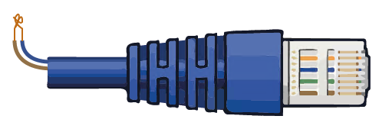
Internal Network Card
In this cards the motherboard has a slot for the network card when it can be inserted. It requires a network cables (RJ45) to provide network access.

Slide 17
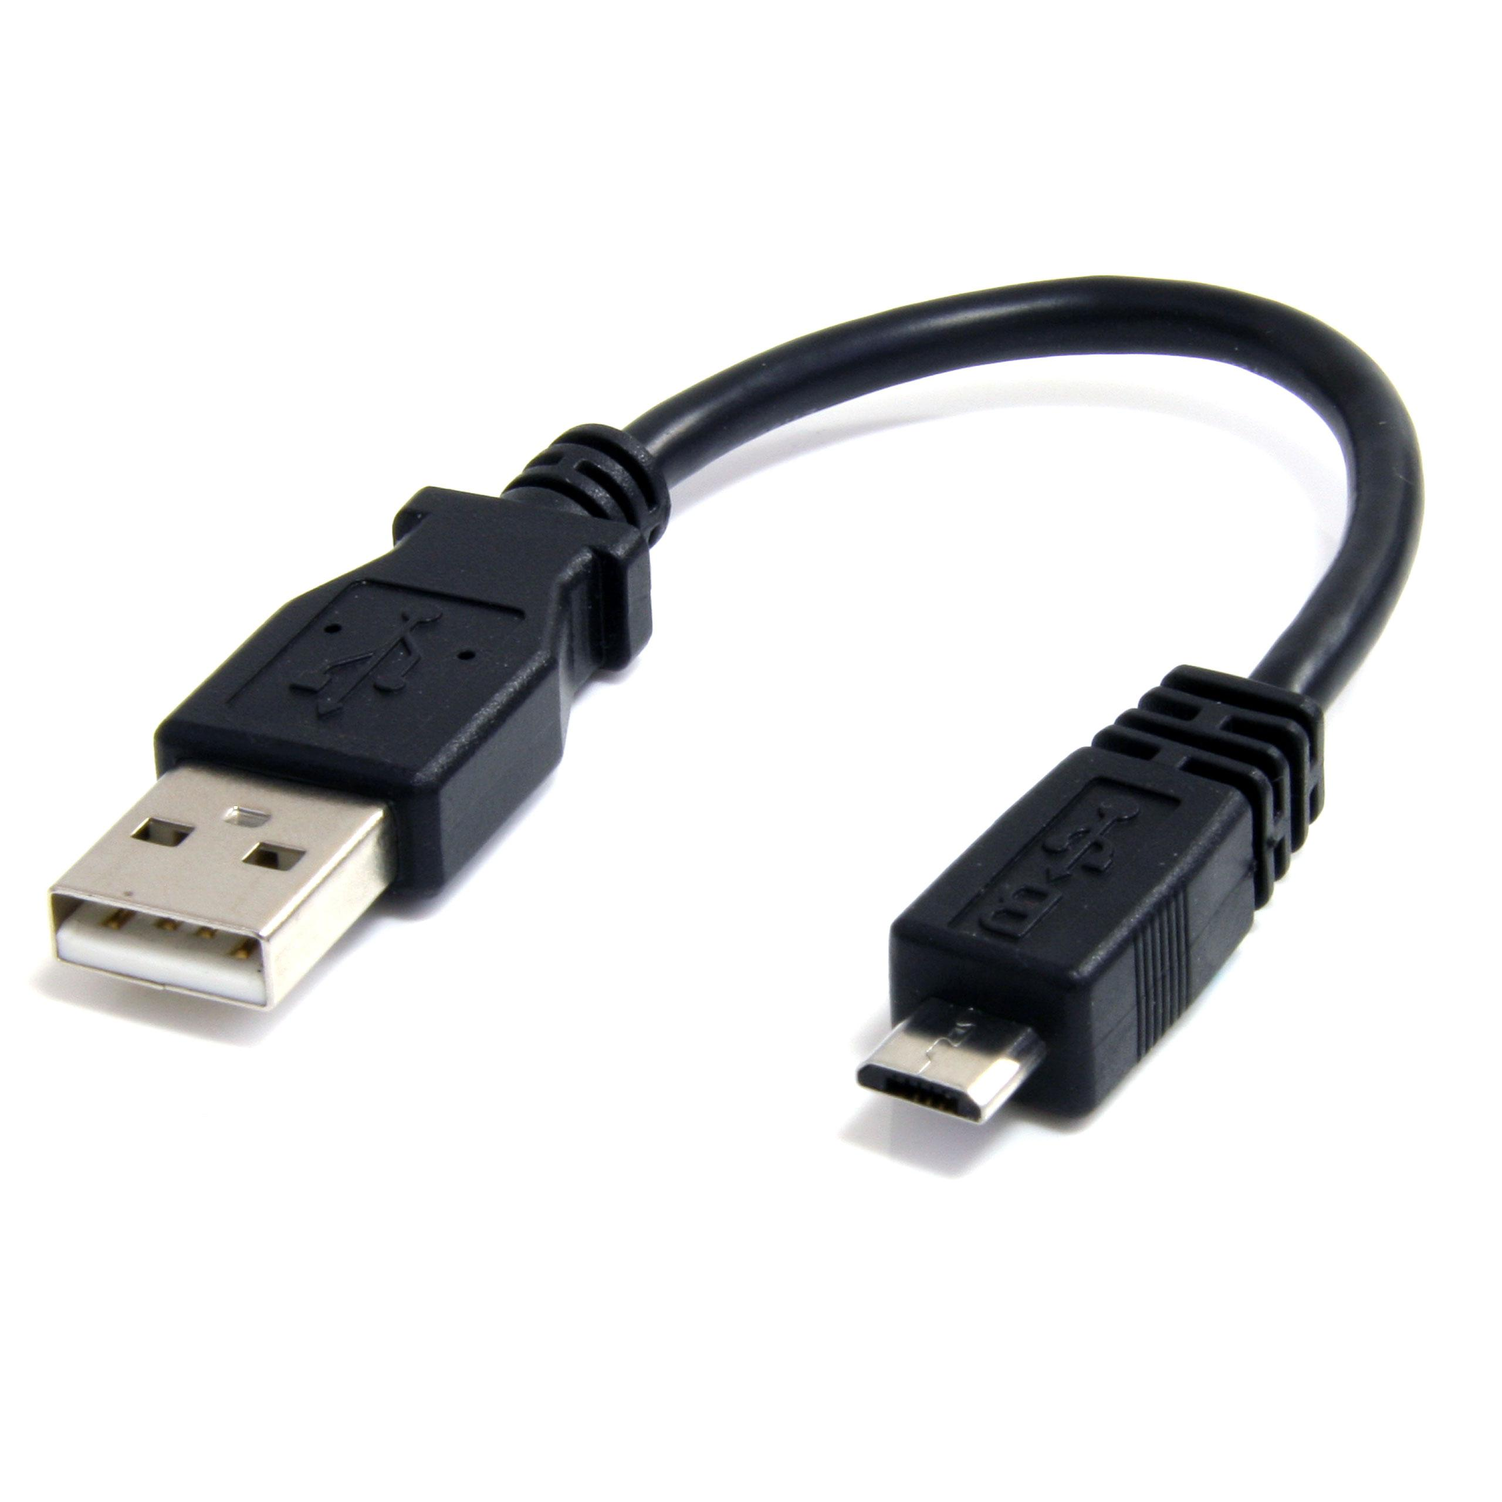
External Network Card
In desktop & laptop that don’t have on internal network card.
External network interface card are used.
It is two types:
Wireless
USB Cables

Slide 18
Advantage of NIC
Allow to connect two network.
To provide wired and wireless.
It have own MAC Address.

Slide 19
Disadvantage of NIC
Not secure data.
Not portable wireless.
Not properly configure

Slide 20
Network Device
Networking hardware, also known as network equipment or computer networking devices, are electronic devices which are required for communication and interaction between devices on a computer network

Slide 21
Types of Networking Devices
HUB
SWITCH
REPEATER
BRIDGE
ROUTER
GATEWAY

Slide 22
HUB
To connect multiple computer in a network.
All the information send to the hub is automatically send to each port to every device.
A hub is less expensive, less intelligence & less complicated.
Hub generally used to connect computers is a LAN.
Transmission mode of hub is half-duplex.

Slide 24
Advantage of Hub
The hub can broadcast the message.
It is less expensive that anyone can use it.
Easy Installation/Set-up

Slide 25
Disadvantage of Hub
No secure
No use for personal/private data sharing
Don’t support full Duplex transmission mode

Slide 26
Switch
Connect multiple computer together in the network.
Use for private message as well as no wasting data.
It can easily identified that which device is connected with network port by using MAC Address.
Note: Switch is intelligent devices compare as Hub.

Slide 27
Advantage of Switch
It is generally used to unicast the message.
Provide more security than hub.
It supports full Duplex data transmission mode.
Send the data packet based on mac address.

Slide 28
Disadvantage of Switch
More expensive
Difficult to set up
If switch is failed then entire network will be failed.

Slide 29
Router
It is control a network traffic.
A main work of router is to choose a free path through which the data packet will travel.
Connect to different network.
Router receive data package to the sender, analyze and forward those data packets than giving the receiver.

Slide 30
Advantage of router
Provide connection between two dis-similar types of network.
Transmission rate is very high.
Provides both wired or wireless.
Internally use some algorithm to find out free path.

Slide 31
Disadvantage of router
Most expensive.
Security issue.
Complex to maintain
Only work with routable protocol.

Slide 32
Repeater
Bootup the week signals.
Use in wired and wireless.
Regenerate the weak signals into fast signals.

Slide 33
Advantage of Repeater
Cheaper than other device.
Increase/maintain the signal performance.
Regenerate the weak signals.
The ability to extend the length of signal.

Slide 34
Disadvantage of Repeater
It use small distances.
Can’t reduce network traffic.
Can’t connect dis-similar types of network.

Slide 35
Bridge
Is a network device that is used to separate LAN into number of section.
It operates both physical and data link layer of OSI Model.

Slide 36
Advantage of Bridge
We extends the network
Broadcast the data to each node/host like Hub
Intelligent Device

Slide 37
Disadvantage of Bridge
It doesn’t stablish two different network
Once it broadcast the message then can’t stop message.
More Expensive
Transmission rate is slower

Slide 38
Gateway
Use connect two dis-similar type of network.
It allow us to send & receive data through the internet even it is LAN network.
It operates all 7 layers of OSI model,

Slide 39
Advantage of Gateway
Access the internet
Operates all 7 layer in OSI Model
Security
Provide Logical Address

Slide 40
Disadvantage of Gateway
Expensive
Data transmission rate is slow
Maintain is very complex
Without gateway we can’t cannot internet

Slide 41
Network Protocols
Is a “Set of rules”
In which are used in digital communication to connect network devices and share information b/w them.
Example: If we want connect two host or node then we use some protocol to connect.

Slide 42
Types of Protocols
TCP/IP - Transmission Control Protocol/Internet Protocol
HTTP/S - Hypertext Transfer Protocol/Secure
SMTP - Simple Mail Transfer Protocol
POP - Post Office Protocol
IMAP - Internet Message Access Protocol
UDP - User Datagram Protocol
PPP - point-to-point protocol
FTP - File Transfer Protocol

Slide 43
TCP/IP
Basic Protocols
TCP is used to transfer the data over the internet, It divided data into small packet and send to the receiver/destination through the network.
IP is used for logical addressing.

Slide 44
TCP and UDP difference b/w
TCP | UDP
Connection orient protocol | Connection less protocol
Slower than UDP | Faster than TCP
Reliable | Not Reliable
Retransmission of lost packets is possible | Retransmission of lost packets is not possible
Use: HTTP/s, SMTP, FTP, etc. | Use: Videos, DNS

Slide 45
Network Port
It is a communication endpoint.
A port is a number used to uniquely identify a transaction over a network by specifying both the host, and the service.
Total No. of Ports -> 0-65,535
Main Ports -> 0-1024
Normal web connection and Reverse connection ports -> 1025 - 40,000
Service Ports used by corporates -> 40,000 -65,535

Slide 46
Important Port name and Number
FTP Data – 20
FTP – 21
SSH – 22
SMTP – 25
DOMAIN – 53
HTTP - 80
HTTPS – 443
SMTP – 110
Windows RPC - 135
Windows NetBIOS over TCP/IP –- 137-139
Microsoft SQL Server - 1434

Slide 47
Server
Mainly server is a main host they provides services over the network.
It is a main computer of any network that fulfills the request of other computers.

Slide 48
Advantage
Backup
Security
Storage
Provide services

Slide 49
Types of Server
File Server
Application Server
Mail Server
Web Server
Database Server
And many more

Slide 50
Data Transmission Mode and Media
There are most important thing and both are different.
Transmission Mode: It is a process to define the way of transmission and there is two ways to transfer the data.
Simplex
Duplex
HDX (Half Duplex)
FDX (Full Duplex)

Slide 51
Data Transmission Media
There are two types
Guided media (wired)
Unguided media (wireless)

Slide 52
Network Topology
Architecture of network, arrangement of networking devices (Physical and Logical).
There are two types of topology
Logical
Physical

Slide 53
Logical and Physical Network
Logical Network | Physical Network
Show how data behaves b/w network devices. | Represents your network’s physical devices and cables.
Line represent data flow, not physical cables. | Lines represent cable connections rather than data flow.

Slide 54
Types of Topologies
BUS
RING
STAR
DUALRING
MESH
TREE
HYBRIED

Slide 55
Bus Topology
All the nodes are connected to a single cable.
That signal cable known as “backbone”.
Short cable length and simple wiring layout.
Easy to extent.
It transmits data only in one direction.

Slide 56
Ring Topology
Short cable length Connectors are use RJ45.
Data single pass around the ring in own direction.
It quite rare.
Each host has equal access to resources.

Slide 57
Star Topology
In this topology one centralized node for data transmit.
No long cable length.
All host share data through the hub or switch.
Ease of service.

Slide 58
Mesh Topology
Each connection can carry its own data load.
Provides security and privacy.
Create point to point connection to every device on network.
Supported by serval hardware & software venders.

Slide 59
Hybrid Topology
This topology mixture star, bus, and ring topology.
Reliable
Costly
Its combines characteristic of bus, ring and star topology.

Slide 60
How to Choose Topology
Performance
Reliable
Size
Component
Communication
Expandability

Slide 61
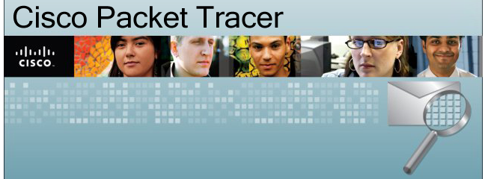

Slide 62
Intranet
It is a private computer network that was uses internet protocols technologies to securely share any part of an organization information or operational system within that organization.

Slide 63
Extranet
It is a private network that use Internet protocols, network connectivity. An extranet can be viewed as part of a company’s intranet that is extended to users outside the company, usually via the internet.

Slide 64
Internet
It is a global system of inter-connected computer networks that uses the standard IP/TCP to server billions of users world wide.

Slide 65
VPN
A virtual private network, is an encrypted connection over the internet from a device to a network.
The encrypted connection helps ensure that sensitive data is safely transmitted.
VPN Technology is widely used in corporate environment.

Slide 66
VPN Advantage
Remote Control
Share files
Online Anonymity
Unblock website & by pass filters
Change Ip address
Better performance
Reduce Costs
Security

Slide 67
IP Address
Ip address known as a logical address
It is a string of numbers they assigned to an internet connected devices.
There are two version of IP address.
Ip version 4 (Ipv4)
Ip version 6 (Ipv6)
There are four types of IP address
Public
Private
Static
Dynamic

Slide 68
How IP address Work
Ip is designed to work over a dynamic network.
Ip is a connectionless protocol that is datagram oriented, so each packet must contain the source IP address and destination Ip address and other data in the header to be successfully delivered.

Slide 69
Who provide IP Address
ISP – Internet service provider
DHCP – Dynamic Host Configuration Protocol

Slide 70
IP version 4 (Ipv4)
It is decimal number address.
It is 32 binary number or 32 bits address.
It have 4 octets and each octets 8 bit.
It start 0 and end 255 (0-255).
Example: 10.0.0.1, 172.20.24,102, 192.168.0.101

Slide 71
Ip address classes (Ipv4 classes)
It divided into five sub-classes.
Class A
Class B
Class C
Class D
Class E

Slide 72
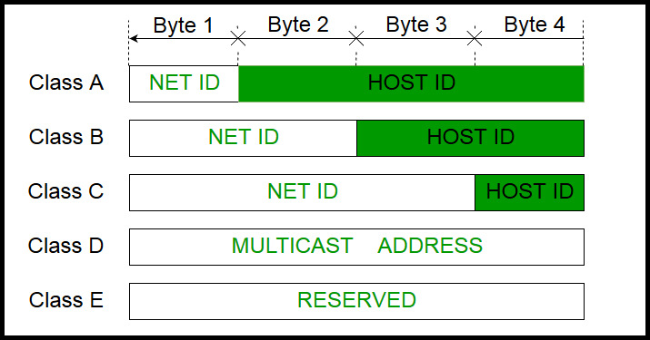
Ipv4 address is divided into two part
Network ID
Host ID

Slide 73
Classes Range
Class | Range | CIDR | Host | Subnet Masks
A | 0-126 | 8 | 2²⁴ | 255.0.0.0
B | 128-191 | 16 | 2¹⁶ | 255.255.0.0
C | 192-223 | 24 | 2⁸ | 255.255.255.0
D | 224-239 | --------------------------------------------------------------------
E | 240-255 | --------------------------------------------------------------------
Note: Class A address 127.0.0.0 to 127.255.255.255 can’t used and it is reserved for loopback testing

Slide 74
What is CIDR
It stand for Classless inter-domain routing .
It is used to create unique identifiers for networks and individual devices.

Slide 75
Special Address
127.0.0.0 -> Loopback address
224.0.0.0 -> Multicast
255.255.255.255 -> Broadcast

Slide 76
Private Address
10.0.0.1 – 10.255.255.255
172.16.0.0 – 172.32.255.255
192.168.0.0 – 192.168.255.255

Slide 77
IP version 6 (Ipv6)
It is hexadecimal format address.
It is 128 bits address.
It divided into eight octets and each octets 16 bits block.
Large address space (approx. 34*10³⁸⁾
End to end connectivity
Auto configuration
Fast Routing and forwarding
No Broadcast
Ip security

Slide 78


Slide 79
MAC Address
It stand for media access control.
It is physical address.
It is used to identify a host world wide.

Slide 80
Who provide MAC Address
IEEE + Manufacturers
IEEE stand for Institute of Electrical and Electronics Engineers

Slide 82
OSI Model
It stand for Open System Inter-connection.
This is framework used to describe the function of networking.
ISO created the OSI reference model as a framework.
In 1980 OSI model published by ISO.
It have 7th different layers.

Slide 83
7 layers of OSI Model
Application Layer
Presentation Layer
Session Layer
Transport Layer
Network Layer
Data Link Layer
Physical Layer

Slide 84
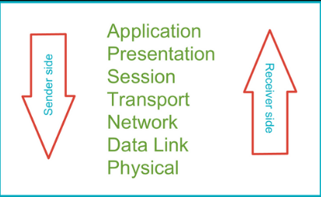

Slide 85
Application Layer
Provides a User Interface
End user Layer
HTTP/S, FTP,IRC,DNS

Slide 86
Presentation Layer
Present Data
Syntax Layer
Handle encryption and decryption

Slide 87
Session Layer
Maintains distention b/w data of separate application.
API, Socket, Win Sock, Cookies
Controls the connection b/w computer/host.
Managing a session between end-user application processes.

Slide 88
Transport Layer
Heart of OSI Model.
Provide End to end connection
Provide reliable or unreliable delivery and flow control
TCP/UDP

Slide 89
Network Layer
Provide Logical Addressing/IP Address.
Send and received packets.
Provide path determination using logical addressing.

Slide 90
Data Link Layer
Provides media assess and physical addressing.
Networking devices.
To deal with transmission errors, regulate the flow of data, and provide a well-defined interface to the network layer

Slide 91
Physical Layer
Converts digital data so that it can be sent over the physical.
Moves data b/w host.
Physical Structure.

Slide 92
TCP/IP Model
There are 4 protocol layer
Application
Transport
Network
Network Interface

Slide 93
Application
Application
Transport
Transport
Network
Network
Network Interface
Network Interface
Internet

Slide 94
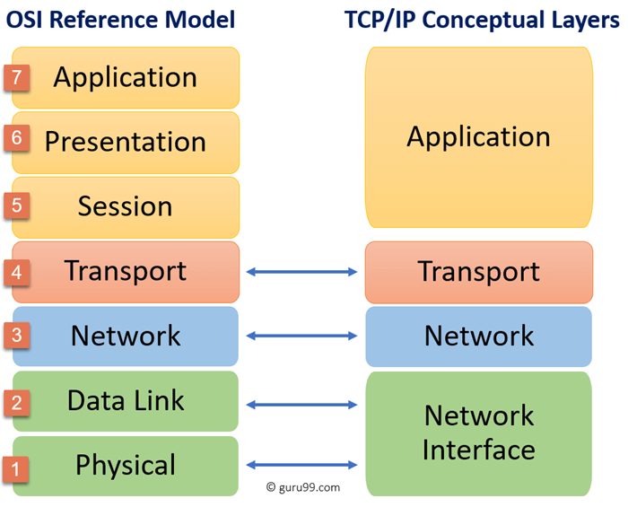

Slide 95


Slide 96

This Photo by Unknown Author is licensed under CC BY

