Slide 1
Internet Part
Surface web, Deep web and dark web

Slide 2
Who am I
Certified Ethical Hacker
Cyber Security Mentor
Ex Intern in keycybr and We are Plymouths
I have own community (CB-Blackhat).
I wrote a one book “Cyber Crime and Online Safety” under Nitin Pandey Sir.

Slide 3
Internet
Internet is nothing but an interconnection of different network around the globe.
The whole internet can be divided into three different categories
Surface Web
Deep Web
Dark Web

Slide 4
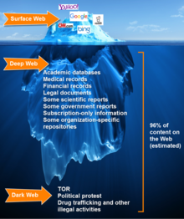

Slide 5
Surface web
Owned by search engines
The surface web is the place where anyone can explore with an internet connection.
The reality is 4% approx. of the whole internet is exposed in the surface web.

Slide 6
Deep web
Only for authorized users
Deep web is the place where we need some kind of authorization to access.
Gmail is a part of deep web, because we need to give our username and password to access our inbox.

Slide 7
dark web/net
World of anonymous users
Dark web is the place where privacy becomes important to the users.
The dark web is invented by us naval research laboratory for data exchange between spies, the technology behind dark web is known as tor(the onion router).
Spy and secure communication that why us army create dark net/web is known as tor.

Slide 8
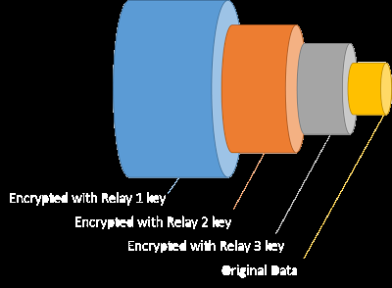
why use onion router name ??

Slide 9
Tor project
US naval research laboratory released the source code to the public. After this the project is developed under "the tor project“
Tor uses onion protocol for communication between users and the server.

Slide 10
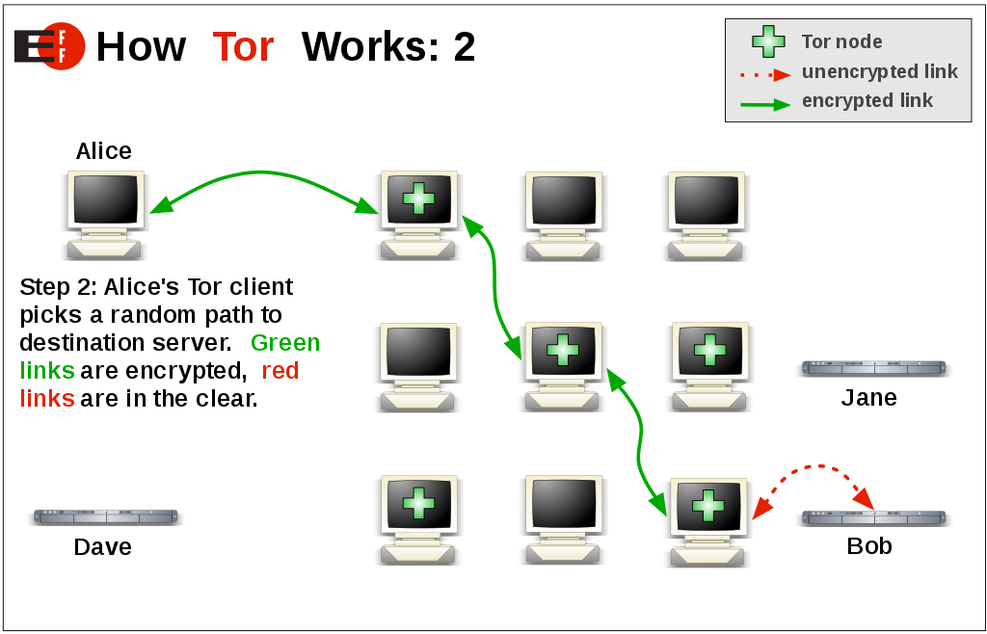
How it works
This Photo by Unknown Author is licensed under CC BY-SA

Slide 11
Duck Duck Go
Is the default search engine in tor browser.
Using tor browser prevents DDG from tracking users, even if they wanted to (they claim not to).
Duckduckgo.com or https://3g2upl4pq6kufc4m.onion/

Slide 12
Things to known about mobile tor
The design of mobile devices makes full privacy impossible.
Mobile tor is best for censorship prevention.
Can also provide better privacy for some threat models
we are making is better all the time and better option for mobile devices are coming out soon.

Slide 13
orbot : tor for android
Anonymity online --> protect your privacy. Defend yourself against network surveillance and traffic analysis.
Tor prevents people from learning your location or browsing habits.
Tor is for web browsers, install messaging clients. and more.
Tor is free and open source for windows, Mac, Linux/Unix, and Android

Slide 14
What are onion services?
The regular internet allow adversaries to see what you are sharing and with whom, whether you're using Dropbox etc., downloading it from email or through your browser so tor devised a sneaky way to hide both the file data and the related metadata
Dark web link are special link having .onion as the extension.
.onion website can't e opened using normal web browsers. We need to use a special browser "tor" for accessing these website.
Tor directs internet traffic through a free, worldwide, volunteer overlay network consisting of more than seven thousand relays to conceal a user's location and usage from anyone conducting network surveillance or traffic analysis.

Slide 15
What are onion services?
.onion communication are end to end encrypted without HTTPS.

Slide 16
Practical
Hidden WiKi http://qbte2zxvhjk6bftp.onion/
Torch http://xmh57jrknzkhv6y3ls3ubitzfqnkrwxhopf5aygthi7d6rplyvk3noyd.onion/cgi-bin/omega/omega
Chatting with Strangers: http://tetatl6umgbmtv27.onion/
Red Room http://redroomfing27toi.onion/
Flare Search http://dlggj2krbqzm5dru.onion
NOT EVIL http://hss3uro2hsxfogfq.onion

Slide 17
Using OS for surface dark net
Tails: https://tails.boum.org/
Whonix: https://www.whonix.org/
Qubes+Whonix: https://www.qubes-os.org/

Slide 18
How to use

Slide 19

This Photo by Unknown Author is licensed under CC BY-NC

Slide 20


