Slide 1
Machine learning group
Crosby Burdon
Mason Lee
Braxton Long
William Lowery
Brendan Standridge

Slide 2
Concept
Having changed projects but trying to keep a similar idea, we will instead simulate a foodweb of organisms and see how long the ecosystem continues to survive as well as taking note of any interesting events that happen with the different “wildlife”.
Unlike most simulations that only run to find a result, this will be an ongoing simulation with analyzing the “life” inside and what characteristics (if any) lead to a stable population being the main goal.

Slide 3
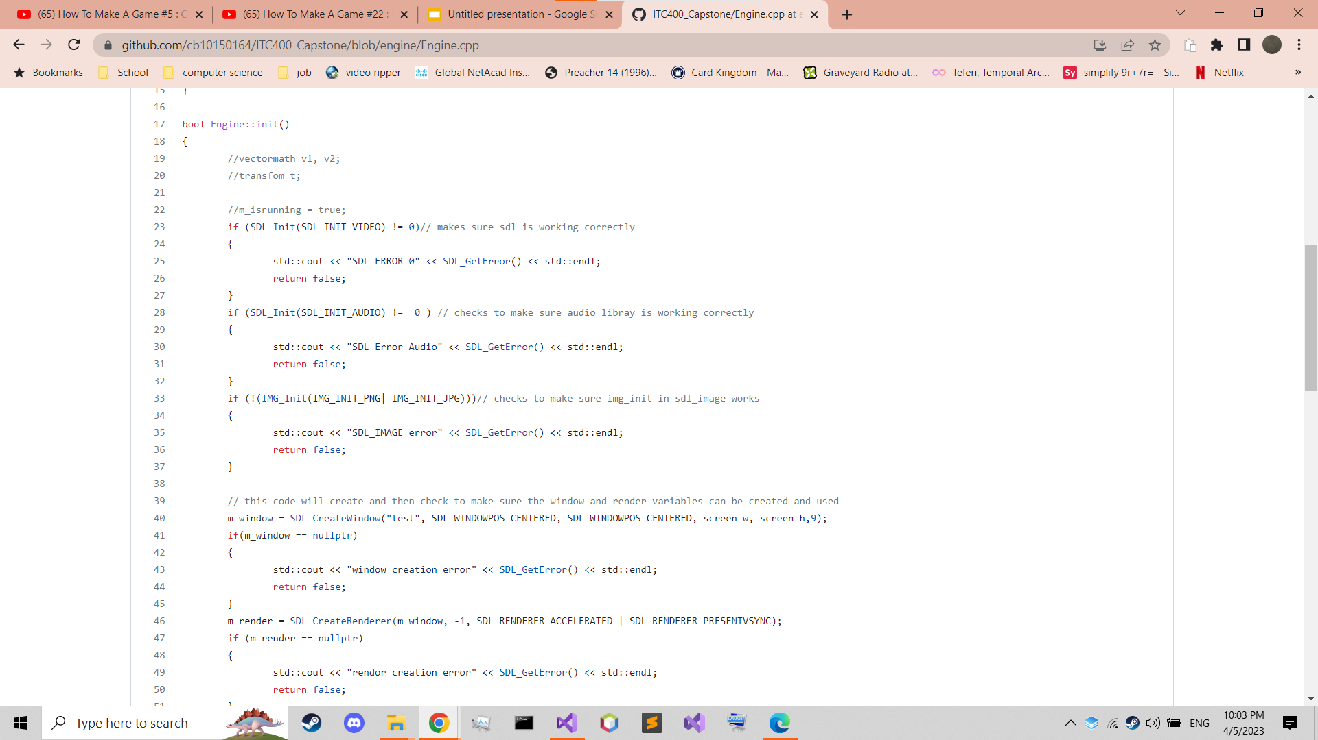
Technology
At the current moment the project is composed of a home built engine built from C++ with the SDL library for graphics.
Python using the pygames library may replace this for sake of simplicity and project time
current engine code

Slide 4
“life”
To simulate the animals, they are given a list of simple behaviors that will over time turn into a more complicated web.
Plant life will be a basic environmental characteristic (int) that resets after an interval to simulate a seed cycle.
A set of these behaviors will be randomly decided at first, with later generations receiving genes from parents.
Depending on time, animals with different mobility characteristics (e.g. flight for birds or swimming or burrowing) could be introduced.
Current animal list:
Bear
Rabbit
Boar
alligator
Notes:
Need more prey animals, maybe some local to the Gulf Coast area like Nutrea or Birds of Prey like Eagles.

Slide 5
Behaviors
The “animals” will be given these planned traits across two classes denoted herbivore and carnivore. If time allows omnivore will also be added
Health - this stat will give an idea of the the size and general durability of a creature (ex. Rabbit.health = 10, Bear.health = 100)
Strength - this stat will be used for confrontation and hunting and is an idea of how strong the animal is
Aggression - this stat will be used to simulate fight or flight response
Territorial - this trait will be one of a few that's decided species wide and causes animals to attack even when not hungry
Hunger – determines how desperate the animals are for food, which could override normal behavior if high enough.
Breeding – chance that another animal will be created which is higher when hunger and health are below/above certain levels, respectively. Can be time-based as well. Genes are inherited as a rounded average of characteristics from parents and have a chance for mutation based on RNG.
Herding - this stat is also another species wide trait that will determine if the animals will group together for self defense although herding and territorial seem like opposites they are not (ex. Boar are an example of territorial yet herding animal, these traits mixed will result in a heard that is territorial not allowing other animals to feed where they live).

Slide 6
Additional Considerations
If time allows, inclusion of certain environmental factors that occur based on random chance (like flooding, tornados, hurricanes) that render certain cells of the environment unusable or low on food for a fixed time period while they “recover”.
Animals with special movement characteristics won’t be affected by certain events (animals with swimming or flight are immune to floods, burrowers are immune to hurricanes etc.), allowing for a more dynamic simulation.
Accuracy of the simulation with mostly fall to pathfinding behavior of the animals, which may require significant adjustment.

Slide 7
Current progress
While the engine is not fully operational at the moment, the rest of the planning has been finished, so it will only be some time till all components are working.
Animal types are in the design phase, with tentative plans for unique predators/prey (like birds of prey or rodents) if time allows.

Slide 8
Late Arrival
This portion of the presentation is not relevant to the projects creation or where it is heading, but is meant to show that a late arrival to the project is studying what’s been done and understands it.

