Slide 1
@Progressive (Web-Apps){
style.css
index.html
presentation: seminar;
/* Charlotte Brown */
}
MA Web Design and Content Planning

Slide 2
Table Of ‘Contents’ {
01
02
03
style.css
index.html
Understanding
What are PWA’s?
Presentation
Good thing I made one.
Key Features
Now I made one, let’s talk about it.
}
MA Web Design and Content Planning

Slide 3
01 {
[Understanding]
style.css
index.html
Let’s get into it.
}
MA Web Design and Content Planning

Slide 4
Progressive Web Apps < 1/2 > {
style.css
index.html
Made with Web Technologies (HTML, CSS, JS), it provides users with a service as an application but runs like an app you’d get off the app store.
It can be used offline, installed onto different devices and be integrated into current apps on the same system.
/* MDN Web Docs – PWAs (2024) */
}
MA Web Design and Content Planning

Slide 5
<QUOTE>
style.css
index.html
“[PWAs]… are built and enhanced with modern APIs to deliver enhanced capabilities, reliability, and installability while reaching anyone, anywhere, on any device with a single codebase.”
/* Pete LePage – Wed.dev (2024)*/
</QUOTE>
MA Web Design and Content Planning

Slide 6
style.css
index.html
Continued… < 2/2 > {
Progressive Web Apps can be installed by anyone, anywhere. They don’t need to be hosted through a specific company app store, you can launch your own through your website.
We can even discover PWA’s in the search engine, if the app has a manifest. The browser is able to view them too!
}
MA Web Design and Content Planning

Slide 7
Steps to make‘a Web App’ {
style.css
index.html
Step 01
Create your app, using index.html, style.css and script.js
Step 02
Create your manifest within a JSON file.
Step 03
Set up your Web Services in another JS file.
Step 04
Host your website over a secure network (localhost or HTTPS).
}
MA Web Design and Content Planning

Slide 8
02 {
[Presentation]
style.css
index.html
Let’s get into it.
}
MA Web Design and Content Planning

Slide 9

Let’s ‘Look’{ Together!

Slide 10
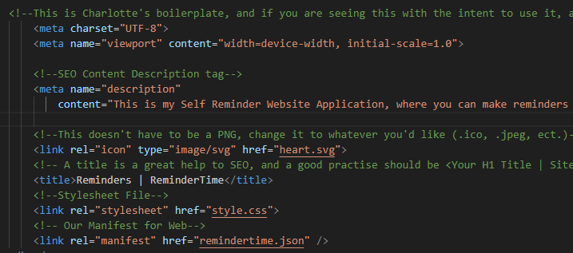
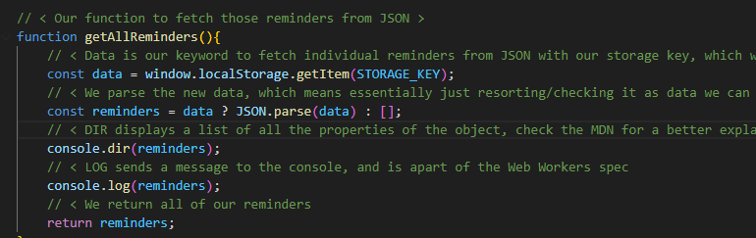
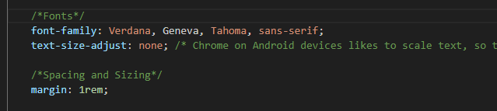
Standard HTML, CSS & JS
style.css
index.html
MA Web Design and Content Planning

Slide 11
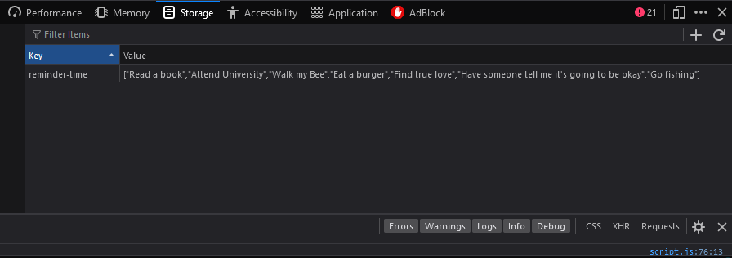
JSON Local Storage
style.css
index.html
MA Web Design and Content Planning

Slide 12
03 {
[Key Features]
style.css
index.html
Let’s get into it.
}
MA Web Design and Content Planning

Slide 13
Our Manifest; {
sw.js
manifest.json
What is a Manifest?
A file that outlines the metadata and behaviours of our app.
Why do we need it?
It helps outline data the clients’ machine will need to help set up the app’s installation properly.
What does it contain?
Let’s find out!
}
MA Web Design and Content Planning
/* MDN Web Docs – Manifest & Learn.Microsoft - PWA*/

Slide 14

style.css
index.html
Our Manifest{
"name": "Reminder Time",
"short_name": "RT",
"description": "An app that helps you with creating reminders.",
"start_url": "/",
"theme_color": "#ecb0b0",
"background_color": "#fff",
"display": "standalone",
"icons": [
{
"src": "heart.svg",
"sizes": "512x512"
}
]
}
MA Web Design and Content Planning
/* Chrome Developers – Manifest Overview & MDN Web Docs – PWA Overview*/
Notes:
Share targets – using an api to act as a share target with other apps on the system
Display – standalone means it opens in a minimal ui application, the default is browser

Slide 15
Our Service Workers; {
manifest.json
sw.js
What are Service Workers?
A file that helps the app provide the minimal support for offline useage.
What does it do?
They help the app run off cached assets (an ‘offline first’ approach) before resorting to the network to gain new information.
‘A service worker functions like a proxy server, allowing you to modify requests and responses replacing them with items from its own cache.’
}
MA Web Design and Content Planning
/* https://developer.mozilla.org/en-US/docs/Web/API/service-worker-api */

Slide 16
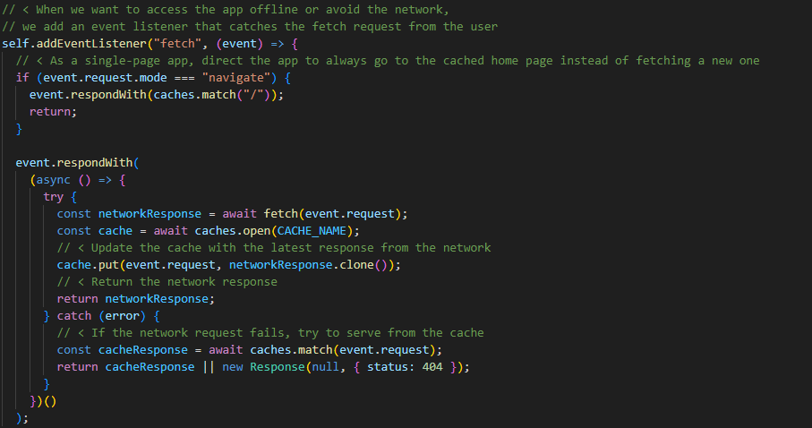
Our Service Workers; {
manifest.json
sw.js
}
MA Web Design and Content Planning
/* https://developer.mozilla.org/en-US/docs/Web/API/service-worker-api */

Slide 17
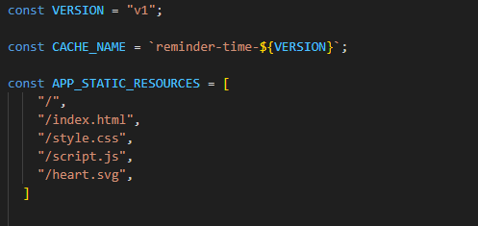
Our Service Workers; {
manifest.json
sw.js
}
MA Web Design and Content Planning
/* MDN Web Docs – Service Workers*/

Slide 18
What Else Goes In ‘SW.JS’ ?{
index.html
style.css
Cache Upload
Cache Deletion
We cache our static resources to the local machine
To avoid conflict, we delete our old cache
Fetch Requests
404 Handling
If the user is offline, we need to focus on fetching cached files first
In case we can’t access our cache or new data from the net, we 404 it!
}
MA Web Design and Content Planning
/* Learn.Microsoft – Debugging SW’s*/

Slide 19
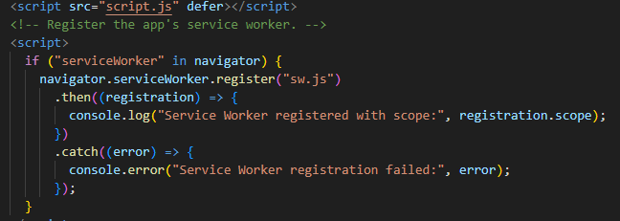
‘SW.JS’ & ‘index.html’ {
index.html
style.css
}
MA Web Design and Content Planning
/* Learn.Microsoft – Debugging SW’s*/

Slide 20
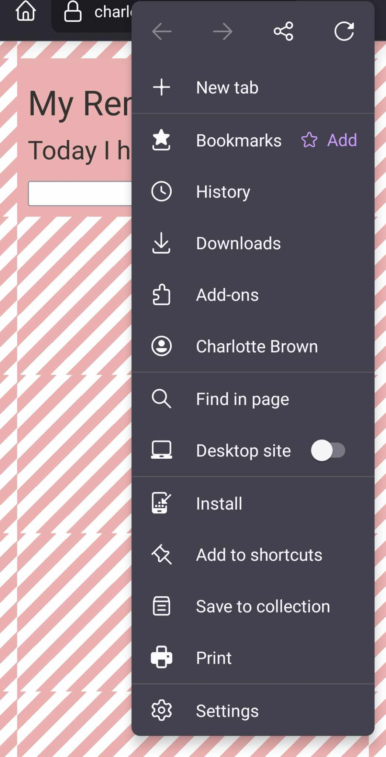
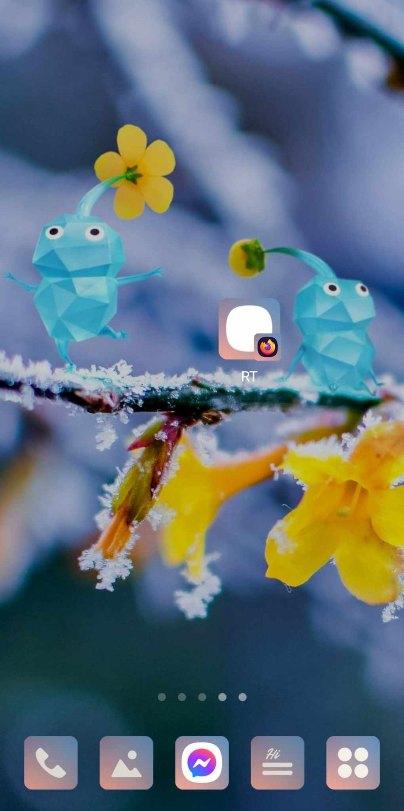
Mobile Ver.
index.html
style.css
MA Web Design and Content Planning
/* Charlie’s Cool Phone*/

Slide 21
A Quick Overview {
index.html
style.css
Languages
JS & JSON
70%
HTML, CSS
30%
The main magic happens in our sw.js file
We can turn any website into a PWA if we work hard enough.
Big Steps
Create a Manifest
Create your Service Worker
Watch the magic happen
}
https://charlotteblogs.uk/pages/side-projects/pwa/index.html

Slide 22
Give it a Go {
index.html
style.css
Find full commented code on my GitHub, or follow the helpful tutorials on MDN Web Docs
}
https://github.com/cb1140/progressive-web-app-tutorial

Slide 23
Thank You!
index.html
style.css
Thank you to MDN Web Docs, Chrome Developer Tools, Firefox Developer Handbook, Microsoft Learning Hub for my information!
MA Web Design and Content Planning

Slide 24

Thank You!; {
index.html
style.css
‘Do you have any questions?’
Thank you to MDN Web Docs, Chrome Developer Tools, Firefox Developer Handbook, Microsoft Learning Hub for my information!
Credit to Freepix for the icons used in this presentation.
You can find the example page on Charlotteblogs.uk or Github/cb1140
}
MA Web Design and Content Planning

