Slide 1
Module1
Python Programming Basics

Slide 2
Syllabus: Module 1
Python Basics: Entering Expressions into the Interactive Shell, The Integer, Floating-Point, and String Data Types, String Concatenation and Replication, Storing Values in Variables, Your First Program, Dissecting Your Program
Flow control: Boolean Values, Comparison Operators, Boolean Operators, Mixing Boolean and Comparison Operators, Elements of Flow Control, Program Execution, Flow Control Statements, Importing Modules, Ending a Program Early with sys.exit(),
Functions: def Statements with Parameters, Return Values and return Statements, The None Value, Keyword Arguments and print(), Local and Global Scope, The global Statement, Exception Handling, A Short Program: Guess the Number
Text Book-”Automate the Boring Stuff with Python” by Al Sweigart :Chapters 1 and 2.

Slide 3
Python Basics: Expressions
>>> 7+2 # Addition
9 #Output
>>> 7-2 # Subtraction
5
>>> 7*2 #Multiplication
14
>>> 7/2 #Division
3.5
>>> 7**2 #Exponentiation
49
Notes:
Exponent operator or power operator

Slide 4
Python Basics: Expressions
>>> 7/2 #Division (real (floating) division)
3.5
>>> 7//2 #Integer Division. (the integer part of the real division)
3
>>> 7%2
1
What are the Quotient, remainder in Python?
When two numbers divide with each other, the result is quotient.
Divide two numbers using '//' operator to get the quotient.
The remainder is calculated using the '%' operator in Python.
Notes:
What is the Quotient in Python? When two numbers divide with each other, the result is known as the quotient. We can divide two numbers using the '//' operator one can derive the quotient. The remainder is calculated using the '%' operator in Python.
using the // operator. This operator will divide the first argument by the second and round the result down to the nearest (???) whole number, making it equivalent to the math. floor() function
>>> 25/3
8.333333333333334
>>> 26/3
8.666666666666666
>>> 25//3
8
>>> 26//3
8

Slide 5
Python Basics: Expressions
Expression: is the most basic kind of programming instruction in Python.
Expressions consist of values (Ex:2) and operators (Ex: +), and they can always evaluate (= reduce) down to a single value.
Expressions can be used anywhere in Python code where a value could be used.
A single value with no operators is also considered an expression, though it evaluates only to itself.
Ex:
>>> 2
2

Slide 6
Python Basics: Expressions
Precedence of operators: The order of operations of Python math operators
It is similar to that of mathematics. From left to right
1. **
2. *, /, //, and %
3. + and -
Use parentheses to override the usual precedence if needed.
Whitespace in between the operators and values doesn’t matter for Python (except for the indentation at the beginning of the line)

Slide 7
Python Basics: Expressions
From left to right
1. ** 2. *, /, //, and % 3. + and -
Use parentheses to override the usual precedence if needed.
>>> 2+3*6
20
>>> (2+3)*6
30
>>> (5 - 1) * ((7 + 1) / (3 - 1))
16.0
Python will keep evaluating parts of the expression until it becomes a single value

Slide 8
Python Basics: Expressions
From left to right
1. ** 2. *, /, //, and % 3. + and -
>>> (5 - 1) * ((7 + 1) / (3 - 1))
4 * ((7 + 1) / (3 - 1))
4 * (8 / (3 - 1))
4 * (8 / 2)
4 * 4.0
16.0
Python will keep evaluating parts of the expression until it becomes a single value

Slide 9
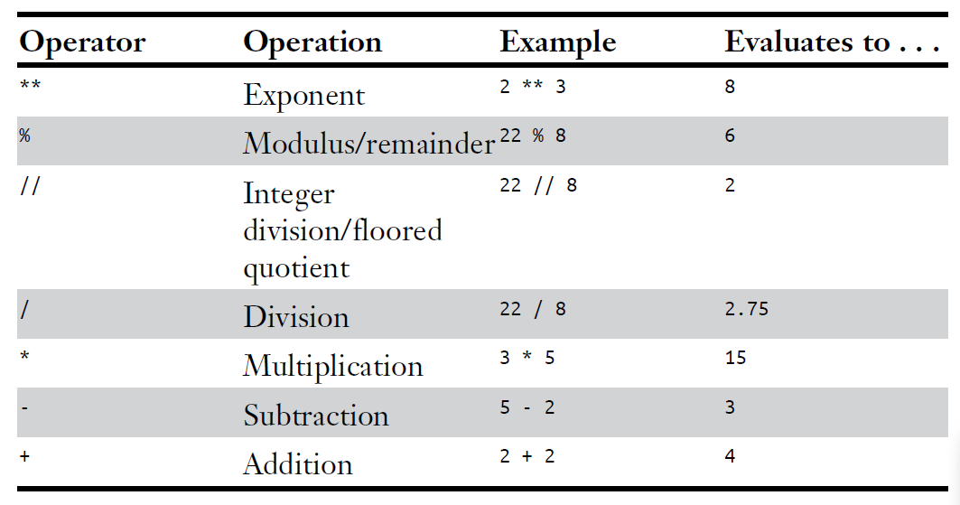
Python Basics: Expressions

Slide 10
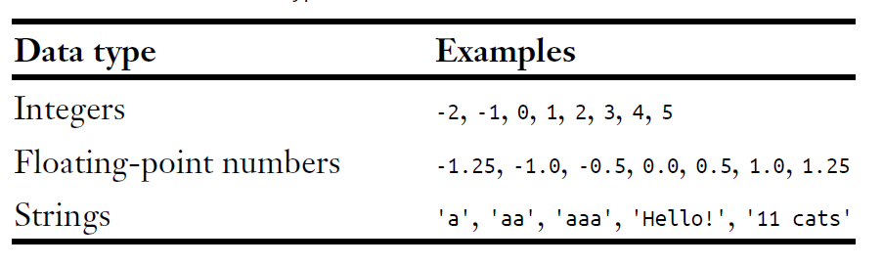
The Integer, Floating-Point, and String Data Types
A data type is a category for values, and
Every value belongs to exactly one data type
Most common data types:

Slide 11
The Integer, Floating-Point, and String Data Types
Integers :
An integer is a whole number that can be positive or negative.
Ex:
There is no limit to how long an integer value can be. It can grow to have as many digits as computer’s memory space allows.
Ex: 99999999999999999999999999999999999999999999
Normally integers are written in base 10. However, Python allows to write integers in Hexadecimal (base 16), Octal (base 8), and Binary (base 2) formats.
10 -10 123456789

Slide 12
The Integer, Floating-Point, and String Data Types
Floating-Point Number(Float):
Float is a positive or negative number with a fractional part(decimal point).
Ex: 10.1 -10.5 1.123456
>>> type(42.0)
<class 'float'>
>>> type(42)
<class 'int'>
Notes:
42 Int 42.0 float

Slide 13
The Integer, Floating-Point, and String Data Types
Strings:
Text values used in Python program are called
strings or strs
Always surround string in single quote or double quote or triple quote.
Ex: 'Hello World‘, “Hello World”, ‘”Hello World”‘
>>> 'Hello World'
'Hello World'
>>> "Hello World"
'Hello World'
>>> "'Hello World'"
"'Hello World'"

Slide 14
The Integer, Floating-Point, and String Data Types
Strings:
String with no characters in it - blank string or an empty string
If the error message is :
SyntaxError: EOL while scanning string literal.
Meaning: forgot the final single quote character at the end of
the string.
Ex: 'Hello World!
SyntaxError: EOL while scanning string literal

Slide 15
String Concatenation and Replication
The meaning of an operator may change based on the data types of the values next to it.
Ex: + is the addition operator when it operates on two integers or floats.
>>> 7+2 # addition
9 #Output
However, when + is used on two string values, it joins the strings as the string concatenation operator.
>>> 'Alice' + 'Bob‘ # Concatenation
'AliceBob‘
The expression evaluates down to a single, new string value that
combines the text of the two strings.

Slide 16
String Concatenation and Replication
>>> 'Alice' + 'Bob'
'AliceBob‘
The expression evaluates down to a single, new string value that
combines the text of the two strings.
If + operator is used on a string and an integer value:
Python will not know how to handle this, and it will display an error message.
>>> 'Alice'+42
Traceback (most recent call last):
File "<pyshell#0>", line 1, in <module>
'Alice'+42
TypeError: can only concatenate str (not "int") to str
Notes:
Concatenation = joining
The error message can only concatenate str (not "int") to str means that
Python thought you were trying to concatenate an integer to the string
'Alice'. Your code will have to explicitly convert the integer to a string
because Python cannot do this automatically.

Slide 17
String Concatenation and Replication
The * operator multiplies two integer or floating-point values.
When the * operator is used on one string value and one integer value:
It becomes the string replication operator.
Enter a string multiplied by a number into the interactive shell:
>>> 'Alice‘ * 3
'AliceAliceAlice'

Slide 18
String Concatenation and Replication
The * operator can be used with
only two numeric values : for multiplication
one string and one integer : for string replication.
Otherwise:???????
Python will just display an error message:
>>> 'Alice' * 'Bob'
Traceback (most recent call last):
File "<pyshell#2>", line 1, in <module>
'Alice' * 'Bob'
TypeError: can't multiply sequence by non-int of type 'str'

Slide 19
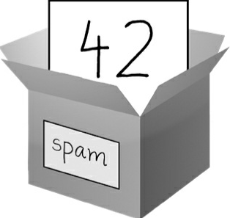
Storing Values in Variables
A variable is like a box in the computer’s memory which can be used to store a single value.
The result of an evaluated expression can be saved inside a variable.
Values are stored in variables with an assignment statement.

Slide 20
Storing Values in Variables: Assignment statement
An assignment statement consists of :
a variable name,
an equal sign (called assignment operator)
the value to be stored.
Ex: spam = 42
A variable named spam will have the
integer value 42 stored in it.
A variable = a labeled box with a value
placed in

Slide 21
Storing Values in Variables: Assignment statement
➊ >>> spam = 40
>>> spam
40
>>> eggs = 2
➋ >>> spam + eggs
42
>>> spam + eggs + spam
82
➌ >>> spam = spam + 2
>>> spam
42

Slide 22
Storing Values in Variables: Assignment statement
A variable is initialized (or created) the first time a value is stored in it.
➊ >>> spam = 40; eggs=2
After that, it can be used in expressions
with other variables and values
➋ >>> spam + eggs O/P: 40+2=42
Overwriting the variable: When a variable is assigned a new value, the old value is forgotten.
➌ >>> spam = spam + 2 O/P: 42
Notes:
which is why spam evaluated to 42 instead of 40 at the end of the example.

Slide 23
Storing Values in Variables: Assignment statement
>>> spam = 'Hello'
>>> spam
'Hello'
>>> spam = 'Goodbye'
>>> spam
'Goodbye'
Notes:
the spam variable in this example stores
'Hello' until you replace the string with 'Goodbye'.

Slide 24
Variable Names
Rules to be followed while naming a variable:
It can be only one word with no spaces.
It can use only letters, numbers, and the underscore (_) character.
It can’t begin with a number.
Variable names are case-sensitive: spam, SPAM, Spam, and sPaM are four different variables.
Usual Python convention :start variables with a lowercase letter.

Slide 25
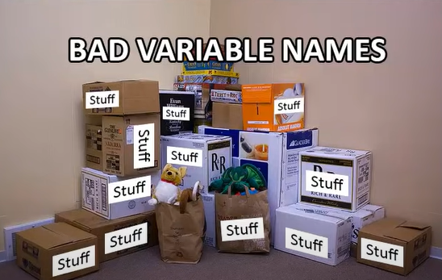
Variable Names
A good variable name describes the data it contains.
Imagine that you moved to a new house and labeled all of the moving boxes as Stuff.
One would never find anything!
Descriptive name will help make code more readable.

Slide 26
Variable Names
Valid variable names | Invalid variable names
current_balance | current-balance
currentBalance | current balance
account4 | 4account
_42 | 42
TOTAL_SUM | TOTAL_SUM
hello | 'hello'
Notes:
(hyphens are not allowed)
(spaces are not allowed)
(can’t begin with a number)
(can’t begin with a number)
(special characters like $ are not allowed)
(special characters like ' are not allowed)

Slide 27
Your First Program
Interactive shell : runs Python instructions one at a time
File editor: To write entire Python program.
The file editor is similar to text editors such as Notepad
but it has some special features for entering source code.
To open a new file: click the New button on the top row.

Slide 28
Your First Program
Difference between :
Interactive shell window | File editor window
Has >>> prompt | No >>> prompt
Runs Python instructions as soon as you press ENTER | Lets to type in many instructions, save the file, and run the program.
Runs Python instructions one at a time | Allows to create or edit from existing python files
Notes:
"Terminal" is the usual word in a Linux/Mac context, and "command prompt" on Windows. It's the window where you type in commands to your operating system to run programs, etc.

Slide 29
Your First Program
How to save the file?
Once you’ve entered your source code, Click the Save button in the top row,
give the File Name as name.py and then click Save.
.py is the extension of the Python file.
Save program every once in a while as you type them.
To save : press CTRL-S on Windows
To run : Press F5 key
Program runs in the interactive shell window. Press F5 from the file editor window, not the interactive shell window.
Notes:
That way, if the computer crashes or you accidentally exit Mu, you
won’t lose the code.

Slide 30
Your First Program
When there are no more lines of code to execute, the Python program terminates; that is, it stops running. (= Python
program exits.)
Close the file editor by clicking the X at the top of the
window.
Reload a saved program: select File▸Open... from the menu.
In the window that appears, choose filename hello.py and click the Open button. Previously saved hello.py program opens in the file editor window.

Slide 31
Your First Program
View the execution of a program using the Python Tutor visualization tool :
http://pythontutor.com/
You can see the execution of this particular program at https://autbor.com/hellopy/
Click the forward button to move through each step of the program’s execution.
You’ll be able to see how the variables’ values and the output change.

Slide 32
Your First Program
➊ # This program says hello and asks for my name.
➋ print('Hello, world!')
print('What is your name?') # ask for their name
➌ myName = input()
➍ print('It is good to meet you, ' + myName)
➎ print('The length of your name is:')
print(len(myName))
➏ print('What is your age?') # ask for their age
myAge = input()
print('You will be ' + str(int(myAge) + 1) + ' in a year.')

Slide 33
Dissecting Your Program: Comments
➊ # This program says hello and asks for my name.
Comment: the line following a hash mark (#)
Any text for the rest of the line following a hash mark (#) is part of a comment
Python ignores comments,
Why Comment?
use them to write notes or
remind yourself what the code is trying to do.
Commenting out code: putting a ‘#’ in front of a line of code to
temporarily remove it while testing a program.
useful when trying to figure out why a program isn’t working.
remove the # later when ready to put the line back in.
Python also ignores blank line after comment. Add any number of blank lines to program as you want. This can make your code easier to read, like paragraphs in a book.
Notes:
programmers usual practice

Slide 34
The print() Function
➋ print('Hello, world!')
print('What is your name?') # ask for their name
The print() statement: is a function
Purpose: displays the string value inside its parentheses on the screen.
The line print('Hello, world!') means “Print out the text in the string
When Python executes this line,
it is calling the print() function and
the string value is being passed to the function.

Slide 35
The print() Function
➋ print('Hello, world!')
print('What is your name?') # ask for their name
Argument: A value that is passed to a function call.
Notice that the quotes are not printed to the screen. They just mark where the string begins and ends; they are not part of the string value.
You can also use this function to put a blank line on the screen; just call print() with nothing in between the parentheses.
When you write a function name, the opening and closing parentheses at the end identify it as the name of a function.
It is print() rather than print. (If not: error)

Slide 36
The input() Function
➌ myName = input()
input() function waits for the user to type some text on the keyboard and press ENTER.
This function call
evaluates to a string equal to the user’s text(user’s text=string data type) and
The line of code assigns the myName variable to this string value.
Consider input() function call as an expression that evaluates to whatever string the user typed in.
If the user entered 'Al', then the expression would evaluate to myName = 'Al'.
Notes:
Defining the variable not needed
If you call input() and see an error message, like NameError: name 'Al' is
not defined, the problem is that you’re running the code with Python 2
instead of Python 3.

Slide 37
Printing the User’s Name
➍ print('It is good to meet you, ' + myName)
Expressions can always evaluate to a single value.
If 'Al' is the value stored in myName on line ➌, then this expression evaluates to:
'It is good to meet you, Al'.
This single string value is then passed to print(), which prints it on the screen.

Slide 38
The len() Function
➎ print('The length of your name is:')
print(len(myName))
The len() function takes a string value (or a variable containing a string), and the function evaluates to the
integer value equal to the number of characters in that
string
Python does not have a character data type,
a single character =a string with a length of 1.
Notes:
The function len() is one of Python's built-in functions. It returns the length of an object. For example, it can return the number of items in a list. You can use the function with many different data types.
The integer, float, Boolean, and complex types are examples of built-in data types that you can't use with len() . The function raises a TypeError when the argument is an object of a data type that doesn't have a length.

Slide 39
The len() Function
➎ print('The length of your name is:')
print(len(myName))
The len() function takes a string value (or a variable containing a string), and the function evaluates to the integer value equal to the number of characters in that string
>>> len('hello')
5
>>> len('My Name')
7
>>> len('')
0

Slide 40
The len() Function
➎ print('The length of your name is:')
print(len(myName))
>>> len('My very energetic monster just scarfed nachos.')
46
len(myName)
evaluates to an integer and
It is then passed to print() to be displayed on the screen.
The print() function allows you to pass it either integer values or string values, but not this:

Slide 41
>>> print('I am ' + 29 + ' years old.')
Traceback (most recent call last):
File "<pyshell#6>", line 1, in <module>
print('I am ' + 29 + ' years old.')
TypeError: can only concatenate str (not "int") to str
The print() function isn’t causing that error, but rather it’s the expression you tried to pass to print().
You get the same error message if you type the expression into the interactive shell on its own.

Slide 42
➎ >>> 'I am ' + 29 + ' years old.'
Traceback (most recent call last):
File "<pyshell#7>", line 1, in <module>
'I am ' + 29 + ' years old.'
TypeError: can only concatenate str (not "int") to str
Python gives an error because the + operator can only add two integers together or concatenate two strings.
You can’t add an integer to a string.
Fix this by using a string version of the integer instead.
Notes:
because this is ungrammatical in Python.

Slide 43
The str(), int(), and float() Functions
To concatenate an integer with a string, convert integer into string
Ex: >>> 'I am ' + 29 + ' years old.‘
First get the value '29', which is the string form of 29.
To get the string form of an integer value, pass it to the str() function. This will evaluate to a string value version of the integer.
Ex:
>>> str(29) #converting integer into string(=Type casting)
'29‘ # string form of 29
Notes:
Type casting is a method used to change the variables/ values declared in a certain data type into a different data type to match the operation required to be performed by the code snippet. In python, this feature can be accomplished by using constructor functions like int(), string(), float(), etc.

Slide 44
The str(), int(), and float() Functions
>>> 'I am ' + str(29) + ' years old.‘
I am 29 years old. #O/P ??????????????
str(29) evaluates to '29',
The expression 'I am ' + str(29) + 'years old.' evaluates to
'I am ' + '29' + ' years old.', which in turn evaluates to 'I am 29 years old.'.
>>> print('I am ' + 29 + ' years old.‘)
The above evaluated value is then passed to the print() function.
Notes:
Type casting is a method used to change the variables/ values declared in a certain data type into a different data type to match the operation required to be performed by the code snippet. In python, this feature can be accomplished by using constructor functions like int(), string(), float(), etc.

Slide 45
The str(), int(), and float() Functions
str(): Evaluates the value you pass to the string data type
int(): Evaluates the value you pass to the int data type
float(): Evaluates the value you pass to the floating-point data type.
>>> str(0)
'0'
>>> str(-3.14)
'-3.14'
>>> int('42')
42
>>> int('-99')
-99
Notes:
because this is ungrammatical in Python.

Slide 46
The str(), int(), and float() Functions
str(): Evaluates the value you pass to the string data type
int(): Evaluates the value you pass to the int data type
float(): Evaluates the value you pass to the floating-point data type.
>>> int(1.25)
1
>>> int(1.99)
1
>>> float('3.14')
3.14
>>> float(10)
10.0

Slide 47
The str(), int(), and float() Functions
Call the str() function and pass other data types: to obtain a string
Call the int() function and pass other data types: to obtain a integer form of passed value.
Call the float() function and pass other data types: to obtain a floating-point form of passed value.
The str() function is handy when an integer or float value has to be concatenated to a string.
The int() function is helpful when a number as a string value to be used in mathematics.
Ex: input() function always returns a string, even if user enters a number.

Slide 48
The str(), int(), and float() Functions
>>> spam = input() and enter 101 when it waits for your text.
>>> print(spam)
'101'. #The value stored inside spam isn’t integer 101 but the string
If you want to do mathematic calculation using the value in spam, use the int() function to get the integer form of spam and then store this as the new value in spam.
>>> spam = int(spam)
>>> spam
101
Now spam variable has an integer value instead of a string.

Slide 49
The str(), int(), and float() Functions
>>> spam * 10 / 5
202.0
If you pass a value to int() function that Python cannot evaluate as an
integer, Python will display an error message.
>>> int('99.99') # first convert into float else throws an error
Traceback (most recent call last):
File "<pyshell#18>", line 1, in <module>
int('99.99')
ValueError: invalid literal for int() with base 10: '99.99‘
>>> int(float('99.99'))
99

Slide 50
The str(), int(), and float() Functions
>>> int('twelve')
Traceback (most recent call last):
File "<pyshell#19>", line 1, in <module>
int('twelve')
ValueError: invalid literal for int() with base 10: 'twelve‘
The int() function is also used to round a floating-point number down.
>>> int(7.7)
7
>>> int(7.7) + 1
8

Slide 51
The str(), int(), and float() Functions
print('What is your age?') # ask for their age
myAge = input() #myAge has string value.
print('You will be ' + str(int(myAge) + 1) + ' in a year.')
An integer can be equal to a floating point form of that number.
String value of a number is not = that number
>>> 42 == '42'
False
>>> 42 == 42.0
True
>>> 42.0 == 0042.000
True
Notes:
The myAge variable contains the value returned from input(). Because
the input() function always returns a string (even if the user typed in a
number), you can use the int(myAge) code to return an integer value of the
string in myAge. This integer value is then added to 1 in the expression
int(myAge) + 1.
The result of this addition is passed to the str() function: str(int(myAge)
+ 1). The string value returned is then concatenated with the strings 'You
will be ' and ' in a year.' to evaluate to one large string value. This large
string is finally passed to print() to be displayed on the screen.

Slide 52
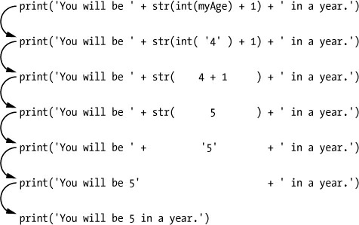
The str(), int(), and float() Functions
If user enters the string '4' for myAge
'

Slide 53
FLOW CONTROL
Program is just a series of instructions.
But programming’s real strength isn’t simply executing every line, straight to the end from beginning, just running one instruction after another.
Based on how expressions evaluate, a program can decide to skip instructions, repeat them, or choose one of several instructions to run. In fact, you
Flow control statements can decide which Python instructions to execute under which conditions.
Notes:
Errand=a short and quick trip to accomplish a specific purpose, as to buy something, deliver a package, or convey a message, often for someone else.

Slide 54
Boolean Values
Integer, floating-point, and string data types have an unlimited number of possible values,
Boolean data type has only two values: True and False.
Boolean data type is named after mathematician George Boole
Don’t use the quotes for Boolean values True & False in Python code.
They always start with a capital T or F, with rest in lowercase.

Slide 55
Boolean Values
➊ >>> spam = True
>>> spam
True
➋ >>> true
Traceback (most recent call last):
File "<pyshell#2>", line 1, in <module> true
NameError: name 'true' is not defined
➌ >>> True = 2 + 2
SyntaxError: can't assign to keyword

Slide 56
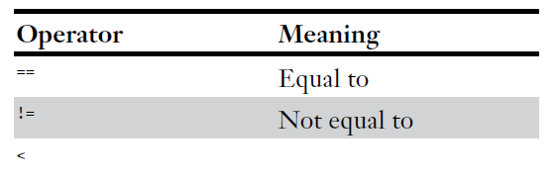
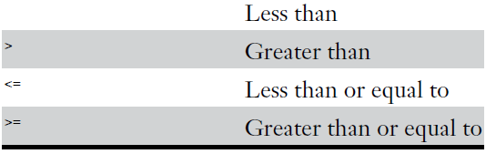
Comparison Operators
Comparison operators compare two values and evaluate down to a single Boolean value
They are also called as relational operators
These operators evaluate to True or False depending on the values entered

Slide 57
Comparison Operators
>>> 42 == 42
True
>>> 42 == 99
False
>>> 2 != 3
True
>>> 2 != 2
False
== (equal to equal to) evaluates to True when the values on
both sides are the same,
!= (not equal to) evaluates to True when the two values are different.
The == and != operators can actually work with values of any data type.

Slide 58
Comparison Operators
>>> 'hello' == 'hello'
True
>>> 'hello' == 'Hello'
False
>>> 'dog' != 'cat'
True
>>> True == True
True
>>> True != False
True
>>> 42 == 42.0
True
➊ >>> 42 == '42'
False.
because Python considers the integer 42 to be different from string '42'.
Notes:
Note that an integer or floating-point value will always be unequal to a
string value. The expression 42 == '42' ➊ evaluates to

Slide 59
Comparison Operators
The <, >, <=, and >= operators, work properly only
with integer and floating-point values.
>>> 42 < 100
True
>>> 42 > 100
False
>>> 42 < 42
False
>>> eggCount = 42
➊ >>> eggCount <= 42
True
>>> myAge = 29
➋ >>> myAge >= 10
True

Slide 60
Comparison Operators
THE DIFFERENCE BETWEEN THE == AND = OPERATORS:
== OPERATOR | = OPERATOR
This is a comparison operator | This is an assignment operator
This has two equal signs | This has just one equal sign
asks whether two values are the same as each other | puts the value on the right into the Variable on the left.

Slide 61
Boolean Operators
The three Boolean operators (and, or, and not) are used to compare
Boolean values.
Like comparison operators, they evaluate these
expressions down to a Boolean value.
Binary Boolean Operators: and, or operators
They always take two Boolean values (or expressions).
The and operator evaluates an expression to True if both Boolean values are True; otherwise, it evaluates to False.
>>> True and True
True
>>> True and False
False

Slide 62
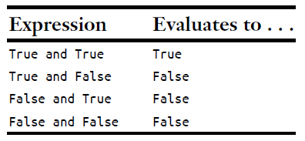
Boolean Operators
>>> True and True
True
>>> True and False
False
and Operator’s Truth Table

Slide 63
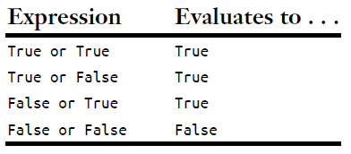
Boolean Operators
On the other hand, the or operator evaluates an expression to True if
either of the two Boolean values is True.
>>> False or True
True
>>> False or False
False #If both are False, it evaluates to False.
or Operator’s Truth Table

Slide 64
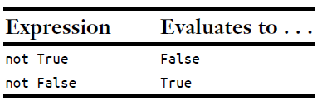
Boolean Operators
The not Operator:
not operator operates on only one Boolean value (or expression).
This makes it a unary operator.
The not operator simply evaluates to the opposite Boolean value.
>>> not True
False
➊ >>> not not not not True #nest not operators ➊
True
not Operator’s Truth Table:
Notes:
though there’s never not no reason to do this in real
programs.

Slide 65
Mixing Boolean and Comparison Operators
Since the comparison operators evaluate to Boolean values, use
them in expressions with the Boolean operators.
and, or, and not operators are called Boolean operators
because they always operate on the Boolean values True and False.
While expressions like 4 < 5 aren’t Boolean values, they are expressions that evaluate down to Boolean values.
Ex:
>>> (4 < 5) and (5 < 6)
True
>>> (4 < 5) and (9 < 6)
False
>>> (1 == 2) or (2 == 2)
True
Notes:
though there’s never not no reason to do this in real
programs.

Slide 66
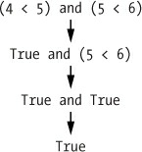
Mixing Boolean and Comparison Operators
The computer will evaluate the left expression first, and then it will
evaluate the right expression.
When it knows the Boolean value for each, it will then evaluate the whole expression down to one Boolean value.
Ex:

Slide 67
Mixing Boolean and Comparison Operators
Multiple Boolean operators can be used in an expression, along
with the comparison operators
>>> 2 + 2 == 4 and not 2 + 2 == 5 and 2 * 2 == 2 + 2
True
order of operations for the Boolean operators:
Python evaluates any math and comparison operators first,
Evaluates the not operators,
then the and operators,
then the or operators.
Notes:
The Boolean operators have an order of operations just like the math
operators do. After any math and comparison operators evaluate, Python
evaluates the not operators first, then the and operators, and then the or
operators.

Slide 68
Elements of Flow Control
Condition: Starting part of Flow Control Statements
Clause: a block of code following the Condition.
Conditions:
They are the Boolean expressions, in the context of flow control statements
Conditions always evaluate down to a Boolean value, True or False
Every flow control statement uses a condition and
Flow control statement decides what to do based on whether
its condition is True or False.
Notes:
though there’s never not no reason to do this in real
programs.

Slide 69
Blocks of Code
name = 'Mary'
password = 'swordfish'
if name == 'Mary':
➊ print('Hello, Mary')
if password == 'swordfish':
➋ print('Access granted.')
else:
➌ print('Wrong password.')
The first block of code ➊ starts at the line print('Hello, Mary') and contains all the lines after it.
Inside this block is another block ➋, which has only a
single line in it: print('Access Granted.').
The third block ➌ is also one line long: print('Wrong password.').
View the execution of this program at https://autbor.com/blocks/.

Slide 70
Program Execution
Python starts executing instructions at the top of the program going down, one after another.
The program execution is a term for the current instruction being executed.
If you print the source code on paper and put your finger on each line as it is executed, you can think of your finger as the program execution.
Program with flow control statements: If you use your finger to trace this, you’ll find yourself jumping around the source code based on conditions, and you’ll probably skip entire clauses.

Slide 71
Flow Control Statements
They are the actual decisions which programs will make.
if Statements
If statement’s condition is True: An if statement’s clause (=block following the if statement) will execute
If statement’s condition is False : The clause is skipped
In plain English, if statement could be read as,
“If this condition is true, execute the code in the clause.”
Notes:
The most common type of flow control statement is the if statement

Slide 72
Flow Control Statements
if statement consists of the following:
The if keyword
A condition (an expression that evaluates to True or False)
A colon
Starting on the next line, an indented block of code (= if clause)
Ex: Consider a code that checks to see whether
someone’s name is Alice.
name=input(‘Enter your name: ‘)
If name==‘Alice’:
print(‘Hi! Alice’)

Slide 73
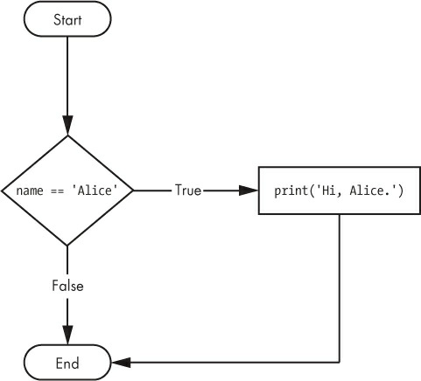
Flow Control Statements
name=input(‘Enter your name: ‘)
if name==‘Alice’:
print(‘Hi! Alice’)
All flow control statements end with a colon and
They are followed by a new block of code (the clause).
This if statement’s clause: block with print('Hi, Alice.').
Notes:
Figure 2-2 shows what a flowchart of this code would
look like.

Slide 74
else Statements
else statement optionally follows if clause
Else clause is executed only when the if statement’s condition is False.
In plain English, else statement could be read as, “If this condition is true, execute this code.
Or else, execute that code.”
An else statement doesn’t have a condition
Notes:
Figure 2-2 shows what a flowchart of this code would
look like.

Slide 75
else Statements
An else statement doesn’t have a condition
else statement consists of the following:
The else keyword
A colon
Starting on the next line, an indented block of
code (=else clause)
if name == 'Alice':
print('Hi, Alice.')
else:
print('Hello, stranger.')
Notes:
Returning to the Alice example, let’s look at some code that uses an
else statement to offer a different greeting if the person’s name isn’t Alice.

Slide 76
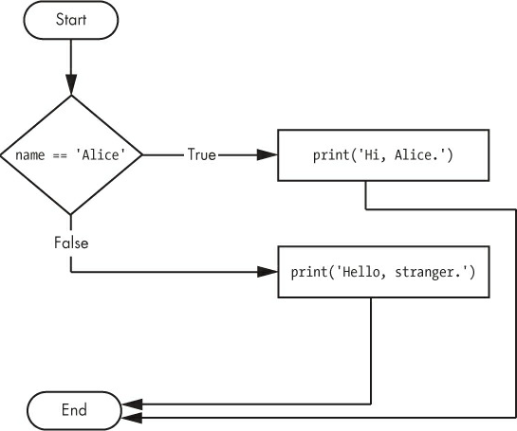
else Statements
if name == 'Alice':
print('Hi, Alice.')
else:
print('Hello, stranger.')
Notes:
Returning to the Alice example, let’s look at some code that uses an
else statement to offer a different greeting if the person’s name isn’t Alice.

Slide 77
Elif Statements
elif statement: use when you want one of many possible clauses to execute.
It is an “else if” statement.
It always follows an if or another elif statement.
It provides another condition that to be checked only if all of the previous conditions were False.
elif statement always consists of the following:
The elif keyword
A condition (=an expression that evaluates to True or False)
A colon
Starting on the next line, an indented block of code (= elif clause)
Notes:
While only one of the if or else clauses will execute

Slide 78
elif Statements
if name == 'Alice':
print('Hi, Alice.')
elif age < 12:
print('You are not Alice, kiddo.')
Two conditions are checked name and person’s age, and the program will tell something different if they’re younger than 12.
elif clause executes, if age < 12 is True & name == 'Alice' is False.
However, if both of the conditions are False, then both of the clauses are skipped.
It is not guaranteed that at least one of the clauses will be
executed. When there is a chain of elif statements, only one or none of the clauses will be executed.
Once one of the statements’ conditions is found to be True, the rest of the elif clauses are automatically skipped.
Notes:
While only one of the if or else clauses will execute

Slide 79
elif Statements
Ex: consider a program with name vampire.py
name = 'Carol'
age = 3000
if name == 'Alice':
print('Hi, Alice.')
elif age < 12:
print('You are not Alice, kiddo.')
elif age > 2000:
print('Unlike you, Alice is not an undead, immortal vampire.')
elif age > 100:
print('You are not Alice, grannie.')
View the execution of this program at https://autbor.com/vampire/.
Notes:
open a new file editor window and enter the following code,
saving it as vampire.py
added two more elif statements to
make the name checker greet a person with different answers based on
age.

Slide 80
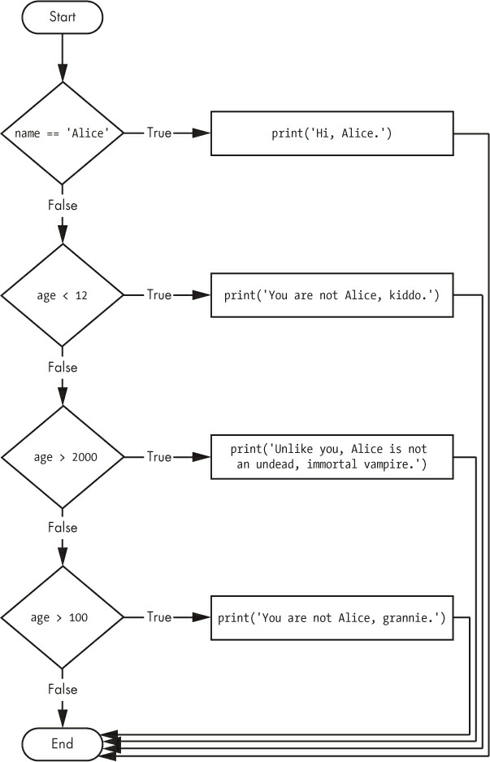
elif Statements
name = 'Carol'
age = 3000
if name == 'Alice':
print('Hi, Alice.')
elif age < 12:
print('You are not Alice, kiddo.')
elif age > 2000:
print('Unlike you, Alice is not an undead,
immortal vampire.')
elif age > 100:
print('You are not Alice, grannie.')
Notes:
While only one of the if or else clauses will execute

Slide 81
elif Statements
Order of the elif statements matters?
Rearrange statements in in vampire.py to introduce a bug.
Imp: rest of the elif clauses are automatically skipped once a True condition has been found.
name = 'Carol'
age = 3000
if name == 'Alice':
print('Hi, Alice.')
elif age < 12:
print('You are not Alice, kiddo.')
➊ elif age > 100:
print('You are not Alice, grannie.')
elif age > 2000:
print('Unlike you, Alice is not an undead, immortal vampire.')
age > 100 condition is True (after all, 3,000 is greater than 100) ➊, the string
'You are not Alice, grannie.' is printed
Expected o/P: 'Unlike you, Alice is not an
undead, immortal vampire.'.
Actual o/P: 'You are not Alice, grannie.'
view the execution of this program at
https://autbor.com/vampire2/.
Notes:
Say the age variable contains the value 3000
before this code is executed. You might expect the code to print the string
'Unlike you, Alice is not an undead, immortal vampire.'. However, because the
age > 100 condition is True (after all, 3,000 is greater than 100) ➊, the string
'You are not Alice, grannie.' is printed, and the rest of the elif statements
are automatically skipped. Remember that at most only one of the clauses
will be executed, and for elif statements, the order matters!

Slide 82
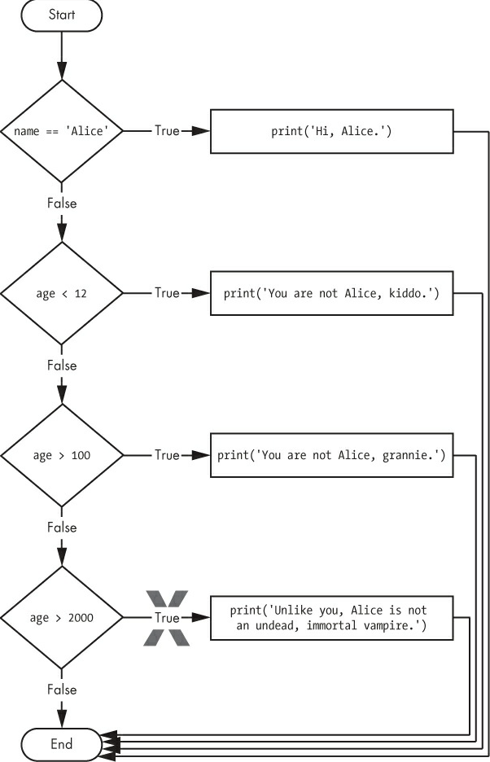
Elif and else Statements
Note: how the diamonds for
age > 100 and age > 2000 are swapped.
To ensure that at least one (and only one) of the clauses will be executed :
Have an else statement after the last elif statement.
In that case, it is guaranteed that: Suppose conditions in every if and elif statement are False,
then the else clause is executed.

Slide 83
Elif and else Statements
Ex: the Alice program to use if, elif, and else clauses:
name = 'Carol'
age = 3000
if name == 'Alice':
print('Hi, Alice.')
elif age < 12:
print('You are not Alice, kiddo.')
else:
print('You are neither Alice nor a little kid.')
View the execution of this program at
https://autbor.com/littlekid/.
Notes:
While only one of the if or else clauses will execute

Slide 84
else Statements
flowchart for this new code, littleKid.py.
In plain English:
“If the first condition is true, do this.
Else, if the second condition is true, do that. Otherwise, do something else.”
Imp: When you use if, elif, and else
statements together, remember these rules about how to order them to avoid bugs like the one in vampire.py.
Notes:
While only one of the if or else clauses will execute

Slide 85
Elif and else Statements
Summary:
First, there is always exactly one if statement.
Any elif statements should follow the if statement.
Second, if you want to be sure that at least one clause is executed, close the structure with an else statement.
Notes:
While only one of the if or else clauses will execute

Slide 86
While Loop Statements
Use of While Statement: To execute a block of code over
and over again.
The code in a while clause will be executed as long as
the while statement’s condition is True.
Code in a while statement consists of :
The while keyword
A condition (=an expression that evaluates to True or False)
A colon
Starting on th next line, an indented block of code (called
while clause)

Slide 87
While Loop Statements
a while statement looks similar to an if statement.
The difference is in how they behave.
while clause is often called the while loop or just the loop.
Ex: if statement:
At the end of an if clause, the program execution continues after the if statement.
spam = 0
if spam < 5:
print('Hello, world.')
spam = spam + 1
O/P : Hello, world.
Ex: while statement:
at the end of a while clause, the program execution jumps back to the start of the while statement
spam = 0
while spam < 5:
print('Hello, world.')
spam = spam + 1
O/P : Hello, world repeated five times!
Notes:
Let’s look at an if statement and a while loop that use the same
condition and take the same actions based on that condition
These statements are similar—both if and while check the value of spam,
and if it’s less than 5, they print a message. But when you run these two
code snippets, something very different happens for each one.
These statements are similar—both if and while check the value of spam,
and if it’s less than 5, they print a message. But when you run these two
code snippets, something very different happens for each one. For the if
statement, the output is simply "Hello, world.". But for the while statement,

Slide 88
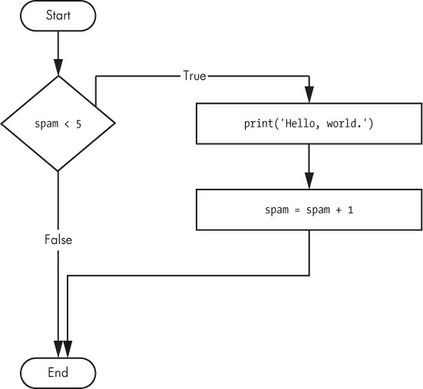
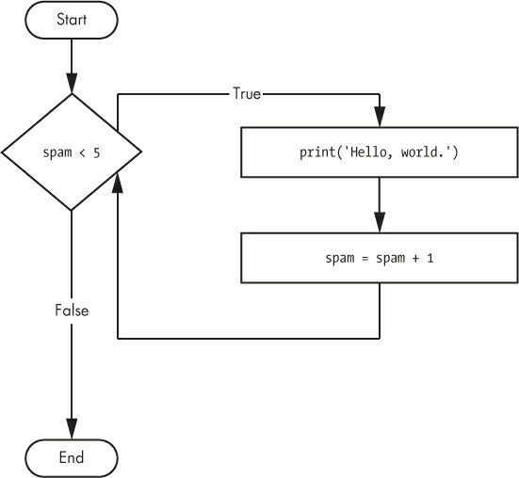
While Loop Statements
Flowchart for the if statement code
flowchart for while statement code

Slide 89
While Loop Statements
if statement checks the condition, and it prints
Hello, world. only once if that condition is true. The code with the while
loop, on the other hand, will print it five times. The loop stops after five
prints because the integer in spam increases by one at the end of each loop
iteration, which means that the loop will execute five times before spam < 5
is False.
In the while loop, the condition is always checked at the start of each
iteration (that is, each time the loop is executed). If the condition is True,
then the clause is executed, and afterward, the condition is checked again.
The first time the condition is found to be False, the while clause is
skipped.

Slide 90
While Loop Statements
if statement checks the condition, and it prints Hello, world, only once if that condition is true.
The code with the while loop, will print it five times.
The loop stops after five prints because the integer in spam increases by one at the end of each loop iteration, which means that the loop will execute five times before spam < 5 is False.
In the while loop, the condition is always checked at the start of each
iteration (that is, each time the loop is executed).
If the condition is True, then the clause is executed, and afterward, the condition is checked again.
The first time the condition is found to be False, the while clause is
skipped.
Notes:
The code with the

Slide 91
Annoying while Loop
An Annoying while Loop:
Ex: program that will keep asking to type, your name.
➊ name = ''
➋ while name != 'your name':
print('Please type your name.')
➌ name = input()
➍ print('Thank you!')
view the execution of this program at
https://autbor.com/yourname/.

Slide 92
Annoying while Loop
First, the program sets the name variable ➊ to an empty string.
This is so that the name != 'your name' condition will
evaluate to True and the program execution will enter the
while loop’s clause ➋.
The code inside this clause asks the user to type their name, which is
assigned to the name variable ➌. Since this is the last line of the block, the execution moves back to the start of the while loop and reevaluates the condition. If the value in name is not equal to the string 'your name', then the condition is True, & execution enters the while clause again.
But once the user types your name, the condition of the while loop will be 'your name' != 'your name', which evaluates to False. The condition is now False, & instead of program execution reentering the while loop’s clause, Python skips past it & continues running rest of program ➍.
Notes:
Figure 2-10 shows a flowchart for the yourName.py program.

Slide 93
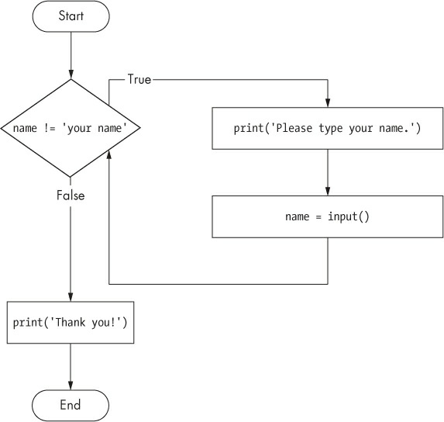
Annoying while Loop
Please type your name.
Al
Please type your name.
Albert
Please type your name.
%#@#%*(^&!!!
Please type your name.
your name
Thank you!
Notes:
Now, let’s see yourName.py in action. Press F5 to run it, and enter
something other than your name a few times before you give the program
what it wants.

Slide 94
Annoying while Loop
If you never enter your name????
Then the while loop’s condition will never
be False, and the program will just keep asking forever.
Here, the input() call lets the user enter the right string to make the program move on.
How to break out of a while loop???
Notes:
While only one of the if or else clauses will execute

Slide 95
break Statements
Break Statement: a shortcut to break out of a
while loop’s clause early.
If the execution reaches a break statement, it
immediately exits the while loop’s clause.
break statement: use keyword in code: break
Consider a program: Name2.py
uses a break statement to escape the loop:
➊ while True:
print('Please type your name.')
➋ name = input()
➌ if name == 'your name':
➍ break
➎ print('Thank you!')
Notes:
While only one of the if or else clauses will execute

Slide 96
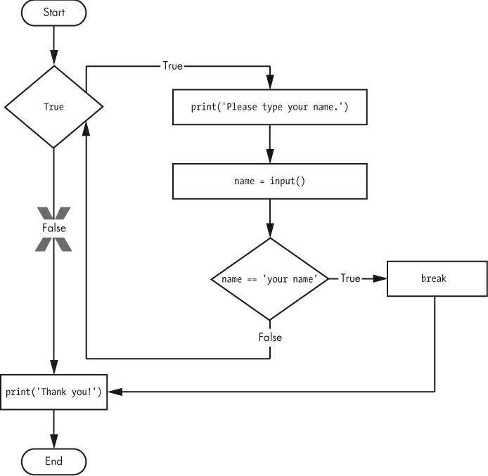
break Statements
https://autbor.com/yourname2/.
Name2.py
➊ while True: #program starts
print('Please type your name.')
➋ name = input()
➌ if name == 'your name':
➍ break
➎ print('Thank you!') #ends
Notes:
view the execution of this program at
https://autbor.com/yourname2/.

Slide 97
break Statements
The first line ➊ creates an infinite while loop
Because condition is always True.
(expression True, always evaluates down to value True.) (An infinite loop that never exits is a common programming bug.)
Name2.py
➊ while True: #program starts
print('Please type your name.')
➋ name = input()
➌ if name == 'your name':
➍ break
➎ print('Thank you!') #ends
Program asks user to enter your name ➋.
Execution is still inside the while loop, an if statement checks ➌ whether name is equal to 'your name'.
If this condition is True, the break statement is run ➍, and the execution moves out of the loop to print('Thank you!') ➎.

Slide 98
break Statements
The first line ➊ creates an infinite while loop Because condition is always True.
Program asks user to enter your name ➋.
Execution is still inside the while loop,
if statement checks ➌ whether name is
equal to 'your name'.
If this condition is True, the break statement is run ➍, and the execution moves out of the loop to print('Thank you!') ➎.
Name2.py
➊ while True: #program starts
print('Please type your name.')
➋ name = input()
➌ if name == 'your name':
➍ break
➎ print('Thank you!') #ends
Otherwise, the if statement’s clause that contains the break statement is skipped, which puts the execution at the end of the while loop.
At this point, the program execution jumps back to the start of the
while statement ➊ to recheck the condition.
Since this condition is merely True Boolean value, the execution enters the loop to ask the user to type your name again.
Notes:
view the execution of this program at
https://autbor.com/yourname2/.

Slide 99
break Statements
Run yourName2.py, and enter the same text you entered for
Your Name.py
The rewritten program should respond in the same way as the original.
Note that the
X path will logically never happen, because the loop condition is always True.
Notes:
While only one of the if or else clauses will execute

Slide 100
TRAPPED IN AN INFINITE LOOP?
Create a program: infiniteLoop.py
while True:
print('Hello, world!')
Press CTRL-C or
select Shell ▸ Restart Shell from IDLE’s menu
This will send a KeyboardInterrupt error to your program and cause it to stop immediately.
When run this program, it will print Hello, world! to screen
forever because while statement’s condition is always True.
CTRL-C is also handy if you want to simply terminate your
program immediately, even if it’s not stuck in infinite loop.
Notes:
While only one of the if or else clauses will execute

Slide 101
continue Statements
Continue statements are used inside loops
When the program execution reaches a continue statement,
the program execution
Immediately jumps back to the start of the loop and
reevaluates the loop’s condition.
(This is also what happens when the execution reaches the end
of the loop.)
Consider a program that asks for a name and Password,
as swordfish.py
Notes:
While only one of the if or else clauses will execute

Slide 102
swordfish.py
while True:
print('Who are you?')
name = input()
➊ if name != 'Joe':
➋ continue
print('Hello, Joe. What is the password? (It is a fish.)')
➌ password = input()
if password == 'swordfish':
➍ break
➎ print('Access granted.')
Run this program:
Until you claim to be Joe,
the program shouldn’t ask for a pwd
once you enter correct
password, it should exit.
Notes:
While only one of the if or else clauses will execute

Slide 103
break Statements
If the user enters any name besides Joe ➊, the continue statement ➋ causes the program execution to jump back to the start of the loop.
When the program reevaluates the condition, the execution will always enter the loop, since condition is = value True.
Once the user makes it past that if statement, they are asked for a password ➌.
If the password entered is swordfish, then the break statement ➍ is run, and the execution jumps out of the while loop to print Access granted ➎.
Otherwise, the execution continues to the end of the while loop, where it then jumps back to the start of the loop.
while True:
print('Who are you?')
name = input()
➊ if name != 'Joe':
➋ continue
print('Hello, Joe. What is the pwd?
➌ password = input()
if password == 'swordfish':
➍ break
➎ print('Access granted.')
Run this program:
Until you claim to be Joe,
the program shouldn’t ask for a pwd
once you enter correct
password, it should exit.

Slide 104
break Statements
swordfish.py
If the user enters any name besides Joe ➊, the continue statement ➋ causes the program execution to jump back to the start of the loop.
When the program reevaluates the condition, the execution will always enter the loop, since condition is = value True.
Once the user makes it past that if statement, they are asked for a password ➌.
If the password entered is swordfish, then the break statement ➍ is run, and the execution jumps out of the while loop to print Access granted ➎.
Otherwise, the execution continues to the end of the while loop, where it then jumps back to the start of the loop.
Notes:
A flowchart for swordfish.py. The X path will logically never happen, because the
loop condition is always True.

Slide 105
“TRUTHY” AND “FALSEY” VALUES
Conditions will consider some values equivalent to True and False.
When used in conditions,
0, 0.0, and ‘’ (the empty string) are considered False,
all other values are considered True.
Ex, consider program howmanyguests:
Name=‘’
➊ while not name:
print('Enter your name:')
name = input()
print('How many guests will you have?')
numOfGuests = int(input())
➋ if numOfGuests:
➌ print('Be sure to have enough room for all your guests.')
print('Done')
View the execution at: https://autbor.com/howmanyguests/.

Slide 106
“TRUTHY” AND “FALSEY” VALUES
If the user enters a blank string for name, then the while statement’s condition will be True ➊,
and program continues to ask for a name.
If the value for numOfGuests is not 0 ➋, then the condition is considered to be True, & program will print a reminder for user ➌.
name=‘’
➊ while not name:
print('Enter your name:')
name = input()
print('How many guests will you have?')
numOfGuests = int(input())
➋ if numOfGuests:
➌ print('Be sure to have enough room for all your guests.')
print('Done')

Slide 107
“TRUTHY” AND “FALSEY” VALUES
You could have entered name != ‘’ instead of
not name,
numOfGuests != 0
instead of numOfGuests, but using the truthy and falsey values can make your code easier to read.
name=‘’
➊ while not name:
print('Enter your name:')
name = input()
print('How many guests will you have?')
numOfGuests = int(input())
➋ if numOfGuests:
➌ print('Be sure to have enough room for all your guests.')
print('Done')

Slide 108
for Loops and the range() function
The while loop keeps looping while its condition is True (which is the reason for its name).
What if you want to execute a block of code only a certain number of times? ???????
You can do this with a for loop statement and the range() function.
Notes:
The while loop keeps looping while its condition is True (which is the
reason for its name),

Slide 109
for Loops and the range() function
In code, for statement looks like:
for i in range(5):
includes the following:
for keyword
A variable name
in keyword
A call to the range() method with up to three integers passed to it
A colon
Starting on the next line, an indented block of code (=for clause)

Slide 110
for Loops and the range() Function
Consider a program - fiveTimes.py
print('My name is')
for i in range(5):
print('Jimmy Five Times (' + str(i) + ')')
The code in the for loop’s clause is run five times.
1.The first time it is run, the variable i is set to 0; i=0
For clause is executed: calls print() function -will print Jimmy Five Times (0)
After Python finishes for loop’s clause of first iteration, the execution goes back
to the top of the loop, and
2. for statement increments i by one. i=1
For clause is executed: calls print() function -will print Jimmy Five Times (1)
After Python finishes for loop’s clause of second iteration, the execution goes back
to the top of the loop, and
3. for statement increments i by one. i=2
This is why range(5) results in five iterations through the clause,
with i being set to 0, then 1, then 2, then 3, and then 4.
The variable i will go up to, but will not include, the integer passed to range().
Figure 2-13 shows a flowchart for the fiveTimes.py program.
When you run this program, it should print Jimmy Five Times followed
by the value of i five times before leaving the for loop.
Notes:
Let’s create a new program called fiveTimes.py to help you see a for
loop in action.
You can view the execution of this program at
https://autbor.com/fivetimesfor/.

Slide 111
for Loops and the range() Function
Consider a program - fiveTimes.py
print('My name is')
for i in range(5):
print('Jimmy Five Times (' + str(i) + ')')
The code in the for loop’s clause is run five times.
1.The first time it is run, i=0; print Jimmy Five Times (0)
2. for statement increments i by one. i=1 will print Jimmy Five Times (1)
3. for statement increments i by one. i=2 : will print Jimmy Five Times (2)
4. for statement increments i by one. i=3; will print Jimmy Five Times (3)
4. for statement increments i by one. i=4; will print Jimmy Five Times (4)
This is why range(5) results in five iterations through the clause,
with i =0, then 1, then 2, then 3, and then 4.
Imp: The variable i will go up to, but will not include, the integer passed to range().
Notes:
Let’s create a new program called fiveTimes.py to help you see a for
loop in action.
You can view the execution of this program at
https://autbor.com/fivetimesfor/.

Slide 112
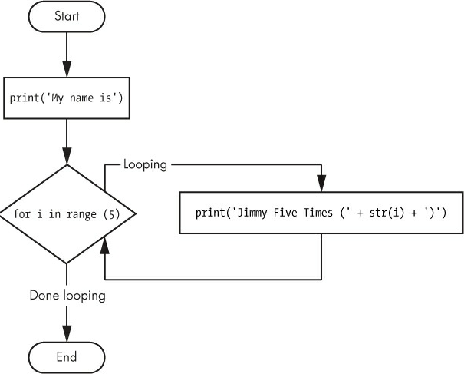
for Loops and the range() Function
The flowchart for fiveTimes.py
When you run this program, it should print:
My name is
Jimmy Five Times (value of i )
5 times before leaving for loop.
My name is
Jimmy Five Times (0)
Jimmy Five Times (1)
Jimmy Five Times (2)
Jimmy Five Times (3)
Jimmy Five Times (4)

Slide 113
for Loops and the range() Function
NOTE:
for loops allow break and continue statements as well.
The continue statement will continue to the next value of the for loop’s counter, as if the program execution had reached the end of the loop and returned to the start.
Use continue and break statements only inside while and
for loops.
If you try to use these statements elsewhere, Python will give you an error.

Slide 114
for Loops and the range() Function
Example2: to add up all the numbers from 0 to 100, Using for loop.
➊ total = 0
➋ for num in range(101):
➌ total = total + num
➍ print(total)
When the program first starts, the total variable is set to 0 ➊.
The for loop ➋ then executes total = total + num ➌ 100 times.
By the time the loop has finished all of its 100 iterations, every
integer from 0 to 100 will have been added to total. At this point, total is
printed to the screen ➍.
The result should be 5,050.
On slowest computers, this program takes less than a second to complete.
Notes:
(Young Gauss figured out a way to solve the problem in seconds.
There are 50 pairs of numbers that add up to 101: 1 + 100, 2 + 99, 3 + 98,
and so on, until 50 + 51. Since 50 × 101 is 5,050, the sum of all the
numbers from 0 to 100 is 5,050. Clever kid!)

Slide 115
An Equivalent while Loop
Rewrite fiveTimes.py to use a while loop equivalent of a for loop.
print('My name is')
i = 0
while i < 5:
print('Jimmy Five Times (' + str(i) + ')')
i = i + 1
O/P should look same as fiveTimes.py program, which uses a for loop.
View the execution of this program at
https://autbor.com/fivetimeswhile/.

Slide 116
Starting, Stopping, and Stepping Arguments to range()
Some functions can be called with multiple arguments separated by a
Comma
Ex: range().
for i in range(start, stop):
print(i)
This lets the integer passed to range() to follow any sequence of integers, including starting at a number other than zero.
start= loop’s variable starts at this. (1st argument)
end= number to stop at, Imp: will be up to, but not including(2nd argument)

Slide 117
Starting, Stopping, and Stepping Arguments to range()
for i in range(start, stop):
print(i)
for i in range(12, 16):
print(i)
O/P:
12
13
14
15

Slide 118
Starting, Stopping, and Stepping Arguments to range()
The range() function can also be called with three arguments.
The first two arguments will be the start and stop values, and the third will be the step argument.
step is the amount that variable is increased by after each iteration.
Syntax:
for i in range(start, stop):
print(i)
for i in range(0, 10, 2):
print(i)
O/P:
0
2
4
6
8

Slide 119
Starting, Stopping, and Stepping Arguments to range()
for loop takes a negative number
then for loop counts down instead of up.
Ex:
for i in range(5, -1, -1):
print(i)
O/P:
5
4
3
2
1
0
Notes:
The range() function is flexible in the sequence of numbers it produces for for loops.

Slide 120
Importing Modules
built-in functions= basic set of functions.
Ex: print(), input(), and len() functions
Python also comes with a set of modules called standard library.
Each module is a Python program that contains a related group of
functions that can be embedded in programs
Ex: 1. math module has mathematics-related functions,
2. random module has random number-related functions, and so on
import the module with an import statement to use the functions in a module
Notes:
All Python programs can call a basic set of functions called built-in
functions, including the print(), input(), and len() functions you’ve seen
before.

Slide 121
Importing Modules
import statement consists of following:
The import keyword
The name of the module
Sometimes, more module names, separated by commas
Once you import a module, you can use all the functions of that module.
Ex: import random module, to get access to random.randint() function.

Slide 122
Importing Modules
Consider the program: printRandom.py:
import random
for i in range(5):
print(random.randint(1, 10))
O/P:
4
1
8
4
1
view the execution of this program at
https://autbor.com/printrandom/.

Slide 123
DON’T OVERWRITE MODULE NAMES
Don’t use the names of the Python’s modules to save Python scripts, Ex: don’t use random.py, sys.py, os.py, or math.py.
If accidentally name is given, ex: random.py,
and use an import random statement in another program, your program would import your random.py file instead of
Python’s random module.
This leads to errors such as AttributeError: module 'random' has no attribute 'randint', since your random.py doesn’t have the functions that real random module has.
Don’t use the names of any built-in Python functions either, such as print() or input().

Slide 124
Importing Modules
The random.randint() function:l evaluates to a random integer value between the two integers that you pass it.
Since randint() is in the random module, first type random. in front of
the function name to tell Python to look for this function inside the
random module.
Syntax:
import random, sys, os, math

Slide 125
from import Statements
An alternative form of the import statement:
from keyword,
then the module name,
the import keyword,
and a star;
Ex: from random import *
With this form of import statement, calls to functions
in random will not need the random prefix.
But to make it readable code, so it is better to use the
import random form of the statement

Slide 126
Ending a program early with the sys.exit() function
how to terminate the program before last instruction???????
Programs always terminate when the execution reaches the bottom of the instructions.
sys.exit() function: when called it causes the program to terminate, or exit, before the last instruction.
import sys before using it.
Ex: exitExample.py:

Slide 127
Ending a program early with the sys.exit() function
Ex: exitExample.py:
import sys
while True:
print('Type exit to exit.')
response = input()
if response == 'exit':
sys.exit()
print('You typed ' + response + '.')
This program has an infinite loop with no break statement inside.
The only way this program will end is if the execution reaches the sys.exit() call.
When response is equal to exit, the line containing the sys.exit() call is executed. Since the response variable is set by the input() function, the user must enter exit in order to stop the program.

Slide 128
Functions
built-in functions: print(), input(), and len() functions
function: is a miniprogram within a program.
Ex: Create a program helloFunc.py
➊ def hello():
➋ print('Howdy!')
print('Howdy!!!')
print('Hello there.')
➌ hello()
hello()
hello()
view at:
https://autbor.com/hellofunc/

Slide 129
Functions
The first line is a def statement ➊, which
defines a function named hello().
➊ def hello():
➋ print('Howdy!')
print('Howdy!!!')
print('Hello there.')
➌ hello()
hello()
hello()
code in the block that follows the
def statement ➋ is the body of function
This code is executed when
the function is called, not when the function is first defined
The hello() lines after the function ➌ are function calls.

Slide 130
Functions
In code, a function call is just the function’s name followed by parentheses, sometimes with some number of arguments in between the parentheses.
➊ def hello():
➋ print('Howdy!')
print('Howdy!!!')
print('Hello there.')
➌ hello()
hello()
hello()
When program execution reaches these calls, it will jump to the top line in function and begin executing code there.
When it reaches end of function, execution returns to the line that
called the function and continues moving through the code as before.

Slide 131
Functions
Since this program calls hello() three times, the code in the hello()
function is executed three times.
➊ def hello():
➋ print('Howdy!')
print('Howdy!!!')
print('Hello there.')
➌ hello()
hello()
hello()
Output:
Howdy!
Howdy!!!
Hello there.
Howdy!
Howdy!!!
Hello there.
Howdy!
Howdy!!!
Hello there.

Slide 132
Functions
function: is a miniprogram within a program.
Purpose of function is to group code that gets executed multiple times.
With function
➊ def hello():
➋ print('Howdy!')
print('Howdy!!!')
print('Hello there.')
➌ hello()
hello()
hello()
Without function:
print('Howdy!')
print('Howdy!!!')
print('Hello there.')
print('Howdy!')
print('Howdy!!!')
print('Hello there.')
print('Howdy!')
print('Howdy!!!')
print('Hello there.')
Notes:
Without a function defined, you would have to copy and
paste this code each time, and the program would look like this

Slide 133
Functions
Avoid duplicating code, Why?????
because if you ever decide to update the code—if, for example, you find a bug you need to fix—you’ll have to remember to change the code everywhere you copied it.
Deduplication makes programs shorter, easier to read, and easier to update.

Slide 134
Functions
function: is a miniprogram within a program
Purpose of function is to group code that gets executed multiple times.
This avoids duplication.
Deduplication makes programs shorter, easier to read, and easier to update.

Slide 135
def Statements with Parameters
arguments: values that are passed by typing them between the parentheses when the built-in (Ex: print() or len()) or user defined function is called.
Create a program: helloFunc2.py
Output:
➊ def hello(name):
➋ print('Hello, ' + name)
➌ hello('Alice')
hello('Bob')
Hello, Alice
Hello, Bob
view at:
https://autbor.com/hellofunc2/

Slide 136
def Statements with Parameters
➊ def hello(name):
➋ print('Hello, ' + name)
➌ hello('Alice')
hello('Bob')
What are Parameters ?
Parameters are the variables that contain arguments.
These parameters appear between the parentheses in function definition.
When a function is called with arguments, the arguments are stored in parameters in function definition.
The definition of the hello() function in this
program has a parameter called name ➊.

Slide 137
def Statements with Parameters
Note: the value stored in a
parameter is forgotten when the function returns.
Ex: if you add print(name) after hello('Bob') in the previous program, the program
would give a NameError
because there is no variable
called name.
This variable is destroyed after the function call hello('Bob') returns, so print(name) would refer to a name variable that does not exist.
➊ def hello(name):
➋ print('Hello, ' + name)
➌ hello('Alice')
hello('Bob')
This is similar to how a program’s variables are forgotten when the
program terminates.

Slide 138
Define, Call, Pass, Argument, Parameter
What is defining a function?
To define a function is to create it, just like an assignment statement
like spam = 42 creates the spam
variable.
The def statement defines(=creates) the sayHello() function ➊.
Code Ex:
➊ def sayHello(name):
print('Hello, ' + name)
➋ sayHello('Al')
This function call is also known as passing the string value 'Al' to the function.
The sayHello('Al') line ➋ calls the now-created function, sending the execution to the definition of the function’s code.
Variables that have arguments assigned to them are parameters.
Notes:
Let’s look at a code example to review these terms:

Slide 139
Return Values and return Statements
When creating a function using the def statement, you can specify what the return value should be with a return statement.
When you call len() function and pass it an argument such as 'Hello', the function call evaluates to the integer value 5, which is the length of the string passed to it.
the value that a function call evaluates to is called the return value of the function
A return statement consists of following:
The return keyword
The value or expression that
the function should return

Slide 140
Return Values and return Statements
When an expression is used with a return statement,
the return value =value, expression
evaluates to.
Ex:
Consider a program, magic8Ball.py that defines a function that returns a different string depending on what number it is passed as an argument.
Notes:
view the execution of this program at
https://autbor.com/magic8ball/.

Slide 141
Return Values and return Statements
➊ import random
➋ def getAnswer(answerNumber):
➌ if answerNumber == 1:
return 'It is certain'
elif answerNumber == 2:
return 'It is decidedly so'
elif answerNumber == 3:
return 'Yes'
elif answerNumber == 4:
return 'Reply hazy try again'
elif answerNumber == 5:
return 'Ask again later'
elif answerNumber == 6:
return 'Concentrate and ask again'
elif answerNumber == 7:
return 'My reply is no'
elif answerNumber == 8:
return 'Outlook not so good'
elif answerNumber == 9:
return 'Very doubtful'
➍ r = random.randint(1, 9)
➎ fortune = getAnswer(r)
➏ print(fortune)
Notes:
view the execution of this program at
https://autbor.com/magic8ball/.

Slide 142
Return Values and return Statements
➊ import random
➋ def getAnswer(answerNumber):
➌ if answerNumber == 1:
return 'It is certain'
elif answerNumber == 2:
return 'It is decidedly so'
elif answerNumber == 3:
return 'Yes'
elif answerNumber == 4:
return 'Reply hazy try again'
elif answerNumber == 5:
return 'Ask again later'
elif answerNumber == 6:
Python imports the random module ➊.
Then getAnswer() function is defined ➋
Because the function is being defined (and not called), the execution skips
over the code in it.
Notes:
view the execution of this program at
https://autbor.com/magic8ball/.

Slide 143
Return Values and return Statements
return 'Concentrate and ask again'
elif answerNumber == 7:
return 'My reply is no'
elif answerNumber == 8:
return 'Outlook not so good'
elif answerNumber == 9:
return 'Very doubtful'
➍ r = random.randint(1, 9)
➎ fortune = getAnswer(r)
➏ print(fortune)
Next, the random.randint() function
is called with two arguments: 1 and 9 ➍
It evaluates to a random integer between 1 and 9 (including 1 and 9 themselves), and this value is stored in a variable named r.
Notes:
view the execution of this program at
https://autbor.com/magic8ball/.

Slide 144
Return Values and return Statements
The getAnswer() function is called with
r as the argument ➎.
➊ import random
➋ def getAnswer(answerNumber):
➌ if answerNumber == 1:
return 'It is certain'
return 'Concentrate and ask again'
elif answerNumber == 7:
return 'My reply is no'
elif answerNumber == 8:
return 'Outlook not so good'
elif answerNumber == 9:
return 'Very doubtful'
➍ r = random.randint(1, 9)
➎ fortune = getAnswer(r)
➏ print(fortune)
The program execution moves to the top of the getAnswer() function ➌, and the value r is stored in a parameter named answerNumber.
Then, depending on the value in answerNumber, the function returns
one of many possible string values.
The program execution returns to the line at the bottom of the program that originally called getAnswer() ➎.
The returned string is assigned to a variable named fortune, which then gets passed to a print() call ➏ and is printed to the screen.
Notes:
view the execution of this program at
https://autbor.com/magic8ball/.

Slide 145
Return Values and return Statements
Note:
you can pass return values as an argument to another
function call, you could shorten these three lines as:
r = random.randint(1, 9)
fortune = getAnswer(r)
print(fortune)
expressions are composed of values and operators.
A function call can be used in an expression as value because the call evaluates to its return value.
single equivalent line:
print(getAnswer(random.randint(1, 9)))
Notes:
view the execution of this program at
https://autbor.com/magic8ball/.

Slide 146
The None Value
In Python, there is a value called None, which represents the
absence of a value.
The None value is the only value of the NoneType data type.
(Other programming languages might call this value null, nil, or undefined.)
Just like the Boolean True and False values, None must be typed
with a capital N.
This value-without-a-value can be helpful when you need to store
something that won’t be confused for a real value in a variable.
Notes:
view the execution of this program at
https://autbor.com/magic8ball/.

Slide 147
The None Value
One place where None is used is as the return value of print().
The print() function displays text on the screen, but it doesn’t need to
return anything in the same way len() or input() does.
But since all function calls need to evaluate to a return value,
print() returns None.

Slide 148
The None Value
>>> spam = print('Hello!')
Hello!
>>> None == spam
True
Behind the scenes, Python adds return None to the end of any function definition with no return statement.
Also, if you use a return statement without a value (that is, just the return keyword by itself), then None is returned.
This is similar to how a while or for loop implicitly ends with a continue statement.
Notes:
enter the
following into the interactive shell:

Slide 149
Keyword Arguments and the print() Function
Most arguments are identified by their position in function call.
Ex: random.randint(1, 10) ≠ random.randint(10, 1).
The function call random.randint(1, 10) will return a random integer between 1 and 10 because the first argument is the low end of the range and the second argument is the high end.
while random.randint(10, 1) causes an error
rather than through their position, keyword arguments are
identified by the keyword put before them in the function call.
Keyword arguments are often used for optional parameters.

Slide 150
Keyword Arguments and the print() Function
rather than through their position, keyword arguments are
identified by the keyword put before them in the function call.
Keyword arguments are often used for optional parameters.
Ex: the print() function has the optional parameters end and sep to specify what should be printed at end of its arguments and between its arguments (separating them), respectively.
Program:
print('Hello')
print('World')
Output:
Hello
World

Slide 151
Keyword Arguments and the print() Function
Program:
print('Hello')
print('World')
The two outputted strings appear on separate lines because the print() function automatically adds a newline character to the end of the string it is passed.
You can set the end keyword argument to change the newline character to a different string.
Ex: print('Hello', end='')
print('World')
Output:
Hello
World
Output:
HelloWorld

Slide 152
Keyword Arguments and the print() Function
Program:
print('Hello')
print('World')
Ex: print('Hello', end='')
print('World')
Output:
Hello
World
Output:
HelloWorld
The output is printed on a single line because there is no longer a newline printed after 'Hello'.
Instead, the blank string is printed.
This is useful if you need to disable the newline that gets added to the end of every print() function call.

Slide 153
Keyword Arguments and the print() Function
Similarly, when you pass multiple string values to print(), the function will automatically separate them with a single space.
>>> print('cats', 'dogs', 'mice')
cats dogs mice
But you could replace the default separating string by passing the sep keyword argument a different string.
Ex:
>>> print('cats', 'dogs', 'mice', sep=',')
cats,dogs,mice
Takeaway: some functions have optional keyword arguments that can be specified when the function is called.

Slide 154
Local and Global Scope
Local Scope: Parameters and variables that are assigned in a called function are said to exist in that function’s local scope.
A variable that exists in a local scope is called a local variable.
A local scope is created whenever a function is called.
Any variables assigned in function exist within function’s local scope.
When the function returns, the local scope is destroyed, and these variables are forgotten.
The next time you call the function, the local variables will not
remember values stored in them from the last time the function was called.
Global Scope: Variables that are assigned outside all
functions are said to exist in the global scope.
A variable that exists in the global scope is called a global variable.
There is only one global scope, & it is created when program begins
When program terminates, the global scope is destroyed,
and all its variables are forgotten.

Slide 155
Local and Global Scope
A variable must be one or the other; It cannot be both local & global.
Scopes matter for several reasons:
Code in the global scope, outside of all functions, cannot use any
local variables.
However, code in a local scope can access global variables.
Code in a function’s local scope cannot use variables in any other
local scope.
You can use the same name for different variables if they are in
different scopes. That is, there can be a local variable named spam and a global variable also named spam.

Slide 156
Local and Global Scope
Python has different scopes instead of just making everything a global variable. Why?
when variables are modified by the code in a particular call to a function, the function interacts with the rest of the program only through its parameters and the return value.
This narrows down number of lines of code that may be causing a bug.
If your program contained nothing but global variables and had a bug because of a variable being set to a bad value, then it would be hard to track down where this bad value was set.
It could have been set from anywhere in the program, and your program could be hundreds or thousands of lines long!
But if the bug is caused by a local variable with a bad value, you know that only the code in that one function could have set it incorrectly.
While using global variables in small programs is fine, it is a bad habit
to rely on global variables as programs get larger and larger.

Slide 157
Local Variables Cannot Be Used in Global Scope
Consider the program:
def spam():
➊ eggs = 31337
spam()
print(eggs)
Output
Traceback (most recent call last):
File "C:/test1.py", line 4, in <module> print(eggs)
NameError: name 'eggs' is not defined
The error happens because the eggs variable exists only in the local scope which got created when spam() is called ➊.
Once the program execution returns from spam, that local scope is destroyed, and there is no longer a variable named eggs.
So when your program tries to run print(eggs), Python gives an error saying that eggs is not defined.
When the program execution is in the global scope, no local scopes exist, so there can’t be any local variables.
This is why only global variables can be used in the global scope.

Slide 158
Local Scopes Cannot Use Variables in Other Local Scopes
A new local scope is created whenever a function is called, including when a function is called from another function.
Consider this program:
def spam():
➊ eggs = 99
➋ bacon()
➌ print(eggs)
def bacon():
ham = 101
➍ eggs = 0
➎ spam()
When the program starts, the spam()
function is called ➎, and a local scope is created.
The local variable eggs ➊ is set to 99.
Then the bacon() function is called ➋, and a second local scope is created.
In this new local scope, local variable ham is set to 101, & a local variable eggs—which is different from one in spam()’s local scope—is also created ➍ & set to 0.
When bacon() returns, the local scope for that call is destroyed, including its eggs variable. The program execution continues in the spam() function to print the value of eggs ➌.
Since local scope for call to spam() still exists, the only eggs variable is the spam() function’s eggs variable, which was set to 99. This is what program prints.
Footnote ; Multiple local scopes can exist at the same time.
Notes:
You can view the execution of this program at
https://autbor.com/otherlocalscopes/.

Slide 159
Global Variables Can Be Read from a Local Scope
Consider the following program:
def spam():
print(eggs)
eggs = 42
spam()
print(eggs)
Since there is no parameter named eggs or any code that assigns eggs a value in the spam() function, when eggs is used in spam(), Python considers it a reference to the global variable eggs.
This is why 42 is printed when the previous program is run.
Notes:
You can view the execution of this program at
https://autbor.com/readglobal/.

Slide 160
Local and Global Variables with the Same Name
Technically, it’s perfectly acceptable to use the same variable name for a global variable and local variables in different scopes in Python.
But, better avoid doing this, to make job simpler.
Consider a program, localGlobalSameName.py:
def spam():
➊ eggs = 'spam local'
print(eggs) # prints 'spam local'
def bacon():
➋ eggs = 'bacon local'
print(eggs) # prints 'bacon local'
spam()
print(eggs) # prints 'bacon local'
➌ eggs = 'global'
bacon()
print(eggs) # prints 'global'
Outputs:
bacon local
spam local
bacon local
global
Notes:
view the execution of this program at
https://autbor.com/localglobalsamename/.

Slide 161
Local and Global Variables with the Same Name
There are actually three different variables in this program, but confusingly they are all named eggs. The variables are as follows:
➊ A variable named eggs that exists in a local scope when spam() is called.
➋ A variable named eggs that exists in a local scope when bacon() is called.
➌ A variable named eggs that exists in the global scope.
def spam():
➊ eggs = 'spam local'
print(eggs) # prints 'spam local'
def bacon():
➋ eggs = 'bacon local'
print(eggs) # prints 'bacon local'
spam()
print(eggs) # prints 'bacon local'
➌ eggs = 'global'
bacon()
print(eggs) # prints 'global'
Since these three separate variables all have the same name, it can be confusing to keep track of which one is being used at any given time.
This is why you should avoid using the same variable name in different scopes.
Outputs:
bacon local
spam local
bacon local
global
Notes:
view the execution of this program at
https://autbor.com/localglobalsamename/.

Slide 162
The global Statement
If you need to modify a global variable from within a function, use the
global statement.
If you have a line such as global variablename (Ex:global eggs) at the top of a function, it tells Python, “In this function, eggs refers to global variable, so don’t create a local variable with this name.”
Ex: consider a program, globalStatement.py:
def spam():
➊ global eggs
➋ eggs = 'spam'
eggs = 'global'
spam()
print(eggs)
Because eggs is declared global at the top
of spam() ➊, when eggs is set to 'spam' ➋, this assignment is done to the
globally scoped eggs.
No local eggs variable is created.
Output:
spam
Notes:
You can view the execution of this program at
https://autbor.com/globalstatement/.

Slide 163
The global Statement
There are four rules to tell whether a variable is in a local scope or global scope:
If a variable is being used in the global scope (that is, outside of all functions), then it is always a global variable.
If there is a global statement for that variable in a function, it is a global variable.
Otherwise, if the variable is used in an assignment statement in the function, it is a local variable.
But if the variable is not used in an assignment statement, it is a global variable.
Example:
Notes:
You can view the execution of this program at
https://autbor.com/globalstatement/.

Slide 164
The global Statement
There are four rules to tell whether a variable is in a local scope or global scope:
If a variable is being used in the global scope (that is, outside of all functions), then it is always a global variable.
If there is a global statement for that variable in a function, it is a global variable.
Otherwise, if the variable is used in an assignment statement in the function, it is a local variable.
But if the variable is not used in an assignment statement, it is a global variable.
Ex: Consider a program, sameNameLocalGlobal.py::
Notes:
You can view the execution of this program at
https://autbor.com/globalstatement/.

Slide 165
The global Statement: sameNameLocalGlobal.py:
Output:
spam
def spam():
➊ global eggs
eggs = 'spam' # this is the global
def bacon():
➋ eggs = 'bacon' # this is a local
def ham():
➌ print(eggs) # this is the global
eggs = 42 # this is the global
spam()
print(eggs)
In the spam() function, eggs is the global eggs variable because there’s a global statement for eggs at the beginning of the function ➊.
In bacon(), eggs is a local variable because there’s an assignment statement for it in that function ➋.
In ham() ➌, eggs is the global variable because there is no
assignment statement or global statement for it in that function.
Imp: In a function, a variable will either always be global or always be local. The code in a function can’t use a local variable named eggs and then use the global eggs variable later in that same function.
Notes:
You can view the execution of this program at
https://autbor.com/sameNameLocalGlobal/.

Slide 166
The global Statement
NOTE: If you ever want to modify the value stored in a global variable from in a function, you must use a global statement on that variable.
The code in a function can’t use a local variable named eggs and then use the global eggs variable later in that same function.
If you try to use a local variable in a function before you assign a value
to it, Python will give you an error. Consider a program, sameNameError.py:
it produces an error message:
Traceback (most recent call last):
File "C:/sameNameError.py", line 6, in <module> spam()
File "C:/sameNameError.py", line 2, in spam print(eggs) # ERROR!
UnboundLocalError: local variable 'eggs' referenced before assignment
def spam():
print(eggs) # ERROR!
➊ eggs = 'spam local'
➋ eggs = 'global'
spam()
Notes:
You can view the execution of this program at
https://autbor.com/sameNameError/.

Slide 167
The global Statement
Consider a program, sameNameError.py:
it produces an error message:
Traceback (most recent call last):
File "C:/sameNameError.py", line 6, in <module> spam()
File "C:/sameNameError.py", line 2, in spam print(eggs) # ERROR!
UnboundLocalError: local variable 'eggs' referenced before assignment
def spam():
print(eggs) # ERROR!
➊ eggs = 'spam local'
➋ eggs = 'global'
spam()
This error happens because
an assignment statement for eggs in
spam() function ➊ identified.
Hence considers eggs to be local.
print(eggs) is executed before eggs
is assigned anything,
the local variable eggs doesn’t exist.
global eggs variable ➋ will not be considered.
Notes:
You can view the execution of this program at
https://autbor.com/sameNameError/.

Slide 168
Exception (=Error) Handling
If an error (=exception), is encountered, Python program will crash
This needs to be avoided in real world programs.
Instead, the program should detect errors, handle
them, and then continue to run.
Ex: consider the following program, zeroDivide.py:
def spam(divideBy):
return 42 / divideBy
print(spam(2))
print(spam(12))
print(spam(0))
print(spam(1))
Defined a function called spam,
given it a parameter, and then
printed the value of that function with various parameters to see what happens.

Slide 169
Exception (=Error) Handling
zeroDivide.py:
Output:
21.0
3.5
Traceback (most recent call last):
File "C:/zeroDivide.py", line 6, in <module>
print(spam(0))
File "C:/zeroDivide.py", line 2, in spam
return 42 / divideBy
ZeroDivisionError: division by zero
def spam(divideBy):
return 42 / divideBy
print(spam(2))
print(spam(12))
print(spam(0))
print(spam(1))
A ZeroDivisionError happens whenever you try to divide a number by zero.
From the line number given in the error message, you know that the return statement in spam() is causing an error.
Notes:
You can view the execution of this program at
https://autbor.com/zerodivide/.

Slide 170
Exception (=Error) Handling
Errors can be handled with try and except statements.
The code that could potentially have an error is put in a try clause.
The program execution moves to the start of a following except clause if an error happens.
put the previous divide-by-zero code in a try clause and have an except clause contain code to handle what happens when this error occurs.
def spam(divideBy):
try:
return 42 / divideBy
except ZeroDivisionError:
print('Error: Invalid argument.')
print(spam(2))
print(spam(12))
print(spam(0))
print(spam(1))
When code in a try clause causes an error, the program execution
immediately moves to the code in the except clause.
After running that code, the execution continues as normal.
Notes:
You can view the execution of this program at
https://autbor.com/zerodivide/.

Slide 171
Exception (=Error) Handling
When code in a try clause causes an error, the program execution
immediately moves to the code in the except clause.
After running that code, the execution continues as normal.
def spam(divideBy):
try:
return 42 / divideBy
except ZeroDivisionError:
print('Error: Invalid argument.')
print(spam(2))
print(spam(12))
print(spam(0))
print(spam(1))
Output:
21.0
3.5
Error: Invalid argument.
None
42.0
Notes:
You can view the execution of this program at
https://autbor.com/tryexceptzerodivide/.

Slide 172
Exception (=Error) Handling
Any errors that occur in function calls in a try block will also be caught.
Consider the program: which has the spam() calls in the try block:
Output:
21.0
3.5
Error: Invalid argument.
def spam(divideBy):
return 42 / divideBy
try:
print(spam(2))
print(spam(12))
print(spam(0))
print(spam(1))
except ZeroDivisionError:
print('Error: Invalid argument.')
The reason print(spam(1)) is never executed: because once the execution jumps to the code in the except clause, it does not return to the try clause.
Instead, it just continues moving down the program as normal.
Notes:
You can view the execution of this program at
https://autbor.com/spamintry/.

Slide 173
A short Program: guess the number.
# This is a guess the number game.
import random #to generate random number
secretnumber=random.randint(1,20) print('i am thinking a number between 1 and 20 ')
# Ask the player to guess 6 times.
for guessestaken in range(1,7):
print('Take a guess')
guess=int(input())
if guess<secretnumber:
print('your guess is too low')
elif guess> secretnumber:
print('your guess is too high')
else:
break #this is the correct guess case
if guess==secretnumber:
print('Good job! You guessed the secret number i thought. for this you have taken '+str(guessestaken)+' guesses')
else:
print('Nope. Number i was thinking of was ' + str(secretnumber))
Notes:
You can view the execution of this program at
https://autbor.com/spamintry/.

Slide 174
A short Program: guess the number.
# This is a guess the number game.
import random #to generate random number
secretnumber=random.randint(1,20) #random nember generated between 1, 20 (both inclusive)
print('i am thinking a number between 1 and 20 ')
# Ask the player to guess 6 times.
for guessestaken in range(1,7): #Change this range and check
print('Take a guess')
guess=int(input())
if guess<secretnumber:
print('your guess is too low')
elif guess> secretnumber:
print('your guess is too high')
else:
break #this is the correct guess case
if guess==secretnumber:
print('Good job! You guessed the secret number i thought. for this you have taken '+str(guessestaken)+' guesses')
else:
print('Nope. Number i was thinking of was ' + str(secretnumber))
i
Output:
I am thinking a number
between 1 and 20 Take a guess
10
your guess is too high
Take a guess
5
Good job! You guessed the secret number i thought. for this you have taken 2 guesses
Notes:
You can view the execution of this program at
https://autbor.com/spamintry/.

