Slide 1
Module 2
Python Programming Basics

Slide 2
Lists, Dictionaries and Structuring Data
Syllabus:
Lists: The List Data Type, Working with Lists, Augmented Assignment Operators, Methods, Example Program: Magic 8 Ball with a List, List-like Types: Strings and Tuples, References,
Dictionaries and Structuring Data: The Dictionary Data Type, Pretty Printing, Using Data Structures to Model Real-World Things,
Textbook 1: Chapters 4 – 5

Slide 3
The List Data Type
A list is a value that contains multiple values in an ordered sequence
The term list value refers to the list itself not the values
inside the list value.
The list value can be stored in a variable or passed to a function like any other value
Ex: ['cat', 'bat', 'rat', 'elephant'],
[1,2,3,4,5]
A list begins with an opening square bracket and ends with a closing square bracket, [ ]
Notes:
Just as string values are typed with quote characters to mark
where the string begins and ends, a list begins with an opening square
bracket and ends with a closing square bracket, [].

Slide 4
The List Data Type
Values inside the list are also called items. Items are separated with commas (=they are comma-delimited).
>>> [1, 2, 3]
[1, 2, 3]
>>> ['cat', 'bat', 'rat', 'elephant']
['cat', 'bat', 'rat', 'elephant']
>>> ['hello', 3.1415, True, None, 42]
['hello', 3.1415, True, None, 42]
➊ >>> spam = ['cat', 'bat', 'rat', 'elephant']
>>> spam
['cat', 'bat', 'rat', 'elephant']
The spam variable ➊ is still assigned only one value: the list value.
But the list value itself contains other values.
Notes:
Just as string values are typed with quote characters to mark
where the string begins and ends, a list begins with an opening square
bracket and ends with a closing square bracket, [].

Slide 5

Getting Individual Values in a List with Indexes
Consider a list: spam= ['cat', 'bat', 'rat', 'elephant']
spam[0]= 'cat', spam[1]= 'bat', spam[2]= ‘rat', spam[3]=‘elephant’
index: The integer inside square brackets that follows the list
The first value in the list is at index 0, the second value is at index 1, the third value is at index 2, and so on.
Notes:
Consider a list ['cat', 'bat', 'rat', 'elephant'] stored in a variable
named spam.
spam[0] would evaluate to 'cat', and spam[1]
would evaluate to 'bat', and so on
Figure 4-1 shows a list value assigned to spam, along with what the index
expressions would evaluate to.

Slide 6
Getting Individual Values in a List with Indexes
spam[0]= 'cat', spam[1]= 'bat', spam[2]= ‘rat', spam[3]=‘elephant’
Note:
First index is = 0,
the last index is = size of the list – 1
= 4 - 1= 3
Notes:
Consider a list ['cat', 'bat', 'rat', 'elephant'] stored in a variable
named spam.
spam[0] would evaluate to 'cat', and spam[1]
would evaluate to 'bat', and so on
Figure 4-1 shows a list value assigned to spam, along with what the index
expressions would evaluate to.

Slide 7
Getting Individual Values in a List with Indexes
Note: The value [ ] is an empty list that contains no values, similar to '‘(empty string)
Notes:
Consider a list ['cat', 'bat', 'rat', 'elephant'] stored in a variable
named spam.
spam[0] would evaluate to 'cat', and spam[1]
would evaluate to 'bat', and so on
Figure 4-1 shows a list value assigned to spam, along with what the index
expressions would evaluate to.

Slide 8
Getting Individual Values in a List with Indexes
>>> spam = ['cat', 'bat', 'rat', 'elephant']
>>> spam[0]
'cat'
>>> spam[1]
'bat'
>>> spam[2]
'rat'
>>> spam[3]
'elephant'
>>> ['cat', 'bat', 'rat', 'elephant'][3]
'elephant'
➊ >>> 'Hello, ' + spam[0]
➋ 'Hello, cat'
>>> 'The ' + spam[1] + ' ate the ' + spam[0] + '.'
'The bat ate the cat.'
Notes:
Notice that the expression 'Hello, ' + spam[0] ➊ evaluates to 'Hello, ' +
'cat' because spam[0] evaluates to the string 'cat'. This expression in turn
evaluates to the string value 'Hello, cat' ➋.

Slide 9
Getting Individual Values in a List with Indexes
>>> spam = ['cat', 'bat', 'rat', 'elephant']
>>> spam[10000]
Traceback (most recent call last):
File "<pyshell#9>", line 1, in <module>
spam[10000]
IndexError: list index out of range
IndexError error message : occurs if you use an index
that exceeds the number of values in your list value.

Slide 10
Getting Individual Values in a List with Indexes
TypeError error message : This error message will be thrown if index not = integer. Indexes can be only integer values, not floats.
>>> spam = ['cat', 'bat', 'rat', 'elephant']
>>> spam[1]
'bat'
>>> spam[1.0]
Traceback (most recent call last):
File "<pyshell#13>", line 1, in <module>
spam[1.0]
TypeError: list indices must be integers or slices, not float
>>> spam[int(1.0)]
'bat'

Slide 11
Getting Individual Values in a List with Indexes
The values in these lists of lists can be accessed using multiple indexes
Ex: >>>spam[0][1] 'bat'
=the second value in the first list.
>>> spam = [['cat', 'bat'], [10, 20, 30, 40, 50]]
>>> spam[0]
['cat', 'bat']
>>> spam[0][1]
'bat'
>>> spam[1][4]
50
The first index dictates which list value to use, and the second
indicates the value within the list value.

Slide 12
Getting Individual Values in a List with Indexes
>>> spam = [['cat', 'bat'], [10, 20, 30, 40, 50]]
>>> spam[0]
['cat', 'bat']
>>> spam[0][1]
'bat'
>>> spam[1][4]
50
Ex: >>>spam[0]
['cat', 'bat']
=the full list value at index=0
If you only use one index, the
program will print the full list value at that index.
Notes:
If you only use one index, the
program will print the full list value at that index.
Negative Indexes

Slide 13
Getting a List from Another List USING Slices
>>> spam = ['cat', 'bat', 'rat', 'elephant']
>>> spam[0:4]
['cat', 'bat', 'rat', 'elephant']
>>> spam[1:3]
['bat', 'rat']
>>> spam[0:-1]
['cat', 'bat', 'rat']
Index gets a single value from a list
Slice gets several values from a list, in the form of a new list.
A slice evaluates to a new list value.
A slice is typed between square brackets, like an index, but it has two integers separated by a colon.
Notes:
If you only use one index, the
program will print the full list value at that index.
Negative Indexes

Slide 14
Getting a List from Another List USING Slices
>>> spam = ['cat', 'bat', 'rat', 'elephant']
>>> spam[0:4]
['cat', 'bat', 'rat', 'elephant']
>>> spam[1:3]
['bat', 'rat']
>>> spam[0:-1]
['cat', 'bat', 'rat']
In a slice, the first integer is the index where slice starts.
The second integer is the index where the slice ends.
A slice goes up to, but
will not include, the value at
the second index.
spam[2] is a list with an index (one integer).
spam[1:4] is a list with a slice (two integers).
Notes:
If you only use one index, the
program will print the full list value at that index.
Negative Indexes

Slide 15
Getting a List from Another List USING Slices
>>> spam = ['cat', 'bat', 'rat', 'elephant']
>>> spam[:2]
['cat', 'bat']
>>> spam[1:]
['bat', 'rat', 'elephant']
>>> spam[:]
['cat', 'bat', 'rat', 'elephant']
Leaving out the first index is =
using 0, or the list starts from beginning of the list.
Leaving out the second index will slice to the end of the list= list ends at the last item
As a shortcut, you can leave out one or both of the indexes on either side of the colon in the slice.
Notes:
If you only use one index, the
program will print the full list value at that index.
Negative Indexes

Slide 16
Getting a List’s Length with the len() Function
The len() function will return the number of items that are in a list value passed to it.
The len() function counts the number of characters when string value is passed to it.
>>> spam = ['cat', 'dog', 'moose']
>>> len(spam)
3

Slide 17
Getting a List’s Length with the len() Function
>>> spam = [cat', 'bat', 'rat', 'elephant']
>>> spam[1] = 'aardvark'
>>> spam
['cat', 'aardvark', 'rat', 'elephant']
>>> spam[2] = spam[1]
>>> spam
['cat', 'aardvark', 'aardvark', 'elephant']
>>> spam[-1] = 12345
>>> spam
['cat', 'aardvark', 'aardvark', 12345]
Use an index of a list to change the value at that index.
Ex: spam[1] = 'aardvark' means
“Assign the value at index 1 in the list spam to the string 'aardvark'.”
Notes:
Normally, a variable name goes on the left side of an assignment
statement, like spam = 42.

Slide 18
List Concatenation and List Replication
>>> [1, 2, 3] + ['A', 'B', 'C']
[1, 2, 3, 'A', 'B', 'C']
>>> ['X', 'Y', 'Z'] * 3
['X', 'Y', 'Z', 'X', 'Y', 'Z', 'X', 'Y', 'Z']
>>> spam = [1, 2, 3]
>>> spam = spam + ['A', 'B', 'C']
>>> spam
[1, 2, 3, 'A', 'B', 'C']
Lists can be concatenated and replicated just like strings.
The + operator => combines two lists to create a new list value
the * operator => replicates integer value times the given list when used with an integer.

Slide 19
Removing Values from Lists with del Statements
The del statement will delete values at an index in a list.
All of the values in the list after the deleted value will be moved up one index.
The del statement can also be used on a simple variable to delete it.
NameError error message : will be thrown if the variable is used after deleting it because the variable no longer exists.
>>> spam = ['cat', 'bat', 'rat', 'elephant']
>>> del spam[2]
>>> spam
['cat', 'bat', 'elephant']
>>> del spam[2]
>>> spam
['cat', 'bat']

Slide 20
Working with Lists
a bad way to write code: to create many individual variables to store a group of similar values
if the number of cats changes, this program will never be able to store more cats than the number of variables.
These types of programs also have a lot of duplicate or
nearly identical code in them
Ex: store the names of my cats:
catName1 = 'Zophie'
catName2 = 'Pooka'
catName3 = 'Simon'
catName4 = 'Lady Macbeth'
catName5 = 'Fat-tail'
catName6 = 'Miss Cleo'

Slide 21
Working with Lists
allmycats1.py:
print('Enter the name of cat 1:')
catName1 = input()
print('Enter the name of cat 2:')
catName2 = input()
print('Enter the name of cat 3:')
catName3 = input()
print('Enter the name of cat 4:')
catName4 = input()
print('Enter the name of cat 5:')
catName5 = input()
Instead of using multiple, repetitive variables, you can use a single variable that contains a list value.
print('Enter the name of cat 6:')
catName6 = input()
print('The cat names are:')
print(catName1 + ' ' + catName2 + ' ' + catName3 + ' ' + catName4 + ' ' +
catName5 + ' ' + catName6)
Notes:
You can view the execution of these programs at
https://autbor.com/allmycats1/ and https://autbor.com/allmycats2/.

Slide 22
Working with Lists
allMyCats2.py:
catNames = []
while True:
print('Enter the name of cat ' + str(len(catNames) + 1) + ' (Or enter nothing to stop.):')
name = input()
if name == '':
break
catNames = catNames + [name] # list concatenation
print('The cat names are:')
for name in catNames:
print(' ' + name)
This new version uses a single list and can store any number of cats that the user types in.
Notes:
new and
improved version of the allMyCats1.py program.
https://autbor.com/allmycats2/. View code execution

Slide 23
Working with Lists
allMyCats2.py: Output:
Enter the name of cat 1 (Or enter nothing to stop.):
Zophie
Enter the name of cat 2 (Or enter nothing to stop.):
Pooka
Enter the name of cat 3 (Or enter nothing to stop.):
Simon
Enter the name of cat 4 (Or enter nothing to stop.):
Lady Macbeth
Enter the name of cat 5 (Or enter nothing to stop.):
Fat-tail
Enter the name of cat 6 (Or enter nothing to stop.):
Miss Cleo
Enter the name of cat 7 (Or enter nothing to stop.):
The cat names are:
Zophie
Pooka
Simon
Lady Macbeth
Fat-tail
Miss Cleo
The benefit of using a list is that data entered is in a structure, so such a program is much more flexible in processing the data than it would be with several repetitive variables.

Slide 24
Using for Loops with Lists
a for loop repeats the code block
once for each item in a list value.
Ex:
for i in range(4):
print(i)
the return value from range(4) is a sequence value ~ [0, 1, 2, 3].
The following program has the
same output as the previous one:
for i in [0, 1, 2, 3]:
print(i)
Output:
0
1
2
3
Notes:
you learned about using for loops to execute a block of code
a certain number of times.
Sequences are described in
“Sequence Data Types” on page 93.

Slide 25
Using for Loops with Lists
A common Python technique is to use range(len(someList)) with a for loop to iterate over the indexes of a list
Ex:
>>> supplies = ['pens', 'staplers', 'flamethrowers', 'binders']
>>> for i in range(len(supplies)):
…. print('Index ' + str(i) + ' in supplies is: ' + supplies[i]) ???????
Index 0 in supplies is: pens
Index 1 in supplies is: staplers
Index 2 in supplies is: flamethrowers
Index 3 in supplies is: binders

Slide 26
Using for Loops with Lists
Using range(len(supplies)) in for loop is handy because the code in the loop can access the index =i and the value at that index=as supplies[i].
Ex:
>>> supplies = ['pens', 'staplers', 'flamethrowers', 'binders']
>>> for i in range(len(supplies)):
…. print('Index ' + str(i) + ' in supplies is: ' + supplies[i]) ???????
Index 0 in supplies is: pens
Index 1 in supplies is: staplers
Index 2 in supplies is: flamethrowers
Index 3 in supplies is: binders
range(len(supplies)) will iterate through all the indexes of supplies, no matter how many items it contains.

Slide 27
The in and not in Operators
Ex:
>>> 'howdy' in ['hello', 'hi', 'howdy', 'heyas']
True
>>> spam = ['hello', 'hi', 'howdy', 'heyas']
>>> 'cat' in spam
False
>>> 'howdy' not in spam
False
>>> 'cat' not in spam
True
in and not in operators: used to determine whether a value is or isn’t in a list.
Like other operators, in and not in are used in expressions
and connect two values: a value
to look for in a list and the list
where it may be found.
These expressions will evaluate to a Boolean value.

Slide 28
The in and not in Operators
myPets.py:
myPets = ['Zophie', 'Pooka', 'Fat-tail']
print('Enter a pet name:')
name = input()
if name not in myPets:
print('I do not have a pet named ' + name)
else:
print(name + ' is my pet.')
Consider a program that lets the user type in a pet name
and then checks to see whether the name is in a list of pets
Output:
Enter a pet name:
Footfoot
I do not have a pet named Footfoot
Notes:
You can view the execution of this program at
https://autbor.com/mypets/.

Slide 29
The Multiple Assignment Trick
The multiple assignment trick (= tuple unpacking) is a shortcut that lets to assign multiple variables with the values in a list in one line of code.
The number of variables and the length of the list must be exactly
equal, or Python will give a ValueError:
>>> cat = ['fat', 'gray', 'loud']
>>> size = cat[0]
>>> color = cat[1]
>>> disposition = cat[2]
>>> cat = ['fat', 'gray', 'loud']
>>> size, color, disposition = cat
>>> cat = ['fat', 'gray', 'loud']
>>> size, color, disposition, name = cat
Traceback (most recent call last):
File "<pyshell#84>", line 1, in <module>
size, color, disposition, name = cat
ValueError: not enough values to unpack (expected 4, got 3)
Notes:
could type this line of code:

Slide 30
Using the enumerate() Function with Lists
On each iteration of the loop, enumerate() will return two
values: the index of the item in the list, and the item in the list itself.
Ex:
>>> supplies = ['pens', 'staplers', 'flamethrowers', 'binders']
>>> for index, item in numerate(supplies):
... print('Index ' + str(index) + ' in supplies is: ' + item)
Index 0 in supplies is: pens
Index 1 in supplies is: staplers
Index 2 in supplies is: flamethrowers
Index 3 in supplies is: binders
The enumerate() function is useful if both the item and the
item’s index in the loop’s block are needed
Notes:
Instead of using the range(len(someList)) technique with a for loop to obtain
the integer index of the items in the list, you can call the enumerate()
function instead.

Slide 31
random.choice() and random.shuffle()
random module has a couple functions that accept lists for arguments.
random.choice() function will return a randomly selected item from list.
random.shuffle() function will reorder the items in a list.
This function modifies the list in place, rather than returning a new list.
>>> import random
>>> pets = ['Dog', 'Cat', 'Moose']
>>> random.choice(pets)
'Dog'
>>> random.choice(pets)
'Cat'
>>> random.choice(pets)
'Cat'
>>> import random
>>> people = ['Alice', 'Bob', 'Carol', 'David']
>>> random.shuffle(people)
>>> people
['Carol', 'David', 'Alice', 'Bob']
>>> random.shuffle(people)
>>> people
['Alice', 'David', 'Bob', 'Carol']

Slide 32
Augmented Assignment Operators
After assigning 42 to the variable spam, code used to increase the value in spam by 1 :
>>> spam = 42
>>> spam = spam + 1
>>> spam
43
Using Augmented Operator:
>>> spam = 42
>>> spam += 1
>>> spam
43
As a shortcut, use the augmented assignment operator += to do the same thing.
There are augmented assignment operators for the +, -, *, /, and %
Operators.

Slide 33
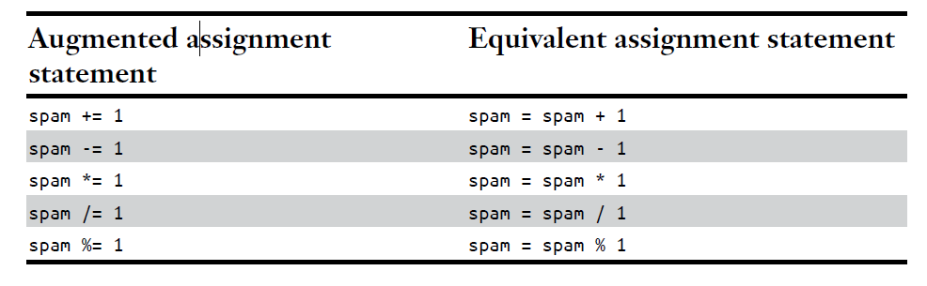
Augmented Assignment Operators

Slide 34
Augmented Assignment Operators
+= operator => used for string and list concatenation
*= operator => used for string and list replication
>>> spam = 'Hello,'
>>> spam += ' world!'
>>> spam
'Hello world!'
>>> bacon = ['Zophie']
>>> bacon *= 3
>>> bacon
['Zophie', 'Zophie', 'Zophie']

Slide 35
Methods
A method is the same as a function, except it is “called on” a value.
The method part comes after the value, separated by a period.
Ex: if a list value were stored in spam, call the index() list method on that list :
spam.index('hello').
Each data type has its own set of methods.
Methods belong to a single data type.
The list data type, has several useful methods for finding, adding, removing, and manipulating values in a list.

Slide 36
Finding a Value in a List with the index() Method
List values have an index() method that can be passed a value, and if that value exists in the list, the index of the value is returned.
If the value isn’t in the list, then Python produces a ValueError error.
>>> spam = ['hello', 'hi', 'howdy', 'heyas']
>>> spam.index('hello')
0
>>> spam.index('heyas')
3
>>> spam.index('howdy howdy howdy')
Traceback (most recent call last):
File "<pyshell#31>", line 1, in <module>
spam.index('howdy howdy howdy')
ValueError: 'howdy howdy howdy' is not in list

Slide 37
Finding a Value in a List with the index() Method
When there are duplicates of the value in the list, the index of its first appearance is returned.
>>> spam = ['Zophie', 'Pooka', 'Fat-tail', 'Pooka']
>>> spam.index('Pooka')
1

Slide 38
Adding Values to Lists with the append() and insert() Methods
To add new values to a list, use append( ) and insert( ) methods
append( ) method call adds the argument to end of the list.
The insert( ) method can insert a value at any index in the list.
The first argument to insert( ) is the index for the new value, and the second argument is the new value to be inserted.
>>> spam = ['cat', 'dog', 'bat']
>>> spam.append('moose')
>>> spam
['cat', 'dog', 'bat', 'moose']
>>> spam = ['cat', 'dog', 'bat']
>>> spam.insert(1, 'chicken')
>>> spam
['cat', 'chicken', 'dog', 'bat']

Slide 39
Adding Values to Lists with the append() and insert() Methods
code is spam.append('moose')
not spam = spam.append('moose')
spam.insert(1, 'chicken'),
not spam = spam.insert(1, 'chicken')
append( ) and insert( ) don’t return
new value of spam. Rather, the list is modified in place.
The return value of append( ) and
insert( ) is None.
append() and insert() methods are list methods and can be called only on list values, not on other values such as
strings or integers.
>>> eggs = 'hello'
>>> eggs.append('world')
Traceback (most recent call last):
File "<pyshell#19>", line 1, in <module>
eggs.append('world')
AttributeError: 'str' object has no attribute 'append'
>>> bacon = 42
>>> bacon.insert(1, 'world')
Traceback (most recent call last):
File "<pyshell#22>", line 1, in <module>
bacon.insert(1, 'world')
AttributeError: 'int' object has no attribute
'insert'

Slide 40
Removing Values from Lists with the remove() Method
>>> spam = ['cat', 'bat', 'rat', 'elephant']
>>> spam.remove('bat')
>>> spam
['cat', 'rat', 'elephant']
The remove() method is passed the value to be removed from the list it is called on.
Attempting to delete a value that does not exist in the list will result in a ValueError error.
>>> spam = ['cat', 'bat', 'rat', 'elephant']
>>> spam.remove('chicken')
Traceback (most recent call last):
File "<pyshell#11>", line 1, in <module>
spam.remove('chicken')
ValueError: list.remove(x): x not in list

Slide 41
Removing Values from Lists with the remove() Method
If the value appears multiple times in the list, only the first instance of
the value will be removed
>>> spam = ['cat', 'bat', 'rat', 'cat', 'hat', 'cat']
>>> spam.remove('cat')
>>> spam
['bat', 'rat', 'cat', 'hat', 'cat']
The del statement is good to use when you know the index of value
you want to remove from the list.
The remove() method is useful when you know the value you want to remove from the list.

Slide 42
Sorting the Values in a List with the sort() Method
>>> spam = [2, 5, 3.14, 1, -7]
>>> spam.sort()
>>> spam
[-7, 1, 2, 3.14, 5]
>>> spam = ['ants', 'cats', 'dogs', 'badgers', 'elephants']
>>> spam.sort()
>>> spam
['ants', 'badgers', 'cats', 'dogs', 'elephants']
List of number values or list of strings can be sorted with the sort() method.
Pass True for the reverse keyword argument to have sort() sort the values in reverse order.
>>> spam.sort(reverse=True)
>>> spam
['elephants', 'dogs', 'cats', 'badgers', 'ants']

Slide 43
Sorting the Values in a List with the sort() Method
Three important things about the sort() method:
1. sort() method sorts the list in place; don’t try to capture the return
value by writing code like spam = spam.sort( )
2. Cannot sort lists that have both number values and string values in them, since Python doesn’t know how to compare these values.
>>> spam = [1, 3, 2, 4, 'Alice', 'Bob']
>>> spam.sort()
Traceback (most recent call last):
File "<pyshell#70>", line 1, in <module>
spam.sort()
TypeError: '<' not supported between instances of 'str' and 'int'

Slide 44
Sorting the Values in a List with the sort() Method
3. sort() uses “ASCIIbetical order” rather than actual alphabetical
order for sorting strings.
This means uppercase letters come before lowercase letters.
Therefore, the lowercase a is sorted so that it comes after the uppercase Z.
To sort the values in regular alphabetical order, pass
str.lower for the key keyword argument in the sort() method call.
>>> spam = ['Alice', 'ants', 'Bob', 'badgers', 'Carol', 'cats']
>>> spam.sort()
>>> spam
['Alice', 'Bob', 'Carol', 'ants', 'badgers', 'cats']
>>> spam = ['a', 'z', 'A', 'Z']
>>> spam.sort(key=str.lower)
>>> spam
['a', 'A', 'z', 'Z']

Slide 45
Reversing the Values in a List with reverse() Method
to quickly reverse the order of the items in a list, call
reverse() list method
Like the sort( ) list method, reverse( ) doesn’t return a list.
This is why you write spam.reverse( ), instead of spam = spam.reverse( ).
>>> spam = ['cat', 'dog', 'moose']
>>> spam.reverse()
>>> spam
['moose', 'dog', 'cat']

Slide 46
EXCEPTIONS TO INDENTATION RULES IN PYTHON
the amount of indentation for a line of code tells Python what block it is in.
There are some exceptions to this rule
Ex: lists can actually span several lines in the source code file.
Indentation of these lines does not matter; Python knows that list is not finished until it sees ending square bracket
spam = ['apples',
'oranges',
'bananas',
'cats']
print(spam)

Slide 47
EXCEPTIONS TO INDENTATION RULES IN PYTHON
split up a single instruction across multiple lines using the \ line continuation character at the end.
\ = “This instruction continues on the next line.”
The indentation on the line after a \ line continuation is not significant
These tricks are useful to rearrange long lines of Python code to be a bit more readable.
print('Four score and seven ' + \
'years ago...')

Slide 48
Sequence Data Types
strings and lists are actually similar if you consider a string to be a “list” of single text characters.
The Python sequence data
types include lists, strings, range objects returned by range(), and tuples
Many of the things you can do with lists can also be done with strings and other values of sequence types: indexing; slicing; using for loops, with len(), in and not in operators.
>>> name = 'Zophie'
>>> name[0]
'Z'
>>> name[-2]
'i'
>>> name[0:4]
'Zoph'
>>> 'Zo' in name
True
>>> 'z' in name
False
>>> 'p' not in name
False
>>> for i in name:
... print('* * * ' + i + ' * * *')
* * * Z * * *
* * * o * * *
* * * p * * *
* * * h * * *
* * * i * * *
* * * e * * *

Slide 49
Mutable and Immutable Data Types
Lists and strings are different in an important way.
A list value is a mutable data type: it can have values added, removed, or changed.
However, a string is immutable: it cannot be changed.
Trying to reassign a single character in a string results in a TypeError error,
>>> name = 'Zophie a cat'
>>> name[7] = 'the'
Traceback (most recent call last):
File "<pyshell#50>", line 1, in <module>
name[7] = 'the'
TypeError: 'str' object does not support item assignment

Slide 50
Mutable and Immutable Data Types
The proper way to “mutate” a string is to use slicing and concatenation to build a new string by copying from parts of the old string.
>>> name = 'Zophie a cat'
>>> newName = name[0:7] + 'the' + name[8:12]
>>> name
'Zophie a cat'
>>> newName
'Zophie the cat'
We used [0:7] and [8:12] to refer to the characters that we don’t wish to replace.
Note that the original 'Zophie a cat' string is not modified, because strings are immutable.

Slide 51
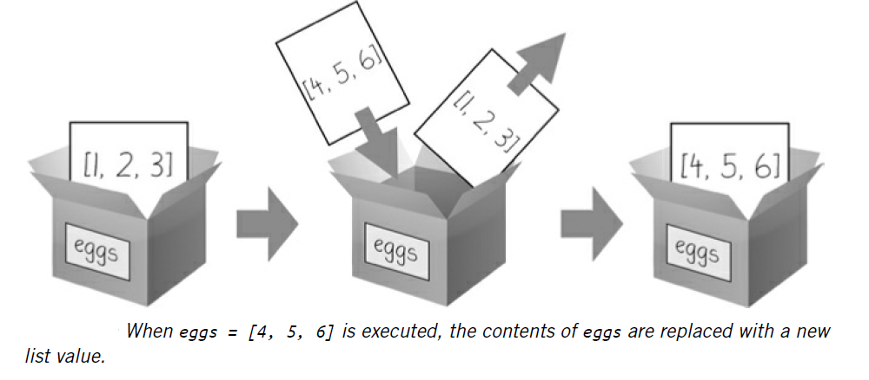
Mutable and Immutable Data Types
Although a list value is mutable, the second line in the following code
does not modify the list eggs:
>>> eggs = [1, 2, 3]
>>> eggs = [4, 5, 6]
>>> eggs
[4, 5, 6]
The list value in eggs isn’t being changed here; rather, an entirely new and different list value ([4, 5, 6]) is overwriting old list value ([1, 2, 3]).
Changing a value of a mutable data type (Ex: del statement and append()) changes value in place, since variable’s value is not replaced with a new list value.

Slide 52
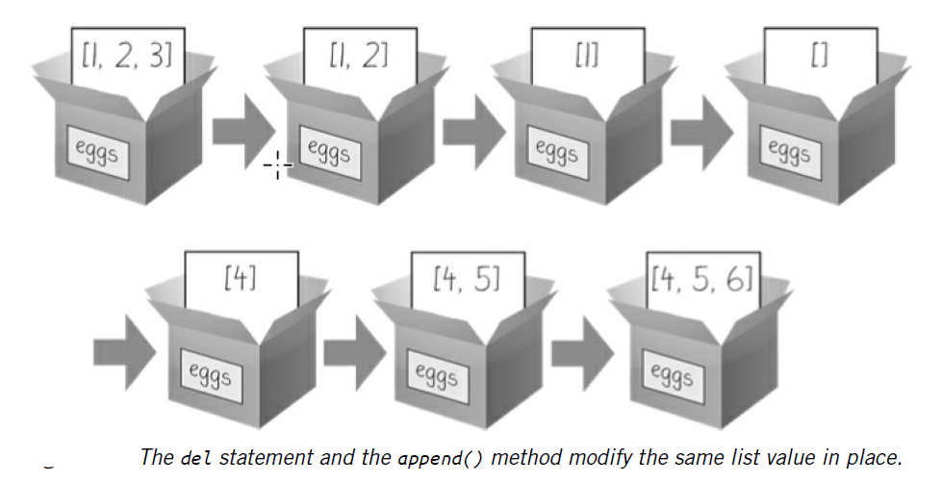
Mutable and Immutable Data Types
To actually modify the original list in eggs to contain [4, 5, 6], do something like this:
>>> eggs = [1, 2, 3]
>>> del eggs[2]
>>> del eggs[1]
>>> del eggs[0]
>>> eggs.append(4)
>>> eggs.append(5)
>>> eggs.append(6)
>>> eggs
[4, 5, 6]

Slide 53
The Tuple Data Type
tuple data type is almost identical to the list data type, except in two ways.
tuples are typed with parentheses, ( ), instead of square brackets, [ ].
tuples, like strings, are immutable, where as lists are mutable. Tuples cannot have their values modified, appended, or removed.
>>> eggs = ('hello', 42, 0.5)
>>> eggs[0]
'hello'
>>> eggs[1:3]
(42, 0.5)
>>> len(eggs)
3
>>> eggs = ('hello', 42, 0.5)
>>> eggs[1] = 99
Traceback (most recent call last):
File "<pyshell#5>", line 1, in <module>
eggs[1] = 99
TypeError: 'tuple' object does not support item assignment

Slide 54
The Tuple Data Type
If only one value is present in a tuple, then indicate this by placing
a trailing comma after the value inside the parentheses.
Otherwise, Python will think you’ve just typed a value inside regular parentheses.
The comma lets Python know this is a tuple value.
Ex: type() function
>>> type(('hello',))
<class 'tuple'>
>>> type(('hello'))
<class 'str'>

Slide 55
The Tuple Data Type
Tuples are immutable and their contents don’t change
Use tuples to convey reader that you don’t intend for that sequence
of values to change.
Uses a tuple:
1. If you need an ordered sequence of values that never changes.
2. Since code using tuples run slightly faster than code using lists, can be used to implement some optimizations .

Slide 56
Converting Types with the list() and tuple() Functions
str(42) will return '42', the string representation of the integer 42
Functions list() and tuple() will return list and tuple versions of the values passed to them.
Note that the return value is of a different data type for the values passed:
>>> tuple(['cat', 'dog', 5])
('cat', 'dog', 5)
>>> list(('cat', 'dog', 5))
['cat', 'dog', 5]
>>> list('hello')
['h', 'e', 'l', 'l', 'o']
Converting a tuple to a list is handy when a mutable version of a tuple value is needed

Slide 57
References
Variables “store” strings and integer values.
This is a simplification explanation of what Python is actually doing
Technically, variables are storing references to the computer memory locations where the values are stored.
When you assign 42 to the spam variable, you are actually creating the 42 value in the computer’s memory and storing a reference to it in the spam
When you copy the value in spam and assign it to the variable cheese, you are actually copying the reference.
>>> spam = 42
>>> cheese = spam
>>> spam = 100
>>> spam
100
>>> cheese
42

Slide 58
References
Both the spam and cheese variables refer to the 42 value in the computer’s memory.
When you later change the value in spam to 100, you’re creating a new 100 value and storing a reference to it in spam. This doesn’t affect the value in cheese.
Integers are immutable values that don’t change; changing the spam variable is actually making it refer to a completely different value in memory.
>>> spam = 42
>>> cheese = spam
>>> spam = 100
>>> spam
100
>>> cheese
42

Slide 59
References
Lists don’t work like variables, because lists are mutable, that is, list values can change.
Consider the code that will make this distinction easier to understand:
➊ >>> spam = [0, 1, 2, 3, 4, 5]
➋ >>> cheese = spam # The reference is being copied, not the list.
➌ >>> cheese[1] = 'Hello!' # This changes the list value.
>>> spam
[0, 'Hello!', 2, 3, 4, 5]
>>> cheese # The cheese variable refers to the same list.
[0, 'Hello!', 2, 3, 4, 5]
The code touched only the cheese list, but
both the cheese and spam
lists have changed.

Slide 60
References
When you create the list ➊, you assign a reference to it in the spam variable.
But the next line ➋ copies only the list reference in spam to cheese, not the list value itself.
This means the values stored in spam and cheese now both refer to the same list.
There is only one underlying list because the list itself was never actually copied.
➊ >>> spam = [0, 1, 2, 3, 4, 5]
➋ >>> cheese = spam # The reference is being copied, not the list.
➌ >>> cheese[1] = 'Hello!' # This changes the list value.
>>> spam
[0, 'Hello!', 2, 3, 4, 5]
>>> cheese # The cheese variable refers to the same list.
[0, 'Hello!', 2, 3, 4, 5]
So when you modify the first element of cheese ➌, you are modifying the same list that spam refers to.

Slide 61
References
Variables are like boxes that contain values.
Lists in boxes aren’t exactly accurate, because list variables don’t actually contain lists—they contain references to lists.
These references will have ID numbers that Python uses internally
What happens when a list is assigned to the spam variable is visualized using boxes as a metaphor.

Slide 62
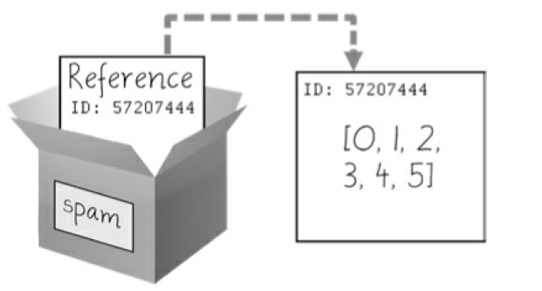
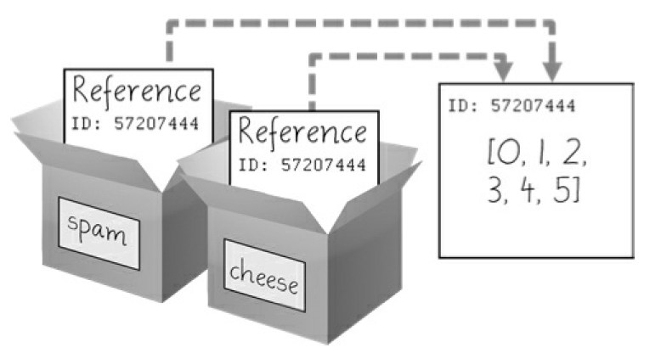
References
➊ >>> spam = [0, 1, 2, 3, 4, 5]
➋ >>> cheese = spam # The reference is being copied, not the list.
➌ >>> cheese[1] = 'Hello!' # This changes the list value.
>>> spam
[0, 'Hello!', 2, 3, 4, 5]
>>> cheese # The cheese variable refers to the same list.
[0, 'Hello!', 2, 3, 4, 5]
spam = [0, 1, 2, 3, 4, 5] stores a reference to a list, not the actual list.
cheese[1] = 'Hello!' modifies the list that both variables refer to.
spam = cheese copies the reference, not the list.
Notes:
the reference in spam is copied to cheese. Only a new reference was created and stored in cheese, not a new list. Note how both references refer to the same list.
When you alter the list that cheese refers to, the list that spam refers to is also changed, because both cheese and spam refer to the same list.
Although Python variables technically contain references to values,
people often casually say that the variable contains the value.

Slide 63
Identity and the id() Function
All values in Python have a unique identity that can be obtained with the id() function.
>>> id('Howdy') # returned number depend on machine.
44491136
When Python runs id('Howdy'), it creates the 'Howdy' string in the
computer’s memory.
The numeric memory address where the string is stored is returned by the id() function.
Python picks this address based on which memory bytes happen to be free on computer at the time, so it’ll be different each time you run this code.
Notes:
You may be wondering why the weird behavior with mutable lists in the previous section doesn’t happen with immutable values like integers or strings. We can use Python’s id() function to understand this.

Slide 64
Identity and the id() Function
Like all strings, 'Howdy' is immutable and cannot be changed.
If you “change” the string in a variable, a new string object is being made at a different place in memory, and the variable refers to this new string.
Ex:
>>> bacon = 'Hello'
>>> id(bacon)
44491136
>>> bacon += ' world!' # A new string is made from 'Hello' and ' world!'.
>>> id(bacon) # bacon now refers to a completely different string.
44609712
Notes:
You may be wondering why the weird behavior with mutable lists in the previous section doesn’t happen with immutable values like integers or strings. We can use Python’s id() function to understand this.

Slide 65
Identity and the id() Function
>>> eggs = ['cat', 'dog'] # This creates a new list.
>>> id(eggs)
35152584
>>> eggs.append('moose') # append() modifies the list
"in place".
>>> id(eggs) # eggs still refers to the same list as
before.
35152584
>>> eggs = ['bat', 'rat', 'cow'] # This creates a new list,
which has a new identity.
>>> id(eggs) # eggs now refers to a completely
different list.
44409800
Lists can be modified because they are mutable objects
append() method doesn’t create a new list object; it changes existing list object.
This is known as “modifying the object in-place.”

Slide 66
Identity and the id() Function
If two variables refer to the same list (like spam and cheese in the previous section) and the list value itself changes, both variables are affected because they both refer to same list.
The append(), extend(), remove(), sort(), reverse(), and other list methods modify their lists in place.
Python’s automatic garbage collector deletes any values not being
referred to by any variables to free up memory.
Notes:
You don’t need to worry about how the garbage collector works, which is a good thing: manual
memory management in other programming languages is a common source of bugs.

Slide 67
Passing References
passingReference.py:
def eggs(someParameter):
someParameter.append('Hello')
spam = [1, 2, 3]
eggs(spam)
print(spam)
References are particularly important for understanding how arguments get passed to functions
When a function is called, the values of the arguments are copied to the parameter variables.
For lists and dictionaries, this means a copy of the reference is used for the parameter.
Note that when eggs() is called, a return value is not used to assign a new value to spam.

Slide 68
Passing References
passingReference.py:
def eggs(someParameter):
someParameter.append('Hello')
spam = [1, 2, 3]
eggs(spam)
print(spam)
Note that when eggs() is called, a return value is not used to assign a new value to spam.
Instead, it modifies the list in place, directly.
When run, this program produces the following output:
[1, 2, 3, 'Hello']
Even though spam & someParameter contain separate references, they both refer to same list.
This is why the append('Hello') method call inside the function affects the list even after the function call has returned.

Slide 69
copy Module’s copy() and deepcopy() Functions
Although passing around references is often the handiest way to deal with lists and dictionaries, if the function modifies the list or dictionary that is passed, you may not want these changes in the original list or dictionary value.
For this, Python provides a module named copy that provides both
the copy() and deepcopy() functions.
copy.copy(), can be used to make a duplicate copy of a mutable value like a list or dictionary, not just a copy of a reference.

Slide 70
copy Module’s copy() and deepcopy() Functions
>>> import copy
>>> spam = ['A', 'B', 'C', 'D']
>>> id(spam)
44684232
>>> cheese = copy.copy(spam)
>>> id(cheese) # cheese is a different list with different
identity.
44685832
>>> cheese[1] = 42
>>> spam
['A', 'B', 'C', 'D']
>>> cheese
['A', 42, 'C', 'D']
copy.copy(), can be used to make a duplicate copy of a mutable value like a list or dictionary, not just a copy of a reference.

Slide 71
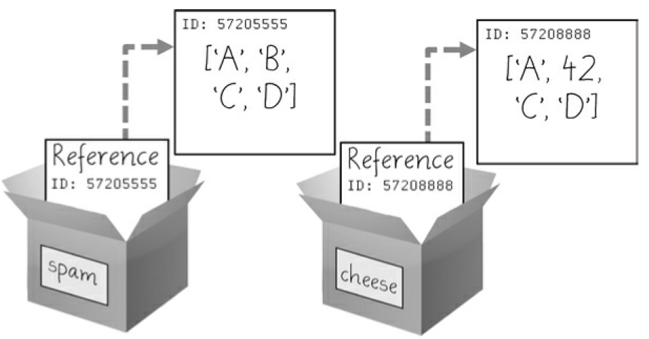
copy Module’s copy() and deepcopy() Functions
Now the spam and cheese variables refer to separate lists, which is why only the list in cheese is modified when you assign 42 at index 1.
cheese = copy.copy(spam) creates a second list that can be modified independently of first.
reference ID numbers are no longer the same for both variables because the variables refer to independent lists.

Slide 72
copy Module’s copy() and deepcopy() Functions
If the list you need to copy contains lists, then use the copy.deepcopy() function instead of copy.copy().
The deepcopy() function will copy these inner lists as well. A Short Program: Conway’s Game
Notes:
Demonstrate through a snippet deepcopy functionality

Slide 73
DICTIONARIES and STRUCTURING DATA

Slide 74
The Dictionary Data Type
Dictionary data type, provides a flexible way to access and organize data
Dictionary is a mutable collection of many values
Unlike indexes for lists, indexes for dictionaries can use many different data types, not just integers.
Indexes for dictionaries are called keys, and a key with its associated value is called a key-value pair.
dictionary is typed with braces, { }.

Slide 75
The Dictionary Data Type
>>> myCat = {'size': 'fat', 'color': 'gray', 'disposition': 'loud'}
This assigns a dictionary to the myCat variable
This dictionary’s keys are 'size', 'color', and 'disposition'.
The values for these keys are 'fat', 'gray', and 'loud', respectively.
You can access these values through their keys:
>>> myCat['size']
'fat'
>>> 'My cat has ' + myCat['color'] + ' fur.'
'My cat has gray fur.'

Slide 76
The Dictionary Data Type
Ex:
>>> myCat = {'size': 'fat', 'color': 'gray', 'disposition': 'loud'}
Dictionaries can still use integer values as keys, just like lists use
integers for indexes, but they do not have to start at 0 and can be
any number.
>>> spam = {12345: 'Luggage Combination', 42: 'The Answer'}

Slide 77
Dictionaries vs. Lists
Unlike lists, items in dictionaries are unordered.
The first item in a list named spam would be spam[0].
But there is no “first” item in a dictionary.
Order of items matters for determining whether two lists are the same.
But it does not matter in what order the key-value pairs are typed in a dictionary.
Because dictionaries are not ordered, they can’t be sliced like lists.
>>> spam = ['cats', 'dogs', 'moose']
>>> bacon = ['dogs', 'moose', 'cats']
>>> spam == bacon
False
>>> eggs = {'name': 'Zophie', 'species': 'cat', 'age': '8'}
>>> ham = {'species': 'cat', 'age': '8', 'name': 'Zophie'}
>>> eggs == ham
True

Slide 78
Dictionaries vs. Lists
List’s throws IndexError error message, when “out-of-range” is encountered
Similarly, trying to access a key that does not exist in a dictionary will result in a KeyError error message.
>>> spam = {'name': 'Zophie', 'age': 7}
>>> spam['color']
Traceback (most recent call last):
File "<pyshell#1>", line 1, in <module>
spam['color']
KeyError: 'color'
Error message shows up because there is no 'color' key:

Slide 79
Dictionaries vs. Lists
Though dictionaries are not ordered, the arbitrary values for the keys allows to organize data in powerful ways.
Ex: Consider a program that stores data about friends’ birthdays.
Use a dictionary with the names as keys and the birthdays as values.
Consider a program: birthdays.py

Slide 80
Dictionaries vs. Lists
Enter a name: (blank to quit)
Alice
Apr 1 is the birthday of Alice
Enter a name: (blank to quit)
Eve
I do not have birthday information for Eve
What is their birthday?
Dec 5
Birthday database updated.
Enter a name: (blank to quit)
Eve
Dec 5 is the birthday of Eve
Enter a name: (blank to quit)
➊ birthdays = {'Alice': 'Apr 1', 'Bob': 'Dec 12', 'Carol': 'Mar 4'}
while True:
print('Enter a name: (blank to quit)')
name = input()
if name == '':
break
➋ if name in birthdays:
➌ print(birthdays[name] + ' is the birthday of ' + name)
else:
print('I do not have birthday information for ' + name)
print('What is their birthday?')
bday = input()
➍ birthdays[name] = bday
print('Birthday database updated.')
Notes:
You can view the execution of this program at
https://autbor.com/bdaydb.
You create an initial dictionary and store it in
birthdays ➊. You can see if the entered name exists as a key in the
dictionary with the in keyword ➋, just as you did for lists. If the name is in
the dictionary, you access the associated value using square brackets ➌; if
not, you can add it using the same square bracket syntax combined with
the assignment operator ➍.
Of course, all the data you enter in this program is forgotten when the
program terminates.

Slide 81
ORDERED DICTIONARIES IN PYTHON 3.7
Dictionaries will remember the insertion order of their key-value pairs if you create a sequence value from them
Ex: note the order of items in the lists made from the eggs and ham dictionaries matches the order in which they were entered:
>>> eggs = {'name': 'Zophie', 'species': 'cat', 'age': '8'}
>>> list(eggs)
['name', 'species', 'age']
>>> ham = {'species': 'cat', 'age': '8', 'name': 'Zophie'}
>>> list(ham)
['species', 'age', 'name']

Slide 82
The keys(), values(), and items() Methods
keys(), values(), and items(): are three dictionary methods that will return list- like values of the dictionary’s keys, values, or both keys and values.
The values returned by these methods are not true lists: they cannot be modified and do not have an append() method.
But these data types (dict_keys, dict_values, and dict_items, respectively) can be used in for loops.
>>> spam = {'color': 'red', 'age': 42}
>>> for v in spam.values():
... print(v)
red
42
Here, a for loop iterates over each of the values in the spam dictionary.

Slide 83
The keys(), values(), and items() Methods
A for loop can also iterate over the keys or both keys and values.
When you use the keys(), values(), and items() methods, a for loop can
iterate over the keys, values, or key-value pairs in a dictionary, respectively.
>>> for k in spam.keys():
... print(k)
color
age
>>> for i in spam.items():
... print(i)
('color', 'red')
('age', 42)
Note that the values in the dict_items value returned by the items() method are tuples of the key and value.

Slide 84
The keys(), values(), and items() Methods
If you want a true list from one of these methods, pass its list-like
return value to the list() function.
The list(spam.keys()) line takes the dict_keys value returned from keys()
and passes it to list(), which then returns a list value of ['color', 'age'].
>>> spam = {'color': 'red', 'age': 42}
>>> spam.keys()
dict_keys(['color', 'age'])
>>> list(spam.keys())
['color', 'age']

Slide 85
The keys(), values(), and items() Methods
Use the multiple assignment trick in a for loop to assign
the key and value to separate variables.
>>> spam = {'color': 'red', 'age': 42}
>>> for k, v in spam.items():
... print('Key: ' + k + ' Value: ' + str(v))
Key: age Value: 42
Key: color Value: red

Slide 86
Checking Whether a Key or Value Exists in a Dictionary
in and not in operators are used to check whether a value exists in a list
Similarly use these operators to see whether a certain key or value exists in a dictionary
>>> spam = {'name': 'Zophie', 'age': 7}
>>> 'name' in spam.keys()
True
>>> 'Zophie' in spam.values()
True
>>> 'color' in spam.keys()
False
>>> 'color' not in spam.keys()
True
>>> 'color' in spam
False

Slide 87
Checking Whether a Key or Value Exists in a Dictionary
'color' in spam is essentially a shorter version of writing 'color' in spam.keys().
This is always the case: if you ever want to check whether a value is (or isn’t) a key in the dictionary, you can simply use the in (or not in) keyword with the dictionary value itself.
>>> spam = {'name': 'Zophie', 'age': 7}
>>> 'name' in spam.keys()
True
>>> 'Zophie' in spam.values()
True
>>> 'color' in spam.keys()
False
>>> 'color' not in spam.keys()
True
>>> 'color' in spam
False

Slide 88
The get() Method
To check whether a key exists in a dictionary before accessing that key’s value, dictionaries have a get() method.
It takes two arguments: the key of the value to retrieve and a fallback value to return if that key does not exist.
>>> picnicItems = {'apples': 5, 'cups': 2}
>>> 'I am bringing ' + str(picnicItems.get('cups', 0)) + ' cups.'
'I am bringing 2 cups.'
>>> 'I am bringing ' + str(picnicItems.get('eggs', 0)) + ' eggs.'
'I am bringing 0 eggs.'

Slide 89
The get() Method
Because there is no 'eggs' key in the picnicItems dictionary, the default
value 0 is returned by the get() method.
Without using get(), the code would have caused an error message,
>>> picnicItems = {'apples': 5, 'cups': 2}
>>> 'I am bringing ' + str(picnicItems['eggs']) + ' eggs.'
Traceback (most recent call last):
File "<pyshell#34>", line 1, in <module>
'I am bringing ' + str(picnicItems['eggs']) + ' eggs.'
KeyError: 'eggs'

Slide 90
The setdefault() Method
setdefault() method is used to set a value in a dictionary for a certain key only if that key does not already have a value.
in and not in are used as follows: ???????check and put output here
spam = {'name': 'Pooka', 'age': 5}
if 'color' not in spam:
spam['color'] = 'black'

Slide 91
The setdefault() Method
setdefault() method is used to set a value in a dictionary for a certain key only if that key does not already have a value.
setdefault() method offers a way to do this in one line of code.
The first argument passed to the method is the key to check for, and second argument is value to set at that key if the key does not exist.
If the key does exist, the setdefault() method returns the key’s value.
spam = {'name': 'Pooka', 'age': 5}
if 'color' not in spam:
spam['color'] = 'black'

Slide 92
The setdefault() Method
setdefault() method is used to set a value in a dictionary for a certain key only if that key does not already have a value.
The first argument passed to the method is the key to check for, and second argument is value to set at that key if the key does not exist.
If the key does exist, setdefault() method returns the key’s value.
>>> spam = {'name': 'Pooka', 'age': 5}
>>> spam.setdefault('color', 'black')
'black'
>>> spam
{'color': 'black', 'age': 5, 'name': 'Pooka'}
>>> spam.setdefault('color', 'white')
'black'
>>> spam
{'color': 'black', 'age': 5, 'name': 'Pooka'}
Notes:
setdefault() method offers a way to do this in one line of code.

Slide 93
The setdefault() Method
The first time setdefault() is called, the dictionary in spam changes to
{'color': 'black', 'age': 5, 'name': 'Pooka'}.
The method returns value 'black' because this is now the value set for the key 'color'.
When spam.setdefault('color', 'white') is called next, the value for that key is not changed to 'white', because spam already has a key named 'color'.
>>> spam = {'name': 'Pooka', 'age': 5}
>>> spam.setdefault('color', 'black')
'black'
>>> spam
{'color': 'black', 'age': 5, 'name': 'Pooka'}
>>> spam.setdefault('color', 'white')
'black'
>>> spam
{'color': 'black', 'age': 5, 'name': 'Pooka'}
Notes:
setdefault() method offers a way to do this in one line of code.

Slide 94
The setdefault() Method
characterCount.py:
message = 'It was a bright cold day in April, and the clocks were striking thirteen.'
count = {}
for character in message:
➊ count.setdefault(character, 0)
➋ count[character] = count[character] + 1
print(count)
The setdefault() method call ➊ ensures that the key is in the count dictionary (with a default value of 0) so the program doesn’t throw a KeyError error when count[character] = count[character] + 1 is executed ➋.
The program loops over each character in the message variable’s string, counting how often each character appears.
Notes:
You can view the execution of this program at
https://autbor.com/setdefault.

Slide 95
Pretty Printing
characterCount.py:
message = 'It was a bright cold day in April, and the clocks were striking thirteen.'
count = {}
for character in message:
➊ count.setdefault(character, 0)
➋ count[character] = count[character] + 1
print(count)
In Output, lowercase letter c appears 3 times, space character appears 13 times & uppercase letter A appears 1 time.
This program will work no matter what string is inside the message variable, even if the string is millions of characters long!
Output:
{' ': 13, ',': 1, '.': 1, 'A': 1, 'I': 1, 'a': 4, 'c': 3, 'b': 1, 'e': 5, 'd': 3, 'g': 2,
'i': 6, 'h': 3, 'k': 2, 'l': 3, 'o': 2, 'n': 4, 'p': 1, 's': 3, 'r': 5, 't': 6,
'w': 2, 'y': 1}
Notes:
You can view the execution of this program at
https://autbor.com/setdefault.

Slide 96
Pretty Printing
import pprint module into programs, to have access to pprint() and pformat() functions that will “pretty print” a dictionary’s values.
Helpful when a cleaner display of the items is needed in a dictionary than what print() provides.
import pprint
message = 'It was a bright cold day in April, and the clocks were striking
thirteen.'
count = {}
for character in message:
count.setdefault(character, 0)
count[character] = count[character] + 1
pprint.pprint(count)
Consider prettyCharacterCount.py.
{' ': 13,
',': 1,
'.': 1,
'A': 1,
'I': 1,
--snip--
't': 6,
'w': 2,
'y': 1}
This time, when the program is run, the output
looks much cleaner, with the keys sorted.
Notes:
You can view the execution of this program at
https://autbor.com/pprint/.
Modify the previous
characterCount.py program and save it as prettyCharacterCount.py.

Slide 97
Nested Dictionaries and Lists
As you model more complicated things, you may find you need dictionaries and lists that contain other dictionaries and lists.
Lists are useful to contain an ordered series of values, and dictionaries are useful for associating keys with values.
Ex: Consider a program that uses a dictionary that contains
other dictionaries of ‘what items guests are bringing to a picnic’.
The totalBrought() function can read this data structure and calculate the total number of an item being brought by all the guests.
Notes:
.

Slide 98
Nested Dictionaries and Lists
allGuests = {'Alice': {'apples': 5, 'pretzels': 12},
'Bob': {'ham sandwiches': 3, 'apples': 2},
'Carol': {'cups': 3, 'apple pies': 1}}
def totalBrought(guests, item):
numBrought = 0
➊ for k, v in guests.items():
➋ numBrought = numBrought + v.get(item, 0)
return numBrought
print('Number of things being brought:')
print(' - Apples ' + str(totalBrought(allGuests, 'apples')))
print(' - Cups ' + str(totalBrought(allGuests, 'cups')))
print(' - Cakes ' + str(totalBrought(allGuests, 'cakes')))
print(' - Ham Sandwiches ' + str(totalBrought(allGuests, 'ham sandwiches')))
print(' - Apple Pies ' + str(totalBrought(allGuests, 'apple pies')))
Notes:
You can view the execution of this program at
https://autbor.com/guestpicnic/.

Slide 99
Nested Dictionaries and Lists
Inside the totalBrought() function, the for loop iterates over the key-value pairs in guests ➊.
Inside the loop, the string of the guest’s name is assigned to k, and the dictionary of picnic items they’re bringing is assigned to v.
If the item parameter exists as a key in this dictionary, its value (the quantity) is added to numBrought ➋.
If it does not exist as a key, the get() method returns 0 to be added to
numBrought.
Notes:
You can view the execution of this program at
https://autbor.com/guestpicnic/.

Slide 100
Nested Dictionaries and Lists
allGuests = {'Alice': {'apples': 5, 'pretzels': 12},
'Bob': {'ham sandwiches': 3, 'apples': 2},
'Carol': {'cups': 3, 'apple pies': 1}}
def totalBrought(guests, item):
numBrought = 0
➊ for k, v in guests.items():
➋ numBrought = numBrought + v.get(item, 0)
return numBrought
print('Number of things being brought:')
print(' - Apples ' + str(totalBrought(allGuests, 'apples')))
print(' - Cups ' + str(totalBrought(allGuests, 'cups')))
print(' - Cakes ' + str(totalBrought(allGuests, 'cakes')))
print(' - Ham Sandwiches ' + str(totalBrought(allGuests, 'ham sandwiches')))
print(' - Apple Pies ' + str(totalBrought(allGuests, 'apple pies')))
Output:
Number of things being brought:
- Apples 7
- Cups 3
- Cakes 0
- Ham Sandwiches 3
- Apple Pies 1
Notes:
You can view the execution of this program at
https://autbor.com/guestpicnic/.

Slide 101
Nested Dictionaries and Lists
This may seem like such a simple thing to model that you may feel no
need to bother with writing a program to do it.
But realize that this same totalBrought() function could easily handle a
dictionary that contains thousands of guests, each bringing thousands of
different picnic items.
Then having this information in a data structure along with the
totalBrought() function would save you a lot of time!
Model things with data structures in whatever way needed, as
long as the rest of the code in your program can work with the data
model correctly.
When you first begin programming, don’t worry so much about the “right” way to model data.
As you gain more experience, you may come up with more efficient models.
Important thing is that the data model works for your program’s needs.
Notes:
You can view the execution of this program at
https://autbor.com/guestpicnic/.

Slide 102
Summary
Lists and dictionaries are values that can contain multiple values, including other lists and dictionaries.
Dictionaries are useful because you can map one item (key) to another (value), as opposed to lists, which simply contain a series of values in order
Values inside a dictionary are accessed using square brackets just as with lists.
Instead of an integer index, dictionaries can have keys of a variety of data types: integers, floats, strings, or tuples.
By organizing a program’s values into data structures, you can create
representations of real-world objects.
Notes:
Sample programs, questions, projects

