Slide 1
Classes and Objects

Slide 2
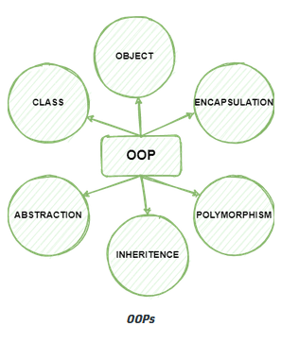
Objected oriented programming using Python

Slide 3
Class in OOPS
A programmer-defined type is also called a class.
The class can be defined as a collection of objects.
class Point:
"""Represents a point in 2-D space.""“
print(point)
The header indicates that the new class is called Point. The body is a docstring that explains what the class is for.

Slide 4
Contd…
Defining a class named Point creates a class object:
>>> Point
<class '__main__.Point'>
The class object is like a factory for creating objects.
>>> blank = Point()
>>> blank
Print(blank)
<__main__.Point object at 0xb7e9d3ac>
The return value is a reference to a Point object, which we assign to blank.

Slide 5
Objects
Creating a new object is called instantiation, and the object is an instance of the class.
When you print an instance, Python tells you what class it belongs to and where it is stored in memory (the prefix 0x means that the following number is in hexadecimal).
Every object is an instance of some class, so “object” and “instance” are interchangeable.

Slide 6
Attributes
You can assign values to an instance using dot notation:
>>> blank.x = 3.0
>>> blank.y = 4.0
In this case, we are assigning values to named elements of an object. These elements are called attributes.
Attributes represent the characteristics of a class. When an object is instantiated and the values are assigned to attributes, they are then referred to as instance variables.
>>> blank.y
4.0
>>> x = blank.x
>>> x
3.0

Slide 7
Contd…
You can use dot notation as part of any expression.
>>> '(%g, %g)' % (blank.x, blank.y)
'(3.0, 4.0)'
>>> distance = math.sqrt(blank.x**2 + blank.y**2)
>>> distance
5.0
You can pass an instance as an argument in the usual way.
def print_point(p):
print('(%g, %g)' % (p.x, p.y))
print_point takes a point as an argument and displays it in mathematical notation.
>>> print_point(blank)
(3.0, 4.0)
Inside the function, p is an alias for blank, so if the function modifies p, blank changes.

Slide 8
Rectangles
There are at least two possibilities:
You could specify one corner of the rectangle (or the center), the width and the height.
You could specify two opposing corners.
Class definition:
class Rectangle:
"""Represents a rectangle.
attributes: width, height, corner.
""“
The docstring lists the attributes: width and height are numbers; corner is a Point object that specifies the lower-left corner.

Slide 9
Contd…
To represent a rectangle, you have to instantiate a Rectangle object and assign values to the attributes
box = Rectangle()
box.width = 100.0
box.height = 200.0
box.corner = Point()
box.corner.x = 0.0
box.corner.y = 0.0

Slide 10
Instances as Return Values
Functions can return instances.
def find_center(rect):
p = Point()
p.x = rect.corner.x + rect.width/2
p.y = rect.corner.y + rect.height/2
return p
passes box as an argument and assigns the resulting Point to center:
>>> center = find_center(box)
>>> print_point(center)
(50, 100)

Slide 11
Objects Are Mutable
You can change the state of an object by making an assignment to one of its attributes.
box.width = box.width + 50
box.height = box.height + 100
You can also write functions that modify objects.
def grow_rectangle(rect, dwidth, dheight):
rect.width += dwidth
rect.height += dheight
Here is an example that demonstrates the effect:
>>> box.width, box.height
(150.0, 300.0)
>>> grow_rectangle(box, 50, 100)
>>> box.width, box.height
(200.0, 400.0)

Slide 12
Copying
Aliasing can make a program difficult to read because changes in one place might have unexpected effects in another place. It is hard to keep track of all the variables that might refer to a given object.
Copying an object is often an alternative to aliasing. The copy module contains a function called copy that can duplicate any object:

Slide 13
Contd…
>>> p1 = Point()
>>> p1.x = 3.0
>>> p1.y = 4.0
>>> import copy
>>> p2 = copy.copy(p1)
p1 and p2 contain the same data, but they are not the same Point:
>>> print_point(p1)
(3, 4)
>>> print_point(p2)
(3, 4)
>>> p1 is p2
False
>>> p1 == p2
False

Slide 14
copy.copy
If you use copy.copy to duplicate a Rectangle, you will find that it copies the Rectangle object but not the embedded Point:
>>> box2 = copy.copy(box)
>>> box2 is box
False
>>> box2.corner is box.corner
True

Slide 15
deep copy
deepcopy that copies not only the object but also the objects it refers to and the objects they refer to and so on.
>>> box3 = copy.deepcopy(box)
>>> box3 is box
False
>>> box3.corner is box.corner
False
box3 and box are completely separate objects.

Slide 16
Debugging
If you try to access an attribute that doesn’t exist, you get an AttributeError:
>>> p = Point()
>>> p.x = 3
>>> p.y = 4
>>> p.z
AttributeError: Point instance has no attribute 'z'

Slide 17
Contd…
You can also use a try statement to see if the object has the attributes you need:
try:
x = p.x
except AttributeError:
x = 0
If you are not sure what type an object is, you can ask:
>>> type(p)
<class '__main__.Point'>
You can also use isinstance to check whether an object is an instance of a class:
>>> isinstance(p, Point)
True

Slide 18
Contd…
If you are not sure whether an object has a particular attribute, you can use the builtin function hasattr:
>>> hasattr(p, 'x')
True
>>> hasattr(p, 'z')
False
The first argument can be any object; the second argument is a string that contains the name of the attribute.

Slide 19
Classes and functions
Time
Define a class called Time that records the time of day.
class definition
class Time:
"""Represents the time of day.
attributes: hour, minute, second
"""
We can create a new Time object and assign attributes for hours, minutes and seconds:
time = Time()
time.hour = 11
time.minute = 59
time.second = 30

Slide 20
Pure functions

Slide 21
Contd…

Slide 22
Pure functions
The function add_ time() takes two arguments of type Time, and returns a Time object, whereas, it is not modifying contents of its arguments t1 and t2. Such functions are called as pure functions.
The function creates a new Time object, initializes its attributes and returns a reference to the new object. This is called a pure function because it does not modify any of the objects passed to it as arguments and it has no effect, like displaying a value or getting user input, other than returning a value.

Slide 23
Modifiers
Sometimes it is useful for a function to modify the objects it gets as parameters. In that case, the changes are visible to the caller. Functions that work this way are called modifiers.
increment, which adds a given number of seconds to a Time object, can be written naturally as a modifier.

Slide 24
Contd…

Slide 25
Classes and Methods
Object-Oriented Features
Python is an object-oriented programming language, which means that it provides features that support object-oriented programming, which has these defining characteristics:
Programs include class and method definitions.
Most of the computation is expressed in terms of operations on objects.
Objects often represent things in the real world, and methods often correspond to the ways things in the real world interact.

Slide 26
Methods
A method is a function that is associated with a particular class.
Methods are semantically the same as functions, but there are two syntactic differences:
Methods are defined inside a class definition in order to make the relationship between the class and the method explicit.
The syntax for invoking a method is different from the syntax for calling a function.

Slide 27
Printing Objects
class Time:
"""Represents the time of day."""
def print_time(time):
print('%.2d:%.2d:%.2d' % (time.hour, time.minute, time.second))
To call this function, you have to pass a Time object as an argument:
>>> start = Time()
>>> start.hour = 9
>>> start.minute = 45
>>> start.second = 00
>>> print_time(start)
09:45:00

Slide 28
Contd…
class Time:
def print_time(time):
print('%.2d:%.2d:%.2d' % (time.hour, time.minute, time.second))
>>> Time.print_time(start)
09:45:00
>>> start.print_time()
09:45:00
In this use of dot notation, print_time is the name of the method (again), and start is the object the method is invoked on, which is called the subject.
Inside the method, the subject is assigned to the first parameter, so in this case start is assigned to time.
By convention, the first parameter of a method is called self, so it would be more common to write print_time like this:
class Time:
def print_time(self):
print('%.2d:%.2d:%.2d' % (self.hour, self.minute, self.second))

Slide 29
The init Method
The init method (short for “initialization”) is a special method that gets invoked when an object is instantiated. Its full name is __init__ (two underscore characters, followed by init, and then two more underscores).
def __init__(self, hour=0, minute=0, second=0):
self.hour = hour
self.minute = minute
self.second = second

Slide 30
Contd…
It is common for the parameters of __init__ to have the same names as the attributes. The statement
self.hour = hour
stores the value of the parameter hour as an attribute of self.
The parameters are optional, so if you call Time with no arguments, you get the default values:
>>> time = Time()
>>> time.print_time()
00:00:00
If you provide one argument, it overrides hour:
>>> time = Time (9)
>>> time.print_time()
09:00:00
If you provide two arguments, they override hour and minute:
>>> time = Time(9, 45)
>>> time.print_time()
09:45:00
And if you provide three arguments, they override all three default values.

Slide 31
The __str__ Method
__str__ is a special method, like __init__, that is supposed to return a string representation of an object.
def __str__(self):
return '%.2d:%.2d:%.2d' % (self.hour, self.minute, self.second)
When you print an object, Python invokes the str method:
>>> time = Time(9, 45)
>>> print(time)
09:45:00
When you write a new class, start by writing __init__, which makes it easier to instantiate objects and __str__, which is useful for debugging.

Slide 32
Operator overloading
Ability of an existing operator to work on user-defined data type (class) is known as operator overloading.
Operator Overloading means giving extended meaning beyond their predefined operational meaning.
For example operator + is used
To add two integers
To join two strings
To merge two lists.
It is achievable because ‘+’ operator is overloaded by int class and str class.
The same built-in operator or function shows different behavior for objects of different classes, this is called Operator Overloading.

Slide 33
Contd…

Slide 34
Operator Overloading
By defining other special methods, you can specify the behavior of operators on programmer-defined types
def __add__(self, other):
seconds = self.time_to_int() + other.time_to_int()
return int_to_time(seconds)
>>> start = Time(9, 45)
>>> duration = Time(1, 35)
>>> print(start + duration)
11:20:00
When you apply the + operator to Time objects, Python invokes __add__. When you print the result, Python invokes __str__.

Slide 35
Type-Based Dispatch
def __add__(self, other):
if isinstance(other, Time):
return self.add_time(other)
else:
return self.increment(other)
def add_time(self, other):
seconds = self.time_to_int() + other.time_to_int()
return int_to_time(seconds)
def increment(self, seconds):
seconds += self.time_to_int()
return int_to_time(seconds)

Slide 36
Contd…
If other is a Time object, __add__ invokes add_time. Otherwise it assumes that the parameter is a number and invokes increment. This operation is called a type-based dispatch because it dispatches the computation to different methods based on the type of the arguments.
>>> start = Time(9, 45)
>>> duration = Time(1, 35)
>>> print(start + duration)
11:20:00
>>> print(start + 1337)
10:07:17
>>> print(1337 + start)
TypeError: unsupported operand type(s) for +: 'int' and 'instance'

Slide 37
Contd…
The problem is, instead of asking the Time object to add an integer, Python is asking an integer to add a Time object, and it doesn’t know how. But there is a clever solution for this problem: the special method __radd__, which stands for “right-side add”.
This method is invoked when a Time object appears on the right side of the + operator.
def __radd__(self, other):
return self.__add__(other)
>>> print(1337 + start)
10:07:17

Slide 38
Polymorphism
The word polymorphism means having many forms.
In programming, polymorphism means the same function name (but different signatures) being used for different types.
The key difference is the data types and number of arguments used in function

Slide 39
Contd…
Type-based dispatch is useful when it is necessary, but (fortunately) it is not always necessary. Often you can avoid it by writing functions that work correctly for arguments with different types.

Slide 40
Contd…
def histogram(s):
d = dict()
for c in s:
if c not in d:
d[c] = 1
else:
d[c] = d[c]+1
return d

Slide 41
Contd…
>>> t = ['spam', 'egg', 'spam', 'spam', 'bacon', 'spam']
>>> histogram(t)
{'bacon': 1, 'egg': 1, 'spam': 4}
Functions that work with several types are called polymorphic. Polymorphism can facilitate code reuse.
>>> t1 = Time(7, 43)
>>> t2 = Time(7, 41)
>>> t3 = Time(7, 37)
>>> total = sum([t1, t2, t3])
>>> print(total)
23:01:00

Slide 42
Example :Student class in Python
class Student:
def __init__(self,USN,SName):
self.USN = USN
self.Sname = SName
def StudDisp(self):
print('\n Student Details')
print('Student USN: ',self.USN )
print('Student Name:',self.Sname )

Slide 43
Student example
class Student:
def __init__(self,USN,SName, phy, che, maths):
self.USN = USN
self.Sname = SName
self.phy = phy
self.che = che
self.maths = maths
self.total = 0
# compute total method to initalize the student data members
def compute_tot(self):
self.total = self.phy+self.che+self.maths
#Stud_disp() method to display the students details
def Stud_Disp(self):
print('\n Student Details')
print('Student USN: ',self.USN )
print('Student Name:',self.Sname )
print('Total score:',self.compute_tot())

Slide 44
Continued …
def main():
# create instance of Student class S1 and calls __init__()
S1= Student('1SI18MCA25',‘ Asha Gowda',44,45,46)
# display contents of Student instance S1
S1.Stud_Disp()
# create instance of Student class S2 and calls __init__()
S2 = Student('1SI18CS125','Bhargavi', 20,30,40)
# display contents of Student instance S2
S2.Stud_Disp()
main()

Slide 45
Adding two complex numbers
class Complex:
def __init__(self, real, imag):
self.real = real
self.imag = imag
def add_complex(self, c1,c2):
self.real = c1.real + c2.real
self.imag = c2.imag + c2.imag
print(f"{self.real}+{self.imag}i")
=================================================
c1 = Complex(10,5)
c2 = Complex(2,4)
c3 = Complex(0,0)
c3.add_complex(c1,c2)

Slide 46
Over loading ‘+’ for adding two complex numbers and __str__()
class Complex:
def __init__(self, real, imag):
self.real = real
self.imag = imag
def __add__(self, other):
return Complex(self.real+ other.real, self.imag + other.imag)
def __str__(self):
return str(f"{self.real}+{self.imag}i")
c1 = Complex(10,5)
c2 = Complex(2,4)
c3 = c1+c2
print(c3)

Slide 47
# A simple Python function to demonstrate Polymorphism
def add(x, y, z = 0):
return x + y + z
print(add(2, 3))
print(add(2, 3, 4))

Slide 48
Python program to demonstrate in-built poly-morphic functions
# len() being used for a string
print(len("geeks"))
# len() being used for a list
print(len([10, 20, 30]))

Slide 49
Exception handling Python coding
Common errors in Python coding
IndentationError | Raised when indentation is not correct
IndexError | Raised when an index of a sequence does not exist
KeyError | Raised when a key does not exist in a dictionary
NameError | Raised when a variable does not exist
ZeroDivisionError | Raised when the second operator in a division is zero

Slide 50
Examples of error
>>> L1 = [4,90, 'Tumkur',80.89]
>>> L1[5]
Traceback (most recent call last):
File "<pyshell#3>", line 1, in <module>
L1[5]
IndexError: list index out of range
>>> a = 9
>>> b =0
>>> a/b
Traceback (most recent call last):
File "<pyshell#6>", line 1, in <module>
a/b
ZeroDivisionError: division by zero

Slide 51
Continued…
>>> L1 = [ 4,5,’abc’, 10]
>>> sum(L1)
Traceback (most recent call last):
File "<pyshell#7>", line 1, in <module>
sum(L1)
TypeError: unsupported operand type(s) for +: 'int' and 'str'
a = 5, b = 10
>>> z = a+b+c
Traceback (most recent call last):
File "<pyshell#8>", line 1, in <module>
z = a+b+c
NameError: name 'c' is not defined

Slide 52
Continued…
>>>import math
>>> math.sqrt(-100)
Traceback (most recent call last):
File "<pyshell#14>", line 1, in <module>
math.sqrt(-100)
ValueError: math domain error

Slide 53
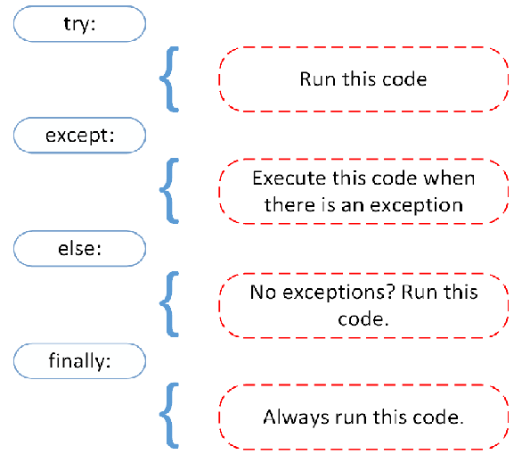
Error handling in Python

Slide 54
Program to illustrate ZeroDivision error
while(1):
try:
x=int(input('Enter a number: '))
y=int(input('Enter another number: '))
z=x/y
except ZeroDivisionError:
print("Division by 0 not accepted")
else:
print("Division = ", z)
break

Slide 55
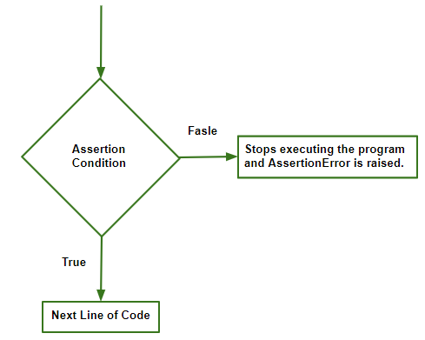
Assertion Error
If the condition is True, the control simply moves to the next line of code.
In case if it is False the program stops running and returns AssertionError Exception.

Slide 56
Syntax of assertion: assert condition, error_message(optional)
# assert without try catch
x = 1
y = 0
assert y != 0, "Invalid Operation"
print(x / y)

Slide 57
Assert with try catch
try:
x = 1
y = 0
assert y != 0, "Invalid Operation"
print(x / y)
except AssertionError as msg:
print(msg)

Slide 58
Alternate way
try:
x = 1
y = 0
assert y != 0
print(x / y)
except AssertionError as msg:
print("Invalid Operation")

