Slide 1
RNA-Seq Analysis in R DGE.Tools2 & DGEobj Packages
John Thompson
Translational Bioinformatics
16Feb2018

Slide 2
Motivation
Two R package that work in concert
DGE.Tools2: Standardizes a “best practice” DGE analysis workflow
Encapsulate common, rational set of methods and parameters for running a DGE workflow
Modular and flexible enough to support alternative workflows
Templates shorten turn around time
DGEobj: A flexible data structure to capture annotated results of analysis
Sharing a common data structure:
Produces a consistently annotated reusable data object
Facilitates data re-use for downstream applications
Designed for DGE workflow
Flexible enough to support any workflow where the base data is N rows of assays by M columns of samples.
e.g. proteomics, panel assays etc.

Slide 3
DGE.Tools/DGEobj Overview
DGE workflow: counts to contrasts
A series of modular functions to standardize best practices while remaining flexible enough to handle most common variations
Includes support for the use of Voom Quality Weights, Nested Designs (duplicateCorrelation), and Detrending unknown variable (Surrogate Variable Analysis)
Standard Data Structure: DGEobj
Captures raw data and downstream analysis objects
Fully annotated via attributes
Plotting Tools: Various QC and Data exploration tools
Dispersion plots, Pvalue Histograms, CDF Plots, Heatmaps, profile (MA) plots, volcano plots, compare plots, Gene Boxplots
Unit Conversion: Tools for gene id mapping and datatype conversion
entrez2GeneSym, ensemblGene2Entrez, GeneSym2Entrez
convertCounts (to CPM, TPM, FPKM, FPK, zFPKM; logged and/or normalized)

Slide 4
Evolution of Gene Expression Data Objects
Two standard Bioconductor data containers for expression data introduced
Expression Set: Developed for microarray data
RangedSummarizedExperiment (RSE): ES concept updated for RNA-Sea
The RSE object is ideal for storing the processed raw data (i.e. counts, FPKM, TPM and associated gene and sample annotation.
Provides a square bracket, subsettable container for RNA-Seq raw data
Limitation: The RSE has a single slot each for row (gene) and column (sample) annotation.
Not suitable for capturing downstream results
DGEobj: R S3 class data object package
Fundamentally a simple list of data items with attributes
Borrows RSE key concepts of assay, row, col, meta data types
Extended to support multiple row and col data types
Attributes document data types, project metadata and capture workflow details
Various function primitives for manipulating DGEobjs
e.g. initDGEobj, get/addItem, get/addAttributes, inventory, …
Interconvert between DGEobj, RSE and ES

Slide 5
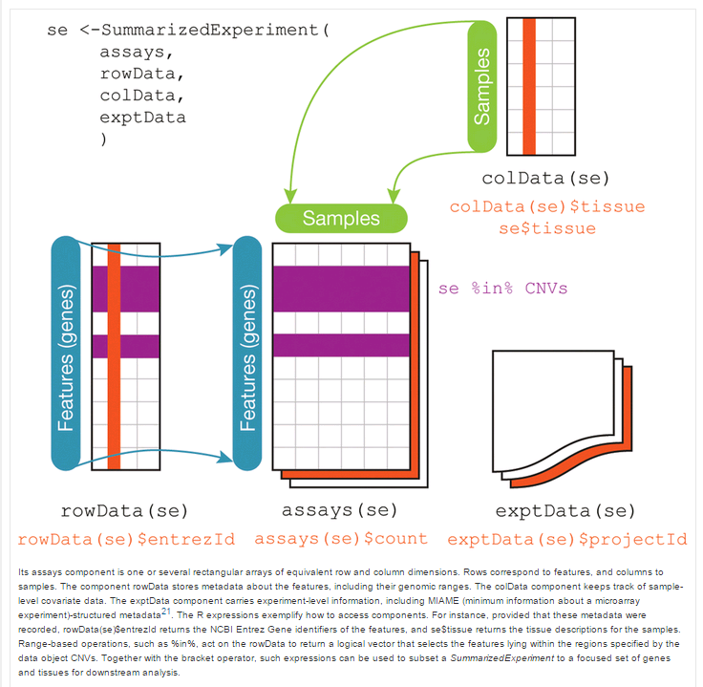
Summarized Experiment structure
Four Basetypes:
Assay: N genes x M Samples
rowData: Gene annotation
colData: Sample annotation (expt design data)
metadata: Anything else
RSE is Limited to one each rowData and colData
DGEobj package builds on RSE concept
Allows unlimited “row” and “col” objects
Exploit R attributes to attach annotations
Parent attributes to trace data flow
meta
The DGEobj can capture and document an entire workflow and enable unanticipated, automated downstream analysis use cases

Slide 6
DGEobj Design Overview
DGEobj is an extension of the RSE concept
Fundamentally a list of data objects
Starting with raw count data
Captures gene and sample (design) data
captures multi-threaded downstream analysis results connected via parent attributes
Exploit R “attributes” to capture project metadata
e.g. ProjectID, Platform technology, TA, GenomeBuild, GeneModel, data owner, Tbio analyst, etc.
Captures relationships between data objects
Parent attribute documents multi-threaded workflows
e.g. multiple formulas, fits and contrasts from one set of raw data

Slide 7
Manipulating DGEobj data
Constructor functions:
counts + gene + sample annotation required to build a DGEobj
Functions to import data directly from Omicsoft or Xpress or text files or dataframes
Inspection, add/retrieve, subsetting functions
inventory(dgeObj)
getItem(dgeObj, “counts”)
addItem(dgeObj, mycontrast, type=topTable)
Square bracket subset
dgeObj[1:1000, 1:5] (subset the 1st 1K genes and 1st 5 samples)
Overloaded bracket function knows how to subset each item based on its “basetype”

Slide 8
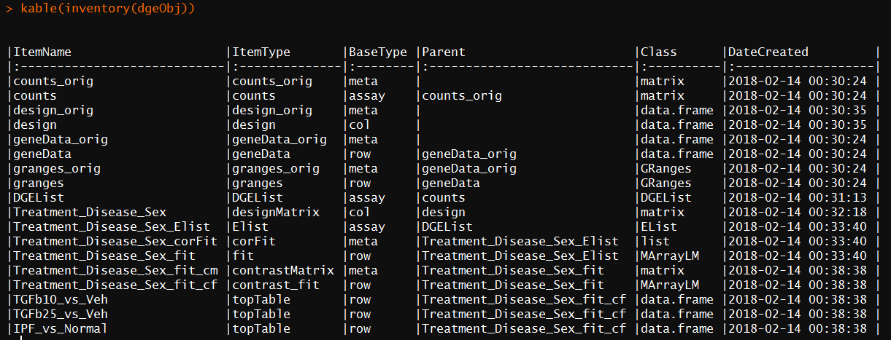
Inspecting a DGEobj
Inventory function to catalog contents of a DGEobj
getItem(s), getType and getBaseType functions to retrieve different objects
addItem function to insert new object
newType function to define new object
inventory and showMeta functions to inspect contents of DGEobjs
showTypes function to show list of pre-defined data types
dim function (genes x samples)
square bracket to subset gene and/or samples

Slide 9
DGEobj Extensibility
Can define new data types
newType(DGEobj, itemType = “IHC”, baseType = “assay”)
The type definitions are stored within the DGEobj
Can define whether an itemType is unique (i.e. can only have one instance)
For RNA-seq “counts” item type is unique
Can customize DGEobj for other datatypes and workflows

Slide 10
Getting data into/out of DGEobj format
From Xpress:
dgeObj <- Xpress2R::Xpress2DGEO (XpressID, level)
From Omicsoft:
pid <- "P-20171107-0002"
aws.signature::use_credentials()
getFilez(pid, projectName=“OmicsoftProjectName", outputDir=inputPath)
dgeObj <- OmicsoftToDgeObj(path=inputPath)
From Dataframes:
myDgeObj <- initDGEobj(counts = MyCounts,
rowData = MyGeneAnnotation,
colData = MyDesign,
level = "gene",
customAttr = list (PID = “P-20171025-0001",
XpressID = "12345",
Genome = "Mouse.B38",
GeneModel = "Ensembl.R91"))
Interconvert RSE/ES/DGEobj/List:
MyDgeObj <- convertRSE(MyRSE, "DGEobj")
MyRSE <- convertDGEobj(dgeObj, "RSE")
MyES <- convertDGEobj(dgeObj, "ES")
MyList <- convertDGEobj(dgeObj, "list")
MyES <- convertRSE(MyRSE, "ES")

Slide 11
Limma Voom/lmFit pipeline (without DGE.Tools)
# define a design matrix
Myformula <- "~ 0 + treatment + disease"
Mydesignmatrix = model.matrix(myformula, mydesign)
# run a limma/voom pipeline
MyFit <- Counts %>% DGEList() %>%
edger::calcNormFactors() %>%
limma::voomWithQualityWeights(design=mydesignmatrix) %>%
limma::lmFit (design=mydesignmatrix) %>%
eBayes(robust=TRUE)
# execute contrasts of interest
MyContrast <- topTable(MyFit, …)
Result is topTable Dataframe with logFC, pval etc.
R Environment littered with formulas, design matrices, DGElists, fit and contrast objects, contrast dataframes

Slide 12
DGE.Tools Pipeline
# Define your design matrix
design <- getItem(dgeObj, "design")
formula <- '~ 0 + Treatment + Disease + Batch'
designMatrix <- model.matrix (as.formula(formula), design)
# capture the formula as an attribute of designMatrix
designMatrix <- setAttributes(designMatrix, list(formula=formula))
# save the designMatrix in the DGEobj
dgeObj <- addItem(dgeObj, item=designMatrix,
itemName="Treatment_Disease_Batch",
itemType="designMatrix",
parent="design", overwrite=TRUE)
# Run the DGE pipeline
dgeObj <- runEdgeRNorm(dgeObj) #TMM is the default
dgeObj <- runVoom(dgeObj, designMatrixName, qualityWeights = TRUE) # runs voom and lmFit
contrastList <- list(TGFb10_vs_Veh = "TGFbeta_10 - vehicle",
TGFb25_vs_Veh = "TGFbeta_25 - vehicle“)
dgeObj <- runContrasts(dgeObj, designMatrixName=designMatrixName,
contrastList=contrastList, Qvalue=TRUE, IHW=TRUE)
All output captured in the DGEobj; Easy to save as .RDS and share

Slide 13
DGE.Tools: DGE Pipeline Functions
Main Functions: listed in typical order of use
runEdgeRNorm: Perform edgeR TMM normalization
Requires an DGEobj
Add an edgeR DGEList object containing counts and normFactors
runVoom: run limma voom and lmFit
Require an DGEobj (with DGEList), and design matrix
Fits the model and adds the Fit object to the DGEobj
Optionally supports QualityWeights and DuplicateCorrelation analyses
runSVA: Surrogate Variable analysis for detrending unknown factors
Requires a DGEobj with a Fit object and design matrix
Adds surrogate factors to the design matrix
Captures the svobj for further inspection
runContrasts: run multiple contrasts against the lmFit Fit object
Requires a DGEobj with Fit; Adds topTable and optionally topTreat contrast tables
runQvalue, runIHW: Provide Alternative FDR methods

Slide 14
DGE.Tools: DGE Plotting Functions
QC Plots:
plotDisp: ggplot version of EdgeR dispersion plot
Mean-variance: voom mean variance plots
Quality Weights: voom barplot of quality weights
plotPvalHist: evaluate distribution of pvalues
plotCDF: alternative way to evaluate pvalue distributions
Data Exploration Plots
profilePlot: LogIntensity vs LogRatio (aka MA plot)
volcanoPlot: LogRatio vs NegLogPval
comparePlot: LogRatio of 2 treatment groups

Slide 15
DGE Workflows : Illustrated Overview
initDGEobj
DGEobj
Low int filtering
DGEobj
runEdgeRNorm
DGEobj
DGEobj
runVoom
qualityWeights=FALSE
runVoom
qualityWeight=TRUE
runVoom
dupCor=TRUE
runSVA
DGEobj
runContrasts
DGEobj
Plot Tools

Slide 16
Practical Noise (low count) Filtering
Why?
reduce multiple test correction burden
improves model performance
3 Methods in common use:
FPK >= 5
Mincount >= 10
zFPKM >= -3
JRT Recommendations:
use (FPK & Mincount) or (zFPKM & Mincount)
preference for FPK
Can measure intergenic FPK and compare directly to calibrate the FPK threshold above the real noise floor

Slide 17
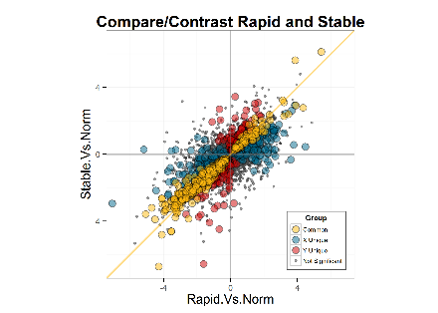
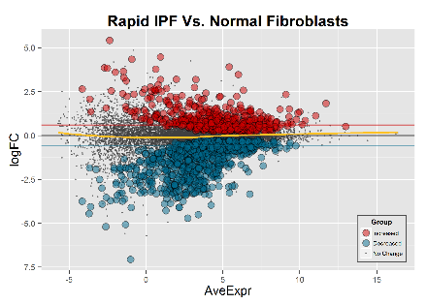
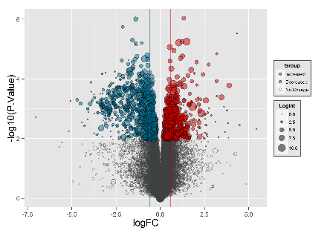
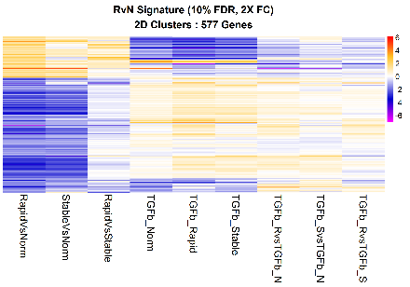
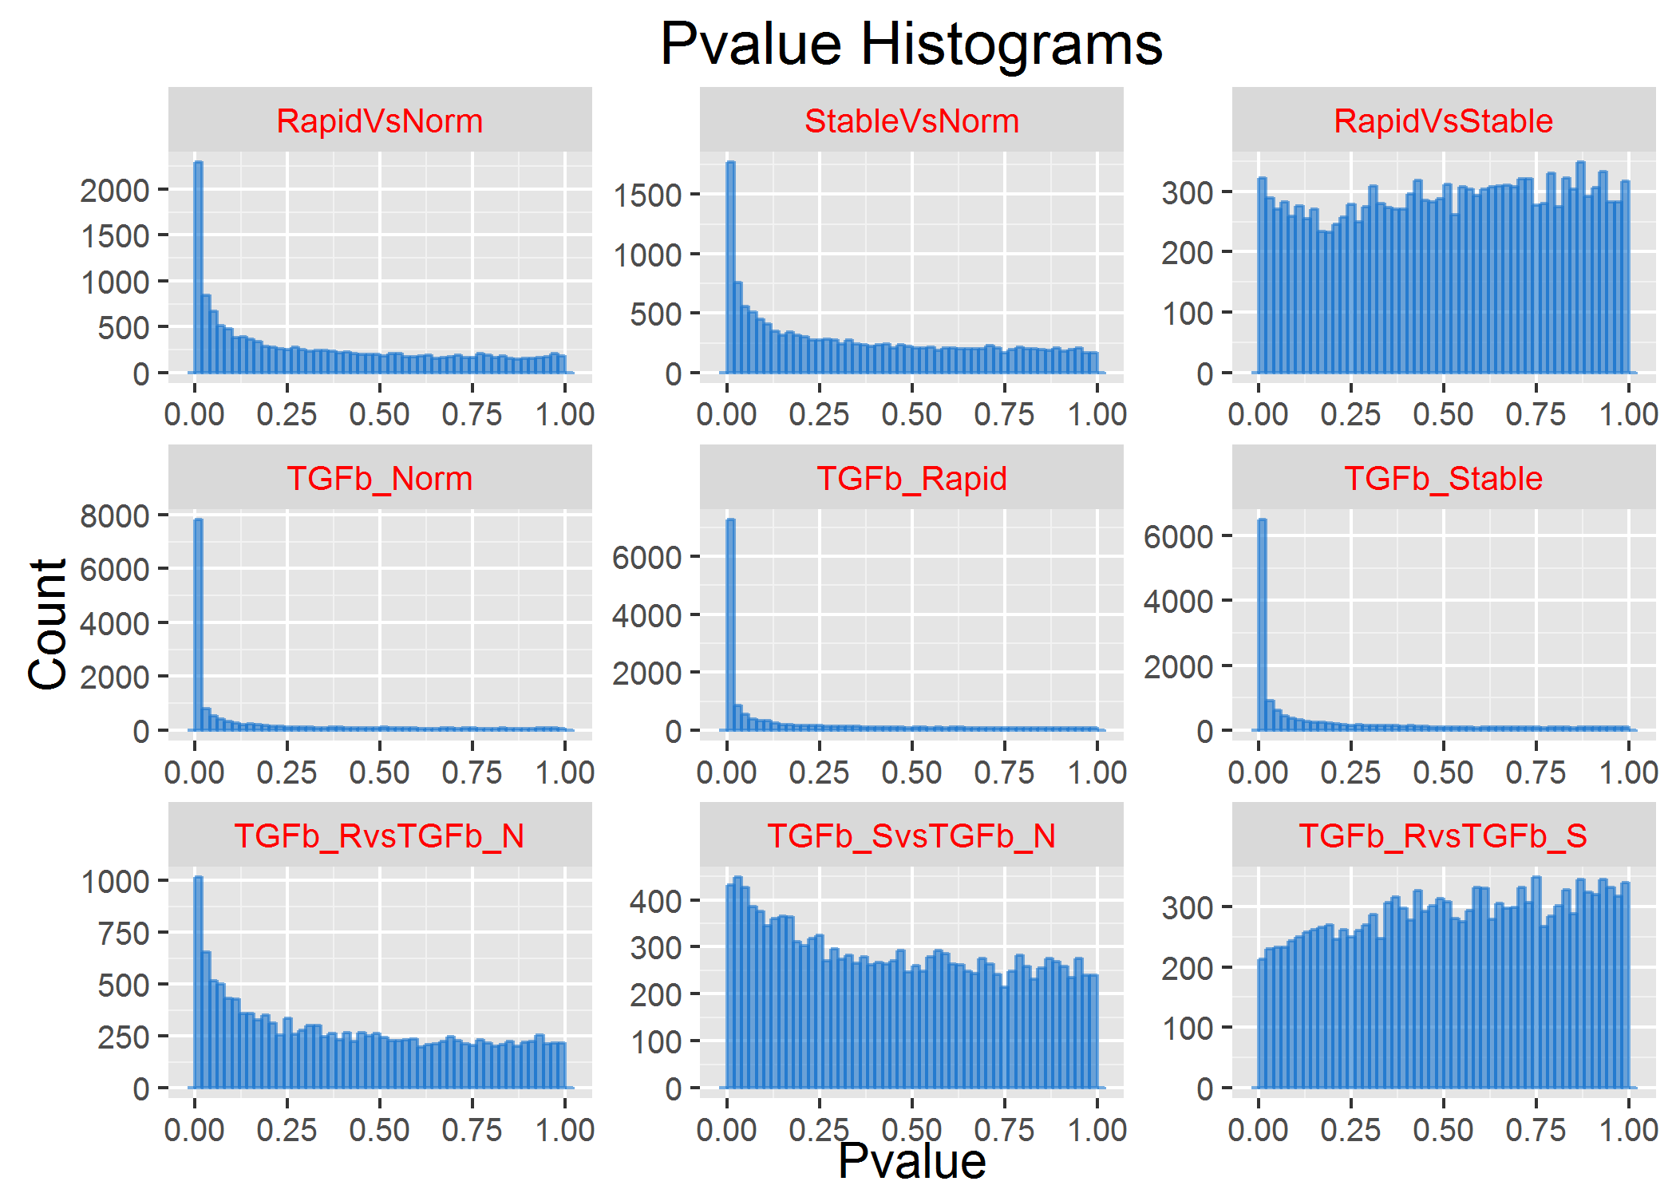
Exploratory Data Analysis
runQvalue
Alt FDR
Methods
runContrasts
Contrast List
runIHW
DGEobj
plotDispersion
comparePlot
ggplotMDS
Plot Tools
plotPvalHist
profilePlot
profilePlot
volcanoPlot
volcanoPlot
cdfPlot
obsPlot
comparePlot
JRT_heatmap
JRT_heatmap
plotPvalHist

Slide 18
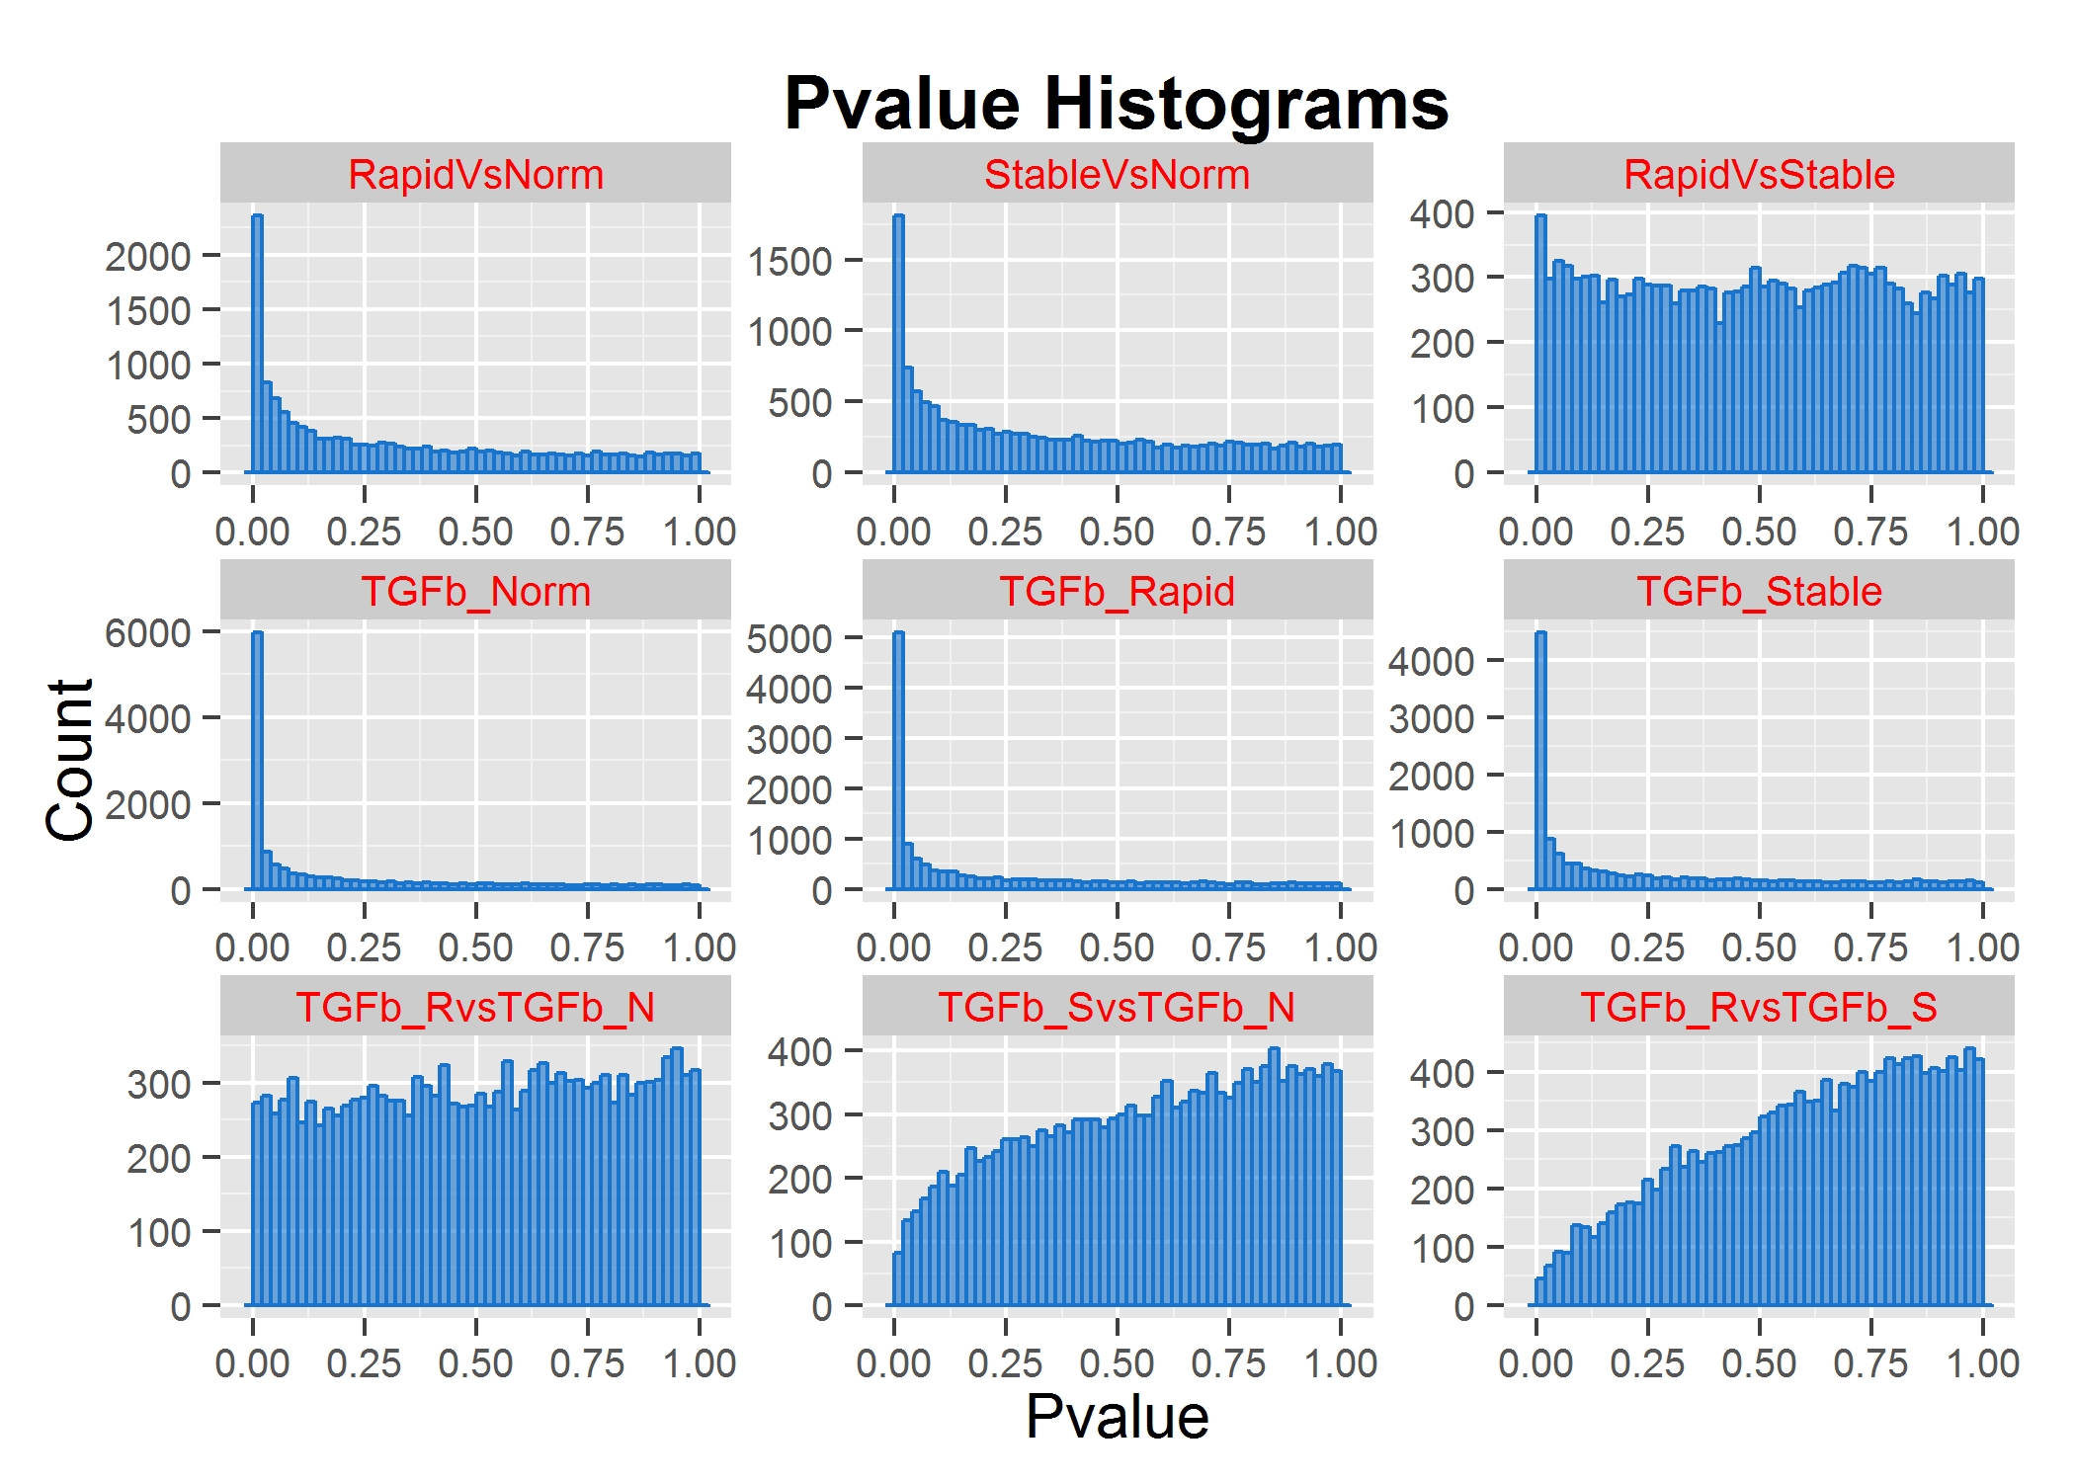
F. plotPvalHist Example
Weaker sig
No sig
Stronger sig
Weird
(see Scott)
Should be flat with a peak near zero if there are bona-fide regulated genes.

Slide 19
Exploiting DGEobj data: Constrast DB
Contrast DB:
Setup a DGEobj drop folder
Autoextract contrast (topTable) and project metadata from DGEobj data to build a cumulative annotated database of contrasts
Biologist-Friendly Shiny App Frontend (Isaac/Connie)
select a plot type
select gene/pathways and experiments of interest
List Tracker
Extract contrast, apply FC/pval cuts, send signature to list tracker

Slide 20
Installing DGE.Tools
The DGEobj, DGE.Tools2, Xpress2R, zFPKM packages have been deposited in BRAN.
For install instructions: https://biogit.pri.bms.com/thompj27/DGE.Tools2
Sample Data: (packaged with DGE.Tools2)
IPF Fibroblasts from normal, rapid and slow progressors
3 donors each; 9 cell lines total
Challenged in vitro with Veh or TGFb
Data Folder : …/library/DGE.Tools2/extdata
Tutorial vignette being prepared

Slide 21
Sample Data and Markdown
Example Markdown (Biogit)
UPenn IPF dataset: (P00931_IPF_Lung_UPenn_2Batches_P-20161128-0001)
UCSD Lung Fibroblasts: (P01132_UCSD_LUNG_FIBROBLASTS_Nov2017)
Other useful tricks:
Dispersion plots
Examine distributions before/after normalization
Plots of TMM normfactors, voom quality weights
Batch correction (comBat or via modeling)
SVA analysis
PVCA and Variant Partitioning analysis
Pvalue distributions
Sex inference
Evaluate multiple models (selectModel)
Summarize Sig Counts
Contingency Tables
Metacore and EGSEA pathway analysis

Slide 23
Using zFPKM to select expressed genes
Validated with encode open/closed promoter chromatin structure epigenetic data on six of the ENCODE cell lines.
Works well for gene level data using FPKM or TPM
Does not appear to calibrate well for transcript level data.
Reference recommends using zFPKM >-3 to select expressed genes.
Reference: Hart et al., 2013 (Pubmed ID 24215113)
R Implementation: Ron Ammar (in Bioconductor)

Slide 24
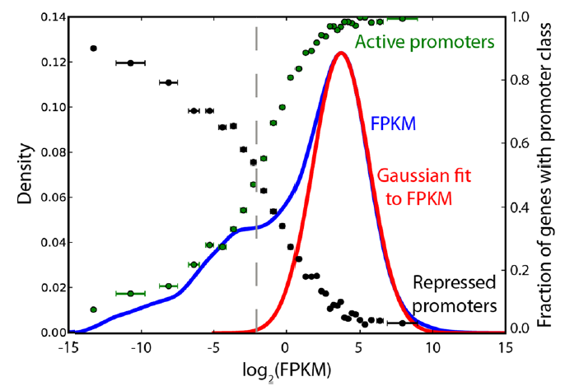
zFPKM Analysis
Gene level intensity is a bimodal distribution
Orthogonally calibrated by ENCODE open/closed chr configuration data
Low peak corresponds to closed (inactive) conformation
zFPKM -3 is the minimum between the peaks (i.e. 50:50 TP:FP)
Developed with FPKM values
TPM behaves similarly

Slide 25
Normalization: F. runEdgeRNorm
Input:
DGEobj with count data
Runs edgeR TMM normalization by default
Use NormMethod argument to specify other normalizations
Returns: DGEobj object containing
DGElist: contains counts and normfactors
Example:
dgeObj <- runEdgeRNorm(dgeObj)

Slide 26
Fit Model: F. runVoom
Input:
DGEobj with DGElist and Design matrix
Runs limma voom followed by lmFit
runs voomWithQualityWeights by default
Duplicate correlation requires a blocking vector
Returns: DGEobj with voom Elist and lmFit fit objects
Example:
MyDgeObj <- runVoom (MyDgeObj, designMatrixName=“MyDesignMatrix”)
Additional arguments support blocking quality weights and running duplicateCorrelation

Slide 27
Surrogate Variable Analysis: F. runSVA
Input:
DGEobj containing a design matrix
Runs SVA analysis
Determine number of unobserved surrogate variables
Add surrogate variable data to Design table and new DesignMatrix
Returns: Updated DGEobj
DesignMatrix updated with surrogate variable data
Repeat runVoom after running SVA, now including the surrogate variables in the analysis
Example:
MyDgeObj <- runSVA(MyDgeObj, designMatrixName="MyDesignMatrix“)

Slide 28
Contrasts: F. runContrasts
Input:
DGEobj with Fit and DesignMatrix
Contrast List
Supports: topTable and/or topTreat analysis
Output: DGEobj containing: contrast matrix, contrastFit, topTable and topTreat dataframes
Example:
#build a named list describing contrasts
MyContrasts <- list(
T1sig = "Treament1 - Veh",
T2sig = "Treatment2 - Veh"
)
MyDgeObj <- runContrasts(MyDgeObj, MyFitName, MyContrasts)

Slide 29
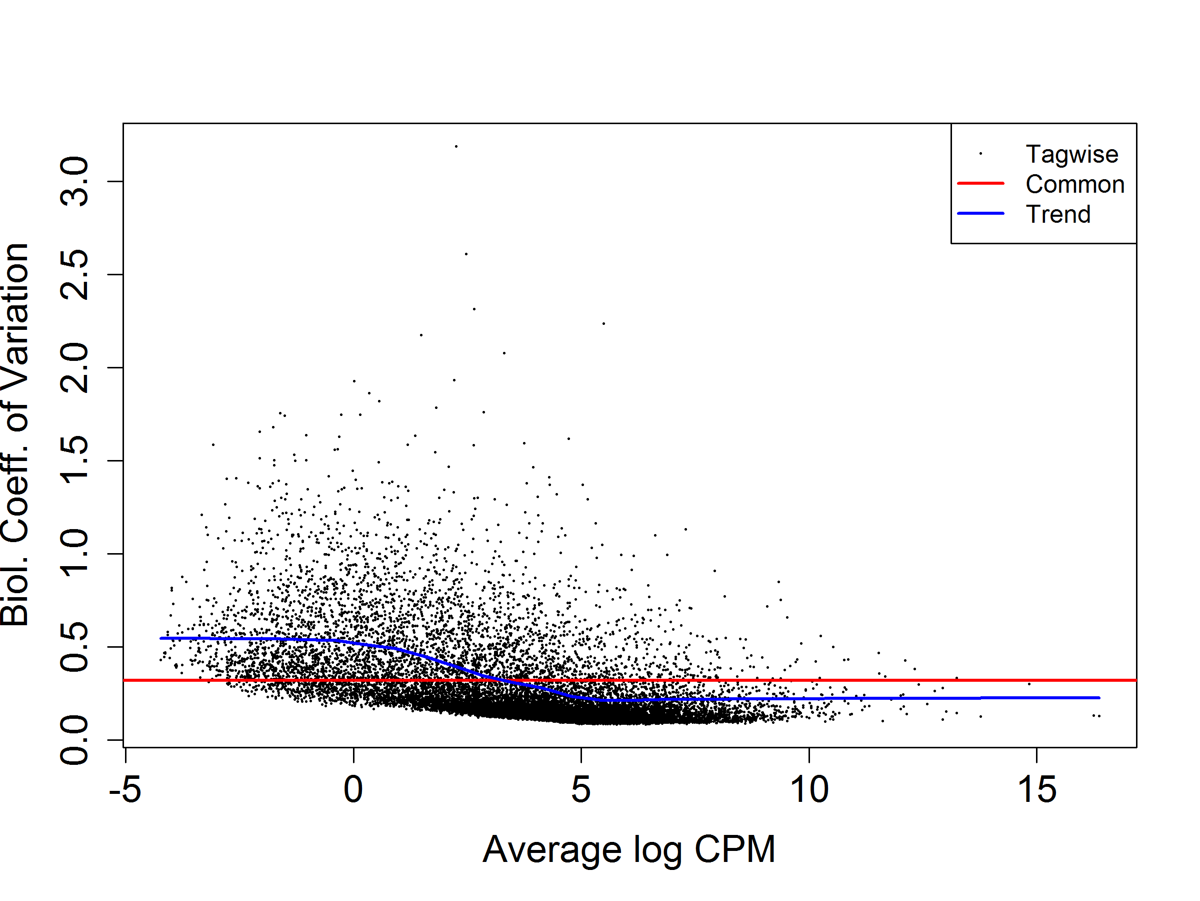
Example Dispersion QC plot {edgeR}
Red line is for Reference. Blue line is a loess fit and should be mostly at or below the redline. Dots represent genes with high points either the regulated genes or (mostly low intensity) noise.

