Slide 1
DGE.Tools2 OverView
John Thompson
Translational Bioinformatics
22Mar2017

Slide 2
DGE.Tools Motivation
A suite of R functions and a data structure to standardize scripted DGE analysis
Standardize functions to establish common “best practice” workflows
This does NOT mean people shouldn’t experiment with variations of edgeR, DESeq2, etc.
But we should establish common, rational parameters for running each of these methods
Standardized Data Structure (DGEobj)
Sharing a common data structure:
Improves reusability
Fosters sharing of code and data among analysts
Facilitates data re-use for downstream applications

Slide 3
DGE.Tools Support Areas
DGE workflow: counts to contrasts
A series of modular functions to standardize and simplify analysis while remaining flexible enough to handle many common variations
Includes support for the use of Quality Weights, Nested Designs (duplicateCorrelation), and Detrending (SVA)
Standard Data Structure: DGEobj
Captures raw data and downstream analysis objects
Fully annotated via attributes
Plotting Tools: Various QC and Data exploration tools
Dispersion plots, Pvalue Histograms, CDF Plots, Heatmaps, profile (MA) plots, volcano plots, compare plots, Gene Boxplots
Conversion: Tools for gene id mapping and datatype conversion
entrez2GeneSym, ensemblGene2Entrez, GeneSym2Entrez
convertCounts (to CPM, TPM, FPKM, FPK, zFPKM; logged and/or normalized)

Slide 4
DGE Tools Evolution of Data Objects
Two standard data containers for expression data introduced
RangedSummarizedExperiment (RSE): for Raw processed data
The RSE object is ideal for storing the processed raw data (i.e. counts, FPKM, TPM and associated gene and sample annotation.
Provides a subsettable container for RNA-Seq raw data
Limitation: The RSE has a single slot each for row (gene) and column (sample) annotation.
Not suitable for most downstream results
DGEobj: R S3 class data object package
Goal: provide a general purpose object to capture raw data (counts) and downstream analysis AND facilitate facile reuse of data
Fundamentally a simple list of data items with attributes
Borrows RSE key concept of assay, row, col, meta data types
Attributes document data types and capture workflow details
Package provides function primitive for manipulating DGEobjs
e.g. initDGEobj, get/addItem, get/addAttributes, print, …

Slide 5
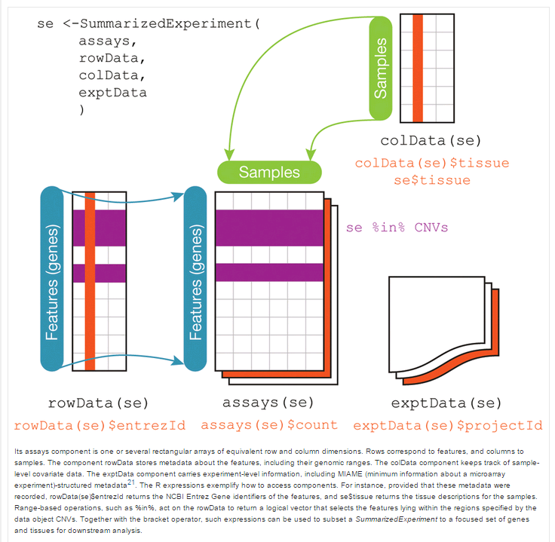
Summarized Experiment structure
New DGEobj package builds on RSE concept
Allows unlimited “row” and “col” objects
Exploit R attributes to attach annotations
Parent attributes to trace data flow
meta
A common well annotated data object enables downstream re-use e.g. build a database of contrast data

Slide 6
DGEobj Design Overview
Fundamentally a list of data objects
Starting with raw count data
Proceeding to capture downstream analysis results
With R “attributes” to capture metadata
e.g. ProjectID, TA, GenomeBuild, GeneModel version, etc
Also relationships between objects
e.g. Contrast X has fit Y as parent

Slide 7
Manipulating DGEobj data
Constructor function: counts + gene and sample annotation required to build
Inspection, add/retrieve, subsetting functions
print(summarize(DGEobj))
getItem(DGEobj, “counts”)
addItem(DGEobj, mycontrast, type=topTable)
DGEobj[1:1000, 1:5] (subset the 1st 1K genes and 1st 5 samples
Overloaded bracket function knows how to subset each item based on its “basetype”

Slide 8
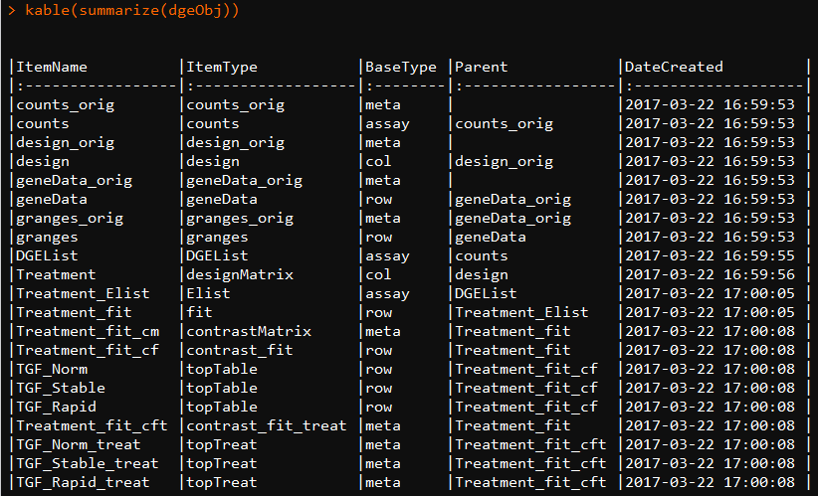
Inspecting a DGEobj

Slide 9
DGEobj Extensibility
Can define new data types
newType(DGEobj, itemType = “IHC”, baseType = “assay”)
The type definitions are stored within the DGEobj
Can define whether an itemType is unique (can only have one instance)
For RNA-seq “counts” data is unique
Allows customizing DGEobj for other datatypes and workflows

Slide 10
DGE.Tools: DGE Pipeline Functions
Main Functions: listed in typical order of use
initDGEobj: Convert Text Files to RSE data structure
Minimally requires Counts, Gene Annotation and Sample Annotation
Produces a class DGEobj variable
runEdgeRNorm: Perform edgeR TMM normalization
Requires an DGEobj
Add an edgeR DGEList object containing counts and normFactors
runVoom: run limma voom and lmFit
Require an DGEobj (with DGEList), and design matrix
Fits the model and adds the Fit object to the DGEobj
Optionally supports QualityWeights and DuplicateCorrelation analyses
runSVA: Surrogate Variable analysis for detrending unknown factors
Requires a DGEobj with a Fit object and design matrix
Adds surrogate factors to the design matrix
Captures the svobj for further inspection
runContrasts: run multiple contrasts against the lmFit Fit object
Requires a DGEobj with Fit; Adds topTable and topTreat contrast tables
runQvalue, runIHW: Provide Alternative FDR methods

Slide 11
DGE.Tools: DGE Plotting Functions
QC Plots:
plotDisp: ggplot version of EdgeR dispersion plot
Mean-variance: voom mean variance plots
Quality Weights: voom barplot of quality weights
plotPvalHist: evaluate distribution of pvalues
plotCDF: alternative way to evaluate pvalue distributions
Data Exploration Plots
profilePlot: LogIntensity vs LogRatio
volcanoPlot: LogRatio vs NegLogPval
comparePlot: LogRatio of 2 treatment groups
JRT_heatmap: Convenience wrapper for pheatmap function

Slide 12
Basic Voom – lmFit pipeline
Mydesignmatrix = model.matrix(myformula, mydesign)
MyFit <- Counts %>%
edger::calcNormFactors() %>%
limma::voom(design=mydesignmatrix) %>%
limma::lmFit (design=mydesignmatrix) %>%
eBayes
MyContrast <- topTable(MyFit, …)
Result is Dataframe with logFC, pval etc.

Slide 13
DGE Workflows : Illustrated Overview
initDGEobj
DGEobj
Low int filtering
DGEobj
runEdgeRNorm
DGEobj
DGEobj
runVoom
qualityWeights=FALSE
runVoom
runVoom
dupCor=TRUE
runSVA
DGEobj
DGEobj
runContrasts
DGEobj
Plot Tools

Slide 14
Use zFPKM to select expressed genes
Validated with encode open/closed promoter chromatin structure epigenetic data on six of the ENCODE cell lines.
Works well for gene level data using FPKM or TPM
Does not appear to calibrate well for transcript level data.
Reference recommends using zFPKM >-3 to select expressed genes.
Reference: Hart et al., 2013 (Pubmed ID 24215113)
R Implementation: Ron Ammar
Packaged by: JRT
Note: you should use zFPKM or some other method to remove undetected genes or your model fit will be compromised.

Slide 15
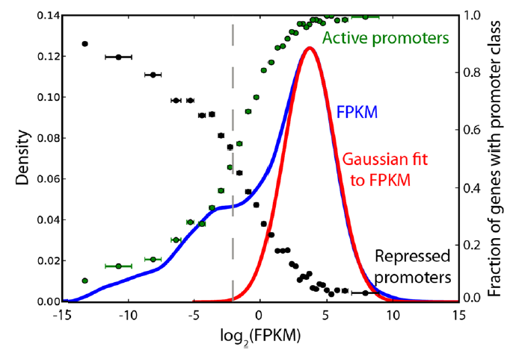
zFPKM Analysis
Gene level intensity is a bimodal distribution
Orthogonally calibrated by ENCODE open/closed chr configuration data
Low peak corresponds to closed (inactive) conformation
zFPKM -3 is the minimum between the peaks (i.e. 50:50 TP:FP)
Developed with FPKM values
TPM behaves similarly

Slide 16
Practical Noise Filtering
3 Methods in common use:
Mincount >= 10
zFPKM >= -3
FPK >= 5
JRT Recommendations:
use (FPK & Mincount) or (zFPKM & Mincount)
preference for FPK
Can measure intergenic FPK and compare directly to calibrate the FPK threshold above the real noise floor

Slide 17
Normalization: F. runEdgeRNorm
Input:
DGEobj with count data
Runs edgeR TMM normalization by default
Use NormMethod argument to specify other normalizations
Returns: DGEobj object containing
DGElist: contains counts and normfactors
Example:
dgeObj <- runEdgeRNorm(dgeObj)

Slide 18
Fit Model: F. runVoom
Input:
DGEobj with DGElist and Design matrix
Runs limma voom followed by lmFit
runs voomWithQualityWeights by default
Duplicate correlation requires a blocking vector
Returns: DGEobj with voom Elist and lmFit fit objects
Example:
MyDgeObj <- runVoom (MyDgeObj, designMatrixName=“MyDesignMatrix”)
Additional arguments support blocking quality weights and running duplicateCorrelation

Slide 19
Surrogate Variable Analysis: F. runSVA
Input:
DGEobj containing a design matrix
Runs SVA analysis
Determine number of unobserved surrogate variables
Add surrogate variable data to Design table and new DesignMatrix
Returns: Updated DGEobj
DesignMatrix updated with surrogate variable data
Repeat runVoom after running SVA, now including the surrogate variables in the analysis
Example:
MyDgeObj <- runSVA(MyDgeObj, designMatrixName="MyDesignMatrix“)

Slide 20
Contrasts: F. runContrasts
Input:
DGEobj with Fit and DesignMatrix
Contrast List
Supports: topTable and/or topTreat analysis
Output: DGEobj containing: contrast matrix, contrastFit, topTable and topTreat dataframes
Example:
#build a named list describing contrasts
MyContrasts <- list(
T1sig = "Treament1 - Veh",
T2sig = "Treatment2 - Veh"
)
MyDgeObj <- runContrasts(MyDgeObj, MyFitName, MyContrasts)

Slide 21
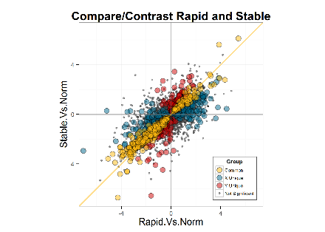
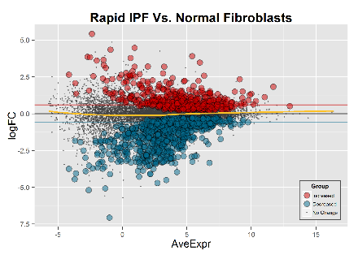
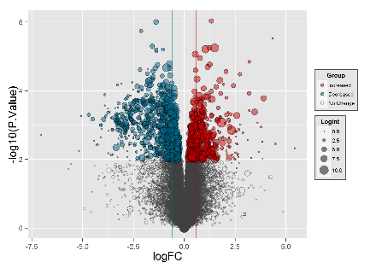
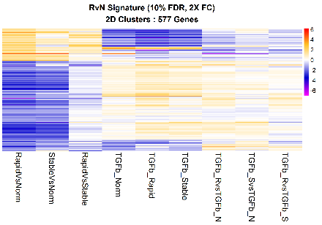
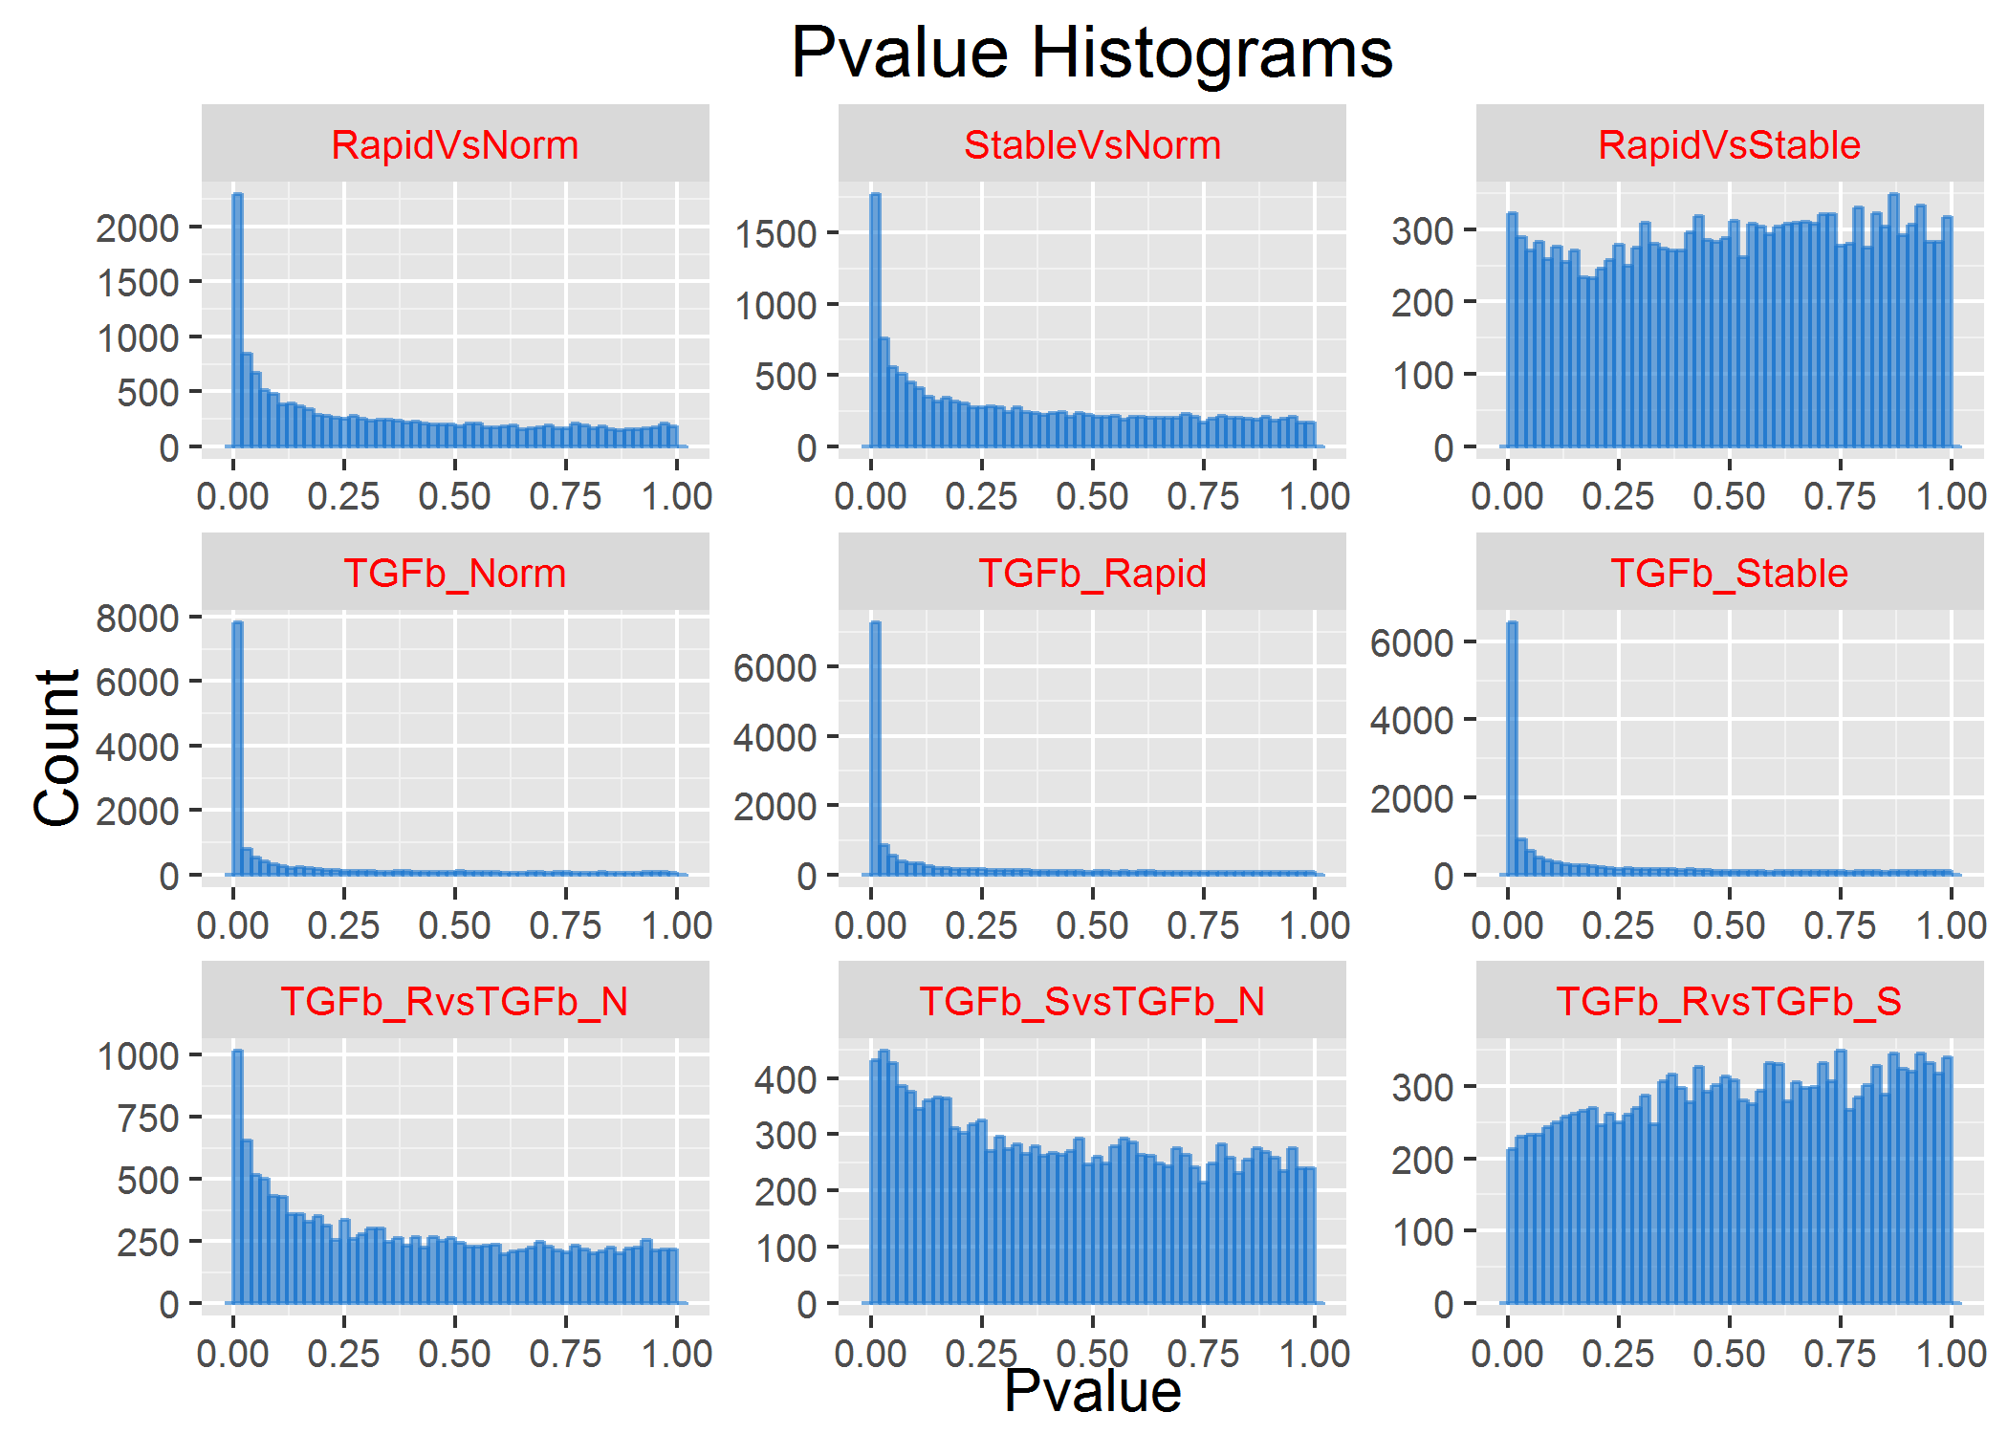
Exploratory Data Analysis
runQvalue
Alt FDR
Methods
runContrasts
Contrast List
runIHW
DGEobj
plotDispersion
comparePlot
ggplotMDS
Plot Tools
plotPvalHist
profilePlot
profilePlot
volcanoPlot
volcanoPlot
cdfPlot
obsPlot
comparePlot
JRT_heatmap
JRT_heatmap
plotPvalHist

Slide 22
Installing DGE.Tools
The DGEobj, DGE.Tools and zFPKM packages have been deposited in the BMS Github.
For install instructions: https://biogit.pri.bms.com/thompj27/DGE.Tools2
Sample Data: (packaged with DGE.Tools2)
IPF Fibroblasts from normal, rapid and slow progressors
3 donors each; 9 cell lines total
Challenged in vitro with Veh or TGFb
Data Folder : …/library/DGE.Tools2/extdata
Tutorial vignette being prepared

Slide 23
Sample Data and Markdown
Sample Data
IPF Fibroblasts from normal, rapid and slow progressors
3 donors each; 9 cell lines total, treated and untreated.
Challenged in vitro with Veh or TGFb
Data Folder : …/library/DGE.Tools2/extdata
Tutorial vignette being prepared

Slide 24
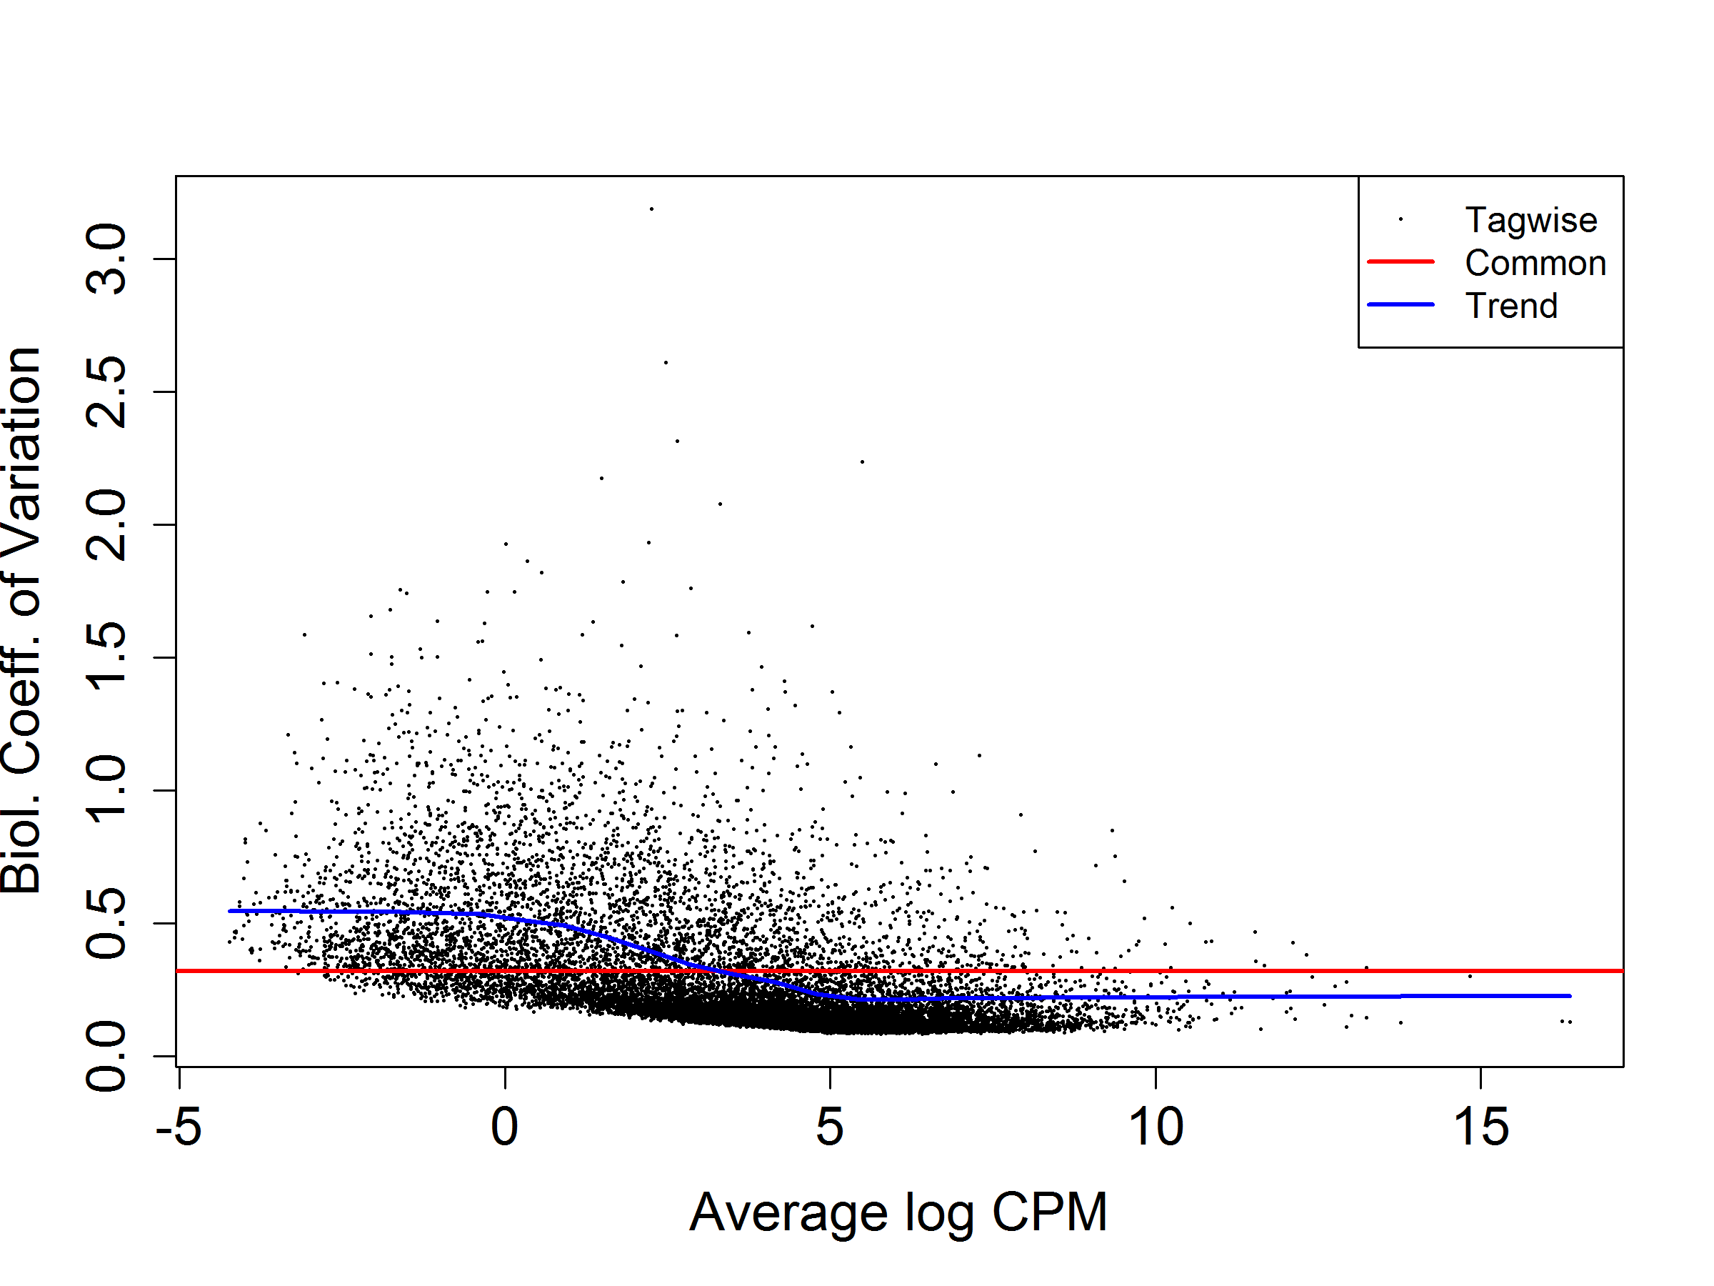
Example Dispersion QC plot {edgeR}
Red line is for Reference. Blue line is a loess fit and should be mostly at or below the redline. Dots represent genes with high points either the regulated genes or (mostly low intensity) noise.

Slide 25
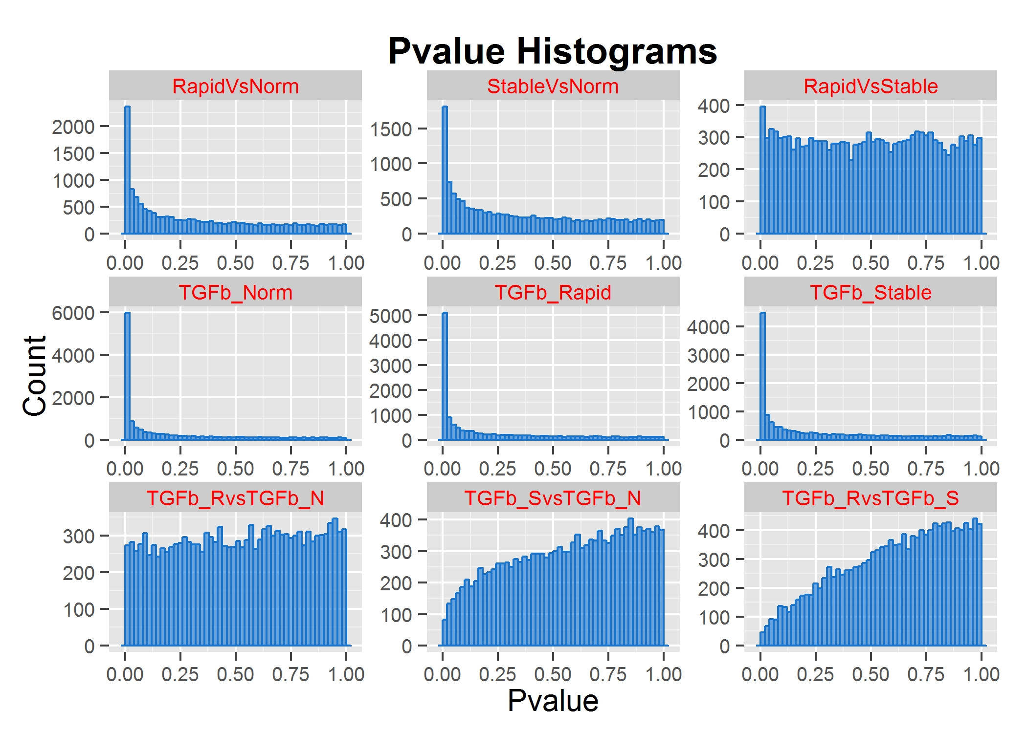
F. plotPvalHist Example
Weaker sig
No sig
Stronger sig
Weird
(see Scott)
Should be flat with a peak near zero if there are bona-fide regulated genes.

