Slide 1
RNA-Seq Analysis in R DGE.Tools2 & DGEobj Packages
John Thompson
Translational Bioinformatics
Mar2019

Slide 2
Outline
Overview of DGEobj, DGE.Tools2 and JRTutil packages
DGEobj as extension of the Summarized Experiment or Expression Set concept
How to get data into DGEobj format
How to run the limma voom pipeline
How to annotate a DGEobj
How to access data in DGEobj format
DGE.Tools2 Plotting Tools

Slide 3
Motivation
DGEobj: A flexible data structure to capture annotated results of analysis
Sharing a common data structure:
Produces a consistently annotated reusable data object
Facilitates data re-use for downstream applications
Designed for DGE workflow
Flexible enough to support any workflow where the base data is N rows of assays by M columns of samples.
e.g. proteomics, panel assays etc.
DGE.Tools2: Standardizes a “best practice” DGE analysis workflow
Encapsulate common, rational set of methods and parameters for running a DGE workflow
Modular and flexible enough to support alternative workflows
Templates shorten turn around time
You do not need DGE.Tools2 to create and use a DGEobj
Using DGE.Tools2 insures a consistent naming and annotation style.

Slide 4
DGE.Tools/DGEobj Overview
DGE workflow: counts to contrasts
A series of modular functions to standardize best practices while remaining flexible enough to handle most common variations
Includes support for the use of Voom Quality Weights, Nested Designs (duplicateCorrelation), and Detrending unknown variable (Surrogate Variable Analysis)
Standard Data Structure: DGEobj
Captures raw data and downstream analysis objects
Fully annotated via attributes
Plotting Tools: Various QC and Data exploration tools
Dispersion plots, Pvalue Histograms, CDF Plots, Heatmaps, profile (MA) plots, volcano plots, compare plots, Gene Boxplots
Unit Conversion: Tools for gene id mapping and datatype conversion
entrez2GeneSym, ensemblGene2Entrez, GeneSym2Entrez
convertCounts (to CPM, TPM, FPKM, FPK, zFPKM; logged and/or normalized)

Slide 5
DGEobj Overview
The DGEobj package defines a data structure that extends the concept of the ExpressionSet and Summarized Experiment to support capture of downstream workflow results
Key Features:
Enforces a standard data structure
Captures intermediate outputs (DGEList, design matrix, fit objects, topTable, etc)
Captures project metadata (as attributes) (owner, genome version, etc)
Captures parent-child relationships of contained data objects
Square bracket subsettable; easy filtering of genes/samples
Accessor functions to build and access data in DGEobj format (add and get functions)
Convert to/from ES and SE data structures
Input data from Xpress, Omicsoft, text files
Plug and play into GECO (shiny app) resource
Facilitates data sharing and automated cross project analysis

Slide 6
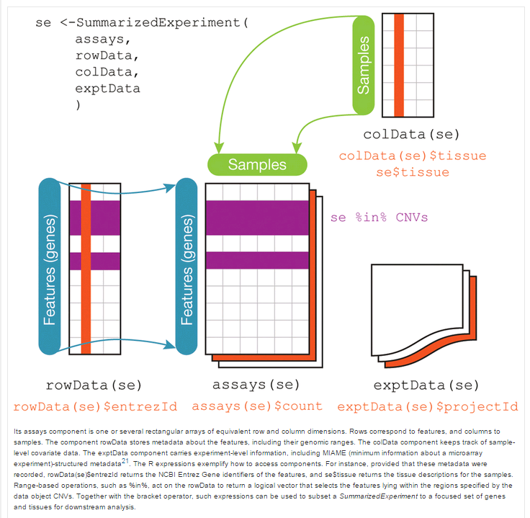
Summarized Experiment structure
SE and ES
limited to 1 each rowData and colData elements
No parent-child relationship
DGEobj removes those limitations and introduces parent-child relationships

Slide 7
DGE.Tools2 Package
Wrapper around DGEobj
Implements Limma/Voom DGE workflow
voom with quality weights
Duplicate Correlation
Surrogate Variable Analysis
Easily extensible
Provides assorted plotting tools for common plots (ggplot)
Automates collection of parent/child relationships, some annotations and standardizes some item names
Codifies best practices for DGE analysis

Slide 8
DGEobj Design Overview
DGEobj is an extension of the RSE concept
Fundamentally a list of data objects
Starting with raw count data
Captures gene and sample (design) data
captures multi-threaded downstream analysis results connected via parent attributes
Exploit R “attributes” to capture project metadata
e.g. ProjectID, Platform technology, TA, GenomeBuild, GeneModel, data owner, Tbio analyst, etc.
Captures relationships between data objects
Parent attribute documents multi-threaded workflows
e.g. multiple formulas, fits and contrasts from one set of raw data

Slide 9
Getting Data Into a DGEobj
From RSE: dgeObj <- convertRSE(RSE, Class="DGEobj")
From ES:
library(SummarizedExperiment)
MyRSE <- as(MyES, "RangedSummarizedExperiment")
dgeObj <- DGEobj::convertRSE(RSE, Class="DGEobj")
From Omicsoft:
#use s3fs or Cloudberry drive to mount bmsrd-ngs-arrayserver
dgeObj <- JRTutil::buildOmicsoftDGEobj(OmicsoftProjectName, mountpoint=s3mp)
From GECO:
# see /stash/data/nonclin/DGEobj_library for list
dgeObj <- JRTutil::getRDSobjFromStash(filename)

Slide 10
Getting Data Into a DGEobj (2)
From Xpress:
Get the Xpress ID from a URL:
http://xpress.pri.bms.com/CGI/project_summary.cgi?project=21194
dgeObj <- Xpress2R::Xpress2DGEO (21194, level="gene“)
From Somalogic .adat files:
dgeObj <- DGEobj::adatToDGEobj(filename)

Slide 11
How to annotate a DGEobj
R attributes are used to attach annotations to a DGEobj
Attributes can be attached individually:
dgeObj <- base::attr(dgeObj, source="mymarkdown.Rmd“
DGEobj::annotateDGEobj function
Read attributes as key=value pairs from a text file:
dgeObj <- annotateDGEobj(dgeObj, regfile = "myannotation.txt“)
Required for GECO: c("class", "level", "ID", "Title", "BMS_PID", "Organism", "PlatformType", "source", "repo")
Highly recommended: c("Description", "Keywords", "Disease", "Tissue", "BusinessUnit", "FunctionalArea", "Disease", "Vendor", "Technology", "LibraryPrep", "AlignmentReference", "GeneModel", "TA_Owner", "ReadType", "Pipeline", "AlignmentAlgorithm", "ScriptID")
showMeta (dgeObj)

Slide 12
Limma Voom/lmFit pipeline (without DGE.Tools)
# create a design matrix
designmatrix <- model.matrix("~ 0 + treatment + disease", designTable)
# run a limma/voom pipeline
MyFit <- Counts %>%
edger::calcNormFactors() %>%
limma::voomWithQualityWeights(design=designmatrix) %>%
limma::lmFit (design=designmatrix) %>%
limma::eBayes(robust=TRUE)
# execute contrasts of interest
ContrastMatrix <- limma::makeContrasts(contrasts = contrastList, levels = designMatrix)
MyFit.Contrasts <- limma::contrasts.fit(fit, ContrastMatrix)
MyContrasts <- limma::topTable(MyFit.Contrasts, …)
Result is topTable Dataframe with logFC, pval etc.
R Environment littered with formulas, design matrices, DGElists, fit and contrast objects, contrast dataframes

Slide 13
DGE.Tools Pipeline
# Define your design matrix
design <- getItem(dgeObj, "design")
formula <- '~ 0 + Treatment + Disease + Batch'
designMatrix <- model.matrix (as.formula(formula), design)
# capture the formula as an attribute of designMatrix
designMatrix <- setAttributes(designMatrix, list(formula=formula))
# save the designMatrix in the DGEobj
dgeObj <- addItem(dgeObj, item=designMatrix, itemName="Treatment_Disease_Batch",
itemType="designMatrix", parent="design", overwrite=TRUE)
# Run the DGE pipeline
dgeObj <- runEdgeRNorm(dgeObj) #TMM is the default
dgeObj <- runVoom(dgeObj, designMatrixName, qualityWeights = TRUE) # runs voom and lmFit
contrastList <- list(TGFb10_vs_Veh = "TGFbeta_10 - vehicle",
TGFb25_vs_Veh = "TGFbeta_25 - vehicle“)
dgeObj <- runContrasts(dgeObj, designMatrixName=designMatrixName,
contrastList=contrastList, Qvalue=TRUE, IHW=TRUE)
All intermediate output captured in the DGEobj; Easy to save as .RDS file and share or upload to GECO
Shared DGEobj folder: /stash/data/noncling/DGEobj_library

Slide 14
DGE.Tools: DGE Pipeline Functions
Main Functions: listed in typical order of use
runEdgeRNorm: Perform edgeR TMM normalization (edgeR::calcNormFactors)
Requires an DGEobj
Add an edgeR DGEList object containing counts and normFactors
runVoom: run limma voom, lmFit and eBayes
Require an DGEobj (with DGEList), and design matrix
Fits the model and adds the Fit object to the DGEobj
Optionally supports QualityWeights and DuplicateCorrelation analyses
runContrasts: run multiple contrasts against the lmFit Fit object
Requires a DGEobj with Fit; Adds topTable and optionally topTreat contrast tables
runDGEWorkflow (combines runEdgeRNorm + runVoom with less options)
TMM normalization
voomWithQualityWeights
lmFIT
eBayes with robust = TRUE
Optionally duplicateCorrelation

Slide 15
How to access data in DGEobj format
What’s in a DGEobj
names(dgeObj)
inventory(dgeObj)
Retrieve DGEobj annotation
showMeta(dgeObj)
Get functions:
getItem, getItems, getType, getBaseType
Standard list references
after all, it is a list of data items
myDesign <- dgeObj$design
myDesign <- dgeObj[[“design”]]

Slide 16
Where do I find TPM, CPM or FPKM?
Derived intensity datatypes are not stored.
Instead we use the convertCounts function:
tpm <- convertCounts(dgeObj, unit=“tpm”)
log2cpm <- convertCounts(counts, unit="cpm", log=TRUE, normalize="tmm")
log2fpkm <- convertCounts(counts, unit="fpkm", geneLength=geneLength, log=TRUE, normalize="tmm")

Slide 17
DGEobj filtering and subsetting
Low Intensity Filtering
dgeObj <- lowIntFilter(dgeObj, zfpkmThreshold = -3, countThreshold = 10, sampleFraction = 0.5, geneLength = geneLength)
Filter by counts, zFPKM and/or FPK
Set fraction of samples required to meet thresholds
geneLength required for zFPKM and FPK filters
Square bracket subsetting supported
Each basetype subsetted appropriately
1st 100 genes, 1st 10 samples
dgeObj <- dgeObj[1:100, 1:10]

Slide 18
DGE.Tools: DGE Plotting Functions
QC Plots:
plotDisp: ggplot version of EdgeR dispersion plot
Mean-variance: voom mean variance plots
Quality Weights: voom barplot of quality weights
plotPvalHist: evaluate distribution of pvalues
plotNorm: distributions or boxplots before/after normalization
QCplots: Plots alignment QC from a dataframe
checkSex: plot X and Y linked genes to infer sex
Data Exploration Plots
profilePlot: LogIntensity vs LogRatio (aka MA plot)
volcanoPlot: LogRatio vs NegLogPval
comparePlot: LogRatio of 2 treatment groups
logRatioPlot: Gene of interest: plots logratio +/- 95% CI
obsPlot2: intensity boxplots for GOI
ggplotMDS: ggplot wrapper around limma:plotMDS
MDS_var_explained: plot variance associated with each component.

Slide 19
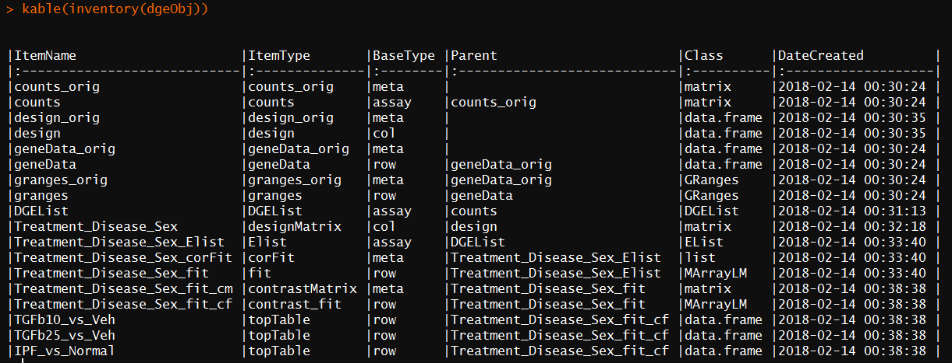
Inspecting a DGEobj

Slide 20
DGEobj Extensibility
Can define new data types
newType(DGEobj, itemType = “IHC”, baseType = “assay”)
The type definitions are stored within the DGEobj as an attribute (objDef)
Can define whether an itemType is unique (i.e. can only have one instance)
For RNA-seq “counts”, “design” and “geneAnnotation” item types are unique
Can customize DGEobj for other datatypes and workflows

Slide 21
JRTutil
A bit of a hodgepodge package:
BMS-specific functions
buildOmicsoftDGEobj: from data in OS S3
checkDGEobj: checks structure before importing into GECO
getRDSobjFromStash: read .RDS data from a stash location
getStashPath(): platform independent stash path
Mapping/Annotation Functions
EnsemblAnnotation: biomaRt queries
EnsemblGeneSpeciesMapping
EnsemblGene2Entrez: via org.**.eg.db databases
EntrezGene2Ensembl
Entrez2GeneSym
Other general utility functions

Slide 22
Installing DGEobj and other packages
# One time setup for BRAN repository
source('http://bran.pri.bms.com/resources/configureRepo.R')
# ... then you can use install.packages() to add BRAN or CRAN packages
# See: http://kraken.pri.bms.com/biohtml/nositeminder/BRAN/
install.packages(c(“DGEobj”, “DGE.Tools2”, “JRTutil”, “rXpress”, “Xpress2R”)
Documentation:
?functionName: most authoritative and up-to-date documentation
This slide deck: https://biogit.pri.bms.com/thompj27/DGE.Tools2/blob/master/DGE_Tools_Training_Mar2019.pptx
Plotting tools: https://biogit.pri.bms.com/thompj27/DGE.Tools2/blob/master/vignettes/DGE.ToolsPlotGallery.pdf
DGEobj vignette:
browseVignettes(“DGEobj”)

Slide 24
Using zFPKM to select expressed genes
Validated with encode open/closed promoter chromatin structure epigenetic data on six of the ENCODE cell lines.
Works well for gene level data using FPKM or TPM
Does not appear to calibrate well for transcript level data.
Reference recommends using zFPKM >-3 to select expressed genes.
Reference: Hart et al., 2013 (Pubmed ID 24215113)
R Implementation: Ron Ammar (in Bioconductor)

Slide 25
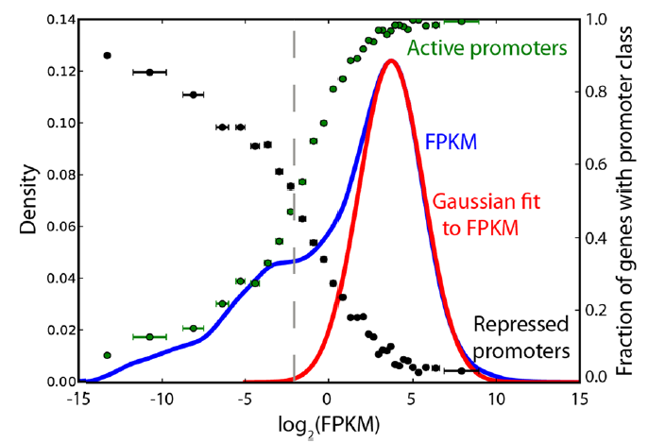
zFPKM Analysis
Gene level intensity is a bimodal distribution
Orthogonally calibrated by ENCODE open/closed chr configuration data
Low peak corresponds to closed (inactive) conformation
zFPKM -3 is the minimum between the peaks (i.e. 50:50 TP:FP)
Developed with FPKM values
TPM behaves similarly

Slide 26
Normalization: F. runEdgeRNorm
Input:
DGEobj with count data
Runs edgeR TMM normalization by default
Use NormMethod argument to specify other normalizations
Returns: DGEobj object containing
DGElist: contains counts and normfactors
Example:
dgeObj <- runEdgeRNorm(dgeObj)

Slide 27
Fit Model: F. runVoom
Input:
DGEobj with DGElist and Design matrix
Runs limma voom followed by lmFit
runs voomWithQualityWeights by default
Duplicate correlation requires a blocking vector
Returns: DGEobj with voom Elist and lmFit fit objects
Example:
MyDgeObj <- runVoom (MyDgeObj, designMatrixName=“MyDesignMatrix”)
Additional arguments support blocking quality weights and running duplicateCorrelation

Slide 28
Contrasts: F. runContrasts
Input:
DGEobj with Fit and DesignMatrix
Contrast List
Supports: topTable and/or topTreat analysis
Output: DGEobj containing: contrast matrix, contrastFit, topTable and topTreat dataframes
Example:
#build a named list describing contrasts
MyContrasts <- list(
T1sig = "Treament1 - Veh",
T2sig = "Treatment2 - Veh"
)
MyDgeObj <- runContrasts(MyDgeObj, MyFitName, MyContrasts)

